Slide 1
Freak my life
Manu Thomas and Jesse Hao

Slide 2
Problem
Problem: Vehicle type classification across 196 car classes from images
Q: How accurately can traditional ML methods classify these images?
Q: What performance gains do deep learning approaches provide compared to traditional methods (SVM vs. CNN) for this case?
Dataset: Stanford Cars Dataset. 16,185 images, 196 classes, real-world variation in lighting, angle, and background
Why? Tests the limits of both traditional and deep learning approaches. Fine-grained categorization is a known hard problem, making it a meaningful testbed for comparing paradigms.

Slide 3
Dataset & Preprocessing
Dataset: 16,185 images across 196 classes; imbalanced class sizes; real-world photography (varying pose, lighting, background); 70/15/15 split
Preprocessing:
SVM + HOG: resize images to fixed dimensions → extract HOG features → train SVM on feature vectors
SVM raw: extract features from raw image pixels
CNN pipeline: resize + normalize pixel values → feed into network
Feature choices: HOG chosen because it captures edge orientation and shape — suited to car body silhouettes. CNN learns its own features hierarchically from raw pixels.
Data-related challenges: None here.

Slide 4
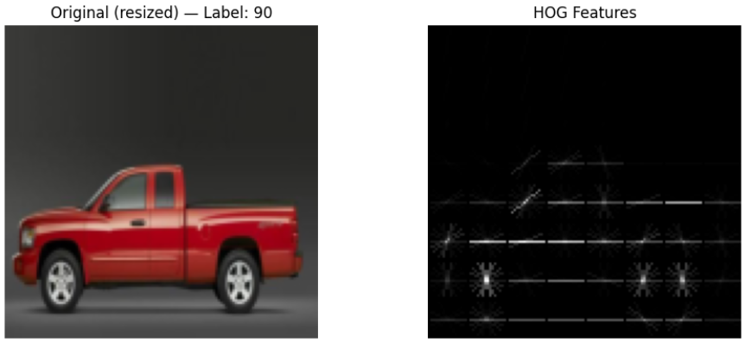
EDA - HOG features

Slide 5
Classical ML Method - SVM
SVM (RBF kernel) + HOG:
HOG captures edge orientations and shape, well-suited to distinguishing car body types (sedan vs. SUV vs. truck) where silhouette structure differs
SVM is a strong classical classifier for fixed-length feature vectors like HOG descriptors
Hypothesis: performs reasonably on coarse distinctions, but struggles with fine-grained differences (e.g., subtle badge/grill details between makes/models) because HOG discards color and fine texture
RBF is the standard default for SVMs on image features because linear separability is rarely guaranteed, and the C/gamma grid search is how you manage the bias-variance tradeoff. If you ran a linear kernel as a comparison and it was competitive, that would actually be an interesting finding worth mentioning.
Raw SVM
Run SVM on raw pixels of images
Test if HOG has any effect (better or worse results) on classifications

Slide 6
Deep Learning Method - CNN
CNN:
Learns hierarchical features automatically via backpropagation. No need for hand-crafted descriptors
Captures both low-level texture/edges and high-level semantic features, which is critical here
Expected to outperform SVM because fine-grained distinctions require richer representations than HOG can provide

Slide 7
Why these methods?
SVM+HOG/raw SVM and CNN represent two distinct approaches: manual feature engineering vs. learned representations.
Comparing them directly answers the project's core research question and makes the performance gap interpretable

Slide 8
Evaluation Setup
Setup: 70/15/15 train/validate/test split. Identical splits used for SVM/CNN.
Metrics: Top-1 accuracy (exact match) and Top-5 accuracy (correct class in top 5 predictions)
Comparisons: SVM vs. CNN on the same split with the same metrics
Alternative settings: SVM
Kernel choices: linear and RBF
Hyperparameter tuning: C and gamma
Class_weight variable: uniform vs ‘balanced’
Alternative settings: CNN
CNN architecture variants
CNN learning rate
CNN regularization

Slide 9
Results
Method | Top-1 Accuracy | Top-5 Accuracy
Raw SVM
SVM (RBF) + HOG
SVM (linear) + HOG
CNN
CNN (improved)

Slide 10
Interpretation
What do the results mean? CNN performed better than HOG/SVM with regards to both Top-1 and Top-5 accuracy.
What worked? HOG seemed to improve/worsen the results for SVM. (If improve: HOG worked. If worsen: raw SVM worked)
What did not work? Struggles included running raw SVM initially.

Slide 11
Error Analysis
Ex. did SVM confuse same-model different-years? Did CNN fail on unusual angles?

Slide 12
Limitations
HOG Limitation: HOG discards color and fine texture, so it likely struggles with distinguishing cars that share body shape but differ in badge/trim details — exactly the kind of distinction needed for 196-class fine-grained classification
CNN Advantage: CNN's ability to learn task-specific features means it can pick up on subtle visual cues HOG cannot encode
Tradeoffs: SVM+HOG is faster to train and more interpretable; CNN is more powerful but requires more data, compute, and tuning

Slide 13
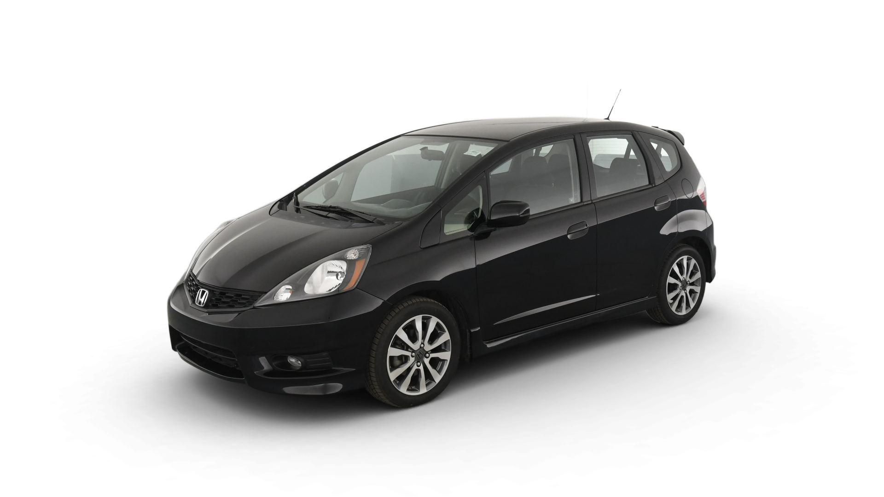
Thank you
Closing activity for the audience. Pretend you’re the svm/cnn model and have 100% top 1 accuracy. What is this car?

