Slide 1
5
C Functions

Slide 2
Form ever follows function.
—Louis Henri Sullivan
E pluribus unum.
(One composed of many.)
—Virgil
O! call back yesterday, bid time return.
—William Shakespeare
Call me Ishmael.
—Herman Melville

Slide 3
When you call me that, smile!
—Owen Wister
Answer me in one word.
—William Shakespeare
There is a point at which methods devour themselves.
—Frantz Fanon
Life can only be understood backward; but it must be lived forward.
—Soren Kierkegaard

Slide 4
OBJECTIVES
In this chapter you will learn:
To construct programs modularly from small pieces called functions.
The common math functions available in the C Standard Library.
To create new functions.
The mechanisms used to pass information between functions.
Simulation techniques using random num­ber generation.
How to write and use recursive functions, i.e., functions that call themselves.

Slide 5
5.1 Introduction
5.2 Program Modules in C
5.3 Math Library Functions
5.4 Functions
5.5 Function Definitions
5.6 Function Prototypes
5.7 Function Call Stack and Activation Records
5.8 Headers
5.9 Calling Functions: Call-by-Value and Call-by- Reference

Slide 6
5.10 Random Number Generation
5.11 Example: A Game of Chance
5.12 Storage Classes
5.13 Scope Rules
5.14 Recursion
5.15 Example Using Recursion: Fibonacci Series
5.16 Recursion vs. Iteration

Slide 7
5.1 Introduction
Divide and conquer
  Construct a program from smaller pieces or components
    These smaller pieces are called modules
  Each piece more manageable than the original program

Slide 8
5.2 Program Modules in C
Functions
  Modules in C
  Programs combine user-defined functions with library functions
    C standard library has a wide variety of functions
Function calls
  Invoking functions
    Provide function name and arguments (data)
    Function performs operations or manipulations
    Function returns results
  Function call analogy:
    Boss asks worker to complete task
      Worker gets information, does task, returns result
      Information hiding: boss does not know details

Slide 9
Good Programming Practice 5.1
Familiarize yourself with the rich collection of functions in the C Standard Library.

Slide 10
Software Engineering Observation 5.1
Avoid reinventing the wheel. When possible, use C Standard Library functions instead of writing new functions. This can reduce program development time.

Slide 11
Portability Tip 5.1
Using the functions in the C Standard Library helps make programs more portable.

Slide 12
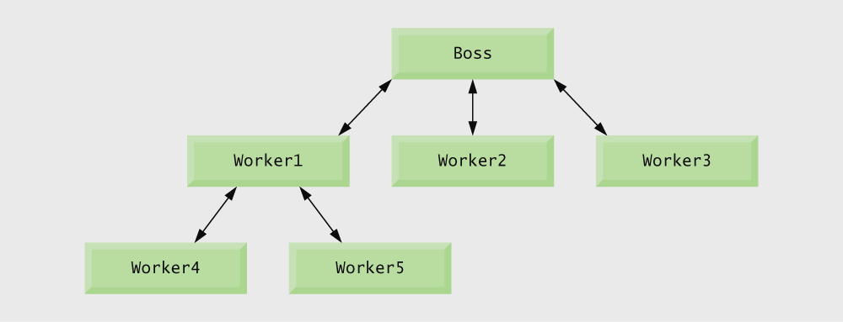
Fig. 5.1 | Hierarchical boss function/worker function relationship.

Slide 13
5.3 Math Library Functions
Math library functions
  perform common mathematical calculations
  #include <math.h>
Format for calling functions
  FunctionName( argument );
    If multiple arguments, use comma-separated list
  printf( "%.2f", sqrt( 900.0 ) );
    Calls function sqrt, which returns the square root of its argument
    All math functions return data type double
  Arguments may be constants, variables, or expressions

Slide 14
Error-Prevention Tip 5.1
Include the math header by using the preprocessor directive #include <math.h> when using functions in the math library.

Slide 15
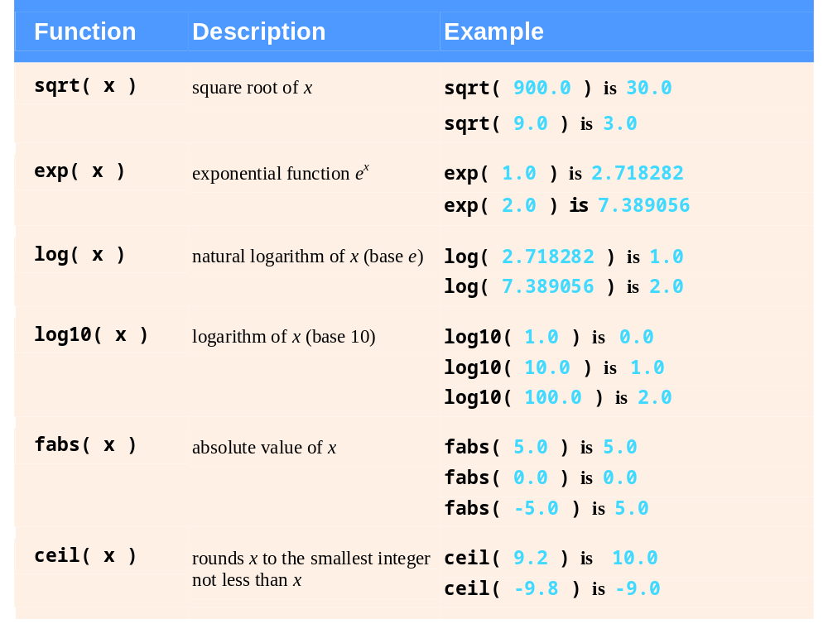
Fig. 5.2 | Commonly used math library functions. (Part 1 of 2.)

Slide 16
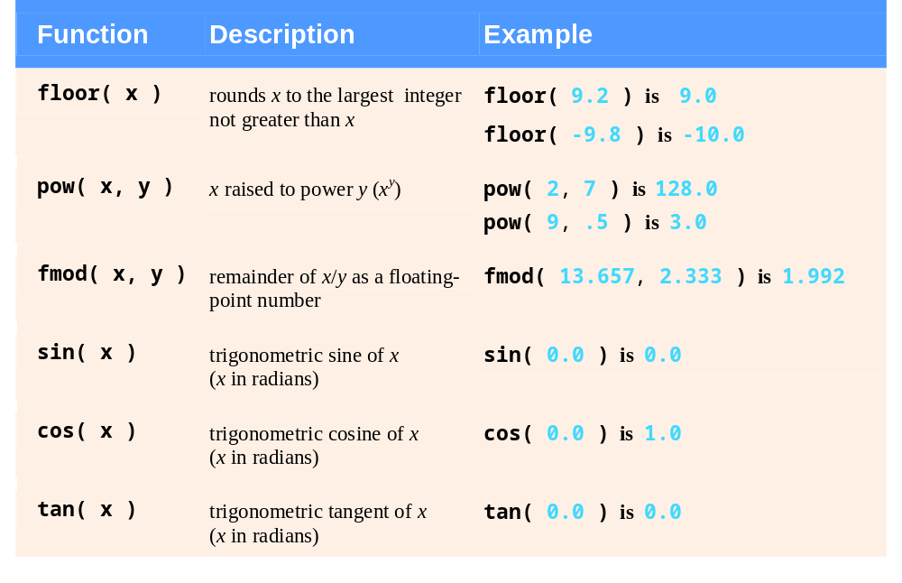
Fig. 5.2 | Commonly used math library functions. (Part 2 of 2.)

Slide 17
5.4 Functions
Functions
  Modularize a program
  All variables defined inside functions are local variables
    Known only in function defined
  Parameters
    Communicate information between functions
    Local variables
Benefits of functions
  Divide and conquer
    Manageable program development
  Software reusability
    Use existing functions as building blocks for new programs
    Abstraction - hide internal details (library functions)
  Avoid code repetition

Slide 18
Software Engineering Observation 5.2
In programs containing many functions, main is often implemented as a group of calls to functions that perform the bulk of the program’s work.

Slide 19
Software Engineering Observation 5.3
Each function should be limited to performing a single, well-defined task, and the func­tion name should effectively express that task. This facilitates abstraction and promotes software reusability.

Slide 20
Software Engineering Observation 5.4
If you cannot choose a concise name that expresses what the function does, it is possible that your function is attempting to perform too many diverse tasks. It is usually best to break such a function into several smaller functions.

Slide 21
5.5 Function Definitions
Function definition format
    return-value-type function-name( parameter-list )
    {
    declarations and statements
    }
  Function-name: any valid identifier
  Return-value-type: data type of the result (default int)
    void – indicates that the function returns nothing
  Parameter-list: comma separated list, declares parameters
    A type must be listed explicitly for each parameter unless, the parameter is of type int

Slide 22
5.5 Function Definitions
Function definition format (continued)
    return-value-type function-name( parameter-list )
    {
    declarations and statements
    }
  Definitions and statements: function body (block)
    Variables can be defined inside blocks (can be nested)
    Functions can not be defined inside other functions
  Returning control
    If nothing returned
      return;
      or, until reaches right brace
    If something returned
      return expression;

Slide 23
Good Programming Practice 5.2
Place a blank line between function definitions to separate the functions and enhance program readability.

Slide 24
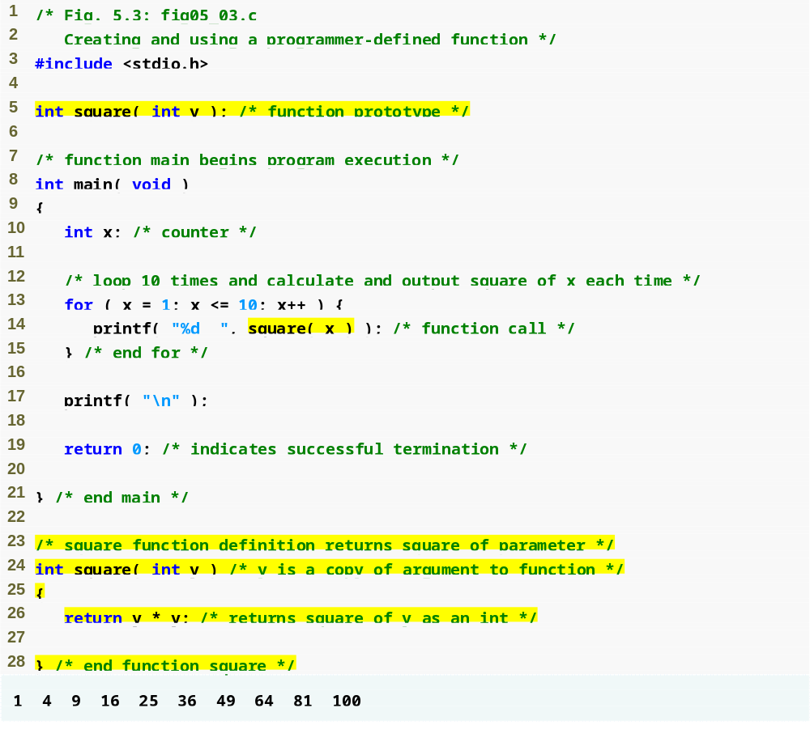
Outline
fig05_03.c
Function prototype indicates function will be defined later in the program
Call to square function
Function definition

Slide 25
Common Programming Error 5.1
Omitting the return-value-type in a function definition is a syntax error if the function prototype specifies a return type other than int.

Slide 26
Common Programming Error 5.2
Forgetting to return a value from a function that is supposed to return a value can lead to unexpected errors. The C standard states that the result of this omission is undefined.

Slide 27
Common Programming Error 5.3
Returning a value from a function with a void return type is a syntax error.

Slide 28
Good Programming Practice 5.3
Even though an omitted return type defaults to int, always state the return
type explicitly.

Slide 29
Common Programming Error 5.4
Specifying function parameters of the same type as double x, y instead of double x, double y might cause errors in your programs. The parameter declaration double x, y would actually make y a parameter of type int because int is the default.

Slide 30
Common Programming Error 5.5
Placing a semicolon after the right parenthesis enclosing the parameter list of a function definition is a syntax error.

Slide 31
Common Programming Error 5.6
Defining a function parameter again as a local variable within the function is a syntax error.

Slide 32
Good Programming Practice 5.4
Include the type of each parameter in the parameter list, even if that parameter is of the default type int.

Slide 33
Good Programming Practice 5.5
Although it is not incorrect to do so, do not use the same names for the arguments passed to a function and the corresponding parameters in the function definition. This helps avoid ambiguity.

Slide 34
Common Programming Error 5.7
Defining a function inside another function is a syntax error.

Slide 35
Good Programming Practice 5.6
Choosing meaningful function names and meaningful parameter names makes programs more readable and helps avoid excessive use of comments.

Slide 36
Software Engineering Observation 5.5
A function should generally be no longer than one page. Better yet, functions should generally be no longer than half a page. Small functions promote software reusability.

Slide 37
Software Engineering Observation 5.6
Programs should be written as collections of small functions. This makes programs easier to write, debug, maintain and modify.

Slide 38
Software Engineering Observation 5.7
A function requiring a large number of parameters may be performing too many tasks. Consider dividing the function into smaller functions that perform the separate tasks. The function header should fit on one line if possible.

Slide 39
Software Engineering Observation 5.8
The function prototype, function header and function calls should all agree in the number, type, and order of arguments and parameters, and in the type of return value.

Slide 40
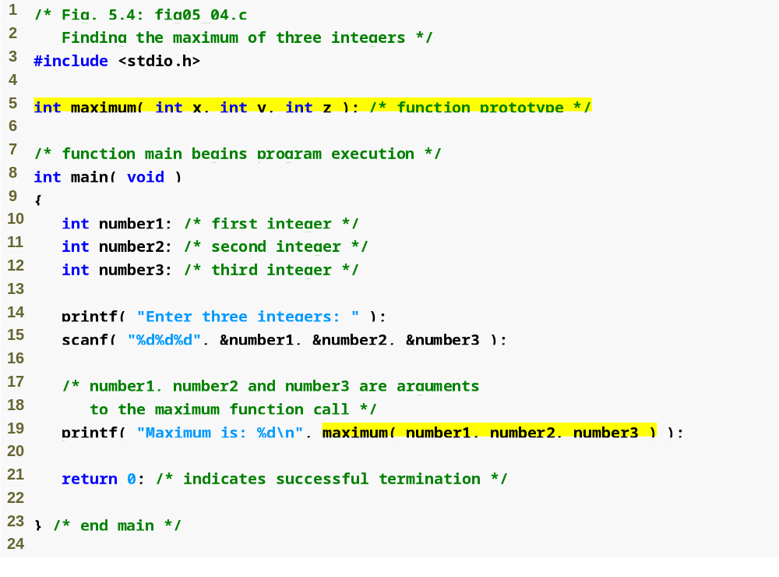
Outline
Function prototype
fig05_04.c
(1 of 2 )
Function call

Slide 41
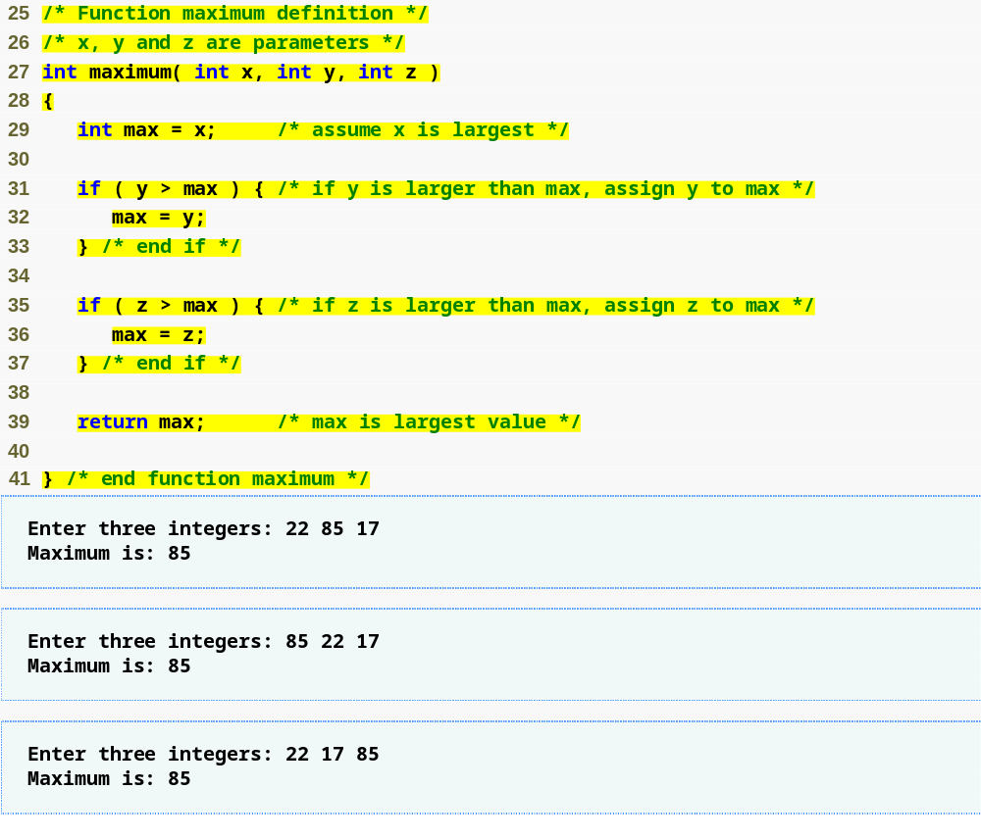
Outline
Function definition
fig05_04.c
(2 of 2 )

Slide 42
5.6 Function Prototypes
Function prototype
  Function name
  Parameters – what the function takes in
  Return type – data type function returns (default int)
  Used to validate functions
  Prototype only needed if function definition comes after use in program
  The function with the prototype
    int maximum( int x, int y, int z );
    Takes in 3 ints
    Returns an int
Promotion rules and conversions
  Converting to lower types can lead to errors

Slide 43
Good Programming Practice 5.7
Include function prototypes for all functions to take advantage of C’s type-checking capabilities. Use #include preprocessor directives to obtain function prototypes for the standard library functions from the headers for the appropriate libraries, or to obtain headers containing function prototypes for functions developed by you and/or your group members.

Slide 44
Good Programming Practice 5.8
Parameter names are sometimes included in function prototypes (our preference) for documentation purposes. The compiler ignores these names.

Slide 45
Common Programming Error 5.8
Forgetting the semicolon at the end of a function prototype is a syntax error.

Slide 46
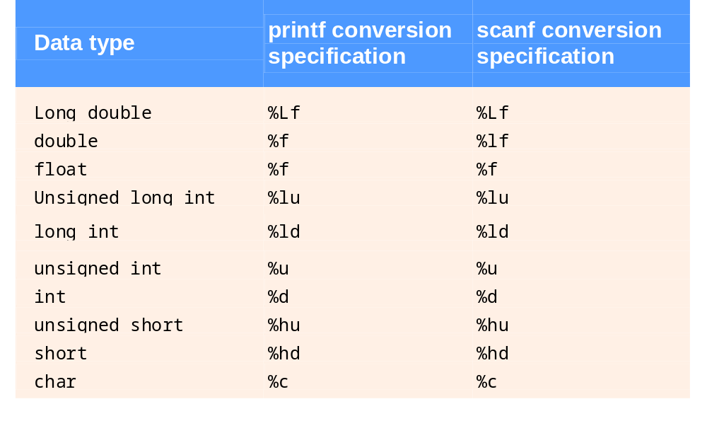
Fig. 5.5 | Promotion hierarchy for data types.

Slide 47
Common Programming Error 5.9
Converting from a higher data type in the promotion hierarchy to a lower type can change the data value.

Slide 48
Common Programming Error 5.10
Forgetting a function prototype causes a syntax error if the return type of the function is not int and the function definition appears after the function call in the program. Otherwise, forgetting a function prototype may cause a runtime error or an unexpected result.

Slide 49
Software Engineering Observation 5.9
A function prototype placed outside any function definition applies to all calls to the function appearing after the function prototype in the file. A function prototype placed in a function applies only to calls made in that function.

Slide 50
5.7 Function Call Stack and Activation Records
Program execution stack
  A stack is a last-in, first-out (LIFO) data structure
    Anything put into the stack is placed “on top”
    The only data that can be taken out is the data on top
  C uses a program execution stack to keep track of which functions have been called
    When a function is called, it is placed on top of the stack
    When a function ends, it is taken off the stack and control returns to the function immediately below it
  Calling more functions than C can handle at once is known as a “stack overflow error”

Slide 51
5.8 Headers
Header files
  Contain function prototypes for library functions
  <stdlib.h> , <math.h> , etc
  Load with #include <filename>
    #include <math.h>
Custom header files
  Create file with functions
  Save as filename.h
  Load in other files with #include "filename.h"
  Reuse functions

Slide 52
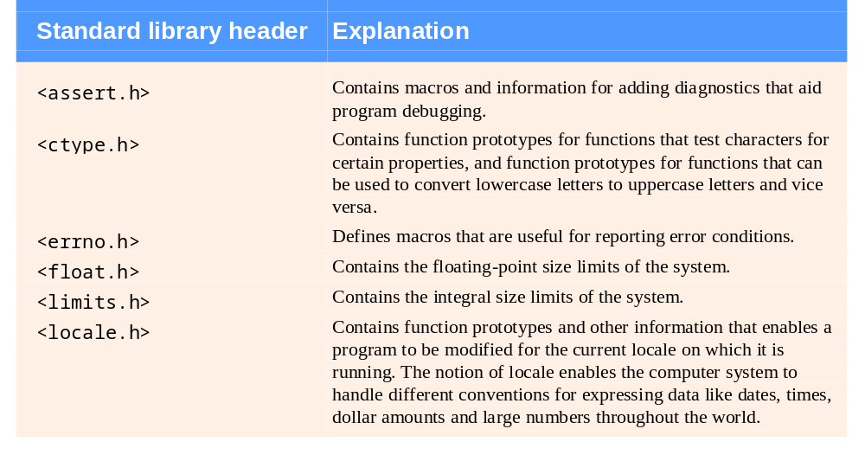
Fig. 5.6 | Some of the standard library headers. (Part 1 of 3.)

Slide 53
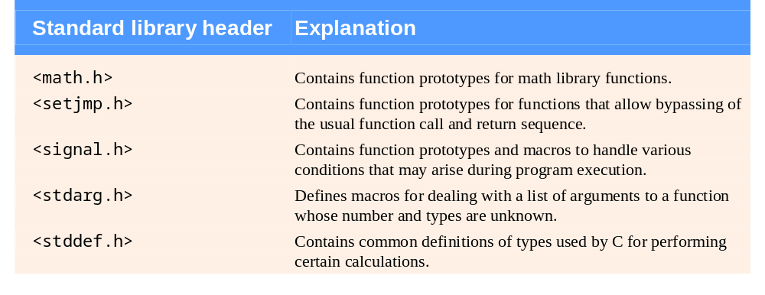
Fig. 5.6 | Some of the standard library headers. (Part 2 of 3.)

Slide 54
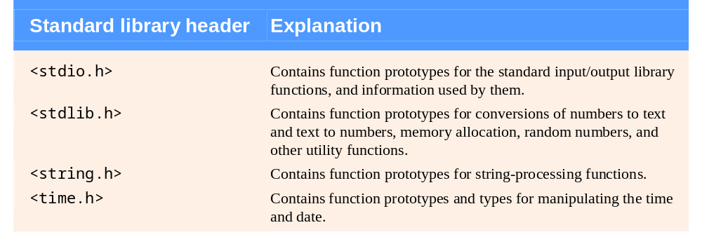
Fig. 5.6 | Some of the standard library headers. (Part 3 of 3.)

Slide 55
5.9 Calling Functions: Call-by-Value and Call-by-Reference
Call by value
  Copy of argument passed to function
  Changes in function do not effect original
  Use when function does not need to modify argument
    Avoids accidental changes
Call by reference
  Passes original argument
  Changes in function effect original
  Only used with trusted functions
For now, we focus on call by value

Slide 56
5.10 Random Number Generation
rand function
  Load <stdlib.h>
  Returns "random" number between 0 and RAND_MAX (at least 32767)
      i = rand();
  Pseudorandom
    Preset sequence of "random" numbers
    Same sequence for every function call
Scaling
  To get a random number between 1 and n
      1 + ( rand() % n )
    rand() % n returns a number between 0 and n - 1
    Add 1 to make random number between 1 and n
      1 + ( rand() % 6)
      number between 1 and 6

Slide 57
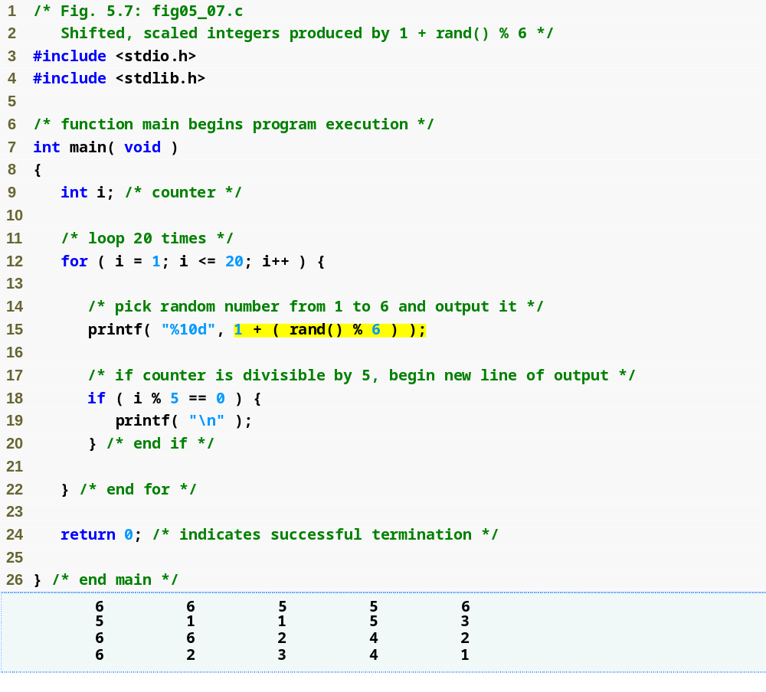
Outline
fig05_07.c
Generates a random number between 1 and 6

Slide 58
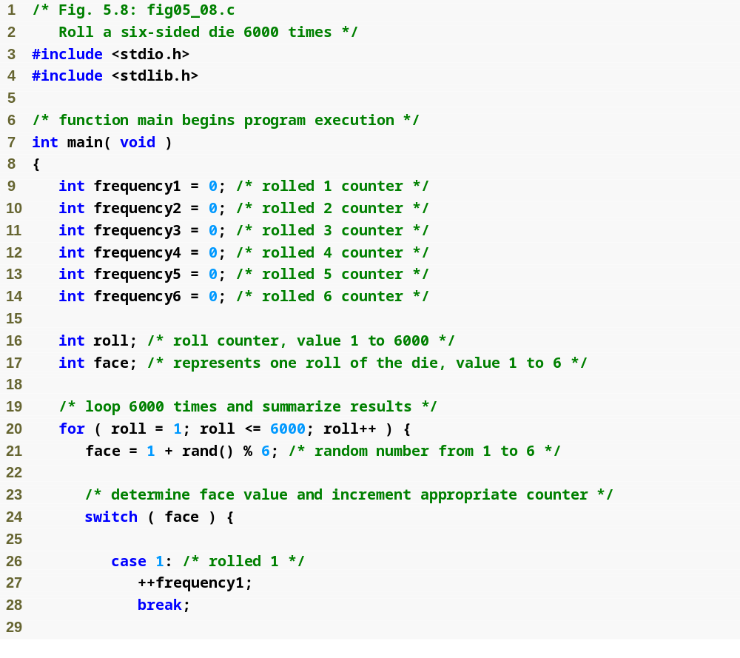
Outline
fig05_08.c
(1 of 3 )

Slide 59
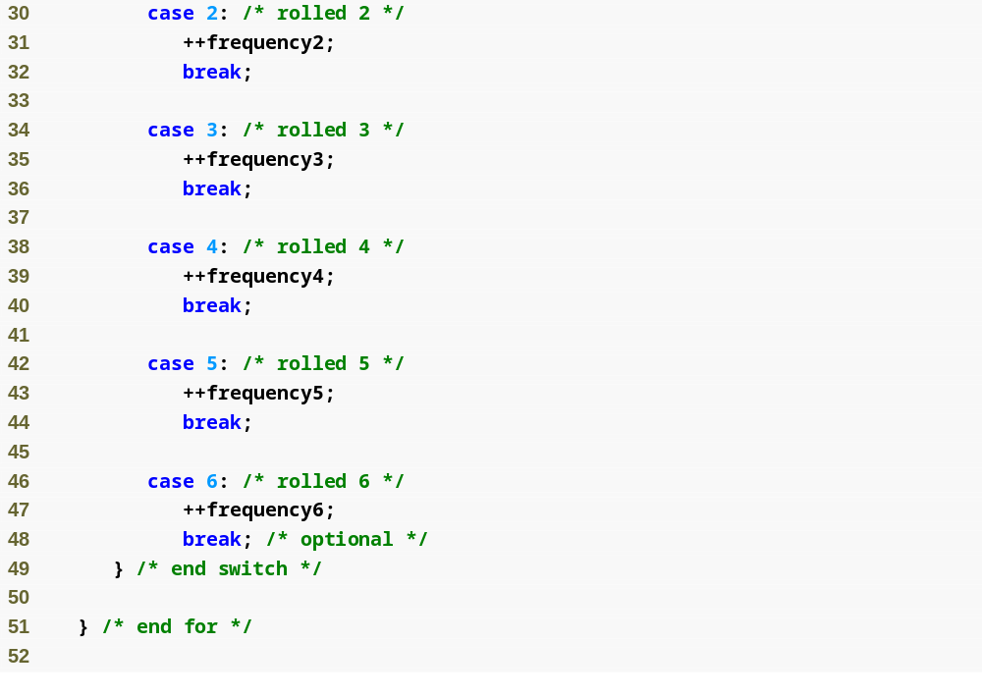
Outline
fig05_08.c
(2 of 3 )

Slide 60
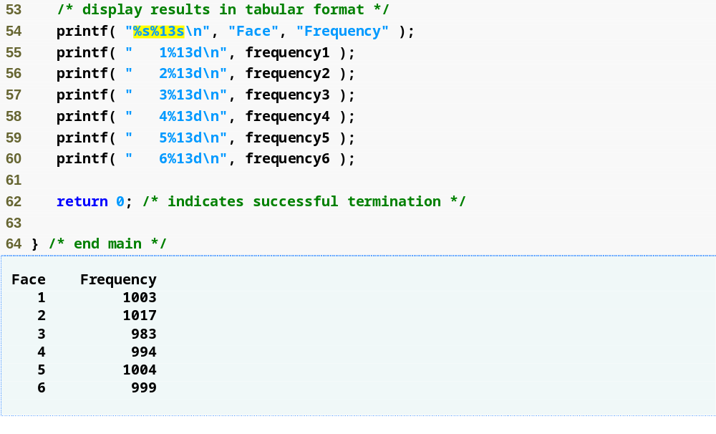
Outline
fig05_08.c
(3 of 3 )

Slide 61
5.10 Random Number Generation
srand function
  <stdlib.h>
  Takes an integer seed and jumps to that location in its "random" sequence
    srand( seed );
  srand( time( NULL ) );/*load <time.h> */
    time( NULL )
      Returns the number of seconds that have passed since January 1, 1970
      “Randomizes" the seed

Slide 62
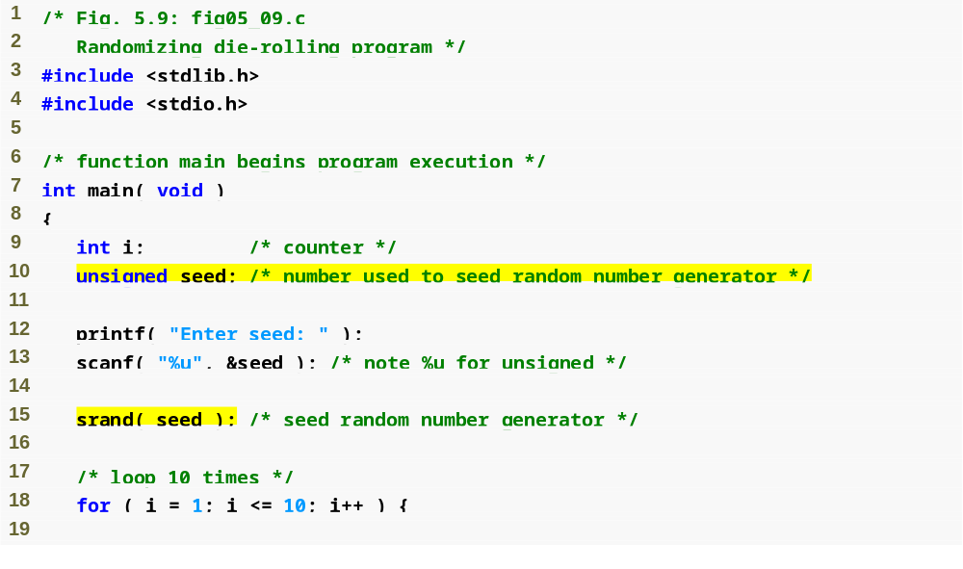
Outline
fig05_09.c
(1 of 2 )
Seeds the rand function

Slide 63
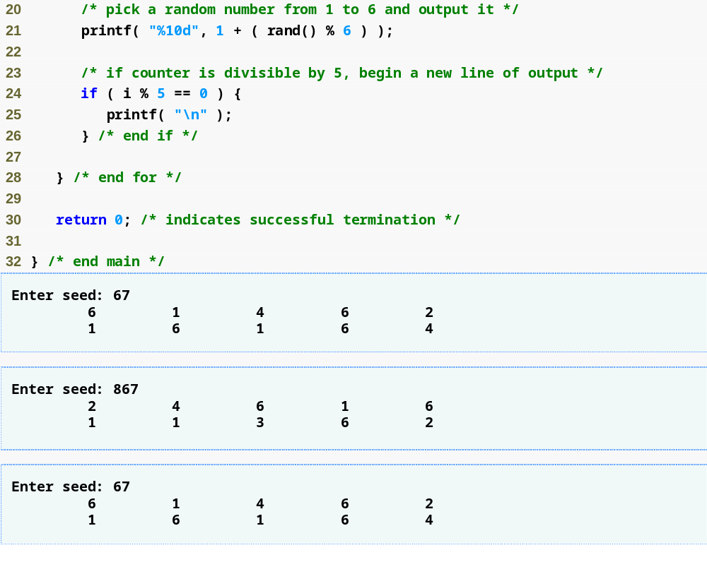
Outline
fig05_09.c
(2 of 2 )

Slide 64
Common Programming Error 5.11
Using srand in place of rand to generate random numbers.

Slide 65
5.11 Example: A Game of Chance
Craps simulator
Rules
  Roll two dice
    7 or 11 on first throw, player wins
    2, 3, or 12 on first throw, player loses
    4, 5, 6, 8, 9, 10 - value becomes player's "point"
  Player must roll his point before rolling 7 to win

Slide 66
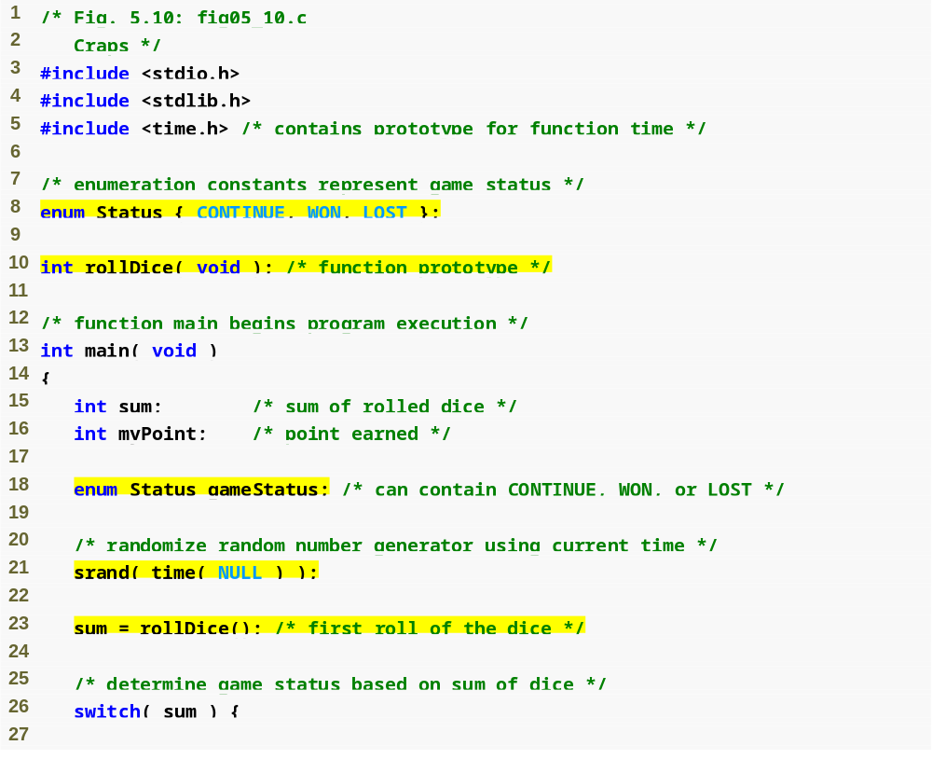
Outline
fig05_10.c
(1 of 4 )
enum (enumeration) assigns numerical values to CONTINUE, WON and LOST

Slide 67
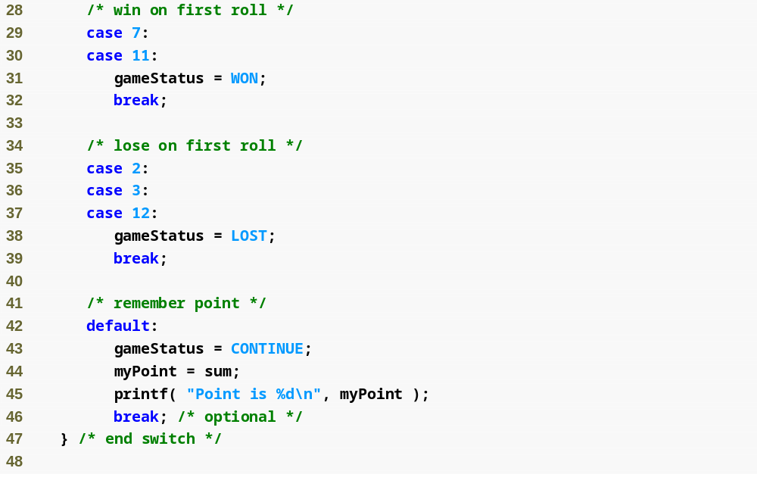
Outline
fig05_10.c
(2 of 4 )

Slide 68
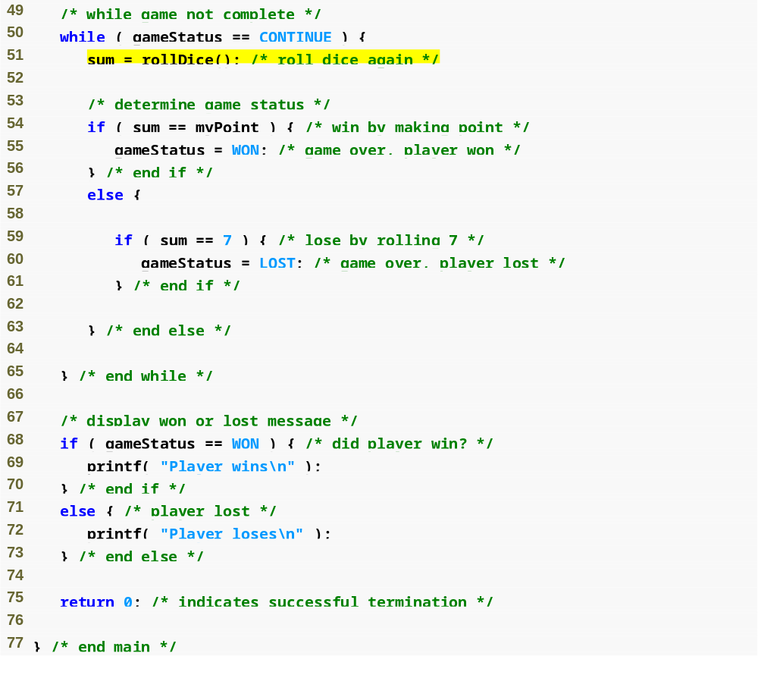
Outline
fig05_10.c
(3 of 4 )

Slide 69
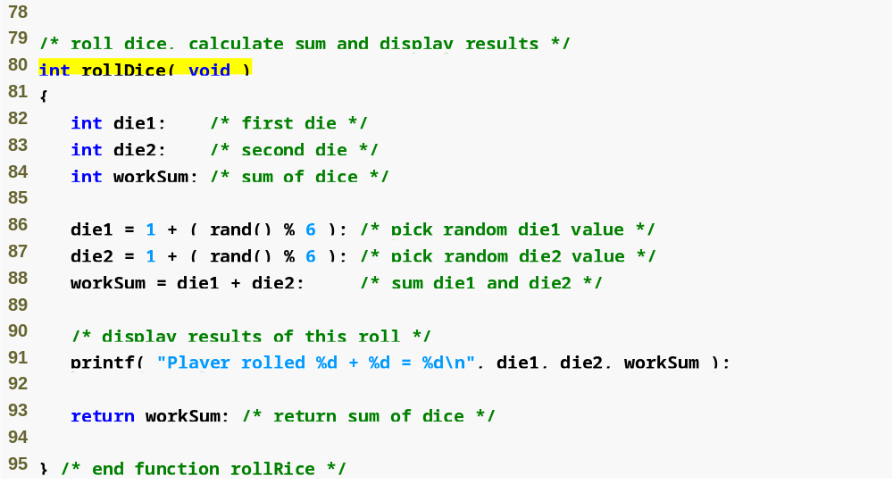
Outline
fig05_10.c
(4 of 4 )

Slide 70
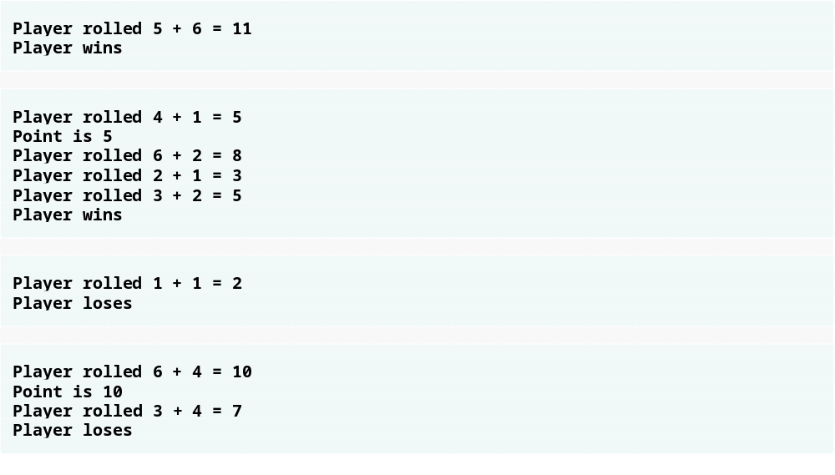
Outline
fig05_11.c

Slide 71
Common Programming Error 5.12
Assigning a value to an enumeration constant after it has been defined is a syntax error.

Slide 72
Good Programming Practice 5.9
Use only uppercase letters in the names of enumeration constants to make these constants stand out in a program and to indicate that enumeration constants are not variables.

Slide 73
5.12 Storage Classes
Storage class specifiers
  Storage duration – how long an object exists in memory
  Scope – where object can be referenced in program
  Linkage – specifies the files in which an identifier is known (more in Chapter 14)
Automatic storage
  Object created and destroyed within its block
  auto: default for local variables
      auto double x, y;
  register: tries to put variable into high-speed registers
    Can only be used for automatic variables
      register int counter = 1;

Slide 74
Performance Tip 5.1
Automatic storage is a means of conserving memory, because automatic variables exist only when they are needed. They are created when the function in which they are defined is entered and they are destroyed when the function is exited.

Slide 75
Software Engineering Observation 5.10
Automatic storage is an example of the principle of least privilege—allowing access to data only when it is absolutely needed. Why have variables stored in memory and accessible when in fact they are not needed?

Slide 76
Performance Tip 5.2
The storage-class specifier register can be placed before an automatic variable declaration to suggest that the compiler maintain the variable in one of the computer’s high-speed hardware registers. If intensely used variables such as counters or totals can be maintained in hardware registers, the overhead of repeatedly loading the variables from memory into the registers and storing the results back into memory can be eliminated.

Slide 77
Performance Tip 5.3
Often, register declarations are unnecessary. Today’s optimizing compilers
are capable of recognizing frequently used variables and can decide to place them in registers without the need for a register declaration.

Slide 78
5.12 Storage Classes
Static storage
  Variables exist for entire program execution
  Default value of zero
  static: local variables defined in functions.
    Keep value after function ends
    Only known in their own function
  extern: default for global variables and functions
    Known in any function

Slide 79
Software Engineering Observation 5.11
Defining a variable as global rather than local allows unintended side effects to occur when a function that does not need access to the variable accidentally or maliciously modifies it. In general, use of global variables should be avoided except in certain situa­tions with unique performance requirements (as discussed in Chapter 14).

Slide 80
Software Engineering Observation 5.12
Variables used only in a particular function should be defined as local variables in that function rather than as external variables.

Slide 81
Common Programming Error 5.13
Using multiple storage-class specifiers for an identifier. Only one storage-class specifier can be applied to an identifier.

Slide 82
5.13 Scope Rules
File scope
  Identifier defined outside function, known in all functions
  Used for global variables, function definitions, function prototypes
Function scope
  Can only be referenced inside a function body
  Used only for labels (start:, case: , etc.)

Slide 83
5.13 Scope Rules
Block scope
  Identifier declared inside a block
    Block scope begins at definition, ends at right brace
  Used for variables, function parameters (local variables of function)
  Outer blocks "hidden" from inner blocks if there is a variable with the same name in the inner block
Function prototype scope
  Used for identifiers in parameter list

Slide 84
Common Programming Error 5.14
Accidentally using the same name for an identifier in an inner block as is used for an identifier in an outer block, when in fact you want the identifier in the outer block to be active for the duration of the inner block.

Slide 85
Error-Prevention Tip 5.2
Avoid variable names that hide names in outer scopes. This can be accomplished simply by avoiding the use of duplicate identifiers in a program.

Slide 86
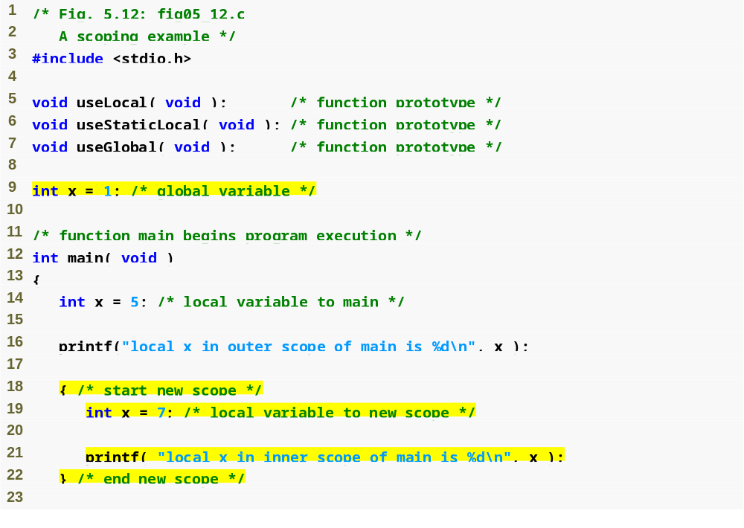
Outline
fig05_12.c
(1 of 4 )
Global variable with file scope
Variable with block scope
Variable with block scope

Slide 87
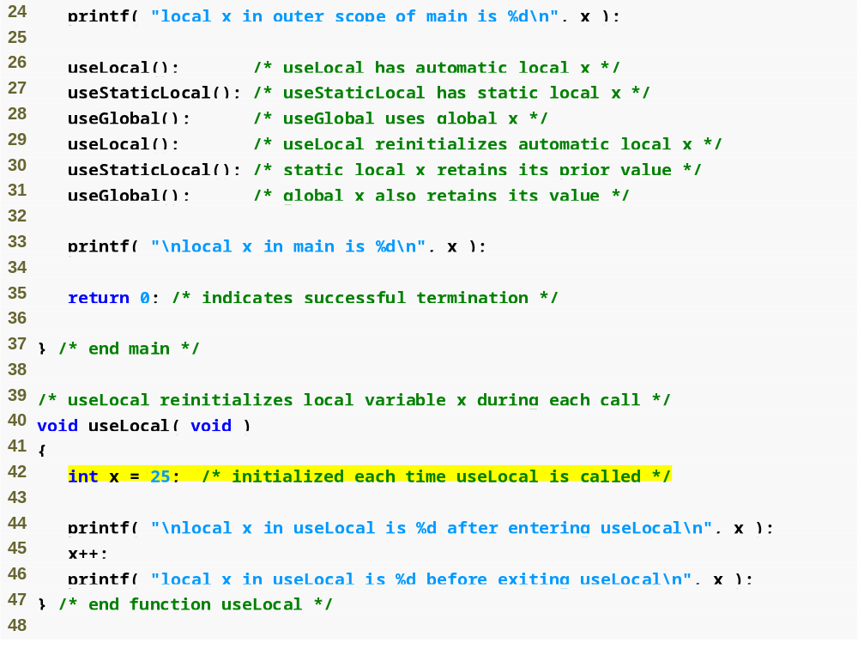
Outline
fig05_12.c
(2 of 4 )
Variable with block scope

Slide 88
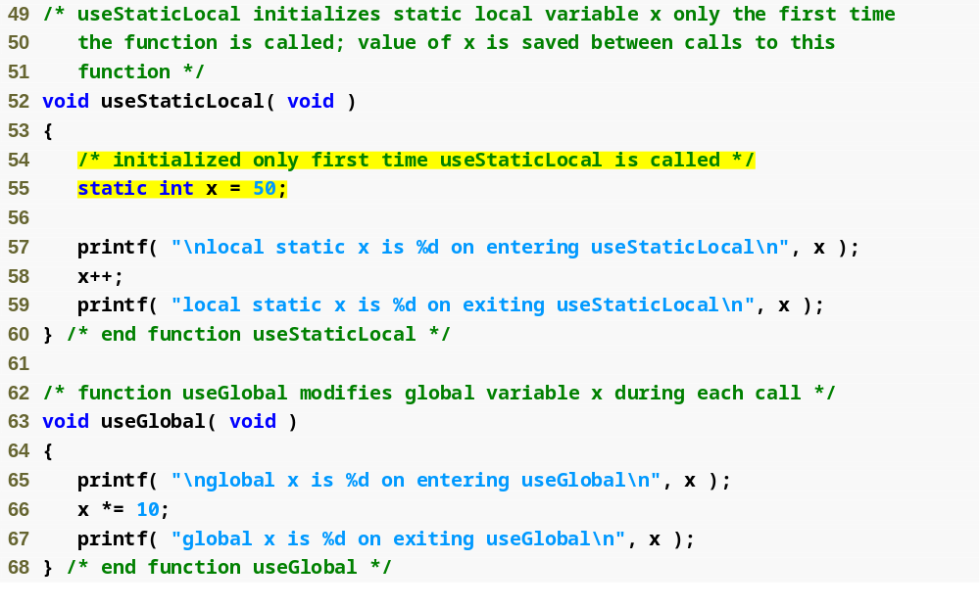
Outline
fig05_12.c
(3 of 4 )
Static variable with block scope
Global variable

Slide 89
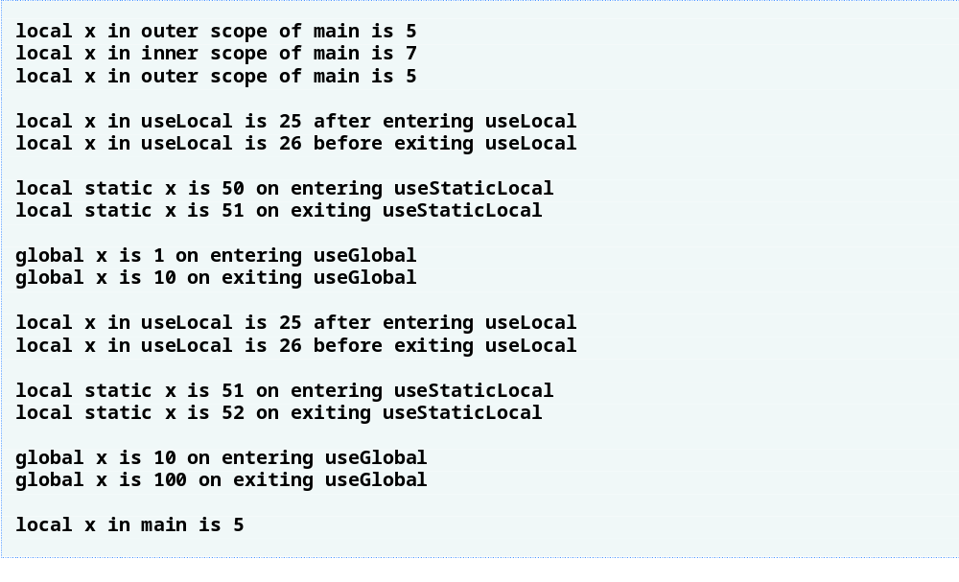
Outline
fig05_12.c
(4 of 4 )

Slide 90
5.14 Recursion
Recursive functions
  Functions that call themselves
  Can only solve a base case
  Divide a problem up into
    What it can do
    What it cannot do
      What it cannot do resembles original problem
      The function launches a new copy of itself (recursion step) to solve what it cannot do
  Eventually base case gets solved
    Gets plugged in, works its way up and solves whole problem

Slide 91
5.14 Recursion
Example: factorials
  5! = 5 * 4 * 3 * 2 * 1
  Notice that
    5! = 5 * 4!
    4! = 4 * 3! ...
  Can compute factorials recursively
  Solve base case (1! = 0! = 1) then plug in
    2! = 2 * 1! = 2 * 1 = 2;
    3! = 3 * 2! = 3 * 2 = 6;

Slide 92
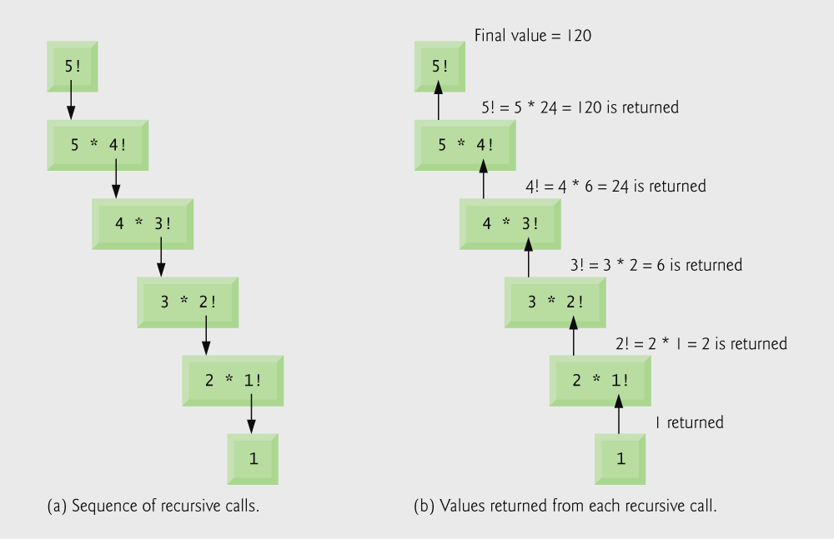
Fig. 5.13 | Recursive evaluation of 5!.

Slide 93
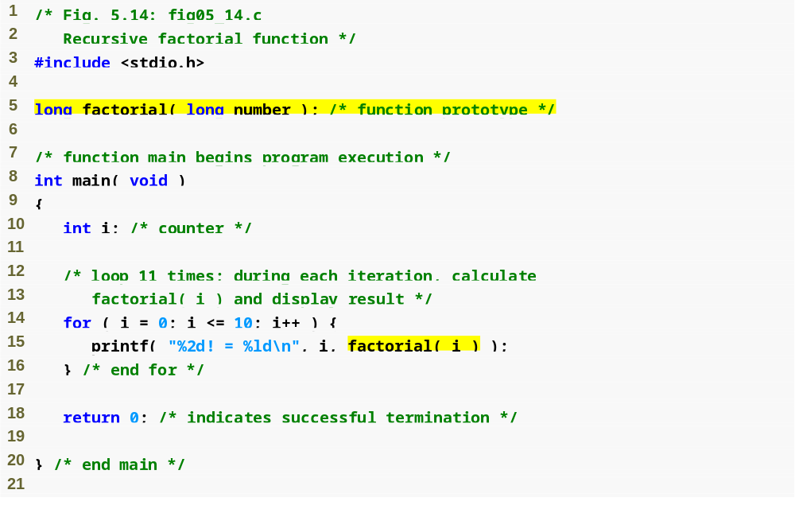
Outline
fig05_14.c
(1 of 2 )

Slide 94
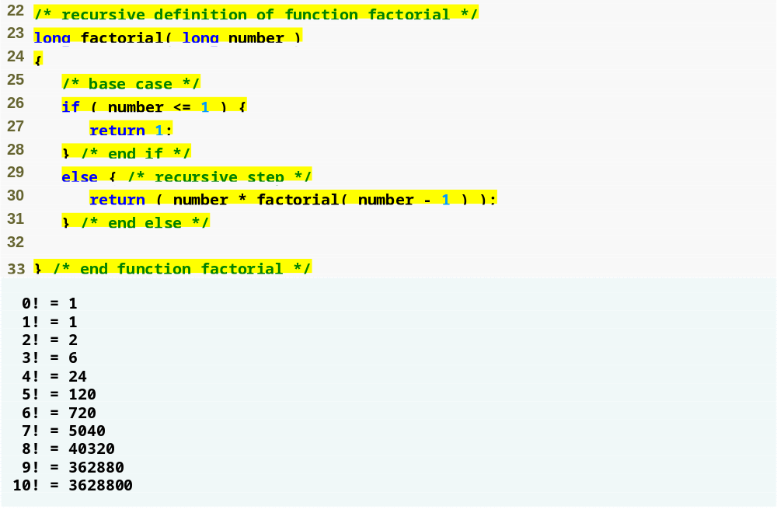
Outline
fig05_14.c
(2 of 2 )

Slide 95
Common Programming Error 5.15
Forgetting to return a value from a recursive function when one is needed.

Slide 96
Common Programming Error 5.16
Either omitting the base case, or writing the recursion step incorrectly so that it does not converge on the base case, will cause infinite recursion, eventually exhausting memory. This is analogous to the problem of an infinite loop in an iterative (nonrecursive) solution. Infinite recursion can also be caused by providing an unexpected input.

Slide 97
5.15 Example Using Recursion: Fibonacci Series
Fibonacci series: 0, 1, 1, 2, 3, 5, 8...
  Each number is the sum of the previous two
  Can be solved recursively:
    fib( n ) = fib( n - 1 ) + fib( n – 2 )
  Code for the fibonacci function
    long fibonacci( long n )
    {
    if (n == 0 || n == 1) // base case
    return n;
    else
    return fibonacci( n - 1) +
    fibonacci( n – 2 );
    }

Slide 98
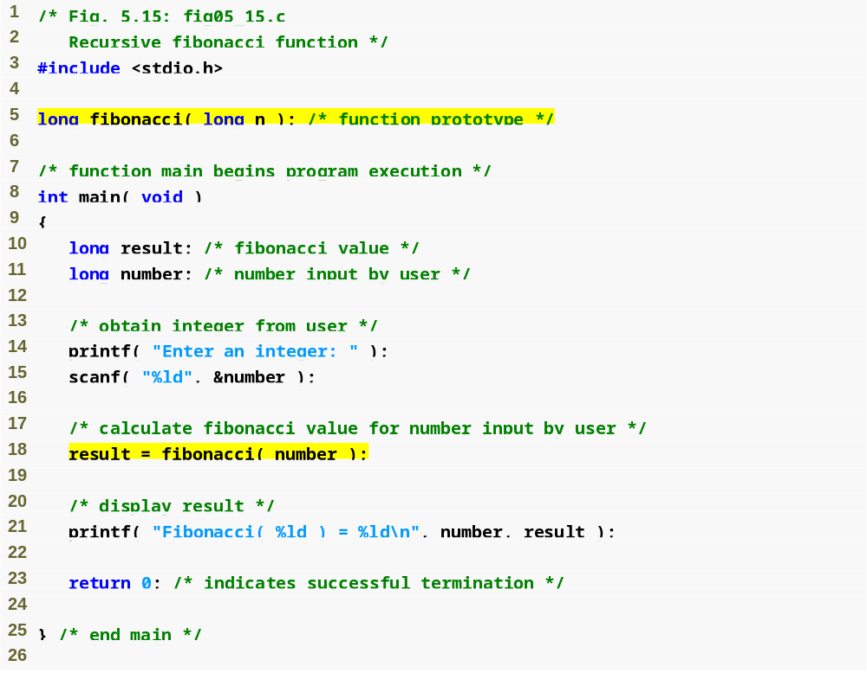
Outline
fig05_15.c
(1 of 4 )

Slide 99
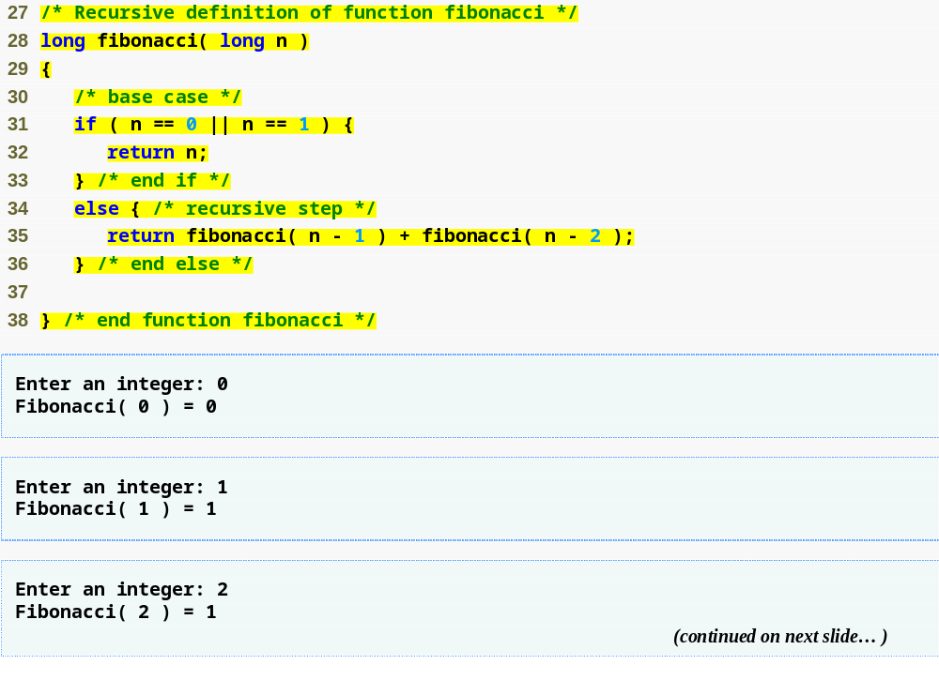
Outline
fig05_15.c
(2 of 4 )

Slide 100
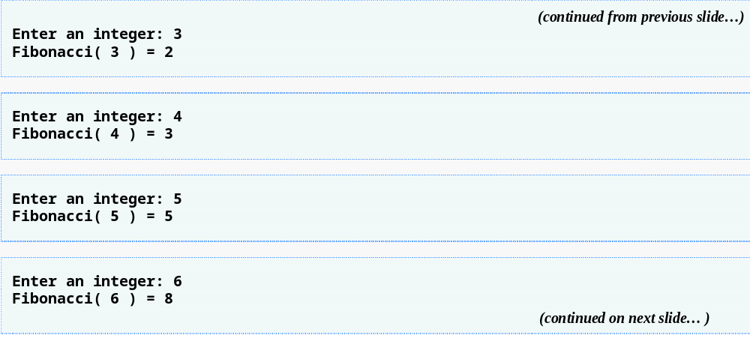
Outline
fig05_15.c
(3 of 4 )

Slide 101
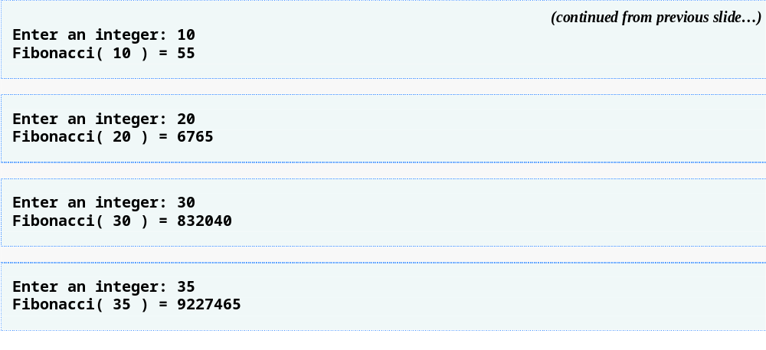
Outline
fig05_15.c
(4 of 4 )

Slide 102
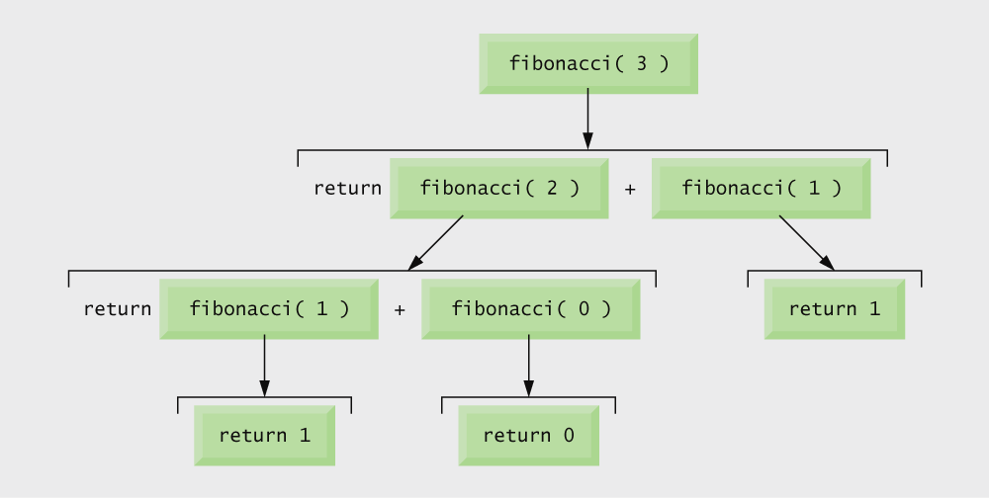
Fig. 5.16 | Set of recursive calls for fibonacci(3).

Slide 103
Common Programming Error 5.17
Writing programs that depend on the order of evaluation of the operands of operators other than &&, ||, ?:, and the comma (,) operator can lead to errors because compilers may not necessarily evaluate the operands in the order you expect.

Slide 104
Portability Tip 5.2
Programs that depend on the order of evaluation of the operands of operators other than &&, ||, ?:, and the comma (,) operator can function differently on systems with different compilers.

Slide 105
Performance Tip 5.4
Avoid Fibonacci-style recursive programs which result in an exponential “explosion” of calls.

Slide 106
5.16 Recursion vs. Iteration
Repetition
  Iteration: explicit loop
  Recursion: repeated function calls
Termination
  Iteration: loop condition fails
  Recursion: base case recognized
Both can have infinite loops
Balance
  Choice between performance (iteration) and good software engineering (recursion)

Slide 107
Software Engineering Observation 5.13
Any problem that can be solved recursively can also be solved iteratively (nonrecursively). A recursive approach is normally chosen in preference to an iterative approach when the recursive approach more naturally mirrors the problem and results in a program that is easier to understand and debug. Another reason to choose a recursive solution is that an iterative solution may not be apparent.

Slide 108
Performance Tip 5.5
Avoid using recursion in performance situations. Recursive calls take time and consume additional memory.

Slide 109
Common Programming Error 5.18
Accidentally having a nonrecursive function call itself either directly, or indirectly through another function.

Slide 110
Performance Tip 5.6
Functionalizing programs in a neat, hierarchical manner promotes good software engineering. But it has a price. A heavily functionalized program—as compared to a monolithic (i.e., one-piece) program without functions—makes potentially large numbers of function calls, and these consume execution time on a computer’s processor(s). So, although monolithic programs may perform better, they are more difficult to program, test, debug, maintain, and evolve.

Slide 111
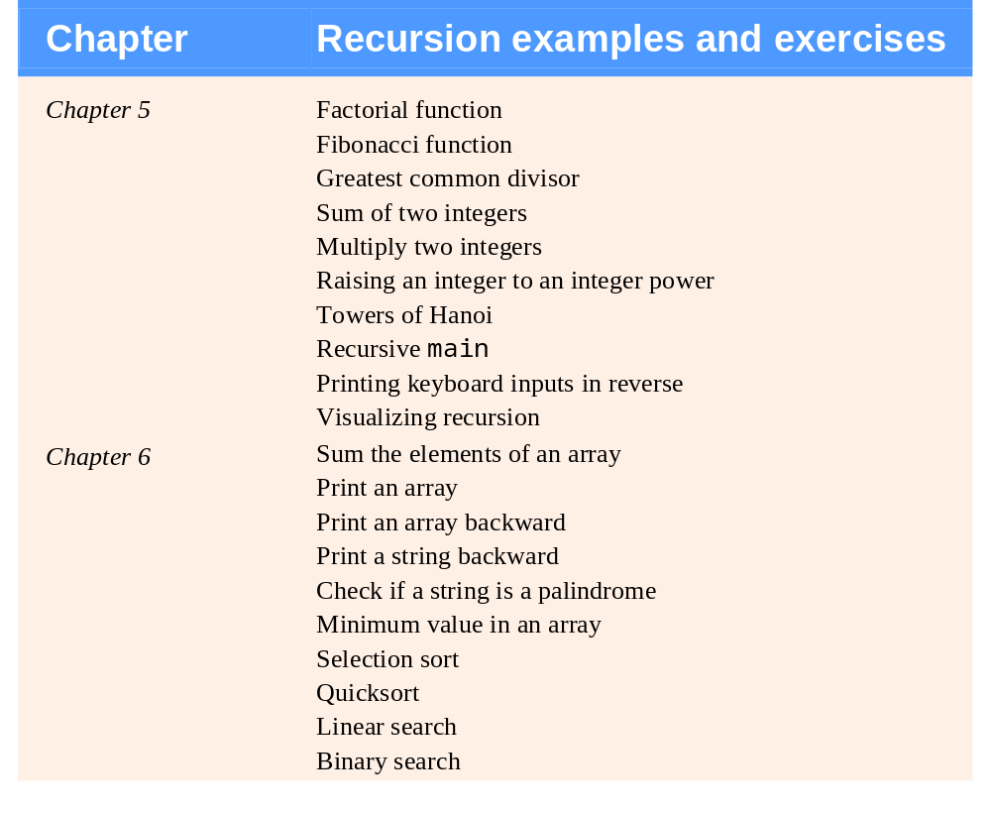
Fig. 5.17 | Recursion examples and exercises in the text. (Part 1 of 2.)

Slide 112
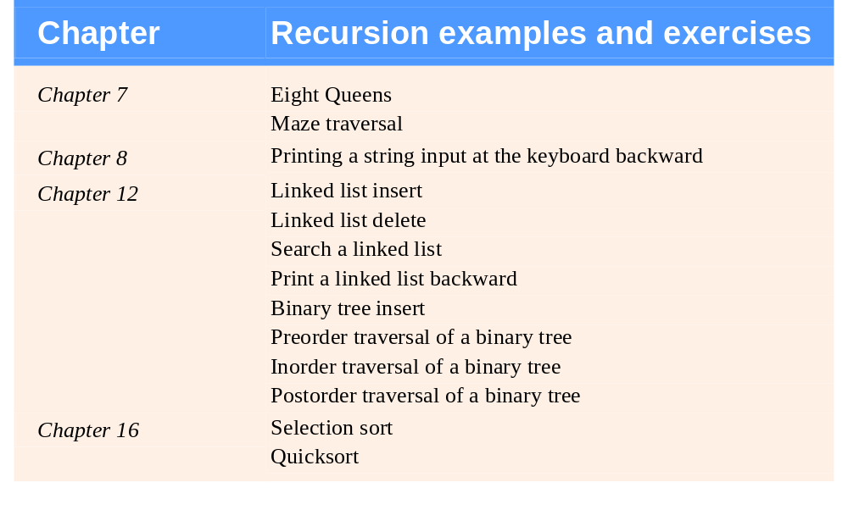
Fig. 5.17 | Recursion examples and exercises in the text. (Part 2 of 2.)

