Slide 1
10
C Structures, Unions, Bit Manipulations and Enumerations

Slide 2
But yet an union in partition.
  William Shakespeare
The same old charitable lie
Repeated as the years scoot by
Perpetually makes a hit—
“You really haven’t changed a bit!”
  Margaret Fishback
I could never make out what those
damned dots meant.
  Winston Churchill

Slide 3
OBJECTIVES
In this chapter you will learn:
To create and use structures, unions and enumerations.
To pass structures to functions by value and by reference.
To manipulate data with the bitwise operators.
To create bit fields for storing data compactly.

Slide 4
10.1 Introduction
10.2 Structure Definitions
10.3 Initializing Structures
10.4 Accessing Members of Structures
10.5 Using Structures with Functions
10.6 typedef
10.7 Example: High-Performance Card Shuffling and Dealing Simulation
10.8 Unions
10.9 Bitwise Operators
10.10 Bit Fields
10.11 Enumeration Constants

Slide 5
10.1 Introduction
Structures
  Collections of related variables (aggregates) under one name
    Can contain variables of different data types
  Commonly used to define records to be stored in files
  Combined with pointers, can create linked lists, stacks, queues, and trees

Slide 6
10.2 Structure Definitions
Example
      struct card {
      char *face;
      char *suit;
      };
  struct introduces the definition for structure card
  card is the structure name and is used to declare variables of the structure type
  card contains two members of type char *
    These members are face and suit

Slide 7
Common Programming Error 10.1
Forgetting the semicolon that terminates
a structure definition is a syntax error.

Slide 8
10.2 Structure Definitions
struct information
  A struct cannot contain an instance of itself
  Can contain a member that is a pointer to the same structure type
  A structure definition does not reserve space in memory
    Instead creates a new data type used to define structure variables
Definitions
  Defined like other variables:
      card oneCard, deck[ 52 ], *cPtr;
  Can use a comma separated list:
      struct card {
      char *face;
      char *suit;
      } oneCard, deck[ 52 ], *cPtr;

Slide 9
Good Programming Practice 10.1
Always provide a structure tag name when creating a structure type. The structure tag name is convenient for declaring new variables of the structure type later in the program.

Slide 10
Good Programming Practice 10.2
Choosing a meaningful structure tag name helps make a program self-documenting.

Slide 11
10.2 Structure Definitions
Valid Operations
  Assigning a structure to a structure of the same type
  Taking the address (&) of a structure
  Accessing the members of a structure
  Using the sizeof operator to determine the size of a structure

Slide 12
Common Programming Error 10.2
Assigning a structure of one type to a structure of a different type is a compilation error.

Slide 13
Common Programming Error 10.3
Comparing structures is a syntax error.

Slide 14

Fig. 10.1 | Possible storage alignment for a variable of type struct example showing an undefined area in memory.

Slide 15
Portability Tip 10.1
Because the size of data items of a particular type is machine dependent and because storage alignment considerations are machine dependent, so too is the representation of a structure.

Slide 16
10.3 Initializing Structures
Initializer lists
  Example:
    card oneCard = { "Three", "Hearts" };
Assignment statements
  Example:
    card threeHearts = oneCard;
  Could also define and initialize threeHearts as follows:
    card threeHearts;
    threeHearts.face = “Three”;
    threeHearts.suit = “Hearts”;

Slide 17
10.4 Accessing Members of Structures
Accessing structure members
  Dot operator (.) used with structure variables
    card myCard;
    printf( "%s", myCard.suit );
  Arrow operator (->) used with pointers to structure variables
    card *myCardPtr = &myCard;
    printf( "%s", myCardPtr->suit );
  myCardPtr->suit is equivalent to
    ( *myCardPtr ).suit

Slide 18
Error-Prevention Tip 10.1
Avoid using the same names for members of structures of different types. This is allowed, but it may cause confusion.

Slide 19
Good Programming Practice 10.3
Do not put spaces around the -> and .
operators. Omitting spaces helps emphasize that the expressions the operators are contained in are essentially single variable names.

Slide 20
Common Programming Error 10.4
Inserting space between the - and > components of the structure pointer operator (or between the components of any other multiple keystroke operator except ?:) is a syntax error.

Slide 21
Common Programming Error 10.5
Attempting to refer to a member of a structure by using only the member’s name is a syntax error.

Slide 22
Common Programming Error 10.6
Not using parentheses when referring to
a structure member that uses a pointer and the structure member operator
(e.g., *cardPtr.suit) is a syntax error.

Slide 23
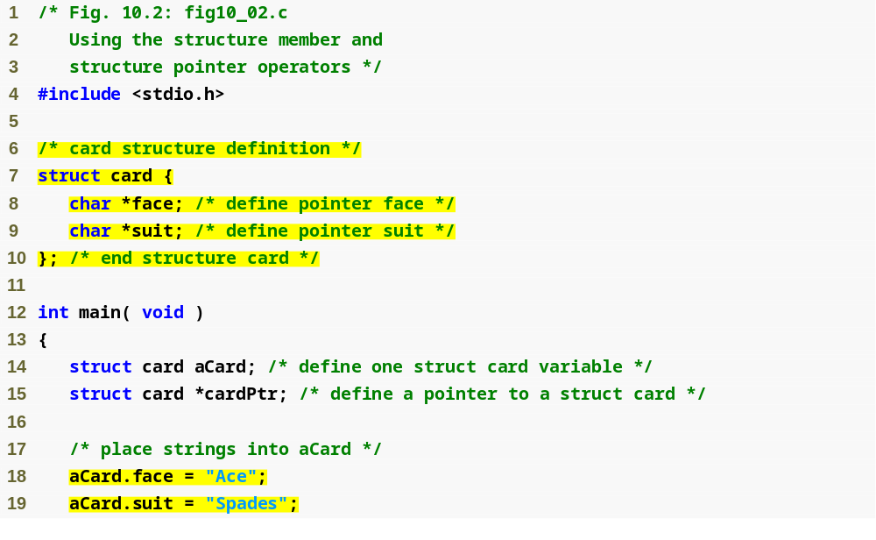
Outline
fig10_02.c
(1 of 2 )
Structure definition
Structure definition must end with semicolon
Dot operator accesses members of a structure

Slide 24
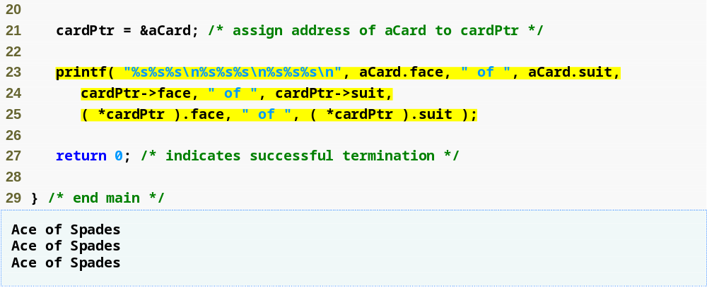
Outline
fig10_02.c
(2 of 2 )
Arrow operator accesses members of a structure pointer

Slide 25
10.5 Using Structures with Functions
Passing structures to functions
  Pass entire structure
    Or, pass individual members
  Both pass call by value
To pass structures call-by-reference
  Pass its address
  Pass reference to it
To pass arrays call-by-value
  Create a structure with the array as a member
  Pass the structure

Slide 26
Common Programming Error 10.7
Assuming that structures, like arrays, are automatically passed by reference and trying to modify the caller’s structure values in the called function is a logic error.

Slide 27
Performance Tip 10.1
Passing structures by reference is more efficient than passing structures by value (which requires the entire structure to be copied).

Slide 28
10.6 typedef
typedef
  Creates synonyms (aliases) for previously defined data types
  Use typedef to create shorter type names
  Example:
      typedef struct Card *CardPtr;
  Defines a new type name CardPtr as a synonym for type struct Card *
  typedef does not create a new data type
    Only creates an alias

Slide 29
Good Programming Practice 10.4
Capitalize the first letter of typedef names to emphasize that they are synonyms for other type names.

Slide 30
Portability Tip 10.2
Use typedef to help make a program
more portable.

Slide 31
10.7 Example: High-Performance Card Shuffling and Dealing Simulation
Pseudocode:
  Create an array of card structures
  Put cards in the deck
  Shuffle the deck
  Deal the cards

Slide 32
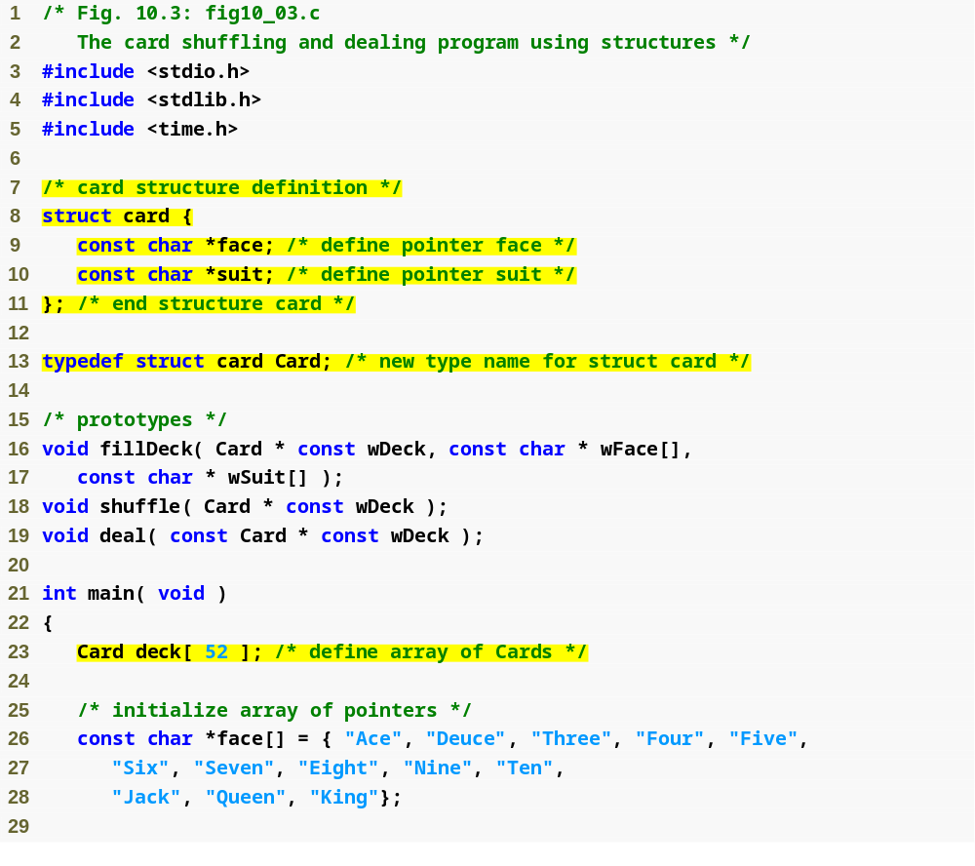
Outline
fig10_03.c
(1 of 3 )
Each card has a face and a suit
Card is now an alias for struct card

Slide 33
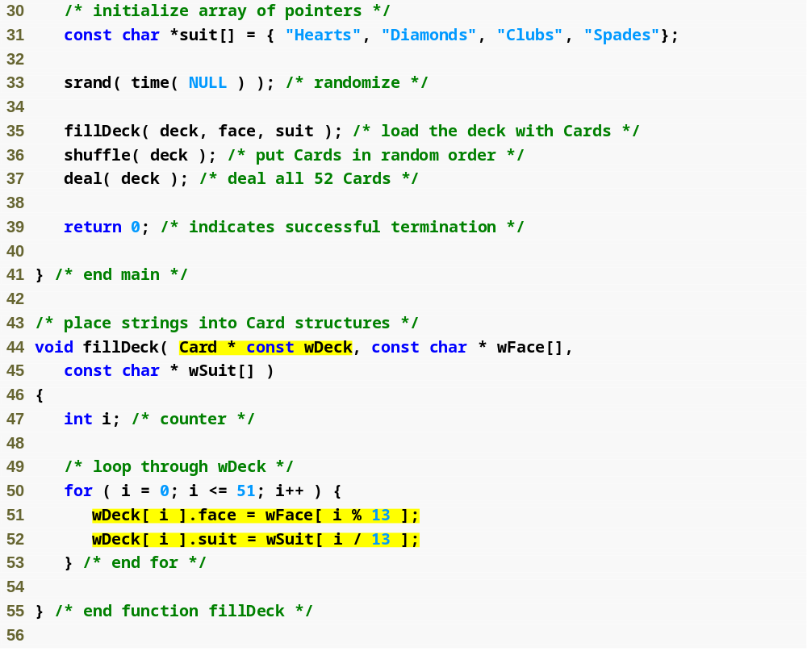
Outline
fig10_03.c
(2 of 3 )
Constant pointer to modifiable array of Cards
Fills the deck by giving each Card a face and suit

Slide 34
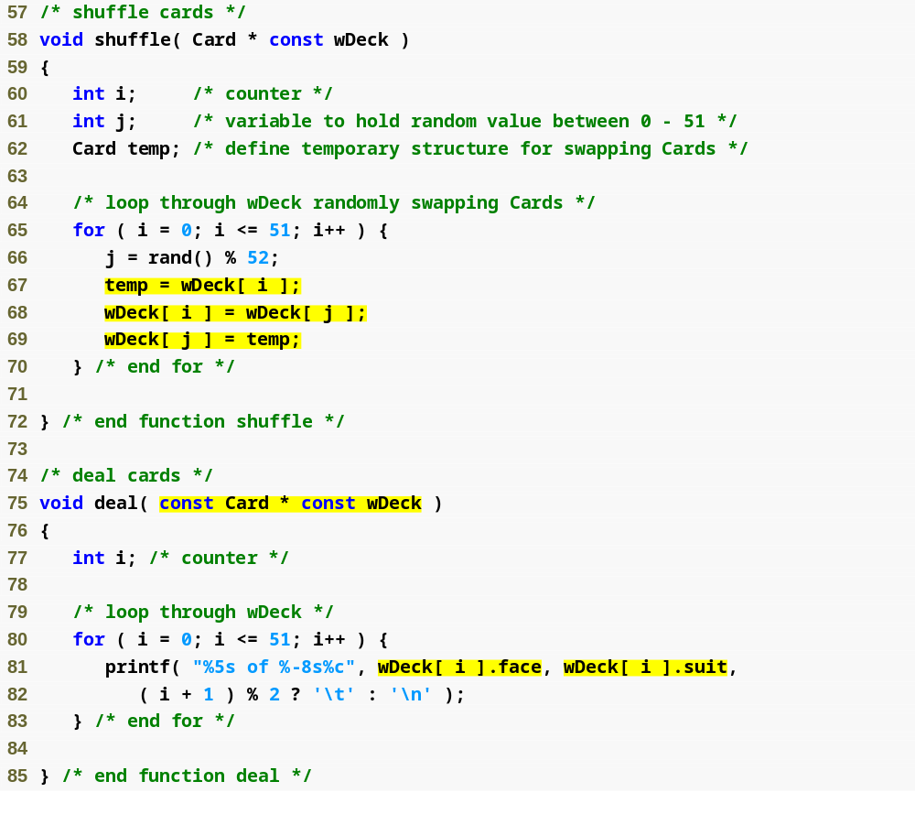
Outline
fig10_03.c
(3 of 3 )
Each card is swapped with another, random card, shuffling the deck

Slide 35
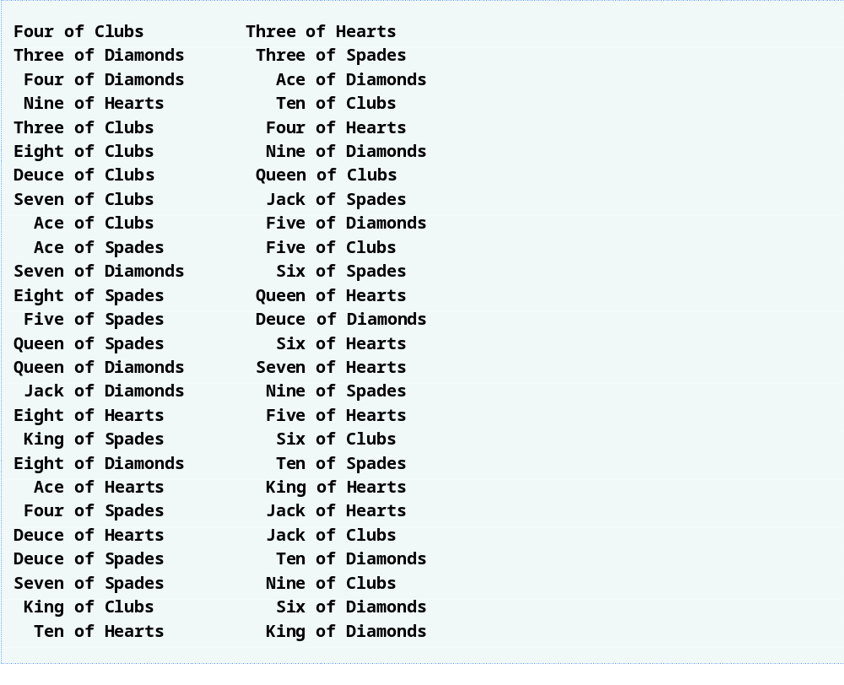
Outline

Slide 36
Common Programming Error 10.8
Forgetting to include the array subscript when referring to individual structures in an array of structures is a syntax error.

Slide 37
10.8 Unions
union
  Memory that contains a variety of objects over time
  Only contains one data member at a time
  Members of a union share space
  Conserves storage
  Only the last data member defined can be accessed
union definitions
  Same as struct
      union Number {
      int x;
      float y;
      };
      union Number value;

Slide 38
10.8 Unions
Valid union operations
  Assignment to union of same type: =
  Taking address: &
  Accessing union members: .
  Accessing members using pointers: ->

Slide 39
Common Programming Error 10.9
Referencing data in a union with a
variable of the wrong type is a logic error.

Slide 40
Portability Tip 10.3
If data is stored in a union as one type and referenced as another type, the results are implementation dependent.

Slide 41
Software Engineering Observation 10.1
As with a struct definition, a union definition simply creates a new type. Placing a union or struct definition outside any function does not create a global variable.

Slide 42
Common Programming Error 10.10
Comparing unions is a syntax error.

Slide 43
Portability Tip 10.4
The amount of storage required to store a union is implementation dependent but will always be at least as large as the largest member of the union.

Slide 44
Portability Tip 10.5
Some unions may not port easily to other computer systems. Whether a union is portable or not often depends on the storage alignment requirements for the union member data types on a given system.

Slide 45
Performance Tip 10.2
Unions conserve storage.

Slide 46
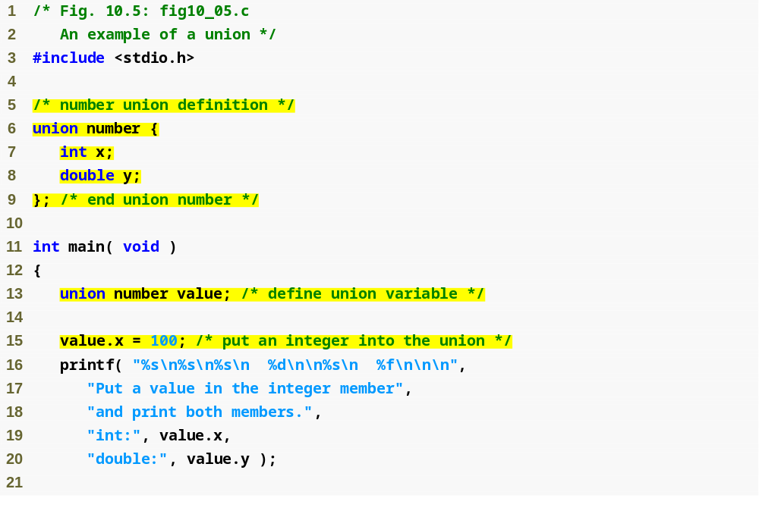
Outline
Union definition
fig10_05.c
(1 of 2 )
Union definition must end with semicolon
Note that y has no value

Slide 47
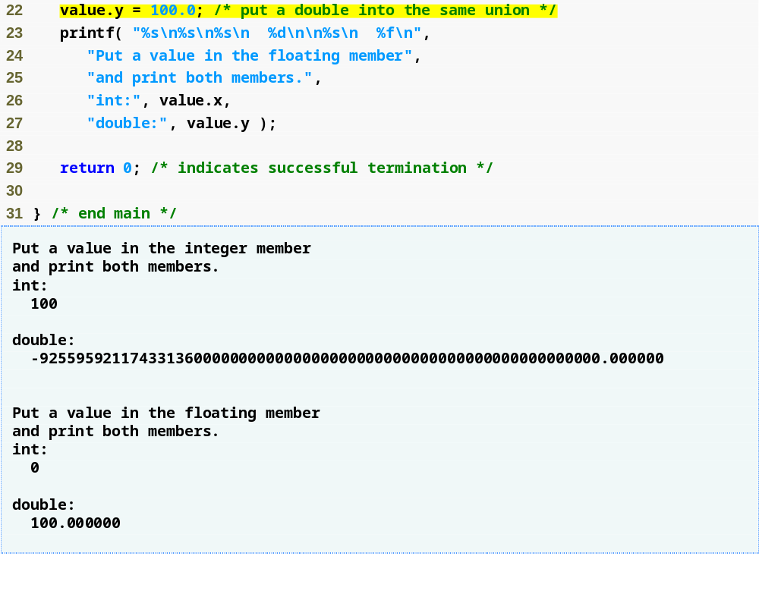
Outline
Giving y a value removes x’s value
fig10_05.c
(2 of 2 )

Slide 48
10.9 Bitwise Operators
All data is represented internally as sequences of bits
  Each bit can be either 0 or 1
  Sequence of 8 bits forms a byte

Slide 49
Portability Tip 10.6
Bitwise data manipulations are machine dependent.

Slide 50
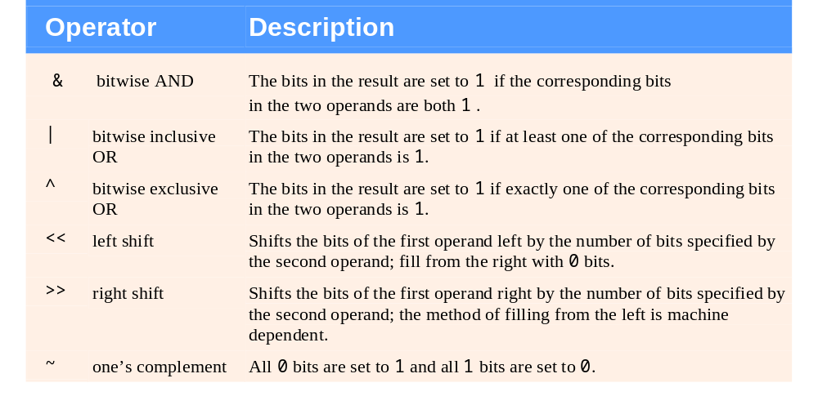
Fig. 10.6 | Bitwise operators.

Slide 51
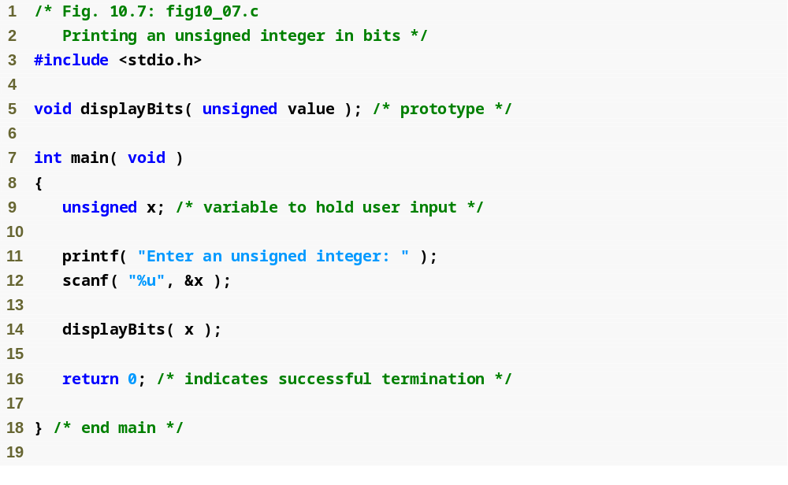
Outline
fig10_07.c
(1 of 2 )

Slide 52
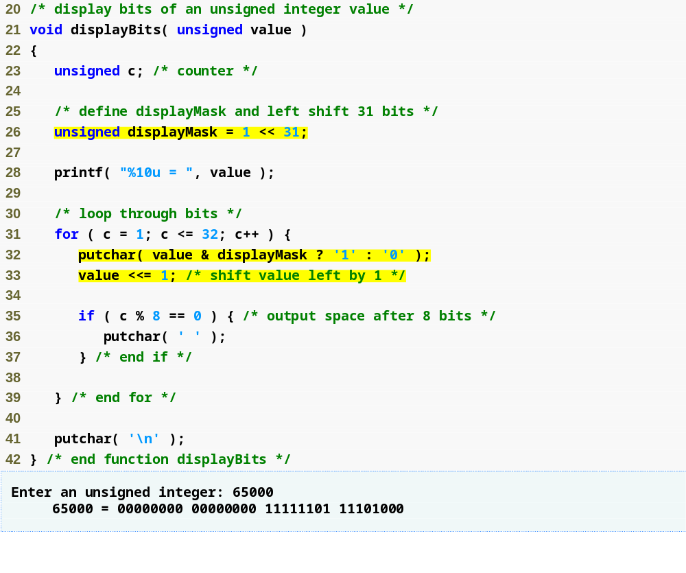
Outline
fig10_07.c
(2 of 2 )
displayMask is a 1 followed by 31 zeros
Bitwise AND returns nonzero if the leftmost bits of displayMask and value are both 1, since all other bits in displayMask are 0s.

Slide 53
Common Programming Error 10.11
Using the logical AND operator (&&) for the bitwise AND operator (&) and vice versa is an error.

Slide 54
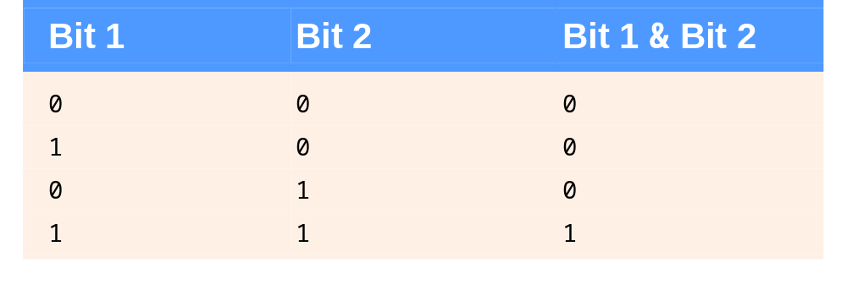
Fig. 10.8 | Results of combining two bits with the bitwise AND operator &.

Slide 55
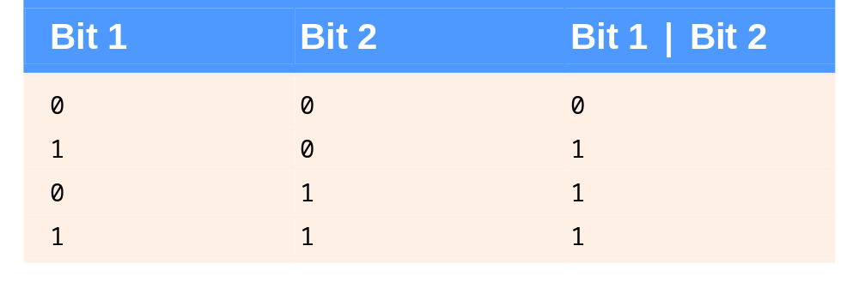
Fig. 10.11 | Results of combining two bits with the bitwise inclusive OR operator |.

Slide 56
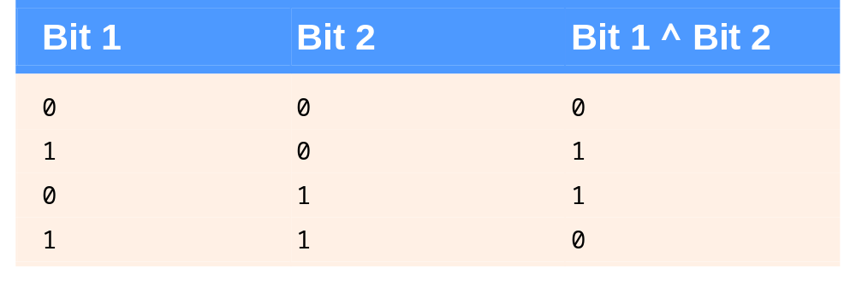
Fig. 10.12 | Results of combining two bits with the bitwise exclusive OR operator ^.

Slide 57
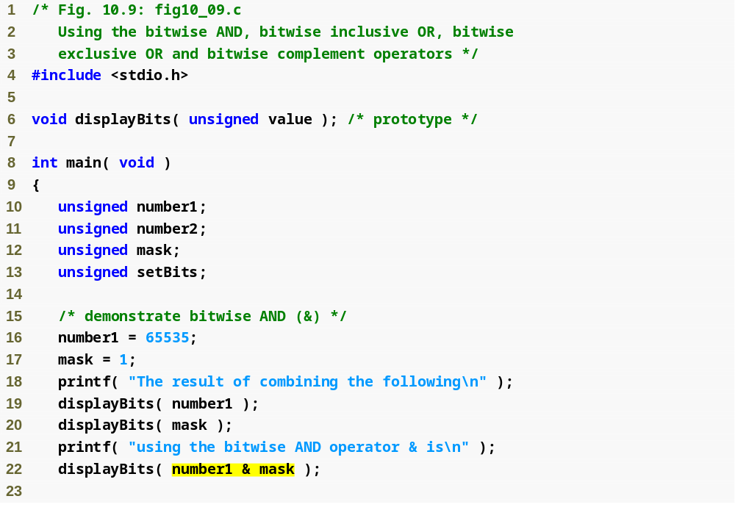
Outline
fig10_09.c
(1 of 3 )
Bitwise AND sets each bit in the result to 1 if the corresponding bits in the operands are both 1

Slide 58
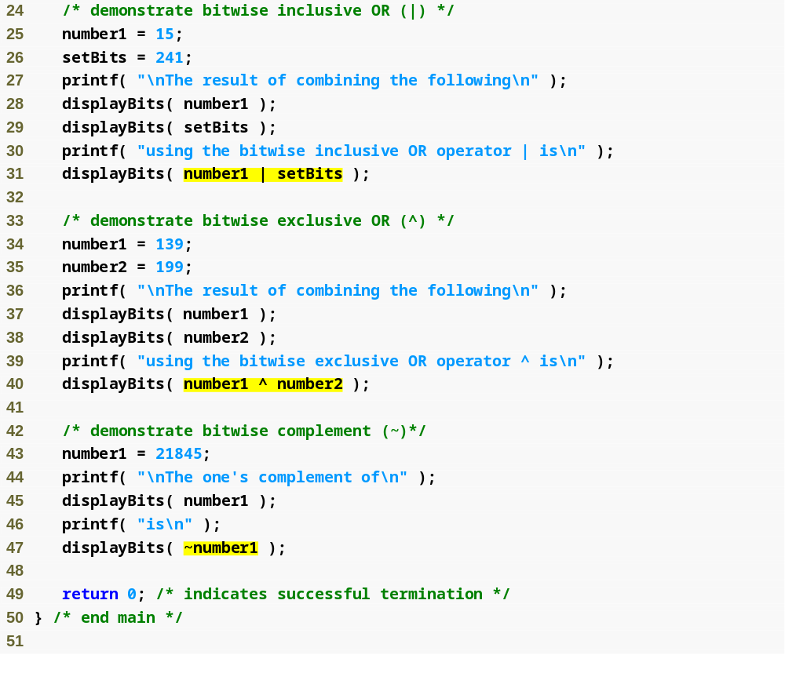
Outline
fig10_09.c
(2 of 3 )
Bitwise inclusive OR sets each bit in the result to 1 if at least one of the corresponding bits in the operands is 1
Bitwise exclusive OR sets each bit in the result to 1 if only one of the corresponding bits in the operands is 1
Complement operator sets each bit in the result to 0 if the corresponding bit in the operand is 1 and vice versa

Slide 59
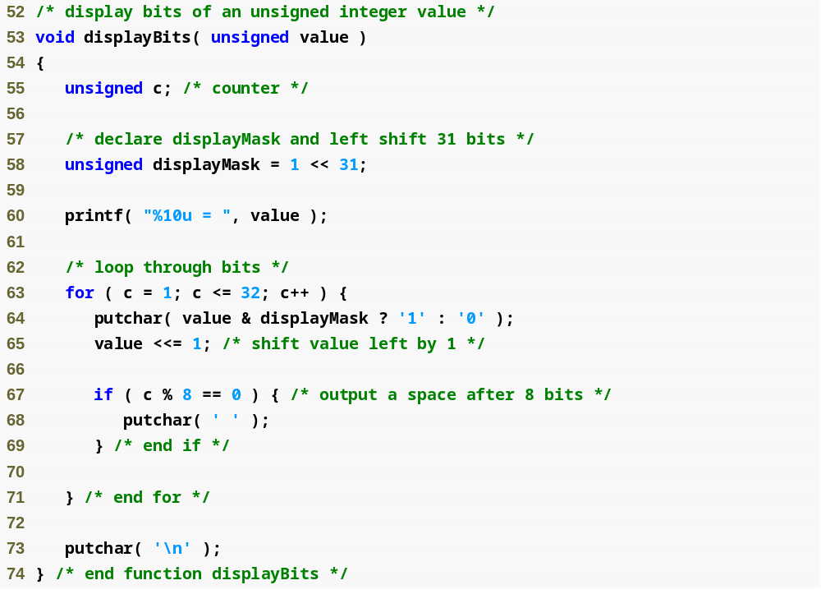
Outline
fig10_09.c
(3 of 3 )

Slide 60
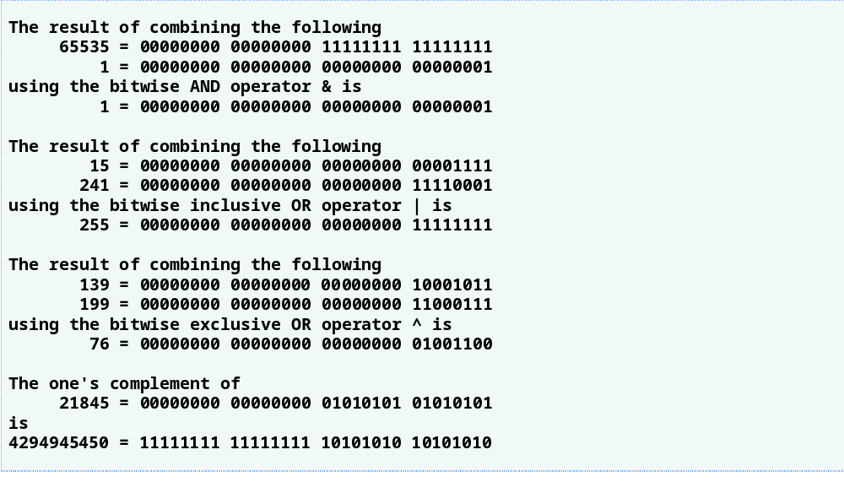
Outline
fig10_10.c

Slide 61
Common Programming Error 10.12
Using the logical OR operator (||) for the bitwise OR operator (|) and vice versa is an error.

Slide 62
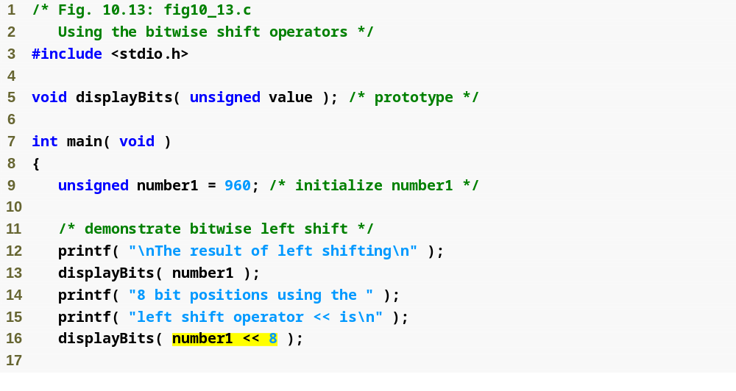
Outline
fig10_13.c
(1 of 3 )
Left shift operator shifts all bits left a specified number of spaces, filling in zeros for the empty bits

Slide 63
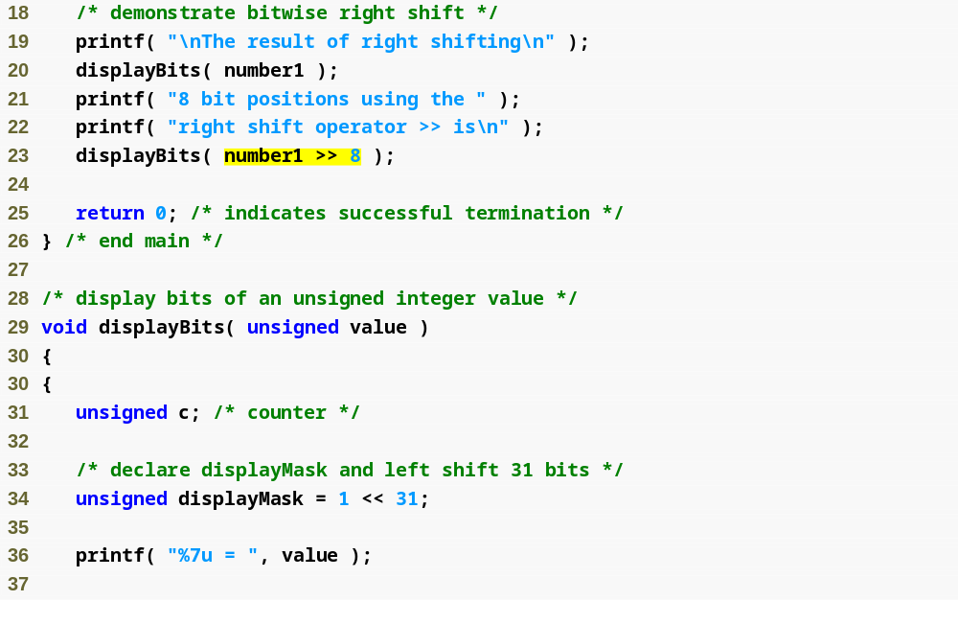
Outline
fig10_13.c
(2 of 3 )
Right shift operator shifts all bits right a specified number of spaces, filling in the empty bits in an implementation-defined manner

Slide 64
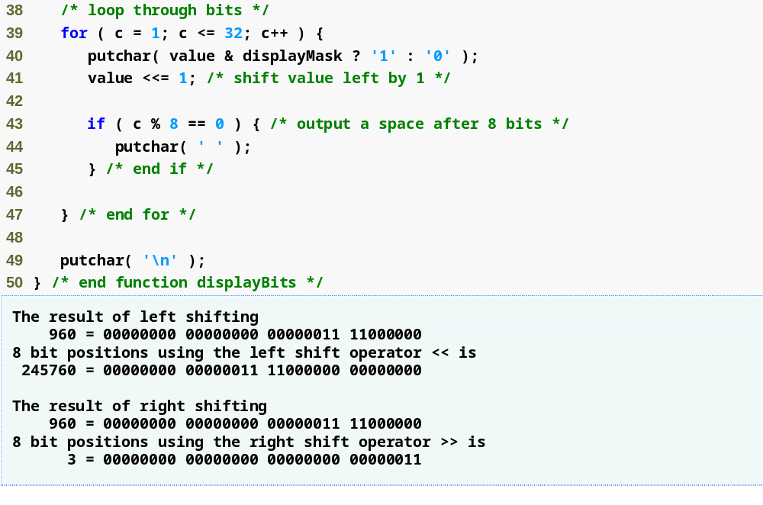
Outline
fig10_13.c
(3 of 3 )

Slide 65
Common Programming Error 10.13
The result of shifting a value is undefined if the right operand is negative or if the right operand is larger than the number of bits in which the left operand is stored.

Slide 66
Portability Tip 10.7
Right shifting is machine dependent. Right shifting a signed integer fills the vacated bits with 0s on some machines and with 1s on others.

Slide 67
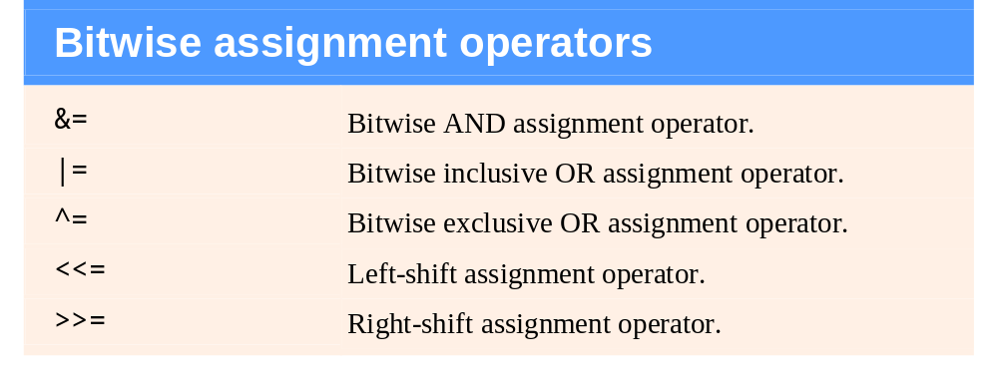
Fig. 10.14 | The bitwise assignment operators.

Slide 68
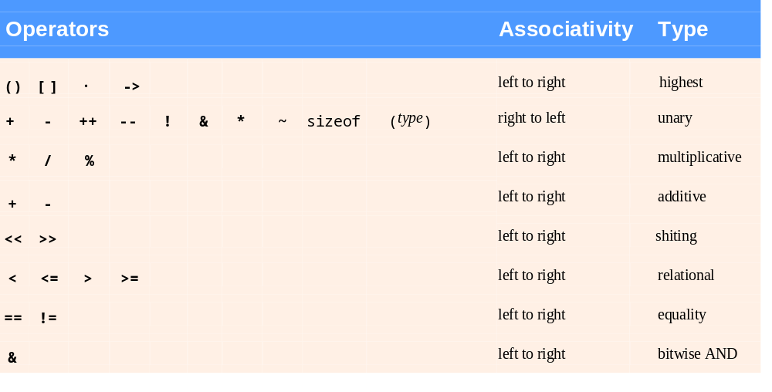
Fig. 10.15 | Operator precedence and associativity. (Part 1 of 2.)

Slide 69
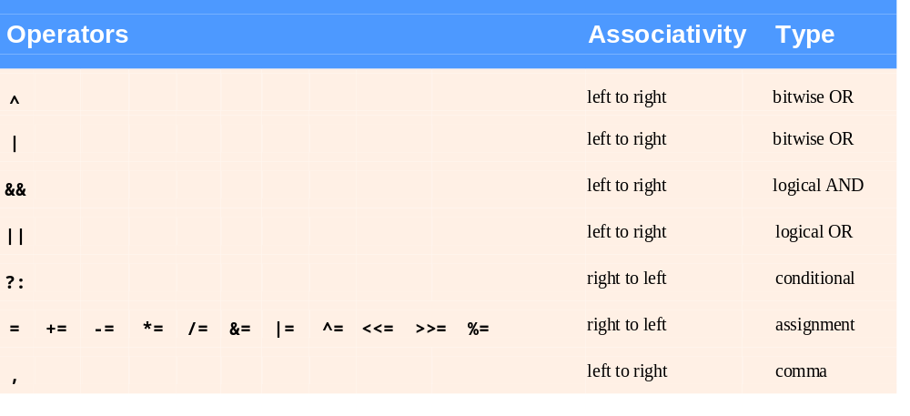
Fig. 10.15 | Operator precedence and associativity. (Part 2 of 2.)

Slide 70
10.10 Bit Fields
Bit field
  Member of a structure whose size (in bits) has been specified
  Enable better memory utilization
  Must be defined as int or unsigned
  Cannot access individual bits
Defining bit fields
  Follow unsigned or int member with a colon (:) and an integer constant representing the width of the field
  Example:
      struct BitCard {
      unsigned face : 4;
      unsigned suit : 2;
      unsigned color : 1;
      };

Slide 71
10.10 Bit Fields
Unnamed bit field
  Field used as padding in the structure
  Nothing may be stored in the bits
      struct Example {
      unsigned a : 13;
      unsigned : 3;
      unsigned b : 4;
      }
  Unnamed bit field with zero width aligns next bit field to a new storage unit boundary

Slide 72
Performance Tip 10.3
Bit fields help conserve storage.

Slide 73
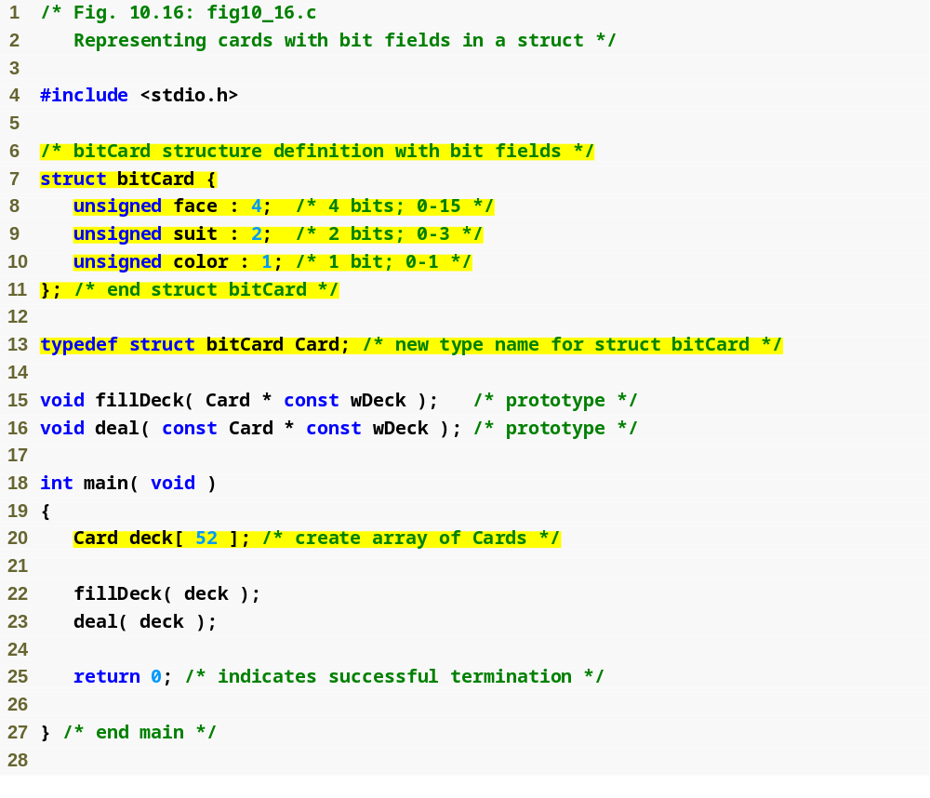
Outline
fig10_16.c
(1 of 2 )
Bit fields determine how much memory each member of a structure can take up

Slide 74
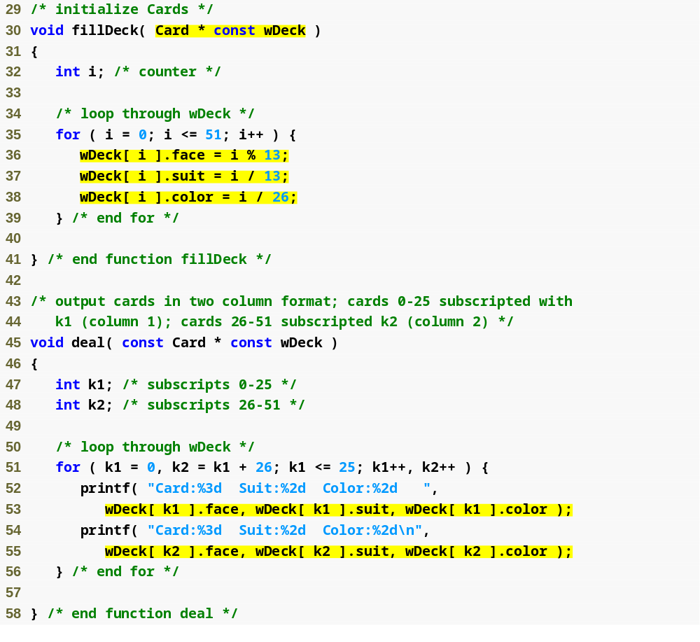
Outline
fig10_16.c
(2 of 2 )

Slide 75
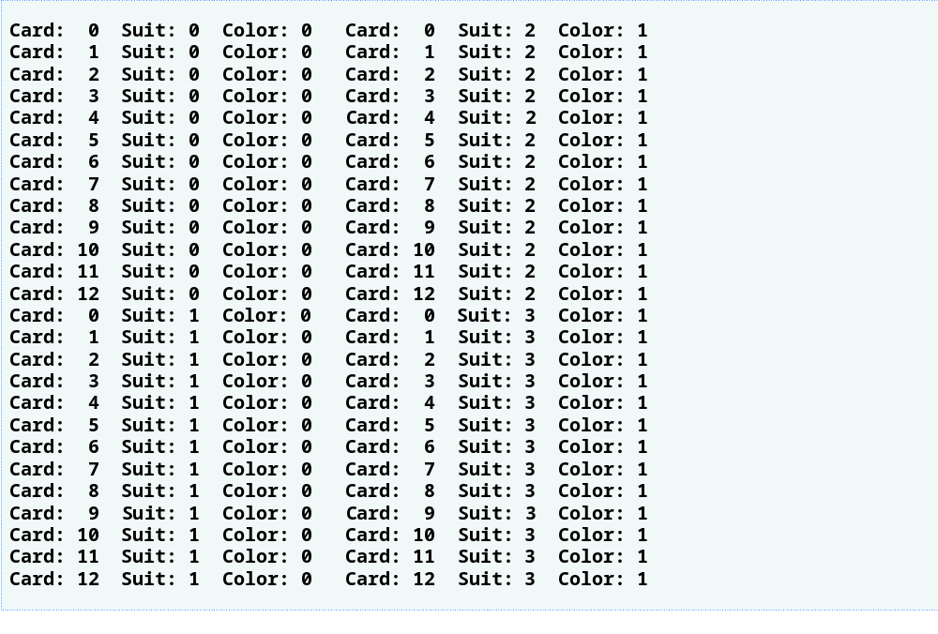
Outline

Slide 76
Portability Tip 10.8
Bit-field manipulations are machine dependent. For example, some computers allow bit fields to cross word boundaries, whereas others do not.

Slide 77
Common Programming Error 10.14
Attempting to access individual bits of a bit field as if they were elements of an array is a syntax error. Bit fields are not “arrays of bits.”

Slide 78
Common Programming Error 10.15
Attempting to take the address of a bit field (the & operator may not be used with bit fields because they do not have addresses).

Slide 79
Performance Tip 10.4
Although bit fields save space, using them can cause the compiler to generate slower-executing machine-language code. This occurs because it takes extra machine language operations to access only portions of an addressable storage unit. This is one of many examples of the kinds of space–time trade-offs that occur in computer science.

Slide 80
10.11 Enumeration Constants
Enumeration
  Set of integer constants represented by identifiers
  Enumeration constants are like symbolic constants whose values are automatically set
    Values start at 0 and are incremented by 1
    Values can be set explicitly with =
    Need unique constant names
  Example:
    enum Months { JAN = 1, FEB, MAR, APR, MAY, JUN, JUL, AUG, SEP, OCT, NOV, DEC};
    Creates a new type enum Months in which the identifiers are set to the integers 1 to 12
  Enumeration variables can only assume their enumeration constant values (not the integer representations)

Slide 81
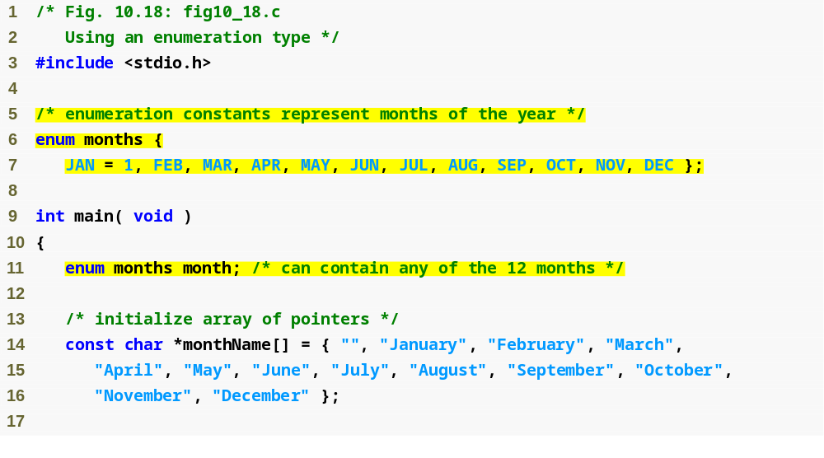
Outline
fig10_18.c
(1 of 2 )
Enumeration sets the value of constant JAN to 1 and the following constants to 2, 3, 4…

Slide 82
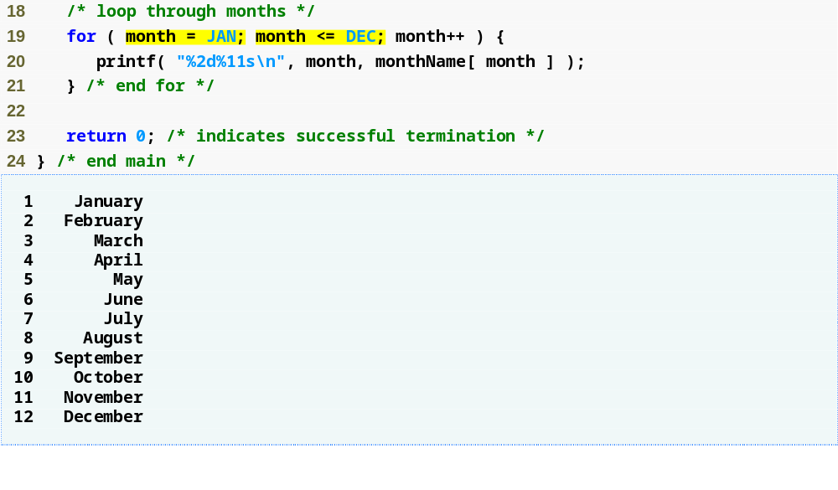
Outline
fig10_18.c
(2 of 2 )
Like symbolic constants, enumeration constants are replaced by their values at compile time

Slide 83
Common Programming Error 10.16
Assigning a value to an enumeration constant after it has been defined is a syntax error.

Slide 84
Good Programming Practice 10.5
Use only uppercase letters in the names of enumeration constants. This makes these constants stand out in a program and reminds you that enumeration constants
are not variables.

