Slide 1
Chapter 11 – File Processing
Outline
11.1 Introduction
11.2 The Data Hierarchy
11.3 Files and Streams
11.4 Creating a Sequential Access File
11.5 Reading Data from a Sequential Access File
11.6 Updating Sequential Access Files
11.7 Random Access Files
11.8 Creating a Random Access File
11.9 Writing Data Randomly to a Random Access File
11.10 Reading Data Sequentially from a Random Access File
11.11 Case Study: A Transaction Processing Program
11.12 Input/Output of Objects

Slide 2
11.1 Introduction
Data files
  Can be created, updated, and processed by C programs
  Are used for permanent storage of large amounts of data
    Storage of data in variables and arrays is only temporary
    Files are used for Permanent retention of data

Slide 3
11.2 The Data Hierarchy
Data Hierarchy:
  Bit – smallest data item
    Value of 0 or 1
  Byte – 8 bits
    Used to store a character
      Decimal digits, letters, and special symbols
  Field – group of characters conveying meaning
    Example: your name
  Record – group of related fields
    Represented by a struct or a class
    Example: In a payroll system, a record for a particular employee that contained his/her identification number, name, address, etc.

Slide 4
11.2 The Data Hierarchy
Data Hierarchy (continued):
  File – group of related records
    Example: payroll file
  Database – group of related files
Sally
Black
Tom
Blue
Judy
Green
File
Iris
Orange
Randy
Red
Judy
Green
Record
Judy
Field
01001010
Byte (ASCII character J)
1
Bit

Slide 5
11.2 The Data Hierarchy
Data files
  Record key
    Identifies a record to facilitate the retrieval of specific records from a file
  Sequential file
    Records typically sorted by key

Slide 6
11.3 Files and Streams
C views each file as a sequence of bytes
  File ends with the end-of-file marker
    Or, file ends at a specified byte
Stream created when a file is opened
  Provide communication channel between files and programs
  Opening a file returns a pointer to a FILE structure
    Example file pointers:
    stdin - standard input (keyboard)
    stdout - standard output (screen)
    stderr - standard error (screen)
Notes:
Three files and their associated streams are automatically opened when program execution begins—the standard input, the standard output and the standard error
File structure includes a file descriptor, i.e., an index into an operating system array called the open file table. Each array element contains a file control block (FCB) that the operating system uses to administer a particular file

Slide 7
11.3 Files and Streams
Read/Write functions in standard library
  fgetc
    Reads one character from a file
    Takes a FILE pointer as an argument
    fgetc( stdin ) equivalent to getchar()
  fputc
    Writes one character to a file
    Takes a FILE pointer and a character to write as an argument
    fputc( 'a', stdout ) equivalent to putchar( 'a' )
  fgets
    Reads a line from a file
  fputs
    Writes a line to a file
  fscanf / fprintf
    File processing equivalents of scanf and printf

Slide 8
11.4 Creating a Sequential Access File
C imposes no file structure
  No notion of records in a file
  Programmer must provide file structure
Creating a File
  FILE *myPtr;
    Creates a FILE pointer called myPtr
  myPtr = fopen("myFile.dat", openmode);
    Function fopen returns a FILE pointer to file specified
    Takes two arguments – file to open and file open mode
    If open fails, NULL returned
  fprintf
    Used to print to a file
    Like printf, except first argument is a FILE pointer (pointer to the file you want to print in)

Slide 9
11.4 Creating a Sequential Access File
  feof( FILE pointer )
    Returns true if end-of-file indicator (no more data to process) is set for the specified file
  fclose( FILE pointer )
    Closes specified file
    Performed automatically when program ends
    Good practice to close files explicitly
Details
  Programs may process no files, one file, or many files
  Each file must have a unique name and should have its own pointer
Notes:
function feof to determine whether the end-of-file indicator is set for the file to which stdin refers

Slide 10
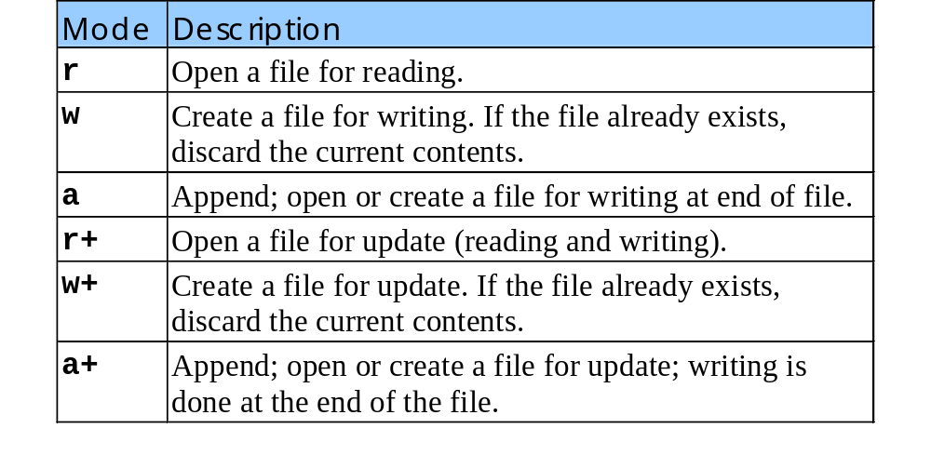
11.4 Creating a Sequential Access File
Table of file open modes:

Slide 11
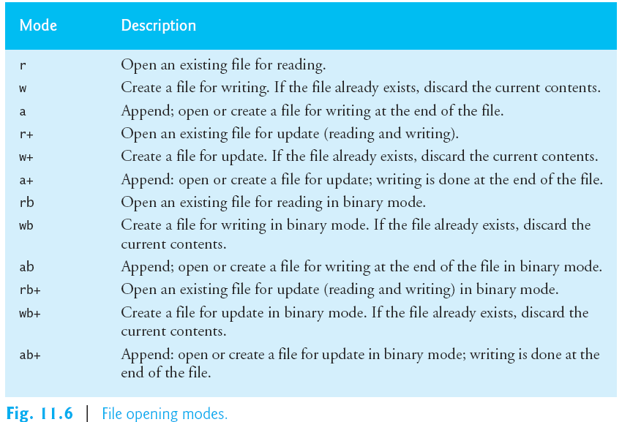



{
{

Slide 12
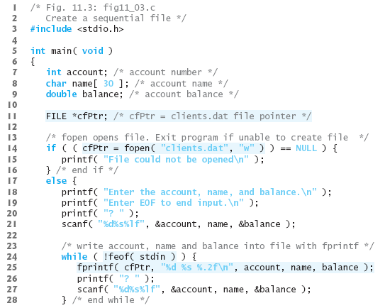

Slide 13
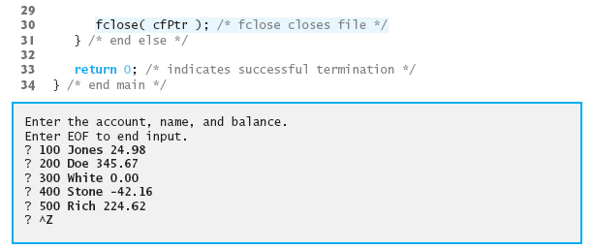

Slide 14
11.5 Reading Data from a Sequential Access File
Reading a sequential access file
  Create a FILE pointer, link it to the file to read
    myPtr = fopen( "myFile.dat", "r" );
  Use fscanf to read from the file
    Like scanf, except first argument is a FILE pointer
    fscanf( myPtr, "%d%s%f", &myInt, myString, &myFloat );
  Data read from beginning to end
  File position pointer
    Indicates number of next byte to be read / written
    Not really a pointer, but an integer value (specifies byte location)
    Also called byte offset
  rewind( myPtr )
    Repositions file position pointer to beginning of file (byte 0)

Slide 15
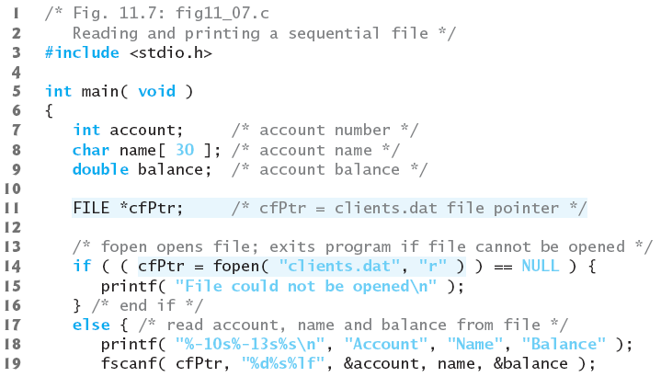
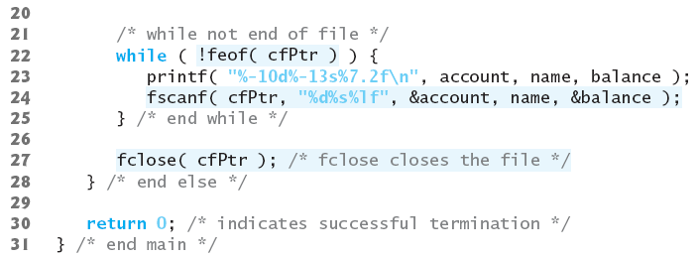

Slide 16
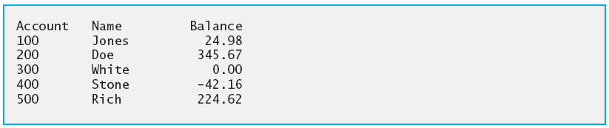
Program Output

Slide 17
#include<stdio.h>
#include<conio.h>
int main()
{
char ch;
FILE *fp;
fp = fopen("t.txt","w");
if(fp == 0)
{
printf("File creation Error!!!");
return 1;
}
while((ch = getche()) !=13)
fputc(ch,fp);
fclose(fp);
return 0;
}

Slide 18
#include<stdio.h>
#include<conio.h>
int main()
{
char ch;
FILE *fp;
fp = fopen("t.txt","r");
if(fp == 0)
{
printf("File openning Error!!!");
return 1;
}
while(!feof(fp))
{
printf("%c",fgetc(fp));
}
fclose(fp);
return 0;
}

Slide 19
#include<stdio.h>
int main()
{
FILE *p,*q;
char file1[20],file2[20];
char ch;
printf("\nEnter the source file name to be copied:");
gets(file1);
p=fopen(file1,"r");
if(p==NULL){
printf("Cannot open %s",file1);
exit(0);
}
printf("\nEnter the destination file name:");
gets(file2);
q=fopen(file2,"w");

Slide 20
if(q==NULL){
printf("Cannot open %s",file2);
exit(0);
}
while((ch=fgetc(p))!=EOF)
{
if(isupper(ch))
ch=tolower (ch);
fputc(ch,q);
}
printf("\nCOMPLETED");
fclose(p);
fclose(q);
return 0;
}

Slide 21
1 /* Fig. 11.8: fig11_08.c
2 Credit inquiry program */
3 #include <stdio.h>
4
1. Initialize variables
2. Open file
2.1 Input choice
2.2 Scan files
3. Print
5 int main()
6 {
7 int request, account;
8 double balance;
9 char name[ 30 ];
10 FILE *cfPtr;
11
12 if ( ( cfPtr = fopen( "clients.dat", "r" ) ) == NULL )
13 printf( "File could not be opened\n" );
14 else {
15 printf( "Enter request\n"
16 " 1 - List accounts with zero balances\n"
17 " 2 - List accounts with credit balances\n"
18 " 3 - List accounts with debit balances\n"
19 " 4 - End of run\n? " );
20 scanf( "%d", &request );
21
22 while ( request != 4 ) {
23 fscanf( cfPtr, "%d%s%lf", &account, name,
24 &balance );
25
26 switch ( request ) {
27 case 1:
28 printf( "\nAccounts with zero "
29 "balances:\n" );
30
31 while ( !feof( cfPtr ) ) {
32

Slide 22
33 if ( balance == 0 )
34 printf( "%-10d%-13s%7.2f\n",
35 account, name, balance );
36
2.2 Scan files
3. Print
37 fscanf( cfPtr, "%d%s%lf",
38 &account, name, &balance );
39 }
40
41 break;
42 case 2:
43 printf( "\nAccounts with credit "
44 "balances:\n" );
45
46 while ( !feof( cfPtr ) ) {
47
48 if ( balance < 0 )
49 printf( "%-10d%-13s%7.2f\n",
50 account, name, balance );
51
52 fscanf( cfPtr, "%d%s%lf",
53 &account, name, &balance );
54 }
55
56 break;
57 case 3:
58 printf( "\nAccounts with debit "
59 "balances:\n" );
60
61 while ( !feof( cfPtr ) ) {
62
63 if ( balance > 0 )
64 printf( "%-10d%-13s%7.2f\n",

Slide 23
65 account, name, balance );
66
67 fscanf( cfPtr, "%d%s%lf",
68 &account, name, &balance );
3.1 Close file
69 }
70
71 break;
72 }
73
74 rewind( cfPtr );
75 printf( "\n? " );
76 scanf( "%d", &request );
77 }
78
79 printf( "End of run.\n" );
80 fclose( cfPtr );
81 }
82
83 return 0;
84 }

Slide 24
Enter request
1 - List accounts with zero balances
2 - List accounts with credit balances
3 - List accounts with debit balances
4 - End of run
? 1
Accounts with zero balances:
300 White 0.00
? 2
Accounts with credit balances:
400 Stone -42.16
? 3
Accounts with debit balances:
100 Jones 24.98
200 Doe 345.67
500 Rich 224.62
? 4
End of run.
Program Output

Slide 25
11.5 Reading Data from a Sequential Access File
Sequential access file
  Cannot be modified without the risk of destroying other data
  Fields can vary in size
    Different representation in files and screen than internal representation
    1, 34, -890 are all ints, but have different sizes on disk
300 White 0.00 400 Jones 32.87 (old data in file)
If we want to change White's name to Worthington,
300 Worthington 0.00
300 White 0.00 400 Jones 32.87
Data gets overwritten
300 Worthington 0.00ones 32.87

Slide 26
11.6 Random Access Files
Random access files
  Access individual records without searching through other records
  Instant access to records in a file
  Data can be inserted without destroying other data
  Data previously stored can be updated or deleted without overwriting
Implemented using fixed length records
  Sequential files do not have fixed length records
0
100
200
300
400
500
}
byte offsets
}
}
}
}
}
}
100
bytes
100
bytes
100
bytes
100
bytes
100
bytes
100
bytes

Slide 27
11.7 Creating a Random Access File
Data in random access files
  Unformatted (stored as "raw bytes")
    All data of the same type (ints, for example) uses the same amount of memory
    All records of the same type have a fixed length
    Data not human readable
Mode Description
rb Open an existing file for reading in binary mode.
wb Create a file for writing in binary mode. If the file already exists, discard the current contents.
ab Append; open or create a file for writing at the end of the file in binary mode.
rb+ Open an existing file for update (reading and writing) in binary mode.
wb+ Create a file for update in binary mode. If the file already exists, discard the current contents.
ab+ Append: open or create a file for update in binary mode; writing is done at the end of the file.
Fig. 11.6 | File opening modes.

Slide 28
11.7 Creating a Random Access File
Unformatted I/O functions
  fwrite
    Transfer bytes from a location in memory to a file
    The data is written beginning at the location in the file indicated by the file position pointer.
  fread
    Transfer bytes from a file to a location in memory
  Example:
    fwrite( &number, sizeof( int ), 1, myPtr );
    &number – Location to transfer bytes from
    sizeof( int ) – Number of bytes to transfer
    1 – For arrays, number of elements to transfer
      In this case, "one element" of an array is being transferred
    myPtr – File to transfer to or from
Notes:
Now, when writing an integer, instead of using fprintf( fPtr, "%d", number ); which could print a single digit or as many as 11 digits (10 digits plus a sign, each of which requires 1 byte of storage) for a 4-byte integer, we can use fwrite( &number, sizeof( int ), 1, fPtr ); which always writes 4 bytes (or 2 bytes on a system with 2-byte integers) from a variable number to the file represented by fPtr.

Slide 29
11.7 Creating a Random Access File
Writing structs
  fwrite( &myObject, sizeof (struct myStruct), 1, myPtr );
  sizeof – returns size in bytes of object in parentheses
To write several array elements
  Pointer to array as first argument
  Number of elements to write as third argument

Slide 30
1 /* Fig. 11.11: fig11_11.c
2 Creating a randomly accessed file sequentially */
3 #include <stdio.h>
4
1. Define struct
1.1 Initialize variable
1.2 Initialize struct
2. Open file
2.1 Write to file using unformatted output
3. Close file
5 struct clientData {
6 int acctNum;
7 char lastName[ 15 ];
8 char firstName[ 10 ];
9 double balance;
10 };
11
12 int main()
13 {
14 int i;
15 struct clientData blankClient = { 0, "", "", 0.0 };
16 FILE *cfPtr;
17
18 if ( ( cfPtr = fopen( "credit.dat", "w" ) ) == NULL )
19 printf( "File could not be opened.\n" );
20 else {
21
22 for ( i = 1; i <= 100; i++ )
23 fwrite( &blankClient,
24 sizeof( struct clientData ), 1, cfPtr );
25
26 fclose( cfPtr );
27 }
28
29 return 0;
30 }

Slide 31
11.8 Writing Data Randomly to a Random Access File
fseek
  Sets file position pointer to a specific position
  fseek( pointer, offset, symbolic_constant );
    pointer – pointer to file
    offset – file position pointer (0 is first location)
    symbolic_constant – specifies where in file we are reading from
    SEEK_SET – seek starts at beginning of file
    SEEK_CUR – seek starts at current location in file
    SEEK_END – seek starts at end of file

Slide 32
1 /* Fig. 11.12: fig11_12.c
2 Writing to a random access file */
3 #include <stdio.h>
4
1. Define struct
1.1 Initialize variables
2. Open file
2.1 Input data
2.2 Write to file
5 struct clientData {
6 int acctNum;
7 char lastName[ 15 ];
8 char firstName[ 10 ];
9 double balance;
10 };
11
12 int main()
13 {
14 FILE *cfPtr;
15 struct clientData client = { 0, "", "", 0.0 };
16
17 if ( ( cfPtr = fopen( "credit.dat", "rb+" ) ) == NULL )
18 printf( "File could not be opened.\n" );
19 else {
20 printf( "Enter account number"
21 " ( 1 to 100, 0 to end input )\n? " );
22 scanf( "%d", &client.acctNum );
23
24 while ( client.acctNum != 0 ) {
25 printf( "Enter lastname, firstname, balance\n? " );
26 fscanf( stdin, "%s%s%lf", client.lastName,
27 client.firstName, &client.balance );
28 fseek( cfPtr, ( client.acctNum - 1 ) *
29 sizeof( struct clientData ), SEEK_SET );
30 fwrite( &client, sizeof( struct clientData ), 1,
31 cfPtr );
32 printf( "Enter account number\n? " );

Slide 33
33 scanf( "%d", &client.acctNum );
34 }
35
36 fclose( cfPtr );
3. Close file
Program Output
37 }
38
39 return 0;
40 }
Enter account number (1 to 100, 0 to end input)
? 37
Enter lastname, firstname, balance
? Barker Doug 0.00
Enter account number
? 29
Enter lastname, firstname, balance
? Brown Nancy -24.54
Enter account number
? 96
Enter lastname, firstname, balance
? Stone Sam 34.98

Slide 34
Enter account number
? 88
Enter lastname, firstname, balance
? Smith Dave 258.34
Enter account number
? 33
Enter lastname, firstname, balance
? Dunn Stacey 314.33
Enter account number
? 0
Program Output

Slide 35
11.9 Reading Data Sequentially from a Random Access File
fread
  Reads a specified number of bytes from a file into memory
    fread( &client, sizeof (struct clientData), 1, myPtr );
  Can read several fixed-size array elements
    Provide pointer to array
    Indicate number of elements to read
  To read multiple elements, specify in third argument

Slide 36
1 /* Fig. 11.15: fig11_15.c
2 Reading a random access file sequentially */
3 #include <stdio.h>
4
1. Define struct
1.1 Initialize variables
2. Read (fread)
2.1 Print
5 struct clientData {
6 int acctNum;
7 char lastName[ 15 ];
8 char firstName[ 10 ];
9 double balance;
10 };
11
12 int main()
13 {
14 FILE *cfPtr;
15 struct clientData client = { 0, "", "", 0.0 };
16
17 if ( ( cfPtr = fopen( "credit.dat", "rb" ) ) == NULL )
18 printf( "File could not be opened.\n" );
19 else {
20 printf( "%-6s%-16s%-11s%10s\n", "Acct", "Last Name",
21 "First Name", "Balance" );
22
23 while ( !feof( cfPtr ) ) {
24 fread( &client, sizeof( struct clientData ), 1,
25 cfPtr );
26
27 if ( client.acctNum != 0 )
28 printf( "%-6d%-16s%-11s%10.2f\n",
29 client.acctNum, client.lastName,
30 client.firstName, client.balance );
31 }
32

Slide 37
33 fclose( cfPtr );
34 }
35
36 return 0;
3. Close file
Program Output
37 }
Acct Last Name First Name Balance
29 Brown Nancy -24.54
33 Dunn Stacey 314.33
37 Barker Doug 0.00
88 Smith Dave 258.34
96 Stone Sam 34.98

Slide 38
11.10 Case Study: A Transaction Processing Program
This program
  Demonstrates using random access files to achieve instant access processing of a bank’s account information
We will
  Update existing accounts
  Add new accounts
  Delete accounts
  Store a formatted listing of all accounts in a text file

Slide 39
1 /* Fig. 11.16: fig11_16.c
2 This program reads a random access file sequentially,
3 updates data already written to the file, creates new
4 data to be placed in the file, and deletes data
1. Define struct
1.1 Function prototypes
1.2 Initialize variables
1.3 Link pointer and open file
2. Input choice
5 already in the file. */
6 #include <stdio.h>
7
8 struct clientData {
9 int acctNum;
10 char lastName[ 15 ];
11 char firstName[ 10 ];
12 double balance;
13 };
14
15 int enterChoice( void );
16 void textFile( FILE * );
17 void updateRecord( FILE * );
18 void newRecord( FILE * );
19 void deleteRecord( FILE * );
20
21 int main()
22 {
23 FILE *cfPtr;
24 int choice;
25
26 if ( ( cfPtr = fopen( "credit.dat", "rb+" ) ) == NULL )
27 printf( "File could not be opened.\n" );
28 else {
29
30 while ( ( choice = enterChoice() ) != 5 ) {
31
32 switch ( choice ) {

Slide 40
33 case 1:
34 textFile( cfPtr );
35 break;
36 case 2:
2.1 Perform action
3. Close file
3.1 Function definitions
37 updateRecord( cfPtr );
38 break;
39 case 3:
40 newRecord( cfPtr );
41 break;
42 case 4:
43 deleteRecord( cfPtr );
44 break;
45 }
46 }
47
48 fclose( cfPtr );
49 }
50
51 return 0;
52 }
53
54 void textFile( FILE *readPtr )
55 {
56 FILE *writePtr;
57 struct clientData client = { 0, "", "", 0.0 };
58
59 if ( ( writePtr = fopen( "accounts.txt", "wb" ) ) == NULL )
60 printf( "File could not be opened.\n" );
61 else {
62 rewind( readPtr );
63 fprintf( writePtr, "%-6s%-16s%-11s%10s\n",
64 "Acct", "Last Name", "First Name","Balance" );

Slide 41
65
66 while ( !feof( readPtr ) ) {
67 fread( &client, sizeof( struct clientData ), 1,
68 readPtr );
3.1 Function definitions
69
70 if ( client.acctNum != 0 )
71 fprintf( writePtr, "%-6d%-16s%-11s%10.2f\n",
72 client.acctNum, client.lastName,
73 client.firstName, client.balance );
74 }
75
76 fclose( writePtr );
77 }
78
79 }
80
81 void updateRecord( FILE *fPtr )
82 {
83 int account;
84 double transaction;
85 struct clientData client = { 0, "", "", 0.0 };
86
87 printf( "Enter account to update ( 1 - 100 ): " );
88 scanf( "%d", &account );
89 fseek( fPtr,
90 ( account - 1 ) * sizeof( struct clientData ),
91 SEEK_SET );
92 fread( &client, sizeof( struct clientData ), 1, fPtr );
93
94 if ( client.acctNum == 0 )
95 printf( "Acount #%d has no information.\n", account );
96 else {

Slide 42
97 printf( "%-6d%-16s%-11s%10.2f\n\n",
98 client.acctNum, client.lastName,
99 client.firstName, client.balance );
100 printf( "Enter charge ( + ) or payment ( - ): " );
3.1 Function definitions
101 scanf( "%lf", &transaction );
102 client.balance += transaction;
103 printf( "%-6d%-16s%-11s%10.2f\n",
104 client.acctNum, client.lastName,
105 client.firstName, client.balance );
106 fseek( fPtr,
107 ( account - 1 ) * sizeof( struct clientData ),
108 SEEK_SET );
109 fwrite( &client, sizeof( struct clientData ), 1,
110 fPtr );
111 }
112 }
113
114 void deleteRecord( FILE *fPtr )
115 {
116 struct clientData client,
117 blankClient = { 0, "", "", 0 };
118 int accountNum;
119
120 printf( "Enter account number to "
121 "delete ( 1 - 100 ): " );
122 scanf( "%d", &accountNum );
123 fseek( fPtr,
124 ( accountNum - 1 ) * sizeof( struct clientData ),
125 SEEK_SET );
126 fread( &client, sizeof( struct clientData ), 1, fPtr );

Slide 43
127
128 if ( client.acctNum == 0 )
129 printf( "Account %d does not exist.\n", accountNum );
130 else {
3.1 Function definitions
131 fseek( fPtr,
132 ( accountNum - 1 ) * sizeof( struct clientData ),
133 SEEK_SET );
134 fwrite( &blankClient,
135 sizeof( struct clientData ), 1, fPtr );
136 }
137 }
138
139 void newRecord( FILE *fPtr )
140 {
141 struct clientData client = { 0, "", "", 0.0 };
142 int accountNum;
143 printf( "Enter new account number ( 1 - 100 ): " );
144 scanf( "%d", &accountNum );
145 fseek( fPtr,
146 ( accountNum - 1 ) * sizeof( struct clientData ),
147 SEEK_SET );
148 fread( &client, sizeof( struct clientData ), 1, fPtr );
149
150 if ( client.acctNum != 0 )
151 printf( "Account #%d already contains information.\n",
152 client.acctNum );
153 else {
154 printf( "Enter lastname, firstname, balance\n? " );
155 scanf( "%s%s%lf", &client.lastName, &client.firstName,
156 &client.balance );

Slide 44
157 client.acctNum = accountNum;
158 fseek( fPtr, ( client.acctNum - 1 ) *
159 sizeof( struct clientData ), SEEK_SET );
3.1 Function definitions
160 fwrite( &client,
161 sizeof( struct clientData ), 1, fPtr );
162 }
163 }
164
165 int enterChoice( void )
166 {
167 int menuChoice;
168
169 printf( "\nEnter your choice\n"
170 "1 - store a formatted text file of acounts called\n"
171 " \"accounts.txt\" for printing\n"
172 "2 - update an account\n"
173 "3 - add a new account\n"
174 "4 - delete an account\n"
175 "5 - end program\n? " );
176 scanf( "%d", &menuChoice );
177 return menuChoice;
178 }

Slide 45
After choosing option 1 accounts.txt contains:
Acct Last Name First Name Balance
29 Brown Nancy -24.54
33 Dunn Stacey 314.33
37 Barker Doug 0.00
88 Smith Dave 258.34
96 Stone Sam 34.98
Program Output
Enter account to update (1 - 100): 37
37 Barker Doug 0.00
Enter charge (+) or payment (-): +87.99
37 Barker Doug 87.99
Enter new account number (1 - 100): 22
Enter lastname, firstname, balance
? Johnston Sarah 247.45

