Slide 1
LECTURE 5: STRUCTURED PROGRAM DEVELOPMENT
Abdul Karim Shahid (akarim@ciitlahore.edu.pk)

Slide 2
CONTROL STRUCTURES
Sequential execution
  Statements executed one after the other in the order written
Transfer of control
  When the next statement executed is not the next one in sequence
  Overuse of goto statements led to many problems
  Structured programming – ‘goto elimination’
Bohm and Jacopini
  All programs written in terms of 3 control structures (7 Control Statements)
    Sequence structures: Built into C. Programs executed sequentially by default
    Selection structures: C has three types: if, if/else, and switch
    Repetition structures: C has three types: while, do/while and for
Slide <number>

Slide 3
IF STATEMENTS

Slide 4
THE ‘IF’ SELECTION STATEMENT
Selection structure:
  Used to choose among alternative courses of action
  Pseudocode:
    If student’s grade is greater than or equal to 60
    Print “Passed”
If condition true
  Print statement executed and program goes on to next statement
  If false, print statement is ignored and the program goes onto the next statement
Slide <number>

Slide 5
THE ‘IF’ SELECTION STATEMENT
Pseudocode statement in C:
    if ( grade >= 60 )
    printf ( "Passed\n" );
  C code corresponds closely to the pseudocode
  Indenting makes programs easier to read
    C ignores whitespace characters
Diamond symbol (decision symbol)
  Indicates decision is to be made
  Contains an expression that can be true or false
  Test the condition, follow appropriate path
Slide <number>

Slide 6
THE ‘IF’ SELECTION STATEMENT
if structure is a single-entry/single-exit structure
A decision can be made on any expression.
zero - false
nonzero - true
Example:
3 - 4 is true
true
grade >= 60
print “Passed”
false
Slide <number>

Slide 7
THE SELECTION STATEMENT
Block:
  A set of statements contained within a pair of braces is called compound statements or a block
Syntax errors
  Caught by compiler
Logic errors:
  Have their effect at execution time
  Non-fatal: program runs, but has incorrect output
  Fatal: program exits prematurely
Slide <number>

Slide 8
SIMPLE IF STATEMENT
Syntax
if (condition)
    Statement;
Condition: specifies a condition or relational expression
Syntax of if condition executing a set of statements
If (condition)
{
statement-1;
statement-2;
……..
}
Note: Any non-zero value is TRUE

Slide 9
Condition
True
False
Set of Statements
Statements after
if Structure
Flowchart: The “if statement

Slide 10
EXAMPLE
/* Program executes a single statement if the given statement is TRUE */
#include<stdio.h>
int main()
{
int a = 100, b = 50;
if(a>b)
printf(“Lahore\n”);
printf(“OK\n”);
return 0;
}

Slide 11
EXAMPLES CONT.
/* Program takes input a number from user. If number is divisible by 3 then print the message on the screen that ‘the number is divisible by three*/
#include<stdio.h>
int main()
{
int n = 0;
printf(“Enter a Number : ”);
scanf(“%d”,&n);
if(n%3==0)
{
printf(“Number %d”, n);
printf(“ is divisible by 3\n”);
}
printf(“OK\n”);
return 0;
}
Output
Enter a number: 9
Number 9 is divisible by 3
OK

Slide 12
Example : While purchasing certain items, a discount of 10% is offered if the quantity purchased is more than 1000. If quantity and price per item are input through the keyboard, write a program to calculate the total expenses.

Slide 13
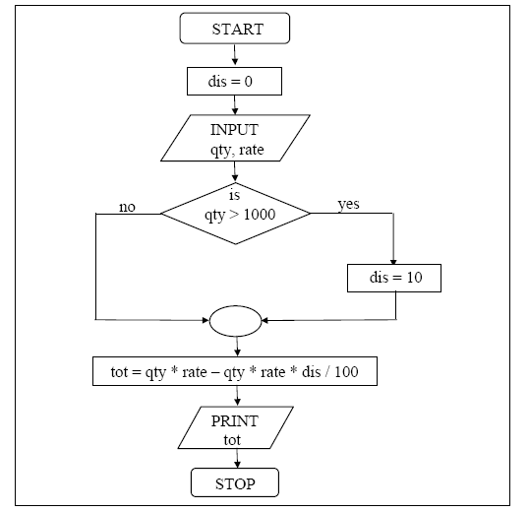


Slide 14
/* Calculation of total expenses */
#include <stdio.h>
int main( )
{
int qty, dis = 0 ;
float rate, tot ;
printf ( "Enter quantity and rate " ) ;
scanf ( "%d %f", &qty, &rate) ;
if ( qty > 1000 )
  dis = 10 ;
tot = ( qty * rate ) - ( qty * rate * dis / 100 ) ;
printf ( "Total expenses = Rs. %f", tot ) ;
return 0;
}
Output
Here is some sample interaction with the program.
Enter quantity and rate 1200 15.50
Total expenses = Rs. 16740.000000
Enter quantity and rate 200 15.50
Total expenses = Rs. 3100.000000

Slide 15
PRACTICE PROGRAM
Write a program to calculate the electricity bill. The rates of electricity per unit are as follow:
  If the units consumed are equal or less than 300,then the cost is Rs. 3/- per unit
  If units consumed are more than 300,then the cost is Rs. 3.5/- per unit and surcharge of 5% of bill is added

Slide 16
SOLUTION
#include<stdio.h>
#include<conio.h>
int main
{
float cu=0 , pu=0 , units=0, bill=0;
printf(“\n Enter current reading?”);
scanf(“%f”, &cu);
printf(“\n Enter previous reading? ”);
scanf(“%f”, &pu);
units = cu-pu;
if(units>300)
bill = units* 3.5 + units*3.5*5 /100.0;
if (units<=300)
bill = units * 3.0;
printf(“\nElectricity bill = %f”,bill);
getch();
return 0;
}

Slide 17
if ( expression )
statement ;
Here the expression can be any valid expression including a relational expression. We can even use arithmetic expressions in the if statement. For example all the following if statements are valid
if ( 3 + 2 % 5 )
printf ( "This works" ) ;
if ( a = 10 )
printf ( "Even this works" ) ;
if ( -5 )
printf ( "Surprisingly even this works" ) ;
Note that in C a non-zero value is considered to be true, whereas a 0 is considered to be false. In the first if, the expression evaluates to 5 and since 5 is non-zero it is considered to be true. Hence the printf( ) gets executed.

Slide 18
IF-ELSE STATEMENT
Syntax
  if (condition)
      Statement-1;
      else
      Statement-2;
  Condition: specifies a condition or relational expression
Syntax of if-else condition executing a set of statements
  If (condition)
  {
  statement-1;
  statement-2;
  ……..
  }
  else
  {
  statement-1;
  statement-2;
  ……..
  }
Note: Any non-zero value is TRUE

Slide 19
Condition
True
False
Block-2
Block-1
Statements after
if Structure
Flowchart: The “if-else statement

Slide 20
Example : In a company an employee is paid as under:
If his basic salary is less than Rs. 1500, then HRA = 10% of basic salary and DA = 90% of basic salary. If his salary is either equal to or above Rs. 1500, then HRA = Rs. 500 and DA = 98% of basic salary. If the employee's salary is input through the keyboard write a program to find his gross salary.

Slide 21
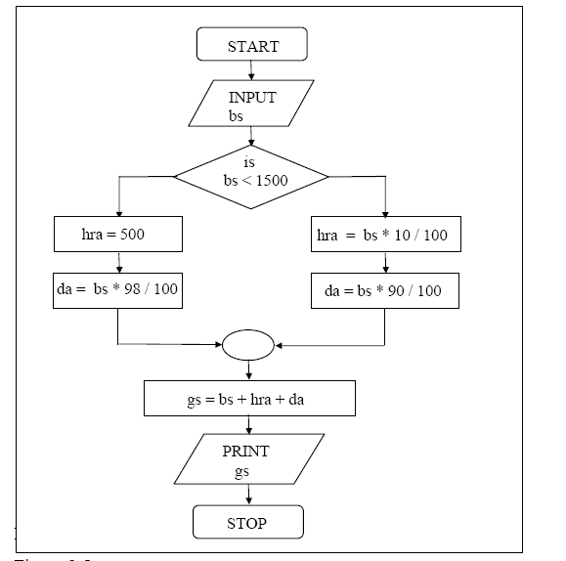
No
Yes

Slide 22
/* Calculation of gross salary */
#include <stdio.h>
int main( )
{
float bs, gs, da, hra ;
printf ( "Enter basic salary " ) ;
scanf ( "%f", &bs ) ;
if ( bs < 1500 )
{
hra = bs * 10 / 100 ;
da = bs * 90 / 100 ;
}
else
{
hra = 500 ;
da = bs * 98 / 100 ;
}
gs = bs + hra + da ;
printf ( "gross salary = Rs. %f", gs ) ;
return 0;
}

Slide 23
EXAMPLE
Program takes a number from user and prints greater if the number is > 100 else prints less
#include<stdio.h>
int main()
{
int n;
printf(“Enter an integer : ”);
scanf(“%d”,&n);
If(n>100)
printf(“Number is greater than 100”);
else
printf(“Number is less than 100”);
return 0;
}

Slide 24
NESTED IF ELSE STATEMENT
Syntax
if(condition-1)
  {
  Statement -1
  }
  else If(condition-2)
    {
      Statement-2;
    }
    else
  Statement-3;
FALSE
Condition-1
TRUE
Statement-1
FALSE
Condition-2
TRUE
Statement-2
FALSE
Statement-3
Next Statement

Slide 25
NESTED IF STATEMENT
Syntax
If(condition-1)
  If(condition-2)
    {
      Statement-2;
    }
  Statement-3;
FALSE
Condition-1
TRUE
FALSE
Condition-2
TRUE
Statement-3
Statement-2
Next Statement

Slide 26
A company insures its drivers in the following cases:
− If the driver is married.
− If the driver is unmarried, male & above 30 years of age.
− If the driver is unmarried, female & above 25 years of age.
In all other cases the driver is not insured. If the marital status, gender and age of the driver are the inputs, write a programme to determine whether the driver is to be insured or not.

Slide 27
/* Insurance of driver - without using logical operators */
#include <stdio.h>
#include<conio.h>
main( )
{
char gender, ms ;
int age ;
printf ( "Enter age, sex, marital status " ) ;
scanf ( "%d %c %c", &age, & gender, &ms ) ;
if ( ms == 'M' || ms == 'm' )
printf ( "Driver is insured" ) ;
else if(ms == 'U' || ms == 'u')
{
if (gender == 'M' || gender == 'm' )
{if ( age > 30 )
printf ( "Driver is insured" ) ;
else
printf ( "Driver is not insured" ) ;
}
else if(gender == 'F' || gender == 'f' )
{
if ( age > 25 )
printf ( "Driver is insured" ) ;
else
printf ( "Driver is not insured" ) ;
}
else
printf("\nInvalid gender charachter!!");
}
else
printf("\nInvalid marital status charachter!!");
return 0;
}

Slide 28
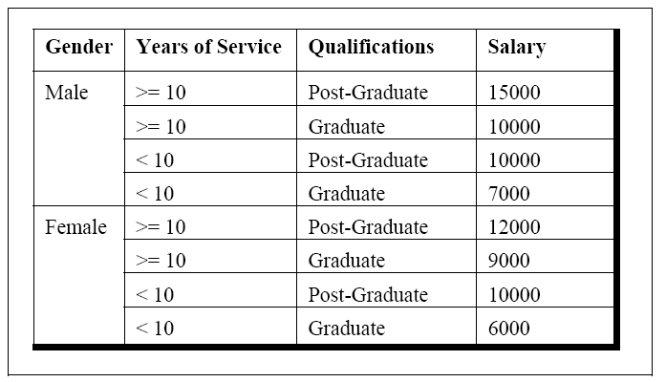
Write a program to calculate the salary as per the following table:

Slide 29
int main( )
{
char g ;
int yos, qual, sal ;
printf ( "Enter Gender, Years of Service and
Qualifications ( 0 = G, 1 = PG ):" ) ;
scanf ( "%c%d%d", &g, &yos, &qual ) ;
if ( g == 'm' && yos >= 10 && qual == 1 )
sal = 15000 ;
else if ( ( g == 'm' && yos >= 10 && qual == 0 ) ||
( g == 'm' && yos < 10 && qual == 1 ) )
sal = 10000 ;
else if ( g == 'm' && yos < 10 && qual == 0 )
sal = 7000 ;
else if ( g == 'f' && yos >= 10 && qual == 1 )
sal = 12000 ;
else if ( g == 'f' && yos >= 10 && qual == 0 )
sal = 9000 ;
else if ( g == 'f' && yos < 10 && qual == 1 )
sal = 10000 ;
else if ( g == 'f' && yos < 10 && qual == 0 )
sal = 6000 ;
printf ( "\nSalary of Employee = %d", sal ) ;
return 0;}

Slide 30
“SWITCH” STATEMENT
A substitute of “nested if-else”
Used when choices are given & one choice is to be selected
Multiple choices are given inside the main body as cases
It evaluates an expression and returns a value
One of the case is executed depending on the value

Slide 31
CONT…
Syantax
switch(expression)
  {
  case const-1:
    statements;
    break;
  case const-2:
    statements;
    break;
  default:
    statements;
  }
  Note: If no case is matched then default statements are executed
  Cannot use floating point or string constants as case constant. Only integer and character constatnt can be used.

Slide 32
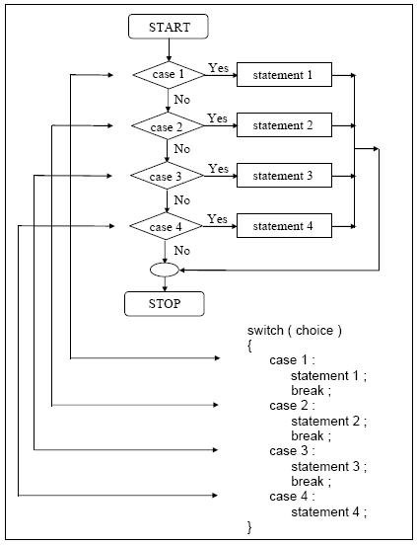

Slide 33
We can check the value of any expression in a switch. Thus the following switch statements are legal.
switch ( i + j * k )
switch ( 23 + 45 % 4 * k )
switch ( a < 4 && b > 7 )
Expressions can also be used in cases provided they are constant expressions. Thus case 3 + 7 is correct, however, case a + b is incorrect.

Slide 34
EXAMPLE
Program takes a number and prints even if the number is even other wise prints odd
#include<stdio.h>
#include<conio.h>
int main()
{
int n;
printf(“Enter an integer : ”);
scanf(“%d”,&n);
switch(n%2)
{
case 0:
printf(“Number is Even”);
break;
case 1:
printf(“Number is Odd”);
}
return 0;
}

Slide 35
Example :At times we may want to execute a common set of statements for multiple cases. How this can be done is shown in the following example.
main( )
{
char ch ;
printf ( "Enter any of the alphabet a, b, or c " ) ;
scanf ( "%c", &ch ) ;
switch ( ch )
{
case 'a' :
case 'A' :
printf ( "a as in ashar" ) ;
break ;
case 'b' :
case 'B' :
printf ( "b as in brain" ) ;
break ;
case 'c' :
case 'C' :
printf ( "c as in cookie" ) ;
break ;
default :
printf ( "wish you knew what are alphabets" ) ;
}
return 0;
}

Slide 36
#include <stdio.h>
int main()
{
int choice;
printf("Select from the following options");
printf("\n---------------------------------");
printf("\n1-Option one.");
printf("\n2-Option two.");
printf("\n\n\nPlease make your selection.");
scanf("%d",&choice);
switch(choice)
{ case 1:
printf("\n\nOption one selected.");
break;
case 2:
printf("\n\nOption two selected.");
break;
default:
printf("\n\n\nW A R N I N G : \"Wrong entry made.\"");
}
return 0;}

Slide 37
Solution using switch cases (nested switch cases)
A company insures its drivers in the following cases:
− If the driver is married.
− If the driver is unmarried, male & above 30 years of age.
− If the driver is unmarried, female & above 25 years of age.
In all other cases the driver is not insured. If the marital status, gender and age of the driver are the inputs, write a programme to determine whether the driver is to be insured or not.

Slide 38
/* Insurance of driver - without using logical operators */
#include <stdio.h>
main( )
{
char gender, ms ;
int age ;
printf ( "Enter age, sex, marital status " ) ;
scanf ( "%d %c %c", &age, & gender, &ms ) ;
switch(ms)
{
case 'M': // Marital status married
case 'm':
printf ( "Driver is insured" ) ;
break;
case 'U': // Marital status unmarried
case 'u':
switch(gender)
{ case 'M': //Gender male
case 'm' :
if ( age > 30 )
printf ( "Driver is insured" ) ;
else
printf ( "Driver is not insured" ) ;
break;
case 'F': //Gender Female
case 'f':
if ( age > 25 )
printf ( "Driver is insured" ) ;
else
printf ( "Driver is not insured" ) ;
break;
default:
printf("\nInvalid gender charachter!!");
}
break;
default:
printf("\nInvalid marital status charachter!!");
}
return 0;
}

Slide 39
THE NESTED IF STATEMENT & SWITCH STATEMENT
Nested if-else statement
It becomes complicated for multiple choices
It uses an independent expression for each case
The tested condition can be given in a specific range of values. If the given condition matches then the statement under it will be executed
Switch statement
It is easy to understand for multiple selections
It uses single expression for all cases, but each case must have a constant value of integer type or character type
Only a single expression is given in the switch statement which returns a single value. The test condition cannot be given in a specific range. It is the major drawback of the switch statement

