Slide 1
Programming with c++
(UE22CS221A)
Mini Project

Slide 2
Project Title & Team Members
Title: Phone Directory
Team Members:
Abishek K PES2UG22CS024
Maddinala Venkat Charan PES2UG22CS289
Mohammed Ashfaq Ali PES2UG22CS316
Motamarri Sai Sathvik PES2UG22CS321

Slide 3
Contribution of each Team Member
Motamarri Sai Sathvik:
Delete Contact,
Delete Front,
Delete End, and
Update File
Maddinala Venkat Charan:
Add Contact,
Insert Front,
Insert End, and
Check
Mohammed Ashfaq Ali:
Initialization,
Display Contacts, and
Search Contacts
Abishek K:
Call Contact,
Display Calls, and
Clear Call Log

Slide 4
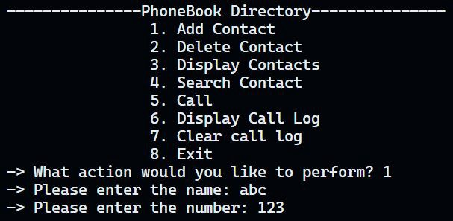
Outputs
1. Add contact

Slide 5
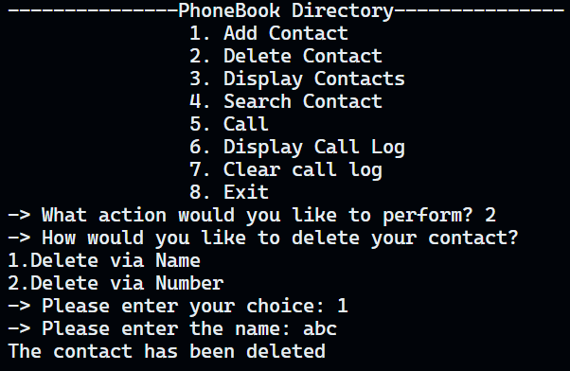
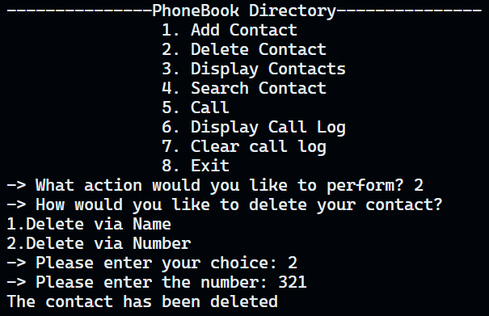
Outputs
2. Delete contact

Slide 6
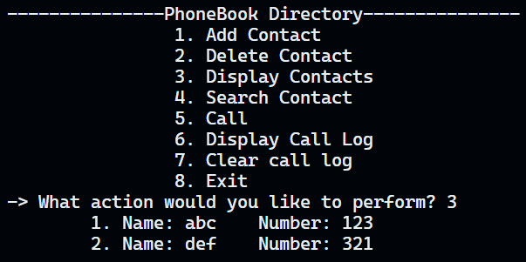
Outputs
3. Display contacts

Slide 7
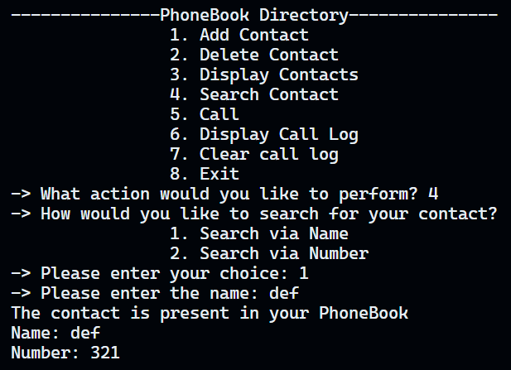
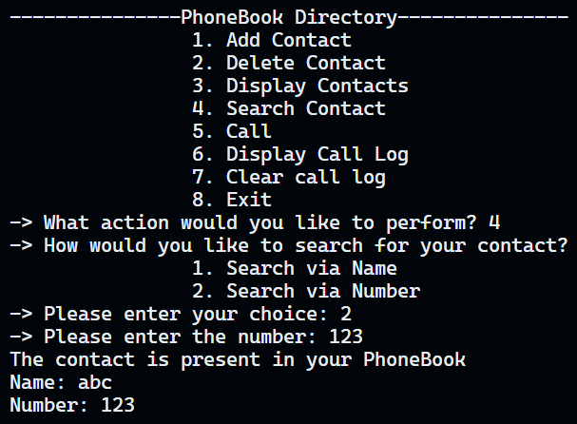
Outputs
4. Search contact

Slide 8
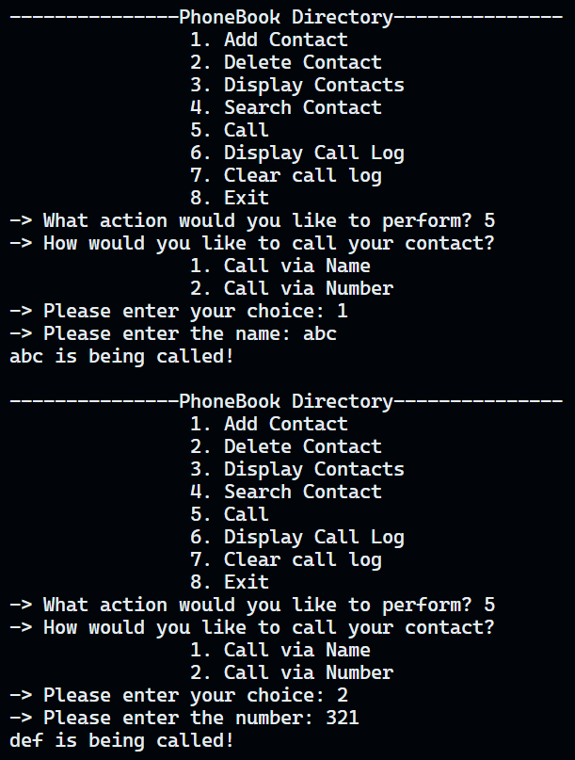
Outputs
5. Call

Slide 9
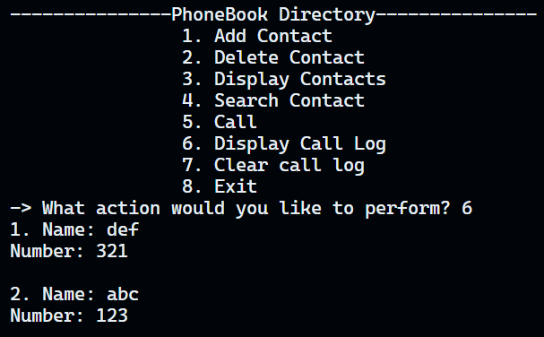
Outputs
6. Display Call Log

Slide 10
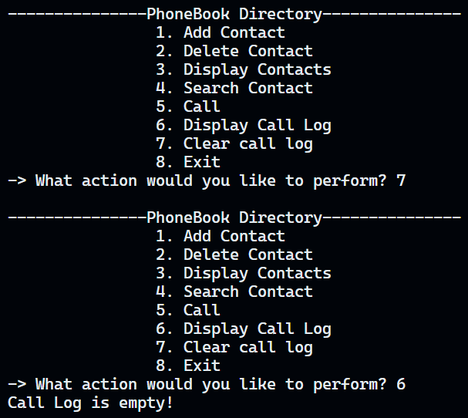
Outputs
7. Clear Call Log

Slide 11
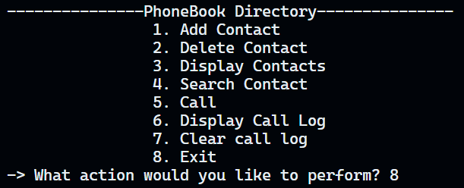
Outputs
8. Exit

Slide 12
Ending Remarks
Thank You!

