Slide 1

E-COMMERCE
Clahan Store
Present by Vignesh Akash Ashutosh Suwetha Elzabeth Dhanigasree

Slide 2

Modern e-commerce platforms require handling high traffic, scalability, and continuous availability
Managing multiple functionalities like:
User management
Product catalog Orders, payments, and shipping
becomes complex in a single system
PROBLEM STATEMENT
Lack of:
Independent service deployment
Efficient resource utilization
Cloud-native scalability
Traditional monolithic systems face challenges such as:
Tight coupling of components
Difficult scalability and deployment Single point of failure

Slide 3

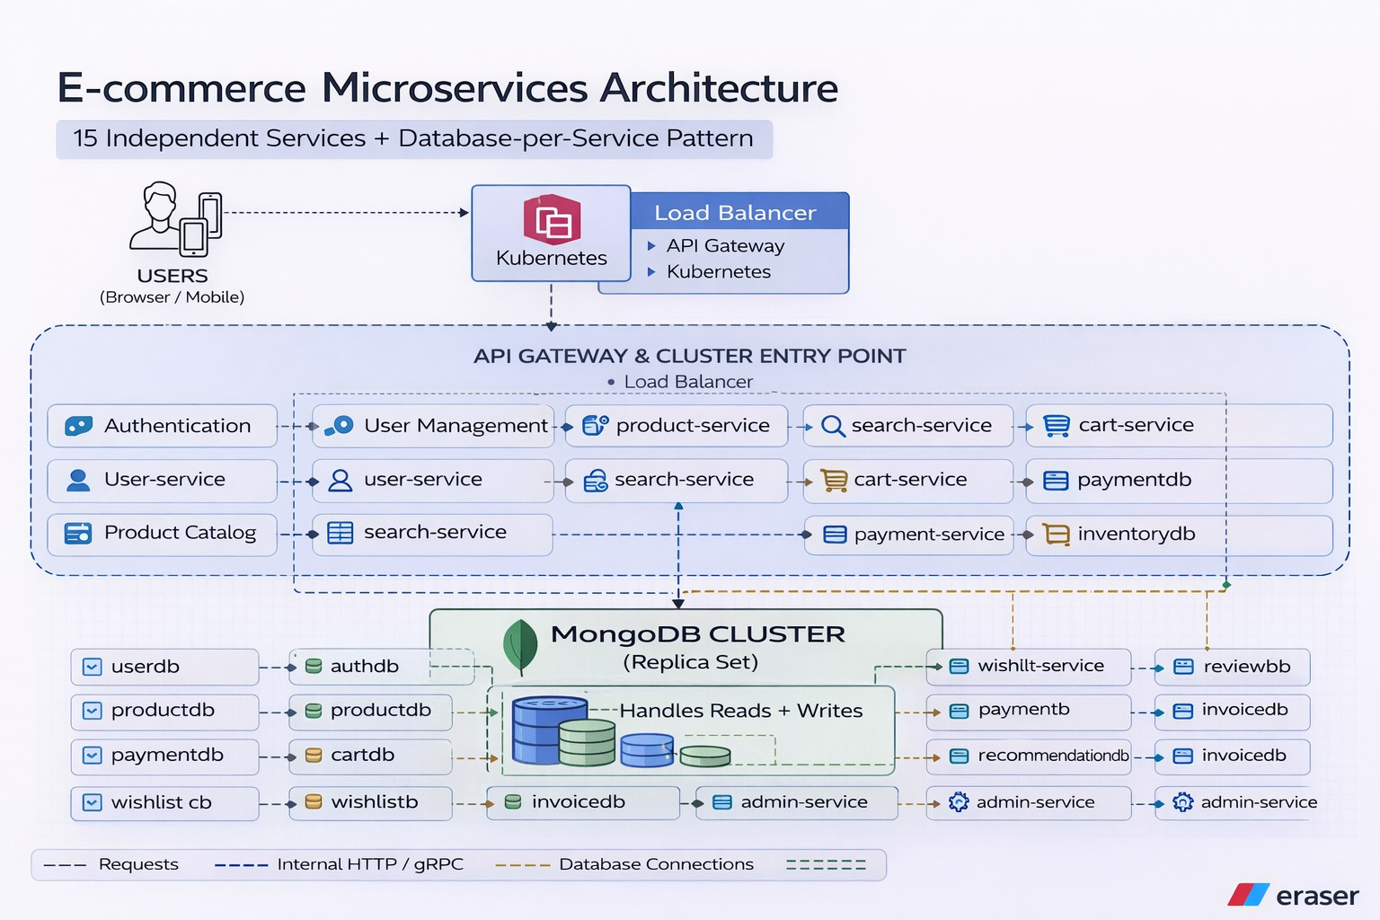
APPLICATION Architecture

Slide 4

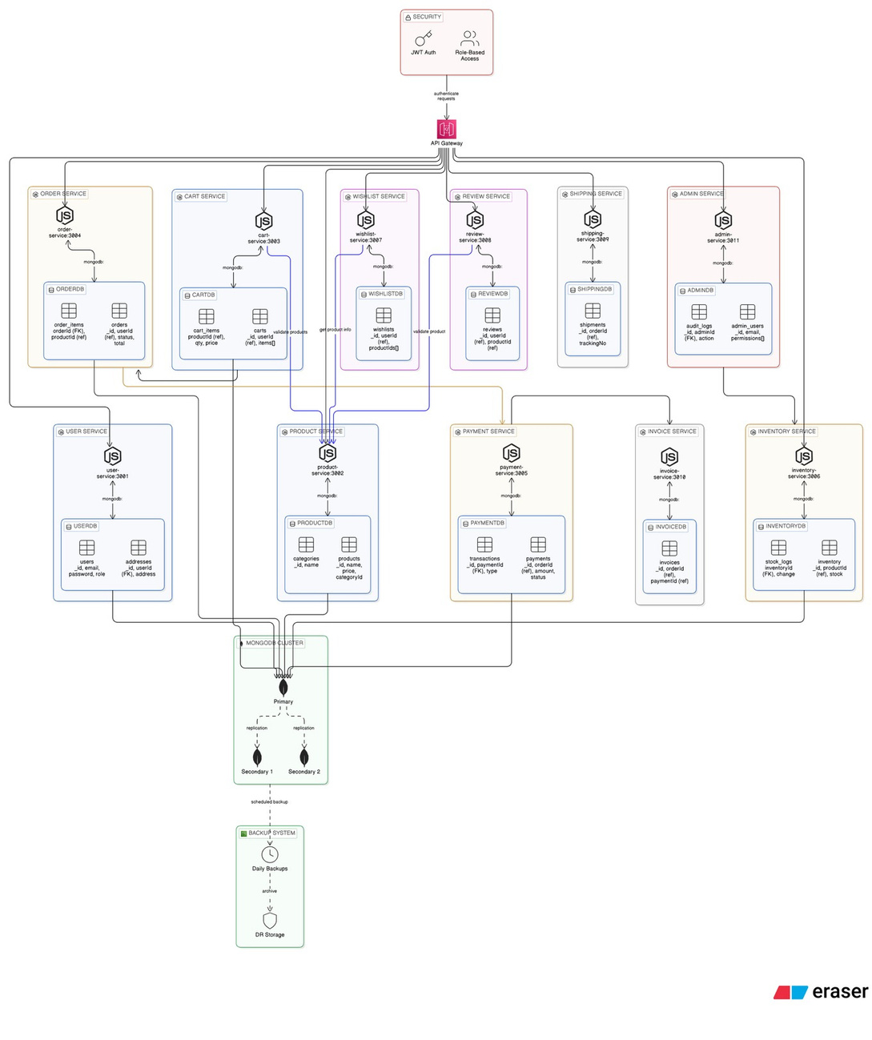
DATABASE Architecture

Slide 5
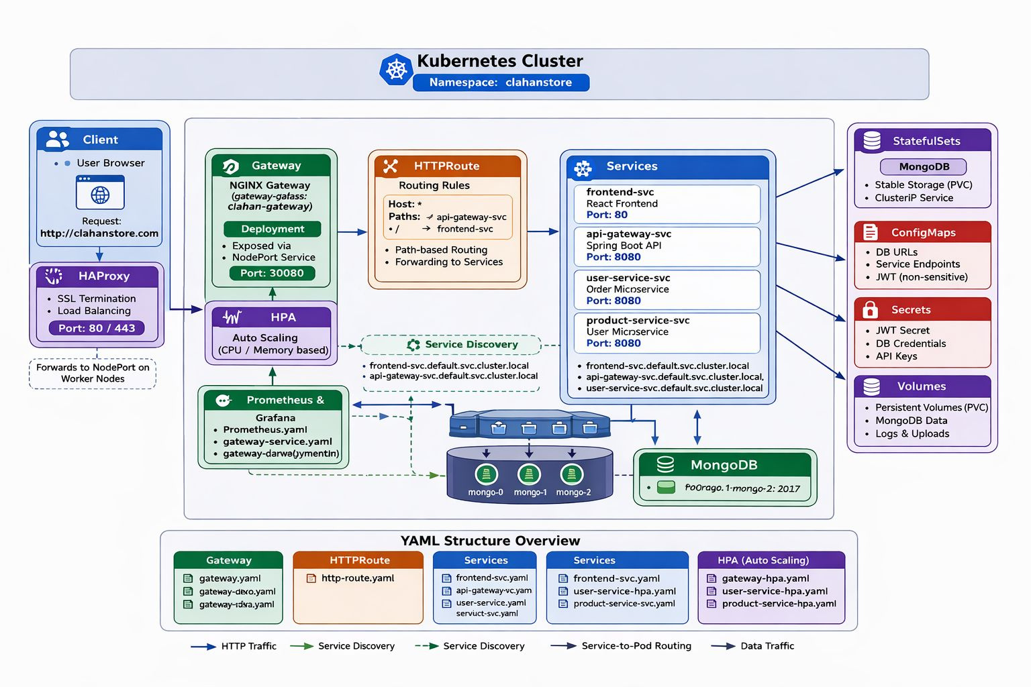
DevOps Architecture

Slide 6
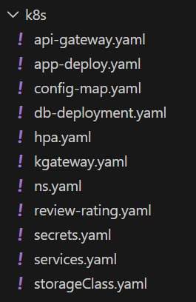
Manifest File
Amanifestfile tells kuberneteswhat to create,
how it should run, and how it should behave
Example
Instead of saying: "Run my application somehow" We say in a manifest file: What application image to run How many replicas Which port it uses How it should be exposed How it should scale Where to store data This is why Kubernetes is called declarative.
List Of Manifest File

Slide 7
Manifests: configmap.yaml secrets.yaml ConfigMap: Non-sensitive configuration Example. Service URLs Port numbers Secrets: Sensitive data Example: MongoDB connection URI Credentials Manifests: -mongo-statefulset.yaml
Manifest File
Manifest: namespace.yaml Purpose: Logical isolation for the entire e-commerce platform Keeps all microservices together Manifests: deployment.yaml (for each microservice) Why Deployment? Microservices are stateless Pods can be recreated any time Kubernetes can scale them horizontally Manifests: service.yaml Why Services are needed: Pods have dynamic IPs Services provide stable networking ConfigMaps & Secrets
Why StatefulSet instead of Deployment? Databases are stateful Need. Stable pod identity Persistent storage IST, IN)... ) Manifest: hpa.yanl Why HPA? Automatically scales services based on CPU usage Handles traffic spikes

Slide 8
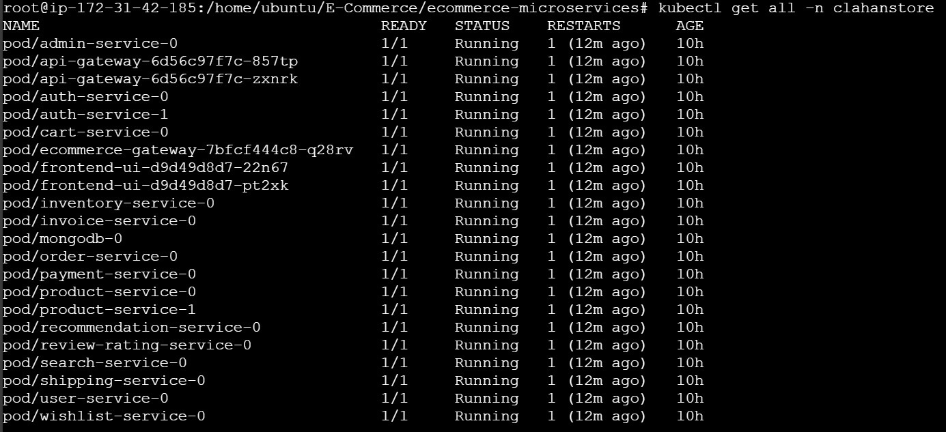
Kubectl get all

Slide 9
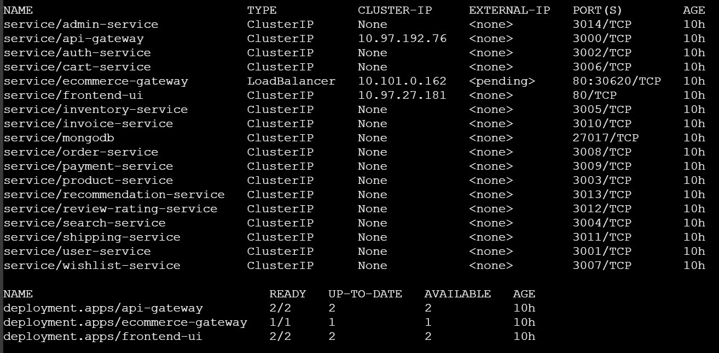

Slide 10
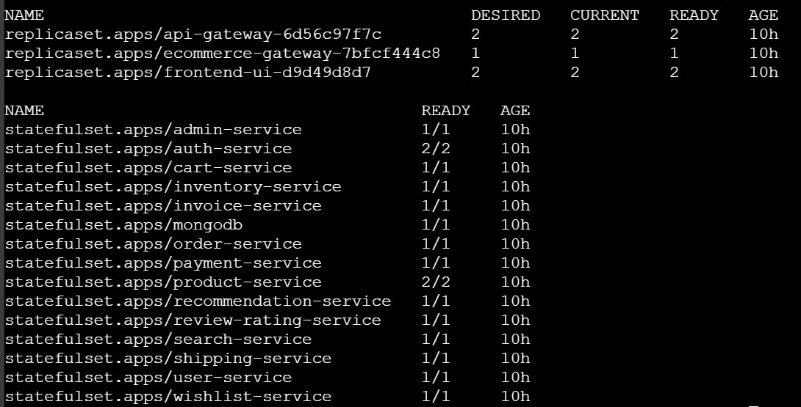

Slide 11
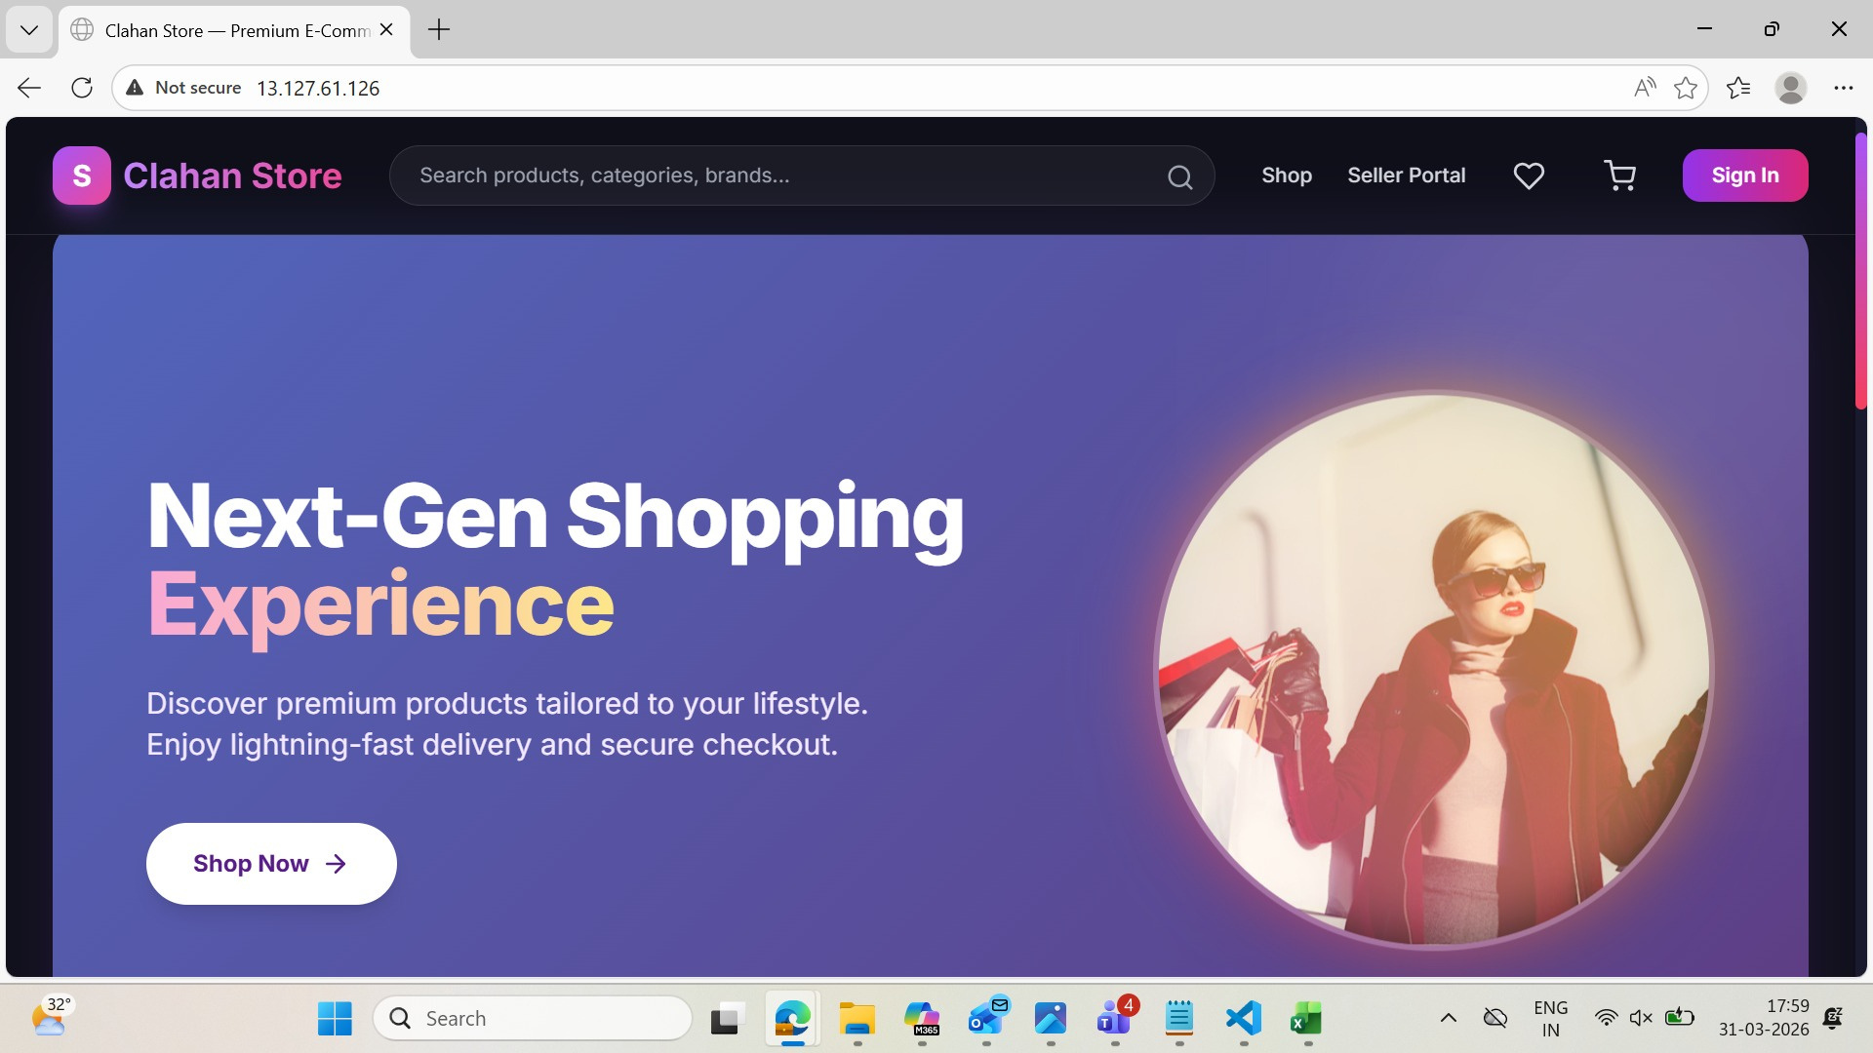
Clahan Store

Slide 12
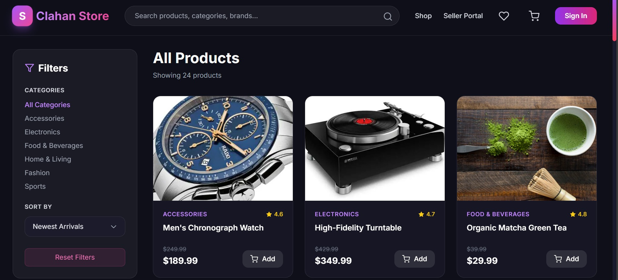

Slide 13
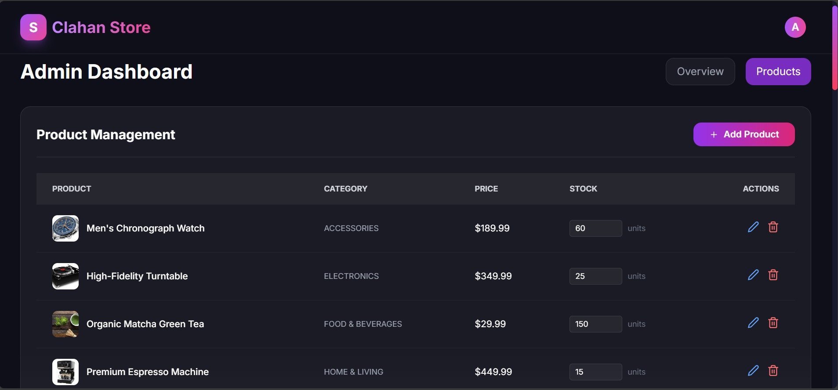

Slide 14
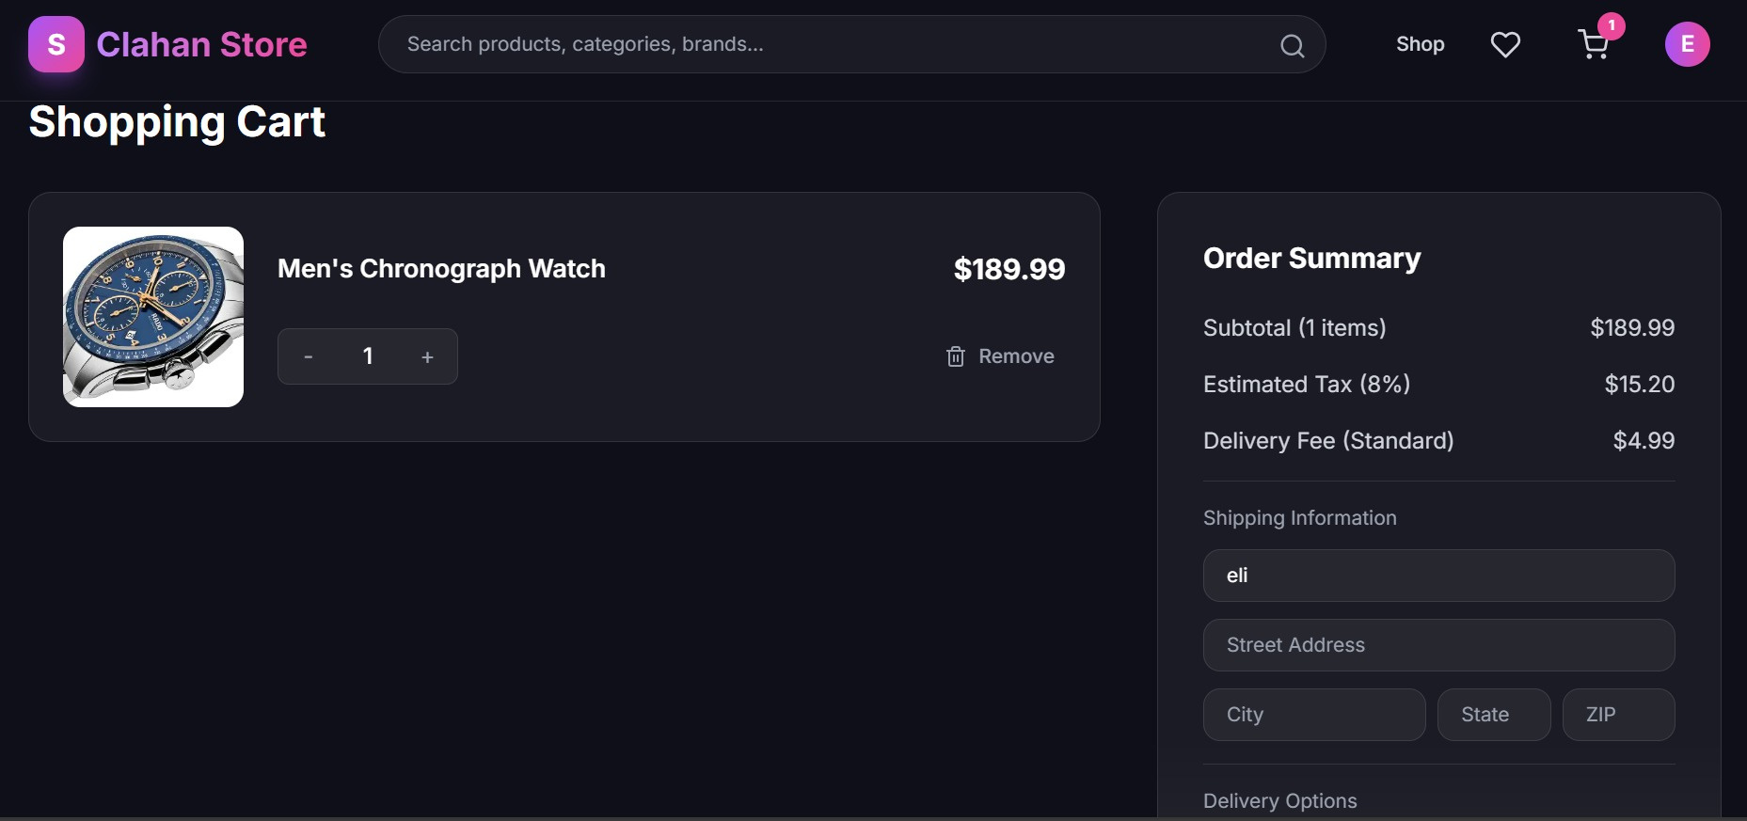

Slide 15

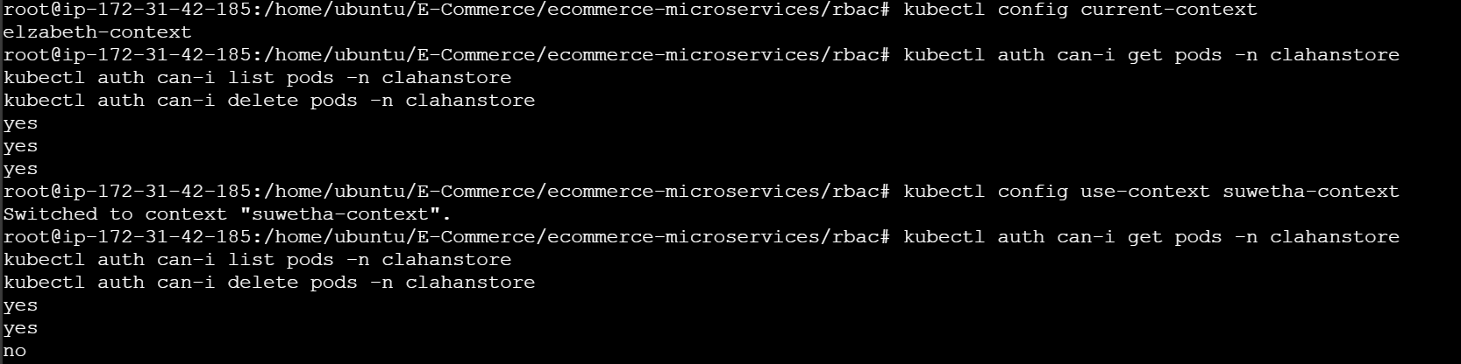
Security

Slide 16
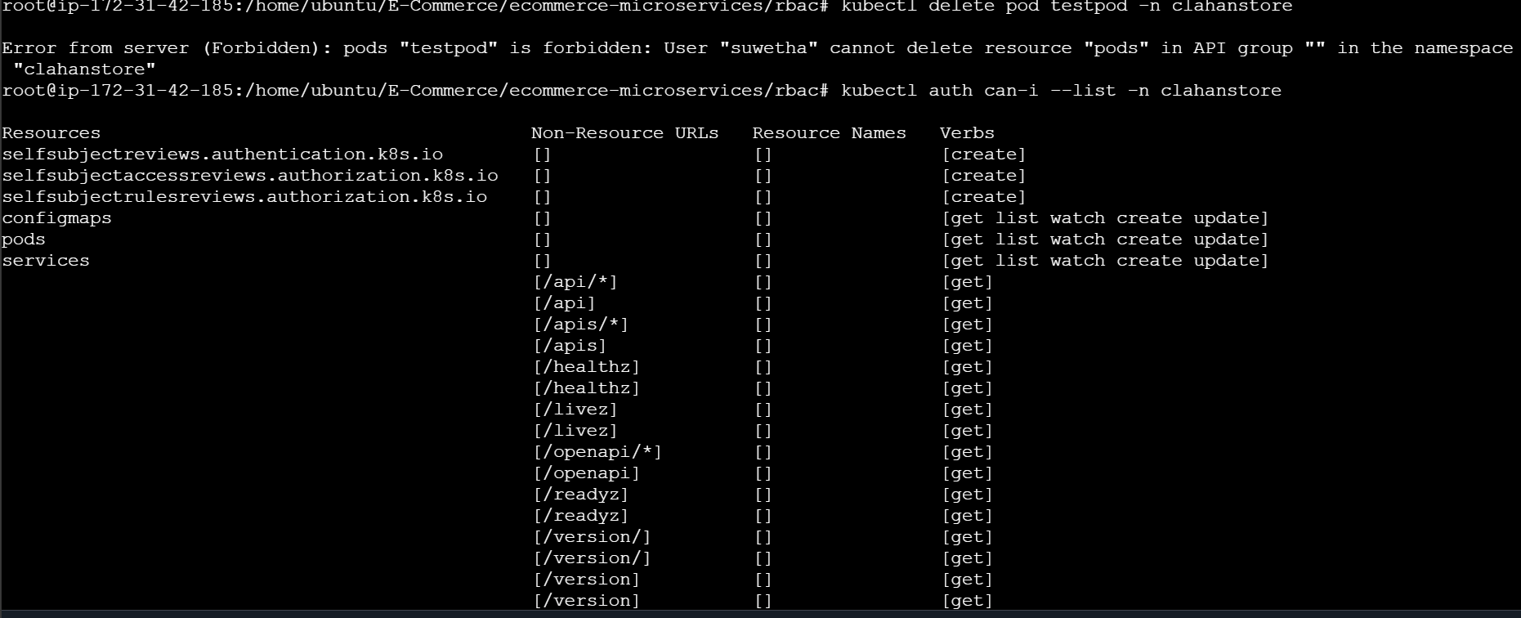

Slide 17
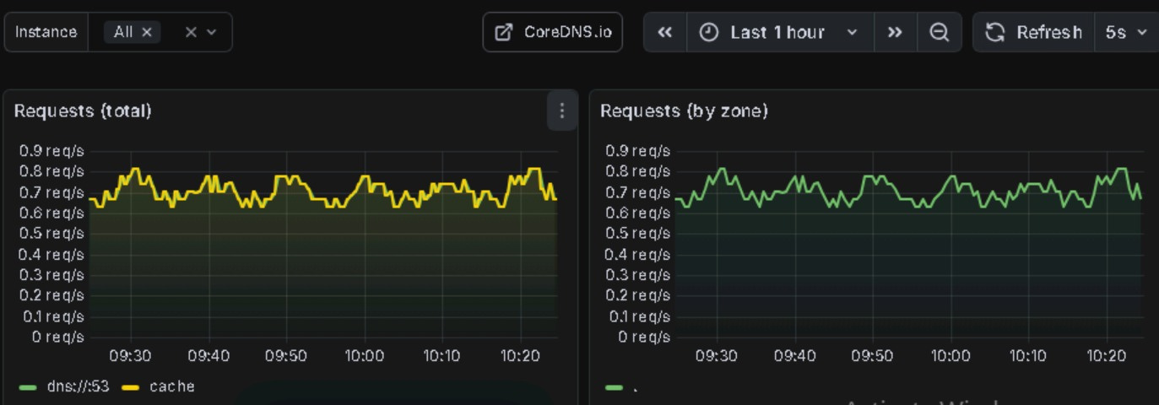
Monitoring

Slide 18
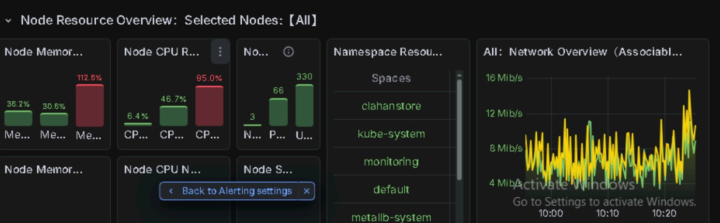

Slide 19
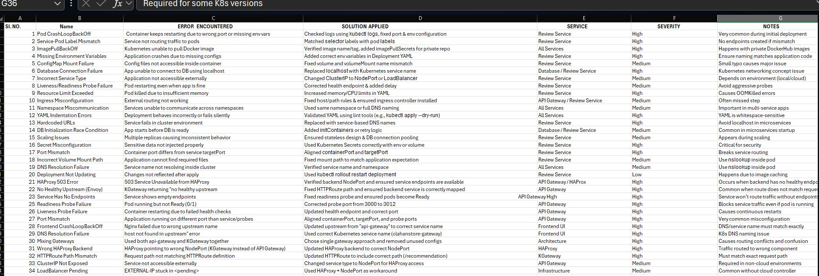
Troubleshooting

Slide 20

This project demonstrates a complete cloud-native e-commerce system built using a microservices architecture deployed on Kubernetes.
We designed the system with independent services, each responsible for a specific business function such as user management, product handling. payments, admin operations, and shipping.
By following the database-per-service pattern and using a MongoDB Replica
Set, we ensured
High availability
Data isolation
Fault tolerance
Kubernetes enabled us to achieve:
Automatic scaling
Self-healing through health probes
Efficient resource utilization
Smooth rolling updates with zero downtime
Conclusion

Slide 21
Thankyou!

