Slide 1
SmartPG – Paying Guest Management System
Production-Grade Cloud-Native PG Management Platform
A modern SaaS platform built on Azure Kubernetes, Terraform, React, Node.js, and MongoDB — designed to digitize and scale paying guest operations end-to-end.

Slide 2
The Problem with Traditional PG Management
Paying guest facilities still rely on manual, paper-based processes — creating friction for tenants, operators, and staff. There is no centralized, scalable digital platform to manage day-to-day operations.
❌ Before SmartPG
✅ After SmartPG
Manual rent tracking with spreadsheets
No structured complaint management
Food/mess coordination via phone calls
No centralized tenant communication
Zero scalability or digital audit trail
No security monitoring or alerting
Automated rent & payment tracking
Digital complaint ticketing system
Real-time meal opt-in/opt-out portal
Unified notification & alert engine
Cloud-native, horizontally scalable
WAF

Slide 3
Introducing SmartPG
SmartPG is a cloud-native, microservices-based SaaS platform that digitizes every aspect of paying guest management — from tenant onboarding to payment tracking, mess management, and real-time notifications. Built for production, deployed on Azure, and engineered to scale.
🏠 Tenant Management
💳 Payment Tracking
End-to-end registration, room allocation, and profile management with secure authentication.
Automated rent billing, payment history, and receipt generation with audit trails.
🍽️ Mess Management
🔔 Notifications & Alerts
Real-time meal opt-in/opt-out, menu publishing, and food preference tracking.
Automated alerts for dues, complaints, meal deadlines, and system events.

Slide 4
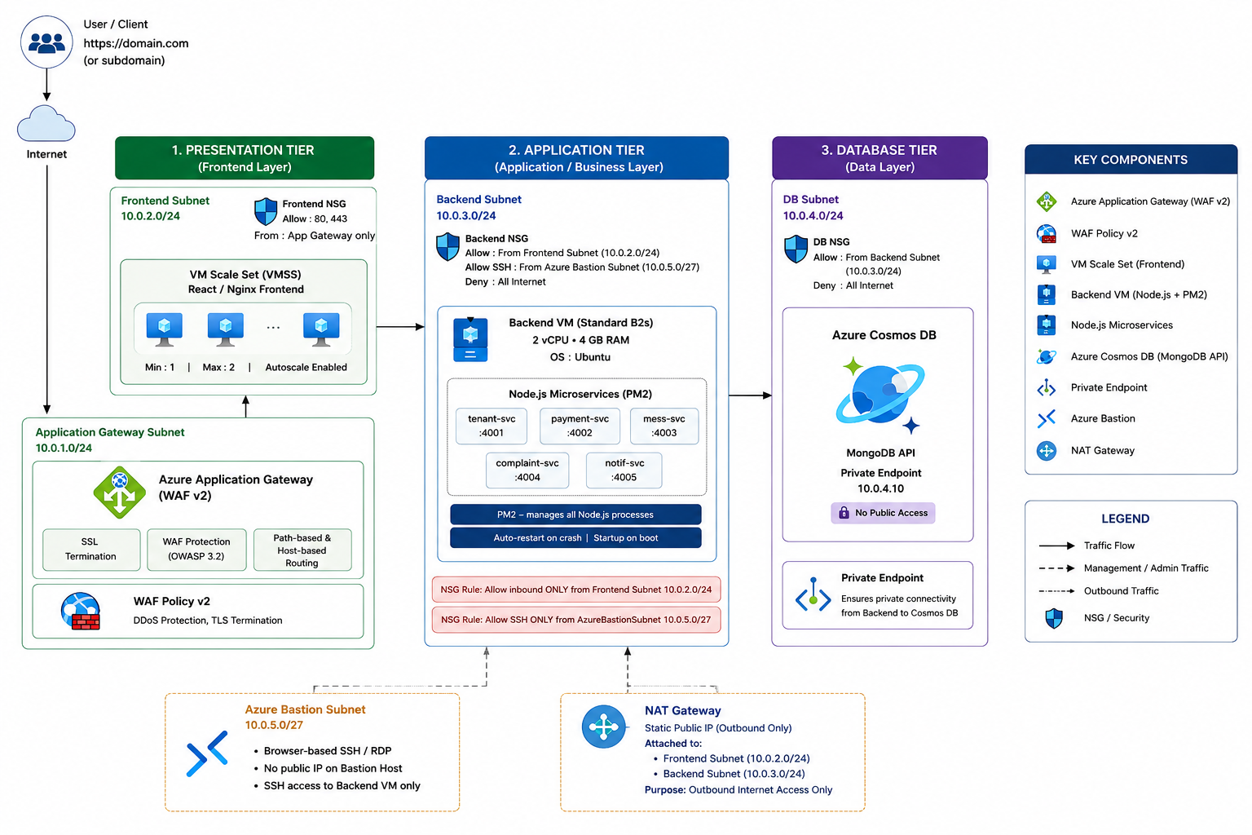
Architecture

Slide 5
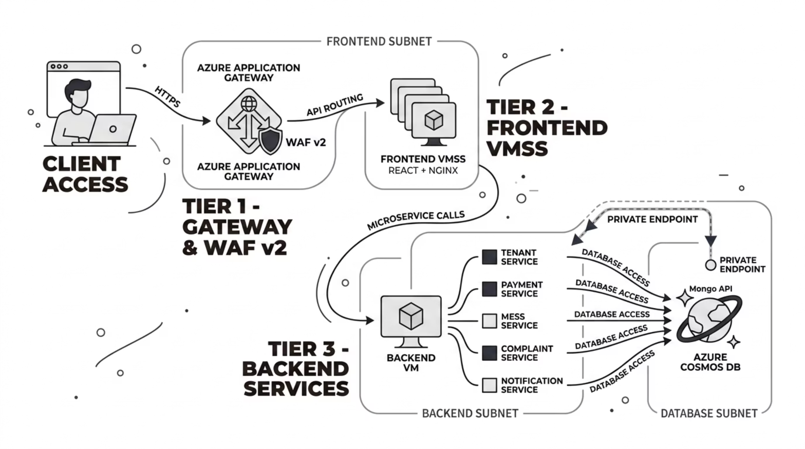
System Architecture Overview

Slide 6
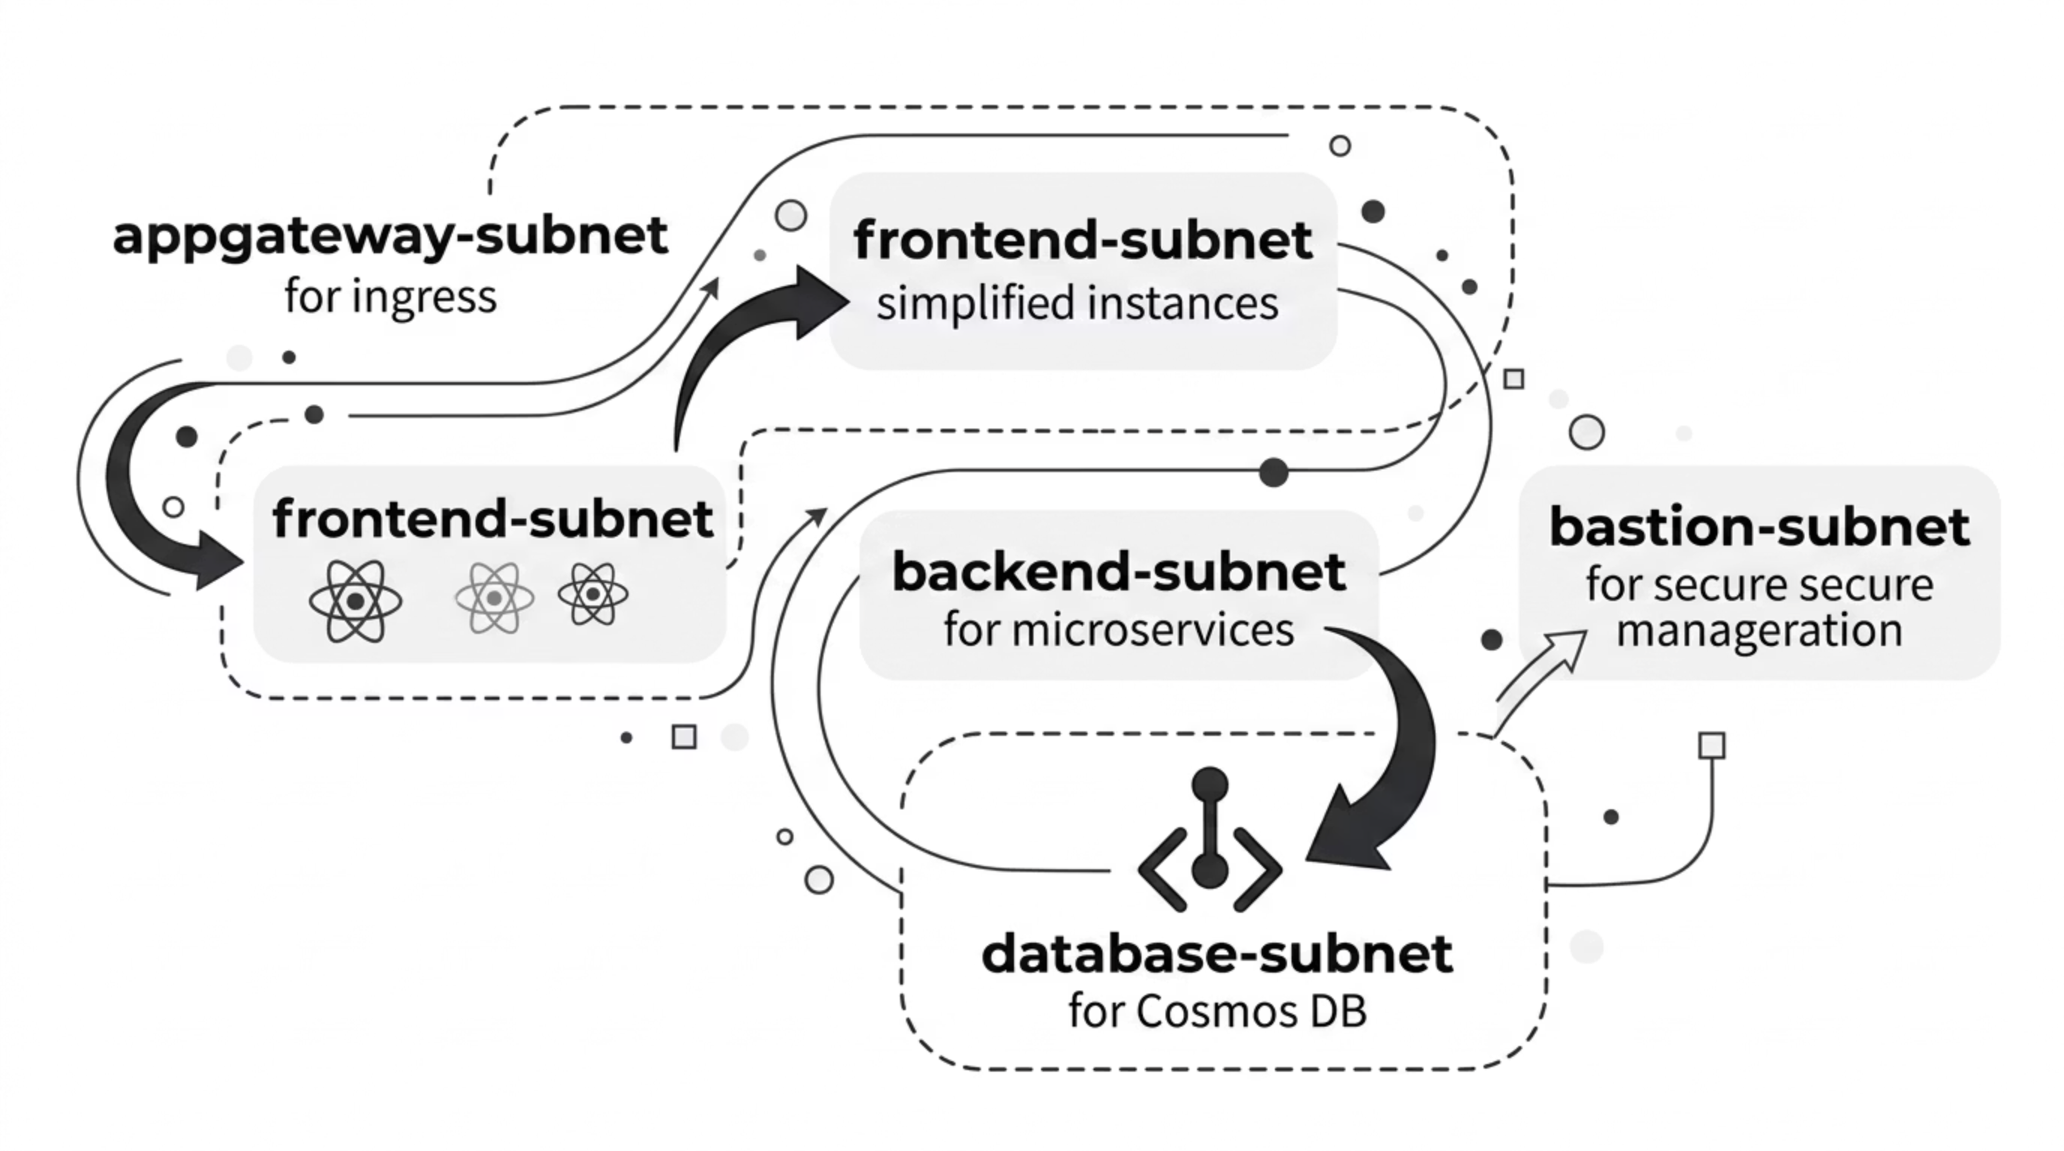
Virtual Network & Subnet Architecture

Slide 7
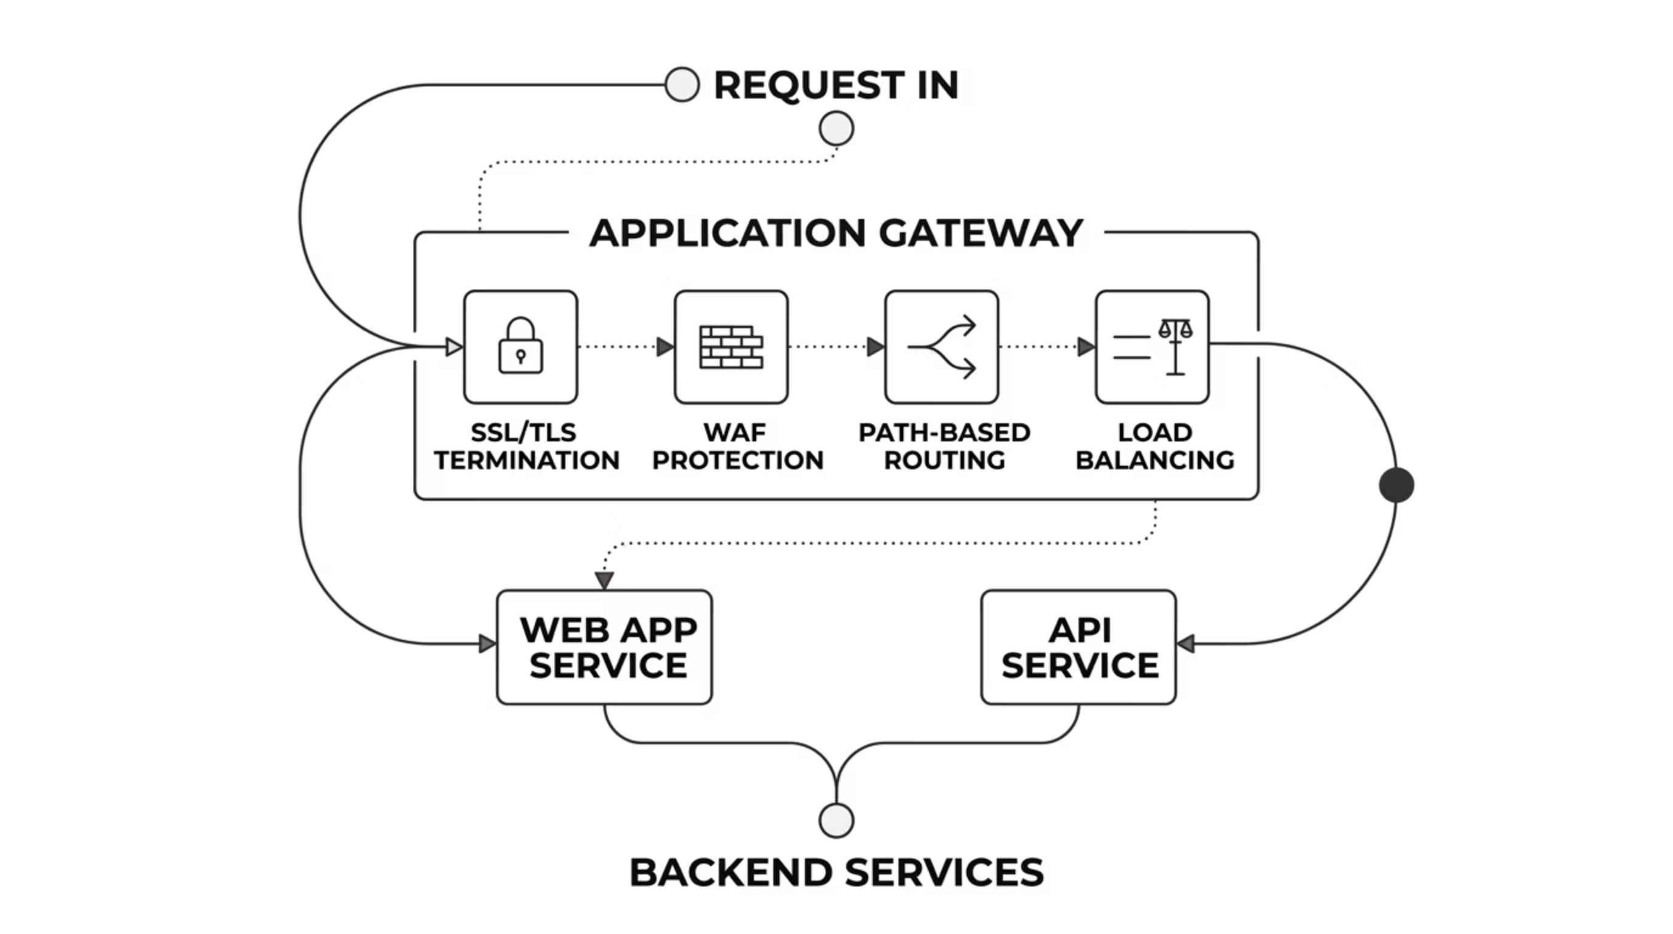
Application Gateway & WAF
🛡️ WAF Protection
🔒 SSL/TLS Termination
Defends against common web vulnerabilities like SQL injection and
cross-site scripting.
Encrypts traffic between clients and the gateway, offloading encryption
n for backend services.
🛣️ Path-Based Routing
⚖️ Load Balancing
Directs requests based on URL paths: / and static assets to
Frontend (React), /api/* to Backend (Node.js).
Distributes incoming traffic across multiple instances of backend services for
high availability and performance.

Slide 8
Key Features at a Glance
Tenant Registration & Auth
Room Allocation
Secure onboarding with JWT-based authentication and role-based access control.
Real-time room availability, assignment, and transfer management.
Rent & Payment Tracking
Meal Opt-in / Opt-out
Automated billing cycles, payment status, and digital receipts.
Flexible daily meal preferences with deadline-based cutoff logic.
Complaint Tracking
Notifications & Alerts
Ticket-based system with status updates and resolution workflows.
Push and in-app notifications for dues, updates, and deadlines.
Secure Infrastructure
Autoscaling Infrastructure
WAF v2,and private endpoints.
automatically scales services under load.

Slide 9

INFRASTRUCTURE
Frontend VM Scale Set: Powering Scalable UI
SmartPG's frontend leverages Azure Virtual Machine Scale Sets (VMSS) to ensure high availability, automatic scaling, and resilient hosting for our React Single Page Application (SPA).
High Availability
Auto-scaling
Distributes instances across Azure Availability Zones for fault tolerance and continuous service.
Automatically adjusts instance count based on real-time CPU and memory metrics to handle traffic spikes.
React SPA Deployment
Nginx Reverse Proxy
Hosts our modern, responsive React frontend, delivering a seamless user experience.
Serves static files, manages SSL termination, and acts as a robust reverse proxy for efficient content delivery.
Presenter Notes: Explain how VMSS is crucial for the frontend's reliability and performance. Highlight the benefits of high availability (no downtime) and autoscaling (handles traffic efficiently without manual intervention). Mention Nginx's role in serving the React app.

Slide 10
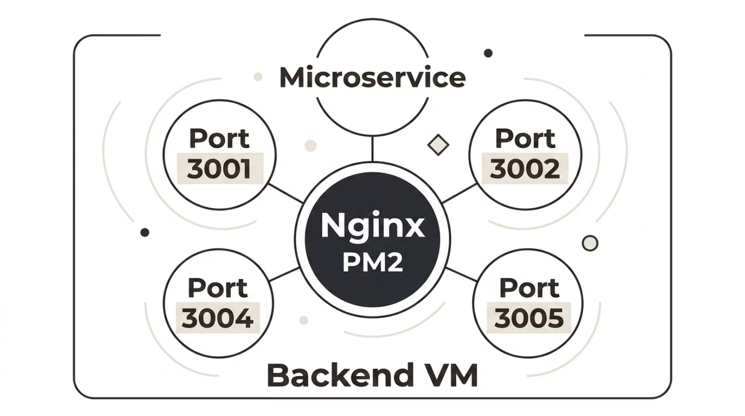
Backend VM & PM2: The Engine of SmartPG
SmartPG's backend runs on a single, efficient Azure VM, orchestrating microservices through PM2 for robust process management
and Nginx for intelligent traffic routing.
Our backend architecture is designed for maintainability and scalability, hosting five independent microservices on distinct ports, each managed for optimal performance and resilience.
Key Backend Features:
Process Monitoring & Health Checks
Real-time oversight of all microservice health and
performance.
Automatic Restart on Failure
PM2 ensures high availability by instantly restarting crashed processes.
Load Balancing
Efficient distribution of incoming requests across available Node.js processes.
Log Aggregation
Centralized logging for easier debugging and
operational insights.

Slide 11
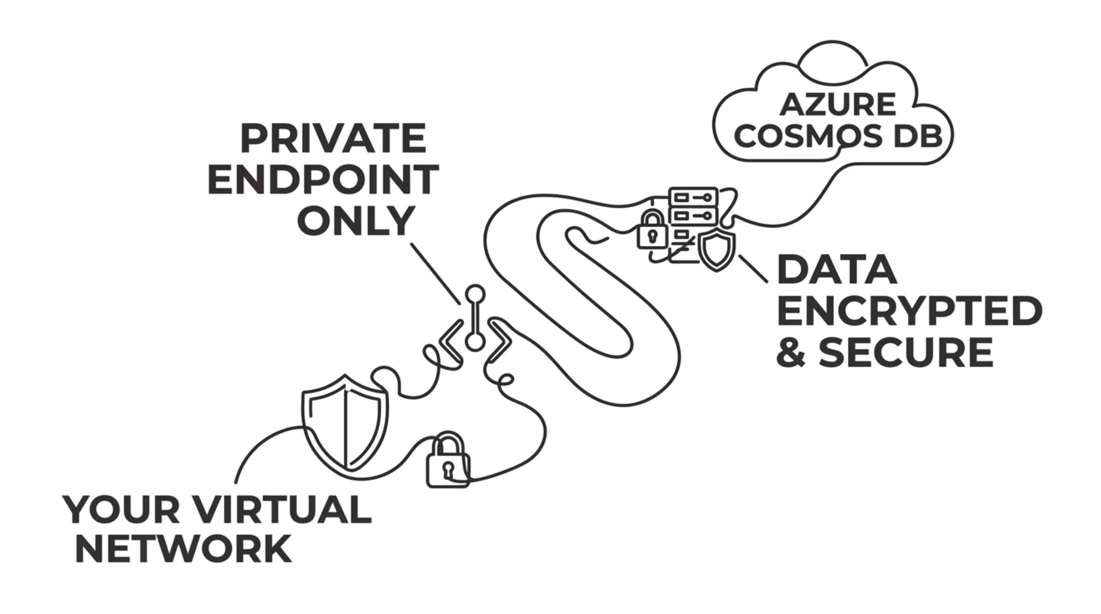
Azure Cosmos DB: Secure & Scalable Database
Cosmos DB Features
Security Benefits
Mongo API: MongoDB-compatible interface for seamless integration.
Network Isolation: Database traffic never traverses the public internet.
Serverless Database: Pay-per-request pricing model for cost efficiency.
Private Connectivity: Direct, secure connection within Azure VNet.
Private Endpoint Integration: Database accessible only from
the Virtual Network.
Firewall Rules: Restrict access to authorized subnets and applications only.
No Public Exposure: Enhanced security posture by eliminating
public internet access.
Encryption: Data protected both in transit and at rest with
Azure's robust encryption.

Slide 12
Database Design — MongoDB + Azure Cosmos DB
SmartPG uses a shared database strategy with Azure Cosmos DB's Mongo API — combining MongoDB's flexible document model with Azure's globally distributed, high-availability infrastructure. All services connect through a private endpoint, ensuring zero public database exposure.
Collections Overview
Why Cosmos DB Mongo API?
tenants — Profiles, room assignments, auth records
payments — Transactions, invoices, payment status
menu — Daily meals, pricing, availability
complaints — Tickets, status, resolution notes
notifications — Alert logs, delivery status
Native MongoDB wire protocol compatibility
Automatic multi-region replication
99.99% SLA-backed availability
Private endpoint connectivity — no public IP
Horizontal scalability without downtime
All five microservices share a single Cosmos DB instance but operate on isolated collections — balancing simplicity with service boundaries.

Slide 13
Thank you

