Slide 1

Hospital Management System
Batch 4:
Microservices-Based Architecture with Docker Containerization
Akash
Ashutosh
Elzabeth Lalson
Dhannigasree
Vignesh
Suwetha

Slide 2
Problem Statement
Traditional hospital systems are monolithic and tightly coupled
Difficult to scale, maintain, and update individual modules
Lack of deployment flexibility and service isolation

Slide 3
Project Objective
To design and implement a containerized microservices-based Hospital Management System where each core functionality (users, patients, doctors, vitals, registration, admin) runs as an independent service, enabling scalability, isolation, maintainability, and simplified deployment using Docker.

Slide 4
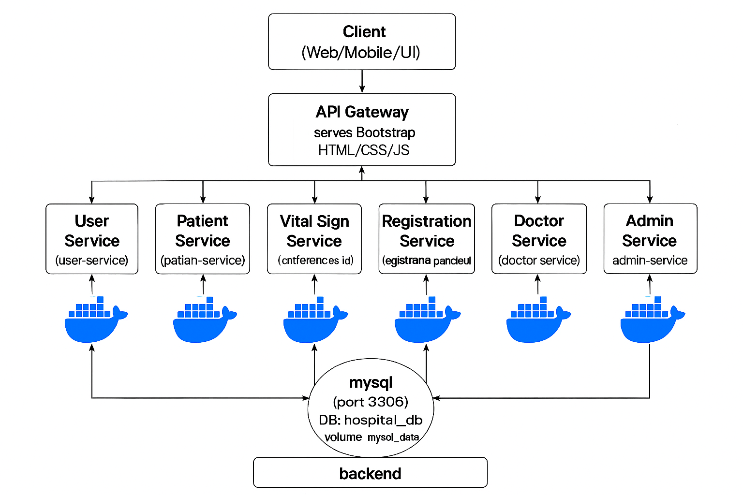
Architecture Diagram

Slide 5
Microservices
Registration-service
Admin-service
Patient-service
Doctor-service
User-service
Vital-signs-service

Slide 6
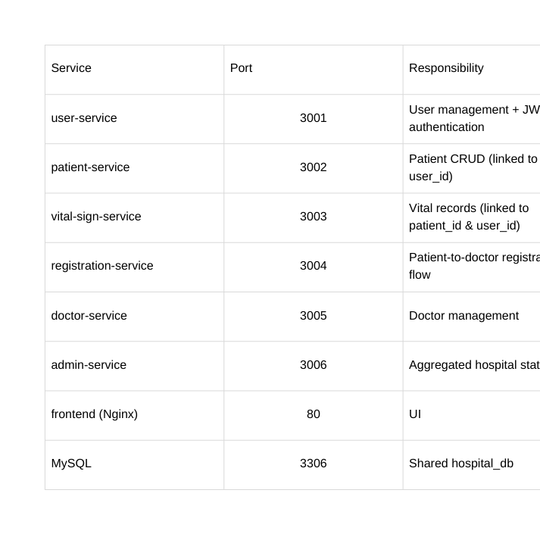
Services

Slide 7
Registration Service Microservice
Hospital Management System
Port: 3004
Handles patient registration and links patients with doctors.

Slide 8
Functionalities
- Register patient to doctor
- Store registration details
- Validate patient information
- Retrieve registration records
- Manage doctor–patient mapping

Slide 9
Dockerfile Snippet
FROM node:18-alpine
WORKDIR /app
RUN apk add --no-cache netcat-openbsd
COPY package.json ./
RUN npm install --production
COPY . .
EXPOSE 3004
CMD sh -c 'while ! nc -z mysql 3306; do sleep 1; done; node app.js'

Slide 10
Docker-compose.yaml
registration-service:
build: ./services/registration-service
container_name: hospital-registration-service
restart: always
environment:
DB_HOST: mysql
DB_USER: root
DB_PASSWORD: ${MYSQL_ROOT_PASSWORD:-root123}
DB_NAME: ${MYSQL_DATABASE:-hospital_db}
JWT_SECRET: ${JWT_SECRET:-hospital_management_secret_key_2024}
depends_on:
mysql:
condition: service_healthy
networks:
- hospital-network

Slide 11
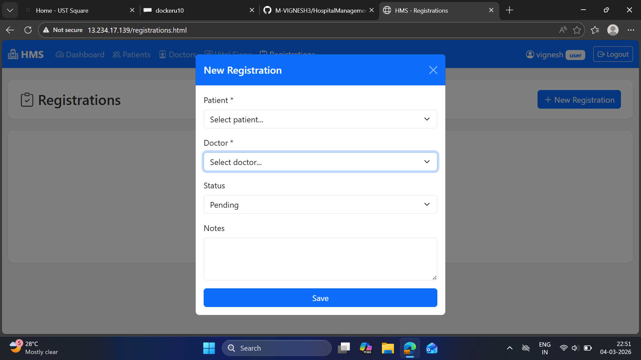
Registration page :

Slide 12
Admin Microservice
• Technology Stack: Node.js, Express.js, MySQL, Docker
• Runs on Port: 3006
• Handles administrative operations
• Aggregates data from hospital services
• Provides dashboard statistics
• Uses JWT authentication

Slide 13
Dockerfile – Admin Service
FROM node:18-alpine
WORKDIR /app
RUN apk add --no-cache netcat-openbsd
COPY package.json ./
RUN npm install --production
COPY . .
EXPOSE 3006
CMD sh -c "while ! nc -z mysql 3306; do sleep 1; done; node app.js"

Slide 14
Docker Compose – Admin Service
admin-service:
build: ./services/admin-service
container_name: admin-service
ports:
- "3006:3006"
depends_on:
- mysql
environment:
DB_HOST: mysql
DB_USER: root
DB_PASSWORD: root123
DB_NAME: hospital_db
JWT_SECRET: hospital_management_secret_key_2024

Slide 15
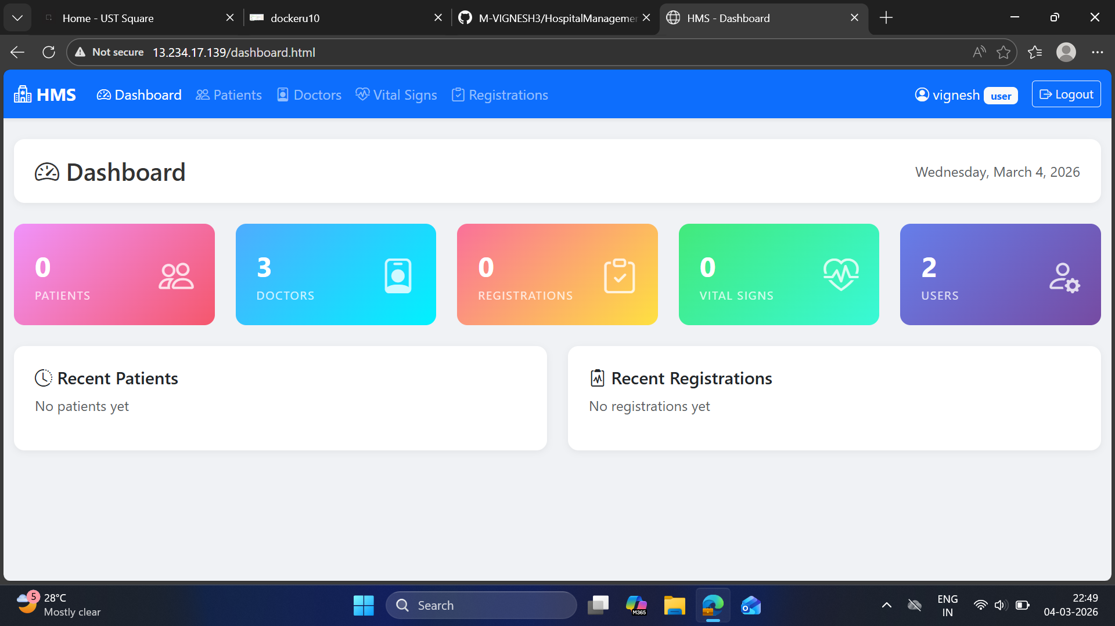
DASHBOARD

Slide 16
User Service Microservice
Hospital Management System
Port - 3001
Handles user management for the Hospital Management System. This service is responsible for managing user accounts and related information used across the platform
Problem - Hospitals need a centralized and scalable system to efficiently manage users, patients, doctors, and registrations, as traditional manual or monolithic systems lead to inefficiencies and data management challenges.

Slide 17
Functionalities
- User registration
- User login authentication
- JWT token generation
- User role management
- User data retrieval

Slide 18
Dockerfile Snippet
FROM node:18-alpine
WORKDIR /app
RUN apk add --no-cache netcat-openbsd
COPY package.json ./
RUN npm install --production
COPY . .
EXPOSE 3001
CMD sh -c 'echo "Waiting for MySQL..."; while ! nc -z mysql 3306; do sleep 1; done; echo "MySQL ready"; node app.js'

Slide 19
Docker Compose
version: "3.8"
services:
user-service:
image: username/user-service:1.0
container_name: hospital-user-service
ports:
- "3001:3001"
networks:
- hospital-network
networks:
hospital-network:
driver: bridge

Slide 20
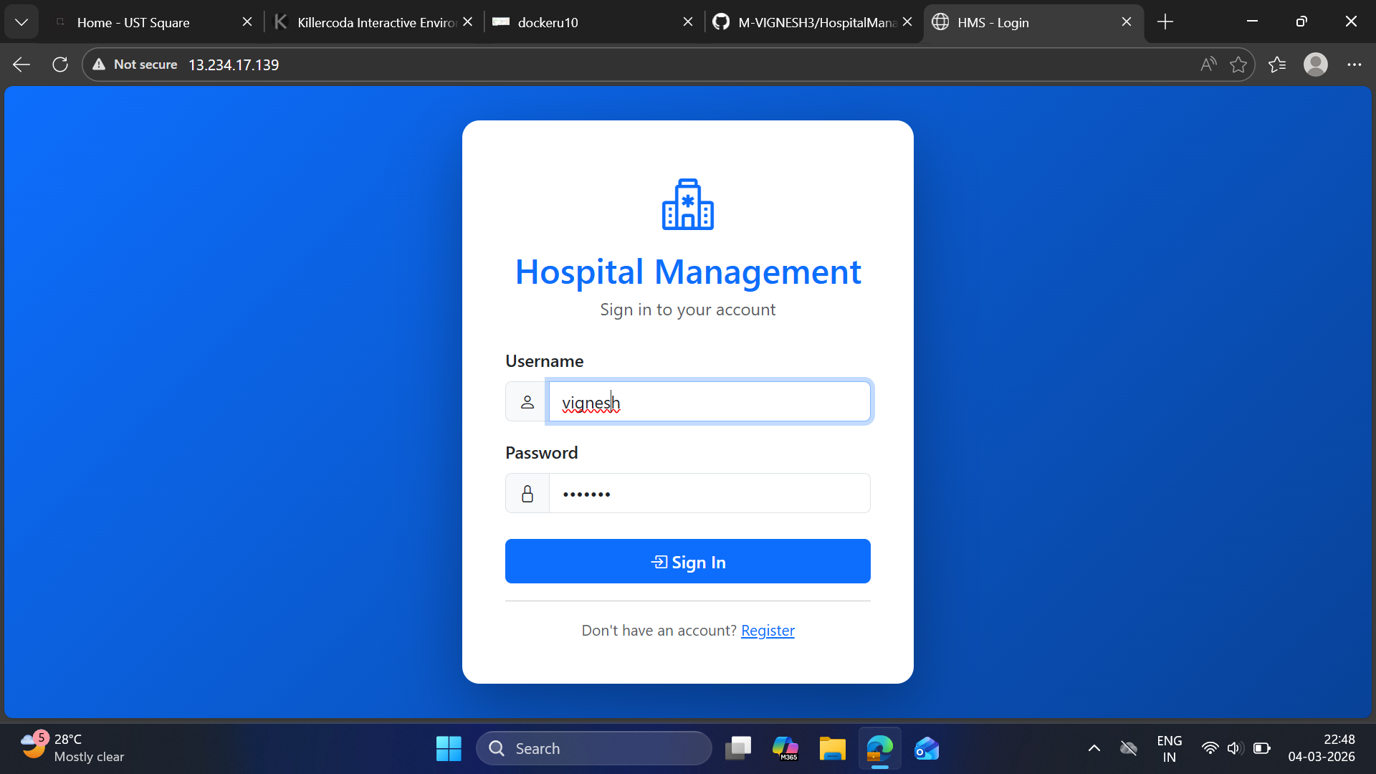
USER LOGIN:

Slide 21
Patient Microservice
Hospital Management System
Port 3002
Handles Patient CRUD operations
Stores and manages patient records
References user_id from user-service
Provides patient_id for other services
Central data layer for patient information
Independently deployable microservice
Dockerized for container-based deployment

Slide 22
Dockerfile Snippet
FROM node:18-alpine
WORKDIR /app
RUN apk add --no-cache netcat-openbsd
COPY package.json ./
RUN npm install --production
COPY . .
EXPOSE 3002
CMD sh -c 'while ! nc -z mysql 3306; do sleep 1; done; node app.js'

Slide 23
patient-service:
build: ./services/patient-service
container_name: hospital-patient-service
restart: always
environment:
DB_HOST: mysql
DB_USER: root
DB_PASSWORD: ${MYSQL_ROOT_PASSWORD:-root123}
DB_NAME: ${MYSQL_DATABASE:-hospital_db}
JWT_SECRET: ${JWT_SECRET:-hospital_management_secret_key_2024}
depends_on:
mysql:
condition: service_healthy
networks:
- hospital-network
docker-compose.yml

Slide 24
Patients page

Slide 25
Vital-Sign-Service
Responsible for managing patient health metrics inside the Hospital Management System
Manages patient health vital records • Performs CRUD operations on vitals • Stores heart rate and blood pressure • Links records using patient_id, user_id • Validates JWT before saving data
It ensures every vital record belongs to a valid patient and authenticated doctor/nurse

Slide 26
Docker file snippet
FROM node:18-alpine
WORKDIR /app
RUN apk add --no-cache netcat-openbsd
COPY package.json ./
RUN npm install --production
COPY . .
EXPOSE 3002
CMD sh -c 'while ! nc -z mysql 3306; do sleep 1; done; node app.js'

Slide 27
Docker compose vital service
vital-sign-service:
build: ./services/vital-sign-service
container_name: hospital-vital-sign-service
restart: always
environment:
DB_HOST: mysql
DB_USER: root
DB_PASSWORD: ${MYSQL_ROOT_PASSWORD:-root123}
DB_NAME: ${MYSQL_DATABASE:-hospital_db}
JWT_SECRET: ${JWT_SECRET:-hospital_management_secret_key_2025}
depends_on:
mysql:
condition: service_healthy
networks:
- hospital-network

Slide 28
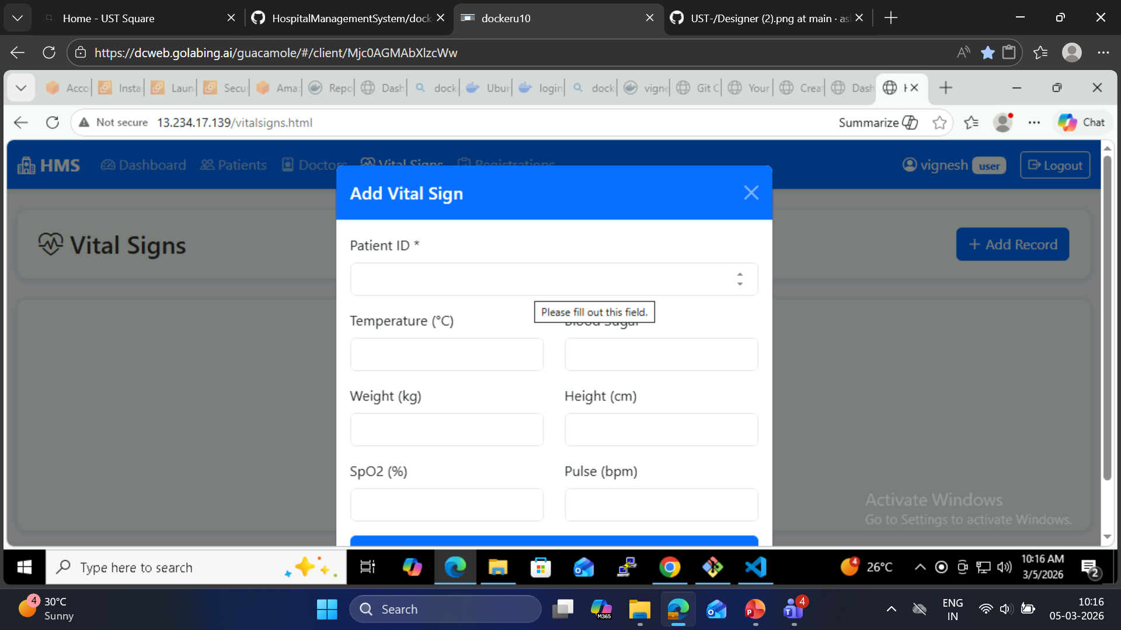
Vital signs page

Slide 29
Doctor Service Microservice
Hospital Management System
Port: 3005
Handles doctor management including specialization and schedules.

Slide 30
Objective
- Manage doctor profiles
- Store specialization details
- Maintain doctor schedules
- Provide doctor data to other microservices
- Enable scalable doctor management

Slide 31
Functionalities
- Add new doctor profiles
- Retrieve doctor information
- Update doctor specialization and schedule
- Delete doctor records
- Provide doctor availability for patient registration

Slide 32
Dockerfile Snippet
FROM node:18-alpine
WORKDIR /app
RUN apk add --no-cache netcat-openbsd
COPY package.json ./
RUN npm install --production
COPY . .
EXPOSE 3005
CMD sh -c 'while ! nc -z mysql 3306; do sleep 1; done; node app.js'

Slide 33
Docker_compose.yaml
doctor-service:
build: ./services/doctor-service
container_name: hospital-doctor-service
restart: always
environment:
DB_HOST: mysql
DB_USER: root
DB_PASSWORD: ${MYSQL_ROOT_PASSWORD:-root123}
DB_NAME: ${MYSQL_DATABASE:-hospital_db}
JWT_SECRET: ${JWT_SECRET:-hospital_management_secret_key_2024}
depends_on:
mysql:
condition: service_healthy
networks:
- hospital-network

Slide 34
Docker Networking
Custom bridge isolates hospital microservices traffic
Internal subnet dynamically assigned by Docker
Containers resolve names via embedded DNS
Network prevents external unauthorized access
Enables scalable horizontal service deployment

Slide 35
Microservice Communication
REST endpoints exchange JSON payloads
Inter-service calls use internal DNS resolution
Containers communicate via hospital-network bridge
Load distributed across independent service instances
JWT tokens validated across secured endpoints

Slide 36
Database & Volumes
MySQL relational schema enforces foreign keys • Patient references user_id relational mapping • Vital-signs linked via patient_id constraints • Volume-backend mounts persistent database storage • ACID compliance ensures transactional consistency

Slide 37
Docker Image Security Scan
Scanned user-service image vulnerabilities detected
Image scanned using Trivy
trivy image username/registration-service:1.0
Reports exported in JSON format to analyze vulnerabilities. • patient-service base image updated securely • vital-sign-service dependencies verified secure mysql image checked for CVEs
Ensured production ready secure containers

Slide 38
Docker hub image
Pushed hospital user-service latest image
Uploaded patient-service DockerHub repository image
vital-sign-service image version tagged properly
Frontend nginx image deployed successfully
Pulled images during AWS deployment

Slide 39
Conclusion
Integrated six independent hospital microservices
Enabled secure JWT authentication system
Established Docker Compose orchestration setup
Implemented centralized MySQL database storage
Achieved scalable cloud ready deployment

