Slide 1
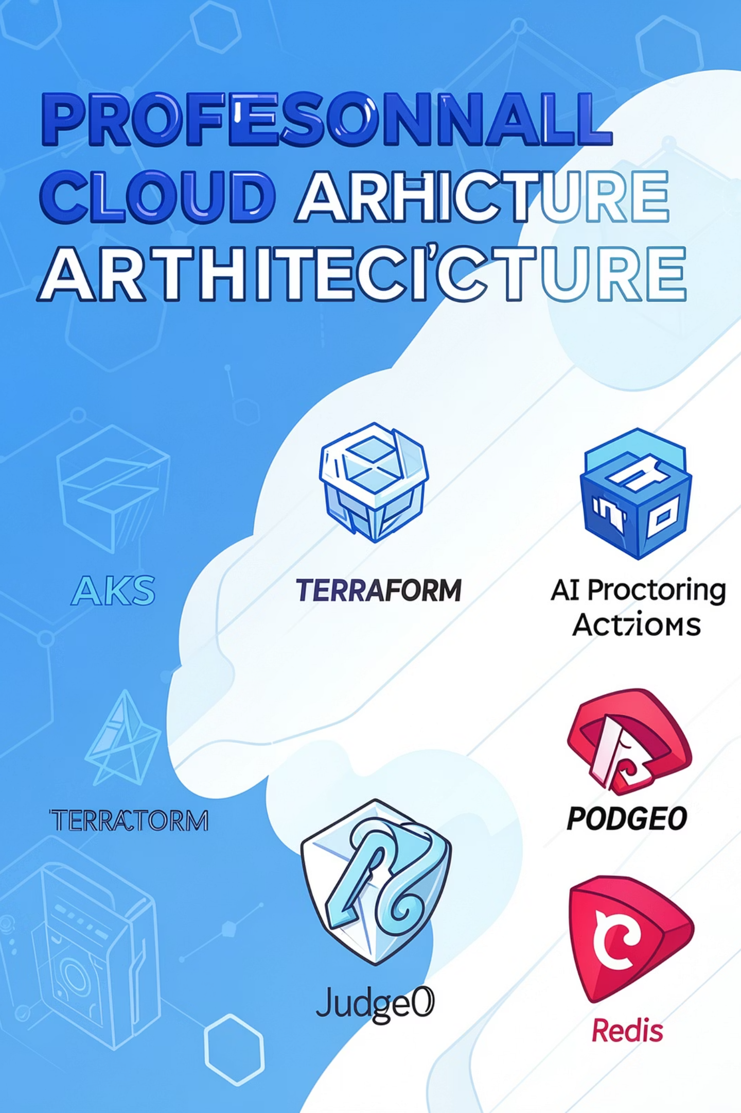
Clahan Academy
Cloud Native AI-Powered Online Examination Platform
Enterprise-grade solution designed for 10,000+ concurrent students — built on Azure, Kubernetes, and AI services for secure, scalable examinations.

Slide 2

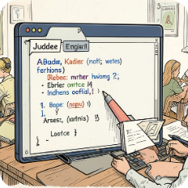
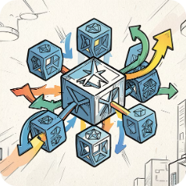
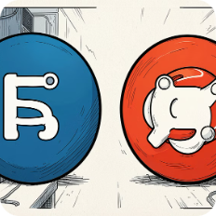
Project Overview
Clahan Academy is a cloud-native online exam platform engineered for scale, security, and automation.
AI Proctoring
Coding Assessments
Scalable AKS Deployment
Data & Cache
Real-time monitoring, face recognition, and anomaly detection to enforce exam integrity.
Judge0 integration for sandboxed compilation and automated scoring.
Microservices on AKS with horizontal autoscale and resilient ingress.
Azure Database for PostgreSQL for persistence and Redis for session and fast-cache.

Slide 3
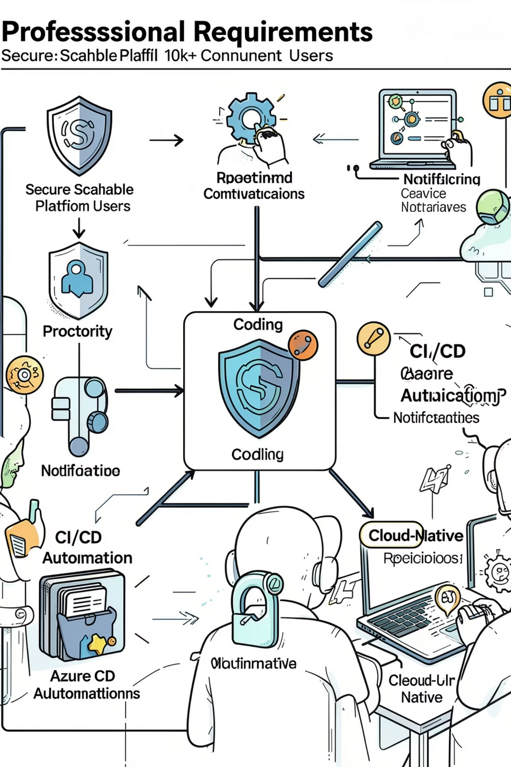
Business Requirements
Key requirements prioritized for enterprise delivery:
Scale to 10,000+ concurrent students with predictable performance
Secure, tamper-resistant exam environment with AI proctoring
Support for MCQ and coding assessments (Judge0), automated evaluation
Real-time monitoring, WebSocket streams, and low-latency notifications
Cloud-native deployment with Terraform and CI/CD automation (GitHub Actions)

Slide 4
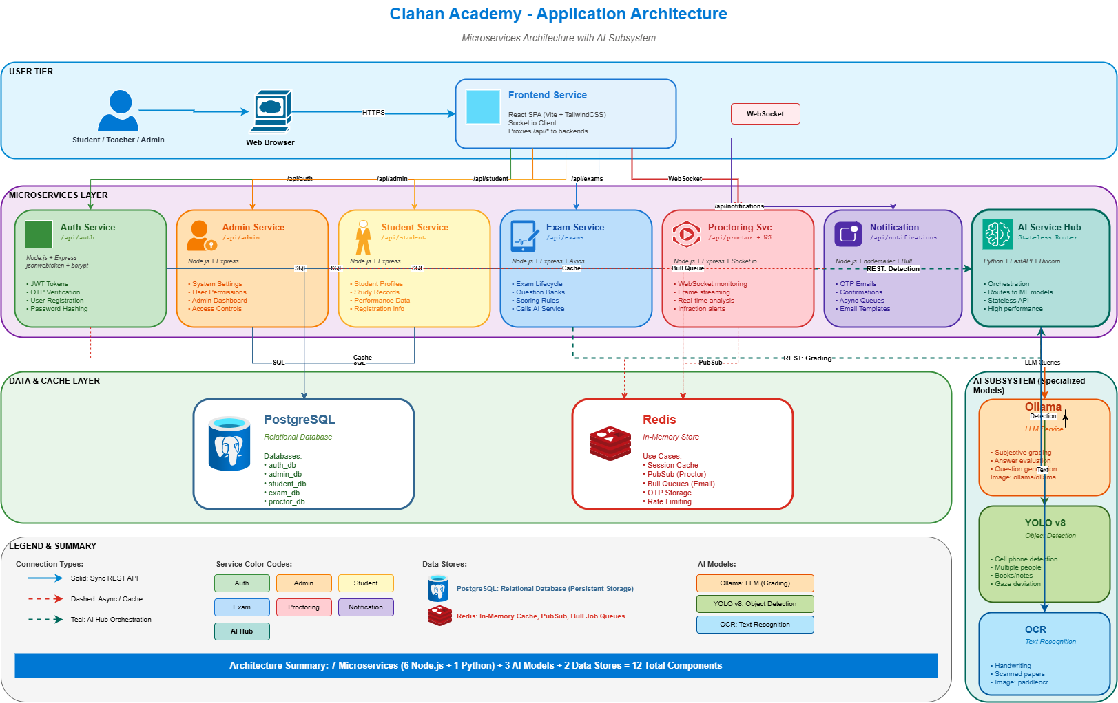

Slide 5
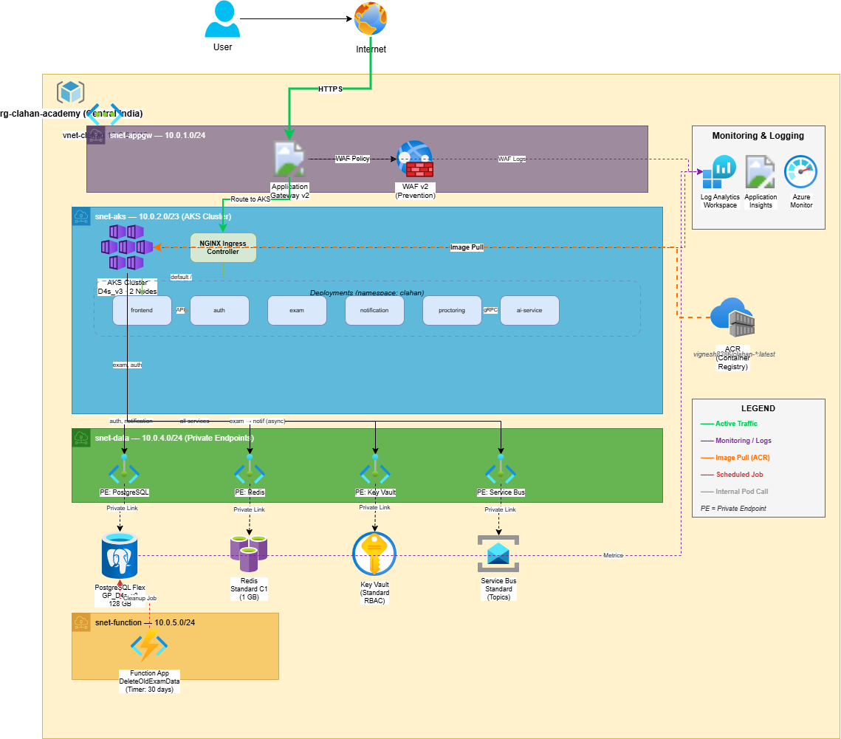
Architecture

Slide 6
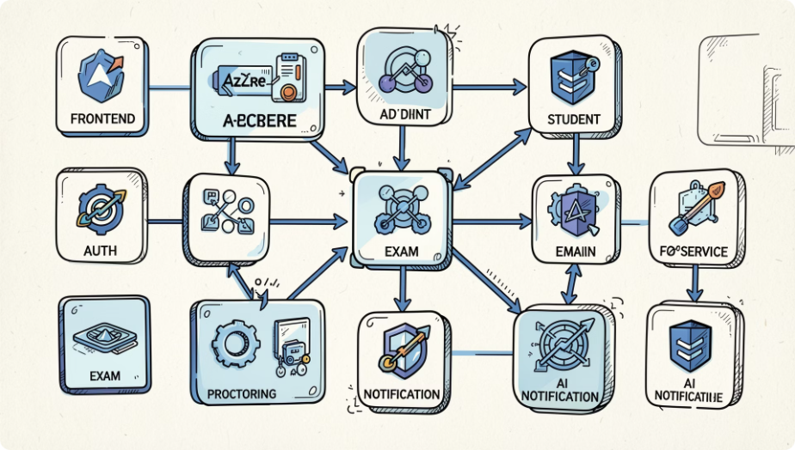
Microservices Architecture
Frontend Service
React + Vite delivering SPA, secure with token refresh and content delivery via CDN.
Auth Service
Login, registration, JWT issuance, OIDC integration, MFA support.
Exam Service
MCQ & coding test orchestration, scheduling, grading hooks to Judge0.
Proctoring Service
WebSocket ingest, stream relay, event generation for AI analysis.
Notification Service
Email/SMS queue integration and event-driven notifications via Service Bus.
AI Service
Runs YOLOv8, InsightFace, and Ollama models for proctoring and evaluation signals.

Slide 7
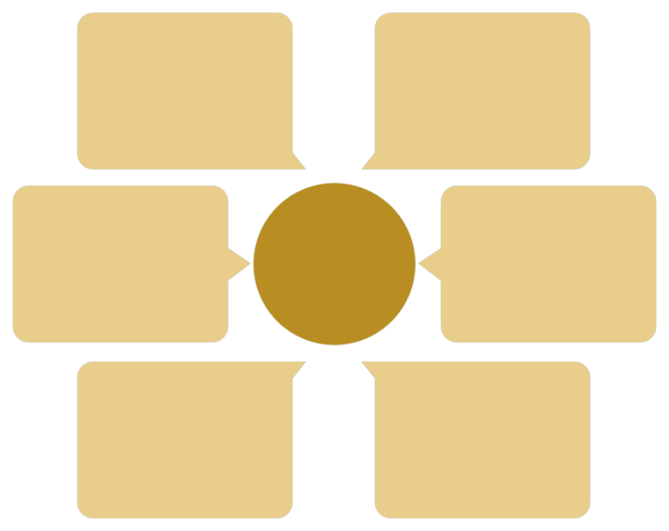
AI Proctoring Workflow
Notification and Exam Service
Student webcam
Alerts & exam control
Live video capture
AI Proctoring Workflow
WebSocket stream
Event bus
Publish detection events
Real-time frame delivery
AI Service
Proctoring Service
InsightFace, YOLOv8, Haar
Frame orchestration & rules

Slide 8
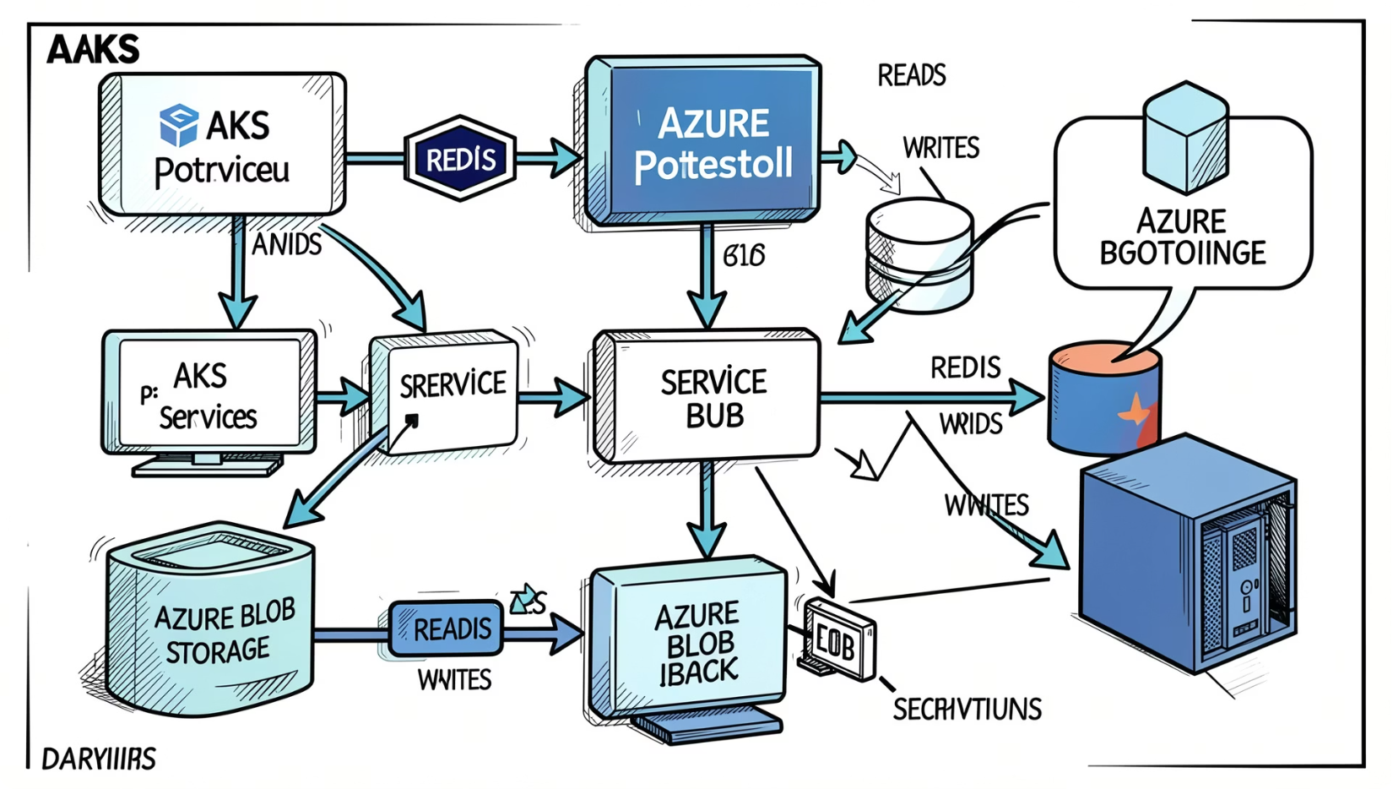
Data Layer Architecture
PostgreSQL
Redis
Primary source for users, exams, results, configuration. Backups and read-replicas for HA and analytics.
Session store, distributed locks, transient exam state and rate-limiting.
Blob Storage
Secure storage for screenshots, recordings, reports, and export artifacts.

Slide 9
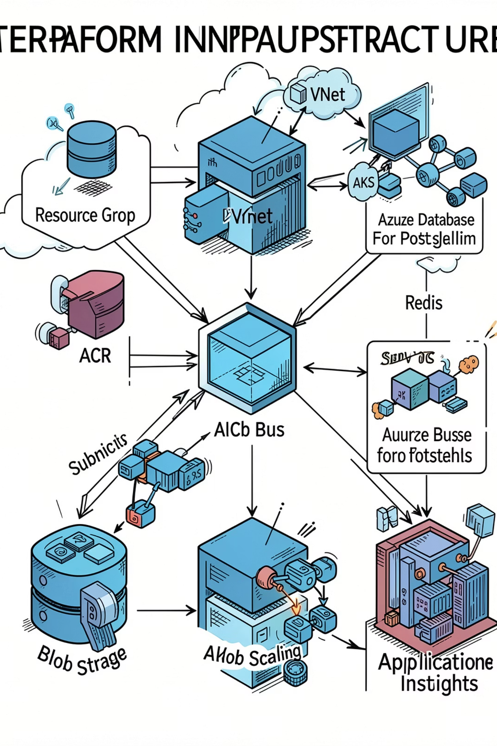
Kubernetes & Azure Infrastructure
Infrastructure as code with Terraform provisions secure network, multi-node AKS, ACR, managed databases, caching, and telemetry. Workload Identity and managed identities enforce least privilege.
Scalability
High Availability
Security
Cluster autoscaler, HPA for pods, node pools for workload separation.
Workload Identity, RBAC, network policies, secrets in Kubernetes backed by Azure Key Vault.
Multi-AZ node pools, read replicas, and redundant storage accounts.

Slide 10
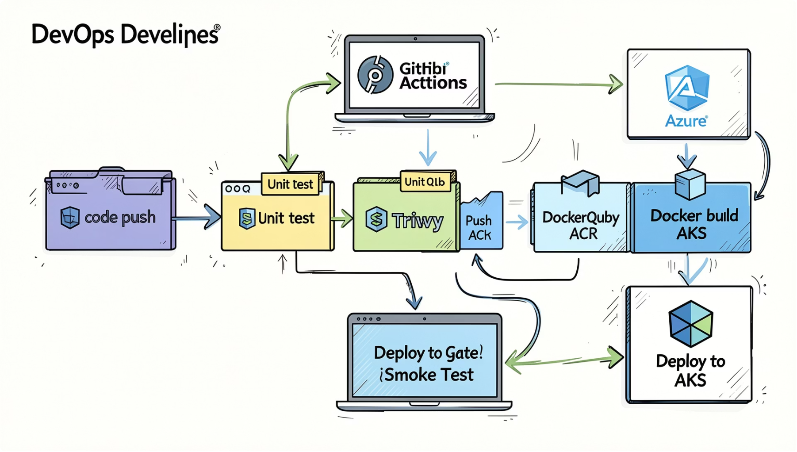
CI/CD Pipeline
01
1. Code Push
Feature branch triggers pipeline in GitHub Actions.
02
2–4. Quality & Security
Unit tests, SonarQube analysis, Trivy container scanning enforce quality gates.
03
5–7. Build & Approve
Docker image built and pushed to ACR, policy/approval gates for production releases.
04
8–9. Deploy & Validate
Deploy to AKS via GitOps/helm, run smoke tests, and auto-promote on success.

Slide 11
Thank You

