Slide 1
Clahan Academy
Online Exam Platform on Azure
Enterprise architecture with Terraform

Slide 2
Project Overview
What is Clahan Academy?
Key Features
Online exam platform for educational institutions
11 microservices (containerised)
Multi-region deployment for high availability
✅ Multi-environment: Dev / Staging / Prod
✅ Active‑Standby Disaster Recovery across regions
✅ Infrastructure as Code using Terraform
✅ Containerised microservices (Azure Container Apps)
✅ AI‑powered proctoring (YOLO, OCR, Ollama)
Visual: Logical flow — User → Internet → Azure Front Door → Regional services (primary / standby)

Slide 3
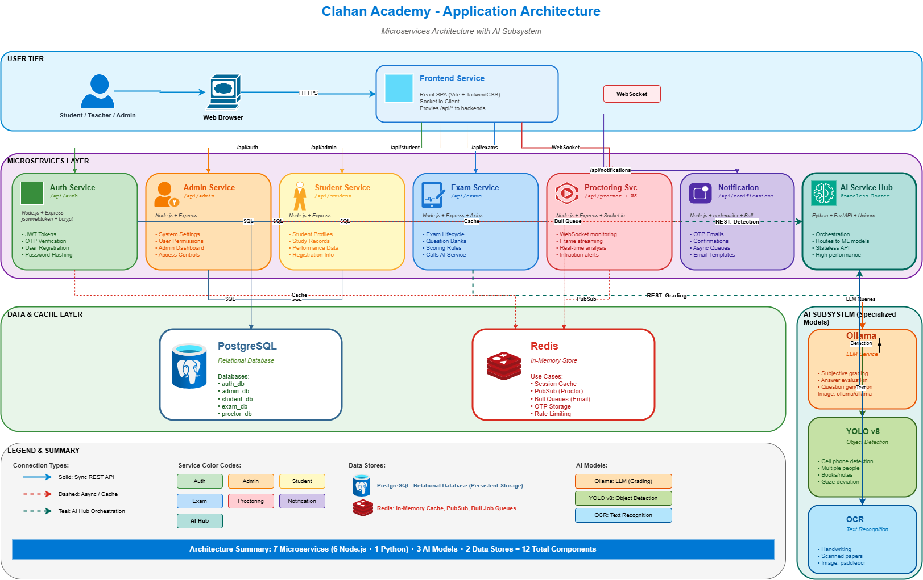

Slide 4
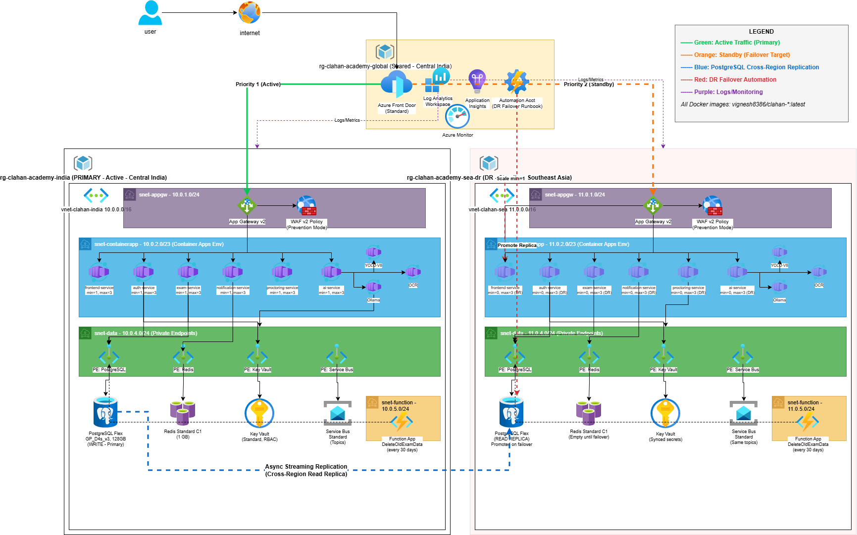

Slide 5
Technology Stack
A concise, enterprise‑grade stack organised by domain.
Cloud & Infrastructure
Compute & Networking
Microsoft Azure · Terraform · Azure CLI
Azure Container Apps · Azure Front Door · App Gateway + WAF v2
Data & Storage
DevOps & Security
PostgreSQL Flexible Server · Azure Cache for Redis · Service Bus
Docker Hub (vignesh8386) · Key Vault · Azure Monitor & Log Analytics

Slide 6
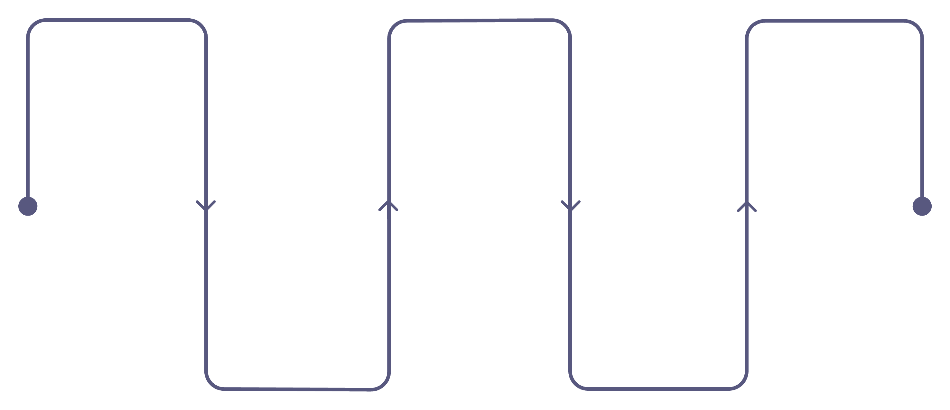
Architecture Overview
Active‑Standby Cross‑Region Deployment
User Entry
Primary Region
Failover
Client request to Front Door
Front Door shifts to standby on probe failure
India: AppGW+WAF, 11 Containers, Postgres, Redis
Standby Region
Global Routing
Indonesia: replicas and scaled containers
Azure Front Door health probes
Note: Front Door performs health probes and routes traffic to the highest‑priority healthy region. Primary: India. Standby: Indonesia (replication & scaled containers).

Slide 7
Microservices Architecture
Containerised on Azure Container Apps — 11 services
Service
Image (tag)
Purpose
frontend-service
vignesh8386/frontend:v1.0.0
React UI — student & instructor portal
auth-service
vignesh8386/auth:v1.0.0
Authentication & authorization (JWT, RBAC)
admin-service
vignesh8386/admin:v1.0.0
Admin dashboards & management
student-service
vignesh8386/student:v1.0.0
Profile & enrollment
exam-service
vignesh8386/exam:v1.0.0
Exam creation, scheduling, scoring
notification-service
vignesh8386/notify:v1.0.0
Email / alerts
proctoring-service
vignesh8386/proctor:v1.0.0
Live proctoring orchestration
ai-service
vignesh8386/ai:v1.0.0
AI orchestration & model routing
yolo-v8
ultralytics/ultralytics:latest
Object detection for proctoring
ocr
openeuler/paddleocr:latest
Text recognition for image checks
ollama
ollama/ollama:latest
LLM for assistant & analysis

Slide 8
Terraform Best Practices Implemented
Enterprise‑grade Infrastructure as Code
Provider & Modules
Provider configuration (azurerm + random). 12 reusable, well‑scoped modules.
Configuration & Environments
Variables & outputs per module, environment‑specific tfvars for dev/staging/prod, and Terraform workspaces.
State & Secrets
Remote state with locking (Azure Storage + blob lease). Secrets exclusively in Key Vault; no secrets in tfvars.
CI / GitOps
GitHub repository tracking and PR‑based plans; automation for workspace initialisation.
Dependencies & Patterns
Explicit and implicit dependencies modelled, naming conventions, tagging policy, and modular outputs for cross‑module wiring.
Bottom note: Project structure: 12 modules · 3 environments · 3 workspaces

Slide 9
Terraform Project Structure
Modular repository layout designed for clarity and reuse.
clahan-academy-terraform
environments/
backend.tf · providers.tf · main.tf · variables.tf · outputs.tf
dev.tfvars · staging.tfvars · prod.tfvars
modules/ (12)
scripts/
networking · container-apps · postgresql-primary · postgresql-replica · redis · keyvault · servicebus · appgateway · frontdoor · function-app · automation · monitoring
bootstrap-backend.sh · init-workspaces.sh · failover-dr.sh
Highlight: Modular design enables repeatable environments and safe drift management.

Slide 10
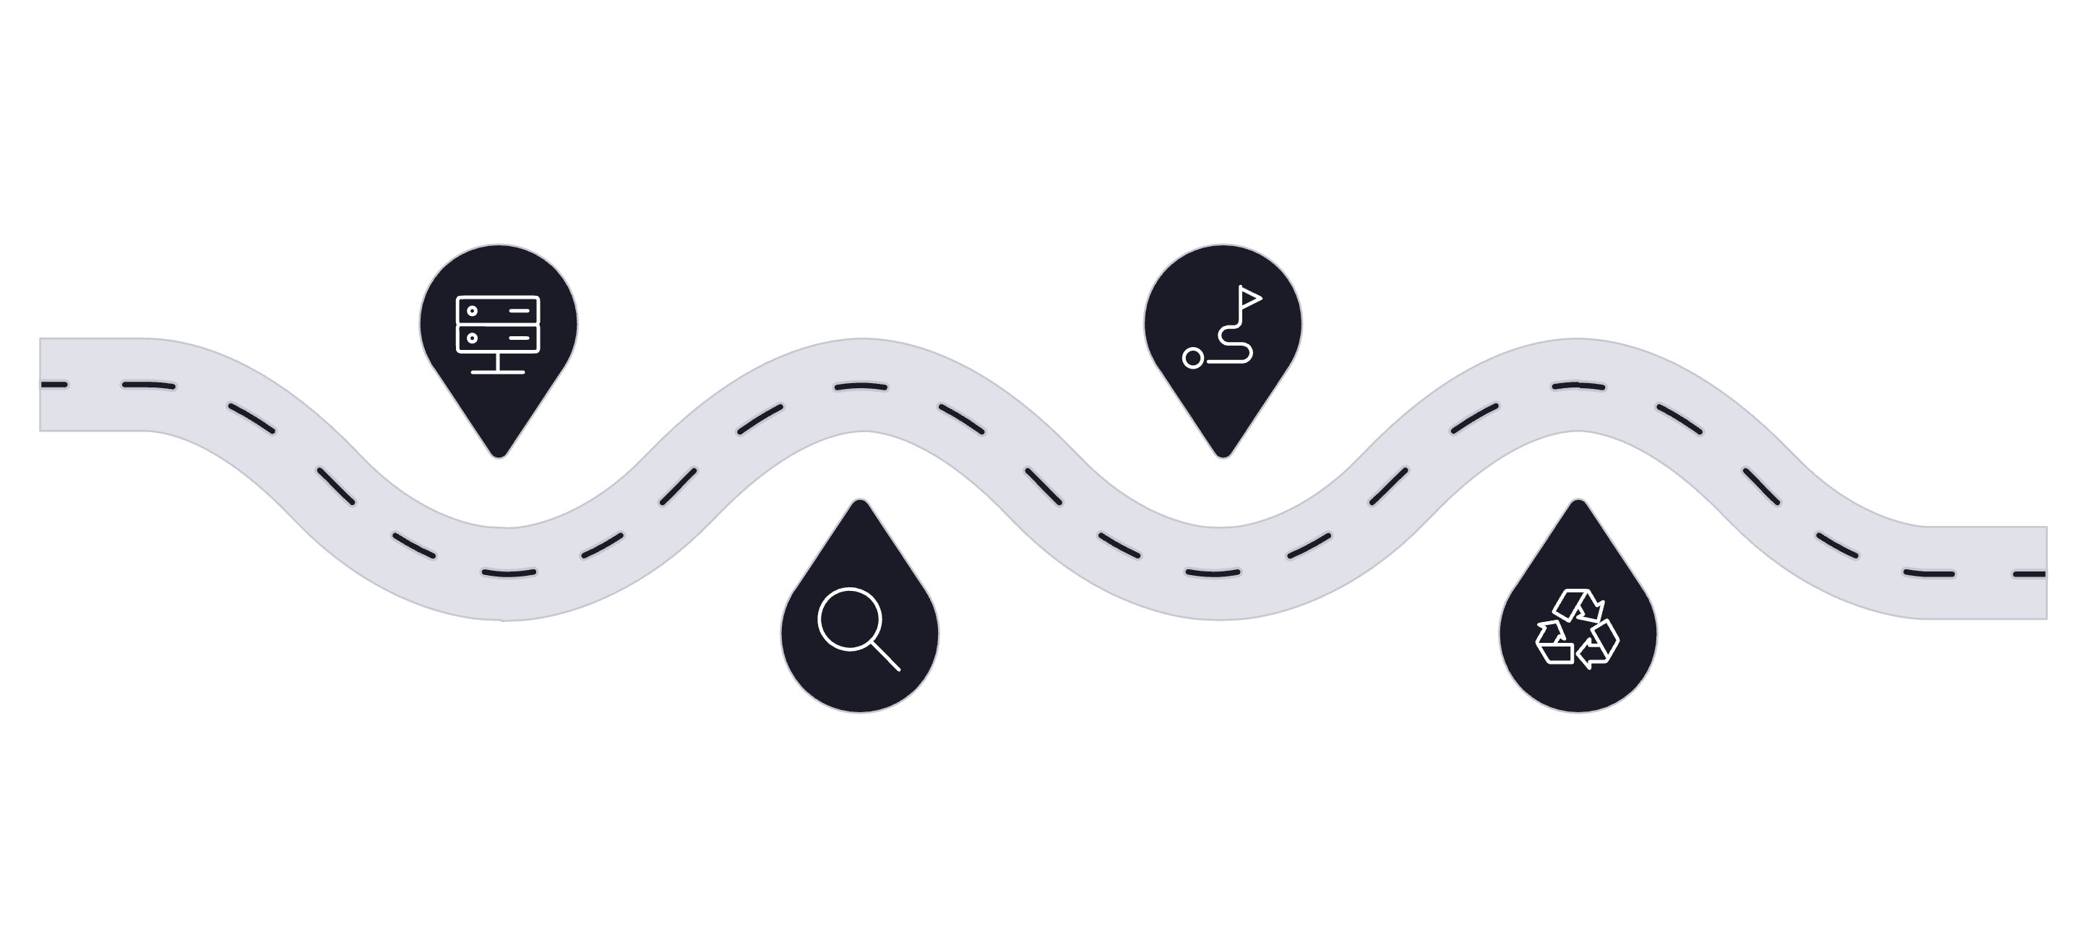
Disaster Recovery (DR) Strategy
Active‑Standby Cross‑Region Failover
Primary Down
Traffic Routed
T+0 primary failure detected
T+60s route to standby
Probe Detects
Recovery
T+30s Front Door health probe
T+5min replica promoted, scaled
Key metrics: RTO ≈ 5 minutes. RPO ≈ 5 minutes (replication lag dependent).
Core components: Azure Front Door, PostgreSQL cross‑region read replica, Automation Account runbooks, scaled Container Apps in DR region.

Slide 11


Security & Secret Management
Zero Secrets in Code — Managed Identities & Key Vault
Container App identity
System-assigned managed identity
No public DB access
Secure Secret Flow
Private endpoint request
Databases deny direct public connections
Key Vault accessed via private endpoint
Network protections
Key Vault response
NSGs and restricted subnets
Secret returned over private network
Network Security
Identity & Access
Application Security
Secrets
Private endpoints for data services · NSGs on subnets · No public DB access
Azure RBAC, system‑assigned managed identities, least‑privilege assignments
WAF v2 (OWASP rules), TLS 1.2+, monitoring & alerts
All secrets in Key Vault · auto‑generated passwords (random_password) · soft delete & purge protection
Clahan Academy | Vignesh | 9/10

Slide 12
Demo & Next Steps
Quick Demo Flow
Key Learnings
terraform init
terraform workspace select prod
terraform plan -var-file=environments/prod.tfvars
terraform apply
Access app via Front Door URL
Simulate DR failover and validate promotion
✅ Multi‑region Azure deployment with Front Door
✅ Terraform modularisation and workspace strategy
✅ Automated DR promotion & runbooks
✅ Secrets managed by Key Vault; no secrets in code

