Slide 1
Budget tracker
Know where your money goes.

Slide 2
Introduction
A budget tracker helps you monitor your expenses, control your spending, and save efficiently. It ensures you stay within your budget, avoid unnecessary expenses, and achieve financial goals without stress.
In the UK:
39% of adults (20.3 million) don’t feel confident managing their money
11.5 million have less than £100 in savings
nearly nine million of us are in serious debt, and only around a third receive help.

Slide 3
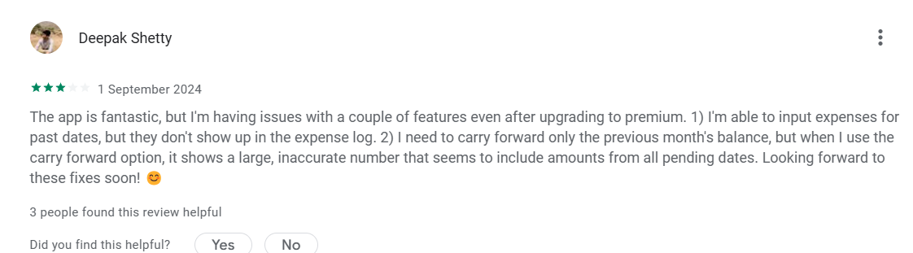
Survey of Existing applications – Money manager
Response 1:

Slide 4
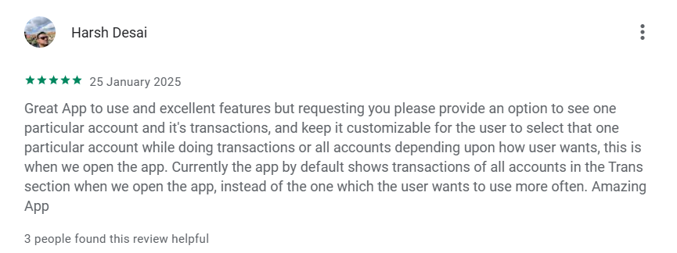
Review from a similar app
Its a very good app simple and easy to understand. But it need an option for SIP and SIP step up investment and all other investment options. And the UI could be made more attractive. Many icons for different types of transactions. And I think Income should be in Green, Expenses in Red, Transfer in Blue and Total in White. I hope you consider my suggestions.

Slide 5
Budget Tracker Features
Secure Account Creation – Sign up and log in using Firebase authentication.
Google Messages Integration – Automatically retrieve and categorize expense-related messages.
Drag & Drop Simplicity – Easily organize transactions with an intuitive interface.
Real-time Sync – Access your budget data across multiple devices seamlessly.
Custom Categories – Add, edit, or remove categories to personalize your expense tracking.

Slide 6
Technologies used
Selenium
Automates web browser interactions.
Key Components:
webdriver – Controls the browser.
By – Locates elements on the page.
WebDriverWait – Waits for elements to appear.
expected_conditions – Defines conditions for waiting.

Slide 7
How Messages Are Retrieved
Setup WebDriver:
A Chrome browser session is initiated using Selenium WebDriver.
User Login:
The user logs into Google Messages via QR code authentication.
Select Contact:
The script searches for a specific
Load All Messages:
The script scrolls down the conversation to ensure all messages are loaded.
Extract Messages:
All messages are retrieved using a CSS selector

Slide 8
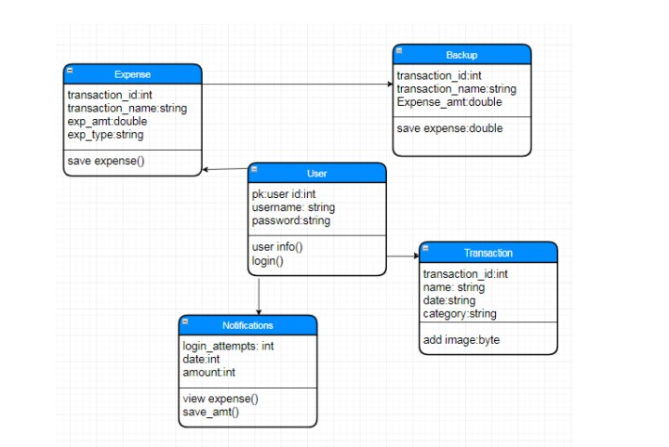

Slide 9
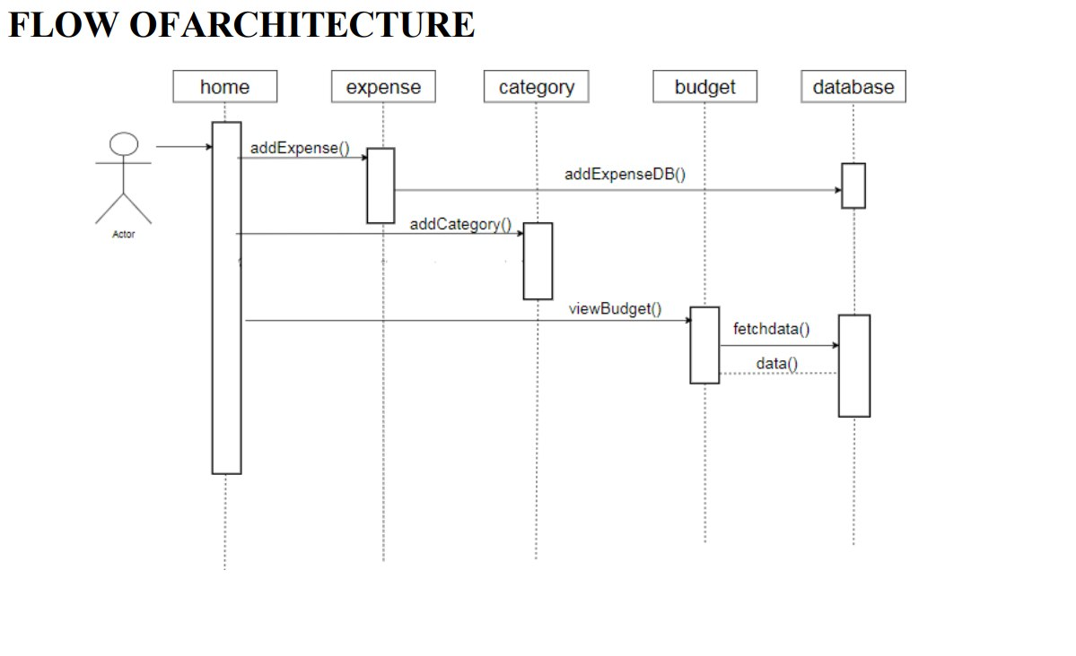

Slide 10
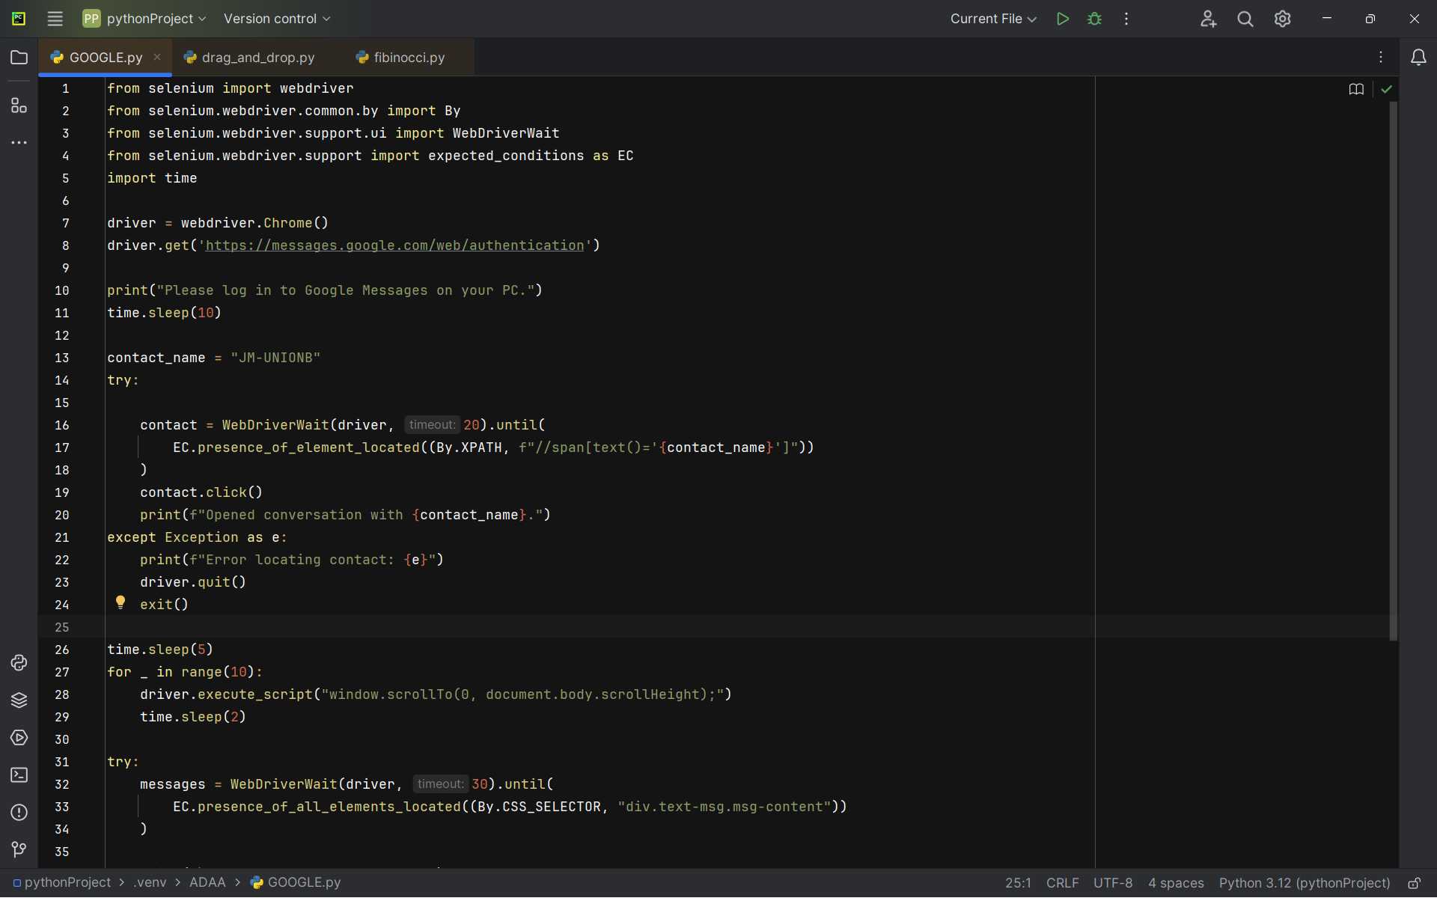
Sample Code for Retrieving Messages from Google Messages

Slide 11
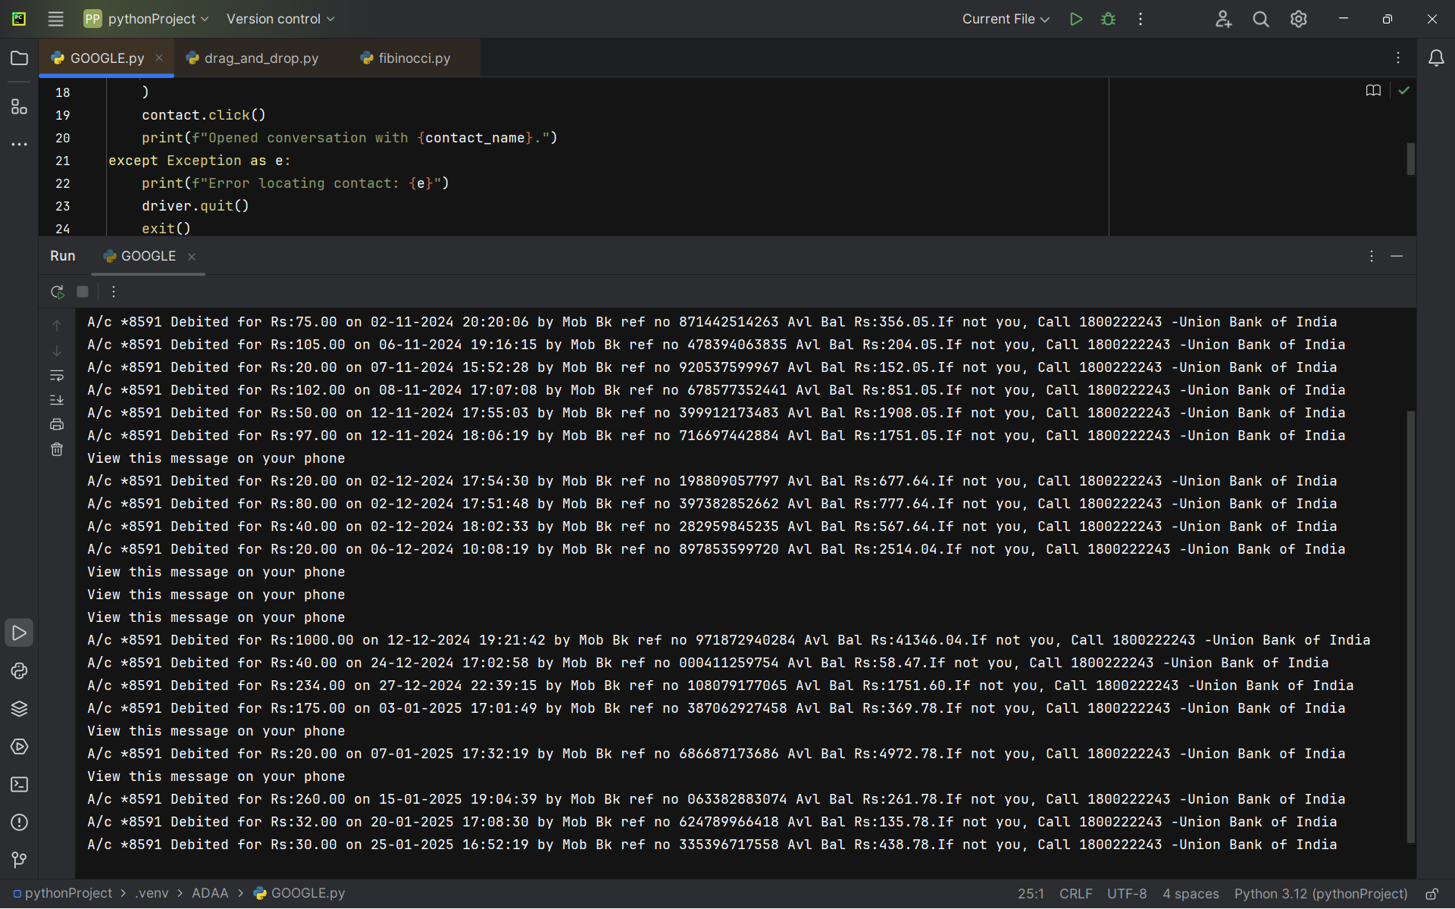
Sample output

Slide 12
Usage of Design Patterns in Message Extraction
Design patterns can significantly improve the structure, scalability, and maintainability of your message extraction project.
1. Strategy Pattern:
Purpose: To allow different extraction methods for various data points (e.g., registration ID, amount).
How it works: Define a family of extraction strategies and select the one that fits the context.
Benefit: Makes it easy to add new types of extraction in the future without modifying existing code.

Slide 13
2. Singleton Pattern
Purpose: To ensure only one instance of WebDriver is used throughout the application.
How it works: Create a class with a static method that ensures only one WebDriver instance is created.
Benefit: Avoids multiple WebDriver instances and saves system resources.
Benefits of Using Design Patterns
Improved Code Organization: Design patterns help in organizing your code into logical components, making it easier to manage and extend.
Reusability: Once you define a pattern, you can reuse it in other parts of your project or even in other projects.
Maintainability: Patterns allow for easier debugging and modification as your project grows.
Scalability: As your project needs evolve, design patterns allow you to scale your system without a complete redesign.

Slide 14
Future implementation / Additional features: Extract Registration ID and Amount
Identify the Pattern for Reg and Amount:
Define keywords or regex patterns for "reg" (registration ID) and "amount".
Fetch Messages:
Continue extracting messages as done in the current code.
Parse the Messages:
Check if messages contain the reg ID and amount using regex or string matching.
Extract Data:
Use regex patterns like:
r"Reg: (\d+)" for registration IDs.
r"Amount: (\d+)" for amounts.

Slide 15
Plotting Retrieved Data in Budget Tracker
In the Java version of the Budget Tracker, we will use Swing for the GUI interface and JFreeChart for generating dynamic pie charts. Users can:
Add/Remove Categories: Manage categories using JList and DefaultListModel for easier manipulation.
Draggable Data: Use mouse events to drag data from one list and drop it into the appropriate category.
Dynamic Pie Chart: The pie chart, created using JFreeChart, updates in real-time based on changes to the categories and data.
Key Components:
JFrame for the main window.
JList for displaying categories and data.
JFreeChart for plotting the pie chart.
MouseListener for drag-and-drop functionality.

Slide 16
Thank you

