Slide 1
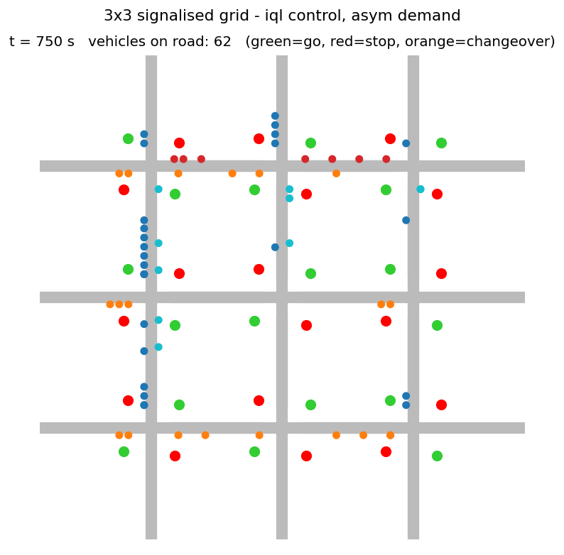
Motivation and Problem Statement
1 / 5
Urban traffic congestion
• Delay, fuel use and emissions concentrate at signalised intersections
• Queues at one junction spill back and block the next, so signals must be coordinated, not tuned one by one
Why conventional signals are not enough
• Fixed-time plans repeat a set cycle whatever the demand
• Green time is wasted on empty approaches; rush-hour imbalance is not handled
Project objectives
1. One RL agent per signal in a 3x3 simulated grid
2. Neighbours share information and reward
3. Compare with Fixed-time, Random and Longest-queue baselines on identical traffic
Our simulator (frame from the animation): vehicles queue at red lights, green lights release them.
Intelligent Traffic Signal Coordination Using Multi-Agent RL | all results from a custom Python simulator (SUMO not used)

Slide 2
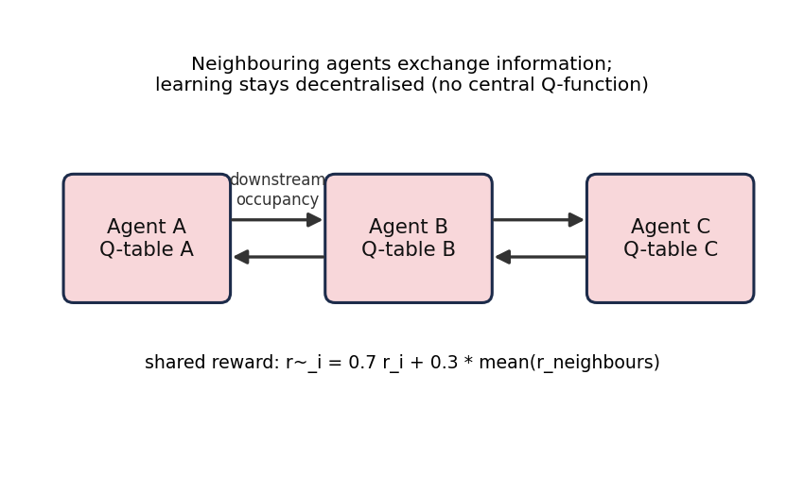
Proposed Method: Multi-Agent Q-Learning
2 / 5
State
Queue on N+S and E+W axes (4 levels each), phase, longest wait of red axis (3 levels); Coop-IQL adds 2 'downstream full' flags
Action
Next 10 s: North-South green or East-West green (2 s all-red when switching)
Reward
-(0.10 x avg queue + 0.50 x longest wait/60 s + 0.50 x spill-back) penalises queues, waiting, congestion
How the agents interact
• All agents act at the same time, so each faces a changing environment (non-stationarity)
• Cooperation is decentralised: no central controller
• Goal: minimise average vehicle waiting time over the whole network
Algorithm
Independent Q-Learning, 9 agents, own Q-table each; alpha 0.1, gamma 0.9, epsilon 1.0 to 0.05
Coordination
Information sharing (downstream occupancy) + reward sharing: 0.7 own + 0.3 mean of neighbours
Intelligent Traffic Signal Coordination Using Multi-Agent RL | all results from a custom Python simulator (SUMO not used)

Slide 3
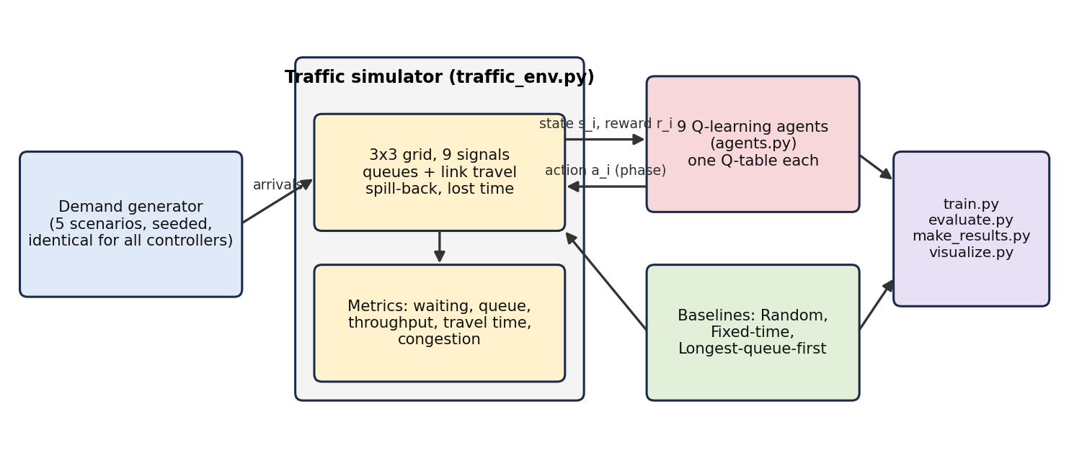
Implementation
3 / 5
Tools and technologies
• Python 3, NumPy, Matplotlib
• Custom queue-based simulator (SUMO not used)
• python-pptx and ReportLab for documents
• No paid APIs; runs on a laptop (Windows)
Training and simulation workflow
1. Each episode: draw a random demand scenario (low, medium, high, asym, peak) and seed; 1800 s simulated, one decision per agent every 10 s
2. Each agent: observe state, choose phase (epsilon-greedy), receive reward, apply the Q-learning update
3. Train 1000 episodes x 5 independent runs for IQL and Coop-IQL (about 10 min on one CPU core)
4. Evaluate greedy policies and baselines on 50 unseen, identical demand realisations (5 scenarios x 10 seeds)
5. Generate charts, tables, report; 5 unit tests check vehicle conservation, queue limits, state ranges
Intelligent Traffic Signal Coordination Using Multi-Agent RL | all results from a custom Python simulator (SUMO not used)

Slide 4
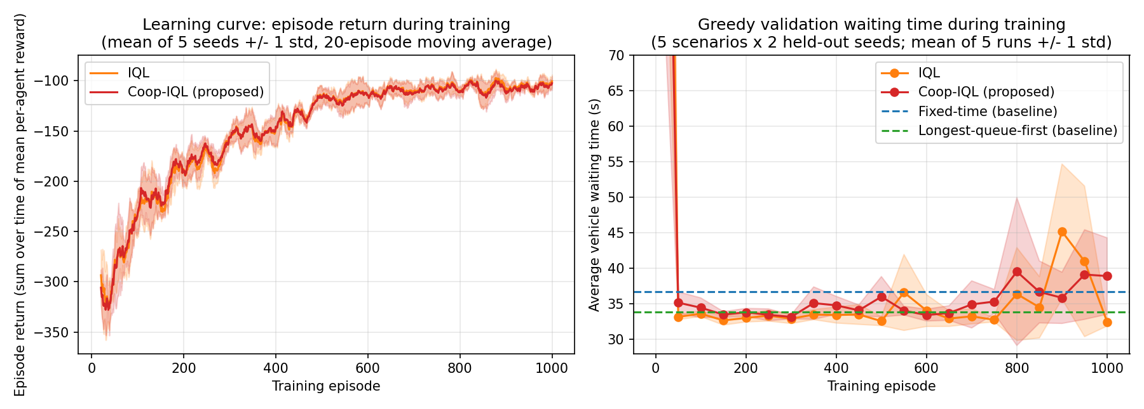
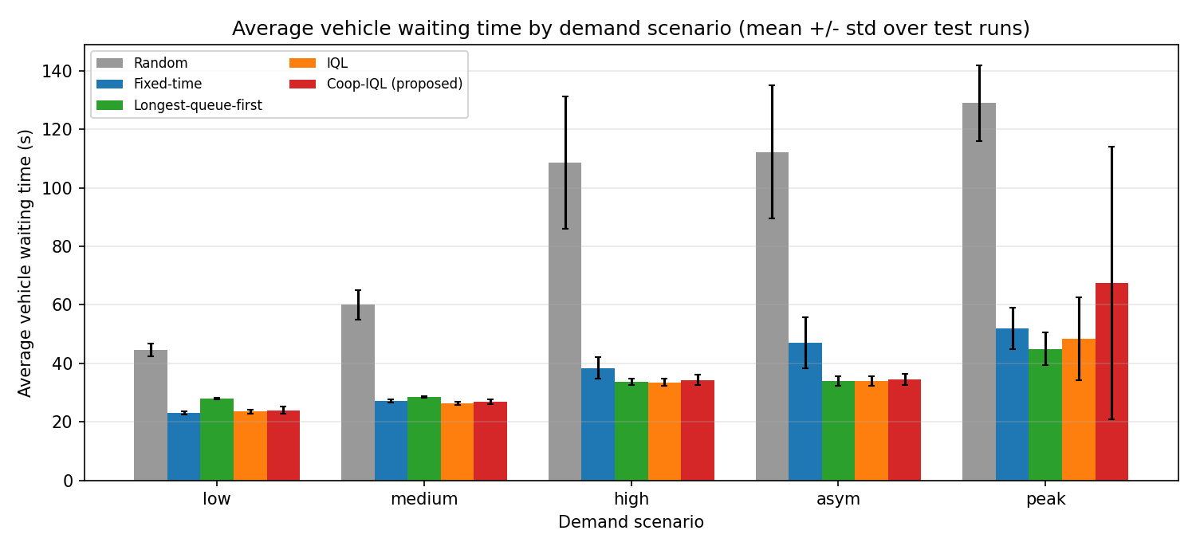
Experimental Results
4 / 5
Controller | Wait (s) | Queue | Thr.
Random | 90.8 | 3.32 | 2083
Fixed-time | 37.5 | 1.35 | 2179
Longest-queue-first | 33.8 | 1.19 | 2190
IQL | 33.1 | 1.18 | 2188
Coop-IQL | 37.4 | 1.35 | 2169
Key findings (means over all test runs)
• IQL cut waiting time 12% vs Fixed-time (33.1 vs 37.5 s); 28% under asym demand
• About equal to Longest-queue-first (33.8 s); Random is far worse (91 s)
• No gain at low demand; throughput barely differs
• Coop-IQL did NOT beat IQL (37.4 s): 3 of 5 runs unstable in the peak scenario (about 80 s) - negative result reported
• Policy good after ~50 episodes; late oscillations seen
Intelligent Traffic Signal Coordination Using Multi-Agent RL | all results from a custom Python simulator (SUMO not used)

Slide 5
Limitations and Ethics
5 / 5
Simulation limitations
Safety and reliability
• Custom queue model, not SUMO; no left turns, pedestrians, vehicle dynamics
• Single 3x3 network; tabular states; only 5 training runs
• Fixed-time baseline not optimised; no max-pressure
• Needs hard safety layer: min green, conflict monitor, fail-safe fallback
• Learned policy can fail in unseen demand (as peak runs did)
• Never validated on real roads
Ethical implications
Future improvements
• Average-delay goals can starve side roads, pedestrians, buses
• Emergency vehicles need priority
• Privacy of sensing data; accountability and transparency of decisions
• Validate in SUMO/CityFlow with real demand
• Deep RL with parameter sharing; ablate info vs reward sharing
• More seeds, tuned fixed-time and max-pressure baselines
Intelligent Traffic Signal Coordination Using Multi-Agent RL | all results from a custom Python simulator (SUMO not used)

