Slide 1


Introduction to Angular 2
TypeScript, Components, Services, Directives, HTTP, Routes
Ivaylo Kenov
Technical Trainer
Software University
https://softuni.bg

Slide 2

The Trainer
Ivaylo Kenov
Various job titles at the same time:
Mathematical competitions champion
Full Stack Technical Trainer
Senior Software Developer
Solutions Architect & Technical Lead
Owner of a Software Company
One-man army @ https://MyTestedASP.NET
{Insert Jot Title Here}
Contacts
https://github.com/ivaylokenov
https://facebook.com/ivaylo.kenov
https://linkedin.com/in/kenov

Slide 3
What Are We Going To Learn
Angular 2 Basics
Modules – the main building block of the app
Components – interact with the DOM
Directives – input and output
Events – custom events
Services – injectable components
HTTP – requests to remote server
Routes – integrating the routes
Contains portions from https://github.com/AngularClass/awesome-angular2

Slide 4
Who Is This Lecture For
This lecture is suitable for:
Developers who are familiar with
HTML
CSS
JavaScript
Angular 1 Developers
Angular 2 Beginners

Slide 5
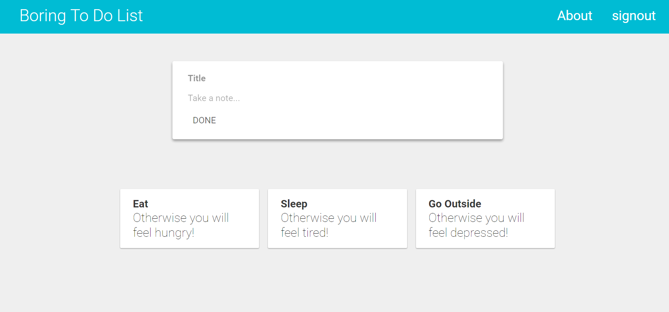
Let's Write Some Code
https://tinyurl.com/softuni-angular2

Slide 6
What's Next?
I really liked Angular 2… What should I learn now?
Application State - https://github.com/ngrx/store
Authentication & Authorization - https://auth0.com/blog/angular-2-authentication/
Reactive Extensions - https://medium.com/google-developer-experts/angular-introduction-to-reactive-extensions-rxjs-a86a7430a61f#.404yymrm1
Tests - https://angular.io/docs/ts/latest/guide/testing.html
Architecture - https://github.com/mgechev/angular-seed
Sky is the limit!

Slide 7
Are There Any Alternatives?
What if I did not like this piece of s**t?!?!
Check out React
https://facebook.github.io/react/
A client-side framework by Facebook
Or Aurelia
http://aurelia.io/
A client-side framework similar to Angular 1

Slide 8
Thank You!

Slide 9








Introduction To Angular 2
https://softuni.bg/trainings/1434/node-js-development-september-2016

Slide 10
License
This course (slides, examples, demos, videos, homework, etc.) is licensed under the "Creative Commons Attribution-NonCommercial-ShareAlike 4.0 International" license
Attribution: this work may contain portions from
"End-to-end JavaScript Applications" course by Telerik Academy under CC-BY-NC-SA license

Slide 11




Free Trainings @ Software University
Software University Foundation – softuni.org
Software University – High-Quality Education, Profession and Job for Software Developers
softuni.bg
Software University @ Facebook
facebook.com/SoftwareUniversity
Software University @ YouTube
youtube.com/SoftwareUniversity
Software University Forums – forum.softuni.bg

