Slide 1
Drivers
MACROS
Typedef
Timers
ICU
UART

Slide 2
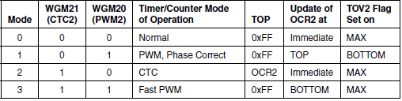
Timers
Mode of operation

Slide 3
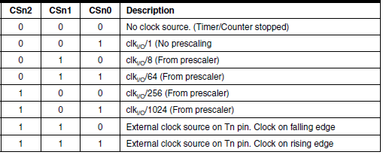
Clk

Slide 4

enum
Structure

Slide 5
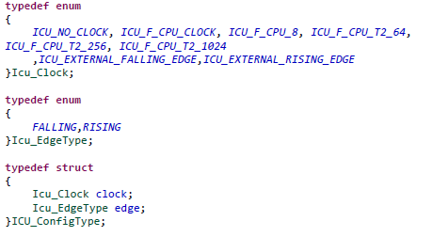
ICU

Slide 6
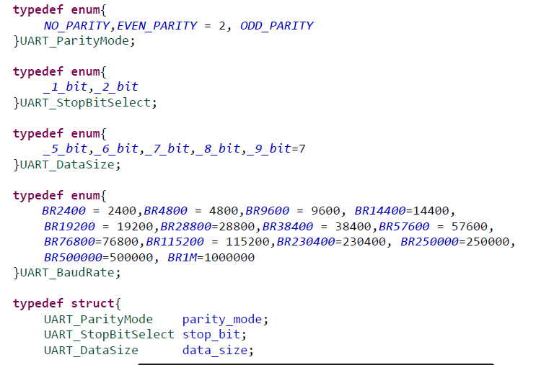
UART

Slide 7
Injection calibration
Code : - Timer 2 - Timer 1 - Main code

Slide 8
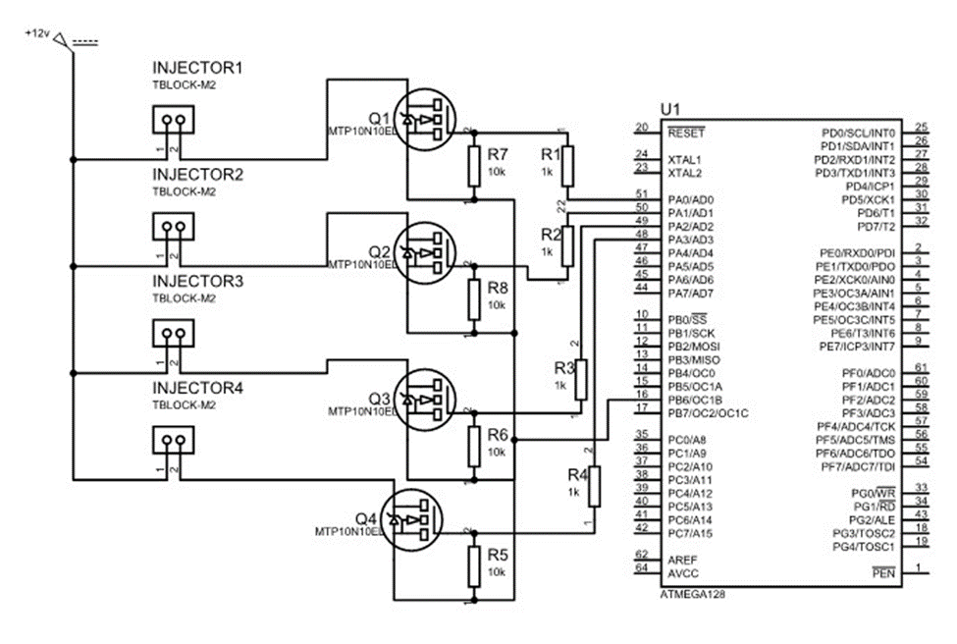
Circuit :

Slide 9
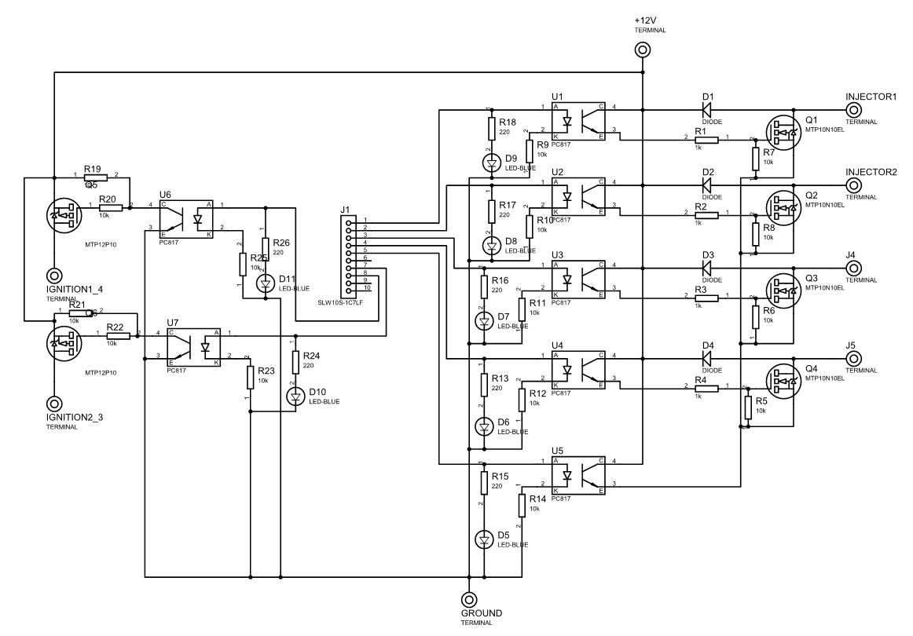
Ignition calibration
Code :
Circuit :

Slide 10
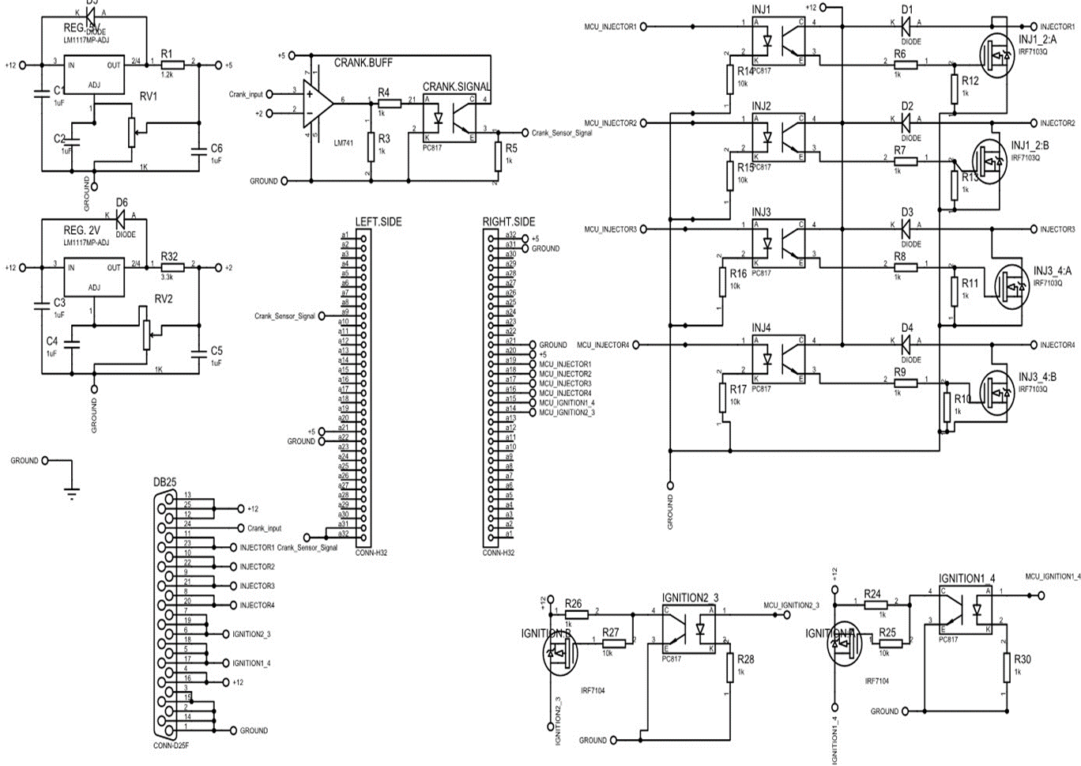
Main ECM circuit :

