Slide 2
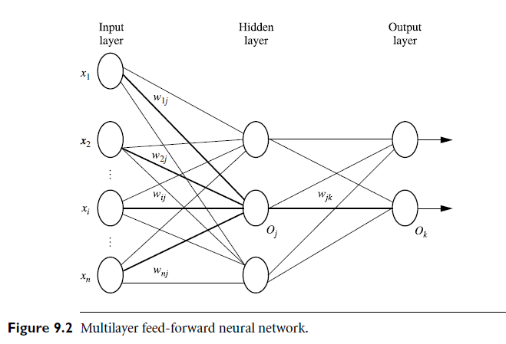

Slide 3
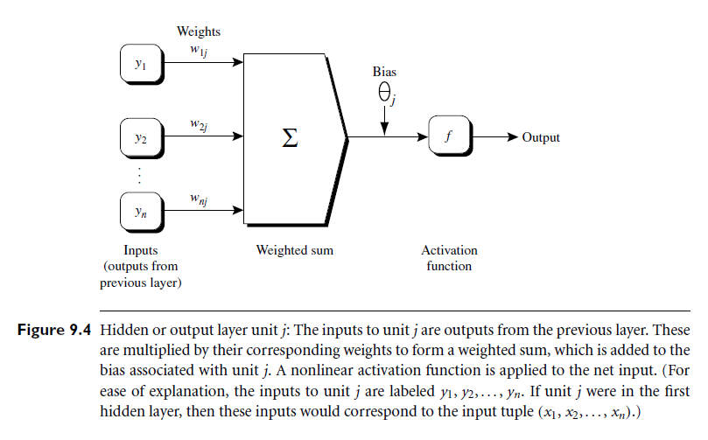

Slide 4
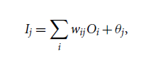

Feed Forward
Input to the hidden or output layer neuron is:
Output of the neuron of hidden or output layer is calculated by an activation function which is usually sigmoid or logistic function:

Slide 5
Backpropagate the error
For a neuron j in the output layer, the error Err_{j} is computed by:
Err_{j} = O_{j} (1- O_{j})(T_{j-} O_{j})
T is known output value and O is actual calculated value from model.
The error of a hidden layer neuron j is
Err_{j} = O_{j} (1- O_{j}) Σ Err_{k} w_{jk}

Slide 6
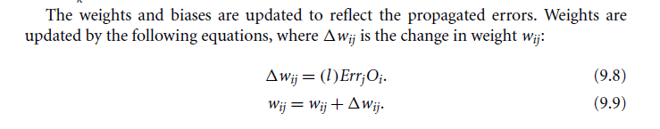
The variable l is the learning rate, a constant typically having a value between 0.0 and 1.0.
A rule of thumb is to set the learning rate to 1/t, where t is the number of iterations through the training set so far.

Slide 7
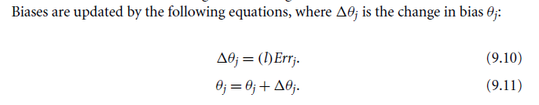

Slide 8
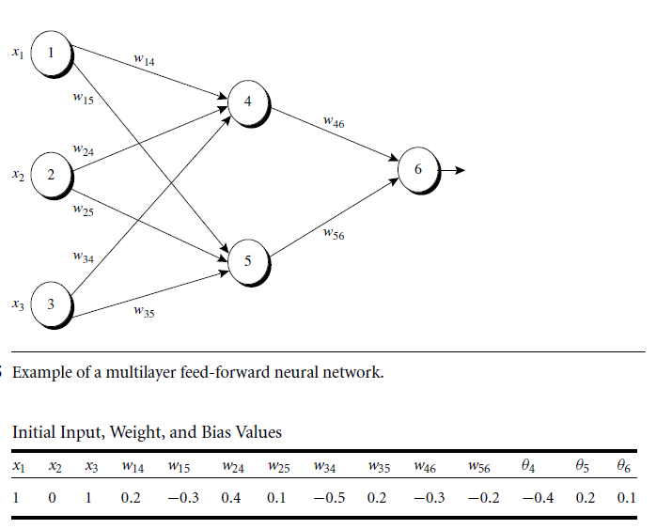
Example

Slide 9
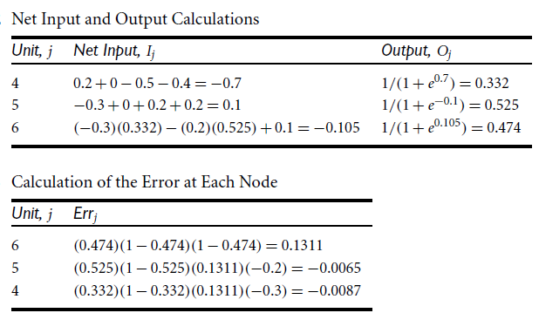

Slide 10
