Slide 1



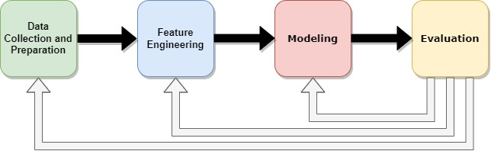
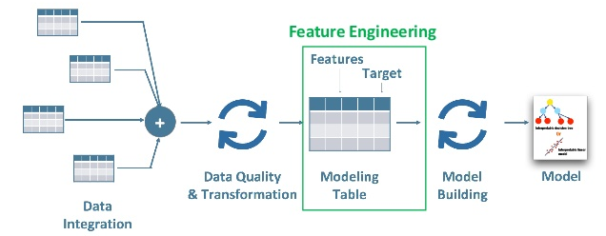
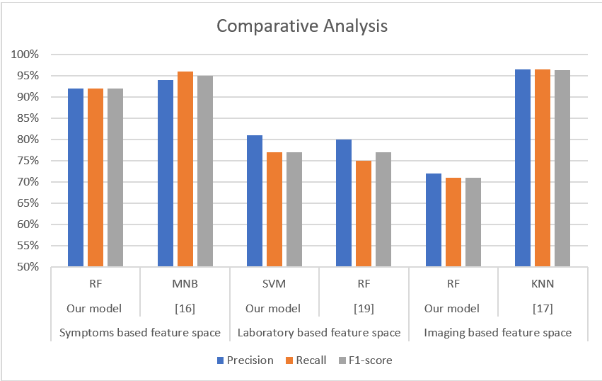
Development of Medical Diagnostic Models Using Artificial Intelligence
Ali Alhawas; Abdulilah Alqasem; Mohammad Zouman
Supervisor: Dr. Sultan Sharidah Aldera
Background
The significance of diagnosis for patient care and research is substantial. We can improve existing medical diagnostic models by using Artificial Intelligence (AI) technology to determine if a patient has a certain medical condition. Models of diagnostic prediction are used to determine whether or not a patient has COVID-19. This is essential for the healthcare sector.
Our objectives are: 1) conducting a literature review.
2) Building a machine learning-based diagnostic modelling pipeline.
3) designing and performing an experimental and comparative analysis.
Methodology
Data collection: There were three categories of datasets. The first one focuses mainly on CT-scan and X-ray imaging in order to identify COVID-19. The second was largely concerned with the findings of a laboratory blood test. The third one focused on typical patient routine questions.
Feature engineering: We used feature selection for all of the feature spaces, as well as the extraction approach for the imaging feature space.
Modeling: We used seven algorithms such as, Logistic Regression (LR), Support Vector Machine (SVM), K-Nearest Neighbors (KNN), Naïve Bayes (NB), Decision Trees (DT), Random Forest (RF), eXtreme Gradient Boosting (XGB)
Evaluation: Our diagnostic models were evaluated using 3 metrics: precision, recall, and f1-score. These 3 are the most common metrics we found in the literature for identifying how precise the model is in predicting the target variable.
Results
Measuring the performance of various classifiers is a key aspect of machine learning. A confusion matrix is a diagnostic tool used to compute various performance indicators. His diagnostic tool helps in determining the error categories of the categorization algorithm. The confusion matrix may be used to construct a variety of assessment measures.
Feature Spaces | Best Algorithm | Precision | Recall | F1-score
Laboratory | SVM | 81% | 77% | 77%
Symptoms | RF | 92% | 92% | 92%
Imaging | RF | 72% | 71% | 71%
Conclusion
Finally, we demonstrated how to apply ML models to predict COVID-19 presence using three types of datasets: imaging, laboratory, and symptoms. The ML models were built using publicly available data from the literature. Our models might be useful in identifying SARS-CoV-2 infected patients in areas where RT-PCR testing is not viable due to budgetary or supply restrictions. Our findings suggest that these models might be used to identify SARS-CoV-2 infected individuals who are at high risk before their RT PCR results are available.
CS Department
1443, Semester # 2

