Slide 1

DEADLOCK
Group # 52
Victor Savage –
vsava3@uic.edu
Micah Olugbamila –
oolug4@uic.edu
Maryann Olugbamila
- aolug3@uic.edu

Slide 2
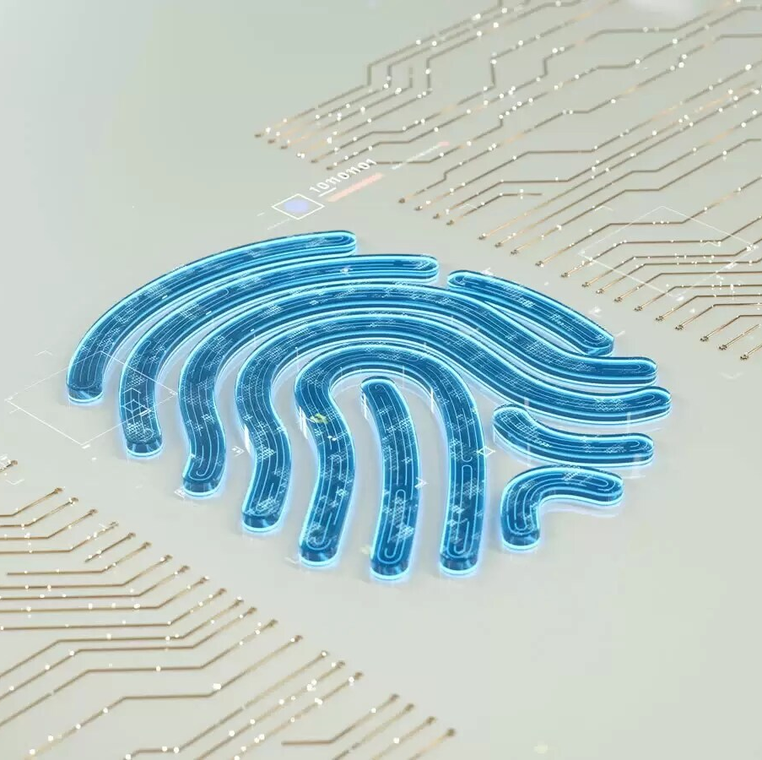
Project Name - Deadlock
This project implements a versatile safe-box lock system that enhances security through dual authentication methods. Users gain access by providing either a passcode or a fingerprint scan, similar to modern mobile devices. This system offers these key features: Enhanced Security, User Convenience, and Potential for Customization.

Slide 3

Project Description
"The increasing need for enhanced security measures in personal and professional spaces led us to develop Deadlock."
Objective: "We aimed to create a cost-effective, Arduino-based lock system that's easy to use yet highly secure."
Significance: "Dual authentication stands out by providing an additional layer of security, setting a new standard for safe locks."

Slide 4
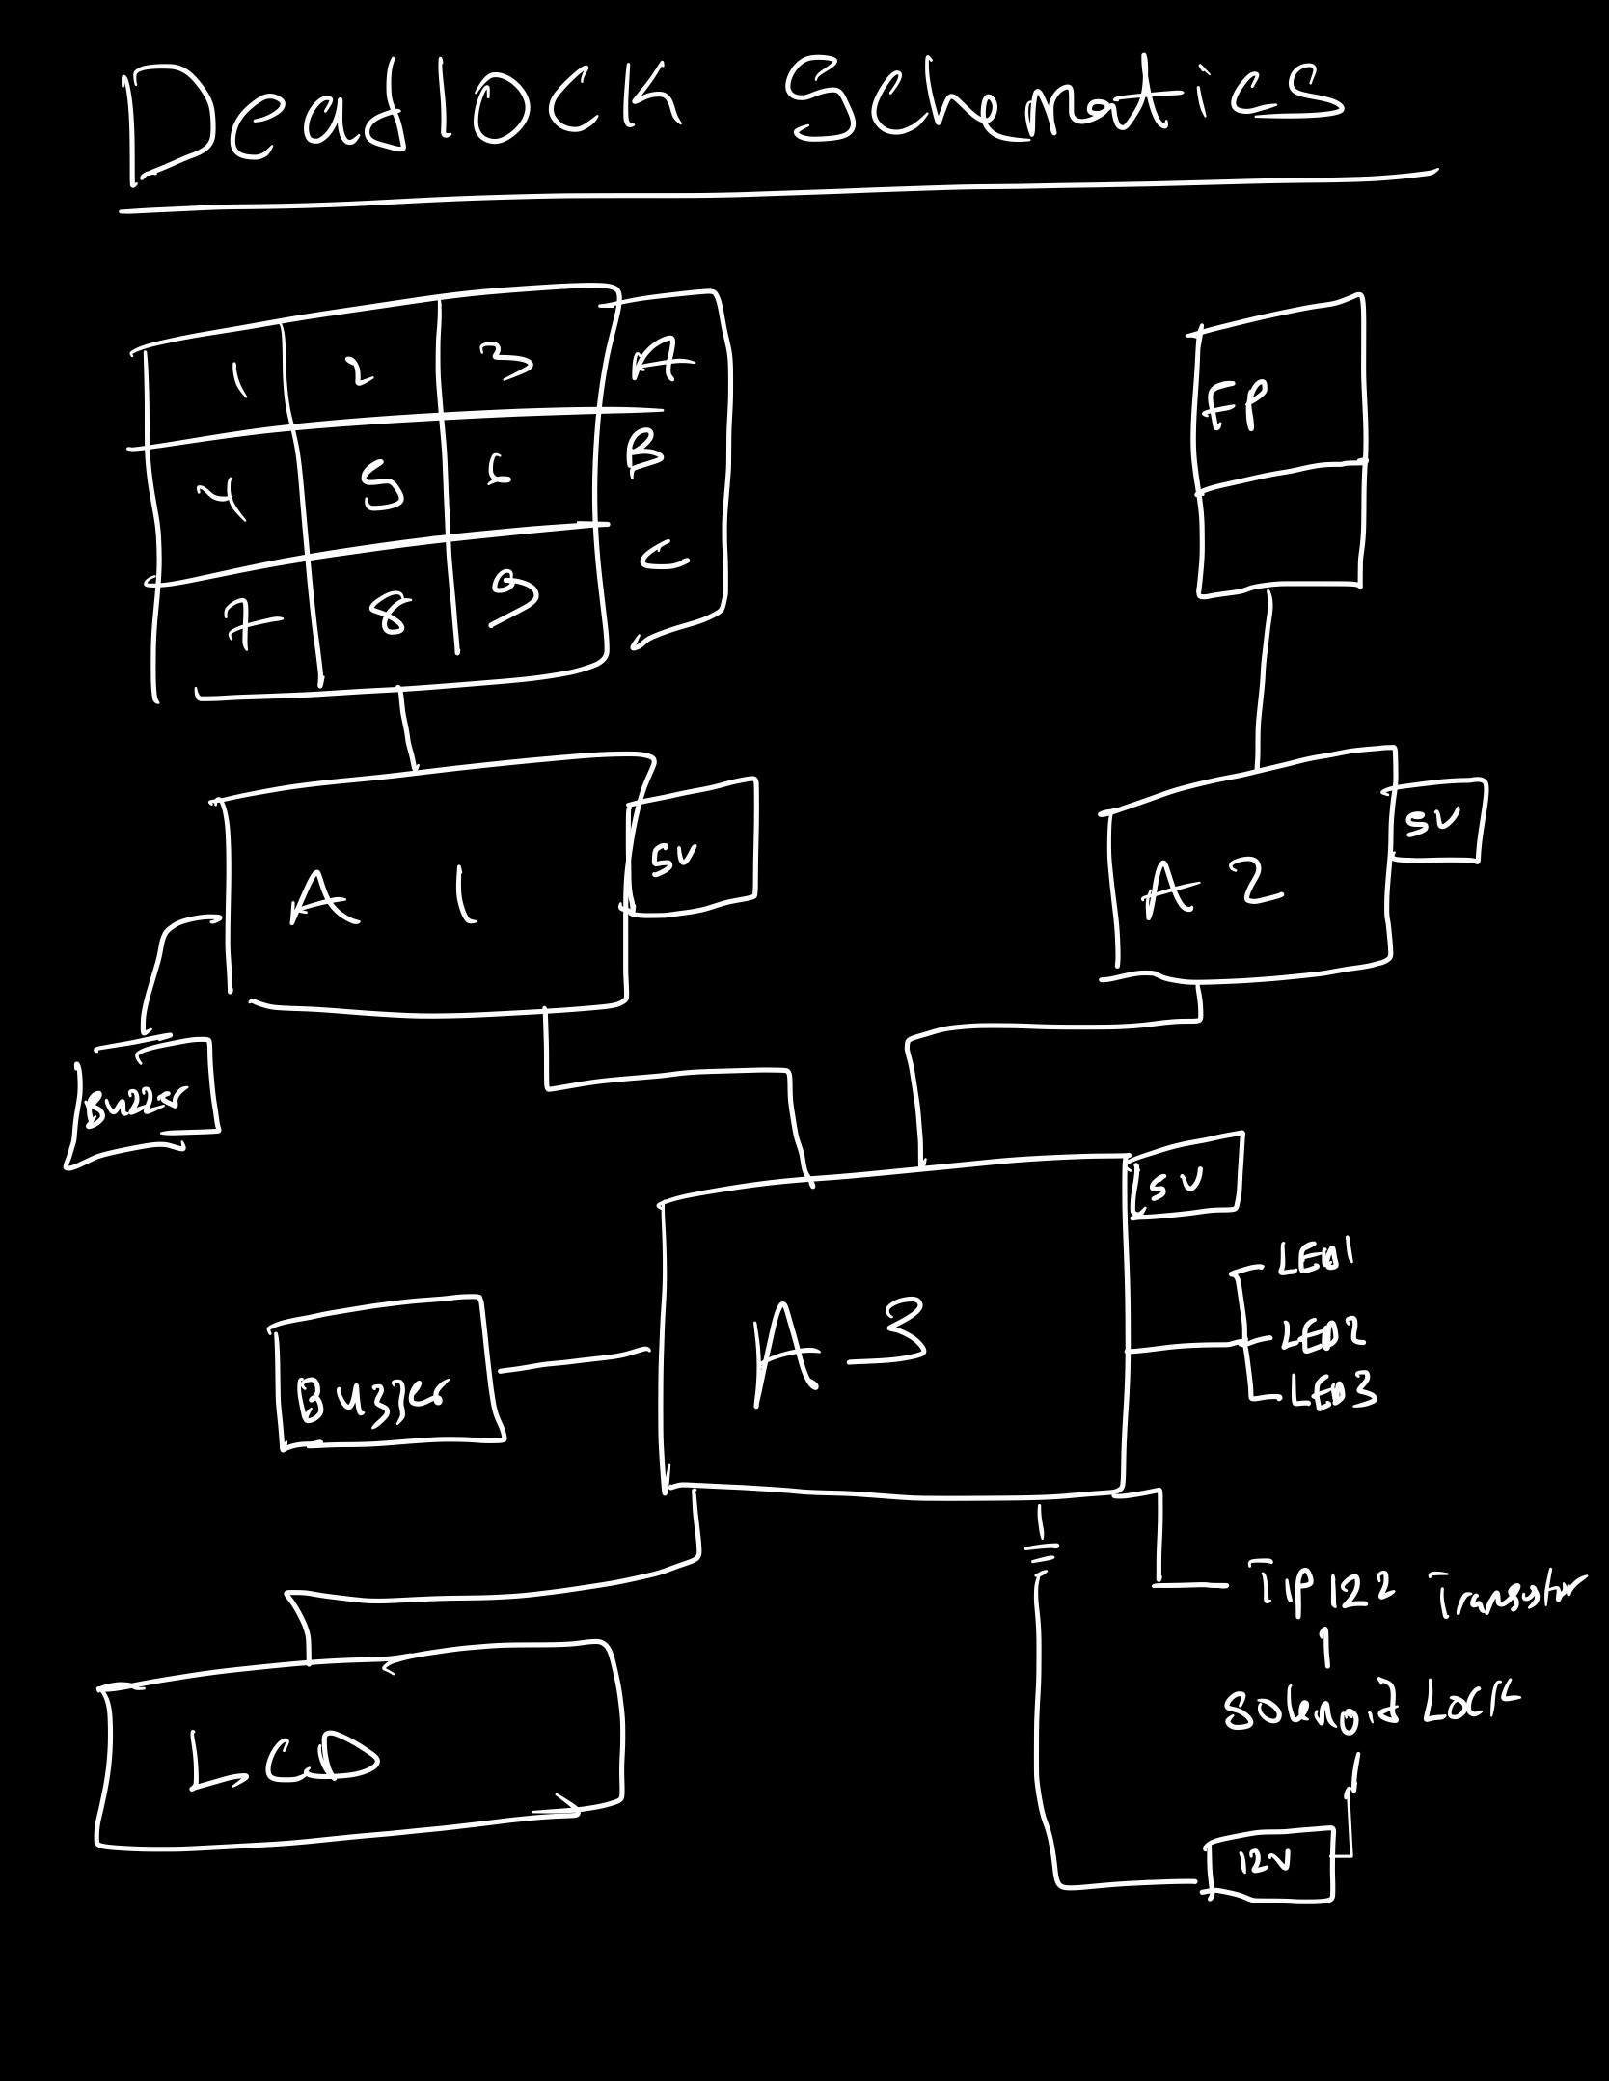
Originality and Innovations
DUAL Authentication mechanism with keypad and fingerprint Security
User Friendly interface
I2C Communication

Slide 5
What works ?
I2C COMMUNICATION
12 V POWER ADAPTER
INTERRUPTS
What doesn't work ?
SERIAL COMMUNICATION
USING TWO - 9 V BATTERIES IN SERIES
DELAY

Slide 6

Team Roles
Maryann played a crucial role in ensuring effective communication and maintaining well-organized documentation.
Victor’s s understanding of hardware systems and expertise in Arduino communication were instrumental in setting up the necessary infrastructure.
Micah's adeptness in Arduino software played a pivotal role in programming and optimizing our system, adding a layer of efficiency and functionality to our project.

Slide 7

Q&A and Acknowledgments
"Thank you for your attention. We're now ready to answer any questions you may have."

