Slide 1
Introduction to Parallel & Distributed computing
Lecure1
Muhammad Kazim

Slide 2
Computing
refers to the process of using a computer to perform tasks or solve problems. It involves taking input data, processing it using software (programs), and then producing an output, such as results or actions.
Example:
Imagine you're using a calculator app on your computer to add two numbers, 5 and 3. Here's how computing works in this case:
Input: You type in the numbers 5 and 3.
Processing: The calculator app performs the addition operation.
Output: The result, 8, is displayed on the screen.
In this simple example, the act of adding two numbers using a computer is a form of computing.

Slide 3
Serial computing
refers to a type of computing where tasks are performed one after another in a sequential manner. In serial computing, a single processor executes instructions step by step, one at a time, without overlapping or simultaneous execution.
Key Characteristics:
Sequential Execution: Each task is completed before the next one begins.
Single Processor: Only one processor (or core) is involved in the execution of tasks.

Slide 4
Serial Computing
Computer software was written conventionally for serial computing.
This meant that to solve a problem, an algorithm divides the problem into smaller instructions.
These discrete instructions are then executed on the Central Processing Unit of a computer one by one.
Only after one instruction is finished, next one starts.

Slide 5
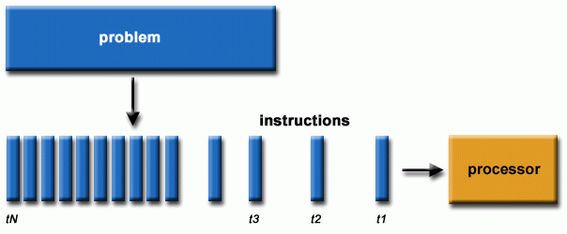
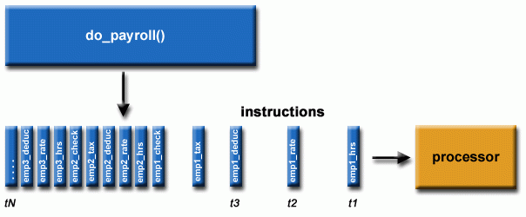
Serial computing

Slide 6
Disadvantages of serial computing
Serial computing was causing a huge problem in the computing industry as only one instruction was getting executed at any moment of time.
This was a huge waste of hardware resources as only one part of the hardware will be running for particular instruction and of time.
As problem statements were getting heavier and bulkier, so does the amount of time in execution of those statements.
Examples of serial processors are Pentium 3 and Pentium 4.

Slide 7
Problem example
A real-life example of serial computing would be people standing in a queue waiting for a movie ticket and there is only a cashier.
The cashier is giving tickets one by one to the persons.
The complexity of this situation increases when there are 2 queues and only one cashier.

Slide 8
Solution
We could definitely say that complexity will decrease when there are 2 queues and 2 cashiers giving tickets to 2 persons simultaneously. This is an example of Parallel Computing.

Slide 9
Parallel Computing
Parallel computing is a type of computing where multiple tasks are executed simultaneously, using multiple processors or cores. Instead of processing tasks one after another, as in serial computing, parallel computing divides tasks into smaller subtasks that can be processed at the same time, speeding up the overall computation.
Key Characteristics:
Simultaneous Execution: Multiple tasks or subtasks are executed at the same time.
Multiple Processors/Cores: Utilizes more than one processor or core to perform computations.
Increased Speed: Can significantly reduce the time required to complete complex tasks.

Slide 10
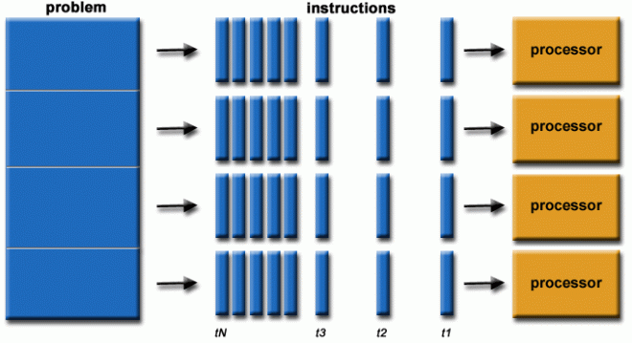
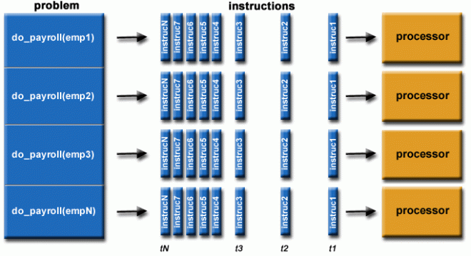

Slide 11
Parallel Computers
Virtually all stand-alone computers today are parallel from a hardware perspective:
  Multiple functional units (L1 cache, L2 cache, GPU, cores, etc.)
  Multiple execution units/cores
  Multiple hardware support

Slide 12
Parallel Computers
Multiple Functional Units (L1 cache, L2 cache, GPU, cores, etc.)
Explanation: These are different parts of a computer's hardware that perform specific tasks to make the computer work faster and more efficiently.
Example: Think of a computer like a kitchen. The L1 cache and L2 cache are like small, nearby shelves where you keep frequently used ingredients for quick access. The cores are like chefs, and the GPU is a special chef focused on graphics and visual tasks. Each unit works together to cook your meal (process data) faster.

Slide 13
Parallel Computers
Multiple Execution Units/Cores
Explanation: These are the parts of a computer's processor that can perform tasks. Having multiple cores means the computer can work on several tasks at the same time.
Example: Imagine you have a group of chefs in the kitchen, each responsible for a different dish. While one chef makes the salad, another cooks the pasta, and another bakes the cake. This way, you can prepare the entire meal faster, as multiple tasks are being done at the same time.

Slide 14
Parallel Computer
Multiple Hardware Support
Explanation: This refers to the computer's ability to use different types of hardware components (like different types of processors, memory, etc.) to improve performance.
Example: Think of a kitchen that is equipped with a variety of tools—like blenders, ovens, and microwaves. Depending on what you're cooking, you can use the most suitable tool to get the job done efficiently. Similarly, a computer uses different hardware components to handle different types of tasks more effectively.

Slide 15
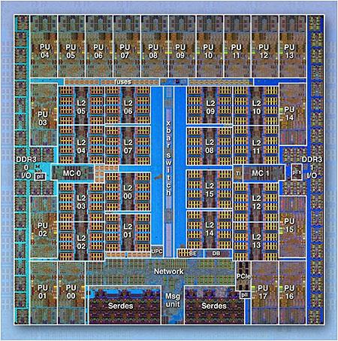
IBM BG/Q Compute Chip with 18 cores (PU) and 16 L2 Cache units (L2)

Slide 16
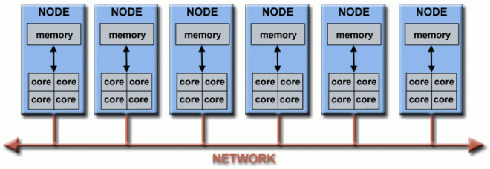
Parallel computer clusters.
Networks connect multiple stand-alone computers (nodes) to make larger parallel computer clusters.

Slide 17
Why Use Parallel Computing?
1.Faster Processing
Explanation: By dividing a large task into smaller parts and processing them simultaneously, parallel computing significantly reduces the time required to complete the task.
Example: If you need to process a massive amount of data, using multiple processors at the same time can get the job done much quicker than if you used just one.
2. Handling Large and Complex Problems
Explanation: Some problems are too large or complex to be solved by a single processor within a reasonable time frame. Parallel computing allows these problems to be broken down into manageable pieces.
Example: Simulating weather patterns involves processing huge amounts of data. Parallel computing allows this data to be processed efficiently, making accurate weather predictions possible.

Slide 18
Why Use Parallel Computing?
3. Improved Efficiency
Explanation: By using all available resources (multiple cores, processors, etc.) more efficiently, parallel computing makes better use of the computer’s capabilities.
Example: When editing a video, different parts of the process (like rendering effects, adjusting colors, and compressing files) can be done in parallel, leading to faster video production.
5. Real-Time Applications
Explanation: For applications that require real-time processing, like video games or financial trading systems, parallel computing ensures that tasks are processed quickly enough to meet time-sensitive demands.
Example: In a video game, parallel computing allows the game to render graphics, process player inputs, and run the game’s logic simultaneously, providing a smooth gaming experience.

Slide 19
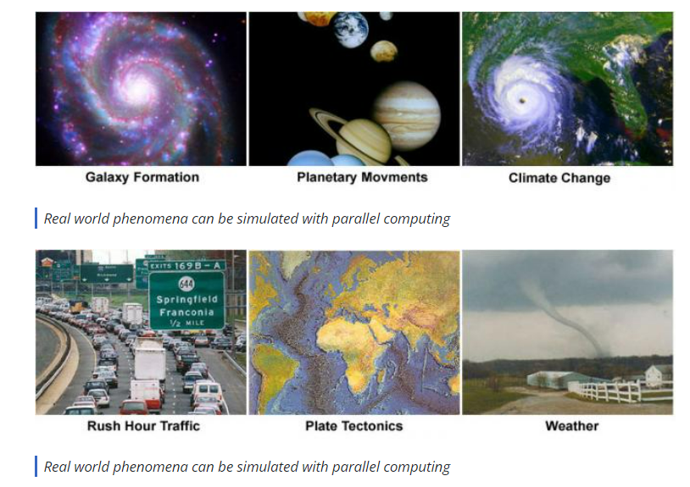

Slide 20

SAVE TIME AND/OR MONEY
Throwing more resources at a task will shorten its time to completion, with potential cost savings.

Slide 21
BETTER USE OF UNDERLYING PARALLEL HARDWARE
Modern computers, even laptops, are parallel in architecture with multiple processors/cores.
Parallel software is specifically intended for parallel hardware with multiple cores, threads, etc.

Slide 22
Who Is Using Parallel Computing?
Science and Engineering
Historically, parallel computing has been considered to be "the high end of computing," and has been used to model difficult problems in many areas of science and engineering:
Atmosphere, Earth, Environment
Physics - Bioscience, Biotechnology, Genetics
Chemistry, Molecular Sciences
Geology
Mechanical Engineering –
Electrical Engineering, Circuit Design, Microelectronics
Computer Science, Mathematics
Defence, Weapons

Slide 23
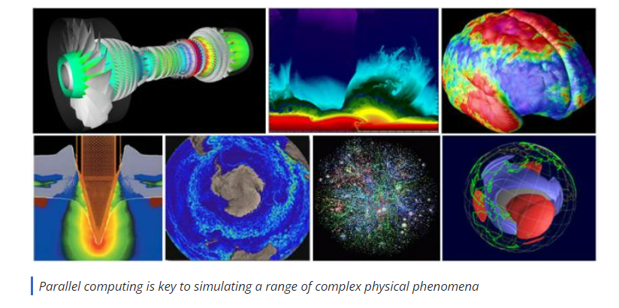
Uses

Slide 24
Industrial and Commercial
Big Data," databases, data mining
Artificial Intelligence (AI)
Web search engines, web based business services
Medical imaging and diagnosis
Pharmaceutical design
Financial and economic modeling
Management of national and multi-national corporations
Advanced graphics and virtual reality, particularly in the entertainment industry
Networked video and multi-media technologies

Slide 25
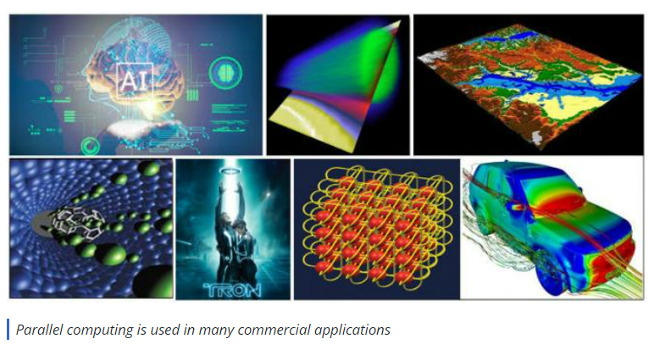
uses

Slide 26
Types of parallel computing(Next Topic)
Bit-level parallelism:
Instruction-level parallelism:
Task Parallelism:

