Slide 1
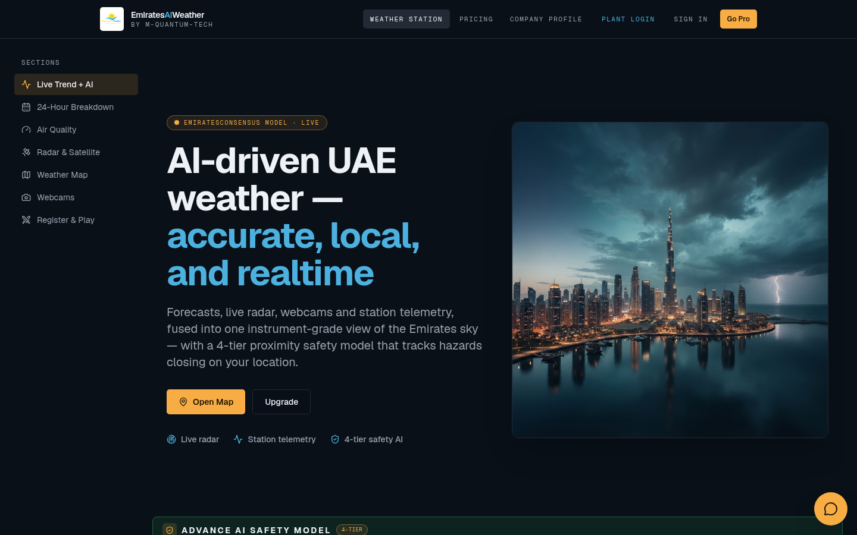
PROJECT OVERVIEW · OCTOBER 2026
EmiratesAIWeather
AI-driven UAE weather station and plant safety console
How the website works, why each function was designed the way it is, and the full date-wise update history.
Prepared by M-Quantum-Tech

Slide 2
CONTENTS
What this deck covers
Website & users
What the site is, who uses it and how it is organised
Weather monitor logic
4-tier proximity model, Wind Event Monitor, auto buzzer with deadband
Data sources
Ghaith mirror as primary source, NCM COSMO / AWS fallback
Engineering console
Escalation rules, buzzer bench, sources, warnings, simulator
Plant IAM
Roles, dashboard, deep trends, CSV export, Push-to-mirror permission
Timeline
Date-wise list of every update and the reason for it
EMIRATESAIWEATHER · M-QUANTUM-TECH
02

Slide 3
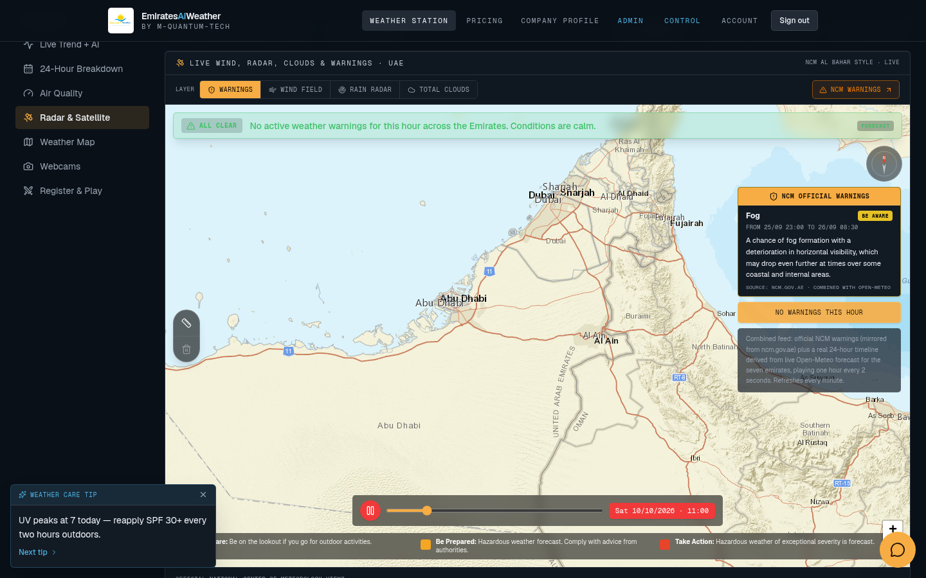
01 · THE WEBSITE
One instrument-grade view of the UAE sky
WHAT IT DOES
• Combines forecasts, live radar, satellite clouds, webcams and station telemetry on one page.
• Live trend charts with AI projection: temperature, wind, rain, humidity, cloud and solar DNI.
• Refreshes every minute and shows the NCM clock so operators know how old the data is.
WHY
• Plant operators used to check several NCM pages separately. One page cuts reaction time.
• Solar DNI and cloud cover feed plant output planning, so they get first-class charts.
EMIRATESAIWEATHER · M-QUANTUM-TECH
03

Slide 4
02 · ARCHITECTURE
How data flows through the system
Ghaith (NCM)
values pushed by allowed users or relay
Weather station page
safety tier · radar · monitor
Next.js server + Neon DB
source priority · freshness window · escalation rules · simulator state · IAM
NCM COSMO / AWS
model grid · fallback
Auto buzzer
tier ranges + deadband
Open-Meteo · NCM warnings
forecast · official alerts
Engineering console · Plant IAM
rules, sources, users
Why: everything reads from one server-side decision layer, so the banner, the Wind Event Monitor and the buzzer always agree on the same tier.
EMIRATESAIWEATHER · M-QUANTUM-TECH
04

Slide 5
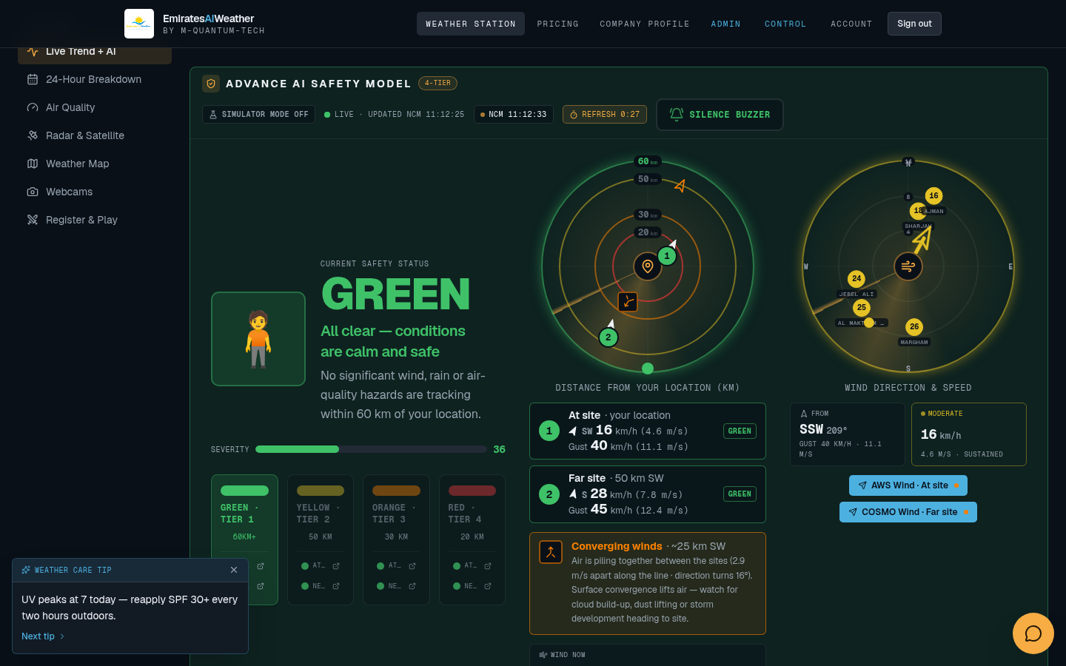
03 · WEATHER MONITOR LOGIC
Advance AI Safety Model (4-tier)
HOW IT WORKS
• Every hazard (convection, gust front, rain cell) is measured by distance from the plant.
• Two sites are tracked: At site (AWS Wind) and Far site 50 km (COSMO Wind).
• The closest and strongest hazard sets the tier: Green, Yellow, Orange or Red.
• Radar rings show distance; the wind rose shows direction and speed.
WHY
• Distance gives operators lead time. A storm 60 km away needs a different action than one at 20 km.
• The far site gives an early warning before wind reaches the plant.
EMIRATESAIWEATHER · M-QUANTUM-TECH
05

Slide 6
03 · WEATHER MONITOR LOGIC
Escalation ladder: what each tier means
GREEN
L1 · Normal
TRIGGER
Convection 60 km+, gust under 10 m/s, no NCM warnings near site.
ACTION
Continue normal operation.
YELLOW
L2 · Watch
TRIGGER
Wind or gust at 13 m/s, or convection approaching, or NCM Yellow warning.
ACTION
Prepare crews, check secured equipment.
ORANGE
L3 · Alert
TRIGGER
Wind 14 m/s, gust 14.5 m/s, satellite convection under 20 km, or rain 3 mm.
ACTION
Buzzer sounds. Stop exposed work.
RED
L4 · Severe
TRIGGER
Wind 14.5 m/s, gust 15 m/s, or Red warning / storm on site.
ACTION
Buzzer sounds. Emergency procedure.
All thresholds are editable in the Engineering console. Values shown are the current defaults.
EMIRATESAIWEATHER · M-QUANTUM-TECH
06

Slide 7
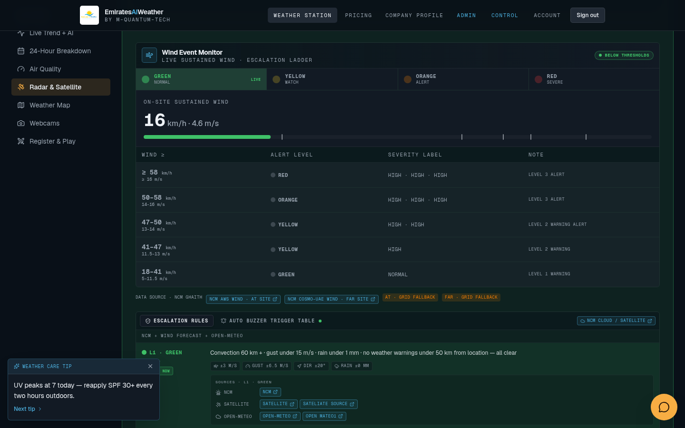
03 · WEATHER MONITOR LOGIC
Wind Event Monitor
HOW IT WORKS
• Shows on-site sustained wind in km/h and m/s against the escalation ladder.
• Default bands: 8 m/s Green, 11.5 and 13 m/s Yellow, 14 m/s Orange, 16 m/s Red.
• Data-source chips show which feed is live (Ghaith mirror or model fallback) and its age.
• Live alarm Test and Reset sit inside this panel.
WHY
• Wind is the main hazard for solar plant equipment, so it gets its own dedicated panel.
• Showing the source and age stops operators trusting stale numbers.
EMIRATESAIWEATHER · M-QUANTUM-TECH
07

Slide 8
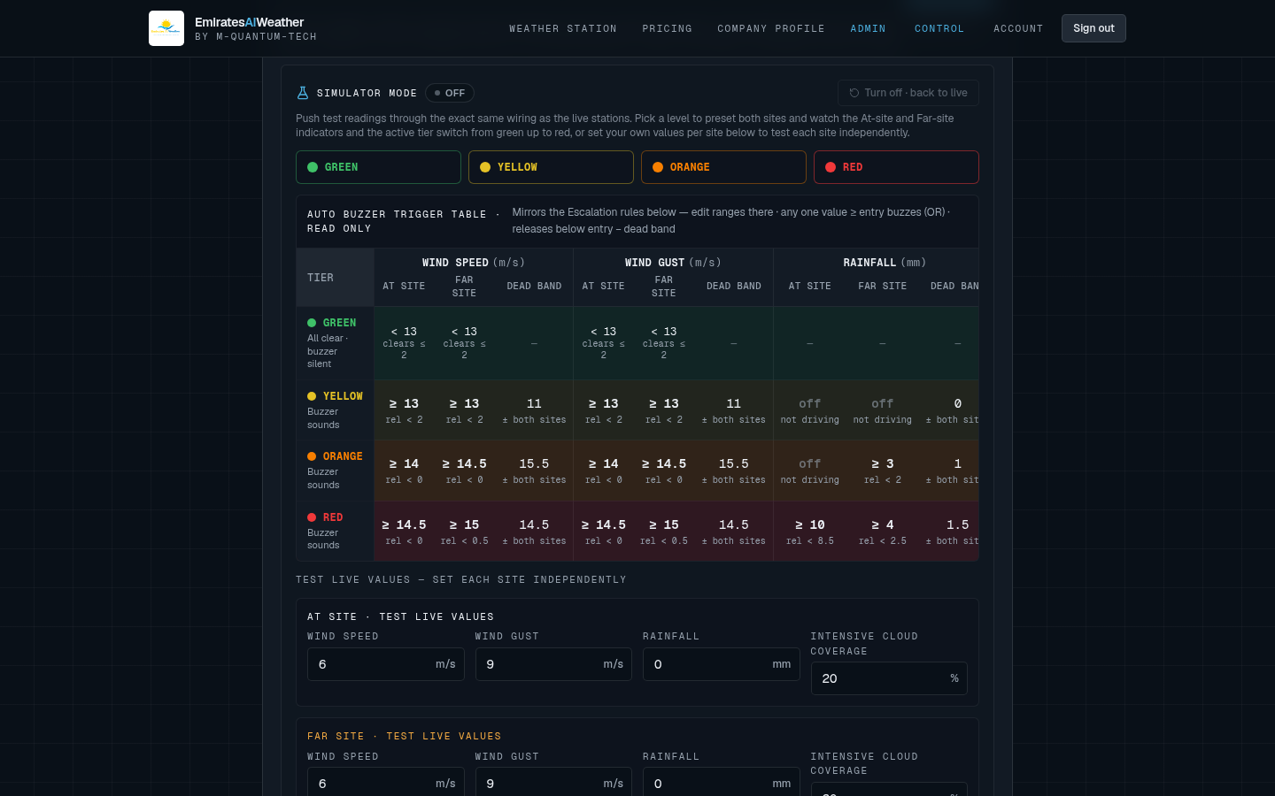
03 · WEATHER MONITOR LOGIC
Auto buzzer: tier ranges with deadband
HOW IT WORKS
• Each tier has an entry value for wind, gust, rainfall and intensive cloud cover, at site and far site.
• The buzzer latches when any value enters Orange or Red.
• It only releases when the value falls below entry minus the deadband (for example 14 m/s on, 13 m/s off).
• Simulator mode pushes test values through the same logic and is shared via the database.
WHY
• Without a deadband, wind hovering at 14 m/s would switch the buzzer on and off every minute.
• A shared simulator lets one engineer test while the whole control room sees the same result.
EMIRATESAIWEATHER · M-QUANTUM-TECH
08

Slide 9
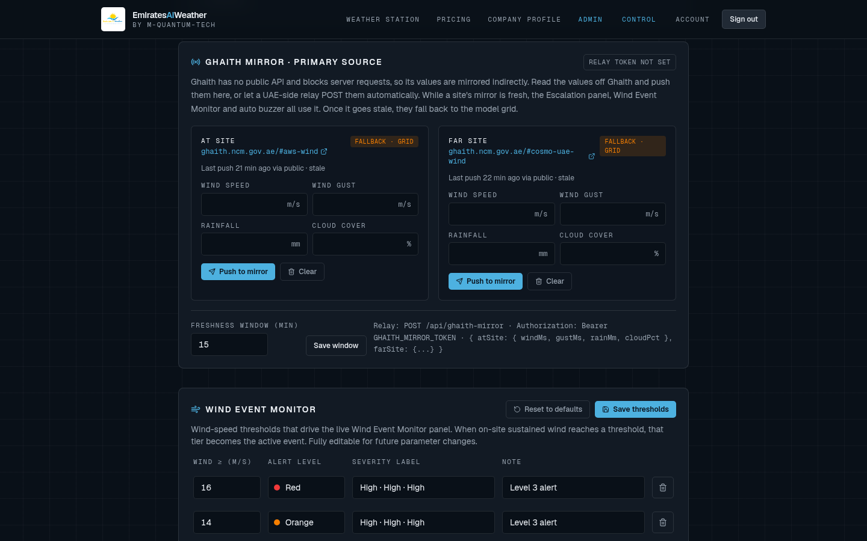
04 · DATA SOURCES
Ghaith mirror: primary source with safe fallback
HOW IT WORKS
• Ghaith has no public API and blocks server requests, so its values are mirrored.
• Allowed users press Push to mirror, or a UAE-side relay POSTs with a secret token.
• While a mirror is fresh (default 15 min), the banner, monitor and buzzer use it.
• When it goes stale, the system falls back to the NCM COSMO / AWS model grid.
WHY
• Ghaith is the closest to real station values, so it is preferred when available.
• The freshness window guarantees the buzzer never acts on old manual readings.
EMIRATESAIWEATHER · M-QUANTUM-TECH
09

Slide 10
04 · DATA SOURCES
Live wind, radar, clouds and warnings map
HOW IT WORKS
• Tabs for warnings, wind field, rain radar and total clouds over the UAE.
• NCM official warnings shown as cards with level, time window and affected areas.
• Timeline scrubber plays the forecast forward hour by hour.
WHY
• Seeing where a storm is and where it is moving explains why the tier changed.
• English, colored basemap so non-Arabic staff read the map easily.
EMIRATESAIWEATHER · M-QUANTUM-TECH
10

Slide 11
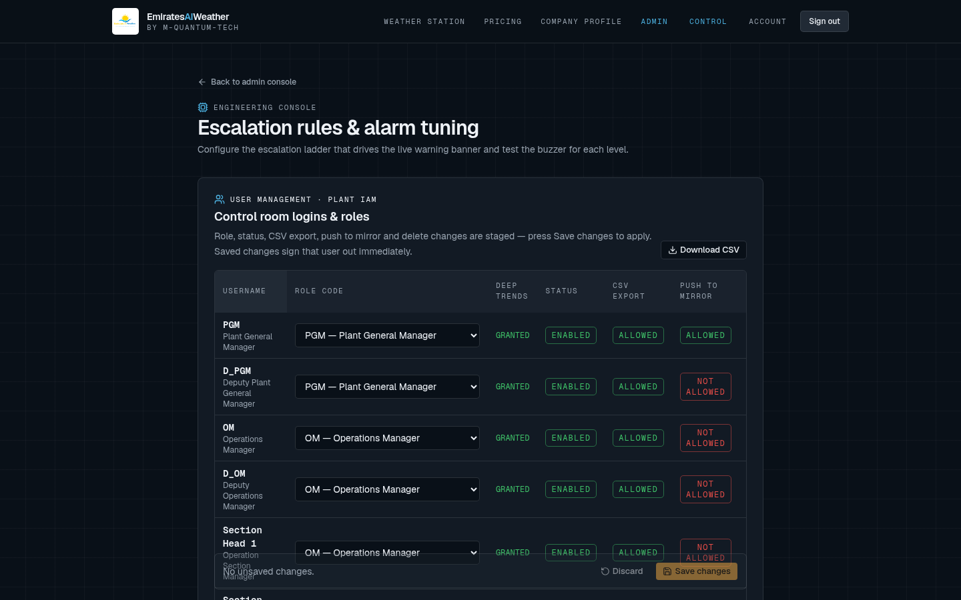
05 · ENGINEERING CONSOLE
One place to tune the whole alarm system
WHAT IS INSIDE
• Plant IAM user management (roles, CSV export, Push to mirror).
• Buzzer test bench, Ghaith mirror, Wind Event Monitor thresholds.
• Wind, cloud and Live Trend data source links.
• NCM official warnings editor and escalation rules with simulator.
WHY
• Thresholds change with season and equipment. Engineers adjust them without a code release.
• Admin-only access, so operators cannot change rules by accident.
EMIRATESAIWEATHER · M-QUANTUM-TECH
11

Slide 12
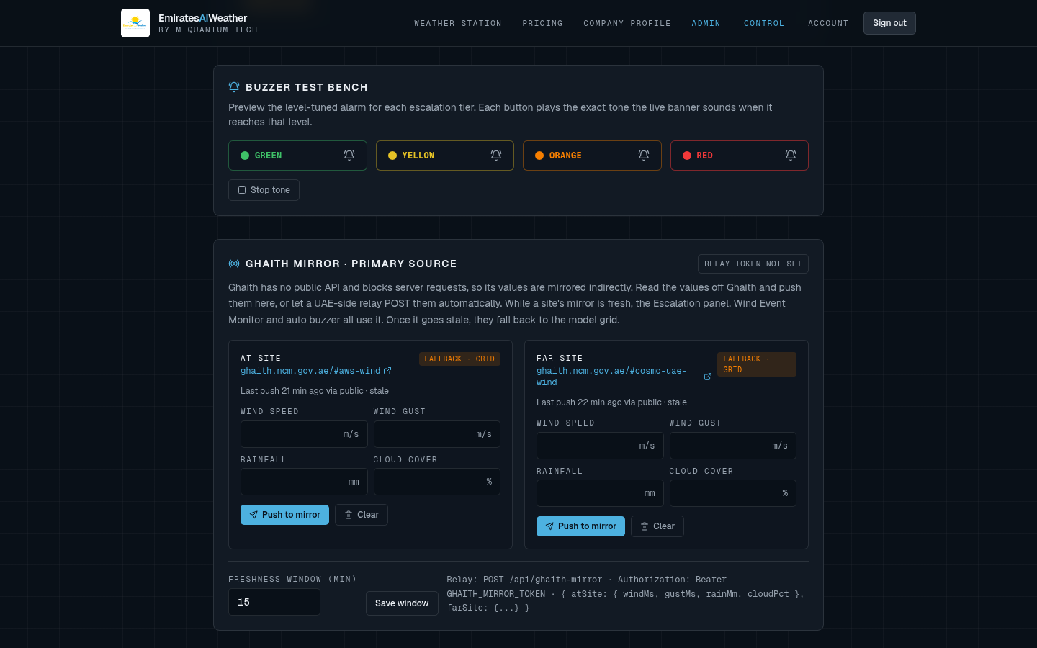
05 · ENGINEERING CONSOLE
Buzzer test bench and Ghaith mirror
HOW IT WORKS
• Each tier button plays the exact tone the live banner uses at that level.
• Stop tone ends the test immediately.
• Mirror cards show At site / Far site status, last push time and fallback state.
WHY
• Control room can confirm speakers work for every tone before a real event.
• Clear Fallback and Stale labels show when Ghaith values are no longer used.
EMIRATESAIWEATHER · M-QUANTUM-TECH
12

Slide 13
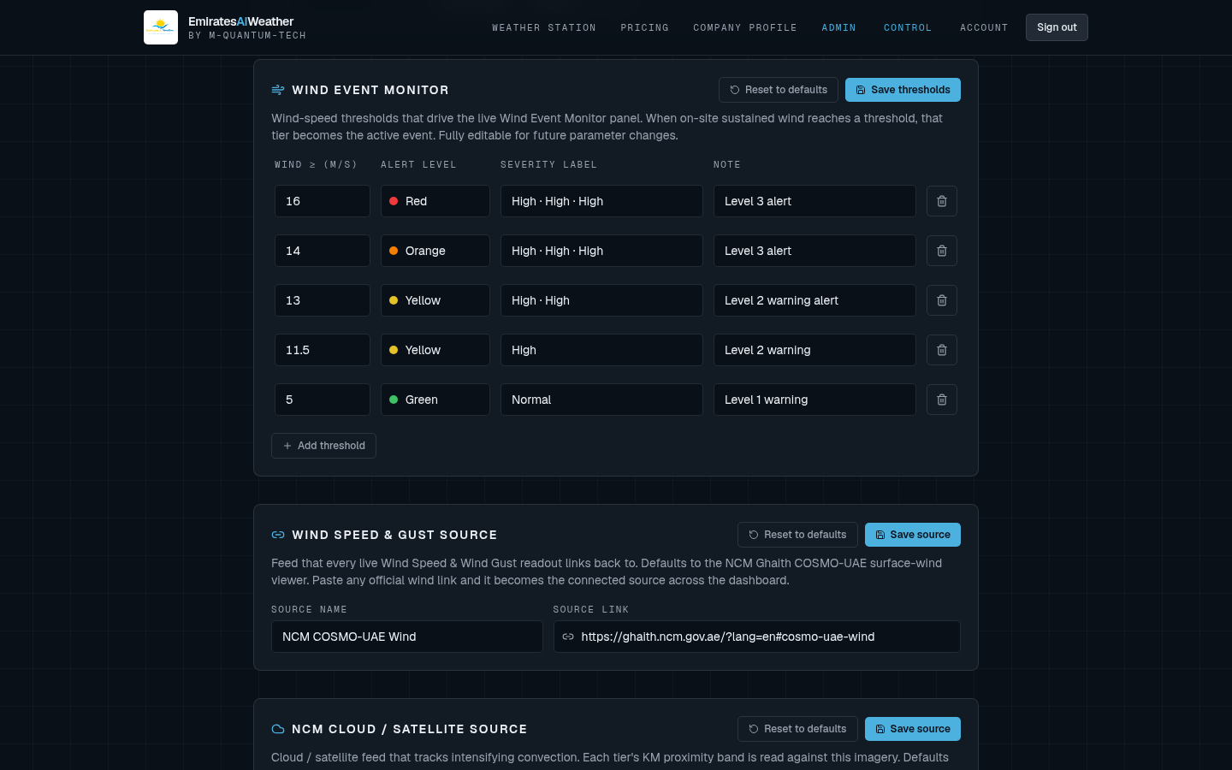
05 · ENGINEERING CONSOLE
Wind thresholds and data source links
HOW IT WORKS
• Wind Event Monitor table: wind value, alert level, severity label and note per row.
• Rows can be added or removed; Reset to defaults restores the standard ladder.
• Every source has a name and link, shown as a clickable chip on the dashboard.
WHY
• Operators can always open the original NCM page to verify a reading.
• Editable sources mean a changed NCM URL is fixed in seconds.
EMIRATESAIWEATHER · M-QUANTUM-TECH
13

Slide 14
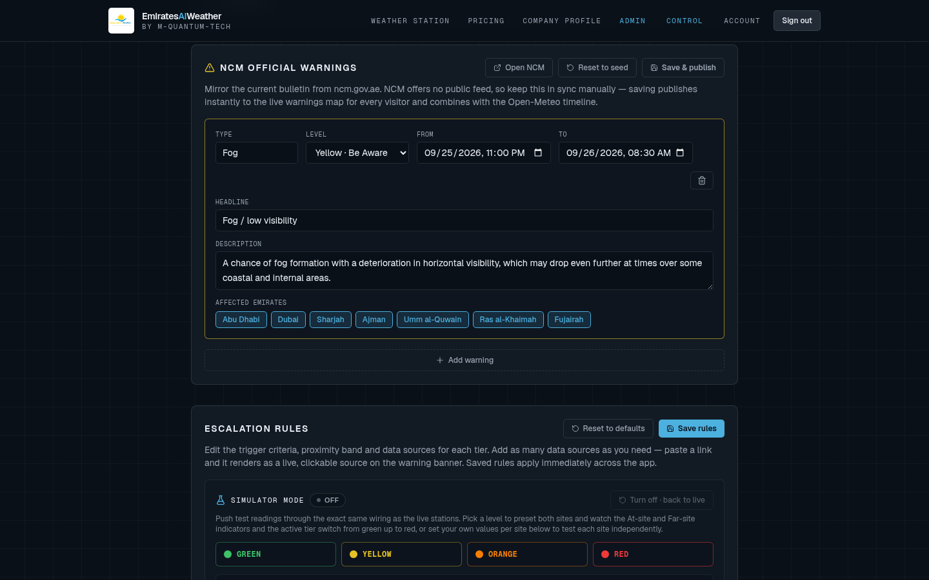
05 · ENGINEERING CONSOLE
NCM warnings and Live Trend sources
HOW IT WORKS
• Admins mirror the current NCM warning: type, level, time window, headline, areas.
• Saving publishes it to the station map instantly.
• Live Trend + AI projection sources are assigned per chart panel.
WHY
• NCM has no warnings API, so a fast manual mirror keeps the map in step with official alerts.
• Per-panel sources make it clear where each trend line comes from.
EMIRATESAIWEATHER · M-QUANTUM-TECH
14

Slide 15
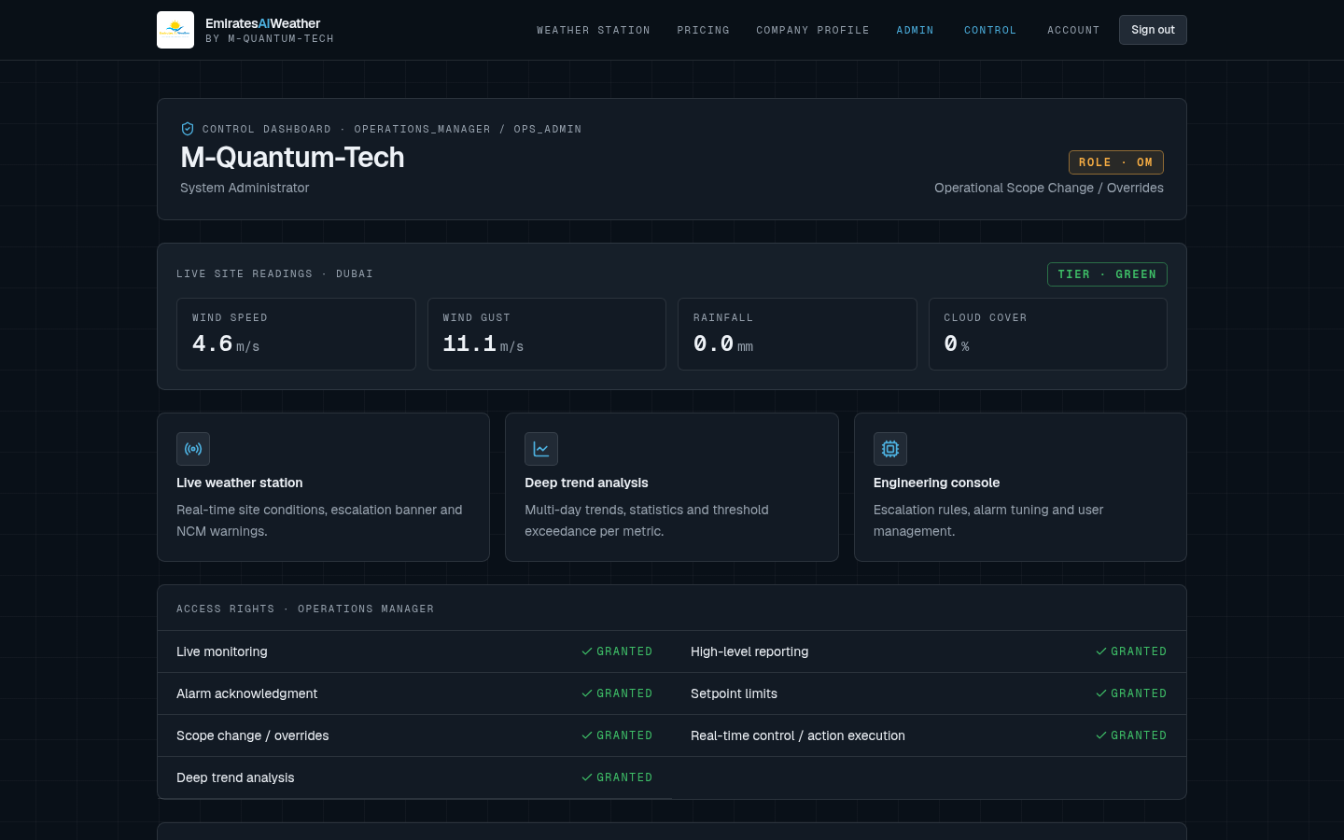
06 · PLANT IAM
Role-based control dashboard
HOW IT WORKS
• Each user signs in and lands on a dashboard for their role (PGM, OM, Section Head, Supervisor, CRO).
• Shows live site readings and the current tier.
• Access rights list exactly what the role is granted.
WHY
• Each person sees only the tools relevant to their job.
• Granted rights are visible, so nobody has to guess their permissions.
EMIRATESAIWEATHER · M-QUANTUM-TECH
15

Slide 16
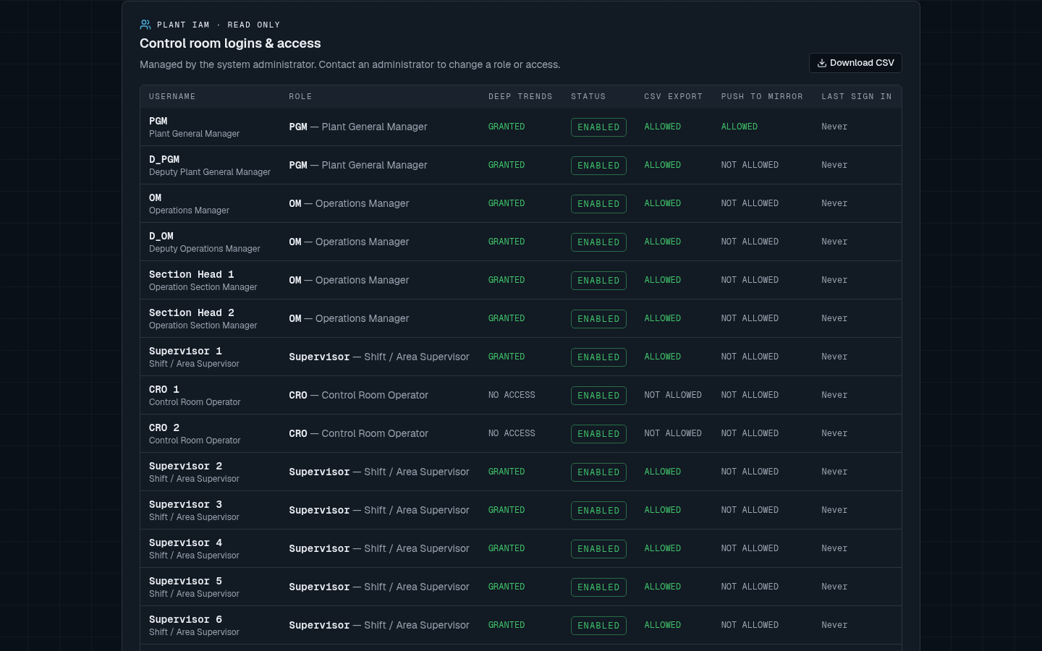
06 · PLANT IAM
Roster, CSV export and Push to mirror
HOW IT WORKS
• Admin sets role, status, deep-trend access, CSV export and Push to mirror for each user.
• Push to mirror defaults to Not allowed. Admin switches it to Allowed per user.
• Changes are staged, then saved together. The affected user is signed out so new rights apply at once.
• The server checks the permission on every push. Guests get 401, users who are not allowed get 403.
WHY
• Mirror values drive the buzzer, so only trusted people may enter them.
• One switch in Plant IAM is simpler to manage than separate tokens.
EMIRATESAIWEATHER · M-QUANTUM-TECH
16

Slide 17
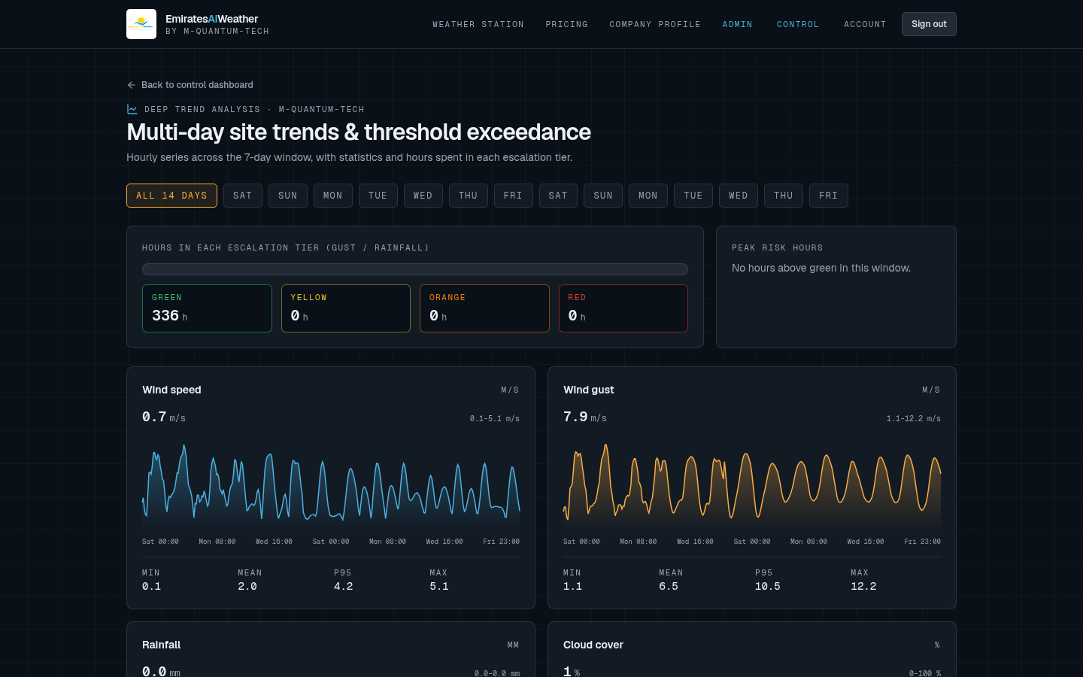
06 · PLANT IAM
Deep trend analysis
HOW IT WORKS
• Hourly series across 7-14 days for wind, gust, rain, cloud, temperature and humidity.
• Min, mean, P95 and max per chart, plus hours spent in each escalation tier.
• CSV export for users who are allowed.
WHY
• Engineers can check if thresholds are too sensitive by counting hours in each tier.
• Exported data supports incident reports and monthly reviews.
EMIRATESAIWEATHER · M-QUANTUM-TECH
17

Slide 18
07 · SECURITY
Why the system is safe to rely on
Sign-in required
Better Auth with hashed passwords and server sessions. No client-only auth.
Server-side checks
Every admin action and every mirror push is checked on the server, not just hidden in the UI.
Least privilege
New permissions like Push to mirror default to Not allowed.
Freshness window
Stale data is never used for the buzzer. The system falls back automatically.
Relay token
The UAE relay uses a secret bearer token kept in project variables.
Audit-friendly
Each push records who sent it and when, shown on the mirror cards.
EMIRATESAIWEATHER · M-QUANTUM-TECH
18

Slide 19
08 · TIMELINE
Update history (1/2)
DATE
UPDATE
WHAT CHANGED
REASON
26 Aug 2026
Project launch
Initial site, live wind layer and UAE warnings layer.
Base map for live UAE weather.
27-29 Aug
Hero + map tools
Marketing hero, live alert, larger measure map, NCM sources.
Clear first impression and accurate measuring.
22 Sep
4-tier safety model
Green/Yellow/Orange/Red labels, 3-min refresh, DNI solar forecast, admin portal, pricing.
Match plant alarm colors; solar planning.
23 Sep
Escalation rules
Admin console, escalation + prediction tables, L3 Orange convection under 20 km, 1-min refresh.
Rules must be visible and match site procedure.
24 Sep
Engineering console
Editable rules, per-level buzzer tests, Total Clouds tab, AWS wind/DNI overlay.
Tune alarms without code changes.
25 Sep
Live Trend sources
Slimmer charts, per-panel sources, stable auth secret, air quality detail.
Traceable data; no sign-in failures.
26 Sep
Live Trend redesign
Layered DNI chart, temperature columns, cloud/wind/rain bars, 24 hour labels.
Readable at a glance on control room screens.
EMIRATESAIWEATHER · M-QUANTUM-TECH
19

Slide 20
08 · TIMELINE
Update history (2/2)
DATE
UPDATE
WHAT CHANGED
REASON
27-28 Sep
Plant IAM
Role dashboards, deep trends, user management.
Right tools for each role.
9 Oct
Auto buzzer
Buzzer from tier ranges with deadband, cloud trigger, Green tier, trend CSV export.
Stop alarm chattering; full trigger control.
9 Oct
Ghaith mirror
Ghaith AWS / COSMO feeds, mirror as primary source, alarm details, live site markers.
Use closest-to-real station values.
10 Oct
Live buzzer inputs
Gust, rain, cloud, far site and NCM warnings feed the buzzer; Red at 14 m/s.
Every hazard can raise the alarm.
10 Oct
Station controls
Alarm Test/Reset in Wind Event Monitor, trigger table on station, shared simulator.
Test from where operators work.
10 Oct
Push to mirror + IAM
Push to mirror on station, sign-in required, per-user permission in Plant IAM.
Live data, controlled by admin.
EMIRATESAIWEATHER · M-QUANTUM-TECH
20

Slide 21
SUMMARY
One trusted tier for the whole plant
Live sources with automatic fallback, a 4-tier distance-based safety model, a buzzer that does not chatter, and Plant IAM control over who can change what.
EmiratesAIWeather · M-Quantum-Tech
EMIRATESAIWEATHER · M-QUANTUM-TECH
21

