Slide 1
The Magnitude of Truth: On Using Magnitude Estimation for Truthfulness Assessment
Marcell Nemeth, Maarten Verhoeff | 07-04-2026

Slide 2
Introduction
Labeling
Used in many data-driven systems
IR: model training & evaluation
Label quality -> system performance
Truthfulness assessment
Labeling claims
Not binary

Slide 3
Problem statement
Existing scales
Coarse (2-3 levels)
Fine (many levels)
Issue
Fixed categories
Note defined distances
Result
Different interpretations
Incosistent labels

Slide 4
Magnitude Estimation
Magnitude Estimation (ME)
Any positive number
Continuous scale (0, ∞)
No fixed categories
Key idea
Captures size of differences
Example
1 vs 0.5 -> 2x
10 -> 10x
Processing
Normalize -> Aggregate

Slide 5
Methodology
Data
120 Political claims
Task
Search for supporting evidence
Assign ME score
Evaluation
Expert labels
6-level scale

Slide 6
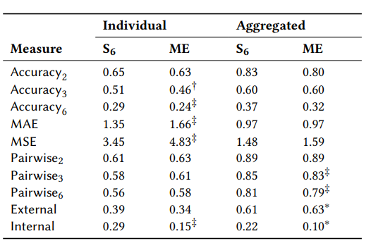
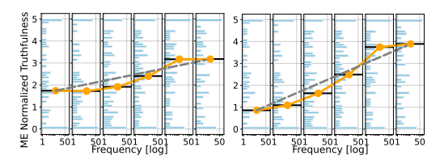
Results
ME is close to expert ground truth (A: 0.80), performance wise on same level as S6 (A:0.83)
The optimal aggregation method is weighted mean, outperforming geometric and arithmetic mean
S6 outperforms ME on accuracy and error, however no significant diff. on aggregate
Perceived clusters around PoF,False, Mostly False and Half True and Mostly True/True (GT3)
Sigmoid gain curve suggests a semi-binary perception, rather than equal S6

Slide 7
Implications
There is no accuracy trade-off for adapting ME instead of ordinal scales
Sigmoid (semi-binary) gain curve suggests S6 does not have equal categories
ME and S6 are complementary (pair wise: 0.75) -> Combining the two could yield better measurement
Treating “Half True” statements as unique category aligns closer to human perception

Slide 8
Critical Review
Strengths:
Robust replication of La Barbera et al.
9 effectiveness metrics, with 4 methods analysed
Gain curve translates perception of truth into analysable results
Easliy reproducible results by data and clean explanation of methods
Weaknesses:
Politically skewed sample (48.5% Democrat and 34% Liberal evaluators)
Min-max normalization causes a loss in ME properties (but needed for comparison)
Scope of evaluated data is narrow (120 US political claims)

Slide 9
Questions

