Slide 1
TASK 4
Data Storytelling & Statistical Validation
ApexPlanet Data Analytics Internship | Sales Performance Analysis

Slide 2
1. Business Objective
Synthesize the previous analysis into a concise business story.
Validate a key business question using a statistical hypothesis test.
Translate the findings into decisions and a clear call to action.
Use the Power BI dashboard as the interactive evidence layer.

Slide 3
2. Data Story — What Is Driving Sales?
Overall sales reached approximately ₹13.94 Cr across 1,000 transactions.
Electronics is the leading category at approximately ₹5.08 Cr.
Laptop is the highest-revenue product at approximately ₹2.54 Cr.
Patna is the highest-performing city at approximately ₹2.08 Cr.
The 35-44 age group contributes the highest sales.
Customer retention is an opportunity because only a small share of customers are repeat purchasers.

Slide 4
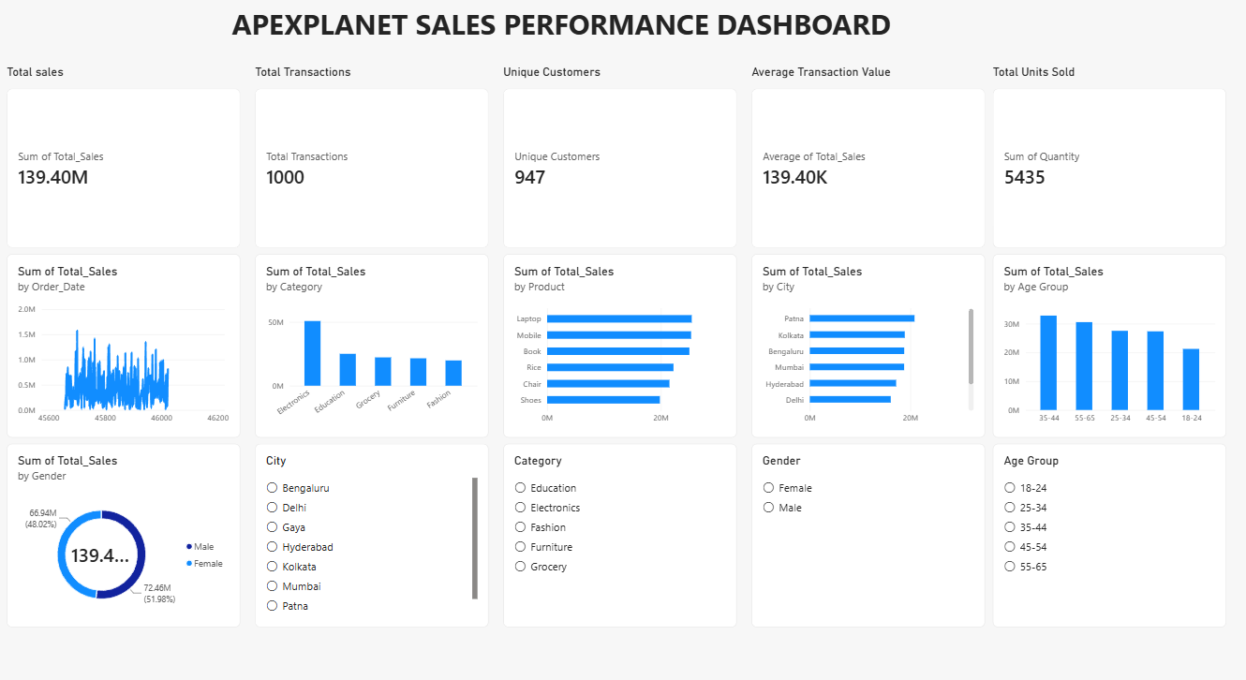
3. Interactive Dashboard
Power BI dashboard with KPI cards, trend analysis, category/product/city views and interactive slicers.

Slide 5
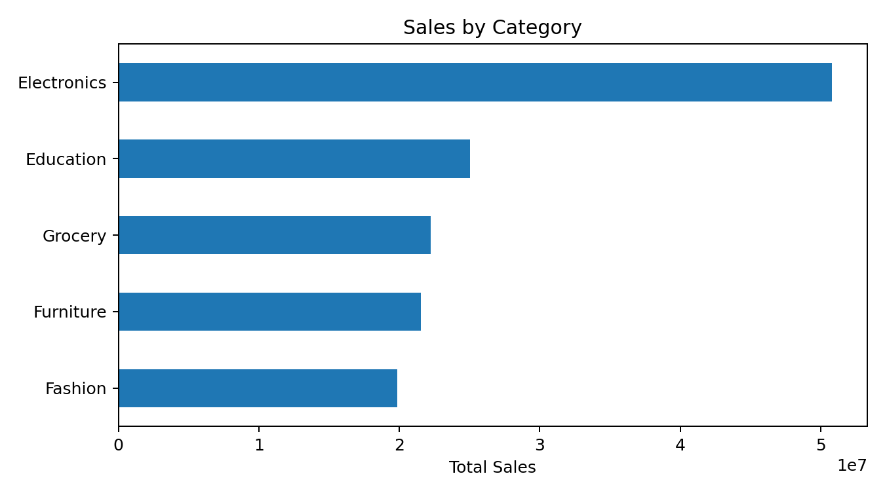
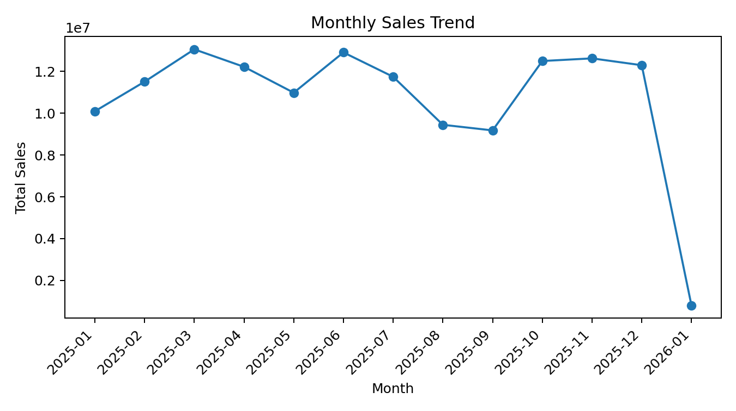
4. Visual Evidence
Peak month: 2025-03 with approximately ₹1.31 Cr in sales.

Slide 6
5. Hypothesis Testing
Business question: Do male and female customers have different average transaction sales?
H₀ (null): Mean transaction sales are equal for male and female customers.
H₁ (alternative): Mean transaction sales are different.
Test: Independent two-sample Welch t-test, two-sided, α = 0.05.

Slide 7
6. Statistical Results
Male transactions: n = 511; mean = ₹141,807.34.
Female transactions: n = 489; mean = ₹136,883.21.
Welch t-statistic = 0.683; degrees of freedom ≈ 998.0.
p-value = 0.495.
95% CI for the mean difference (Male − Female): ₹-9,231.58 to ₹19,079.85.
Decision: Fail to reject H₀ at the 5% significance level.
Conclusion: The observed difference is not statistically significant; gender alone should not be treated as a strong driver of average transaction value.

Slide 8
7. Business Implications & Call to Action
Do not make major pricing or targeting decisions based on gender alone.
Prioritize Electronics and high-revenue products such as Laptop and Mobile.
Investigate lower-performing cities with targeted local campaigns.
Use age group, city, category and purchasing behavior together for segmentation.
Invest in retention initiatives to increase repeat purchases.
Continue monitoring monthly performance to identify seasonal or promotional effects.

Slide 9
8. Conclusion
The dashboard converts sales data into a decision-oriented business story.
Descriptive analysis identifies the strongest categories, products, cities and customer segments.
Statistical validation shows no significant gender difference in average transaction sales.
The most actionable opportunities are category/product focus, city optimization and customer retention.

