Slide 1

Decode Gaming Behavior (Game Analysis Task 2)
Mitali Nitin Kubal
Data Analyst Intern Mentorness Internship Program
(Batch-MIP-DA-06)

Slide 2


PROJECT OVERVIEW
The gaming industry relies on data to make informed decisions & enhance the overall gaming experience. In this project, we delve into gaming data to extract meaningful insights

Slide 3

OBJECTIVE
Our objective is to leverage SQL for in-depth exploration & analysis of the dataset. By addressing specific queries related to the dataset, our goal is to decode gaming behaviors.
TOOLS USED

Slide 4
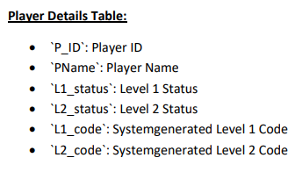
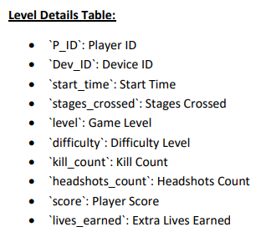
DATASET OVERVIEW
The dataset includes two tables: `Player Details` table (pd) and `Level Details` table (ld).

Slide 5


DATASET EXPLORATION
There are 30 rows in Player Details table & 77 rows in
Level Details table.
In Player Details table modified:
L1_Status varchar(30)
L2_Status varchar(30)
P_ID int primary key
In Level Details table modified:
timestamp to start_time datetime
Dev_Id varchar(10)
Difficulty varchar(15)
primary key(P_ID,Dev_id,start_time)

Slide 6
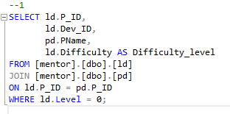
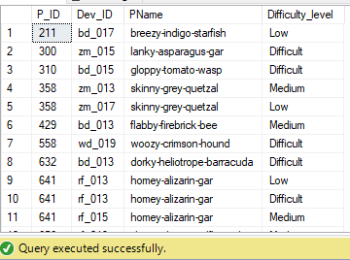
DATA ANALYSIS QUERY
Query 1: Extract `P_ID`, `Dev_ID`, `PName`, and `Difficulty_level` of all players at Level 0.

Slide 7
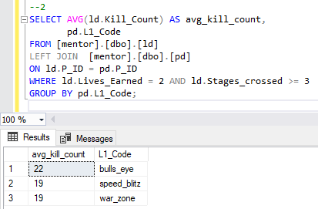
Query 2 : Find `Level1_code`wise average `Kill_Count` where `lives_earned` is 2, and at least 3 stages are crossed.

Slide 8
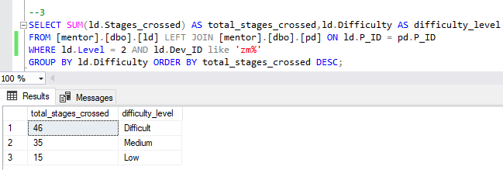
Query 3 : Find the total number of stages crossed at each difficulty level for Level 2 with players using `zm_series` devices. Arrange the result in decreasing order of the total number of stages crossed.

Slide 9
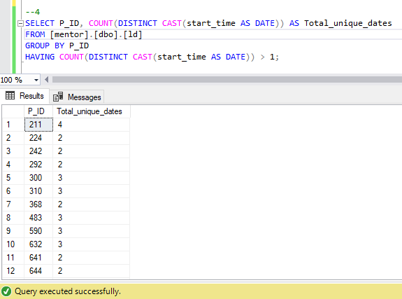
Query 4 : Extract `P_ID` and the total number of unique dates for those players who have played games on multiple days.

Slide 10
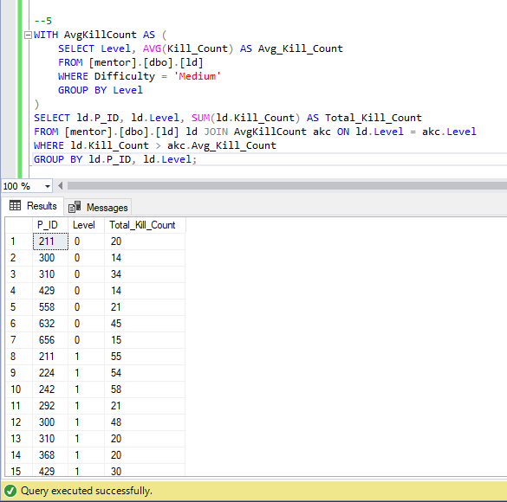
Query 5 : Find `P_ID` and levelwise sum of `kill_counts` where `kill_count` is greater than the average kill count for Medium difficulty.

Slide 11
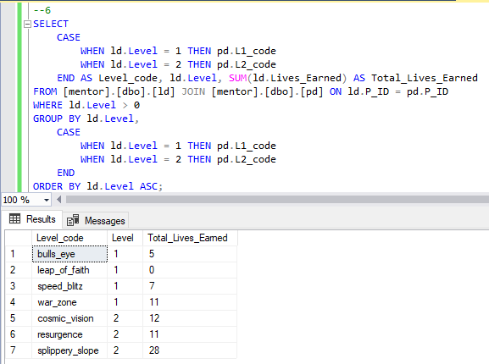
Query 6 : Find `Level` and its corresponding `Level_code`wise sum of lives earned, excluding Level 0. Arrange in ascending order of level.

Slide 12
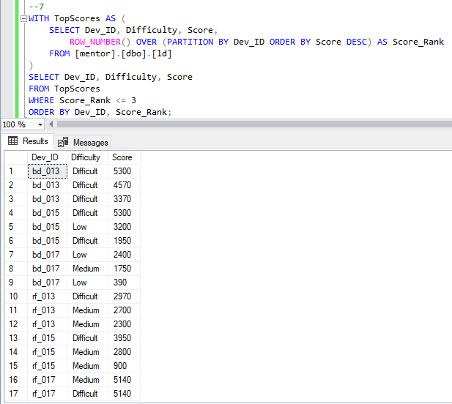
Query 7 : Find the top 3 scores based on each `Dev_ID` and rank them in increasing order using `Row_Number`. Display the difficulty as well.

Slide 13
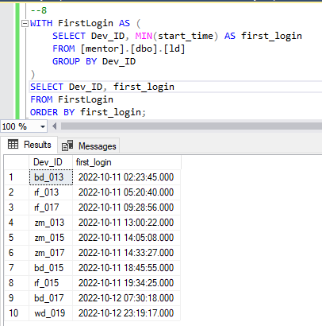
Query 8 : Find the `first_login` datetime for each device ID.

Slide 14
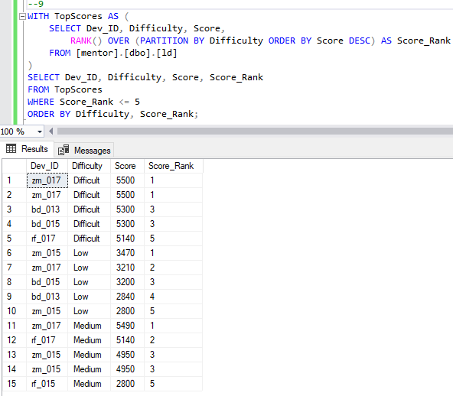
Query 9 : Find the top 5 scores based on each difficulty level and rank them in increasing order using `Rank`. Display `Dev_ID` as well.

Slide 15
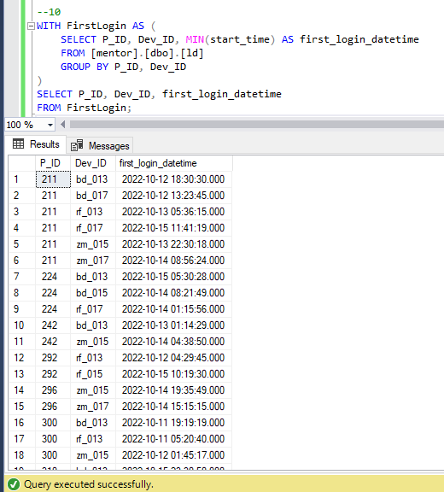
Query 10: Find the device ID that is first logged in (based on `start_datetime` for each player (`P_ID`). Output should contain player ID, device ID, and first login datetime.

Slide 16
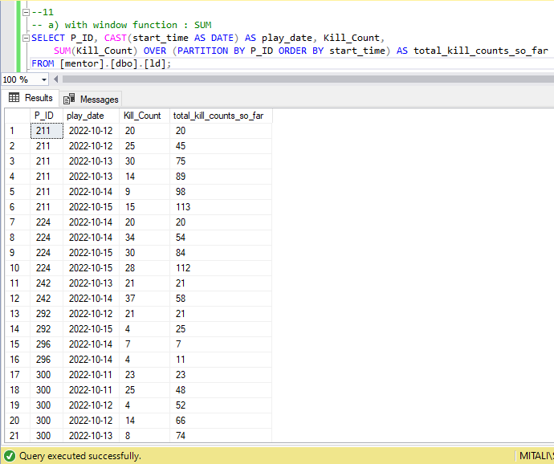
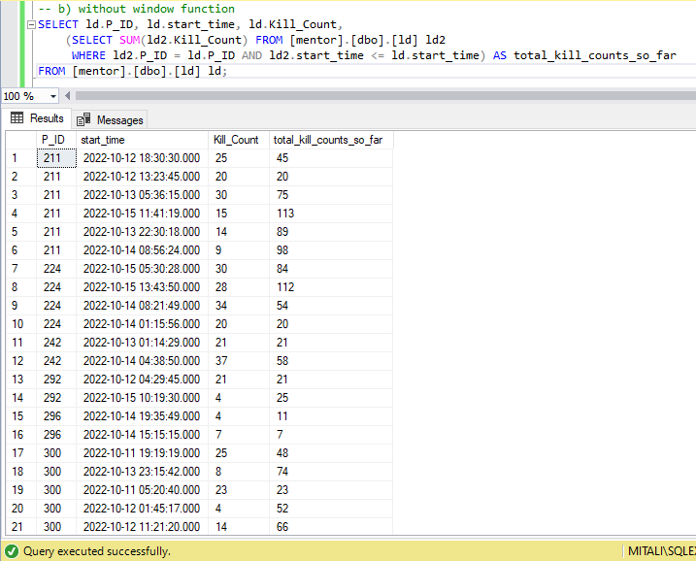
Query 11 : For each player and date, determine how many `kill_counts` were played by the player so far.
a) Using window functions b)Without window functions

Slide 17
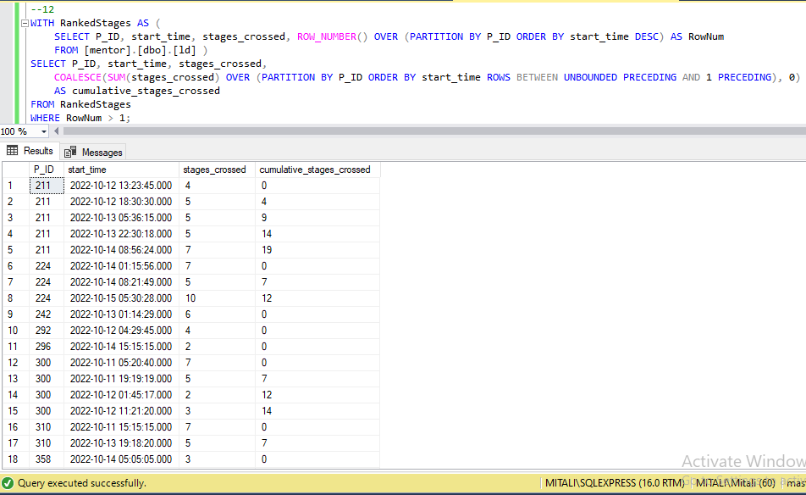
Query 12 : Find the cumulative sum of stages crossed over `start_datetime` for each `P_ID`, excluding the most recent `start_datetime’.

Slide 18
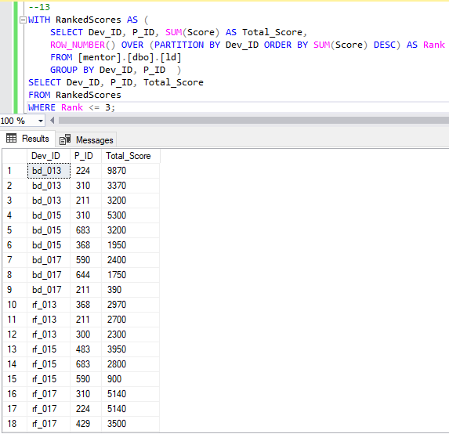
Query 13 : Extract the top 3 highest sums of scores for each `Dev_ID` and the corresponding `P_ID’.

Slide 19
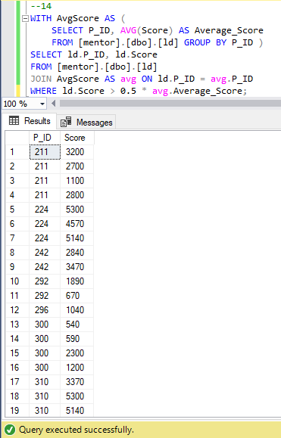
Query 14 : Find players who scored more than 50% of the average score, scored by the sum of scores for each `P_ID’.

Slide 20
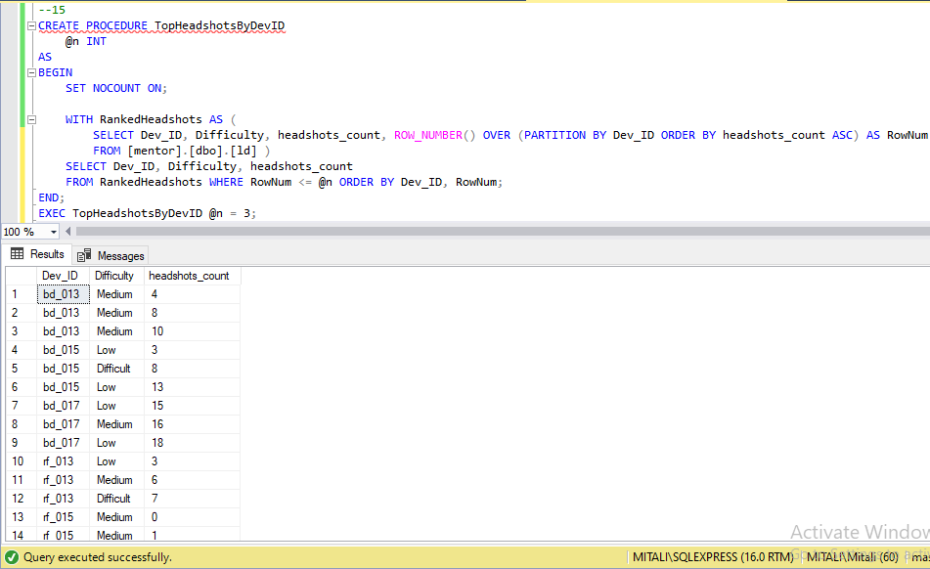
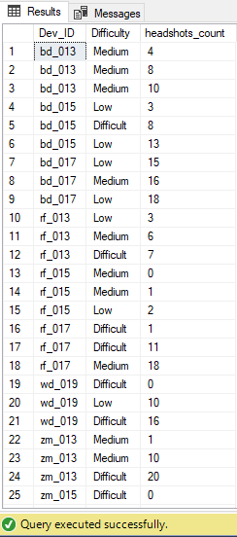
Query 15 : Create a stored procedure to find the top `n` `headshots_count` based on each `Dev_ID` and rank them in increasing order using `Row_Number`. Display the difficulty as well.

Slide 21
KEY QUESTIONS
1)Extract `P_ID`, `Dev_ID`, `PName`, and `Difficulty_level` of all players at Level 0.
2)Find `Level1_code`wise average `Kill_Count` where `lives_earned` is 2, and at least 3 stages are crossed.
3)Find the total number of stages crossed at each difficulty level for Level 2 with players using `zm_series` devices.
Arrange the result in decreasing order of the total number of stages crossed.
4)Extract `P_ID` and the total number of unique dates for those players who have played games on multiple days.
5)Find `P_ID` and levelwise sum of `kill_counts` where `kill_count` is greater than the average kill count for Medium difficulty.
6)Find `Level` and its corresponding `Level_code`wise sum of lives earned, excluding Level 0. Arrange in ascending order of level.
7)Find the top 3 scores based on each `Dev_ID` and rrank them in increasing order using `Row_Number`. Display the difficulty as well.
8)Find the `first_login` datetime for each device ID.
9)Find the top 5 scores based on each difficulty level and rank them in increasing order using `Rank`. Display `Dev_ID` as well.
10)Find the device ID that is first logged in (based on `start_datetime`) for each player (`P_ID`). Output should contain player ID, device ID, and first login datetime.
11)For each player and date, determine how many `kill_counts` were played by the player
so far. a) Using window functions b) Without window functions
12) Find the cumulative sum of stages crossed over `start_datetime` for each `P_ID`, excluding the most recent `start_datetime`.
13)Extract the top 3 highest sums of scores for each `Dev_ID` and the corresponding `P_ID`.
14)Find players who scored more than 50% of the average score, scored by the sum of scores for each `P_ID`.
15)Create a stored procedure to find the top `n` `headshots_count` based on each `Dev_ID` and rank them in increasing order using `Row_Number`. Display the difficulty as well.

Slide 22
INSIGHTS
At Level 0 the difficulty level of all the players are : Easy, Medium, Difficult.
For ‘L1_code’ wise average `Kill_Count` where `lives_earned` is 2, and at least 3 stages are crossed is ‘bulls eye’ with 22 average kill count.
The total number of stages crossed at Level 2 with players using `zm_series` devices is 46 for Difficult, 35 for Medium & 15 for Low.
The P_ID: 211 have played games for total 4 days, followed by 242, 224, 292 for 2 days & so on.
For Level 1 total lives earned (11) is highest for ‘war zone’ & for level 2 total lives earned (28) is highest for ‘slippery slope’.
The top 3 highest scores are for Dev_ID: bd-013 with level Difficult are 5300, 4570, 3370.
The first login was done by Dev_ID : bd-103 on 11th of October,2022on time 02:23:45.
The top 5 score for each difficulty level can be displayed.
For P_ID 211 the highest score is 3200.

Slide 23
THANK YOU…
Data Analyst Intern Mentorness Internship Program
(Batch-MIP-DA-06)

