Slide 1

OPTIMIZING WORK
WITH AI
Practical Applications for Streamlined Productivity
Exploring the most popular AI tools and their specific applications
2026 EDITION • AI PRODUCTIVITY GUIDE

Slide 2

WHAT IS AI & WHY DOES IT MATTER?
🧠 DEFINITION
⚡ THE SHIFT
🚀 THE IMPACT
Artificial Intelligence enables machines to simulate human reasoning — learning from data, recognizing patterns, and making decisions autonomously.
AI has moved from research labs to everyday tools. In 2026, over 80% of knowledge workers use at least one AI-powered application daily.
Studies show AI tools reduce routine task time by up to 40%, freeing professionals to focus on strategic, creative, and high-value work.
⚡ KEY STAT:
McKinsey Global Institute estimates AI could automate up to 30% of work activities in 60% of current occupations by 2030.

Slide 3
HOW AI ENHANCES PRODUCTIVITY
40%
3×
Time Saved
Faster Drafts
Automating repetitive tasks like data entry, scheduling, and formatting gives knowledge workers hours back each week.
AI writing assistants produce first drafts in seconds, accelerating content creation, emails, and reports significantly.
24/7
60%
Availability
Cost Reduction
AI tools work around the clock — no fatigue, no downtime. Businesses can serve customers and process data continuously.
Automating workflows with AI can cut operational costs, reducing the need for manual labor on predictable, structured tasks.

Slide 4

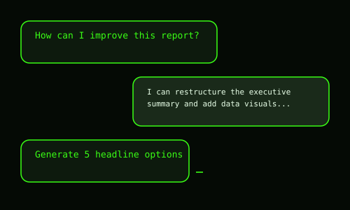
CONVERSATIONAL AI
KEY CAPABILITIES & USE CASES
CHATGPT — PRODUCTIVITY PROFILE
ChatGPT
OpenAI • Text Generation & Conversational AI
01 Intelligent Conversation: Engages in nuanced, context-aware dialogue across virtually any topic — from technical analysis to creative brainstorming sessions.
02 Writing & Content Creation: Drafts emails, articles, reports, proposals, and social posts with adjustable tone, style, and length to match any audience.
03 Research Summarization: Rapidly digests long documents, research papers, or web content into concise, actionable summaries saving hours of reading time.
04 Code Generation & Debugging: Writes, explains, and debugs code across 50+ languages — a force multiplier for both developers and non-technical users.
05 Productivity Automation: Builds custom GPTs for specific workflows: customer support bots, data extractors, and internal knowledge assistants.
GPT-4o
FREE & PRO
API
OPTIMIZING WORK WITH AI • 2026

Slide 5

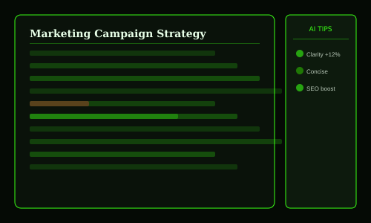
REASONING AI
KEY CAPABILITIES & USE CASES
CLAUDE — PRODUCTIVITY PROFILE
Claude
Anthropic • Advanced Reasoning & Document Analysis
01 Long-Document Analysis: Processes up to 200,000 tokens — entire books, legal contracts, or codebases — extracting key insights with precision.
02 Nuanced Research & Writing: Produces well-structured, thoroughly reasoned content ideal for whitepapers, technical documentation, and executive reports.
03 Safe & Reliable Outputs: Designed with Constitutional AI for trustworthy, honest, and harmless responses — critical for high-stakes business contexts.
04 Complex Problem-Solving: Excels at multi-step reasoning tasks: strategic analysis, scenario planning, data interpretation, and hypothesis evaluation.
05 Developer & API Integration: Powers custom enterprise applications via Anthropic API with streaming, tool use, and advanced prompt engineering support.
SONNET 4.6
OPUS 4.6
200K CONTEXT
OPTIMIZING WORK WITH AI • 2026

Slide 6

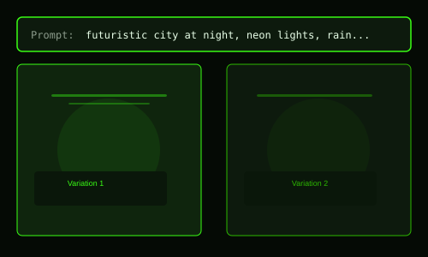
IMAGE GENERATION
KEY CAPABILITIES & USE CASES
MIDJOURNEY — PRODUCTIVITY PROFILE
MidJourney
Midjourney Inc. • AI Art & Creative Image Generation
01 Photorealistic Image Creation: Generates stunning, publication-ready visuals from text prompts — from product mockups to editorial illustrations in seconds.
02 Brand & Marketing Assets: Creates consistent visual branding elements, social media graphics, ad creatives, and campaign imagery at scale with no photographer needed.
03 Concept Visualization: Rapidly prototypes architectural concepts, product designs, UI mockups, and creative directions before committing to production.
04 Style Control & Consistency: Advanced style references and character reference tools ensure brand visual consistency across entire content campaigns.
05 Commercial Licensing: Pro and Mega plans include full commercial rights, enabling use in client work, merchandise, advertising, and digital publications.
V7
DISCORD
WEB APP
OPTIMIZING WORK WITH AI • 2026

Slide 7

IMAGE GENERATION
KEY CAPABILITIES & USE CASES
DALL·E 3 — PRODUCTIVITY PROFILE
DALL·E 3
OpenAI • Integrated AI Image Generation
01 Natural Language to Image: Understands complex, detailed prompts more accurately than previous models — describing scenes, emotions, and compositions naturally.
02 ChatGPT Integration: Seamlessly embedded in ChatGPT — generate images mid-conversation, iterate with chat commands, no separate login required.
03 Text Rendering in Images: Uniquely capable of accurately rendering readable text within generated images — perfect for signage, posters, and infographics.
04 Presentation & Slide Visuals: Quickly generate custom illustrations for presentations eliminating costly stock photo subscriptions or design agency fees.
05 API-Powered Workflows: Integrate into apps and pipelines via OpenAI API to automate image generation at scale for e-commerce, media, and publishing.
GPT-4 NATIVE
API
HD MODE
OPTIMIZING WORK WITH AI • 2026

Slide 8

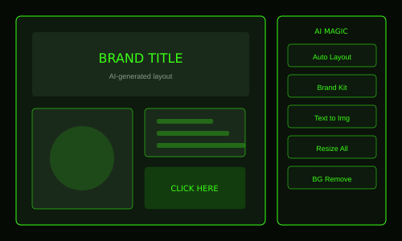
DESIGN AI
KEY CAPABILITIES & USE CASES
CANVA AI — PRODUCTIVITY PROFILE
Canva AI
Canva • AI-Enhanced Design Platform
01 Magic Design Generation: Input a prompt or upload your content and Canva AI creates fully designed templates — presentations, social posts, flyers — instantly.
02 Background Removal & Editing: One-click background removal, AI image expansion, and object eraser tools eliminate hours of manual photo editing work.
03 Brand Kit Automation: AI applies your brand colors, fonts, and logos automatically across hundreds of design variations maintaining visual consistency.
04 Text-to-Image Generation: Generate custom illustrations and photos directly in the editor without leaving your design workflow or sourcing stock images.
05 AI Presentation Builder: Describe your presentation topic and AI creates a full multi-slide deck with layout, content, and visuals — ready in under 60 seconds.
MAGIC STUDIO
FREE TIER
TEAMS
OPTIMIZING WORK WITH AI • 2026

Slide 9

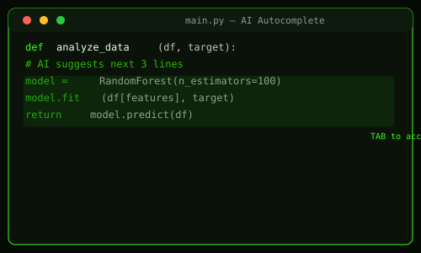
CODING AI
KEY CAPABILITIES & USE CASES
GITHUB COPILOT — PRODUCTIVITY PROFILE
GitHub Copilot
GitHub / Microsoft • AI-Powered Code Completion
01 Real-Time Code Suggestions: Predicts entire functions, classes, and logic blocks as you type — trained on billions of lines of public code across all major languages.
02 Natural Language to Code: Write a comment describing what you need and Copilot generates the implementation — dramatically accelerating feature development.
03 Bug Detection & Fix Suggestions: Identifies potential errors, security vulnerabilities, and logic flaws in real time, offering corrected alternatives before they reach production.
04 Test Generation: Automatically generates unit tests, edge cases, and documentation for existing functions, improving code coverage with minimal effort.
05 Chat for Code Explanation: Ask Copilot Chat to explain complex code blocks, suggest refactors, or walk through architecture decisions in plain language.
VS CODE
JET BRAINS
GPT-4
OPTIMIZING WORK WITH AI • 2026

Slide 10

MARKETING AI
KEY CAPABILITIES & USE CASES
JASPER AI — PRODUCTIVITY PROFILE
Jasper AI
Jasper • Marketing Copy & Content Generation
01 Marketing Copy at Scale: Generates high-converting ad copy, product descriptions, email sequences, and landing page content tuned to your brand voice.
02 SEO Content Optimization: Integrates with Surfer SEO to produce search-optimized blog posts and articles that rank higher while maintaining readability.
03 Campaign Brief to Content: Input a marketing brief and Jasper outputs an entire content suite — social posts, email series, blog articles — in one workflow.
04 Brand Voice Consistency: Learns your company's tone, terminology, and style guidelines to ensure every AI-generated piece sounds authentically on-brand.
05 Multi-Language Content: Generates marketing content in 30+ languages, enabling global campaigns without the cost and time of traditional translation services.
SEO TOOLS
BRAND VOICE
TEAMS
OPTIMIZING WORK WITH AI • 2026

Slide 11

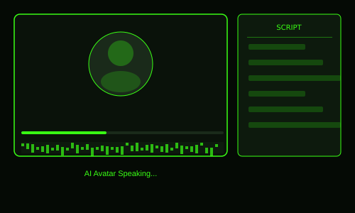
VIDEO AI
KEY CAPABILITIES & USE CASES
SYNTHESIA — PRODUCTIVITY PROFILE
Synthesia
Synthesia • AI Video Generation with Avatars
01 Text-to-Video Production: Transform scripts into professional videos with AI avatars in minutes — no camera, studio, actors, or video editing skills required.
02 Personalized Training Videos: Create employee onboarding and training content at massive scale — update once and regenerate instantly instead of reshootng.
03 Multilingual Video Localization: Produce the same video in 120+ languages with lip-synced AI avatars, eliminating dubbing costs and production delays.
04 Custom Avatar Creation: Build a digital version of real presenters for consistent, scalable video content that maintains personal brand authenticity.
05 Corporate Communication: CEO updates, product launches, and internal communications delivered as polished video — more engaging than text emails.
160+ AVATARS
120 LANGS
NO CAMERA
OPTIMIZING WORK WITH AI • 2026

Slide 12

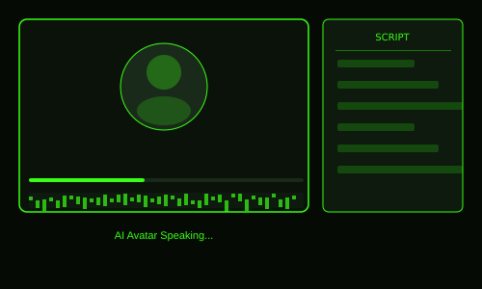
VIDEO AI
KEY CAPABILITIES & USE CASES
RUNWAY — PRODUCTIVITY PROFILE
Runway
Runway AI • AI Video Editing & Creative Generation
01 Text & Image to Video: Generate cinematic video clips from text prompts or still images — enabling filmmakers, marketers, and creators to visualize ideas instantly.
02 AI Video Editing Suite: Remove backgrounds, track objects, apply motion blur, and colorgrade footage using AI tools that previously required professional studios.
03 Motion Brush Control: Paint motion onto specific image regions — animate only a character, only the background, or specific objects with surgical precision.
04 Inpainting & Outpainting: Remove unwanted objects from video, extend frames beyond original boundaries, or replace video elements without re-shooting content.
05 Multi-Modal Workflow: Integrates with Adobe Premiere, After Effects, and other industry tools — AI-enhanced layers within professional production pipelines.
GEN-3 ALPHA
4K OUTPUT
PRO TOOLS
OPTIMIZING WORK WITH AI • 2026

Slide 13

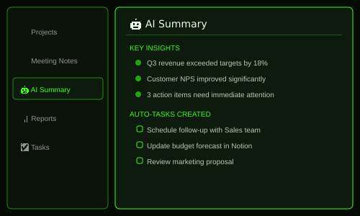
PRODUCTIVITY AI
KEY CAPABILITIES & USE CASES
NOTION AI — PRODUCTIVITY PROFILE
Notion AI
Notion • AI-Powered Note-Taking & Knowledge Management
01 Meeting Notes Automation: Paste raw meeting transcripts and Notion AI extracts summaries, action items, decisions, and follow-up tasks automatically.
02 AI Q&A on Your Workspace: Ask questions across your entire Notion workspace — find information, surface relevant docs, and query databases in natural language.
03 Document Generation: Generate project briefs, PRDs, OKR frameworks, and structured documents from simple outlines — maintaining company templates.
04 Content Improvement: Fix grammar, adjust tone, translate content, and expand or condense documents to match different audiences or communication needs.
05 Database Intelligence: AI surfaces patterns in your project databases, identifies blockers across tasks, and summarizes status across complex multi-team projects.
WORKSPACE AI
Q&A
DATABASES
OPTIMIZING WORK WITH AI • 2026

Slide 14

WRITING AI
KEY CAPABILITIES & USE CASES
GRAMMARLY AI — PRODUCTIVITY PROFILE
Grammarly AI
Grammarly • AI Writing & Editing Assistant
01 Real-Time Writing Assistance: Checks grammar, spelling, punctuation, and sentence structure across every platform — emails, docs, Slack, LinkedIn, and browsers.
02 Tone & Clarity Analysis: Detects the emotional tone of your writing and suggests adjustments to ensure messages land as intended — confident, diplomatic, or friendly.
03 Full-Text Rewrites: Generative AI rewrites entire paragraphs or emails at a higher quality level — preserving meaning while dramatically improving impact.
04 Plagiarism Detection: Cross-references billions of web pages to identify unintentional plagiarism in academic, professional, and content publishing contexts.
05 Team Style Guides: Enterprise plans enforce company-wide writing standards — consistent terminology, tone, and formatting across all team communications.
EVERYWHERE
ENTERPRISE
TONE DETECT
OPTIMIZING WORK WITH AI • 2026

Slide 15

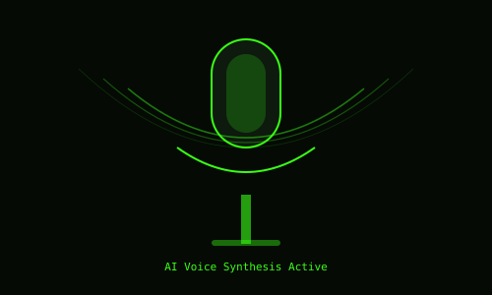
VOICE AI
KEY CAPABILITIES & USE CASES
MURF AI — PRODUCTIVITY PROFILE
Murf AI
Murf • AI Voice-Over & Audio Generation
01 Realistic Voice Synthesis: Convert text to studio-quality voice-overs indistinguishable from professional narrators — available in 120+ voices across 20 languages.
02 eLearning & Training Content: Produce narrated training modules, explainer videos, and educational content at a fraction of traditional voice recording studio costs.
03 Voice Customization: Adjust pitch, speed, emphasis, and pauses to create the perfect narration tone — from energetic marketing to calm instructional content.
04 Slide & Video Sync: Import PowerPoint or video files and sync AI voice-overs directly to timelines, automating the narration layer of presentations.
05 Podcast & Media Production: Script-to-audio workflows for podcast production, audiobooks, and branded audio content without booking expensive recording studios.
120+ VOICES
20 LANGS
STUDIO TOOLS
OPTIMIZING WORK WITH AI • 2026

Slide 16


MEDIA AI
KEY CAPABILITIES & USE CASES
DESCRIPT AI — PRODUCTIVITY PROFILE
Descript AI
Descript • AI Video & Podcast Editing Platform
01 Edit Video Like a Document: Descript transcribes video then lets you edit footage by editing the text transcript — delete a sentence, the video clip disappears instantly.
02 AI Voice Cloning (Overdub): Create a voice clone to fix mispronounced words or add new narration without re-recording — paste text to patch audio seamlessly.
03 Automatic Filler Word Removal: AI detects and removes all 'um,' 'uh,' and 'like' filler words from recordings in one click — no manual audio scrubbing required.
04 Eye Contact Correction: AI algorithmically adjusts gaze to appear direct camera eye contact even when the speaker was looking at their script or screen.
05 Studio Sound Enhancement: One-click noise removal and audio normalization transforms recordings made in home offices into broadcast-quality productions instantly.
OVERDUB
EYE CONTACT AI
TRANSCRIPTION
OPTIMIZING WORK WITH AI • 2026

Slide 17

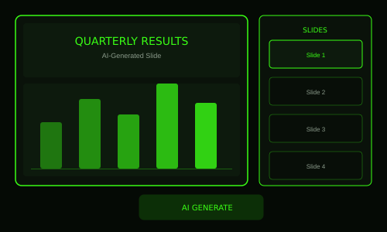
PRESENTATION AI
KEY CAPABILITIES & USE CASES
TOME AI — PRODUCTIVITY PROFILE
Tome AI
Tome • AI Storytelling & Presentation Generation
01 Prompt-to-Presentation: Describe your topic and Tome generates a complete narrative presentation with structure, slides, visuals, and copy — ready in under 2 minutes.
02 Intelligent Storytelling Structure: AI builds a coherent narrative arc across slides, not just content blocks — ensuring logical flow, tension, and clear calls-to-action.
03 Live Data Embedding: Connect Figma files, live web content, and data sources that update in real time — presentations that stay current without manual updates.
04 AI Image Generation Built-In: Generate custom illustrations for each slide contextually — no sourcing stock images or waiting on designers for visual assets.
05 Responsive Web Delivery: Presentations are web-native and responsive — shareable via link, embeddable anywhere, and viewable perfectly on any device.
AI NARRATIVE
WEB NATIVE
LIVE DATA
OPTIMIZING WORK WITH AI • 2026

Slide 18

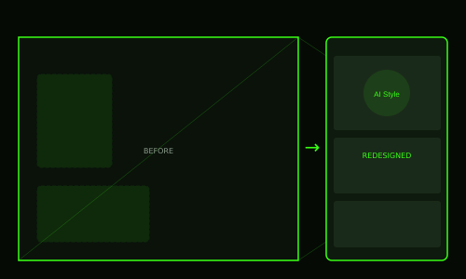
DESIGN AI
KEY CAPABILITIES & USE CASES
REIMAGINE HOME — PRODUCTIVITY PROFILE
Reimagine Home
REimagine Home • AI Interior Design Visualization
01 Instant Room Redesign: Upload a photo of any room and AI reimagines it in 30+ interior design styles — Scandinavian, Industrial, Japandi, and more — in seconds.
02 Real Estate Virtual Staging: Stage empty properties virtually for listings at a fraction of physical staging costs, dramatically increasing buyer engagement and offer speed.
03 Renovation Pre-Visualization: See exactly how different furniture, colors, flooring, and layouts will look before purchasing a single item or starting any physical work.
04 Material & Color Exploration: Swap paint colors, floor materials, countertops, and fixtures across generated images to compare options side by side instantly.
05 Client Presentation Tool: Interior designers use AI-generated renders to pitch concepts to clients, reducing the design iteration cycle from weeks to hours.
PHOTO UPLOAD
30+ STYLES
INSTANT
OPTIMIZING WORK WITH AI • 2026

Slide 19
THE AI-POWERED FUTURE OF WORK
Key Takeaways
01
AI is not a replacement — it's an amplifier. The most productive professionals in 2026 use AI to handle the routine so they can focus on the irreplaceable.
02
Specialization matters. Each AI tool excels in a domain — use the right tool for the right task rather than relying on one solution for everything.
03
The compounding effect is real. Combining AI tools in a workflow stack (writing + design + video + analytics) creates productivity gains that multiply, not add.
04
Start small, scale fast. Begin with one AI tool that addresses your biggest time drain. Master it, measure the gains, then expand to adjacent workflows.
OPTIMIZING WORK WITH AI • 2026 • THE FUTURE IS NOW

