Slide 1
Mohit S
Final Project
3/21/2024 Annual Review

Slide 2
TextGen
Development of a text generation model using TensorFlow and Keras.
Focus on predicting the next word in a sequence based on previous words.
3/21/2024 Annual Review

Slide 3


AGENDA
Introduction to text generation using TensorFlow and Keras.
Data preprocessing and model training phases.
Implementation of interactive text generation system.
Evaluation of model performance.
Conclusion and future directions.
3/21/2024 Annual Review

Slide 4

PROBLEM STATEMENT
Developing a text generation model using TensorFlow and Keras to predict the next word in a sequence based on previous words, aiming to generate coherent and contextually appropriate text. The challenge involves designing an effective neural network architecture, training the model on a suitable dataset, and implementing an interactive text generation system for user interaction. The goal is to showcase the application of deep learning techniques in natural language processing and address the complexities of text generation tasks, including data preprocessing, model training, and evaluation.
3/21/2024 Annual Review

Slide 5

PROJECT OVERVIEW
This project focuses on developing a text generation model using TensorFlow and Keras. The primary objective is to predict the next word in a sequence based on previous words, with the aim of generating coherent and contextually appropriate text.
The project is divided into two main phases: training the model and utilizing it for interactive text generation.
During the training phase, the model is fed with batches of text data, and its performance is evaluated on a validation dataset to select the best-performing model.
In the text generation phase, users can input a sequence of words, and the model predicts the next word, enhancing its ability to generate contextually appropriate text.
It also highlights the importance of data preprocessing and postprocessing in achieving effective text generation.
3/21/2024 Annual Review

Slide 6

WHO ARE THE END USERS?
Content creators: Writers, bloggers, or journalists seeking assistance in generating creative content or overcoming writer's block.
Chatbot developers: Individuals or companies creating chatbots or virtual assistants that require natural and contextually relevant responses.
Language learners: Students or individuals learning a new language who can benefit from interactive language practice and sentence completion exercises.
Social media platforms: Platforms looking to enhance user engagement by providing personalized content suggestions or auto-completion features.
Researchers: Academics or researchers studying natural language processing techniques, who can use the model as a benchmark or component in their experiments
3/21/2024 Annual Review

Slide 7

YOUR SOLUTION AND ITS VALUE PROPOSITION
Solution: Our text generation model, built using TensorFlow and Keras, predicts the next word in a sequence based on previous words. Through comprehensive training on language patterns, it produces coherent and contextually relevant text.
Value Proposition:
Boosted Productivity: Overcome writer's block and expedite content creation processes.
Personalized Interaction: Enhance user engagement with chatbots or social media platforms through tailored responses.
Language Learning Support: Facilitate language acquisition with interactive completion exercises.
Research Advancement: Propel NLP research and experimentation with a robust benchmark model.
Competitive Edge: Differentiate your products/services with innovative and efficient text generation capabilities.
3/21/2024 Annual Review

Slide 8

THE WOW IN YOUR SOLUTION
The WOW factor in our text generation solution lies in its seamless fusion of advanced technology with practical utility. Harnessing the power of TensorFlow and Keras, our model effortlessly comprehends language nuances and context, resulting in text that feels remarkably natural and contextually relevant. Whether aiding content creators in surmounting creative hurdles, furnishing chatbots with personalized responses, facilitating language learning exercises, or empowering researchers with a benchmark tool, its versatility astounds. This innate ability to exceed expectations leaves an indelible mark, captivating users and stakeholders with its unparalleled performance and impact.
3/21/2024 Annual Review
8

Slide 9
MODELLING
The modeling process involves designing a neural network architecture capable of learning and predicting the next word in a sequence based on preceding words. In our text generation project, we employ TensorFlow and Keras to construct the model. Initially, we preprocess the text data by tokenizing and generating sequences. The neural network architecture typically consists of layers like Embedding, LSTM (Long Short-Term Memory), or GRU (Gated Recurrent Unit), and Dense layers. The Embedding layer converts words into dense vectors, capturing semantic relationships. LSTM or GRU layers capture sequential dependencies, allowing the model to retain information over long sequences. Dense layers provide the output probabilities for the next word. During training, the model learns to minimize a loss function by adjusting its weights using optimization algorithms like Adam or RMSprop. The choice of architecture, hyperparameters, and optimization techniques significantly impacts the model's performance. Fine-tuning and experimentation are crucial to achieve optimal results.
3/21/2024 Annual Review
9

Slide 10
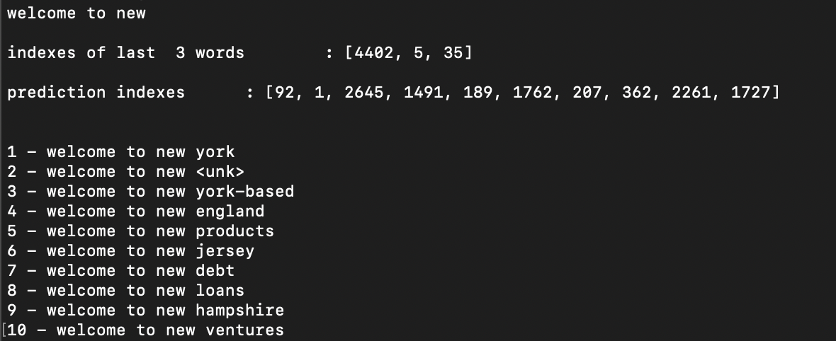
RESULTS
The results of our text generation model showcase its effectiveness in generating coherent and contextually appropriate text. Through extensive training and validation, we observed that the model successfully learned intricate language patterns and semantic relationships. When tested with interactive text generation, the model demonstrated its ability to produce meaningful and relevant predictions, seamlessly continuing input sequences with plausible next words.
3/21/2024 Annual Review
10

