Slide 1

Job Fit Analyzer
Graduation Project
2023-2024
The Egyptian E-Learning University (EELU) Faculty of Information Technology
Supervisors
Prof. Dr. Khaled T. Wassif
Eng. Engy Emad Beshara Salib

Slide 2
Team Members
Mohamed Khaled Mohamed Moghraby
Mohammad Atef Nasr Labib
Ahmed Mohamed Tawab
Makarious Ayman Shafek
Mohamed Montser Mohamed
Sandy Nashaat Wadea
Ziad Mamdouh Ahmed

Slide 3
Agenda
Abstract
Problem Definition
Objective
System Requirements
System Design & Architecture
Database Schema
Authentication
Technology Stack
AI Integration
UI Design
Future Work

Slide 4
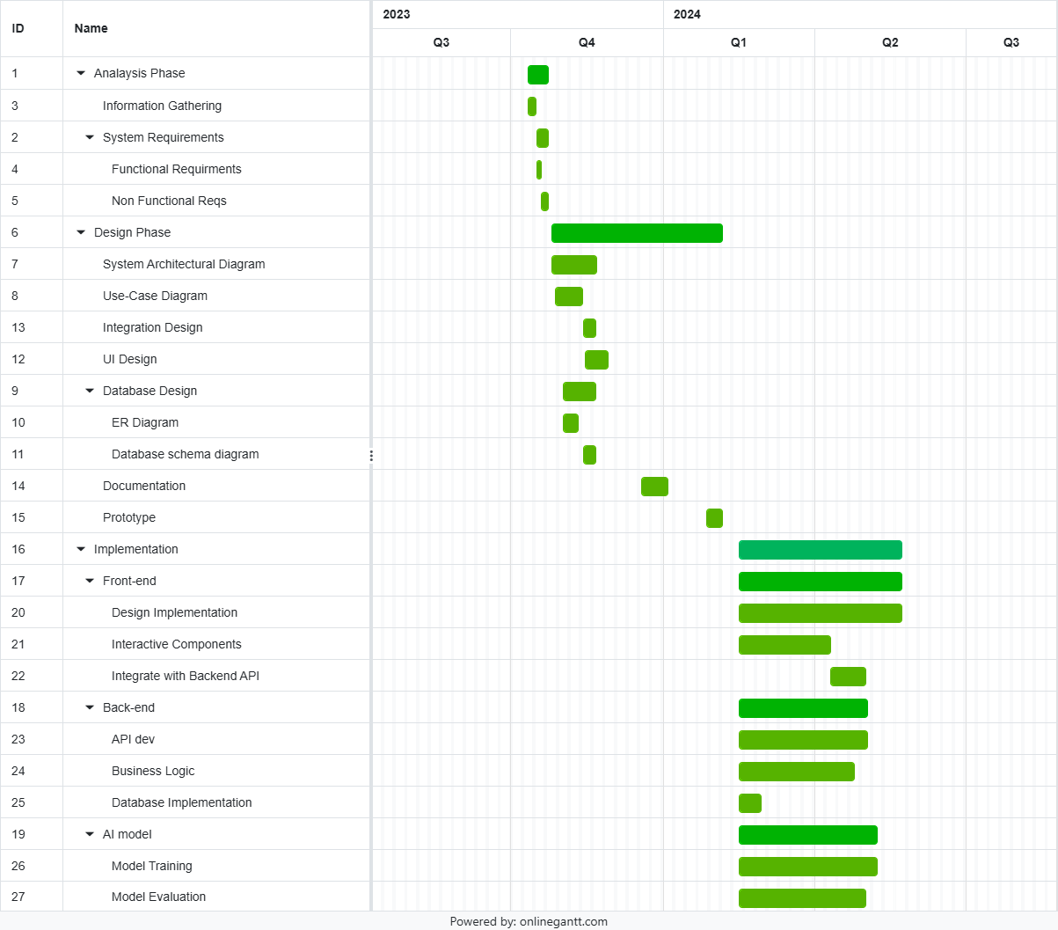
Planning

Slide 5
Abstract
This project addresses the current challenges in job matching, such as complexity and inefficiency, leading to job dissatisfaction and resource-intensive hiring processes. Our solution is the Job Fit Analyzer, a web-based application powered by AI models. This innovative tool aims to optimize the job matching process, providing a user-friendly experience for both job seekers and employers. By leveraging state-of-the-art artificial intelligence techniques, the Job Fit Analyzer revolutionizes how individuals find suitable employment opportunities and organizations identify qualified candidates.

Slide 6
Problem Definition
According to our research on alternative Job portal websites, common problems that job portal websites encounter are:
Job Matching Accuracy
Poor Search Relevance and User Experience
Data Privacy and Security
Internationalization and Localization

Slide 7
Objective
Our goal is to use AI models, Machine Learning and modern software to create a comprehensive Job Fit Analyzer web application, improving the process of connecting job seekers with suitable employment opportunities and enhancing the overall job search and recruitment experience.

Slide 8
System Requirements
Functional Requirements
User Different Roles
Common Login Functionality for All Users
Job Search and Filters
AI-Powered Job Recommendation and Search
Feedback and Ratings
Post Job, Apply, CV Upload/Download
Non-Functional Requirements
Performance
Security
Usability
Integration

Slide 9
System Design & Architecture
Three-Tier Architecture:
Our system architecture is organized into three distinct tiers, each serving specific
functions:
Presentation Tier - This tier is responsible for the user interface and interaction
Application Tier - The application tier houses the core logic and functionality of the job portal.
Data Tier - The data tier handles the storage and retrieval of information.

Slide 10
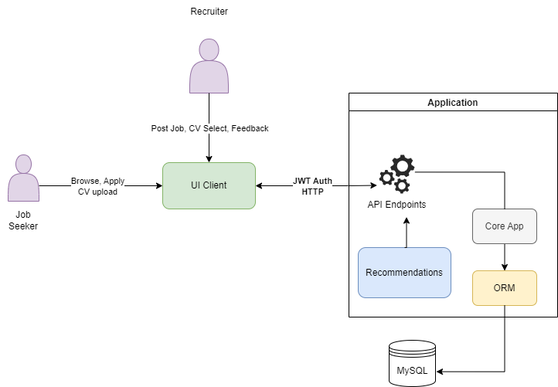
System Design & Architecture
Architecture Diagram

Slide 11
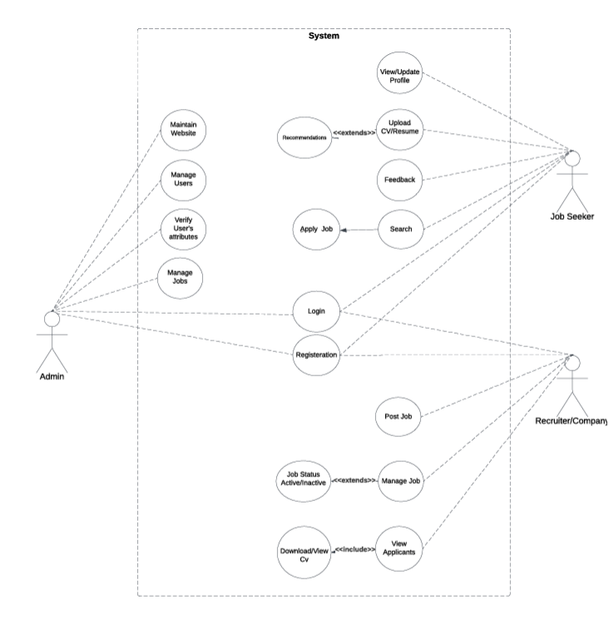
System Design & Architecture
Use Case Diagram

Slide 12
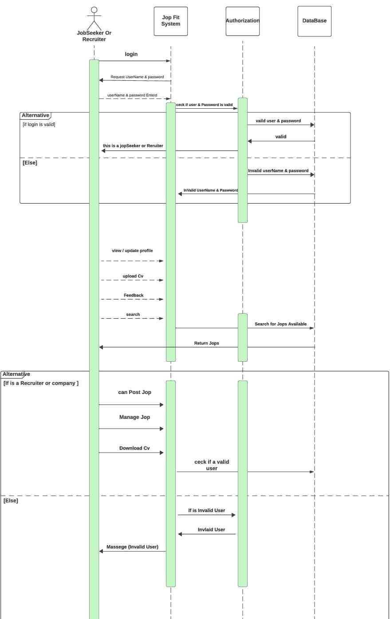
Sequence Diagram

Slide 13
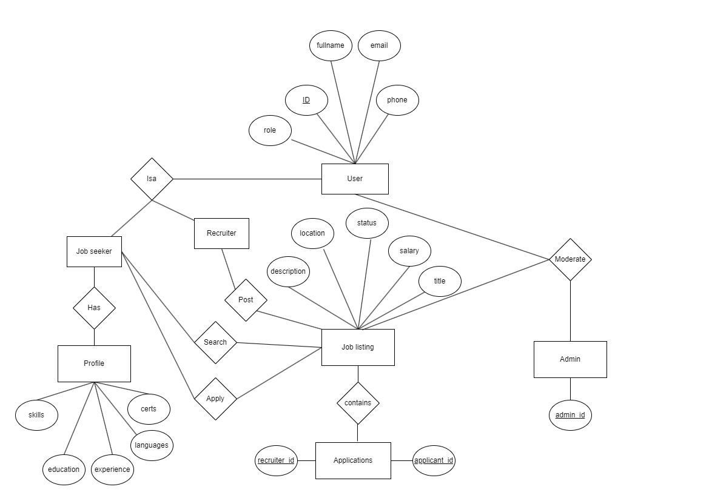
Database Design

Slide 14
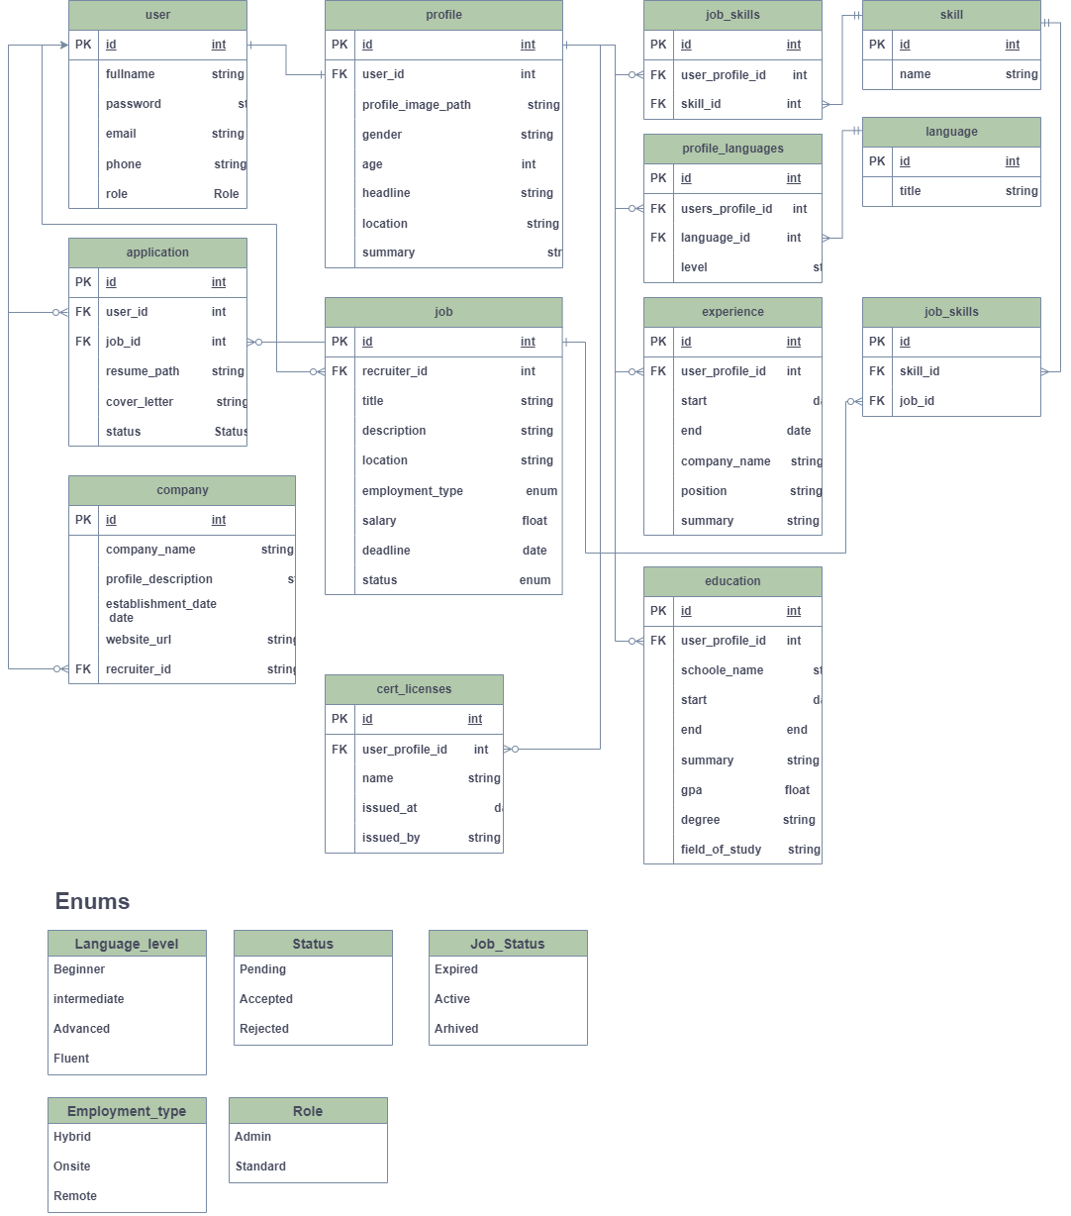
Database Design
Enums

Slide 15
Technologies
Front-end & Back-end NextJs(React), TypeScript
AI integration Python, Flask
Design Tools LucidChart, Draw.io
Database MySQL
UI & UX Figma, Photoshop

Slide 16
Server-side Architecture
Core Functions:
This part manages the essential features and tools the system needs, including the recommendation engine.
Recommendation Engine Area:
Inside the Core Functions, there's a specific area for the recommendation engine.
API Endpoints:
Dependent on the Core Functions, API Endpoints handle external interactions.

Slide 17
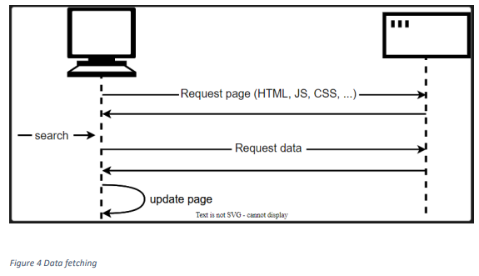
Client-side Architecture
Fetching data from the server:
Instead of the traditional model, many websites use JavaScript APIs to request data from the server and update the page content without a page load. So, when the user searches for a new product, the browser only requests the data which is needed to update the page.
AJAX:
Is a technology that allows web developers to create dynamic, interactive websites without having to reload the page each time a user interacts with the website.
API Integration in React:
Integrating an API in React.js involves making HTTP requests to the API endpoints and handling the data received in your React components.

Slide 18
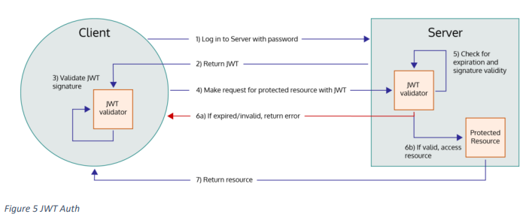
Authentication
JWT(Json Web Token) Auth

Slide 19
UI Design
A Prototype of the Website

Slide 20
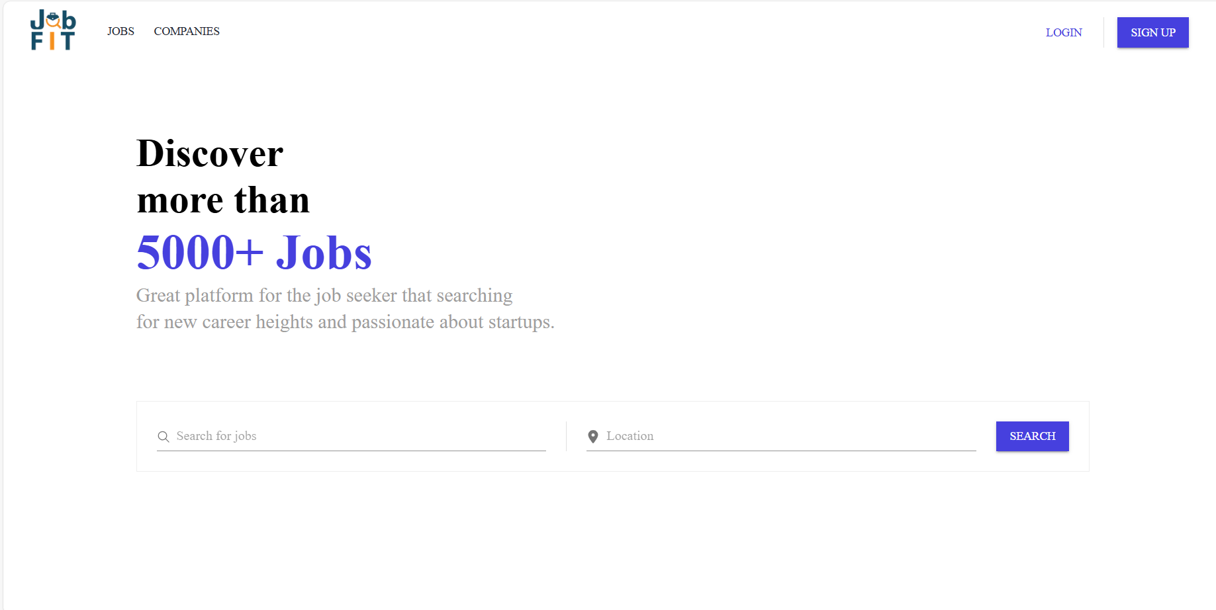
Home Page

Slide 21
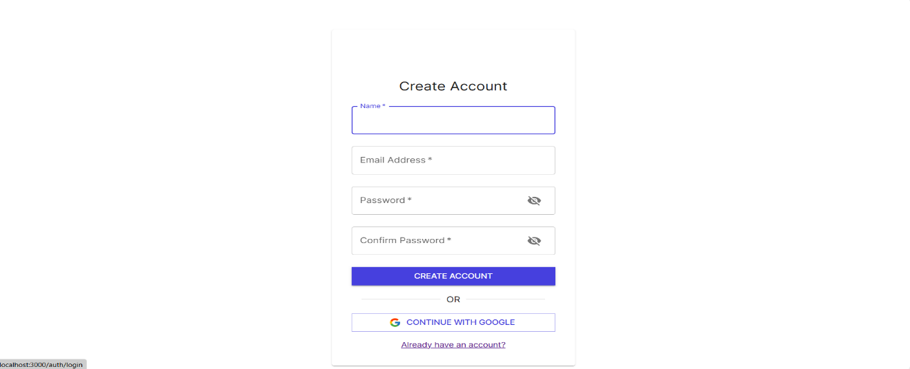

SIGN UP PAGE
LOG IN/SIGN IN PAGE

Slide 22
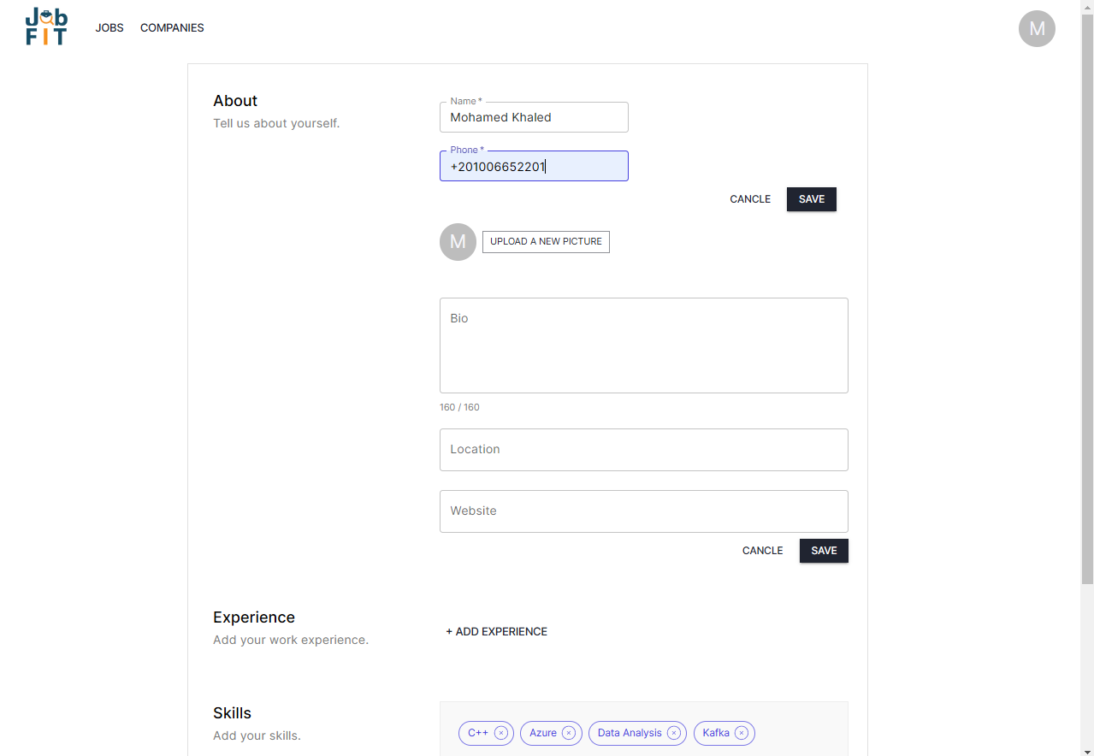
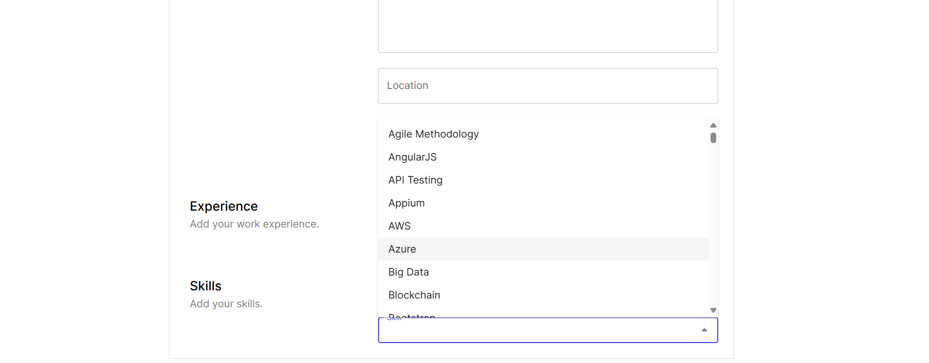
PROFILE PAGE

Slide 23
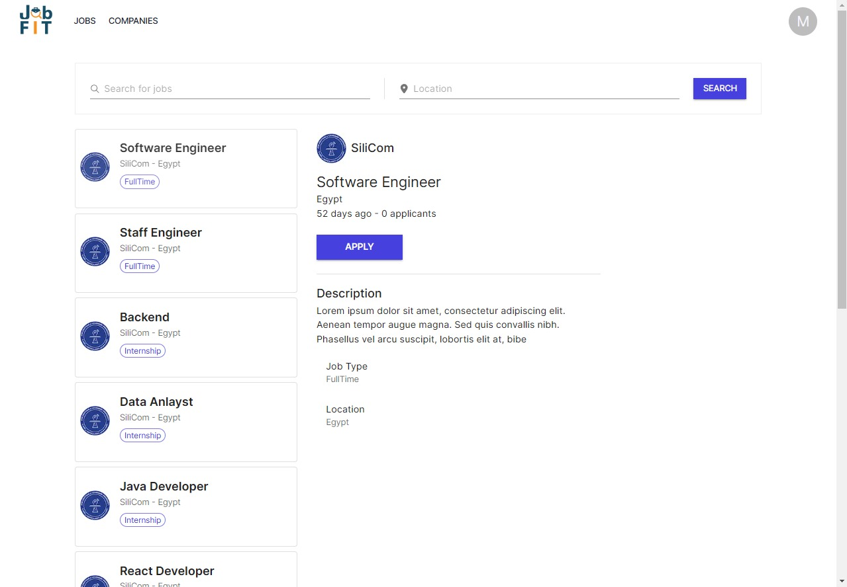
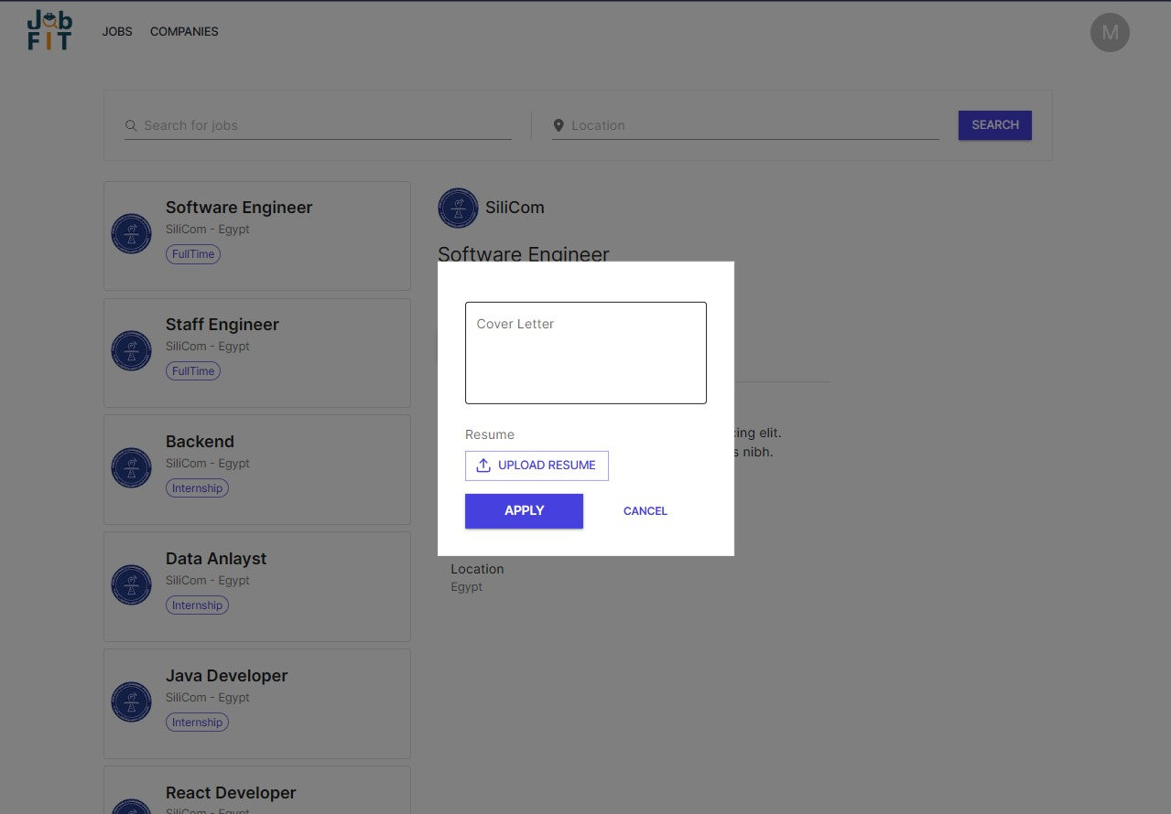
JOBS PAGE

Slide 24
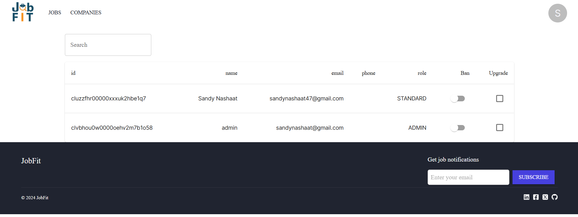
ADMIN PAGE

Slide 25
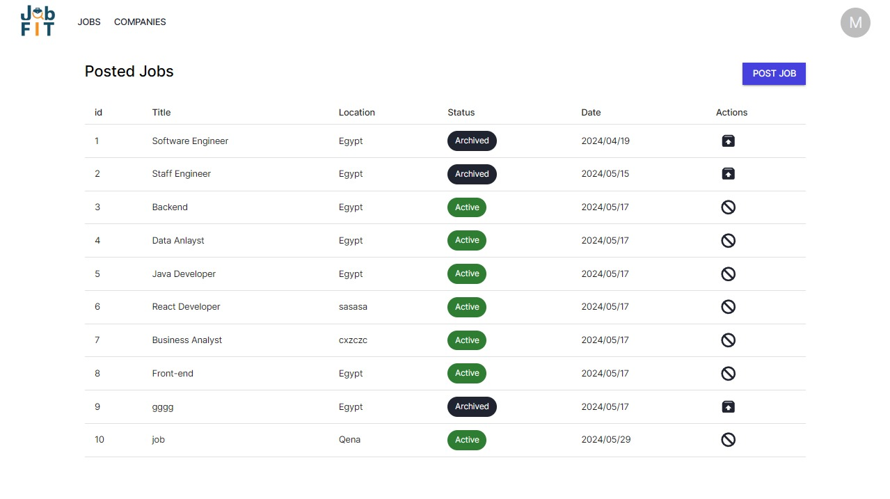
RECRUITER PAGE

Slide 26
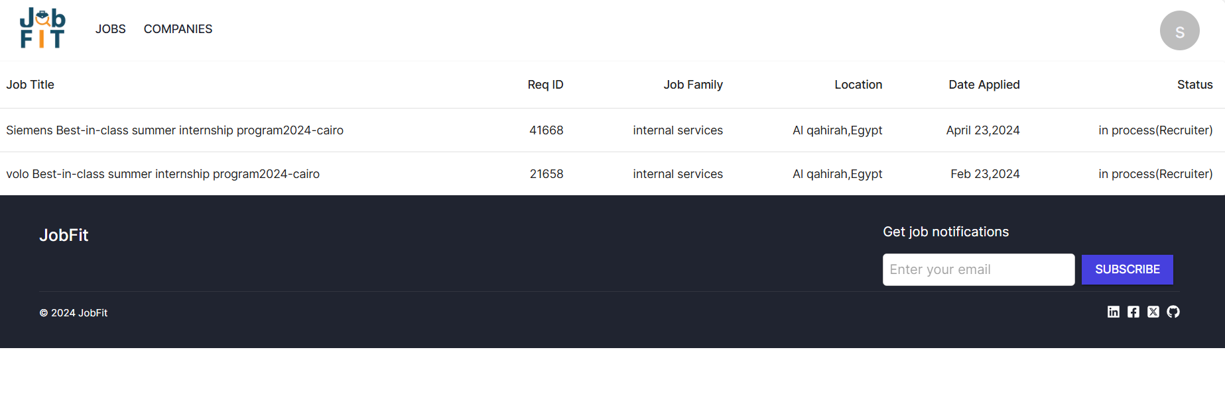
APPLICATION PAGE

Slide 27
Artificial Intelligence
Machine Learning

Slide 28
AI Integration
Key Highlights:
Smart Candidate Matching
Enhanced Employer Insights
User-Centric Experience
Recommendation Systems:
Content-based
Collaborative Filtering
Hybrid

Slide 29
Machine Learning
Supervised Learning:
Support Vector Machines (SVM)
Decision Tree
Random Forest
Unsupervised Learning:
K-Means Clustering

Slide 30
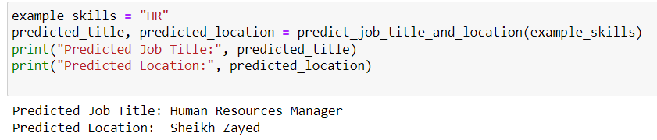
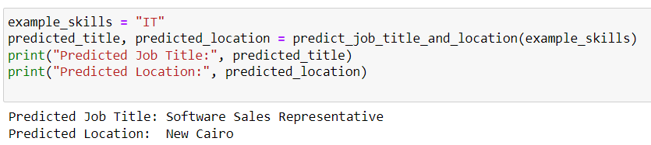
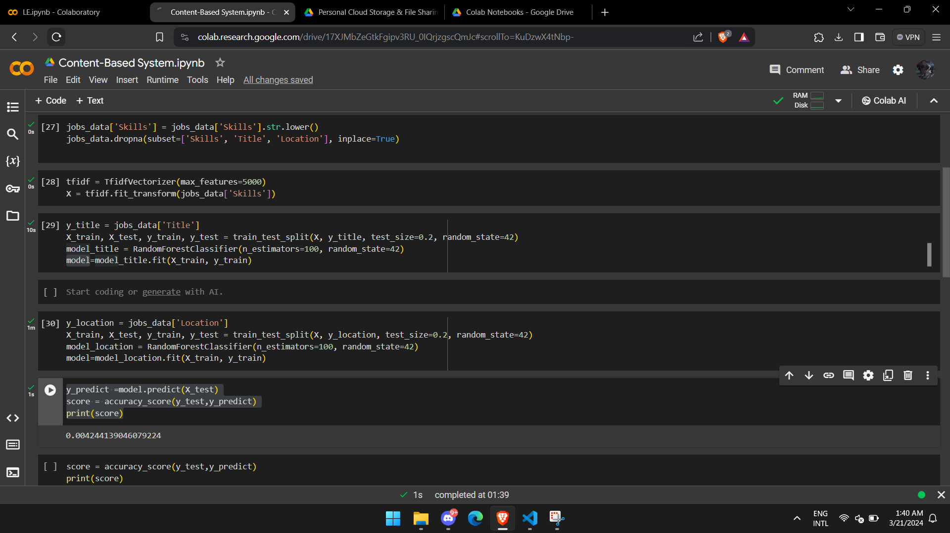
Old Dataset
Dataset used in our system:
Title (Job Title)
Company
Type
Level
Experience (Years)
Location
Skills - it's the column we will be applying our recommendation system algorithm to.

Slide 31
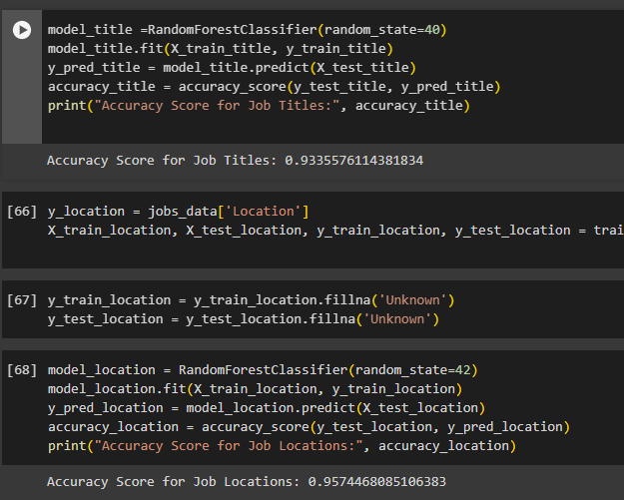
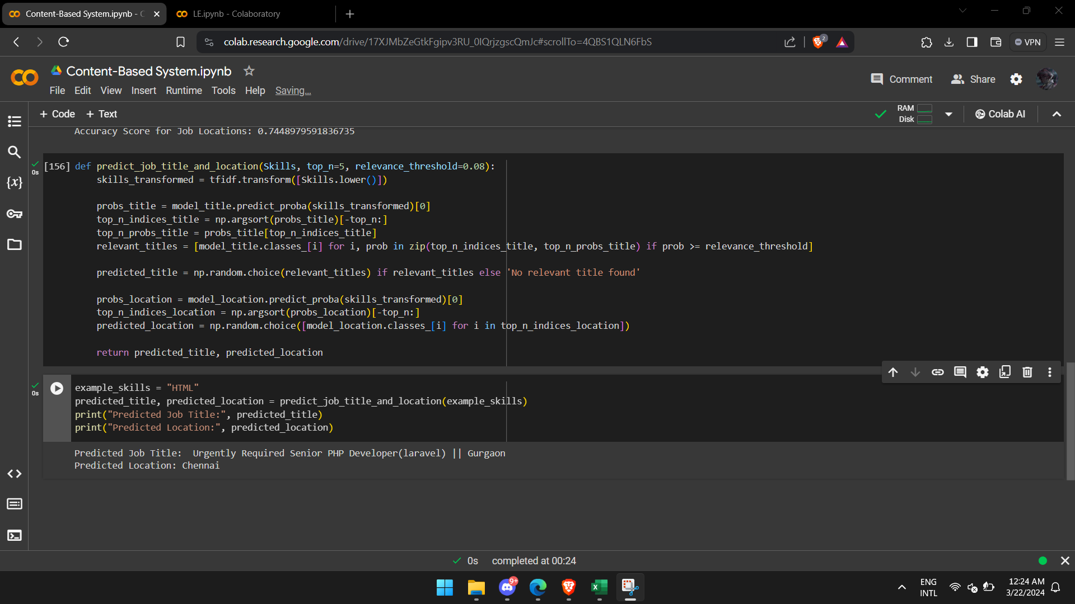
Current Dataset
Dataset used in our system:
Job Title – Applied as an output
Job Experience
Key Skills – Applied as an input where we applied our recommendation system
Role Category
Location – Applied as an output
Functional Area
Industry
Roles
sal(Job Salary)

Slide 32
AI Endpoint
Flask Implementation:
One Endpoint was used.
Endpoint: /predict
Simple
Scalable
Efficient
Focus

Slide 33
Future Work
Implementation
Long-Term Vision
AI Enhancements
Frontend Improvements
Backend Development
Feature Expansion

Slide 34
Thank you

