Slide 1
Problem & Dataset
Dataset
Parkinson's Telemonitoring: 5,875 rows, 22 columns of voice measurements from patients over time.
Problem definition:
Predict whether a patient's Parkinson's disease is progressing to a severe stage using baseline and delta voice features.
Target variable:
severe_and_worse
binary (0 = healthy/stable, 1 = severe & worsening).
Engineered from total UPDRS ≥ 35 AND rate of change > 2.

Slide 2
Challenges
Class imbalance:
Healthy (0): 3,806 samples vs. Severe (1): 834 samples
High dimensionality & multicollinearity:
After delta feature engineering, 35 features remained
Many Jitter/Shimmer variants were highly correlated (r > 0.85), risking redundancy and overfitting.
Data leakage risk:
Multiple temporal records exist per patient, a random split would let the model memorize individual patients rather than learn generalizable patterns.
Non-linearity:
Biological voice markers interact in non-linear ways, limiting purely linear classifiers like Logistic Regression.

Slide 3
Preprocessing
Feature engineering & column filtering:
Computed rate-of-change (delta) features from voice metrics.
WHY: removes irrelevant columns
Multicollinearity removal:
Applied a correlation threshold of 0.85
WHY: Stabilizes Linear Models
Group train/test split (GroupShuffleSplit):
Grouped by patient ID so all records of one patient stay in one partition -> 80% train (4,640 rows), 20% test (1,235 rows).
WHY: Prevents patient data leakage
SMOTE oversampling (train set only):
Synthesized minority class samples by interpolating between nearest neighbors
WHY: Avoid Majority class bias
StandardScaler & Polynomial features:
Fit scaler on training data only, applied to test data.
Added degree-2 interaction terms for Logistic Regression only.

Slide 4
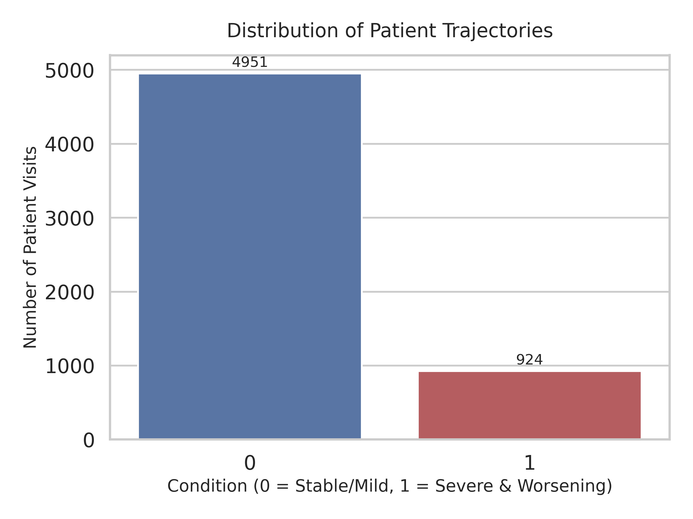
Plot 1: Class Distribution
Significant Class Imbalance: Stable/Mild patients (Class 0) heavily outnumber Severe/Worsening patients (Class 1).
Mitigation Strategy: Implementation of SMOTE is essential to avoid algorithmic bias toward stable patient outcomes.

Slide 5
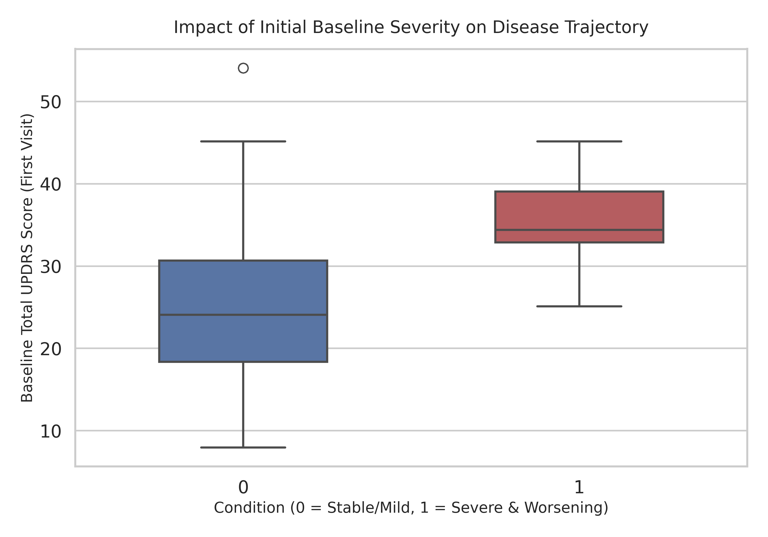
Plot 2: Baseline Severity vs Target
Higher Initial Scores: Patients in the "Severe & Worsening" group show a significantly higher median UPDRS score at their very first visit.
Strong Predictive Power: A patient's initial disease severity acts as a strong early indicator of future rapid decline.

Slide 6
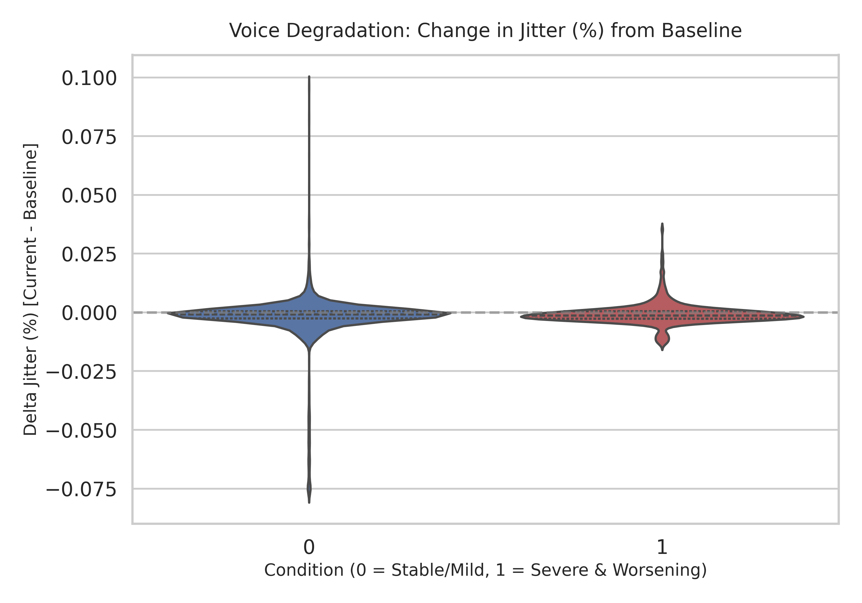
Plot 3: Change in Voice Jitter vs Target
Higher Volatility: Patients in the "Severe & Worsening" group experience much wider, more erratic shifts in their voice jitter.
Extreme Fluctuations: Large deviations from a patient's baseline (both sudden increases or decreases) are strong indicators of rapid disease progression.

Slide 7
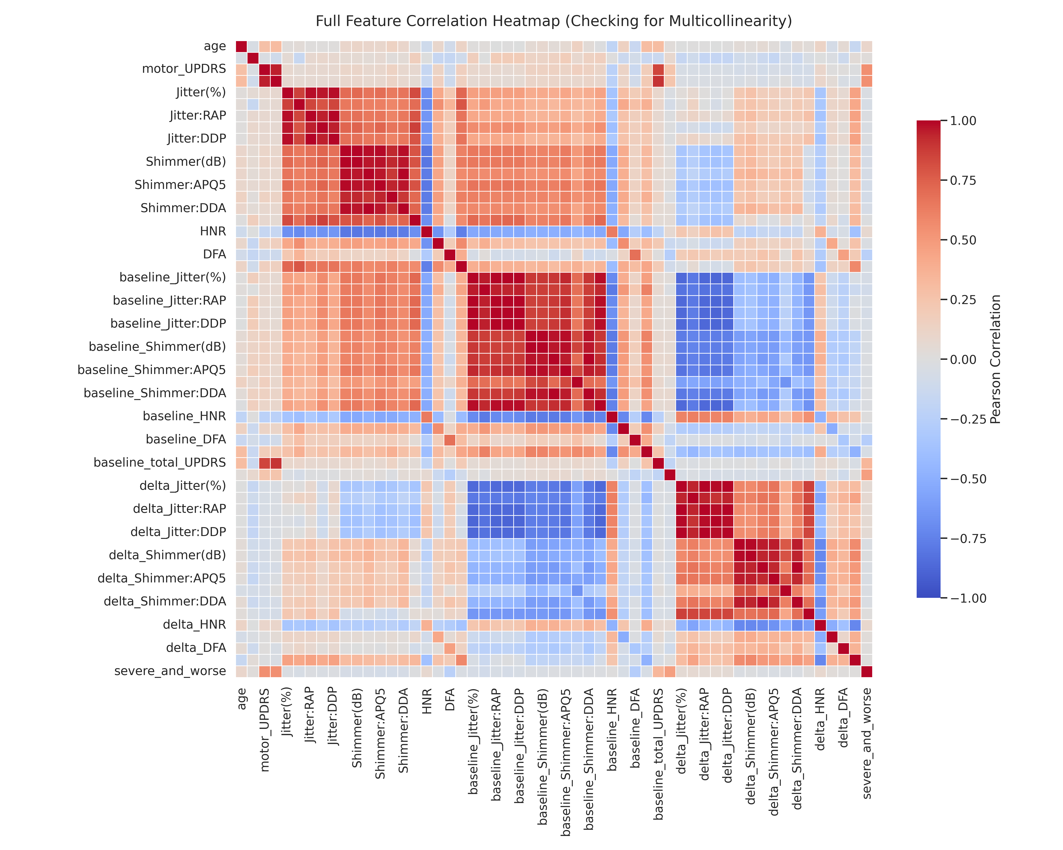
Plot 4: Correlation Heatmap (before Filtering)

Slide 8
Plot 5: Correlation Heatmap (after Filtering)

Slide 9
Models Tuning
Classifier 1: Decision Tree
Tuned hyperparameters: max_depth, min_samples_split, min_samples_leaf
Used Grid Search with cross-validation
Focused on preventing overfitting
Classifier 2: Random Forest
Tuned: n_estimators, max_depth, min_samples_split
Optimized number of trees and tree depth
Balanced model complexity and performance
Classifier 3: K-Nearest Neighbors (KNN)
Tuned: n_neighbors, weights, metric
Tested different distance metrics
Optimized k value for best performance

Slide 10
Models Tuning
Classifier 4: Logistic Regression
Tuned: C (regularization), penalty type
Adjusted regularization strength
Tested L1 and L2 penalties
Classifier 5: Support Vector Machine (SVM)
Tuned: C, kernel, gamma
Tested different kernel functions (RBF, linear)
Optimized decision boundary
Performance Metrics:

Slide 11
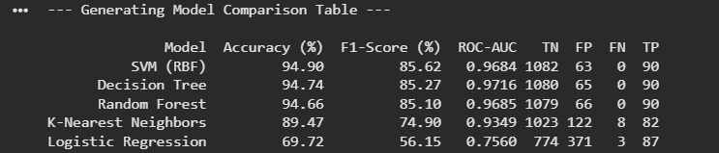
Results
• Top Performers: SVM (RBF), Decision Tree, and Random Forest all exceeded 94.6% accuracy and 0.968 ROC-AUC. • Best Overall: SVM (RBF) achieved the highest accuracy (94.90%) and F1-Score (85.62%), closely matched by Decision Tree (AUC: 0.9716). • Zero False Negatives: All top models recorded FN = 0, a critical advantage for minimizing missed cases in clinical or high-stakes applications. • Underperformers: KNN showed moderate performance, while Logistic Regression struggled (69.72% acc, 0.756 AUC), indicating highly non-linear decision boundaries.

Slide 12
Results
Top Performer: The Support Vector Machine (RBF Kernel) was the best model, achieving the highest clinical priority metric with an 85.62% Macro F1-score and 94.90% overall accuracy.
Why it Won (Architecture): The RBF kernel successfully mapped the high-dimensional acoustic features into a space where it could easily capture the complex, non-linear progression boundaries of Parkinson's disease.
Why it Won (Generalization): Unlike tree-based models, the SVM's margin-maximization objective naturally resisted overfitting to the artificial, locally dense synthetic data points generated by SMOTE.
Weakest Performer: Logistic Regression failed significantly, producing the lowest discriminative power with a Macro F1-score of just 56.15% and 69.72% accuracy.
Why it Failed: As an inherently linear classifier, it lacked the capacity to model the highly non-linear trajectories of voice degradation, and explicitly adding second-degree polynomial features was insufficient to bridge this architectural gap.

Slide 13
Error Analysis
Where the model struggles:
Boundary cases where total UPDRS is near 35 or rate-of-change hovers around 2
the model may misclassify patients near the engineered threshold.
Residual class imbalance effect:
Even after SMOTE, synthetic samples may not perfectly represent true minority-class variation, potentially inflating false negatives on rare severe cases.
Voice metric noise:
Jitter and Shimmer readings can vary due to recording conditions unrelated to disease state, introducing noise that confuses boundary decisions.
Temporal generalization:
The model sees patient snapshots, it cannot capture disease trajectory shape across a full visit sequence, limiting its clinical predictive depth.

Slide 14
AI Usage
How AI was used
One mistake from AI
How you fixed it

Slide 15
Conclusion
Best model
• Limitations
• Future work

