Slide 1
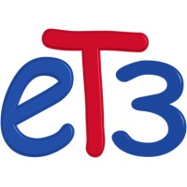

Internship 2024
GoCash
Under the supervision of
Eng. Ahmed Zakaria
Enterprise Integration Division Manager

Slide 2
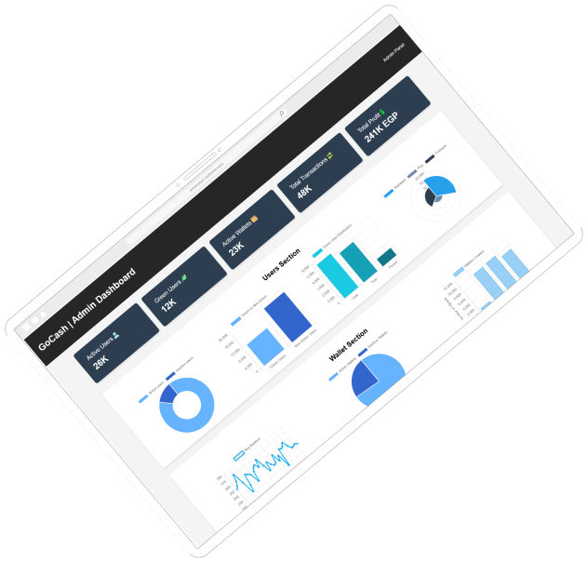
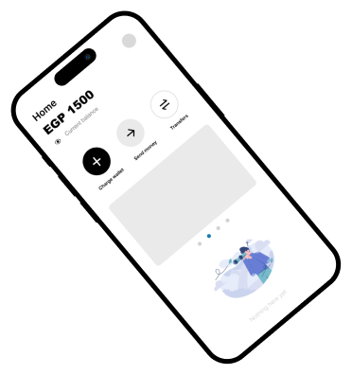

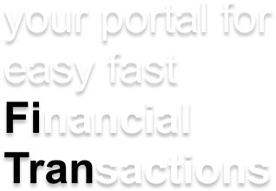
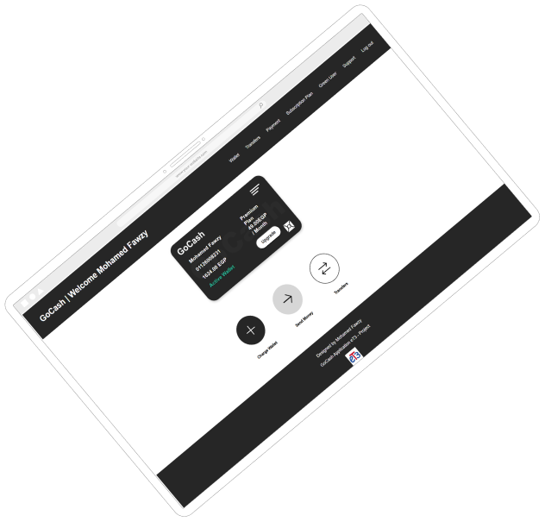
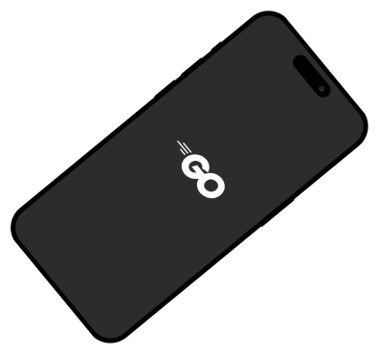

Slide 4
Presentation Plan
Overview
Project Timeline
System Architecture
UI Design
Live Demo
Future Enhancements

Slide 5
Presentation Plan
Overview
Project Timeline
System Architecture
UI Design
Live Demo
Future Enhancements

Slide 6
Project Overview
What is GoCash ?
GoCash is a modern payment and wallet application. It allows users to manage transactions, wallets, subscriptions, and green initiatives.
Core Features:
1- Simple easy to use Application
2- User Dashboard displaying user’s Information along with action buttons for fast and easy control.
3- Wallet charging, money transfers, and transaction logging.
4- Integration of APIs for secure and scalable functionality.

Slide 7
Presentation Plan
Overview
Project Timeline
System Architecture
UI Design
Live Demo
Future Enhancements

Slide 8
Presentation Plan
Overview
Project Timeline
System Architecture
UI Design
Live Demo
Future Enhancements

