Slide 1




Development of BUG TRACKING SYSTEM
TEAM NAME :- GLITCH GLADIATORS
TEAM CODE :- DA3-HYD-TEAM4
Presented By:-
1. Dayala Siddartha Naidu
(Team Lead)
2. Mohammad Kashif
3. Shantanu Dash
4. Agampreet Kaur
5. Preeti Poddar
6. Maddirala Sai Srinivas Sujan
CODE FURY
CHALLENGE 2024
Under the guidance of the GLOBAL TECHNOLOGY ACADEMY

Slide 2


Problem statement
The requirement was to create an online bug tracking system for technical projects.
As with all technical projects, we consider the involvement of employees of the organisation divided into 3 roles – Developers, Testers and Project Managers.
There must be different projects involving different developers, testers and controlled by managers.
Testers should be able to raise bugs for their projects, developers should be able to resolve bugs. The platform should streamline the bug management process in projects, including bug creation, bug documentation, bug status tracking, bug resolution, bug closure, etc.

Slide 3
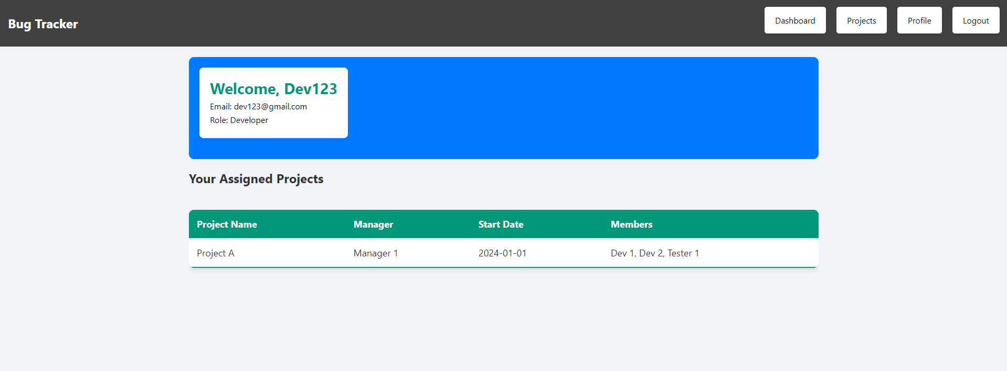
APP FUNCTIONALITY
DEVELOPER PROFILE PAGE

Slide 4
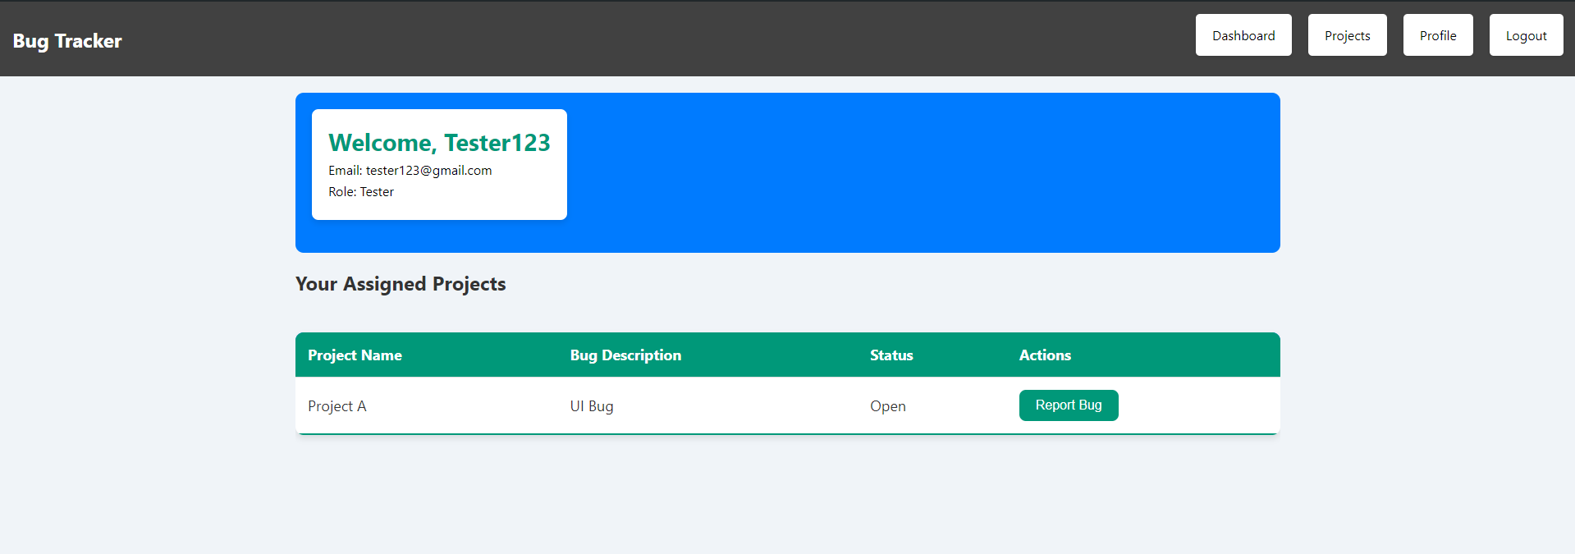
TESTER PROFILE PAGE

Slide 5
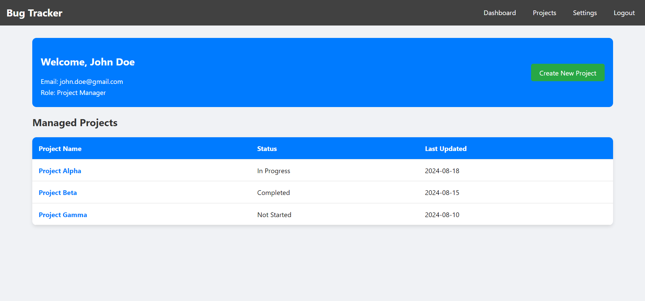
PROJECT MANAGER PROFILE PAGE

Slide 6
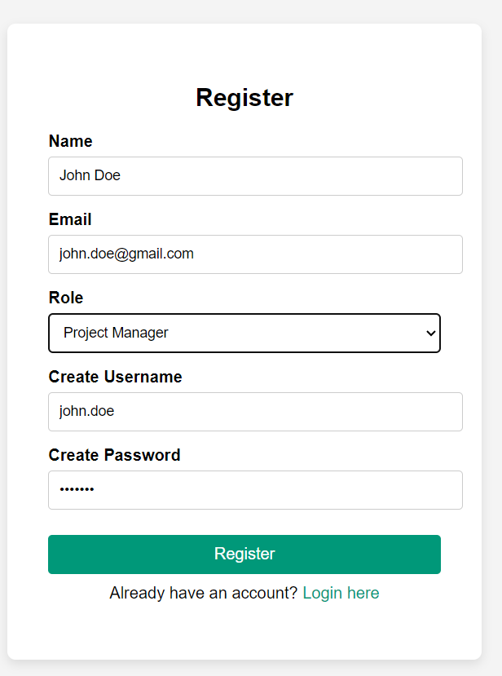
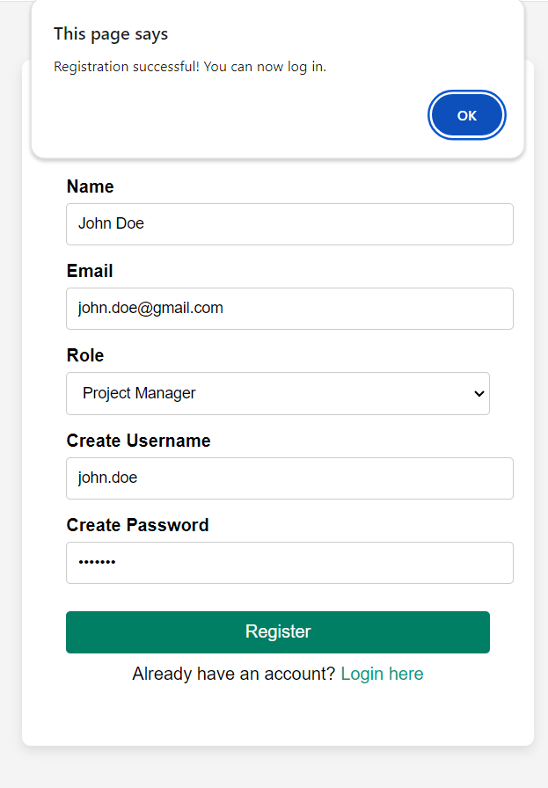
User Registration
User Registration Successful

Slide 7
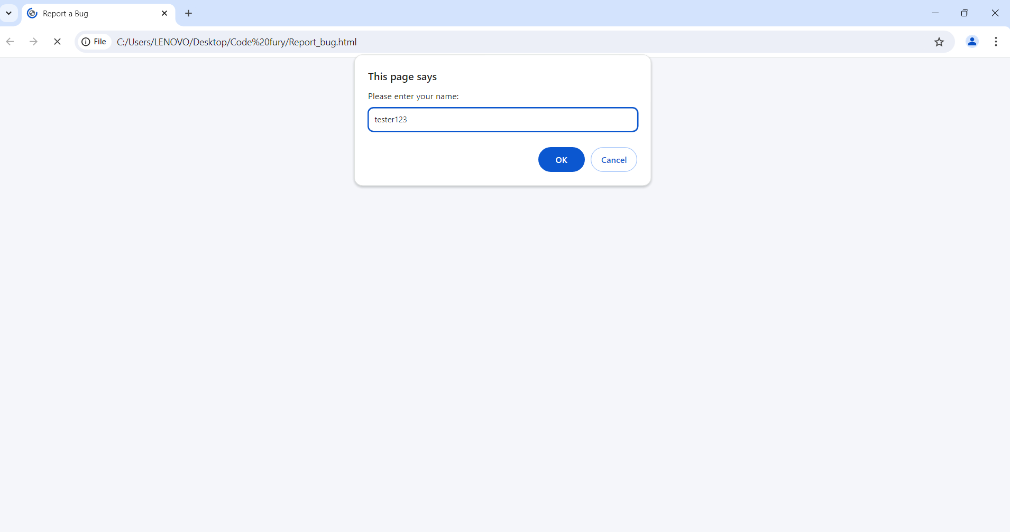
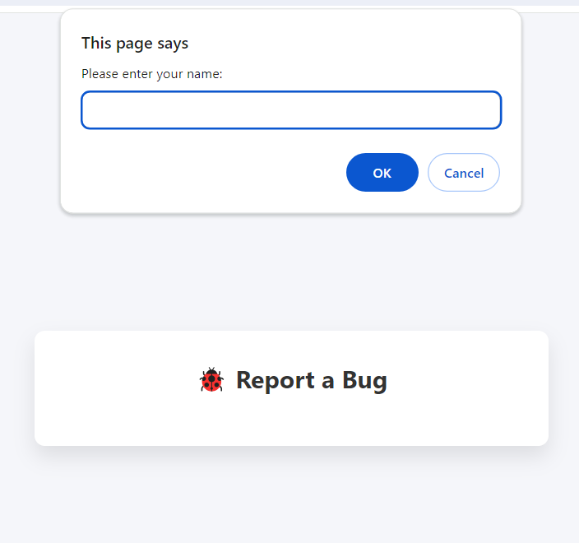
Tester logs in
Bug Report Main Page

Slide 8
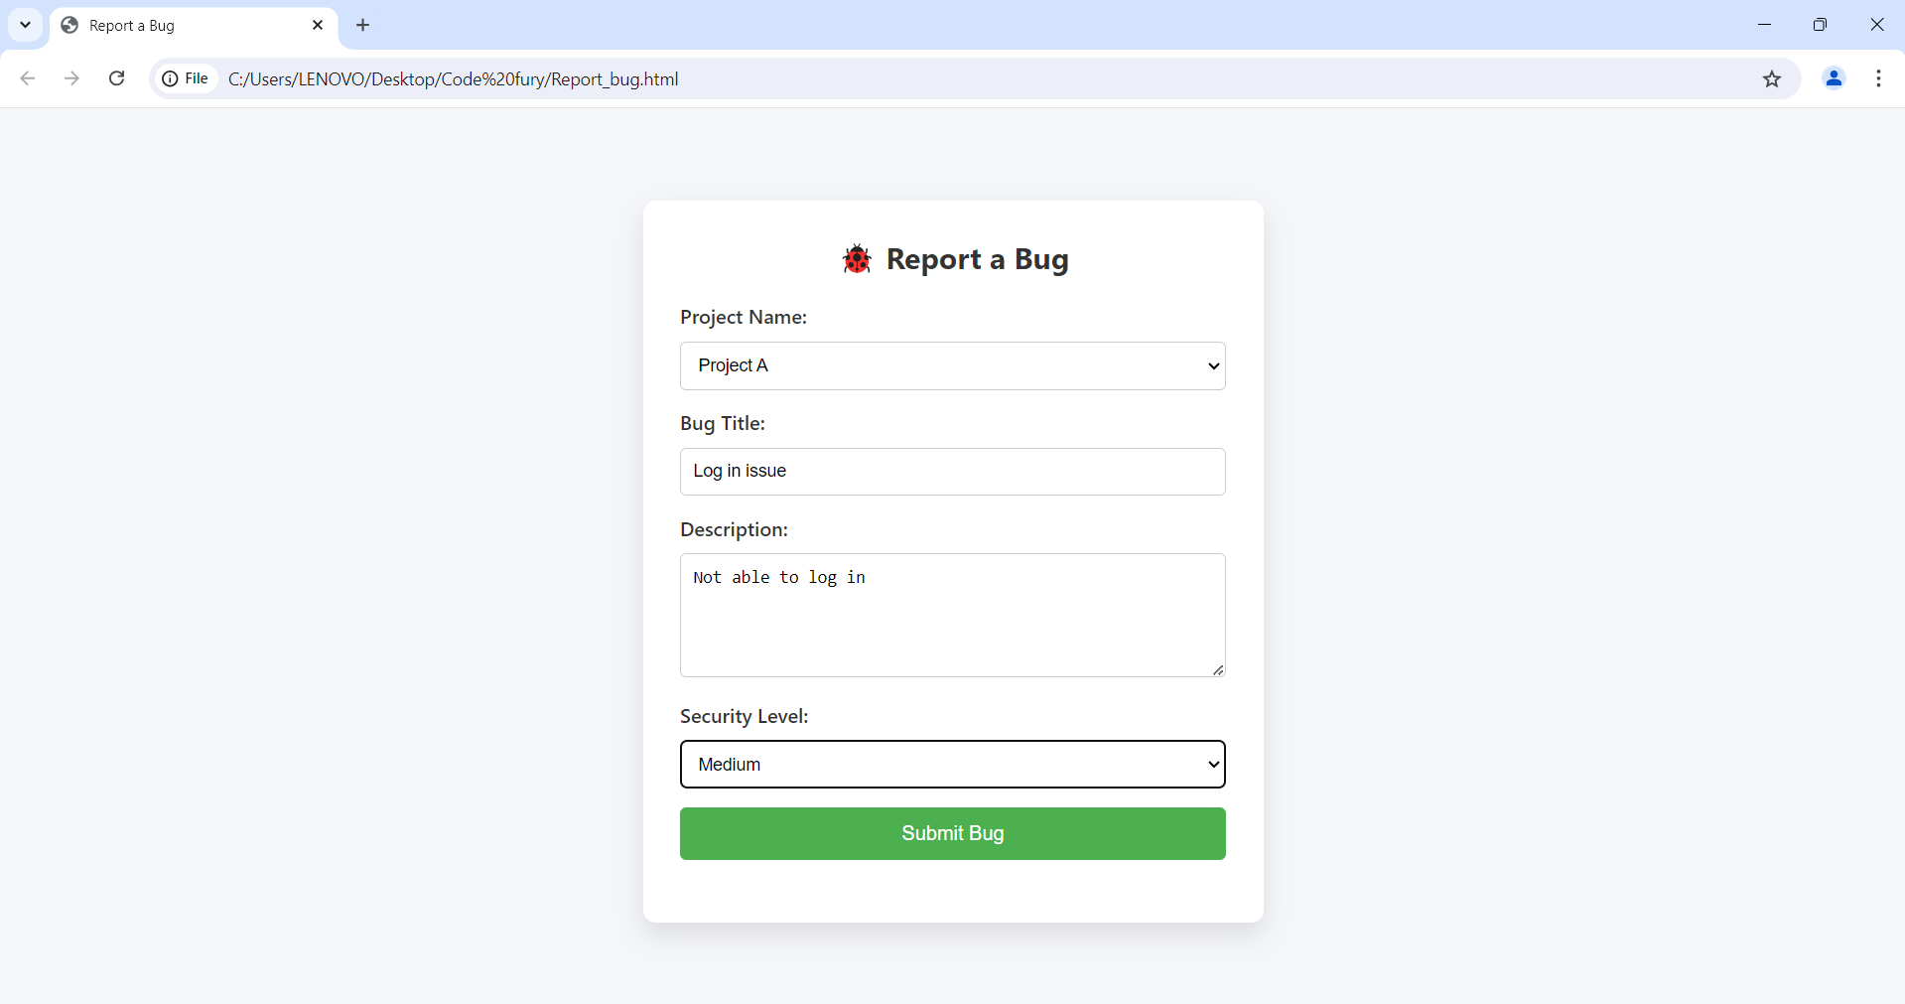
Bug Report Form
Accessible for tester named –
tester123

Slide 9
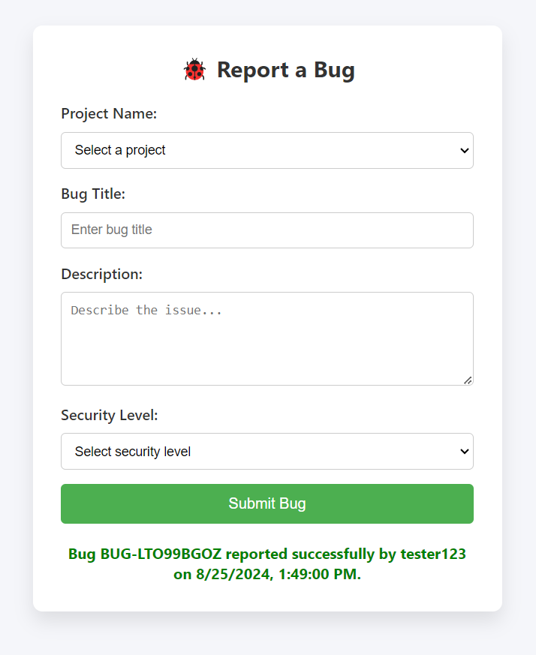
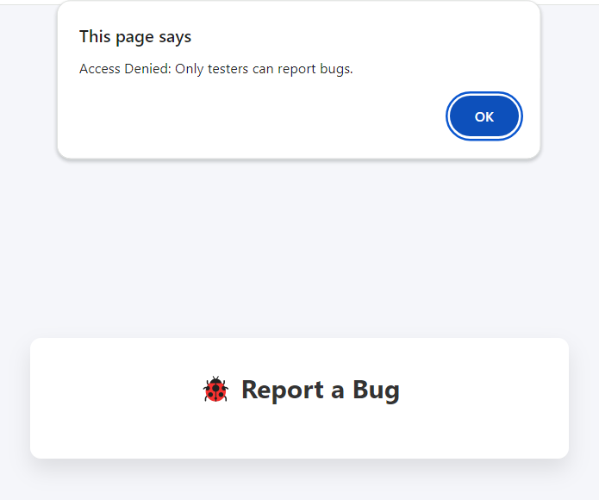
Login denied for
users other than a tester
Bug reported successfully

Slide 10

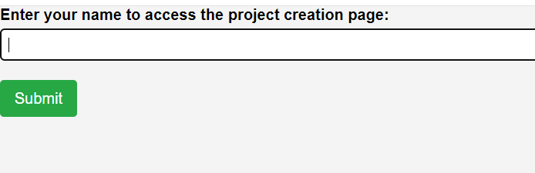
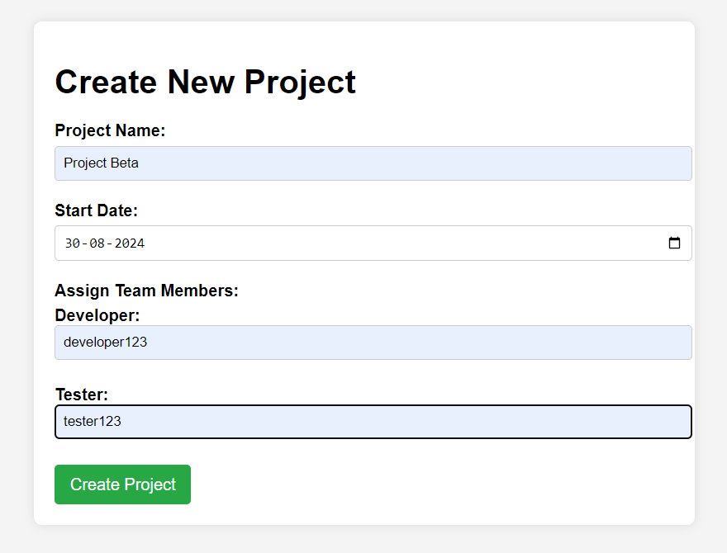
Authorization for Project Creation
New Project creation page
Accessible for manager named – John Doe

Slide 11
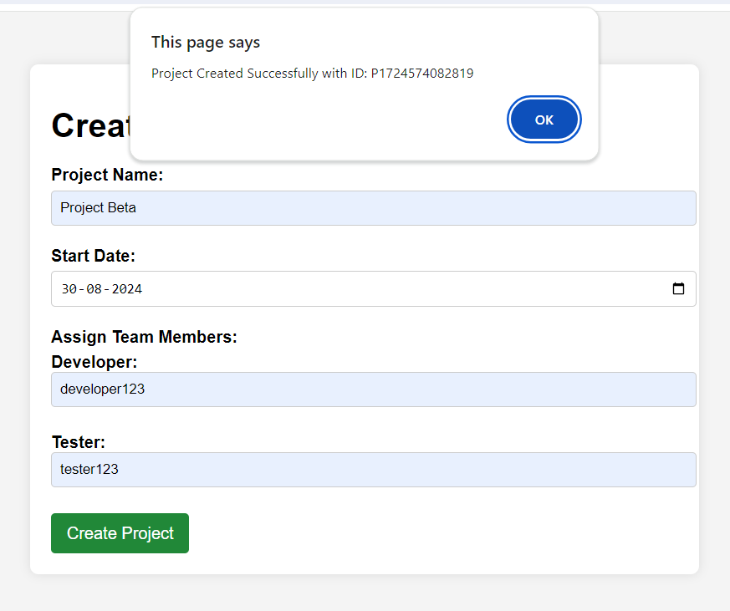
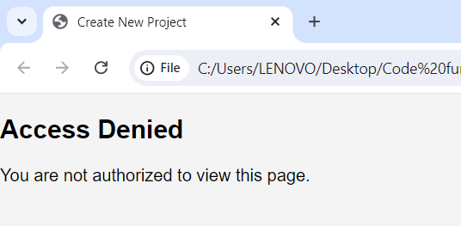
Authorization for Project Creation
No access for non-manager employees

Slide 12

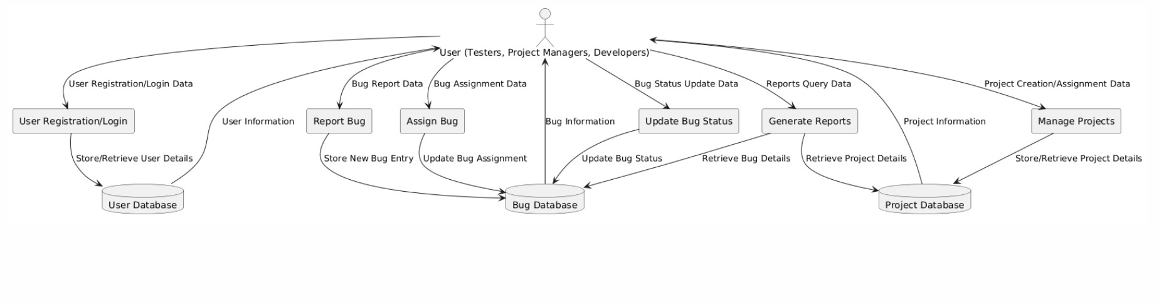
Data flow of the application

Slide 13


HIGHLIGHTS OF OUR LEARNING

Slide 14
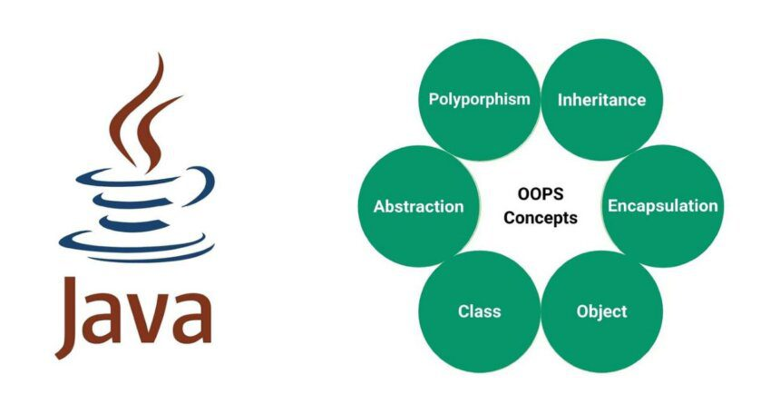
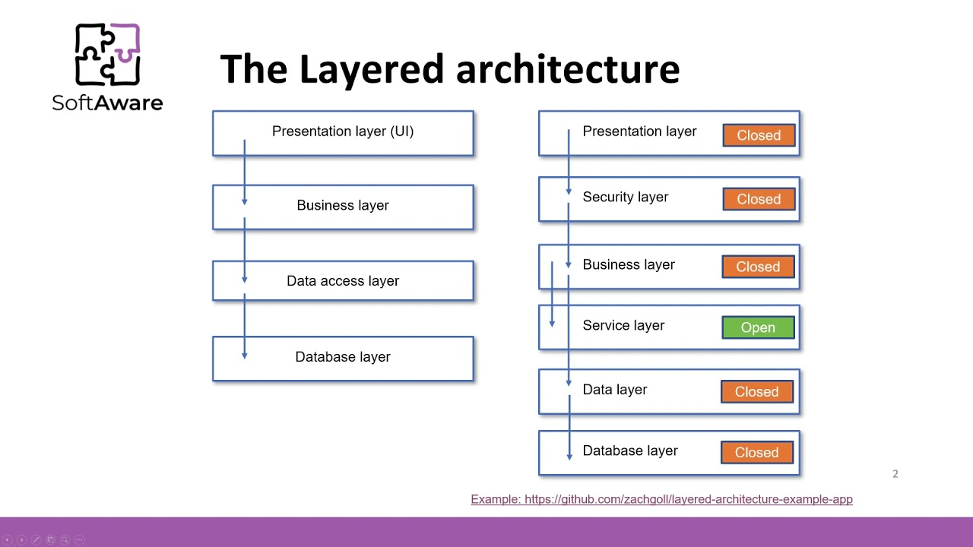
CONCEPTS
Java Classes & Objects – Encapsulation, Inheritance, Polymorphism, Abstraction
Instance, static variables, methods, memory management, packages, constructors, interfaces
Layered Architecture – View Layer, Controller Layer, Service Layer, DAO Layer, Database implementation, Factory pattern
Exception handling, File handling, Multithreading, Collection Framework, Testing with JUnit and Debugging, SQL and working with JDBC
Other Technologies – HTML, CSS, JAVASCRIPT, AJAX, JSON, Server & Servlets, HTTP

Slide 15








TECHNICAL TOOLS

Slide 16




COLLABORATION TOOLS

Slide 17
THANK YOU

