Slide 1
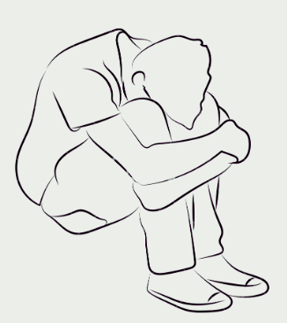
ANALYZE THE VARIABILITIES IN THE SPOKEN RESPONSE OF
DEPRESSED VS NON-DEPRESSED.
HEMAL SHAJI
MOHAMMED AMAAN

Slide 2
CONTENT
Introduction
What is Depression?
Varibilities in Spoken Responses
Objectives
1.Prepare emotional abstract words stimuli.
2. Collect spoken Responses
3.Design & Methodology
Results
Conclution

Slide 3
WHAT IS DEPPRESION?
It is a serious mood disorder that has become one of the major diseases that threaten human mental health
People with depression may experience symptoms such as:
Feelings of sadness, tearfulness, or hopelessness
Loss of interest or pleasure in normal activities
Sleep disturbances (insomnia or excessive sleep)
Fatigue and lack of energy

Slide 4
VARIABILITIES IN SPOKEN RESPONSES
Pitch
Interaction and Responsiveness
Energy & Speech rate
Speech tempo & Rhythm
diminished responses to positive stimuli and Vise Versa

Slide 5
OBJECTIVE
we focused on preparing text-based objects suitable for display, facilitating subsequent analysis
we collected spoken responses from participants in both Indian English and their native languages, recognizing the significance of linguistic details in our investigation
Analyze the cues from the responses to detect a depressed population

Slide 6
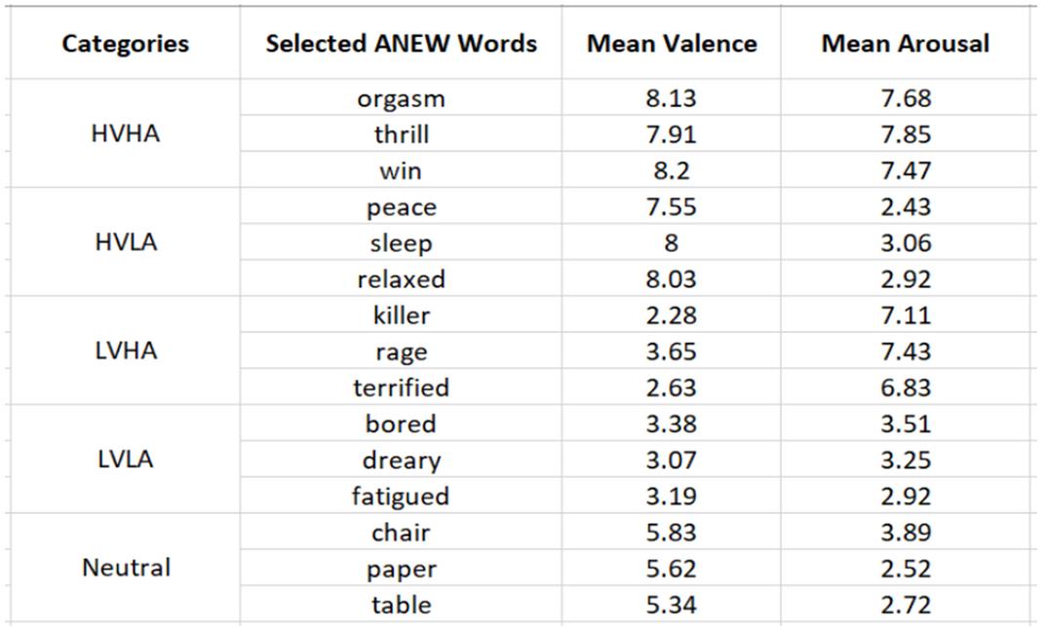
PREPARING TEXT BASED OBJECTS
ANEW (Affective Norms of English Words).
ANEW is a set of 1034 emotion evoking words.
It is rated in terms of pleasure, arousal, and dominance.
They have chosen 5 categories
For each category they taken 3 words each

Slide 7
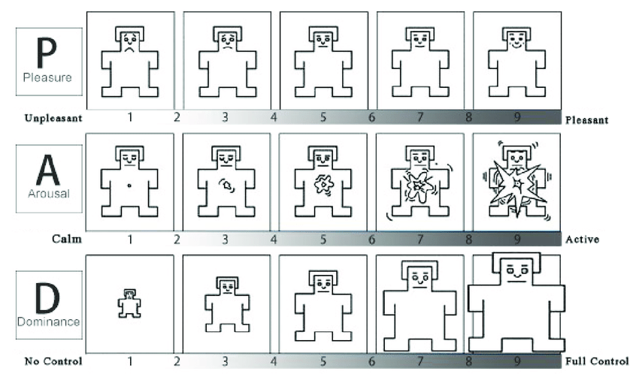
PREPARING TEXT BASED OBJECTS
To assess the dimensions of pleasure, arousal, and dominance, the Self-Assessment Manikin (SAM) scale is used.
The two primary dimensions were one of affective valence (ranging from pleasant to unpleasant) and one of arousal (ranging from calm to excited).

Slide 8
DATA COLLECTION
People in the age group of 18 - 35
Fluent in Indian English and Malayalam,
participants were classified into five depression severity categories based on their PHQ-9 score
• None: 39 participants
• Mild: 63 participants
• Moderate: 36 participants
• Moderately Severe: 7 participants
• Severe: 4 participants
They have selected 15 words (three from each of the five ANEW categories) based on their Self-Assessment Manikin (SAM) ratings obtained from a separate survey with college students

Slide 9
DATA COLLECTION
TASK FOR PARTCIPANTS
1) Affective Rating Task
Participants viewed each word and rated their valence and arousal 9 point Likert scale
The SAM scale served as a visual aid for self reported valence and arousal ratings
Property Generation Task
Participants verbally de scribed their thoughts, feelings, and memories evoked by each word for a
minimum of 20 seconds. They were presented with 15 such words. They were instructed to avoid single
words, phrases, or definitions, Before the experiment, participants received an example word and
spoken response to familiarize them with the task
Mental Health Survey
Participants completed the Patient Health Questionnaire (PHQ-9). Participants read each statement and
selected the response that best described their current state of mind. The PHQ-9 score was obtained by
summing the ratings of its 9 items (0-3 scale).

Slide 10
METHODOLOGY

Slide 11
DATA PREPROCESSING
Raw audio data often comes in various formats (WAV, M4A, MP3). To ensure uniformity and facilitate analysis, they converted all audio files to the .m4a format.
Consistent sampling rate is crucial for accurate comparisons and model training For standardization they sampled data across the dataset to a sampling rate of 16 kHz

Slide 12
FEATURE EXTRACTION
They extract three features
Mel-filterbank (MFB) features,
aperiodic
fundamental frequency
WORLD vocoder system
Normalization
Segmentation
Labeling

Slide 13
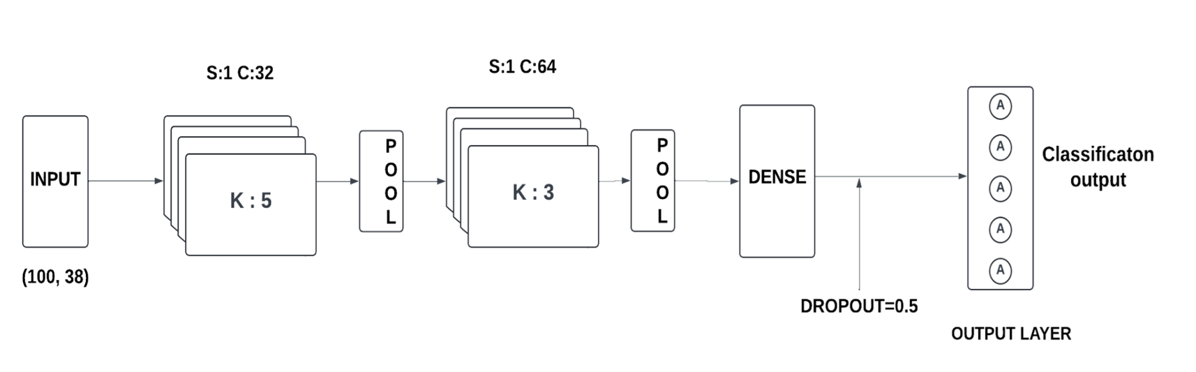
MODEL SELECTION
Inorder to analyze the variabilities we will be focusing on various deep learning models such as CNN, LSTM, BiLSTM.
CNN

Slide 14
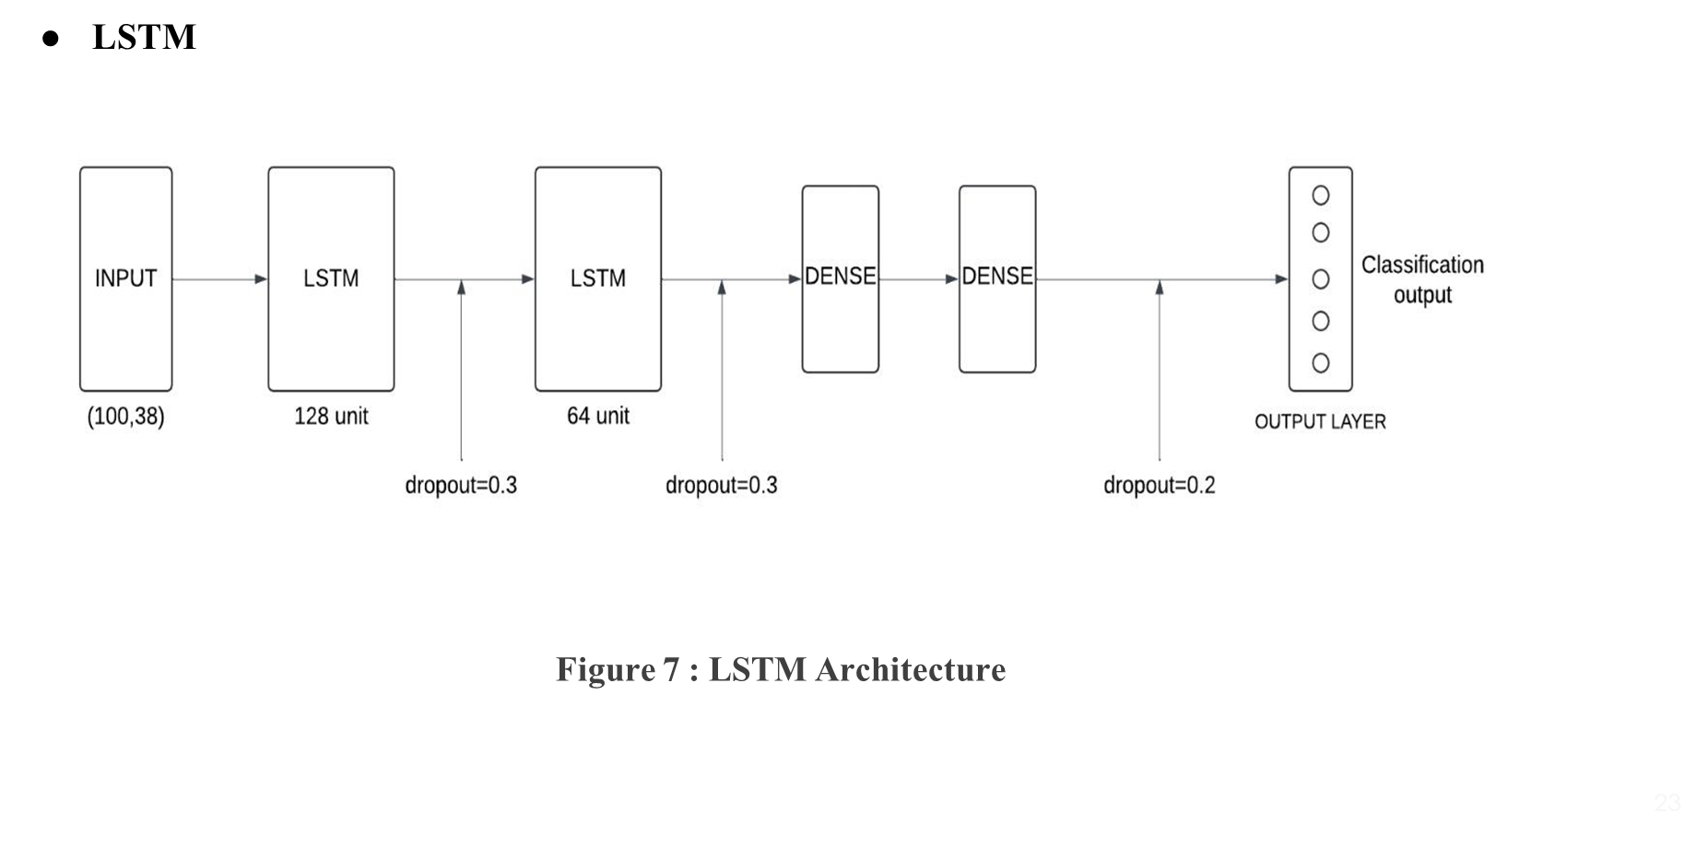
MODEL TRAINING

Slide 15
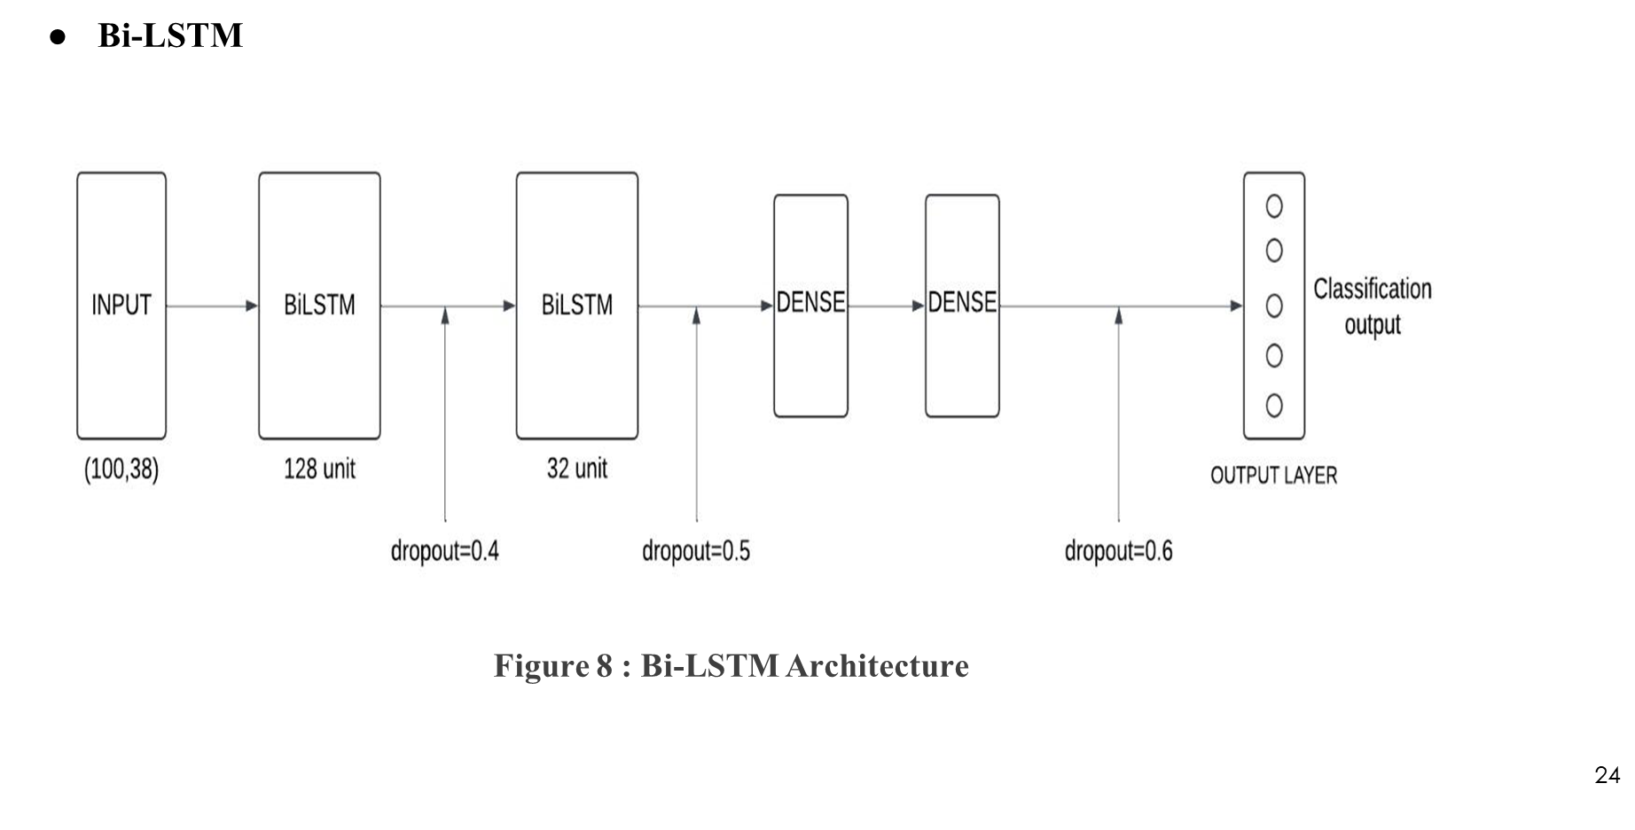
MODEL TRAINING

Slide 16
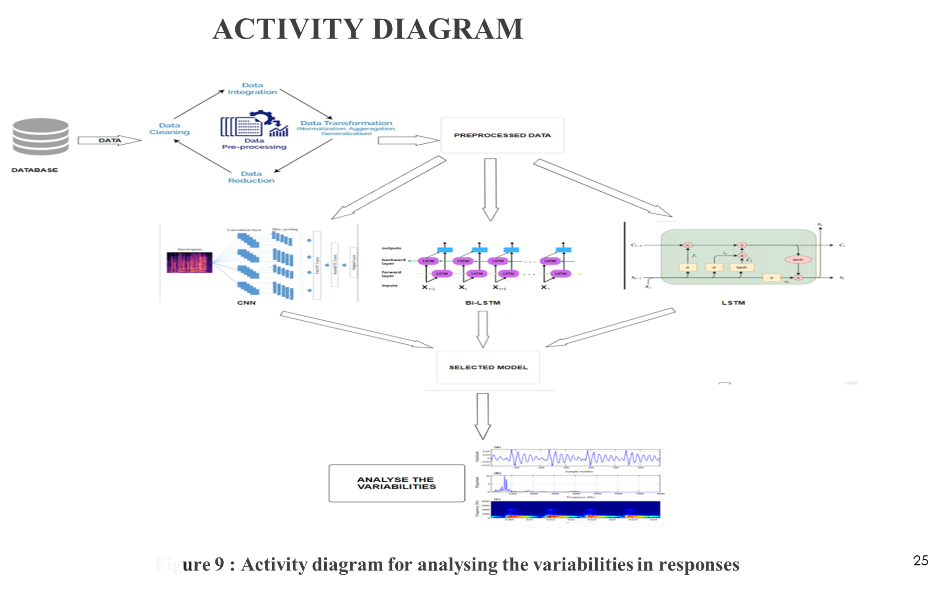

Slide 17
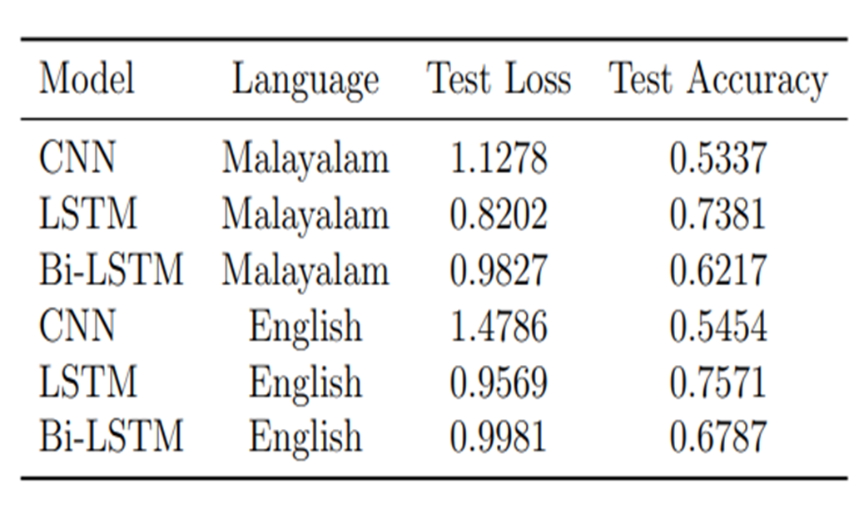
RESULT

Slide 18
CONCLUSION
To sum up, this study highlights how important language analysis is to improving our knowledge and early diagnosis of depression, especially when it comes to spoken responses.

Slide 19
Thank You...

