Slide 1
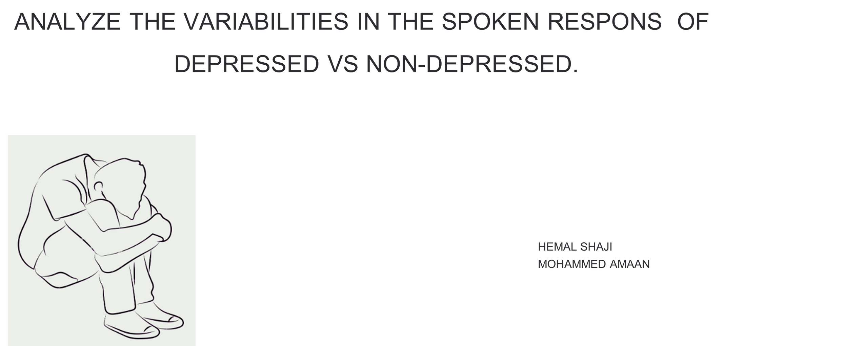

Slide 2
DATA COLLECTION
•People in the age group of 18 - 35
•Fluent in Indian English and Malayalam,
• participants were classified into five depression severity categories based on their PHQ-9 score
• None: 39 participants
• Mild: 63 participants
• Moderate: 36 participants
• Moderately Severe: 7 participants
• Severe: 4 participants
•They have selected 15 words (three from each of the five ANEW categories)
-They has stored the transcript of each audio responses.

Slide 3
TASK FOR PARTCIPANTS
1) Affective Rating Task
Participants viewed each word and rated their valence and arousal 9 point Likert scale
The SAM scale served as a visual aid for self reported valence and arousal ratings
2)Property Generation Task
Participants verbally de scribed their thoughts, feelings, and memories evoked by each word
for a minimum of 20 seconds. They were presented with 15 such words. They were instructed
to avoid single words, phrases, or definitions, Before the experiment, participants received an
example word and spoken response to familiarize them with the task
3)Mental Health Survey
Participants completed the Patient Health Questionnaire (PHQ-9). Participants read each
statement and selected the response that best described their current state of mind. The
PHQ-9 score was obtained by summing the ratings of its 9 items (0-3 scale).

Slide 4
DEPRESSION DETECTION FROM AUDIO
Depressed individuals may show distinct acoustic patterns in these audios, such as less variation in pitch and slower speech rates when responding to emotional words compared to non-depressed individuals."
Perform sentiment analysis on the descriptions provided by students for each word. Depressed individuals may use more negative language or exhibit a tendency to recall unpleasant memories or associations, which could be detected through sentiment scoring and keyword analysis
Depressed individuals might show reduced emotional variability in their responses. This means their responses might be less expressive or dynamic across different categories of words. For example, they might not show as much enthusiasm or emotional intensity in response to HVHA words or as much relaxation in response to HVLA words.

Slide 5
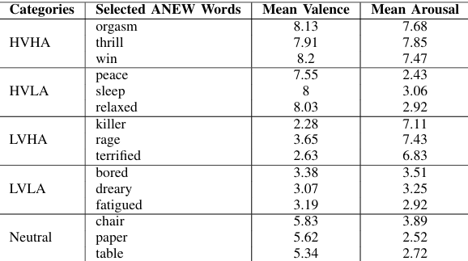
DEPRESSION DETECTION FROM AUDIO
We can create a embedded model by using the audio and transcript which help us to accurately predict the depression level
Self-reference ratio:
Calculate the ratio of self-references to references to others or external events. Depressed individuals
often show a higher self-reference ratio, indicating more self-focused attention.
.

Slide 6
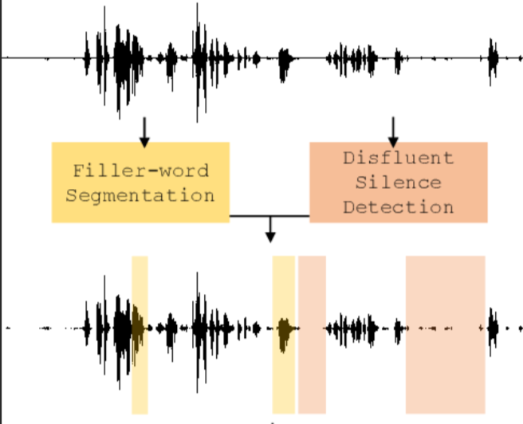
DEPRESSION DETECTION FROM AUDIO
Silence and filler word analysis:
Measure the duration and frequency of pauses and the use of
filler words (e.g., "um", "uh"). Depressed individuals might
exhibit more frequent or longer pauses and increased use of
filler words, indicating potential cognitive processing
difficulties.
Lexical diversity and complexity:
Calculate metrics like Mean Length of Utterance (MLU) for each
response. Depressed individuals might show reduced lexical
diversity and use simpler language structures in their responses.
Breathing patterns:
Analyze the frequency and depth of audible breaths. Depressed individuals might show
altered breathing patterns, such as more frequent sighing or shallow breathing.

Slide 7
DEPRESSION DETECTION FROM TEXT
Sentiment Scores: We'll use a sentiment analysis library (like VADER or TextBlob) to calculate positive, negative, and neutral sentiment scores for each response. Scores range from 0 to 1
Higher score indicates stronger sentiment in that category
Emotion Word Counts involve creating lists of positive and negative emotion words and then counting their occurrences in each response.
To assess emotional variability in text from audio, categorize words into HVHA and LVLA groups and analyze their frequency and context. Depressed individuals often show less variability in emotional expressions, with frequent low-arousal words suggesting reduced emotional range and possible depression

Slide 8
DEPRESSION DETECTION FROM TEXT
Linguistic Complexity Analysis
What We Measure:
a) Average word length
b)Sentence length
c)Type-Token Ratio (unique words / total words)
Depressed individuals tend to use shorter words and sentences, reflecting their mental state. Non-
depressed individuals often have longer, more complex sentences and diverse vocabularies.
Examining these linguistic features across multiple responses reveals consistent patterns that help
differentiate between individuals, aiding in the detection of depression.
Pronoun usage
depressed individuals tend to use more first-person singular pronouns (I, me, my), indicating self-
focus and personal distress.
In contrast, non-depressed individuals might use more first-person plural pronouns (we, us, our),
reflecting a sense of connection with others and broader social engagement.

Slide 9
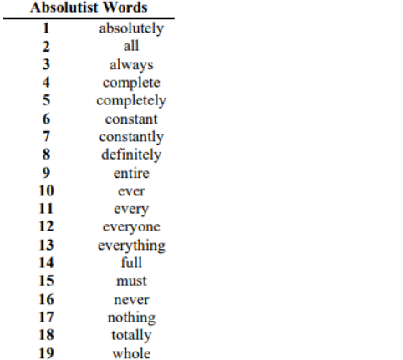
DEPRESSION DETECTION FROM TEXT
Absolustic Words:
We'll look at how absolute terms are used with positive or negative emotions.we can
gain insights into a person's emotional state. Depressed individuals may use more
absolute negative terms, indicating a more pessimistic perspective, while non-
depressed individuals are more likely to use positive or neutral absolute terms.
Temporal Focus:
We count the number of past, present, and future tense verbs in each response to
determine temporal focus. Depressed individuals often use more past tense verbs,
reflecting rumination on past events. Non-depressed individuals are more likely to use
present and future tense verbs, indicating a focus on current activities and future
plans.
Metaphor Analysis: Examining metaphors helps us understand emotional states, with depressed individuals using negative metaphors that reflect pain and struggle, while non-depressed individuals use positive or neutral metaphors that suggest a more balanced or hopeful outlook.

Slide 10
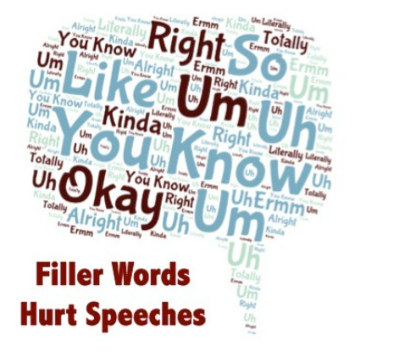
DEPRESSION DETECTION FROM TEXT
Hesitation and filler words:
People who are depressed often use more fillers like "um" and "uh" and show more signs of hesitation by counting how often these elements appear in a text, you can find patterns that may suggest whether someonedepressed or not. Comparing these counts between different texts can help in classifying the emotional state

Slide 11

Thank
You

