Slide 1
Introduction

Slide 2
Problem description

Slide 3

Dataset
`

Slide 4



Tools and Libraries

Slide 5
Exploratory data analysis (EDA)
Data cleaning and Pre-processing
- How to use Libraries?
- How to using Panads to read data
-How to clean data ?
- What the insights from Visualization

Slide 6
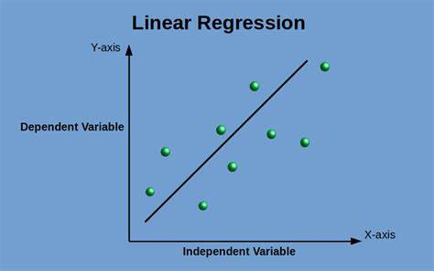
Data Modelling
- linear regression algorithm

Slide 7
Results

