Slide 1

Battle of Neighbourhoods in Munich

Slide 2
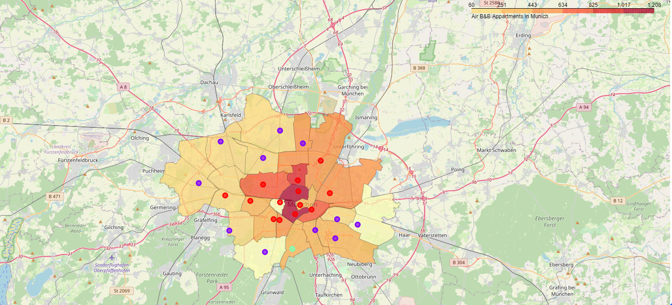
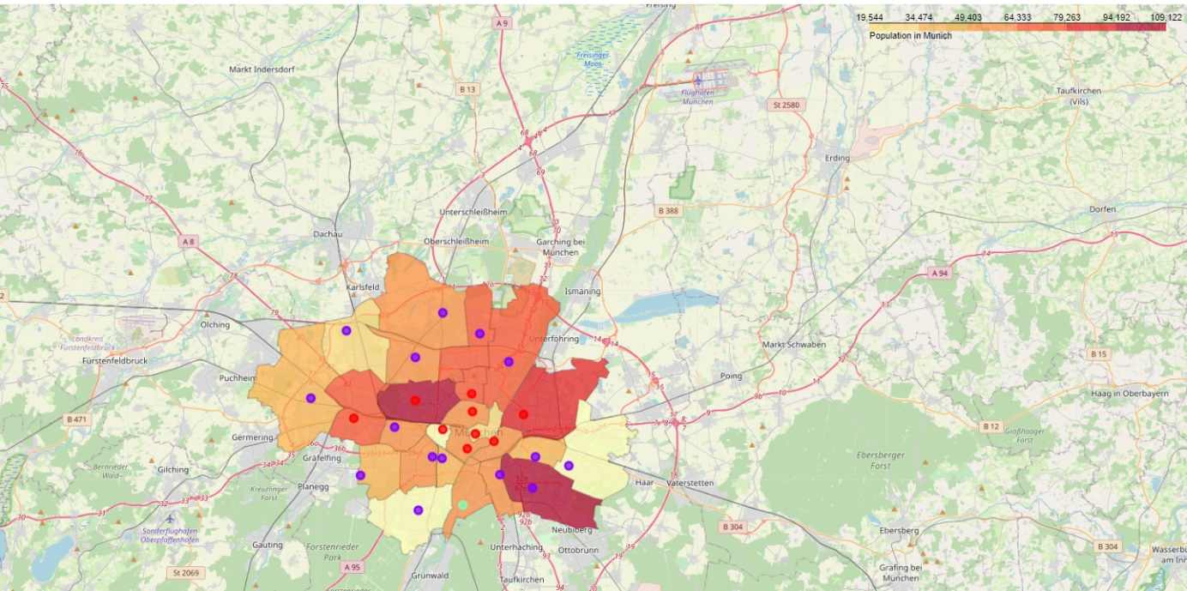
Kmeans Clustering
Number of apartments
Population
Kmeans clustered Munich to an inner and outer circle
The inner city has many AirB&B apartments
First idea: inner city might be better
Questions:
But: are there already enough Bavarian restuarants?
Is the population or the number of apartments more important?

Slide 3
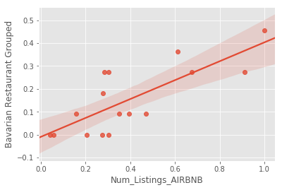
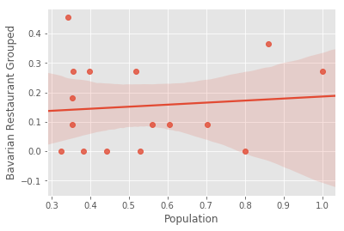
Identify the crucial parameter
Simple linear regression shows correlation between number of apartments and Bavarian restaurants
Population has no significant effect on number of Bavarian restuarants
→ Concentrate on number of apartments

Slide 4
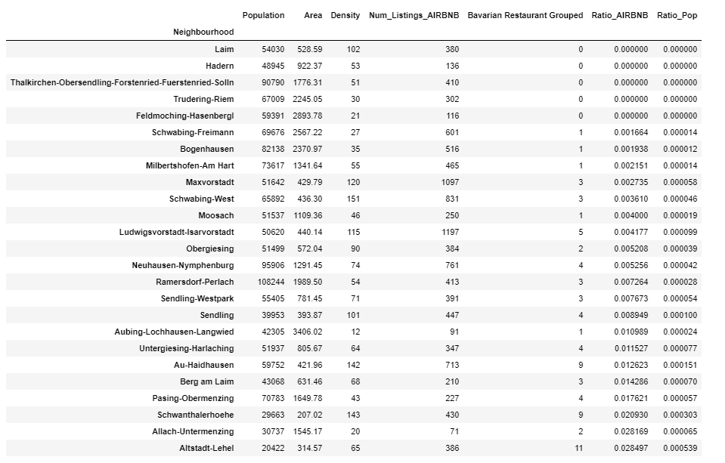
Find the Best Ratio
Ratio gives the following ranking to open a Bavarian restaurant:
Laim
Hadern
Thalkirchen-Obersendling-Fuerstenried-Solln

Slide 5
Coclusion
To options taking into consideration:
1. Decision based on number of Bavarian restuarants and population
2. Decision based on number Bavarian restaurants and AirB&B apartments
→ Stronger correlation of apartments and Bavarian restuarants, so the enterpreneur should open their restaurant in Laim, Hadern or Thalkirchen-Obersendling-Fuerstenried-Solln due to low number of restaurants compared with the number of apartments

