Slide 1
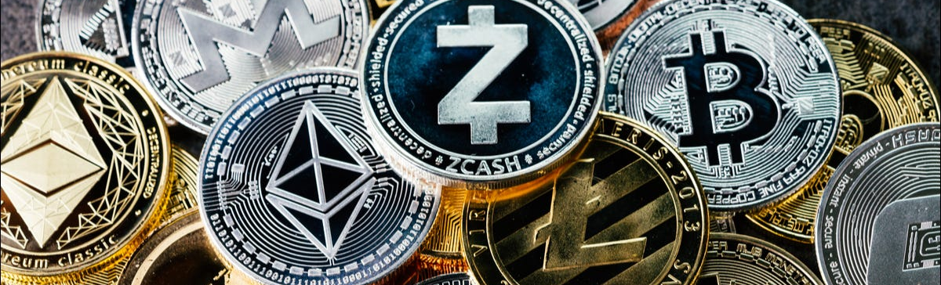
Flask search cryptocurrencies
Damir Akbarov
Elmira Orujova
SE-2008

Slide 2
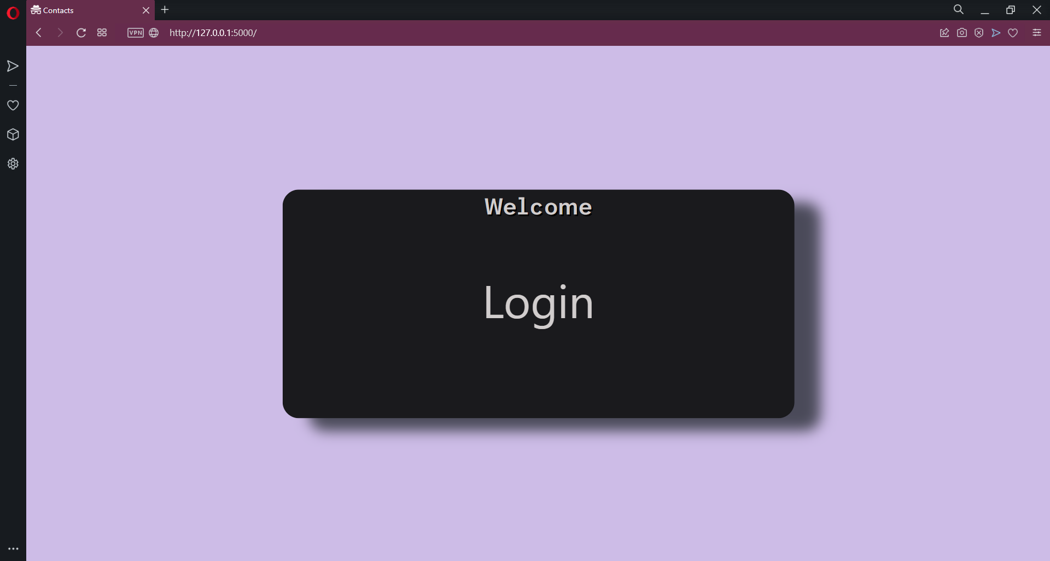
Start page

Slide 3
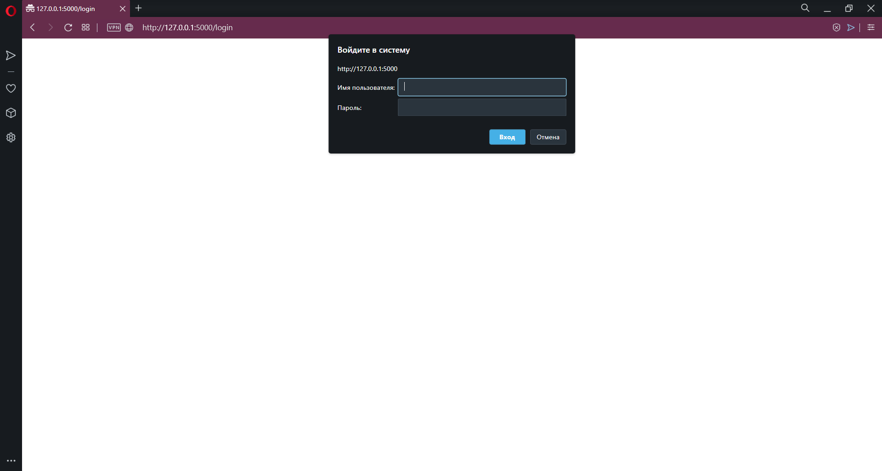
Login window

Slide 4
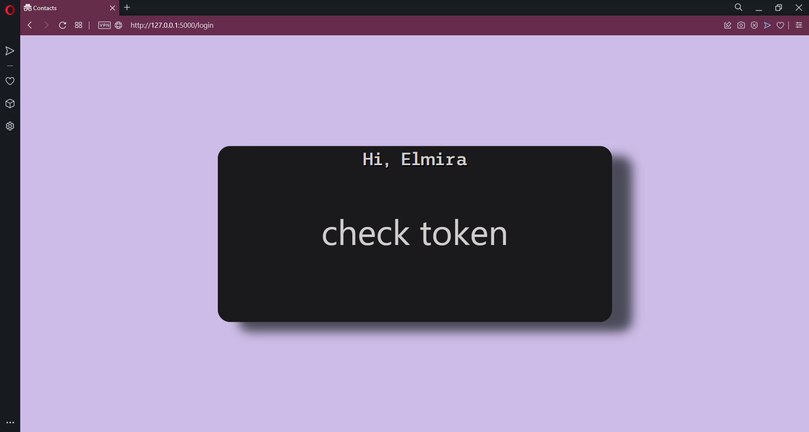
Checking token page

Slide 5

Confirmation

Slide 6
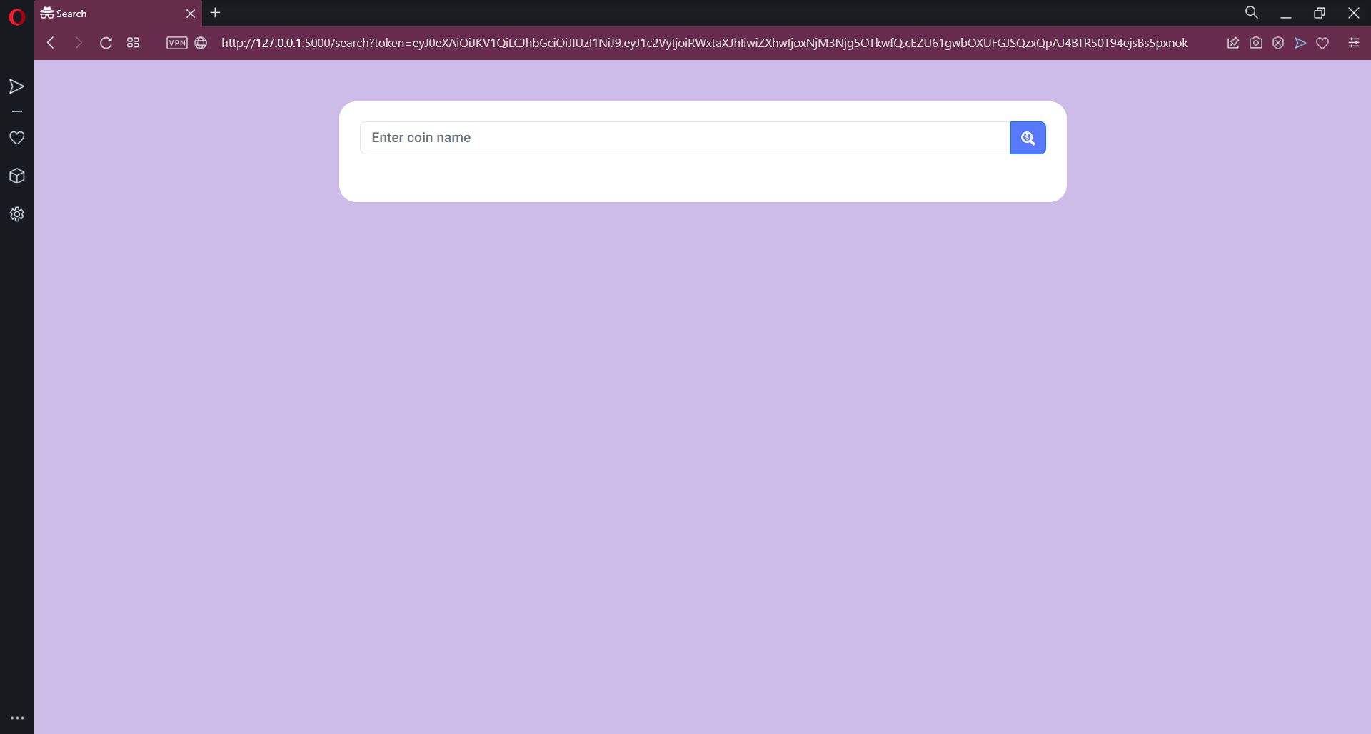
Search page

Slide 7
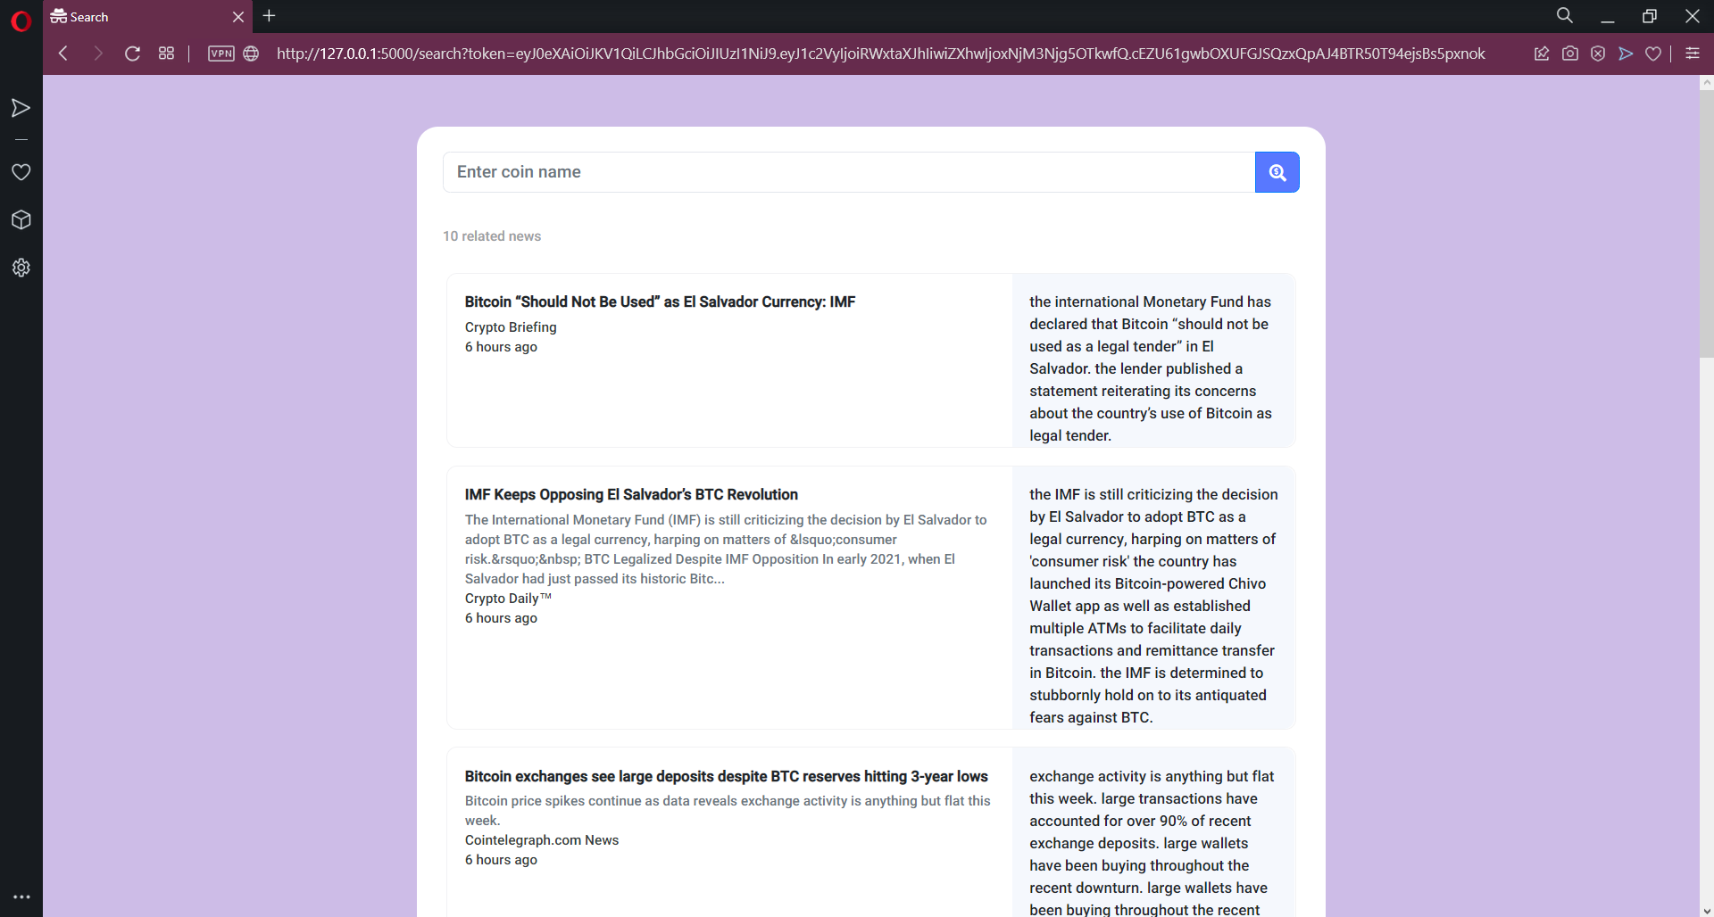
The results of search ‘bitcoin’

Slide 8
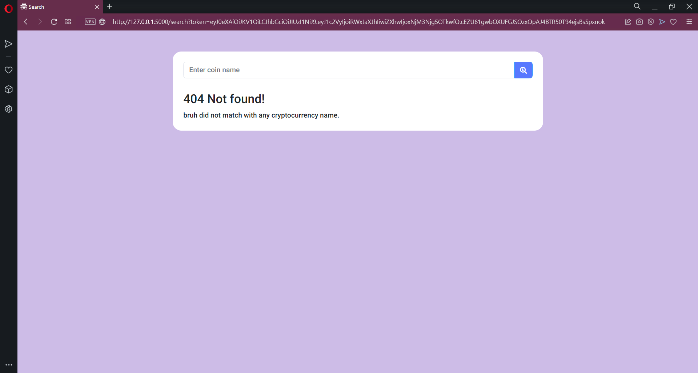
Cryptocurrency not found

Slide 9
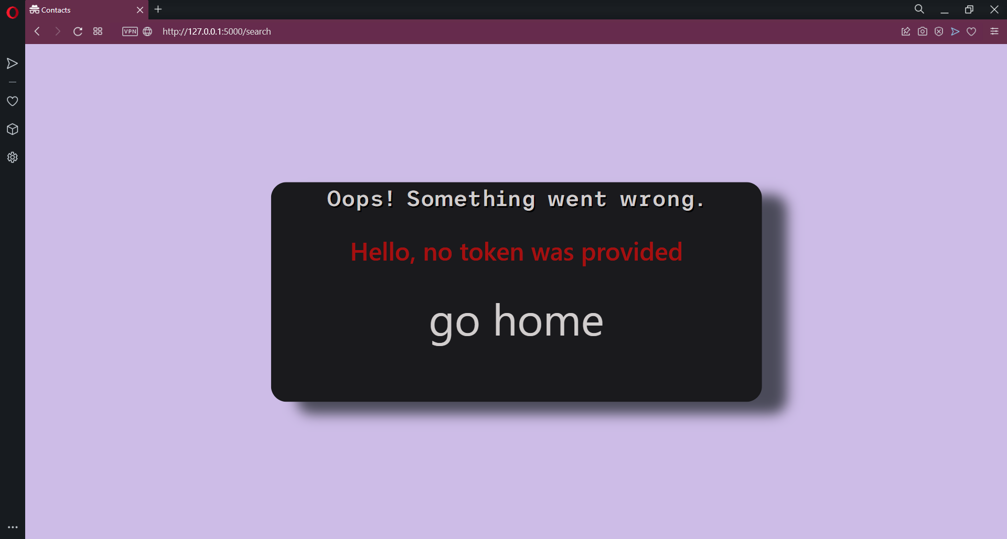
No token provided

Slide 10

Wrong token

