Slide 1
















江柏城 M10307432
江昱霖 M10307431
謝易家 M10407402
余能鈞 M10407509
智慧搭捷運
Smart Taipei Metro
Advisor : Dr. Chung-Hsien Kuo

Slide 2


Outline
1
Motivation
2
Architecture
3
System Flow
4
Technology
5
Vision of the future

Slide 3
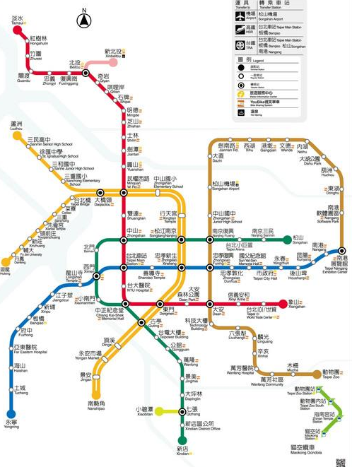
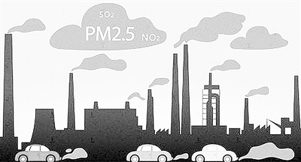
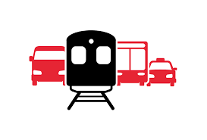


創作動機 Motivation
1
Public Transport
City Development
Tourism
Carbon Reduction
The route map is more complicated.
Notes:
大眾運輸工具發展
城市觀光
便捷交通
節能減碳

Slide 4

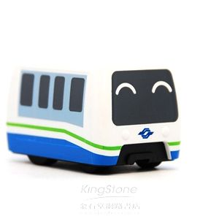
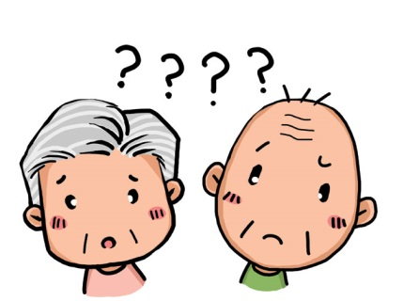


創作動機 Motivation
2
Problems
I've lost my way!
Scale.
Elders.
Complicated Routes
v
v
Tourists.
Transfer.
More and more stations.
Not easy to understand.
Unfamiliar.
Multi-ride routes.
Notes:
常見的問題
路網越來越複雜
年長者反應較慢，理解力較差
外地遊客人生地不熟
轉乘路線多多 霧煞煞

Slide 5
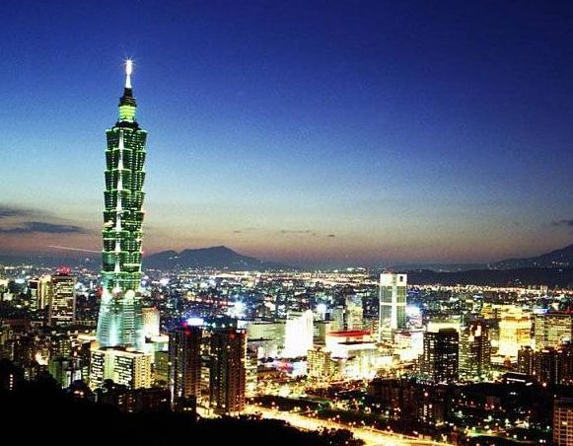
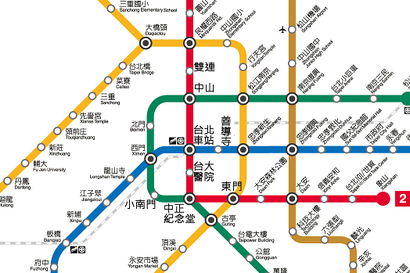
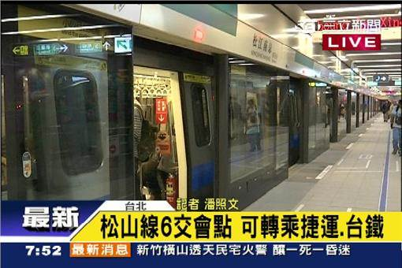
創作動機 Motivation
3
Smart Taipei Metro
Exploring the beauty of the city is very EASY.
Clear Information
Friendly Interface
Notes:
簡單友善的使用介面
清楚明確的乘車資訊
好好體驗台北城之美

Slide 6
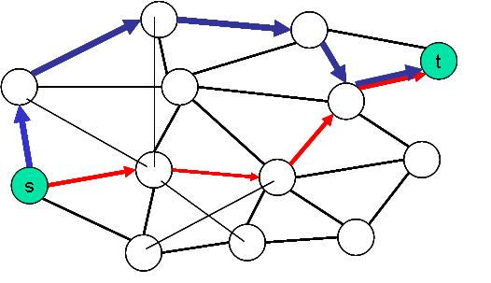
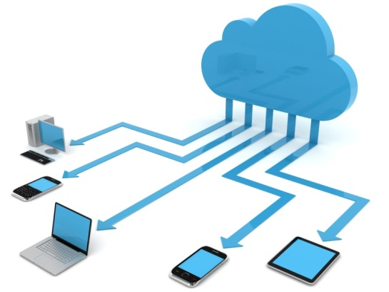
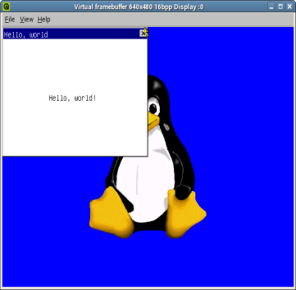
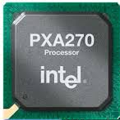
系統架構 Architecture
1
Composition
User Interface
Analysis
Platform
Cloud
MiniGUI
PXA-270
Data Base & Routing
Cloud Application

Slide 7




系統流程 System Flow
2
Scenario
User
Elders, tourists and inexperienced
1
Travel around Taipei City or go to somewhere
Input
Where are you?
Where to go ?
2
Setting current location and destination
Analysis
Data base searching and routing
3
Parsing from data base, computing data and routing
Display
Providing clear information
4
Price, time, distance and transfer information

Slide 8
系統流程 System Flow
3
Flow Chart
Start
Create
Main Window
GUI Initialization
Data Base Initialization
Routing
Information
Computing Engine
Station Selector
Display
Updating Processing

Slide 9
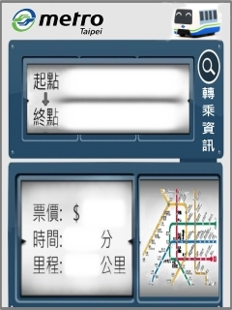
技術應用 Technology
4
User Interface - MiniGUI
Input Botton
台北車站
公館
Text View
Simple Input
Travel Info.
20
Bitmap
Transfer Info.
10
5
Route Map

Slide 10
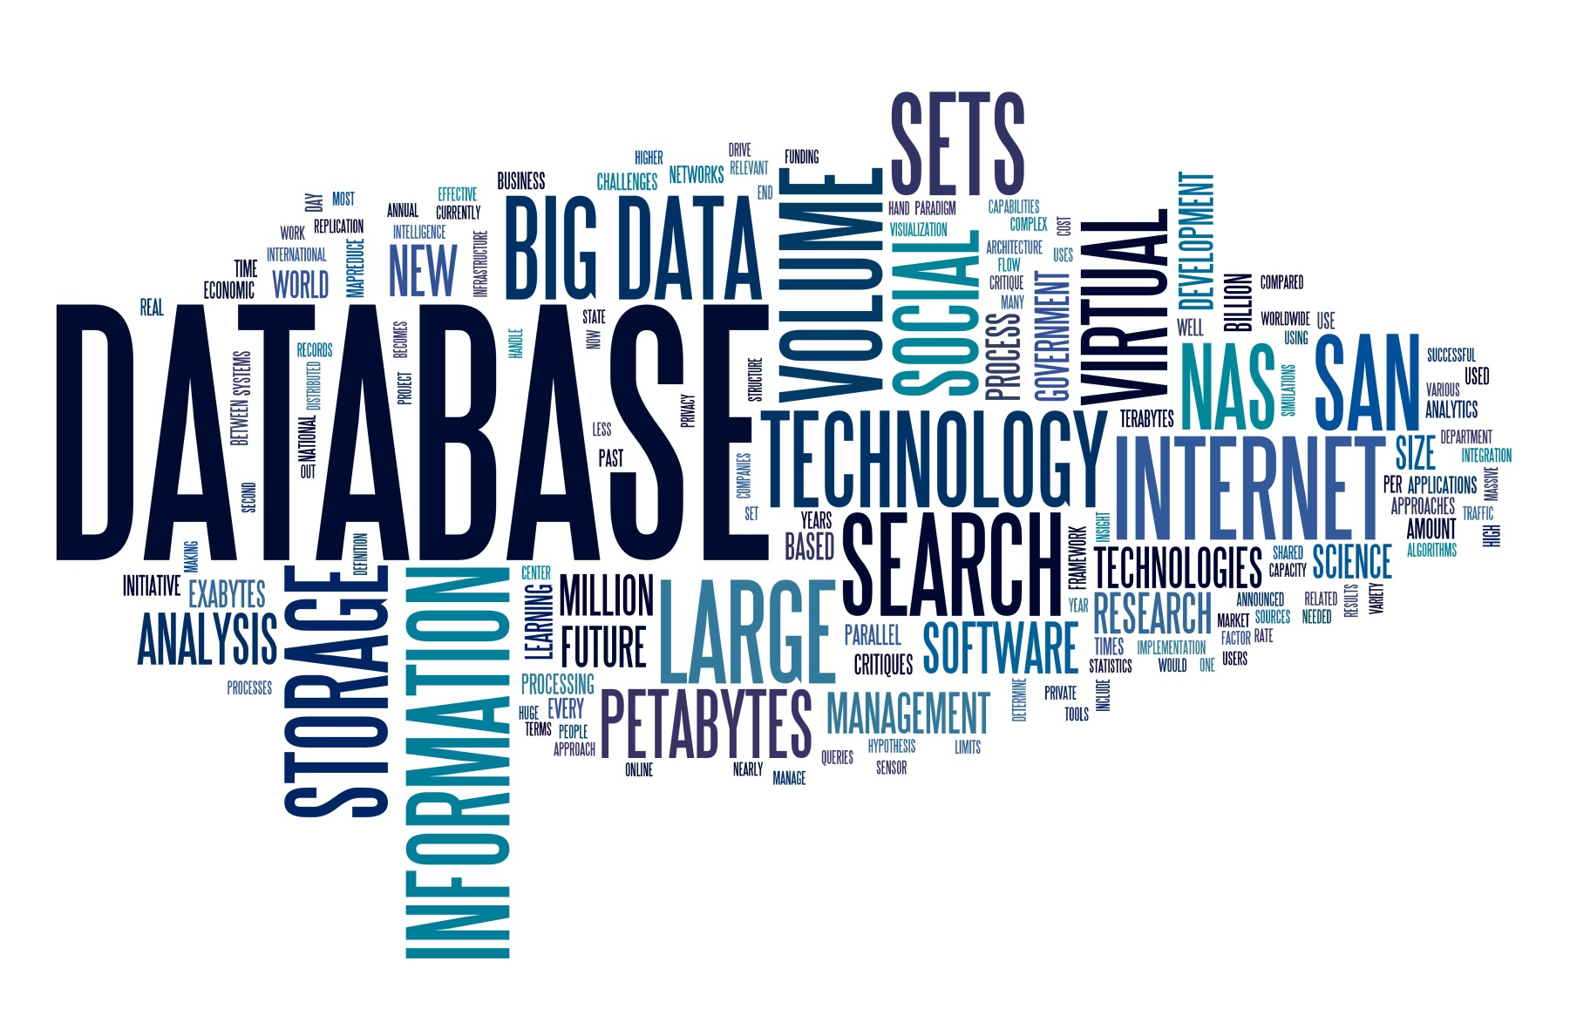


技術應用 Technology
4
Analysis
Database
Quick Searching
Routing

Slide 11
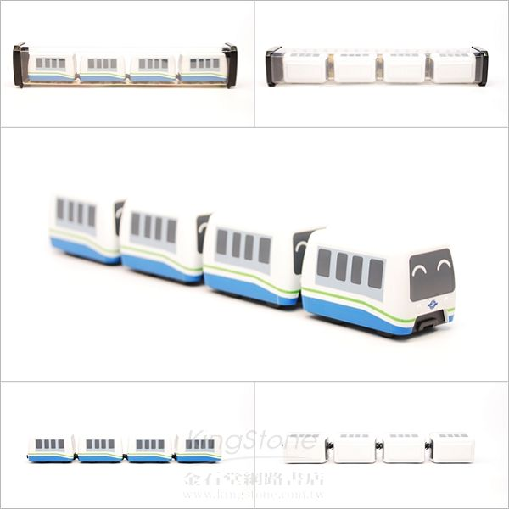
技術應用 Technology
4
Feature
操作簡易
資訊明確
服務多樣
擴展性佳
Easy operation
Clear information
Various service
Good extensibility

Slide 12
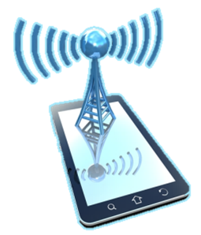

未來展望 Vision of the future
1
Connectivity
WiFi
Bluetooth Low Energy
UI
Internet
Beacon service
Analysis
Data base
Cloud services
Device
Cloud

Slide 13
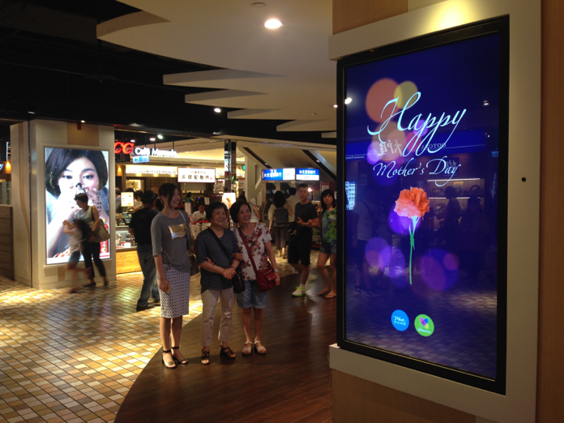


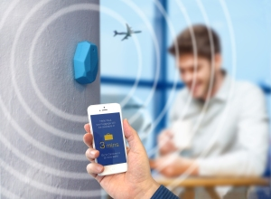


未來展望 Vision of the future
2
Internet of Things
Cloud
Analysis
Real-time
Location
Push
Notifications
Notes:
月台布置beacon節點
可定位目前所在車站，並可即時推播相關乘車資訊。
周邊佈相關感測器收集乘客及環境資訊上傳雲端

Slide 14
未來展望 Vision of the future
3
Big Data Analysis
Provide more services
Statistics
Data mining
Optimization
Notes:
經由巨量分析得知相關資訊並提供更好的服務，也可提供列車動態班次管理

Slide 15
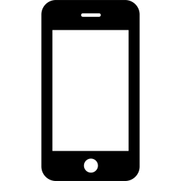

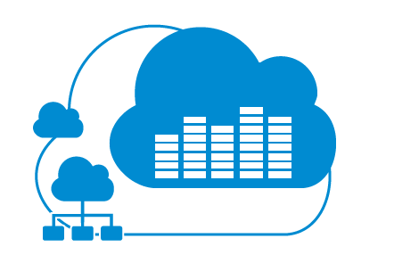
未來展望 Vision of the future
4
Future Work
Gateway
PXA-270
Cloud Server

Slide 16
Smart Taipei Metro
Thanks for your attention !
國立台灣科技大學 電機工程系碩士班

