Slide 1
WIRELESS BODY AREA NETWORK(WBAN)
RAMSHEEDA.K
11bcs1121
Guided by: Mr.SREEKESH NAMBOODIRI
Department of
Computer Science and Engineering
MES COLLEGE OF ENGINEERING
Kuttippuram
January 20, 2015

Slide 2
Outline:
Objective
Introduction
Existing system
Proposed system
3-tier Architecture
Data Flow Diagram
System Requirements
Security Requirements
Applications
Comparison with other networks
Advantages and disadvantages
Future Scope
Conclusion
References

Slide 3
Objective:
“ To implement Ubiquitous and affordable healthcare”

Slide 4
Introduction:
WBAN is a RF based wireless networking technology.
Integration of intelligent, miniaturized, low power sensor node.
Classified into two:
Wearable WBAN
Implantable WBAN
Utilizes wireless sensor nodes
patients health condition can be monitored anytime and anywhere

Slide 5
cont’d..
Continuously monitor the health conditions of patients.
Prevention and early risk detection.
Sharing the information with care seekers and physicians.
Provides greater mobility and flexibility to patients
Alarming the person who wears it.
Auto medication in case of emergency.

Slide 6
What is BAN…???
Definition by IEEE 802.15.6:
“A communication standard optimized for low power devices for their operation on, in or around the human body (but not limited to humans) to serve a variety of applications including medical, consumer electronics or personal entertainment and other.”

Slide 7
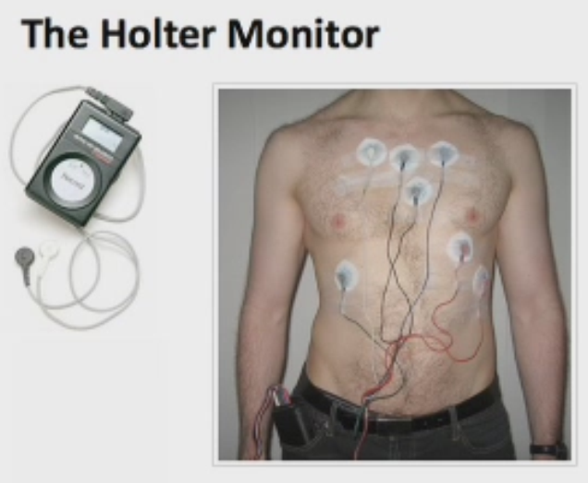
Existing system:
Holter Monitor
Inefficient and Not User Friendly
Lots of wires
Soon to be buried
Just 24 hr battery backup

Slide 8
Proposed system:
Easily accessible
Saves a lot of time.
Close-loop bio-feedback:
If high sugar-level, a device triggers an insulin pump to inject a dose of insulin (artificial pancreas)
Reduction in hospital stays
Managing ILLNESS for managing WELLNESS by focusing on prevention and early detection.

Slide 9
Positioning of WBAN:
The communication in WBAN is divided into:
Intra-body Communication
Extra-body Communication
Figure: Intra-body and Extra-body Communication in WBAN

Slide 10
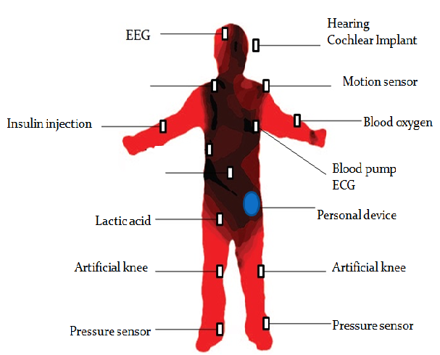
Health Monitoring System Network
positioning
Glucose

Slide 11
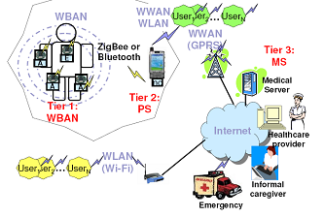
3-tier architecture:

Slide 12
Tire-1: WBAN Sensor
Consists of an intelligent node which is capable of:
Sensing
Sampling
Processing
Communicating
ECG(electrocardiogram)sensor for monitoring heart activity
EMB(electromyography)sensor for monitoring muscle activity
Consists of a blood pressure sensor
A tilt sensor for monitoring

Slide 13
Tire2: Personal server
Interface the WBAN sensor nodes through Zigbee or Bluetooth.
Connected with the medical server through mobile telephone networks (2G, GPRS, 3G) or WLANs—Internet
Functions:
Register type and number sensor node .
manages the network channel sharing, time synchronization, and processing data.
Send data to MS

Slide 14
Tire3-Medical server
Functions include:
To authenticate users
Save patient data into medical records
Analyze the data .
Recognize serious health cases in order to contact emergency care givers
Forward new instruction to user.

Slide 15
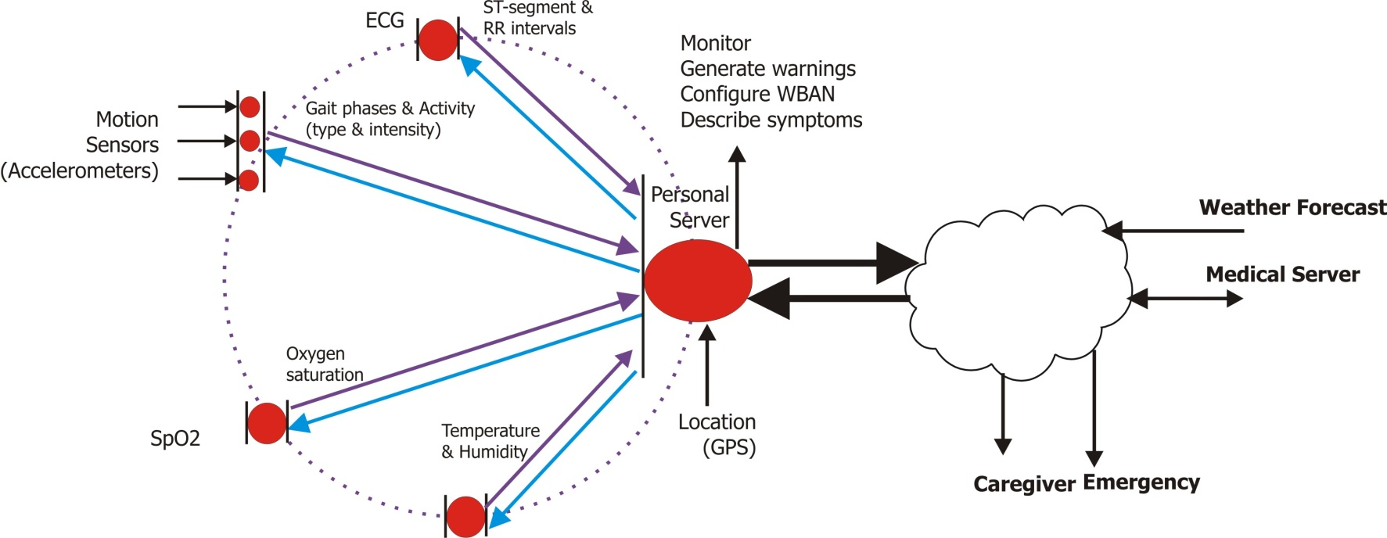
Data flow diagram
actuators
Sensor level
Personal Server Level
Medical Service Level

Slide 16
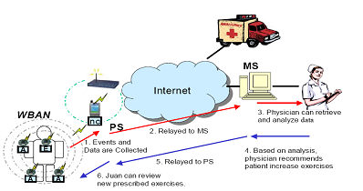
System flow for home monitoring

Slide 17
MAC protocols for WBAN
Low power consuming
Accurate
Less latency
Good performance on varying traffic load
Popular protocols for WBAN are:
TMAC:
Duty-cycling protocol
Active time
Duty cycle changes according to the information traffic load of the network
Handle varying load with low power consumption

Slide 18
SMAC
Similar to TMAC but with fixed duty cycle
Not efficient in handling continuously varying data rates
ZigBee MAC
Two schemes:
CSMA/CA :Gives average performance
TDMA: Reduces the power consumption up to a great extent
Baseline MAC
Uses CSMA/CA scheme
The performance is not average in the case of energy
Throughput is average.

Slide 19
System Requirements
Types of devices
Sensor node:
Gathers data on physical stimuli
Personal Device(BCU):
It gathers all the information acquired by the sensor nodes and informs the users.
Monitoring Server:
Consists of database for data storage and processing and analyzing software
Data rates:
Reliability depends on the data rate
Energy :
Three domains: sensing, communication and data processing

Slide 20
Security requirements
Data storage security requirements:
Confidentiality
Integrity assurance
Dependability
Data access security requirements:
Access control
Accountability
Non-repudiation
Other security requirements:
Authentication
Availability

Slide 21
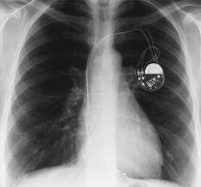
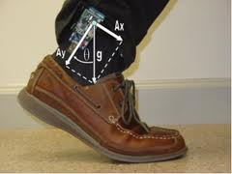
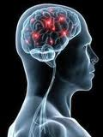
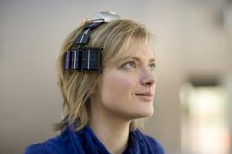
Applications
Medical Heath Care
Sports and Fitness Monitoring
Wireless Audio
Personal Video Devices
Military
Security
Gaming and entertainment

Slide 22
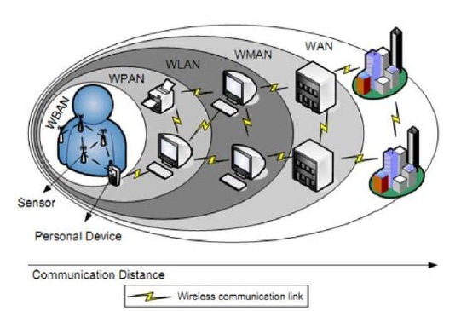
Comparison with other wireless networks
Based on geographical coverage
WBAN operates close to the human body(1m-2m)
WPAN network surrounds the person(up to 10m)
WLAN(up to 100m)
WWAN covers the largest geographical area
WBANs are subset of WSN or WSAN

Slide 23
Advantages and disadvantages
Adavantages
Used for the detection of chronic diseases
Used in military for security purposes
Assists the communication between individual and machine
Disadvantages
Wired network-restriction between the body movement
Interference of the multi devices that share the channel.
Lack of integration-sensors

Slide 24
Conclusion
Benefits to patients,medical personnel and society
Continuous monitoring is possible
Early detection of possible problems.
Improving the Quality of Life
Collected the pulse rate, temperature and the location of the patients

Slide 25
Reference
[1] Samaneh Movassaghi, Mehran Abolhasan, Justin Lipman,David Smith, and Abbas Jamalipour, “Wireless Body Area Networks: A Survey” , IEEE Communications surveys & tutorials,vol.16, No.3, Third Quarter,2014
[2] Aashima Arya Naveen Bilandi, “ A Review: Wireless Body Area Networks for Health Care”, International Journal of Innovative Research in Computer and Communication Engineering, Vol.2, Issue 4, April 2014
[3] Prathamesh Dinkar, Abhishek Gulavani, Sourabh Ketkale, Pratik Kadam,and Sheetal Dabhade, “Remote Health Monitoring using Wireless Body Area Network ”, International Journal of Engineering and Advanced Technology (IJEAT) ISSN: 2249 – 8958, Vol.2, Issue-4, April 2013
[4] Garth V. Crosby, Tirthankar Ghosh, Renita Murimi and Craig A. Chin, “Wireless Body Area Networks for Healthcare: A Survey ”, International Journal of Ad hoc, Sensor & Ubiquitous Computing (IJASUC) ,Vol.3,No.3 June 2012

Slide 26
[5] Changhong Wang, Qiang Wang, and Shunzhong Shi, “A Distributed Wireless Body Area Network for Medical Supervision”, IEEE International, May 2012
[6] Javed Ahmadand Fareeha Zafar,”Review of Body Area Network Technology & Wireless Medical Monitoring”,International Journal of Information and Communication Technology Research ,Volume 2 No. 2, February 2012
[7] Latre, Benoit, Bart Braem, Ingrid Moerman, Chris Blondia, and Piet Demeester. “A survey on wireless body area networks,” Wireless Networks, vol. 17, 2010
[8] Sana ULLAH,Pervez KHAN,Niamat ULLAH,Shahnaz SALEE and Henry HIGGINSandKyung Sup KWAK, “A Review of Wireless Body Area Networks for Medical Applications ”, Int. J. Communications, Network and System Sciences,Vol.2,november 2009
[9] Pervez Khan, Md.Asdaque Hussain and Kyung Sup Kwak “Medical Applications of Wireless Body Area Networks ”, International Journal of Digital Content Technology and its Applications Vol.3, September 2009

Slide 27
Thank you ☺

