Slide 1
Traffic, Collisions and Weather
Presentation by Sri Raghu Malireddi, Mohan Noolu
University of Victoria
TELUS/IEEE SMART CITIES DATATHON

Slide 2
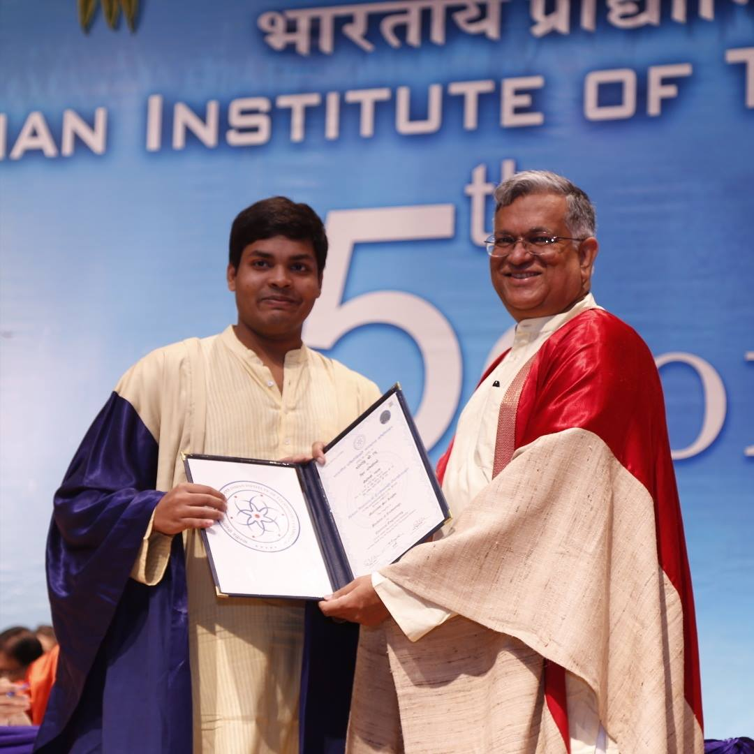
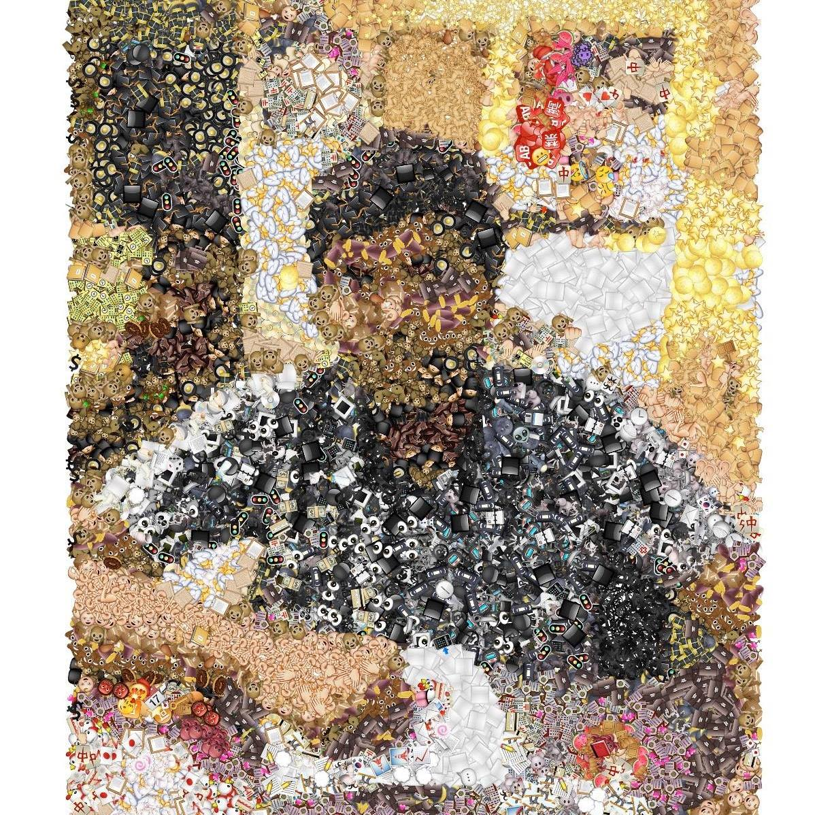

About Us
Sri Raghu Malireddi
Research Areas: Machine Learning, Computer Vision
Mohan Noolu
Research Areas: Data Analysis, Data Mining

Slide 3

Surrey
Open, transparent and accessible government.
Focus on Socio-economic development
https://surrey.ca/images/cos-master/ui/logo.png

Slide 4
Traffic &
Transportation
Environment
Management
Health
Management
City of
Surrey
Infrastructure
Education
Economy &
Business
Crime and
Justice
Misc.

Slide 5
What we did?
Analysis on Traffic
Analysis on weather
Analysis on Fatal Accidents and collisions.

Slide 6
Weather Analysis
Question:
Does Weather has any impact on the accidents that occur in Surrey?

Slide 7

Weather Analysis
Thanks to Wunderground Database.
Acquired weather data from 1st Nov, 2011 to 16th Nov, 2016.
Hourly Data
Daily Data
Monthly
Average

Slide 8
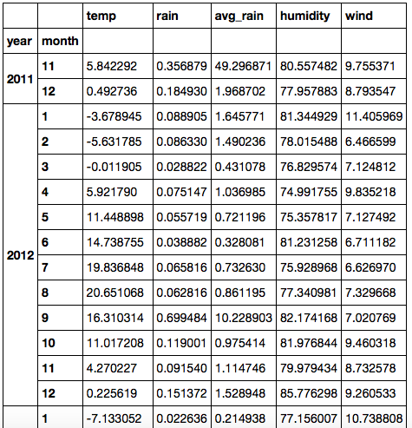
Weather Analysis: Parameters
Pandas DataFrame
Parameters:
Temperature
Avg. Rain
Humidity
Wind

Slide 9
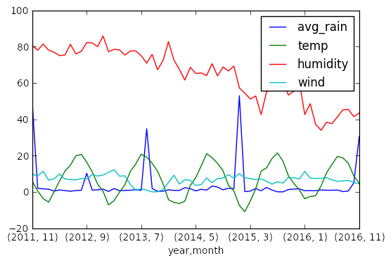
Weather Analysis: Interesting Results

Slide 10
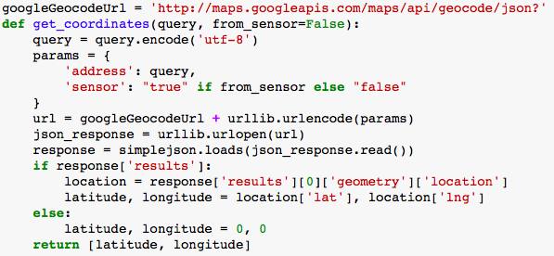
Fatal Accidents/Collisions Analysis
Used the ‘Crime and Collisions’ dataset
Did extensive data mining to refine the initial dataset.
Used the ‘Google GeoCode URL’ to get the locations’ coordinate details.
Problems:
Can use only 2500 requests/day
50 requests/second

