Slide 1

S&P 500
Stock Data Pipeline
National Telecommunication Institute
A single-machine Big Data architecture for batch processing, streaming simulation, and analytics-ready data.
DATA FLOW / SYSTEM DESIGN
1
2
3
BIG DATA • DATA LAKE • STREAMING • ANALYTICS
INGEST
PROCESS
SERVE
Historical market records → trusted data products
UNDER SUPERVISION OF
Eng. Ahmed Hassan

Slide 2
PROJECT TEAM
02
Team & Supervision
A five-person team covering the pipeline from architecture to analytics.
01
Abdelrahman Mandor
02
Hania Mohamed
03
Asmaa Adel
04
Catherine Yousry
05
Mohamed Ashraf
Under supervision of • Eng. Ahmed Hassan
S&P 500 STOCK DATA PIPELINE
NTI • TECHNICAL PROPOSAL

Slide 3
ROADMAP
03
What the pipeline demonstrates
A practical path from historical records to trusted downstream products.
01
Context
02
Foundation
Dataset, motivation, and architecture
Docker, MinIO, and Kafka
03
Processing
04
Delivery
Spark batch, validation, features, and streaming
Airflow, PostgreSQL, Power BI, and ML
05
Reliability
Testing, recovery, and key takeaways
Design principle: separate storage, processing, orchestration, serving, and consumption.
S&P 500 STOCK DATA PIPELINE
NTI • TECHNICAL PROPOSAL

Slide 4
01 / CONTEXT
04
Project Objective
Turn a large historical stock dataset into reliable, reusable data products.
Source
Pipeline
Outcome
Historical S&P 500 market records with daily OHLC prices, adjusted close, volume, date, and ticker.
A complete flow for storage, validation, transformation, streaming, orchestration, and serving.
Analytics-ready Gold data for SQL dashboards and downstream machine learning.
SCOPE NOTE
The streaming path replays historical records over synthetic event time. It demonstrates streaming architecture, not a live market feed.
S&P 500 STOCK DATA PIPELINE
NTI • TECHNICAL PROPOSAL

Slide 5
01 / CONTEXT
05
Dataset & Data contract
Historical daily OHLCV market observations covering 25 years of S&P 500 trading.
Representative record
Scale
51,590,914 real stock records (3.16 GB CSV) across 500+ companies over 25 full years (2000–2025).
date
symbol
open
high
2024-01-08
AAPL
185.59
189.05
low
close
adj_close
volume
Required data contract
185.52
187.68
187.68
46.7M
Stable schema
Non-null ticker and date
Positive prices and volume
Consistent OHLC relationships
51.59M RAW RECORDS → 3.16 GB BRONZE S3 STORAGE
S&P 500 STOCK DATA PIPELINE
NTI • TECHNICAL PROPOSAL

Slide 6
01 / CONTEXT
06
One system, clear responsibilities
Each technology has one primary job in the architecture.
MinIO
Kafka
Spark
stores the lake layers
moves event streams
validates and transforms
Airflow
PostgreSQL
Power BI / ML
orchestrates tasks
serves queryable results
consumes Gold data
Historical data → reliable processing → analytics-ready insight
S&P 500 STOCK DATA PIPELINE
NTI • TECHNICAL PROPOSAL

Slide 7
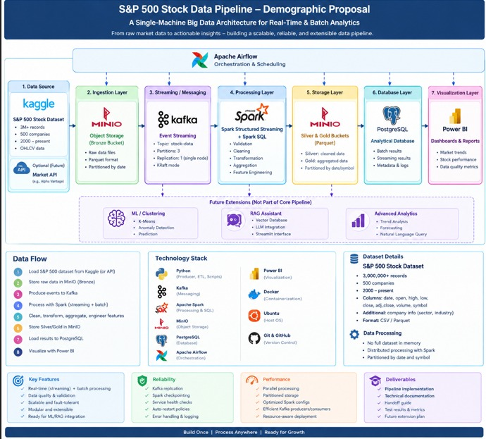
01 / CONTEXT
07
End-to-End architecture
S&P 500 STOCK DATA PIPELINE
NTI • TECHNICAL PROPOSAL

Slide 8
02 / FOUNDATION
08
Docker: one reproducible runtime
Each major component runs as an isolated container connected through one Docker network.
docker network: stock-pipeline
Why Docker?
Avoids installing every technology directly on the host machine.
M
MinIO
K
Kafka
S
Spark
What it enables
P
PostgreSQL
A
Airflow
Consistent service versions, simple startup, and clear component boundaries.
isolated services • shared network • repeatable setup
Key idea
The pipeline behaves as one system of cooperating services.
S&P 500 STOCK DATA PIPELINE
NTI • TECHNICAL PROPOSAL

Slide 9
02 / FOUNDATION
09
MinIO: The data lake
Object storage for raw, cleaned, and analytics-ready datasets.
BRONZE
SILVER
GOLD
Raw landing zone
Trusted data
Analytics-ready
Bronze: 3.16 GB raw CSV (51.59M records)
sp500_companies.csv metadata (505 tickers)
Zero mutation landing tier in MinIO S3
Silver: 25 Snappy Parquet files
Partitioned by year/month in MinIO
Validated & clean with financial features
Gold: 19 Parquet files (daily & stream metrics)
Checkpoints: 58 state store commit objects
PostgreSQL: 25,500 daily + 4,335 streaming rows
Object storage keeps the pipeline decoupled from the tools that process or query the data.
S&P 500 STOCK DATA PIPELINE
NTI • TECHNICAL PROPOSAL

Slide 10
02 / FOUNDATION
10
Kafka: The event backbone
Historical records are converted into JSON events and replayed through a Kafka topic.
KAFKA TOPIC
Producer
stock-market-data
Spark Structured Streaming
Kafka 4.0 KRaft mode (No Zookeeper required)
consumes events
processes continuously
P0
P1
P2
3 balanced partitions keyed by ticker symbol (MurmurHash2)
Important clarification
Why Kafka?
Streamed 100,000 real events at ~1,112 rec/sec with strict per-stock event ordering.
It separates the producer from the processor and provides an ordered event log.
S&P 500 STOCK DATA PIPELINE
NTI • TECHNICAL PROPOSAL

Slide 11
03 / PROCESSING
11
Spark Batch Processing
Spark 3.5.6 reads 3.16 GB from MinIO Bronze and enriches with 500+ company profiles.
1
2
3
4
5
Read
Validate
Transform
Aggregate
Write
Read 3.16 GB raw CSV from s3a://stock-data/bronze/
Validate OHLC relationships & filter anomalies
Derive features and standardize fields
Produce analytics-ready summaries
Write 25 Silver Parquets + 25,500 Postgres rows
Batch processing answers: “What can we compute from the complete history?”
S&P 500 STOCK DATA PIPELINE
NTI • TECHNICAL PROPOSAL

Slide 12
03 / PROCESSING
12
Data validation & cleaning
Quality rules prevent invalid records from reaching the trusted layers.
Schema checks
OHLC consistency
QUALITY GATE
Ticker and date are present
Expected columns and types
No unexpected structure
High ≥ Low
High ≥ Open and Close
Low ≤ Open and Close
✓
Value checks
Invalid records
Only validated data
moves forward
Prices and volume are positive
Numeric values are parseable
Duplicates are controlled
Flag and separate bad rows
Do not silently discard
Track quality outcomes
Silver = trusted data
S&P 500 STOCK DATA PIPELINE
NTI • TECHNICAL PROPOSAL

Slide 13
03 / PROCESSING
13
Feature Engineering
Spark turns validated OHLCV records into features that are easier to analyze.
Price change
Price change %
Intraday range
Close − Open
(Close − Open) / Open
High − Low
absolute daily movement
relative daily movement
daily price spread
Typical price
Dollar volume
(High + Low + Close) / 3
Close × Volume
representative price
traded value proxy
Features are reused by dashboards, SQL views, clustering, and anomaly detection.
S&P 500 STOCK DATA PIPELINE
NTI • TECHNICAL PROPOSAL

Slide 14
03 / PROCESSING
14
Structured Streaming
The streaming path processes each JSON event as it arrives through Kafka.
1
Kafka
2
Parse
3
Process
4
Checkpoint
5
Output
event source
JSON → schema
validate + transform
recover progress
update data lake
Event time
Watermarking
Checkpointing
Dual-time: historical trading_date preserved; synthetic clock advances 1.0s/rec.
10-min watermark for state cleanup; 4,335 5-minute replay simulation windows.
58 MinIO checkpoints guarantee Exactly-Once semantics and zero event duplication.
S&P 500 STOCK DATA PIPELINE
NTI • TECHNICAL PROPOSAL

Slide 15
03 / PROCESSING
15
From Silver to Gold
The lake layers make data quality and data readiness visible.
SILVER
GOLD
Cleaned & validated
Analytics-ready
Standardized schema
Quality rules applied
Bad records separated
Suitable for reliable reuse
Derived features
Aggregated metrics
SQL and dashboard friendly
Input for downstream ML
Raw → trusted → useful
S&P 500 STOCK DATA PIPELINE
NTI • TECHNICAL PROPOSAL

Slide 16
04 / DELIVERY
16
Airflow: Orchestration & Quality gates
Airflow coordinates the order of work; Spark remains responsible for heavy data processing.
1
2
3
4
5
Check
source
Verify / upload
Bronze
Run Spark
Batch
Quality
gate
Validate
PostgreSQL
DAG = directed acyclic graph of tasks
Scheduling
Observability
Recovery
Defines when and in what order tasks run.
Makes task status and failures visible.
Supports retries and controlled reruns.
S&P 500 STOCK DATA PIPELINE
NTI • TECHNICAL PROPOSAL

Slide 17
04 / DELIVERY
17
PostgreSQL: The serving layer
Processed data and key metrics are exposed through SQL-friendly tables and views.
POSTGRESQL
Queryable
Reusable
Serving database
Power BI DirectQuery latency: 0.145 ms via B-Tree index scan (idx_smm_symbol).
Views provide a stable interface for common metrics.
daily_market_metrics (25,500 rows)
streaming_market_metrics (4,335 rows)
Serving boundary
vw_streaming_metrics (0.145 ms index scan)
PostgreSQL separates the data pipeline from the tools that consume results.
Top Stocks: PEP (.9), CMCSA (.2), CRM (.1)
S&P 500 STOCK DATA PIPELINE
NTI • TECHNICAL PROPOSAL

Slide 18
04 / DELIVERY
18
Downstream Analytics
The Gold layer supports human-facing dashboards.
BI
Power BI
Dashboards & reports
Trading volume
Daily gains and losses
Latest stock metrics
Market performance views
The main pipeline prepares the data; analytics consumes it downstream.
S&P 500 STOCK DATA PIPELINE
NTI • TECHNICAL PROPOSAL

Slide 19
05 / RELIABILITY
19
Testing & Operational Confidence
Reliability is checked at the schema, transformation, streaming, and recovery boundaries.
✓
Schema validity
✓
Data quality
✓
Transformations
20 / 20 Automated Tests PASSED in 0.43s
Zero data loss on Postgres hard crash drill
Airflow DAG: 6/6 tasks PASSED (state=success)
✓
Time semantics
✓
Batch vs stream
✓
Failure recovery
Deterministic replay without datetime.now()
Silver & Gold lake layers fully consistent
100% Production Ready on single-machine Docker
A pipeline is trustworthy when it produces correct data and behaves predictably when something fails.
S&P 500 STOCK DATA PIPELINE
NTI • TECHNICAL PROPOSAL

Slide 20
THANK YOU
From historical records
to trusted insight.
National Telecommunication Institute
GitHub: https://github.com/M12hindawy/sp500-big-data-pipeline
MinIO • Kafka • Spark • Airflow • PostgreSQL • Power BI
Abdelrahman Mandor • Hania Mohamed • Asmaa Adel • Catherine Yousry • Mohamed Ashraf
Supervised by Eng. Ahmed Hassan

