Slide 1
Appendix:
Revised Slides for Andes

Slide 2
Variable Naming
int add(int a, int b, int c){
int i=0, j=0, k=0;
i=a+b+3+6;
a=i+j+k+3;
return c;
}
int main(){
int a = 3;
int b = 4;
int c = 5;
int d = 0;
d = add(a, b, c);
printf("d is %d\n",d);
}
Argument list.
Local variables.
Important registers
fp: frame pointer
lp: return address of caller function
r0: return value
Notes:
有問題

Slide 3
Four items in function call handlings
/*Enter and Exit Function Body*/
int add (int a, int b, int c){
/* Section A */
int i=0, j=0, k=0;
/* Section B */
return c;
}
A. Enter function body (callee).
B. Exit function body (callee).
C. Function invocation.
D. Return from function invocation to caller.
/* Function Call */
/* Section C (right-hand side)*/
/* Section D (left-hand side)*/
d = add (a, b, c);
Notes:
Section C D 有問題

Slide 4
A. Entering function body
int add(int a, int b, int c){
int i=0, j=0, k=0;
/* Section A */
i = a+b+3+6;
a= i+j+k+3;
}
high address
fp
sp+32
lp
fp-4
sp+28
old-fp
fp-8
sp+24
fp-12
sp+20
fp-16
sp+16
fp-20
sp+12
/* Section A */
push.s { $fp $lp }
addi $fp, $sp, 8
addi $sp, $sp, -24
fp-24
sp+8
fp-28
sp+4
fp-32
sp
low address
Function add’s stack
Notes:
Mips 為
subu $sp,$sp,8 //
sw $ra,4($sp) //把return address 存起來
sw $fp,0($sp) //把fp存起來
move $fp,$sp //
fp 為主
2. save lp ()and fp
現在 sp 指向 sp-32處 (要存的話是 “+”回去)
4. fp 指到現在 sp 的位置

Slide 5
A-1. Doing function
int add(int a, int b, int c){
int i=0, j=0, k=0;
/* Section A */
i = a+b+3+6;
a= i+j+k+3;}
swi $r0, [$fp+(-24)]
swi $r1, [$fp+(-28)]
swi $r2, [$fp+(-32)]
movi $r0, 0
swi $r0, [$fp+(-12)]
movi $r0, 0
swi $r0, [$fp+(-16)]
movi $r0, 0
swi $r0, [$fp+(-20)]
lwi $r1, [$fp+(-24)]
lwi $r0, [$fp+(-28)]
add $r0, $r1, $r0
addi $r0, $r0, 9
swi $r0, [$fp+(-12)]
lwi $r1, [$fp+(-12)]
...
high address
fp
sp+32
lp
fp-4
sp+28
old-fp
fp-8
sp+24
i
fp-12
sp+20
j
fp-16
sp+16
k
fp-20
sp+12
fp-24
a
sp+8
b
fp-28
sp+4
c
fp-32
sp
low address
Function add’s stack
Notes:
Mips 為
subu $sp,$sp,8 //
sw $ra,4($sp) //把return address 存起來
sw $fp,0($sp) //把fp存起來
move $fp,$sp //

Slide 6
B. Exit function body
int add (int a, int b, int c){
int i=0, j=0, k=0;
i = a+b+3+6;
a= i+j+k+3;
/* Section B */
return c;
}
high address
fp
sp+32
lp
fp-4
sp+28
old-fp
fp-8
sp+24
i
fp-12
sp+20
j
fp-16
sp+16
k
/* Section B */
addi $sp, $fp, -8
pop.s { $fp $lp }
ret
fp-20
sp+12
fp-24
a
sp+8
b
fp-28
sp+4
c
fp-32
sp
low address
Function add’s stack

Slide 7
C. Function invocation
/* Section C */
push.s { $fp $lp }
addi $fp, $sp, 8
addi $sp, $sp, -16
! end of prologue
movi $r0, 3
swi $r0, [$fp+(-12)]
movi $r0, 4
swi $r0, [$fp+(-16)]
movi $r0, 5
swi $r0, [$fp+(-20)]
movi $r0, 0
swi $r0, [$fp+(-24)]
lwi $r0, [$fp+(-12)]
lwi $r1, [$fp+(-16)]
lwi $r2, [$fp+(-20)]
jal add
/* Function Call */
/* Section C (right)*/
/* Section D (left)*/
d = add (a, b, c);
high address
fp
sp+32
lp
fp-4
sp+28
old-fp
fp-8
sp+24
a
fp-12
sp+20
b
fp-16
sp+16
c
fp-20
sp+12
fp-24
d
sp+8
low address
Function main’s stack
Notes:
沒有 a,b,c,d

Slide 8
D. Return from function invocation to caller
/* Function Call */
/* Section C (right)*/
/* Section D (left)*/
d = add (a, b, c);
high address
fp
sp+32
/* Section D */
swi $r0, [$fp+(-24)]
/*return value*/
addi $sp, $fp, -8
pop.s { $fp $lp }
ret
lp
fp-4
sp+28
old-fp
fp-8
sp+24
a
fp-12
sp+20
b
fp-16
sp+16
c
fp-20
sp+12
fp-24
d
sp+8
low address
Function main’s stack

Slide 9
Overview of Routines
extdef:
TYPESPEC notype_declarator ';'
{ if (TRACEON) printf("7 ");
set_global_vars($2);
}
| notype_declarator
{ if (TRACEON) printf("10 ");
cur_scope++;
set_scope_and_offset_of_param($1);
code_gen_func_header($1);
}
'{' xdecls
{ if (TRACEON) printf("10.5 ");
set_local_vars($1);
}
stmts
{
if (TRACEON) printf("11 ");
pop_up_symbol(cur_scope);
cur_scope--; code_gen_at_end_of_function_body($1);
}

Slide 10
Overview of Routines
/* Set up parameter scope and offset */
set_scope_and_offset_of_param(char *s) {
int i,j,index;
int total_args;
index = look_up_symbol(s);
if (index<0) err("Error in function header");
else {
table[index].type = T_FUNCTION;
total_args = cur_counter -index -1;
table[index].total_args=total_args;
for (j=total_args, i=cur_counter-1;i>index; i--,j--)
{
table[i].scope= cur_scope;
table[i].offset= j;
table[i].mode = ARGUMENT_MODE;
}
}
}
Adjust parameter scopes.

Slide 11
Overview of Routines
/* To generate house-keeping work at the beginning of the function */
code_gen_func_header(char *function)
{
fprintf(f_asm," .text\n");
fprintf(f_asm," .global %s\n",function);
fprintf(f_asm,"%s:\n",function);
fprintf(f_asm," push.s { $fp $lp }\n");
fprintf(f_asm," addi $fp, $sp, 8\n");
fprintf(f_asm," addi $sp, $sp, -16\n");
}
Entering function body.
Notes:
addi $sp,$sp,-24
sw $lp,4($sp)
sw $fp,0($sp)
addi $fp, $sp, 0

Slide 12
Overview of Routines
/* To generate house-keeping work at the end of a function */
code_gen_at_end_of_function_body(char *function)
{
fprintf(f_asm," addi $sp, $fp, -8\n");
fprintf(f_asm,” pop.s { $fp $lp }\n");
fprintf(f_asm," ret\n");
}
Exit function body.
Notes:
addi $sp, $fp, 0
lw $lp, 4($sp)
lw $fp, 0($sp)
addi $sp, $sp,20
ret

Slide 13
Expression
Grammars
expr_no_commas: primary
{ if (TRACEON) printf("15 ") ;
$$= $1;
}
| expr_no_commas '+' expr_no_commas
{
if (TRACEON) printf("16 ") ;
fprintf(f_asm,“ lwi $r0, [$fp+(-16)])\n");
fprintf(f_asm," lwi $r1, [$fp+(-20)])\n");
fprintf(f_asm," add $r0, $r1, $r0\n");
fprintf(f_asm," swi $r0, [$fp+(-12)]\n");
$$= NULL;
}
| expr_no_commas '=' expr_no_commas
{ . . .}
| expr_no_commas '*' expr_no_commas
{ . . . }
;
Notes:
ex: a + b
lwi $r1, [$fp+(24)]
lwi $r0, [$fp+(28)]
add $r0, $r1, $r0
addi $r0, $r0, 9
swi $r0, [$fp+(8)]

Slide 14
Expression
Grammars(2)
expr_no_commas: primary
{ if (TRACEON) printf("15 ") ;
$$= $1;
}
| expr_no_commas '+' expr_no_commas
{ . . .}
| expr_no_commas '=' expr_no_commas
{ . . .}
| expr_no_commas '*' expr_no_commas
{ if (TRACEON) printf("18 ") ;
fprintf(f_asm," lwi $r0,[$fp+(-16)]\n");
fprintf(f_asm," lwi $r1,[$fp+(-20)]\n");
fprintf(f_asm," mul $r0, $r1, $r0\n");
fprintf(f_asm," swi $r0, [$fp+(-12)]\n");
$$= NULL;
} ;
Notes:
lwi $r1, [$fp+(24)]
lwi $r0, [$fp+(28)]
mul $r0, $r1, $r0
swi $r0, [$fp+(8)]
fprintf(f_asm," addiu $sp, $sp, 4\n");
fprintf(f_asm," push bx\n");
上面這兩個有要用到嗎?

Slide 15
Variable Naming
add (int a, int b, int c){
int i=0, j=0, k=0;
i = a + b + 3 +6;
a= i+ j+k+3;
}
Argument list.
Local variables.
high address
fp
sp+32
lp
fp-4
sp+28
old-fp
fp-8
sp+24
i
fp-12
sp+20
j
fp-16
sp+16
k
fp-20
sp+12
fp-24
a
sp+8
b
fp-28
sp+4
c
fp-32
sp
Function add’s stack
low address

Slide 16
Expression Assign:
expr_no_commas: . . . { . . .}
| expr_no_commas '=' expr_no_commas
{ char *s; int index;
s= $1; if (!s) err("improper expression at LHS");
index = look_up_symbol(s);
switch(table[index].mode) {
case ARGUMENT_MODE:
fprintf(f_asm," swi $r0, [$fp+(-%d)]\n",table[index].offset*4+8);
case LOCAL_MODE:
fprintf(f_asm,” movi $r0,3” );
fprintf(f_asm,” swi $r0, [$fp+(-%d)]\n”,table[index].offset*4+8);
default: /* Global Vars */
} } . . . ;
X = 3;
Notes:
sethi $r0, hi20(b)
lwi $r0, [$r0+lo12(b)]
把 $ro register 直接設定成x 的前20bits
再用load 把 x 後面的12bits load近來
可能是bandwidth的問題

Slide 17
Primary Expr.
a + b+ 3;
primary: IDENTIFIER {
int index;
index =look_up_symbol($1);
switch(table[index].mode) {
case ARGUMENT_MODE:
fprintf(f_asm," lwi $r1, [$fp+(-%d)]\n" ,table[index].offset*4+8);
break;
case LOCAL_MODE:
fprintf(f_asm," lwi $r1, [$fp+(-%d)]\n"
,table[index].offset*4+8);
break;
default: /* Global Vars */
}
$$=$1; }
;

Slide 18
Constant
Expr.
primary: IDENTIFIER { . . . }
| CONSTANT
{ if (TRACEON) printf("21 ") ;
fprintf(f_asm," movi $r0 ,4);
fprintf(f_asm," swi $r0, [$fp+(-12)]\n");
}
| STRING
{
if (TRACEON) printf("22 ") ;
}
| primary PLUSPLUS
{
if (TRACEON) printf("23 ") ;
}
;
Notes:
就像 a = 4:
movi $r0, 4
swi $r0, [$fp+(8)]

Slide 19
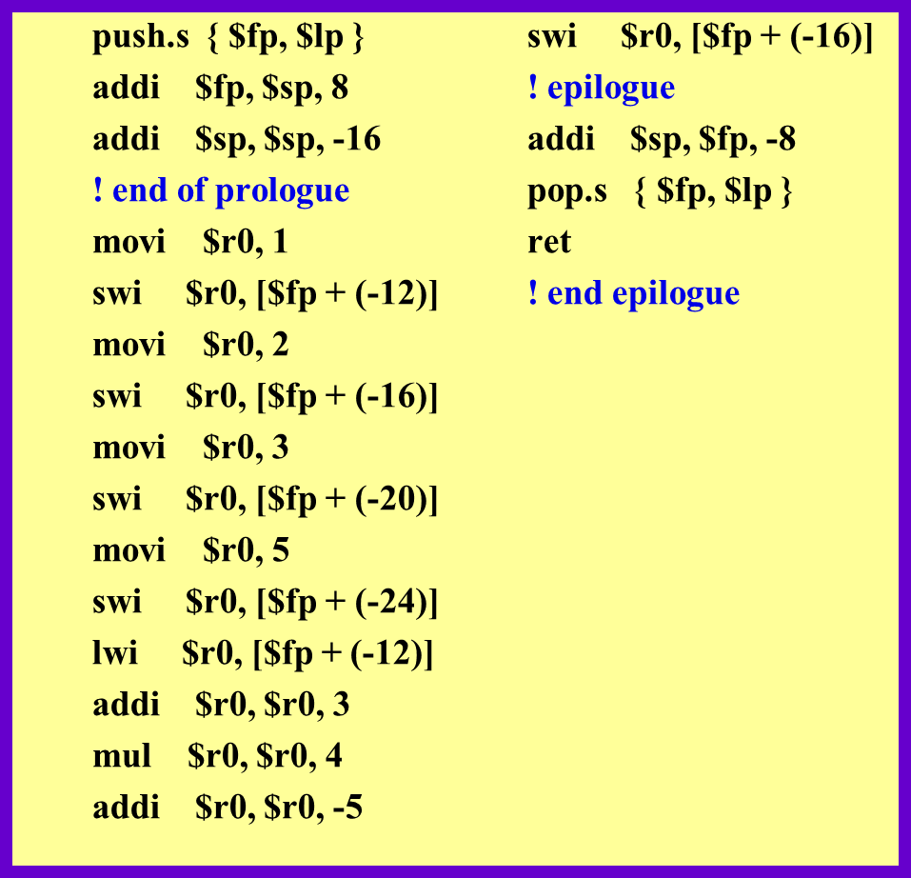
Assignment3/ test1.c
int main()
{
int a;
int b=1;
int c=2;
int d=3;
a=10/2;
c=(b+3)*4-5;
}

