Slide 1

<Presenter_Name>
M17 Project
m17project.org

Slide 2

Amateur Digital Landscape
Many protocols exist and you could use any of them:
AX.25 : Data, VHF/UHF. Adaptation of the X.25 protocol for amateur radio.
DSTAR: First protocol created for amateur radio. Designed for digital voice. VHF/UHF.
Open specifications.
YSF: Proprietary mode from Yaesu. Data and digital voice.
FT-4 / FT-8 : Very long range (1000s km), very low power (10 W), very slow speed, HF
DMR/TETRA/P.25: A whole range of industrial standards adapted for amateur radio use
None is truly FOSS. Sometimes only one, closed source,
implementation exists.

Slide 3

Amateur Digital Landscape
First versions of DSTAR specifications is released in 2001 by JARL
(Japan).
Uses the AMBE vocoder from DVSI.
Specifications are publicly available but no license specified.
A manufacturer does not have to follow the published specifications.
DSTAR de-facto became ICOM’s proprietary mode.

Slide 4

Amateur Digital Landscape
Computing power at the time (2001) was limited.
The vocoder is implemented in an ASIC and the algorithms are
protected by patents, industrial secrets, etc...
The same algorithm (or variants of it) is used in all the mainstream
digital voices modes...
(DSTAR, YSF, DMR, P25, NXDN,...).
There are historic reasons, but how does one tinker with it?
Answer: you do not.

Slide 5

Amateur Digital Landscape
The solution came in the form of Codec 2 released in 2010 by David
Rowe (VK5DGR).
Fully open-source, no patents, no industrial secrets.
Since then the computing power increased significantly, so much that
a 32-bit ARM MCU is enough.

Slide 6

Amateur Digital Landscape
A digital protocol designed by hams, for hams
A response to growing community of digital mode users
A way to get free from patent encumbrances, licenses etc.
A chance to bring back digital radio to the experimenting side of
amateur radio
Uses Codec 2

Slide 7

Why is M17 different?
Created for fun, not profit
Based on Codec 2, not proprietary vocoders
Development driven by users, not by a single manufacturer
Extensible – use cases can be added over time

Slide 8

Who is behind it?
2019 – Started by Wojciech Kaczmarski, SP5WWP in Warsaw, Poland
2022 – 2024 - a large, multinational group of ham radio operators
Now – You!

Slide 9

M17 Timeline

Slide 10
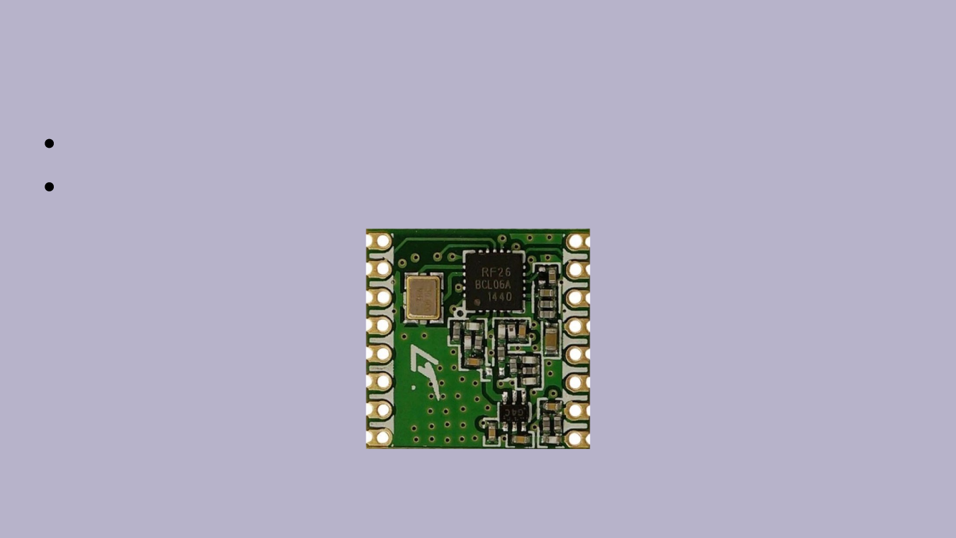
2019
First experiments with Codec 2 and STM32s
Initial tests with RFM26W modules (Si4463)

Slide 11
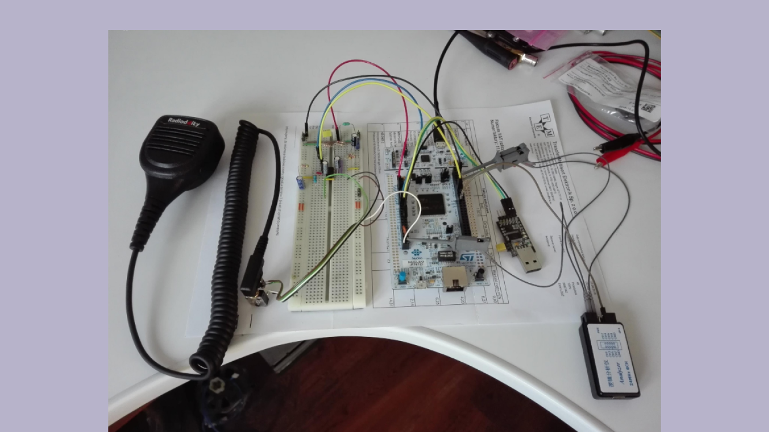

Slide 12

2019
First prototype of an M17-compatible handheld created – TR-9
Dan, KB6NU’s blog entry (M17, an open-source, DMR like system) –
pivot point for the project
https://www.kb6nu.com/m17-an-open-source-dmr-like-system/

Slide 13
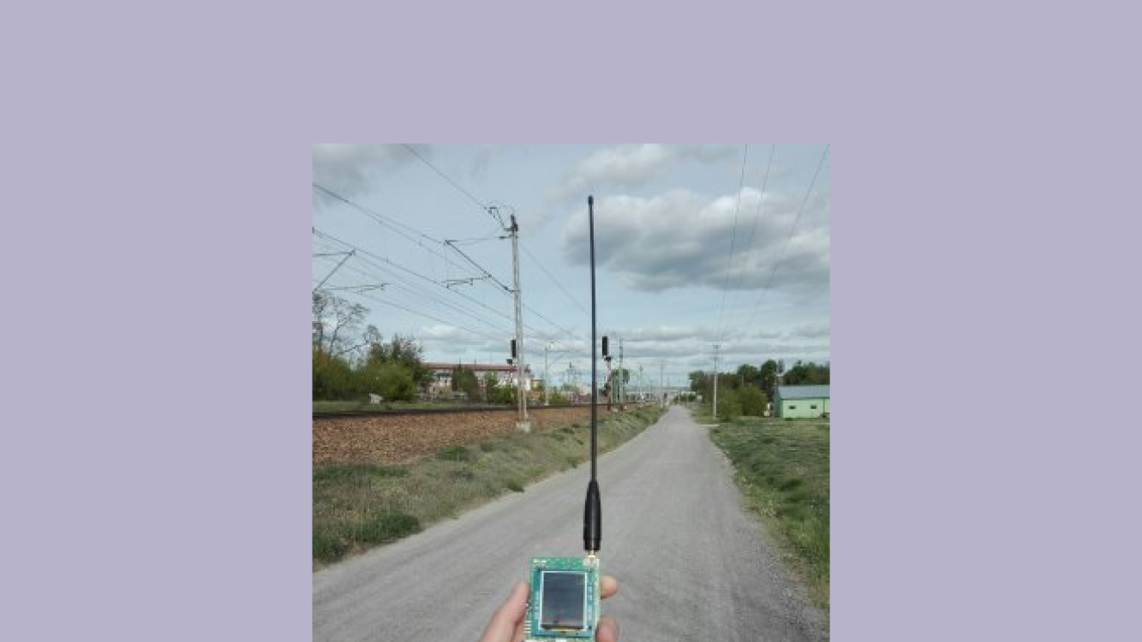
2019

Slide 14
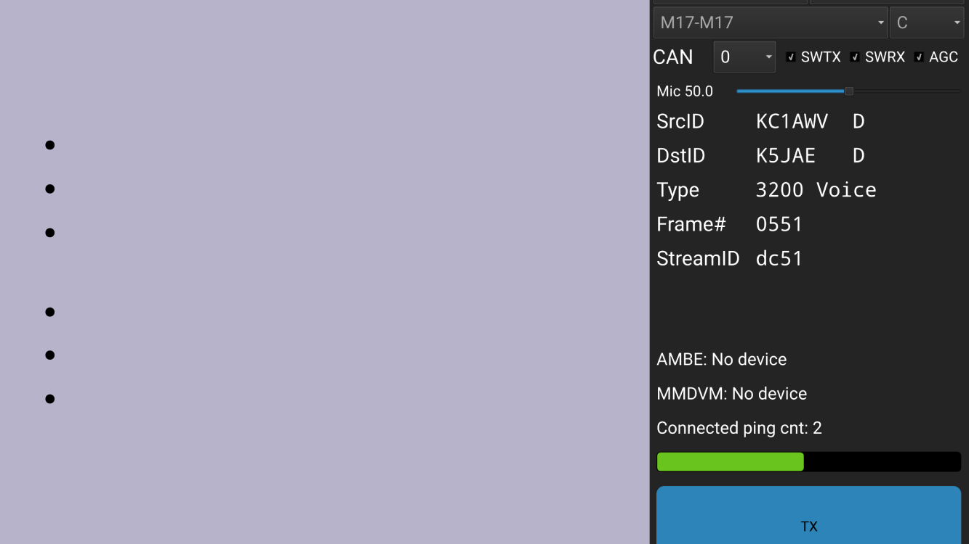
2020
Media coverage increases via Twitter, blogs
Protocol specification refinement
OpenRTX project starts to create
replacement firmware for common HTs
Doug, AD8DP, adds M17 to DroidStar
Tom, N7TAE, creates mvoice
Rob, WX9O, creates m17-cxx-demod
command line encoder/decoder tools

Slide 15
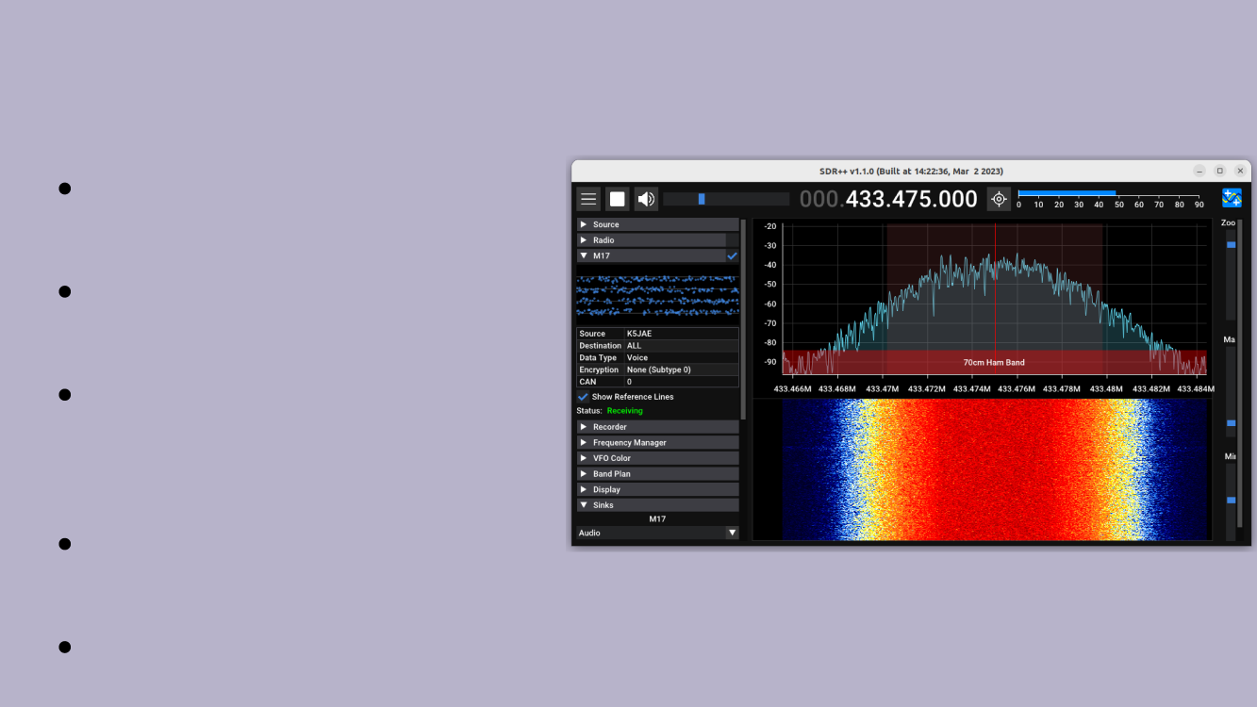
2021
Significant financial
assistance via ARDC grant
Win the ARRL’s Technical
Innovation Award
MMDVM and
OpenWebRX add M17
support
First QO-100 satellite
tests
SDR++ adds M17 support

Slide 16
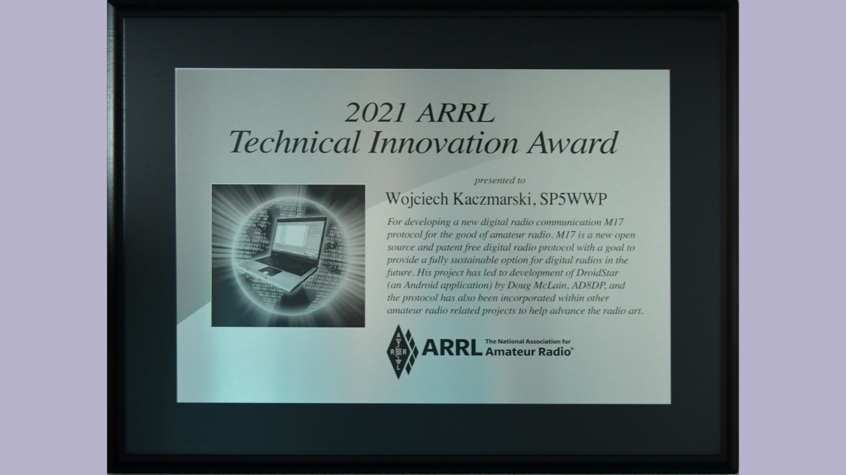

Slide 17
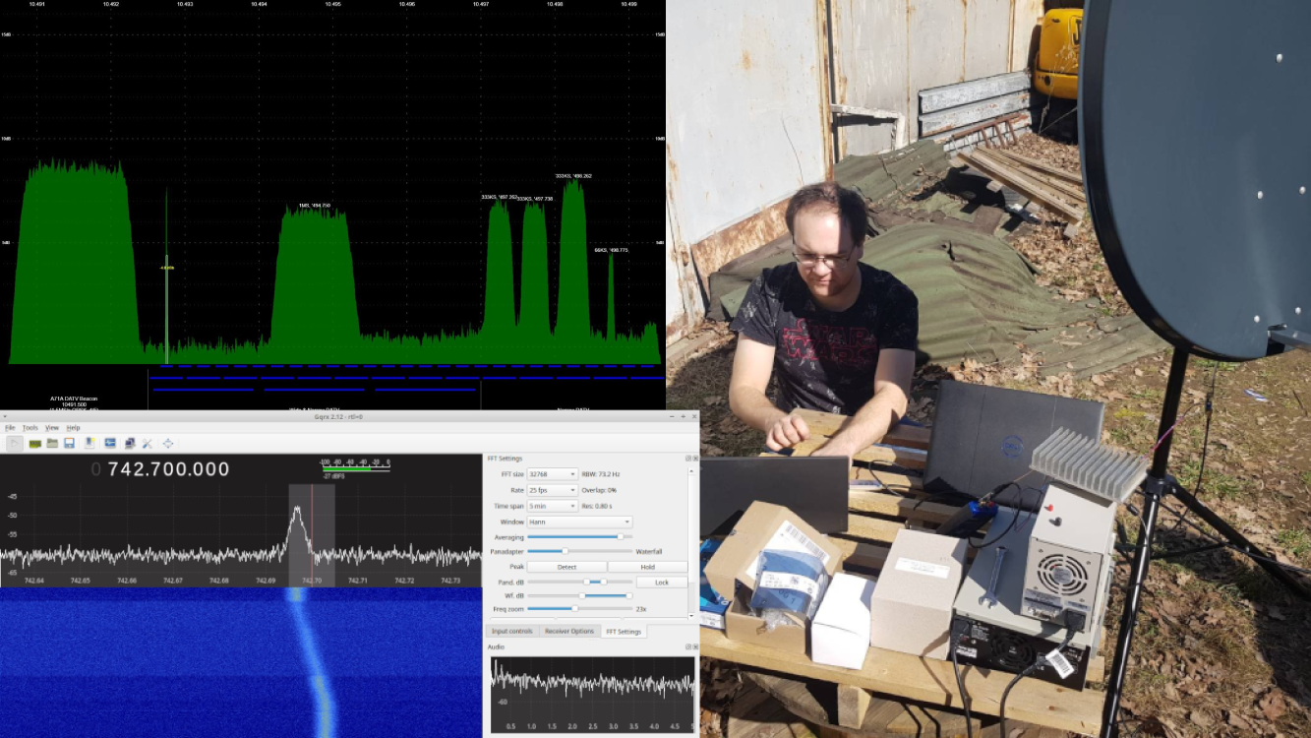

Slide 18
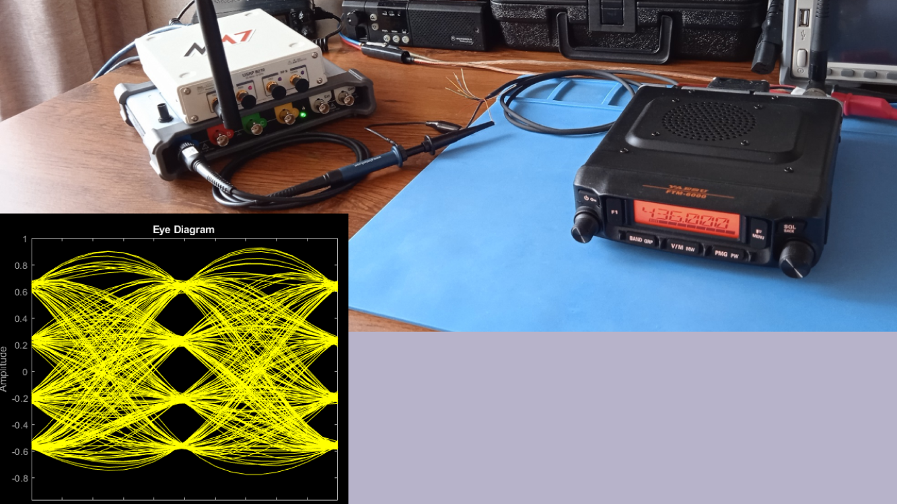

Slide 19

2022
Successful QO-100 loopback test by Charles G4GUO
Ongoing specification improvements by Jay KA1PQK
Upcoming OOT GNU Radio blocks by Dave N1AI
Module17 modem board by Mathis DB9MAT
OpenRTX supports M17 on MD-(UV)380

Slide 20
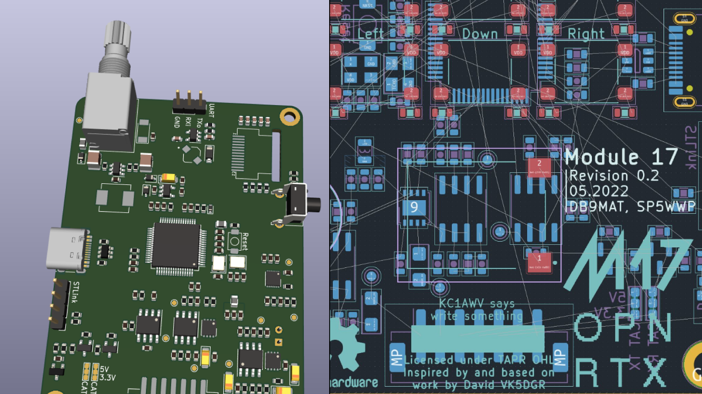

Slide 21
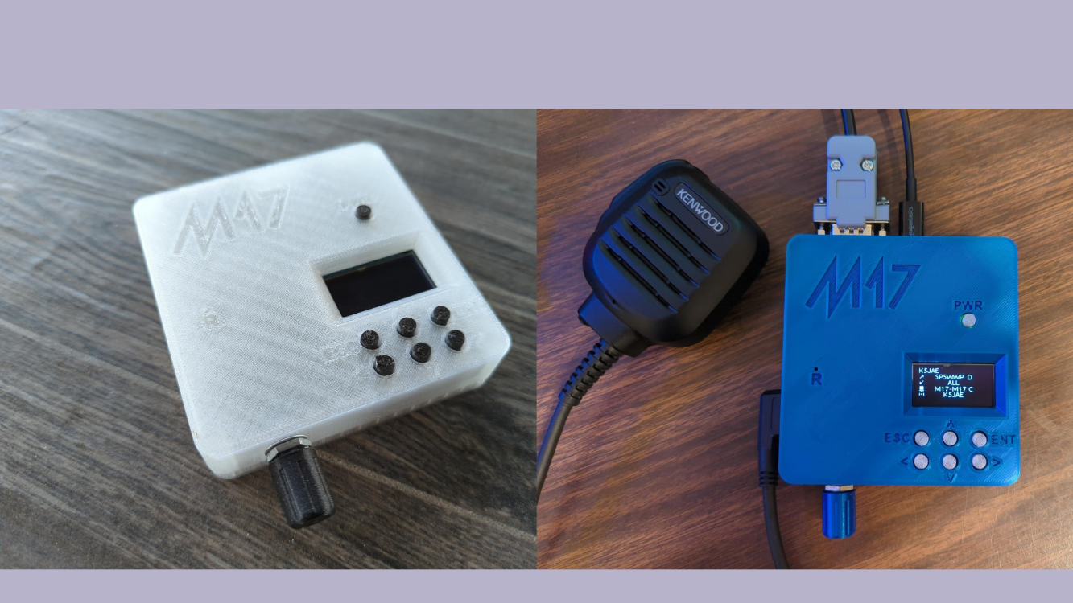
Module 17 pre 1.0

Slide 22

2022
Steve KC1AWV and Ed N2XDD give numerous interviews
QSO Today, Ham Radio 2.0, Ham Radio Crash Course,
KM4ACK, Tank Radio, DixieDX,...
Attendance at major ham festivals in the US
NEARfest/Deerfield, HamCation/Orlando, HamVention/Dayton,
HOPE/NYC, …

Slide 23
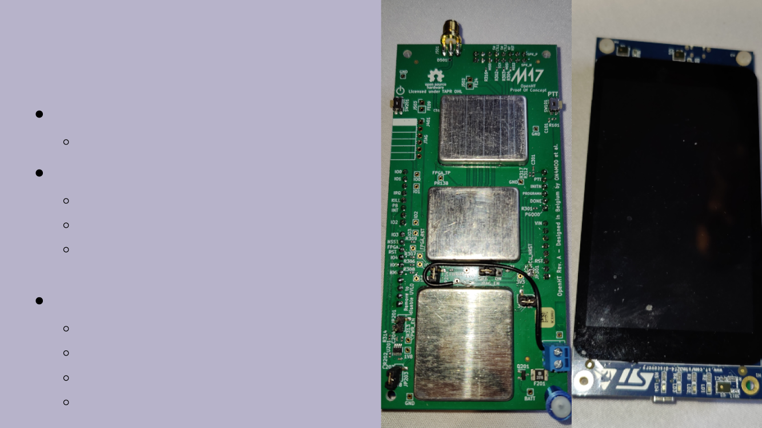
2023 - OpenHT
SDR handheld
If you can modulate it we can send it
Currently
Open-source hardware and firmware*
430 MHz / 2.4 GHz @25 mW
*FPGA toolchain and IPs are not
open-source
In the future
OpenRTX
USB-C charging
Open-source FPGA
5W output

Slide 24
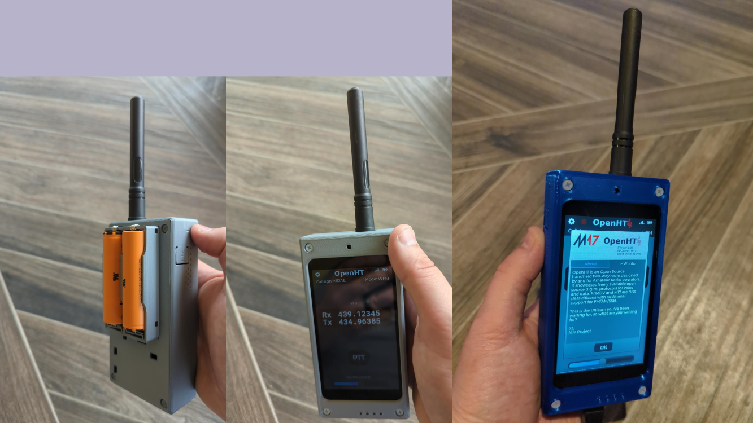
2023 - OpenHT

Slide 25
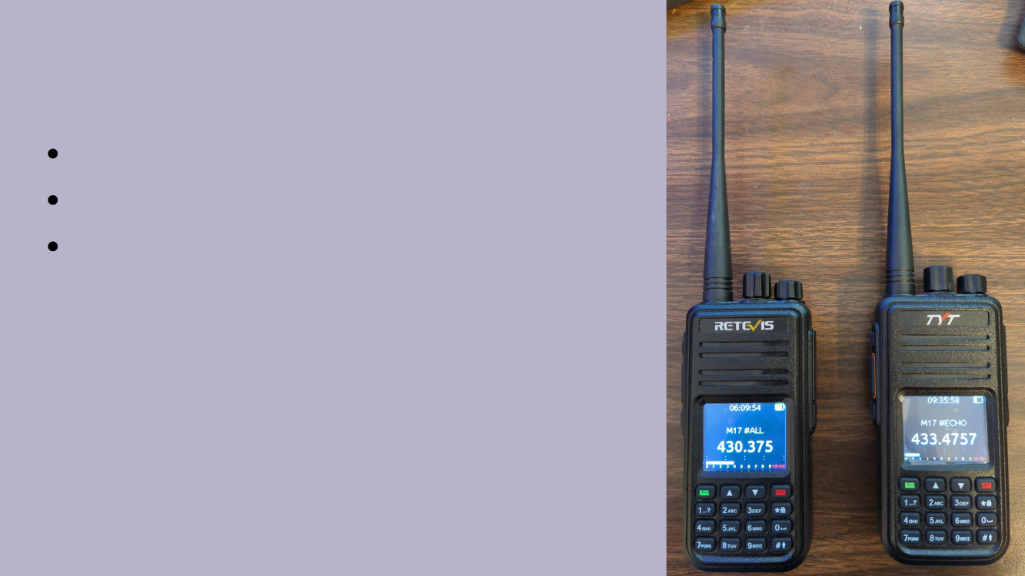
2023 – Supported HTs
TYT and Retevis
Supported by OpenRTX
Require a small hardware mod

Slide 26
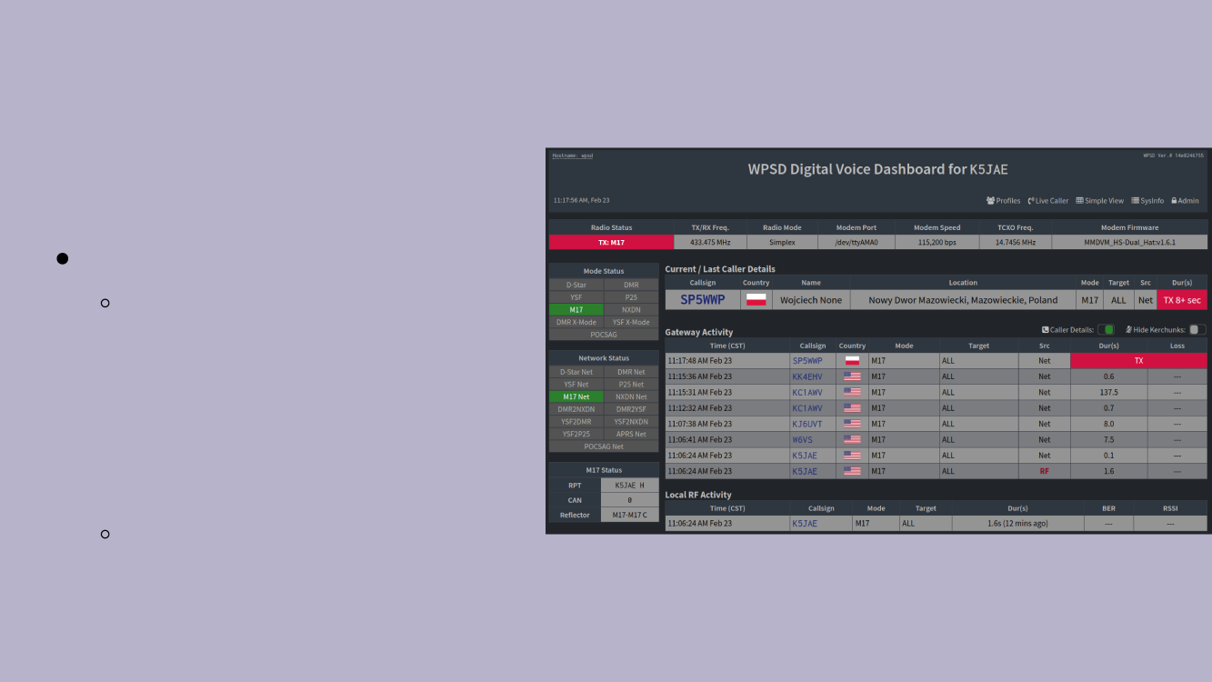
2023 – WPSD
Hotspot
Created by Chip, W0CHP
Originally a web overlay for Pi-
Star,
now is a wholly separate
distribution
for repeater and personal
hotspot
management
Supports M17 as well as other
popular digital protocols

Slide 27
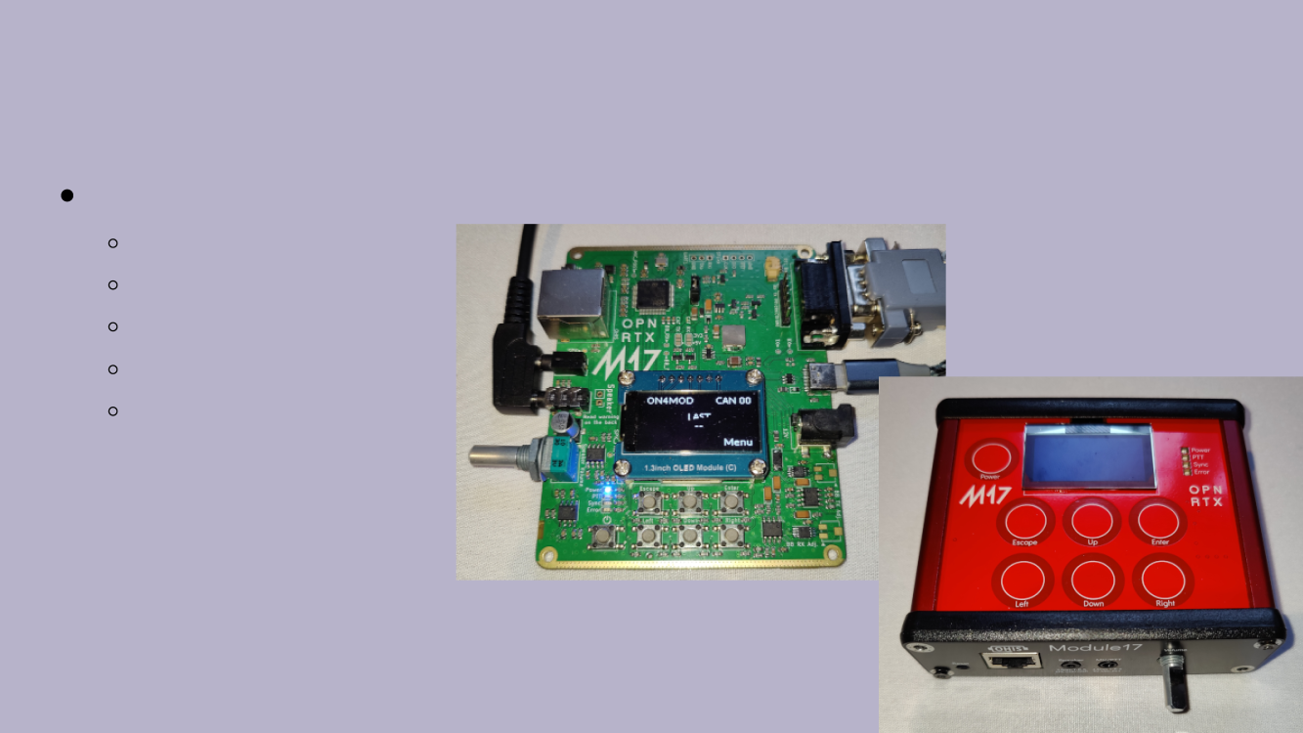
2024 – Module17 v1.0
Modem that allows you to TX/RX M17 using FM radio
Open-source protocol
Open-source hardware
Open-source software
Affordable
Build it yourself!
(or purchase online)

Slide 28
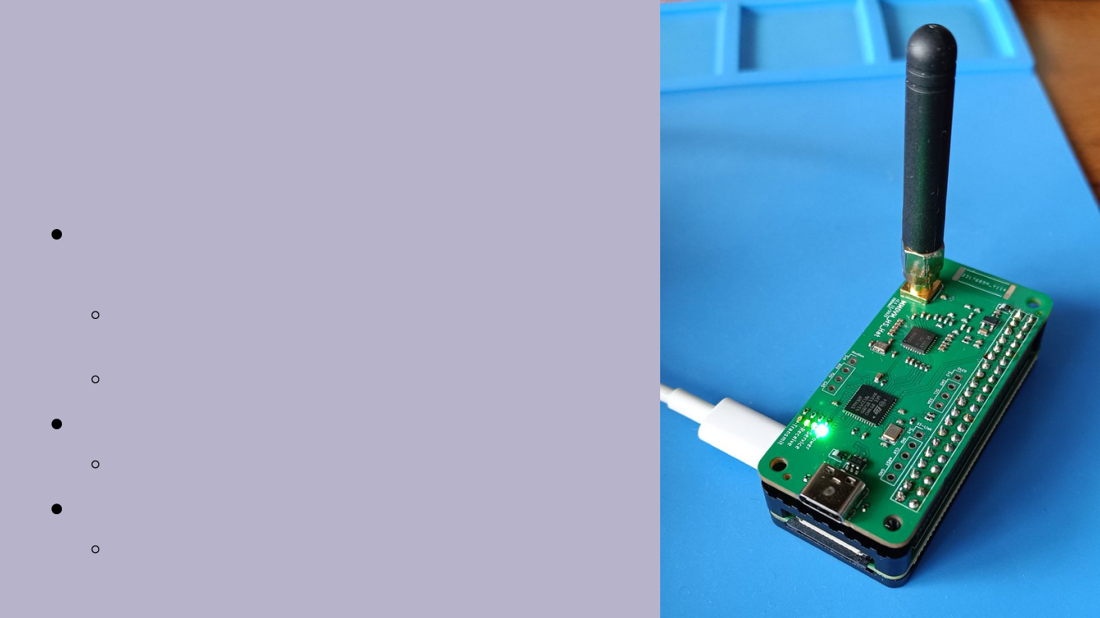
2024 – CC1200
Hotspot
Uses Texas Instruments CC1200
silicon
Superior Adjacent Channel Power Ratio (ACPR)
vs incumbent hotspot hardware (ADF7021)
Designed as a Raspberry PI hat
Full M17 spec conformance
Soft decoding capabilities (with libm17)
Supports FM Analog
Allows for use of FM Analog HTs to access M17
reflectors

Slide 29
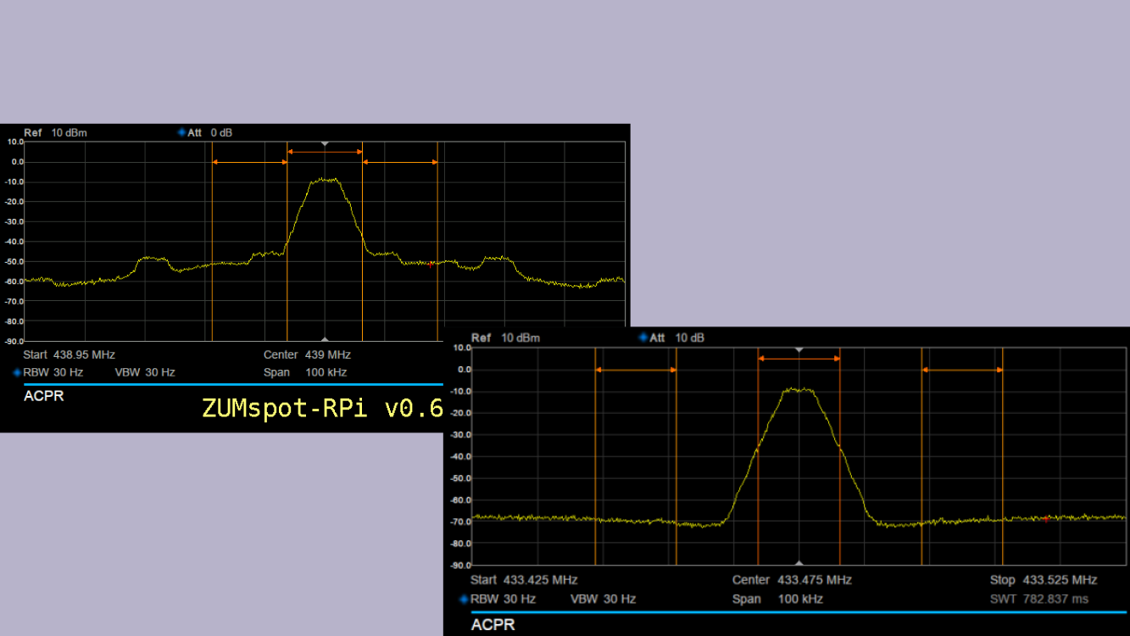
2024 – C1200 Hotspot ACPR Comparison

Slide 30

2024 – M17 Radio Access Network
M17RAN, a repeater project utilizing the philosophy of the cell phone
industry.
Remote Radio Unit (RRU) enclosed in a milled aluminum chassis and
placed on the tower
Uses a pair of CC1200 chips from Texas Instruments and an RF power amplifier.
CC1200 RF front-ends supports various FM-based modes, including M17 and AFSK
Only need Power and Fibre optic network to the ground
No need for expensive hard line and the RF losses that ensue
Baseband Unit (BBU) is placed on the ground in the shelter
Provides all DSP and encoding/decoding
Provides internet backbone interface
Provides the infrastructure to remote boot the RRU

Slide 31
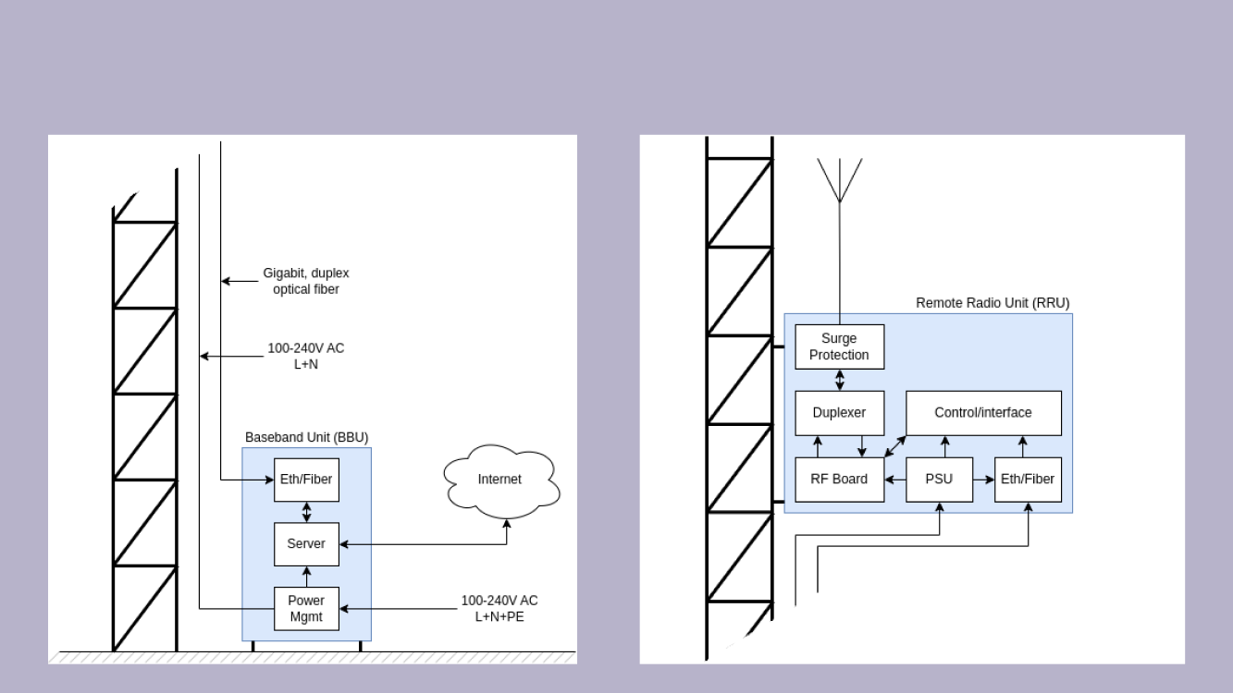
2024 - M17RAN Block Diagram

Slide 32
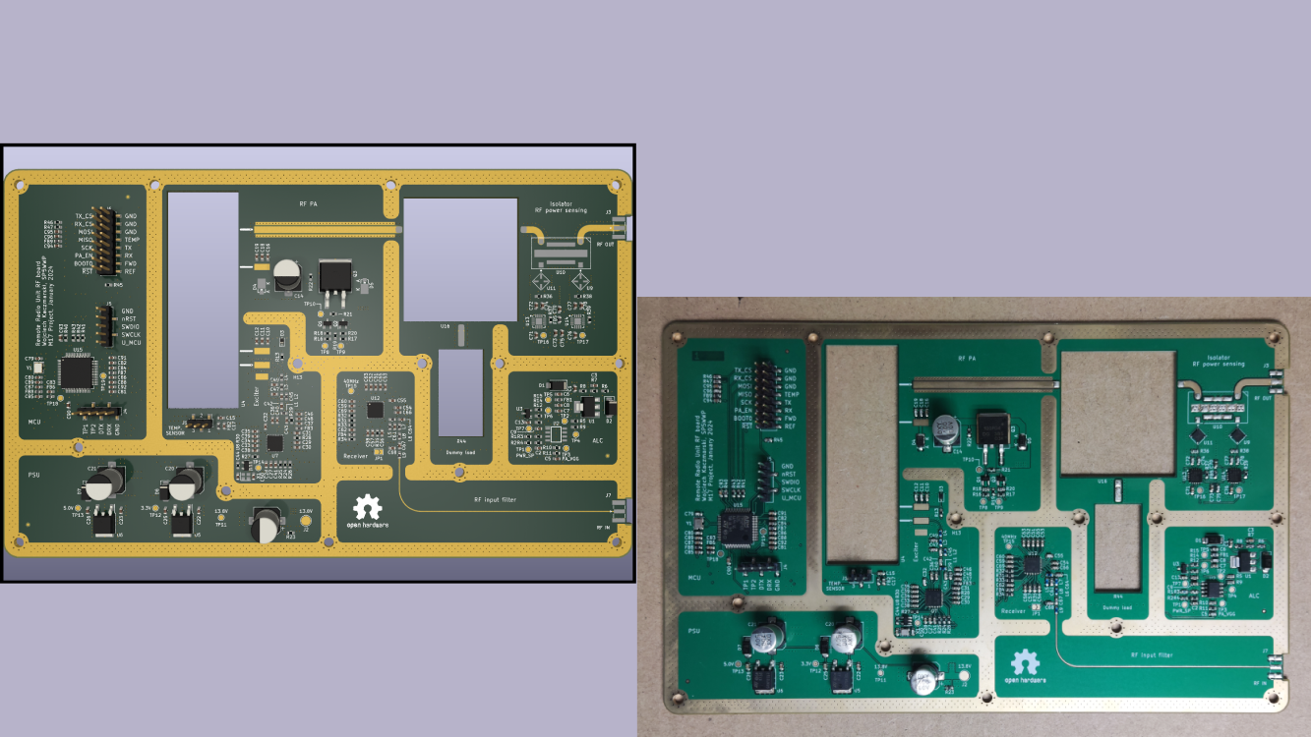
2024 – Remote Radio Unit (RRU)

Slide 33
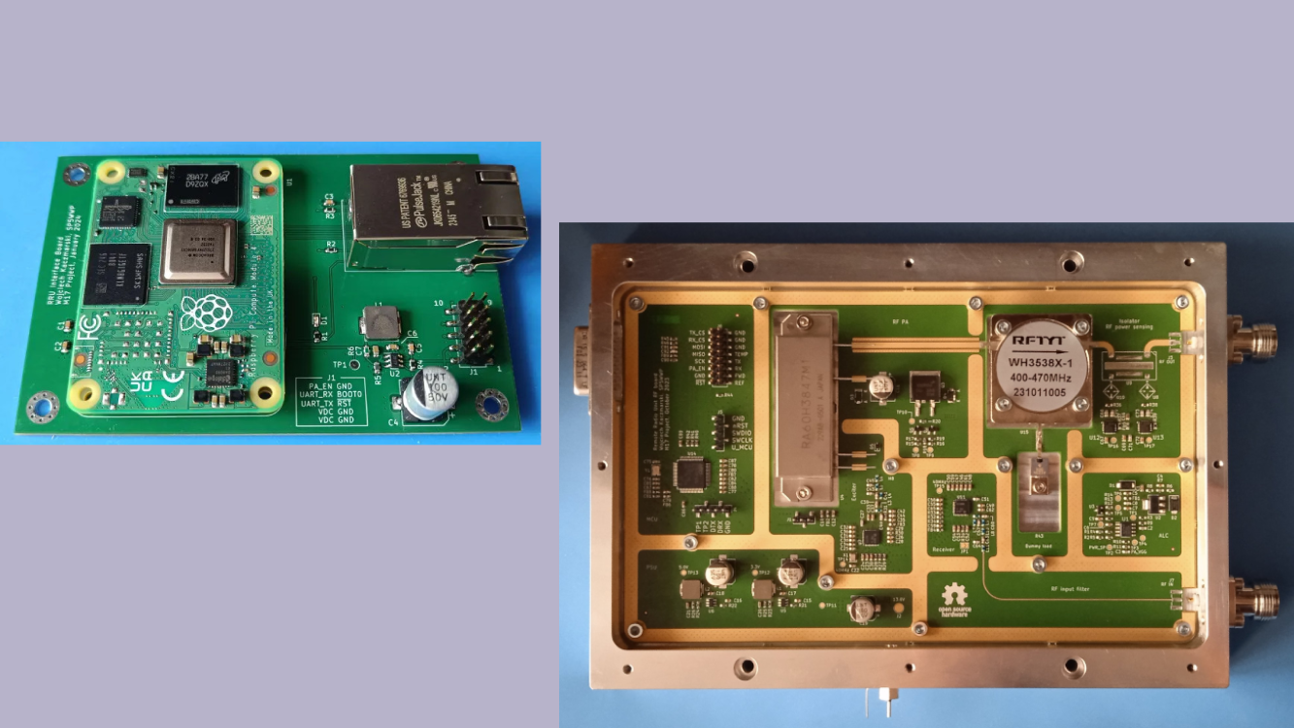
2024 – Remote Radio Unit (RRU)

Slide 34
Some Stats
Over 200 reflectors worldwide
10-15 active weekly NET check-ins at M17-M17 C reflector
Over 3300 X (formerly Twitter) followers
More than 1395 Discord chat users
“M17 (amateur radio)” Wikipedia article in 8 languages

Slide 35
M17 Physical Layer
4FSK modulation, 12.5 kHz channels
4800 symbols per second, 9600 bps gross throughput
Stream and packet modes
Error-control coding

Slide 36
M17 Additional Features
IDs are based on callsigns (no user ID database needed)
16 Channel Access Numbers
AES encryption support

Slide 37

FAQ
How to get involved
Start by going to https://m17project.org
Join the M17 Discord group
Financially (501c3 tax deductible)
How to get on the air
Get a MD-(UV)380 or clone and flash it with OpenRTX
Get a Module17 and connect it to the 9600 bps packet port of your mobile FM transceiver
Get a hotspot and configure it for M17 to connect to online reflectors
Install DroidStar on your mobile device and connect directly to reflectors using M17 over
IP only
How to promote M17
Use it and tell others about it!

Slide 38

Questions ?

Slide 39
Technical Backup

Slide 40
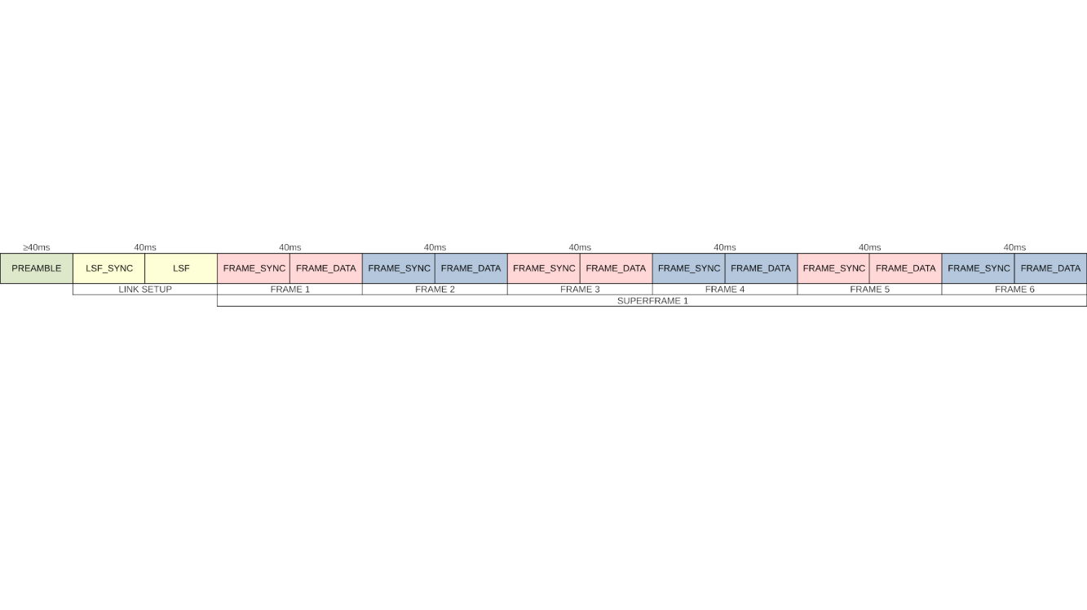
M17 Frame Sequence

Slide 41
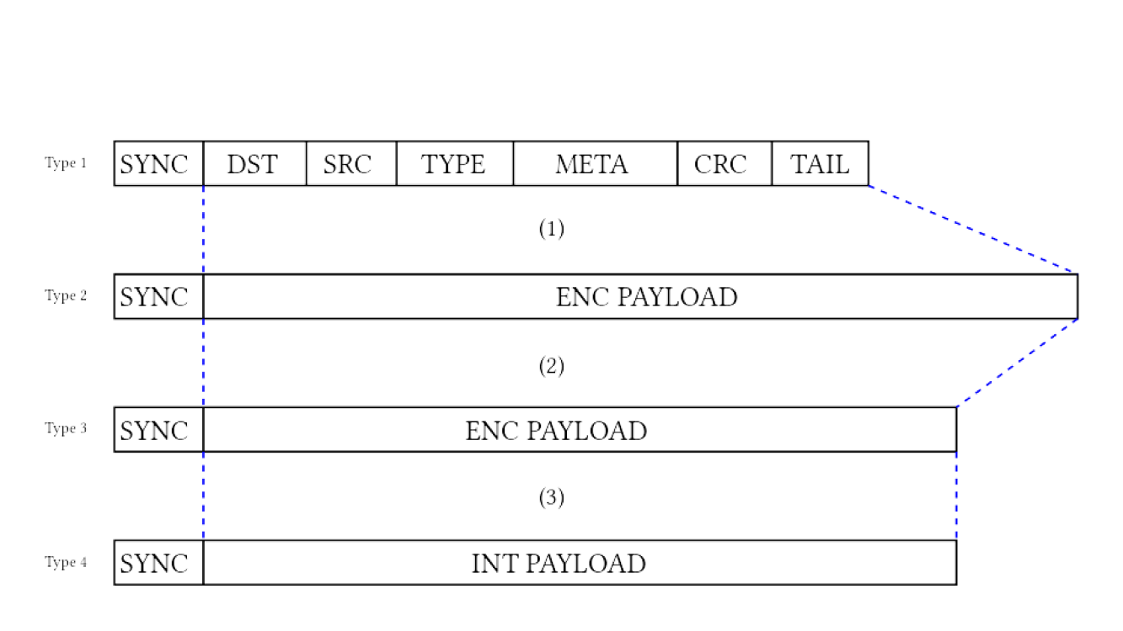
M17 Link Setup Frame (LSF)

Slide 42
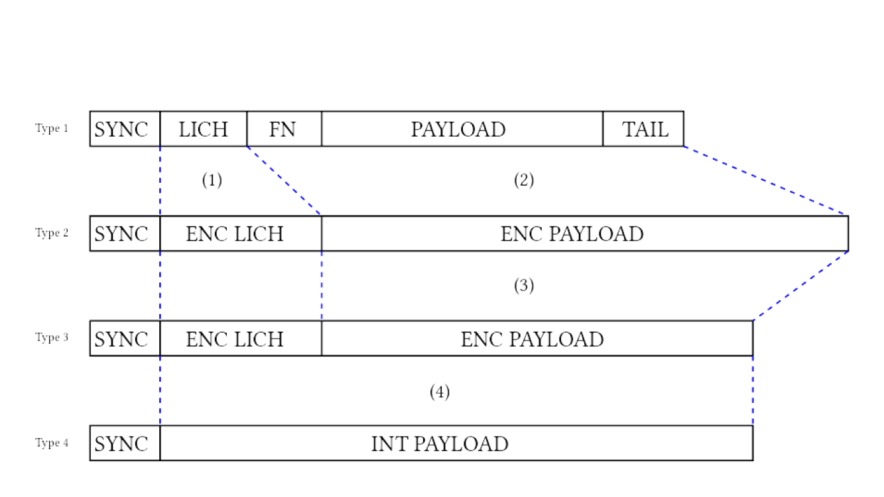
M17 Voice frame

Slide 43

Error-control coding
Golay (24, 12)
Punctured convolutional coding
Bit interleaving (re-ordering)

