Slide 1

Quantizer optimization for LPC based voice coder: Codec 2
Wojciech Kaczmarski, M17 Project
m17project.org

Slide 2
Codec 2 - introduction
A free to use and open-source, low bitrate voice codec
Developed by David Rowe VK5DGR et al.
We are going to focus on the full rate, 3200 bps mode
m17project.org

Slide 3
Modeling speech
Speech is a sound pressure wave generated by vocal chords and filtered by an anatomical structure called the vocal tract
We can coarsely model the speech generation process using an excitation source and a filter
Both the excitation source and filter change their paremeters over time
m17project.org

Slide 4

Speech signal
m17project.org

Slide 5
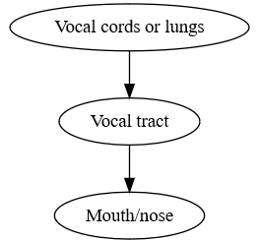
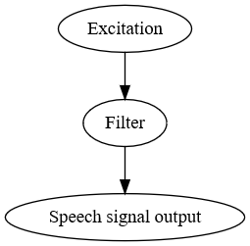
Excitation and filtering
model
m17project.org

Slide 6
Excitation and filtering
The filter can be modeled with an all-pole digital filter
of order p:
m17project.org

Slide 7

20 ms speech frame
m17project.org

Slide 8
Excitation and filtering
Codec 2 obtains the filter coefficients a for each frame by computing p+1=11 autocorrelation values and solving a set of linear equations
m17project.org

Slide 9

DFT vs. |H(z)|
m17project.org

Slide 10
Polynomial to LSF
LSF – Line Spectral Frequency(ies)
A slight error in any value a of the A(z) polynomial representation of the all-pole filter might be catastrophic
Rationale for the conversion: LSF representation is much less susceptible to errors
m17project.org

Slide 11

Polynomial to LSF
m17project.org

Slide 12

Polynomial to LSF
m17project.org

Slide 13
LSF encoding
Codec 2 uses quantized delta encoding for the LSF parameters
LSF1 is mapped ‘as-is’
Every next LSF is encoded as a frequency shift from the previous one
m17project.org

Slide 14
LSF encoding
Eg. LSF1=145 Hz, the best entry is then 150
dlsp1
25
50
75
100
125
150
175
200
m17project.org

Slide 15
LSF encoding
LSF2=560 Hz, 560-150=410
dlsp1
25
50
75
100
125
150
175
200
dlsp2
300
325
350
375
400
425
450
475
m17project.org

Slide 16
LSF encoding
This process continues up to the last LSP
dlsp1
25
50
75
100
125
150
175
200
dlsp2
300
325
350
375
400
425
450
475
dlsp10
400
425
450
475
500
525
550
575
. . .
m17project.org

Slide 17
Quantizer improvements
Two approaches: improve the scalar quantizer – make quanta fit the actual data and its PDF
Use vector quantizer instead
m17project.org

Slide 18
Codebook generation
OpenSLR - free speech corpora for codebook generation
TED-LIUM(v2) has been successfully used for OpenACELP
m17project.org

Slide 19
Codebook generation
Centroid search – Linde-Buzo-Gray (LBG) or
k-means algorithm
m17project.org

Slide 20
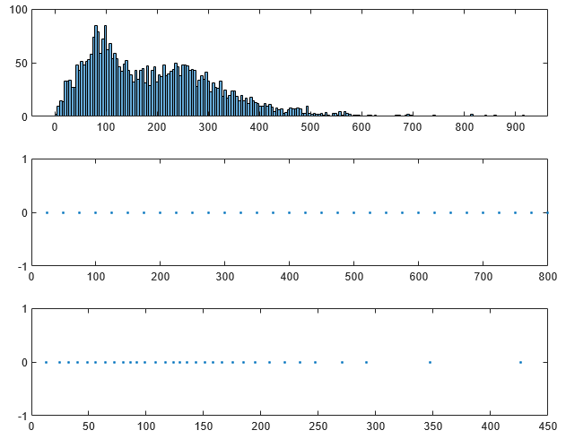
LSF2-LSF1 difference
distribution
PDF
Codec 2 reference codebook
PDF optimized codebook
Frequency (Hz)
m17project.org

Slide 21
Vector quantizer
Proposal: use Multistage Vector Quantizer with Vector Split
Use a coarse codebook for all 10 LSFs
Split LSFs into subvectors of length {3,3,4} and use MSVQ to obtain better approximations of the input vector
m17project.org

Slide 22
Vector quantizer
Bit allocation for the quantizer:
6 bits for the coarse codebook
4 bits per stage for MSVQ
Use 3 stages for LSF1..3, 4 for LSF4..6 and 3 for LSF7..10
Total of 46 bits per frame (Codec 2 uses 50)
m17project.org

Slide 23
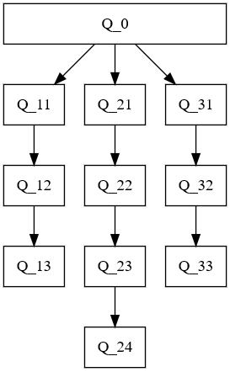
64
16
Codebook length
16
16
16
m17project.org

Slide 24
Vector quantizer
The resulting reconstructed vector is given by
m17project.org

Slide 25
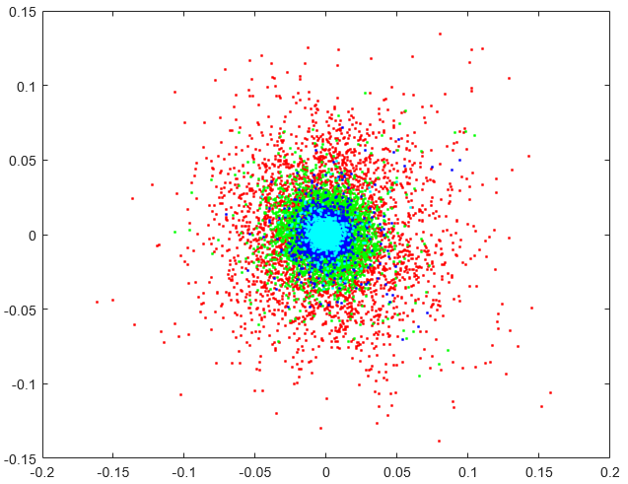
MSVQ convergence
2D cross sections of the training sets used for Q_2x codebook generation
Axes: LSFs in cosine domain
m17project.org

Slide 26
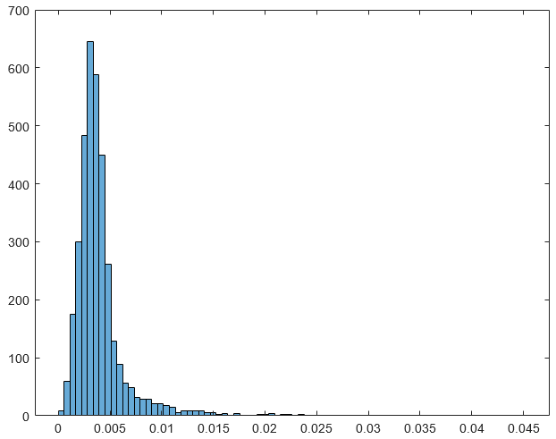
MSVQ error distribution
Error distribution for the Q_2 codebook
Horizontal axis: absolute error bins, Euclidean distance
PDF
m17project.org

Slide 27
Improving SQ - results
Computational complexity is the same
SD is reduced, but the change is likely to be imperceptible
Bitrate doesn’t change
m17project.org

Slide 28
Switch to VQ - results
Saves 200 bps
Cost – more multiplications to perform for the codebook search
SD rises, but the change should be negligible (assuming a simple handheld transceiver is used – low quality reproduction)
m17project.org

Slide 29
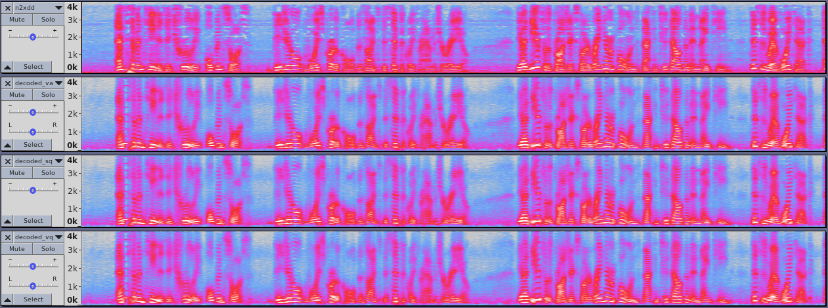
m17project.org

Slide 30
Thank you
m17project.org

