Slide 1
Quantitative Research Methods
Matthew Ivory
matthew.ivory@lancaster.ac.uk

Slide 2
1. Introduction to the course
Session 1: Introduction to quantitative research methods using R
Session 2: Data management and data wrangling
Session 3: Exploratory data analysis
Session 4: Data visualization
Session 5: Live Coding Walkthrough
Session 6: Probability and distributions
Session 7: Tests for discrete variables: Analysing contingency tables
Session 8: Correlations and t-tests
Session 9: ANOVA and linear regression
Session 10: Multiple regression, introduction to generalised linear regression

Slide 3
In this session
Hypothesis Refresher
probabilities
Correlations
t-tests
Confidence Intervals

Slide 4
Hypothesis Testing
The null hypothesis states that there is no difference between the two means (or groups) of interest
Hypotheses can be directional or non-directional
Directional means that we are predicting a difference between groups as well as the direction of the effect
Non-directional means we predict a difference but don’t know which way it will go
Hypothesis should be worded so that it can be tested and must include both independent and dependent variables
Exam scores (DV) will be higher for students who studied more than four hours a week (IV) than those who did not

Slide 5
Hypothesis Testing and p-values
The p-value is the probability of finding a difference equal to or greater than the one found if no difference exists in the population. Let's say our p-value = .010
This indicates a very small probability of finding a difference equal or greater in the population if there was no difference. The obtained p-value is also smaller than the standard cut-off that we use in Psychology of .05
As such we would reject our null hypothesis and suggest that there is a significant difference between the two groups.
If the p-value was greater than .05 (e.g. .1),we would fail to reject the null hypothesis, not accept the null
Reject the null
Fail to reject the null
0
.05
1

Slide 6
Effect sizes and p-values
When we construct an experiment, we construct a research hypothesis:
Two variables are related
An experimental manipulation will affect another variable
We also construct a null hypothesis:
Two variables are not related
The experimental manipulation has no effect
p-value: how confident can we be in rejecting the null hypothesis
A p-value of 0.05 tells us that 5% of the time when we find an effect like this, the null hypothesis is true (a false positive)
If the p-value is less than 0.001, we write by convention: p < .001
If there’s a chance less than one in a thousand that we find this effect when the null hypothesis is true then we’re quite confident in our result

Slide 7
Correlations
Correlation is a test that measures the relationship between two variable.
You measure two variables and the correlation analysis tells you whether they are related in some manner, either positively or negatively, and how strong that relationship is
We can conduct correlations on data when variables are continuous or ordinal

Slide 8
Correlations
When dealing with correlations you should always refer to relationships and not predictions. In a correlation, X does not predict Y, nor does X cause an effect in Y
Correlation != Causation
For correlation, all we can say is that X and Y are related/associated/correlated

Slide 9
Correlation Examples
https://www.tylervigen.com/spurious-correlations

Slide 10
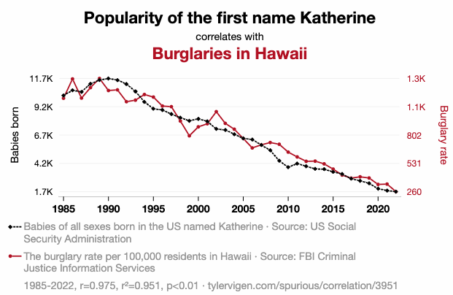
Bad Correlation Examples
https://www.tylervigen.com/spurious-correlations

Slide 11
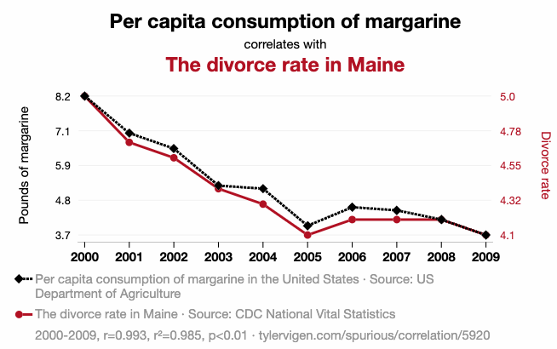
Bad Correlation Examples
https://www.tylervigen.com/spurious-correlations

Slide 12
Bad Correlation Examples
Why do these correlations exist?
In the two examples above: a combination of scientific dishonesty, ‘creative’ data wrangling, and confounds
A confounding variable is an unmeasured variable that influences both the dependent variable and the independent variable
Independent Variables (IV) – is independent to other variables in the study
Dependent Variables (DV) – is dependent on changes in independent variables
The DV is what we are interested in explaining

Slide 13
Correlation
So we must be careful about what claims or inferences that we make, and to consider possible confounds
Now, let’s look at some better and more accessible examples of correlations…

Slide 14
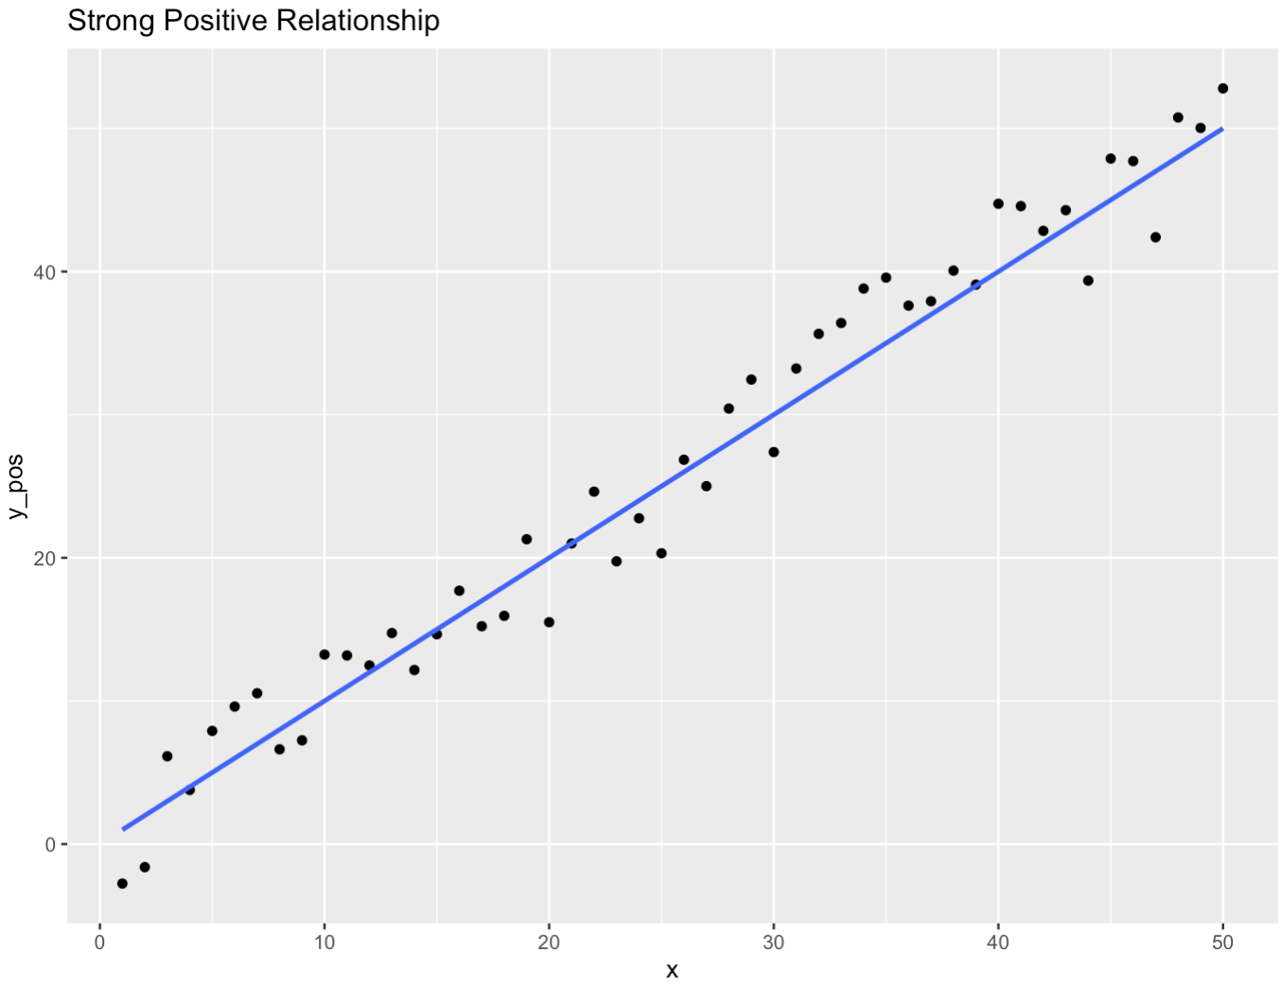
Types of Correlation
As X increases, Y increases

Slide 15
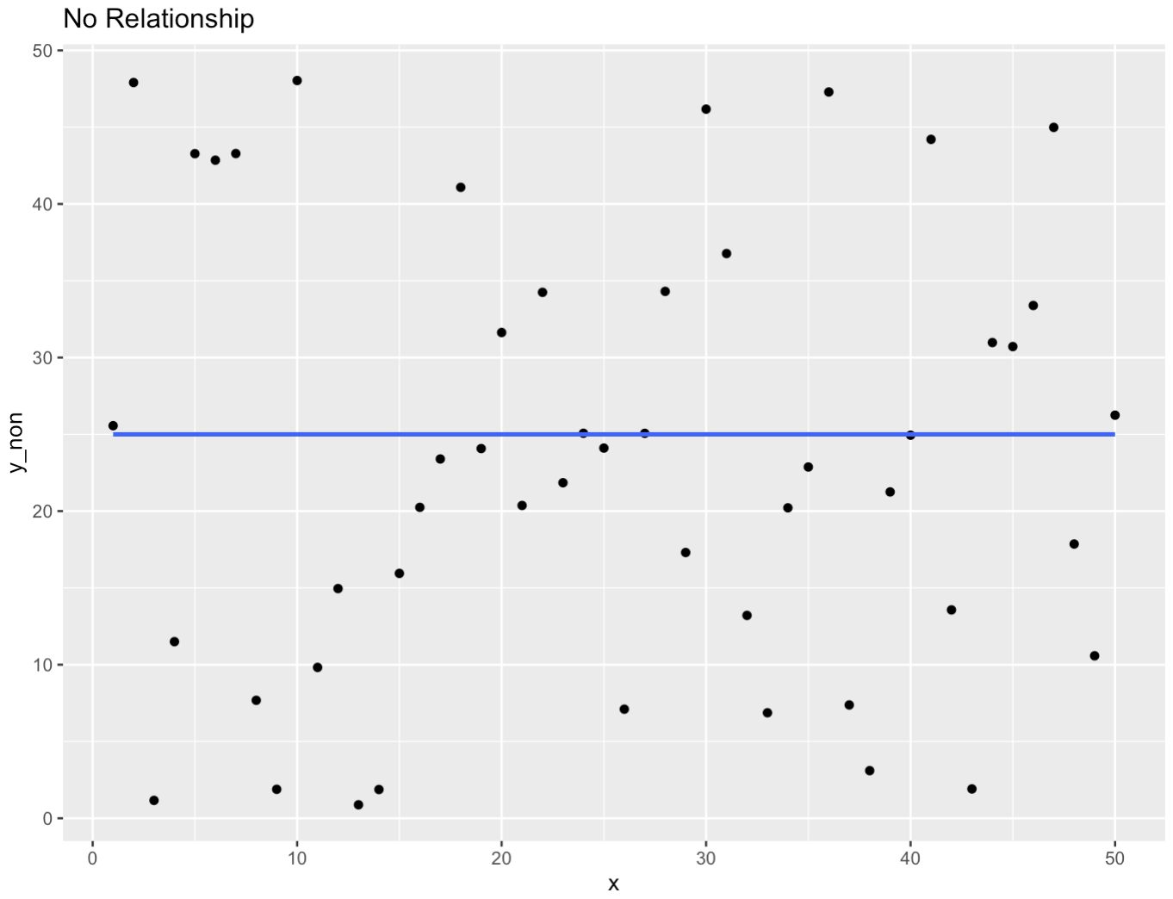
Types of Correlation
As X increases, Y shows no pattern or correlation

Slide 16
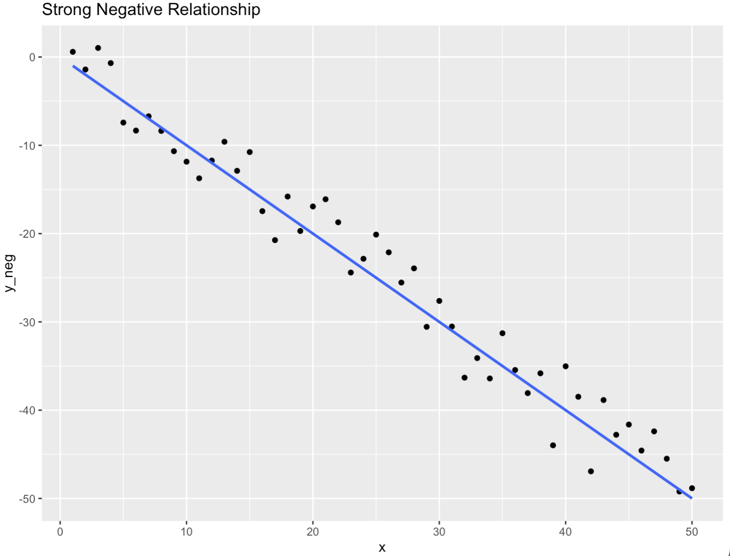
Types of Correlation
As X increases, Y decreases

Slide 17
Assumptions of the test
before running an analysis, we should check the assumptions of the test
Assumptions are the checks that the data must pass before we can use it
The assumptions change depending on the test
You should only use a given test based on how well the data meets the assumptions
Every statistical test relies upon assumptions regarding the data
Some are more lenient than others
Others are very strict

Slide 18
Assumptions of the test
For correlations, the main assumptions we need to check are:
Is the data interval, ratio, or ordinal?
Is there a data point for each participant on both variables?
Is the data normally distributed in both variables?
Does the relationship between variables appear linear?
Does the spread have homoscedasticity?

Slide 19
Assumptions of the test
For correlations, the main assumptions we need to check are:
Is the data interval, ratio, or ordinal?
If we want to run a Pearson correlation then we need interval or ratio data; Spearman correlations can run with ordinal, interval or ratio data.

Slide 20
Assumptions of the test
For correlations, the main assumptions we need to check are:
Is the data interval, ratio, or ordinal?
Is there a data point for each participant on both variables?
all correlations must have a data point for each participant in the two variables being correlated. This should make sense as to why - you can't correlate against nothing

Slide 21
Assumptions of the test
For correlations, the main assumptions we need to check are:
Is the data interval, ratio, or ordinal?
Is there a data point for each participant on both variables?
Is the data normally distributed in both variables?
We went through distributions last week, if we plotted a histogram of the data, they should resemble a normal distribution (we will try this out in the worksheet)

Slide 22
Assumptions of the test
For correlations, the main assumptions we need to check are:
Is the data continuous, or ordinal?
Is there a data point for each participant on both variables?
Is the data normally distributed in both variables?
Does the relationship between variables appear linear?
If we were to plot the variables against each other, would the line look straight?

Slide 23
Assumptions of the test
For correlations, the main assumptions we need to check are:
Is the data interval, ratio, or ordinal?
Is there a data point for each participant on both variables?
Is the data normally distributed in both variables?
Does the relationship between variables appear linear?
Does the spread have homoscedasticity?
Homoscedasticity is an assumption of equal or similar variances in different groups being compared
The error within the data is equal between the DV and IV
Notes:
We talked about this in terms of noise last week

Slide 24
Homoscedasticity
Homoscedasticity is an assumption of equal or similar variances in different groups being compared
The error within the data is equal between the DV and IV
When we take measurements, we get our observations
Observations are made up of the ‘true’ score and additional error terms
The error term can be made up of:
instrument accuracy e.g. scales that vary by ±100g
Researcher recording error e.g. too slow at stopping a timer
Participant error e.g. mistakes in completing surveys
Anything really that isn’t the true reality of what we are trying to measure

Slide 25
Two Correlation Tests
Pearson's product-moment correlation (Pearson’s R)
Used for Continuous data
Spearman’s rank correlation coefficient (Spearman’s Rho)
Used for Ordinal or Continuous data
You will have greater exposure to the correlations, how we interpret them and how to report them in the worksheet
For now… t-tests!

Slide 26
Switching Gears
We just looked at correlations – where we correlate continuous data against continuous data (or ordinal)
But what if we want to compare continuous data between two groups or conditions?
Then we can use t-tests
Useful when we want to know if there is an effect of a given variable

Slide 27
One sample t-tests
Used to compare a single group against a known norm
“does the mean of the sample deviate significantly from the expected norm”
E.g., comparing the mean IQ of a group against the expected population norm of 100

Slide 28
Independent-samples t-tests
Otherwise known as between-subjects
Different participants in different conditions
Comparing the means of two groups against each other
Test scores between two classes

Slide 29
Dependent-samples t-tests
within-subjects, dependent-samples, paired-samples, or repeated-measures
the same participants in all conditions
Each participant experiences each condition
E.g., each subject completes an easy, medium, and hard test

Slide 30
Matched-pairs t-tests
Different people in different conditions but you have matched participants across the conditions so that they are “effectively the same person” (e.g. age, IQ)
Used where you need to make sure that participants don’t demonstrate practice effects
E.g., matching participants on age and IQ to test the effect of condition (maybe levels of glucose) on test scores

Slide 31
Assumptions of the test
Two groups of data/participants (More than 2? Wait until next week)
The data are continuous.
The sample data have been randomly sampled from a population.
There is homoscedasticity (i.e., the variability of the data in each group is similar).
The distribution is approximately normal.

Slide 32
Confidence Intervals
Reported alongside our coefficients or estimates
They give a 95% (typically) interval where we would believe the true population coefficient to lie.
“I am 95% confident that the true value falls between point A and point B
Uncertainty in an estimate of a population parameter based on a sample
when a set of observations have a Normal distribution multiples of the standard deviation mark certain limits on the scatter of the observations. For instance, 1.96 (or approximately 2) standard deviations above and 1.96 standard deviations below the mean (±1.96SD mark the points within which 95% of the observations lie.

Slide 33
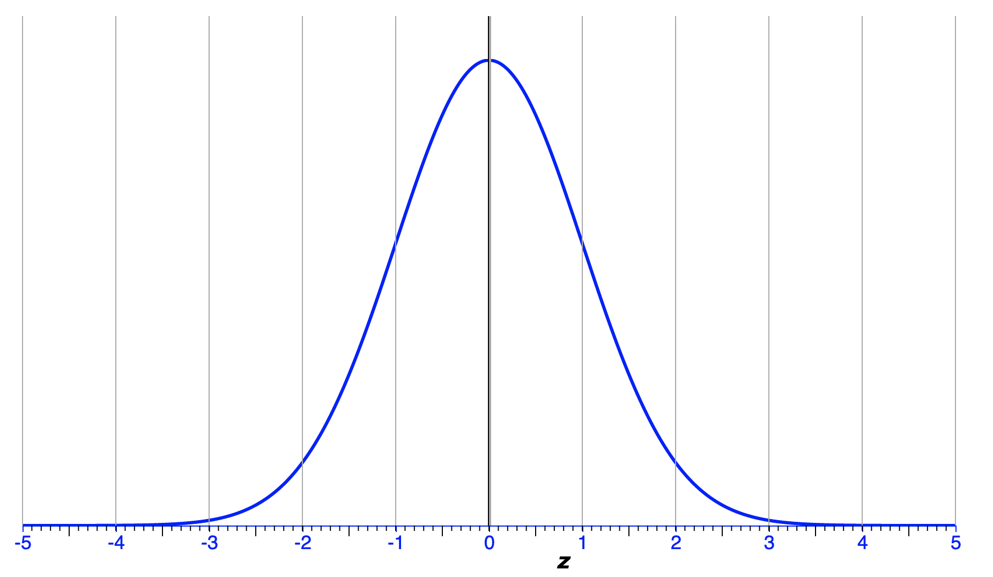
Confidence Intervals
Assuming a normal distribution
Recall that ±2 SDs contains 95% of our observations
Offer an upper and lower bound that contains the true mean 95% of the time
Why not 100% confidence? Because we are talking on probabilities

Slide 34
Worksheet this week
Correlations
t-tests
Confidence intervals
Writing up results for a report
Interpreting the findings

