Slide 1
Quantitative Research Methods
Matthew Ivory
matthew.ivory@lancaster.ac.uk

Slide 2
1. Introduction to the course
Session 1: Introduction to quantitative research methods using R
Session 2: Data management and data wrangling
Session 3: Exploratory data analysis
Session 4: Data visualization
Session 5: Live Coding Walkthrough
Session 6: Probability and distributions
Session 7: Tests for discrete variables: Analysing contingency tables
Session 8: Correlations and t-tests.
Session 9: ANOVA and linear regression
Session 10: Multiple regression, introduction to generalised linear regression

Slide 3
In this session
ANOVA
One way ANOVA
Factorial ANOVA
Linear regression

Slide 4
ANalysis Of VAriance - ANOVA
ANOVA is used to test for significant differences between two or more conditions
Like carrying out multiple t-tests at the same time
When we conduct an ANOVA, we get a common p-value which gives an indication whether at least one pair’s difference in statistically significant
We then conduct further post-hoc tests to test which groups are different

Slide 5

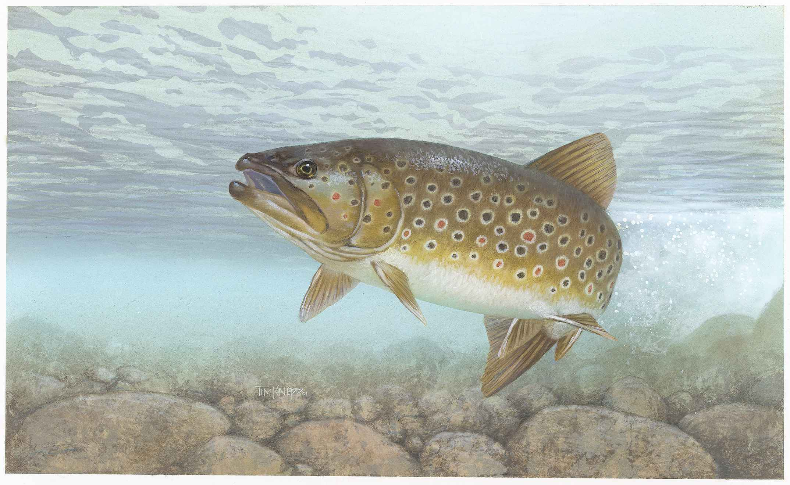
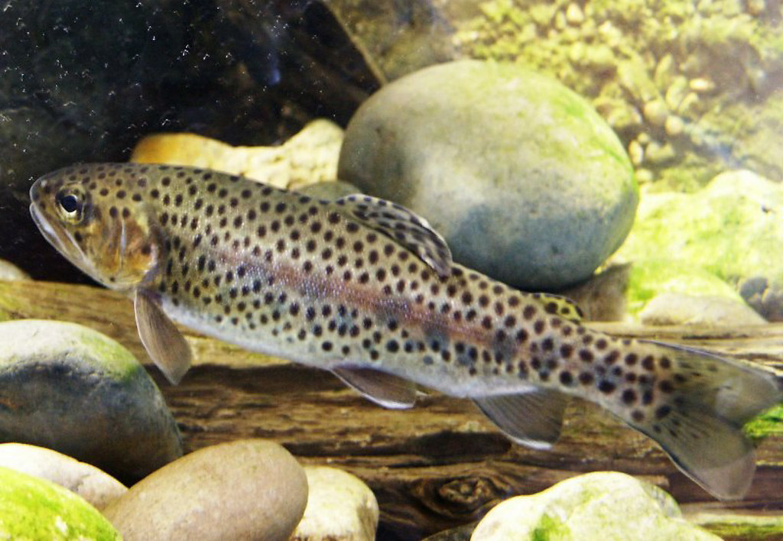
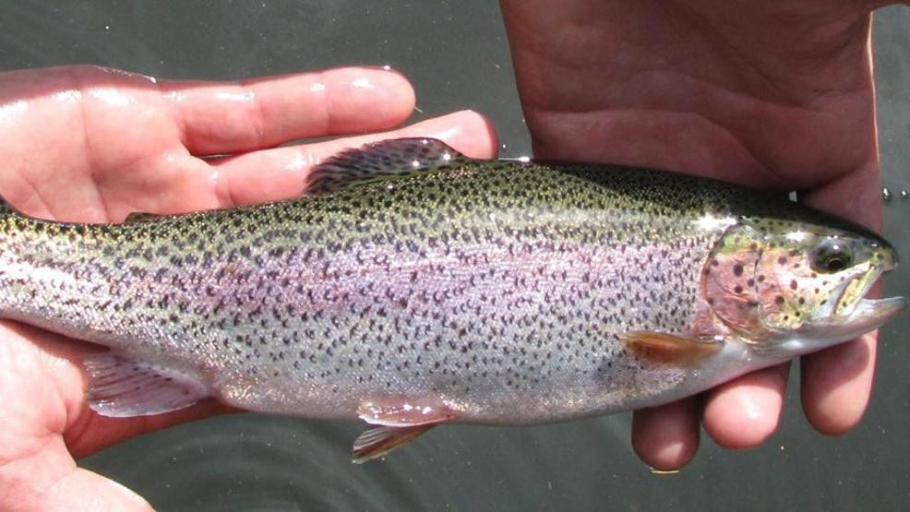
ANalysis Of VAriance - ANOVA
We measure the length of trout at three spots in a water system, one where the water moves fast, slow, and still.
We want to know if their length is different in these different conditions
This Photo by Unknown Author is licensed under CC BY-NC-ND
This Photo by Unknown Author is licensed under CC BY-NC-ND

Slide 6
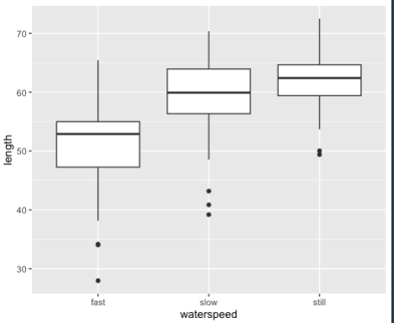
ANalysis Of VAriance - ANOVA
We measure the length of trout at three spots in a water system, one where the water moves fast, slow, and still.
We want to know if their length is different in these different conditions
P < .001, but what are the pairwise comparisons?
The differences between the conditions

Slide 7
ANalysis Of VAriance - ANOVA
We measure the length of trout at three spots in a water system, one where the water moves fast, slow, and still.
We want to know if their length is different in these different conditions
P < .001, but what are the pairwise comparisons?
The differences between the conditions
Tukey Post-hoc test are the differences between each group with
Multiple comparison adjustment
p adj
slow-fast 0.0023509
still-fast 0.0000049
still-slow 0.2002347

Slide 8
ANOVA Assumptions
An ANOVA can only be conducted if there is no relationship between the subjects in each sample. This means that subjects in the first group cannot also be in the second group (e.g., independent samples/between groups).
The different groups/levels must have equal sample sizes.
An ANOVA can only be conducted if the dependent variable is normally distributed so that the middle scores are the most frequent and the extreme scores are the least frequent.
Population variances must be equal (i.e., homoscedastic). Homogeneity of variance means that the deviation of scores (measured by the range or standard deviation, for example) is similar between populations.

Slide 9
ANOVA is just a special case of …

Slide 10
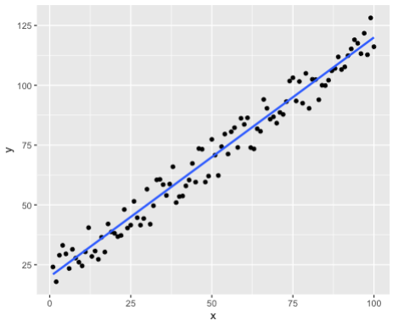
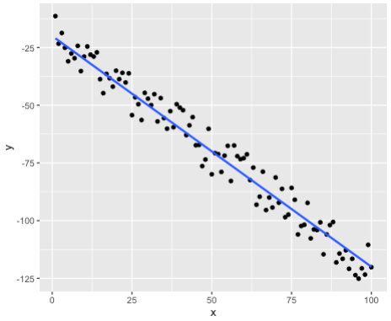
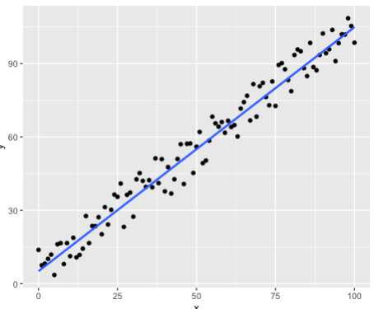
ANOVA is just a special case of the linear model!
The linear model in its simplest form is Y = mX + c
Where we can describe variable Y as a function of X multiplied by some slope (m) and a constant (c)
We use linear regression to “model” a variable using others
We assume a linear relationship exists between the variables (as one increases, so does the other)

Slide 11
The linear model!
The linear model in its simplest form is Y = mX + c
Where we can describe variable Y as a function of X multiplied by some slope (m) and a constant (c)
We use linear regression to “model” a variable using others
We assume a linear relationship exists between the variables (as one increases, so does the other)

Slide 12
The linear model
Y = mX + c
M = 1 means that for every unit increase in X, Y increases by 1. The higher m is, the steeper the line
C in the example below is ~5 because when X is zero, then Y = 0 + c
C is a constant term and can be made up of more than one term e.g., error, minimum theoretical values
Notes:
Getting height and weight on newborns – cannot be zero. We cannot have a baby with zero height or weight.

Slide 13
We rarely see perfect linear relationships
But they offer a way to model behaviours/outcomes with other data
We can use the regression model to predict future data

Slide 14
Questions?
I will be walking around while you work through the worksheet

