Slide 1
Quantitative Research Methods
Matthew Ivory
matthew.ivory@lancaster.ac.uk

Slide 2
1. Introduction to the course
Session 1: Introduction to quantitative research methods using R
Session 2: Data management and data wrangling
Session 3: Exploratory data analysis
Session 4: Data visualization
Session 5: Live Coding Walkthrough
Session 6: Probability and distributions
Session 7: Tests for discrete variables: Analysing contingency tables
Session 8: Correlations and t-tests.
Session 9: ANOVA and linear regression
Session 10: Multiple regression, introduction to generalised linear regression

Slide 3
In this session
Hypothesis Testing
Inferential statistics
Probabilities
Null effects and null hypotheses
Parametric vs Non-parametric data
Testing Nominal data
Chi-squared test
Cramer’s V

Slide 4
The point of a statistical test
To tell us whether there is a pattern in our data
A test gives us two things: the size of the effect, and a p-value, which tells us about the significance
If a test is significant, then it tells us there is a pattern, or some structure in our data
If a test is not significant, then this could be for two reasons
There is no pattern in the data
There is a pattern but we can’t find it through the noise
A statistical test cannot decide between these alternatives

Slide 5
Inferential Statistics – What is it?
Inferential statistics lets us make inferences or predictions about a population based upon our sample
Unrealistic to collect data from an entire population
Too costly in time, money, etc.
Instead, we sample the population at random and using that data, we can make inferences based upon probabilities

Slide 6
Hypothesis Testing
When we are not interested in exact values, but rather asserting some statement regarding the parameter of interest
Examples: the average UK income is more than £35,000, male academics get paid more on average than female academics, an increased visible police presence reduces petty crime rates

Slide 7
Hypothesis Testing
More specifically, we are interested in null hypothesis significance testing
The main idea of NHST is that you are testing that there is no significant difference between two values
Such as between two means
The null hypothesis states that there is no difference between the two means (or groups) of interest
Statistical tests seek to determine the probability of finding a difference you found (or larger) in the same sample, if no real difference exists in the population

Slide 8
Hypothesis Testing
Hypotheses can be directional or non-directional
Directional means that we are predicting a difference between groups as well as the direction of the effect
Exam scores will be higher for students who studied more than four hours a week than those who studied less than four hours a week
Non-directional means we predict a difference but don’t know which way it will go
Exam scores will be different for students who studied more than four hours a week than those who studied less than four hours a week
Hypothesis should be worded so that it can be tested and must include both independent and dependent variables
Exam scores (DV) will be higher for students who studied more than four hours a week (IV) than those who did not

Slide 9
Hypothesis Testing
Independent Variables (IV) – is independent to other variables in the study
Dependent Variables (DV) – is dependent on changes in independent variables
The DV is what we are interested in explaining
We measure both to determine the effect of the IV on the DV
Study time on test scores
Room temperature on plant growth
Population density on violent crime

Slide 10
Hypothesis Testing
We collect test scores from two classes on the same test
class1 <- c(8,6,4,9,5,8,6,8,9,7,5,7)
class2 <- c(3,6,3,7,2,5,2,1,2,7,9,5)
Mean of class1 == 6.83
Mean of class2 == 4.33
The difference between class1 and class2 is -2.5
in terms of the Null Hypothesis, we now want to know: What is the probability of finding a difference between means of -2.5 (or larger) if no real difference between the two groups exists in the population?

Slide 11
Hypothesis Testing and p-values
The p-value is the probability of finding a difference equal to or greater than the one found if no difference exists in the population. Let's say our p-value = .010
This indicates a very small probability of finding a difference equal or greater in the population if there was no difference. The obtained p-value is also smaller than the standard cut-off that we use in Psychology of .05
As such we would reject our null hypothesis and suggest that there is a significant difference between the two groups.
If the p-value was greater than .05 (e.g. .1),we would fail to reject the null hypothesis, not accept the null
Reject the null
Fail to reject the null
0
.05
1

Slide 12
Reproducibility – variation and reliability
Results will not replicate perfectly, because responses contain noise
observed scores are a combination of true score and error
If the error is random then
some people will accidentally score more, and some less, than their true score
true differences between participants’ scores will be unrelated to error differences
So the total variance of observed scores, for a sample of participants, will equal the variance of their true scores plus the variance of their error scores sd_{obs}² = sd_{true}² + sd_{err}²

Slide 13
Effect sizes and p-values
When we construct an experiment, we construct a research hypothesis:
Two variables are related
An experimental manipulation will affect another variable
We also construct a null hypothesis:
Two variables are not related
The experimental manipulation has no effect
p-value: how confident can we be in rejecting the null hypothesis
A p-value of 0.05 tells us that 5% of the time when we find an effect like this, the null hypothesis is true (a false positive)
If the p-value is less than 0.001, we write by convention: p < .001
If there’s a chance less than one in a thousand that we find this effect when the null hypothesis is true then we’re quite confident in our result

Slide 14
Reminder: Types of Data
Numbers have three important functions for researchers:
Classify or categorise – Nominal/Categorical data
E.g. male/female, young/old, red/green/blue
Each case can only be in one category.
Rank or order - Ordinal data
E.g. first, second, third…
Does not indicate magnitude of differences between ranks.
Score – Continuous/Count
E.g. number of correct answers, reaction time
Tells us about the order of data but also the distance between them.

Slide 15
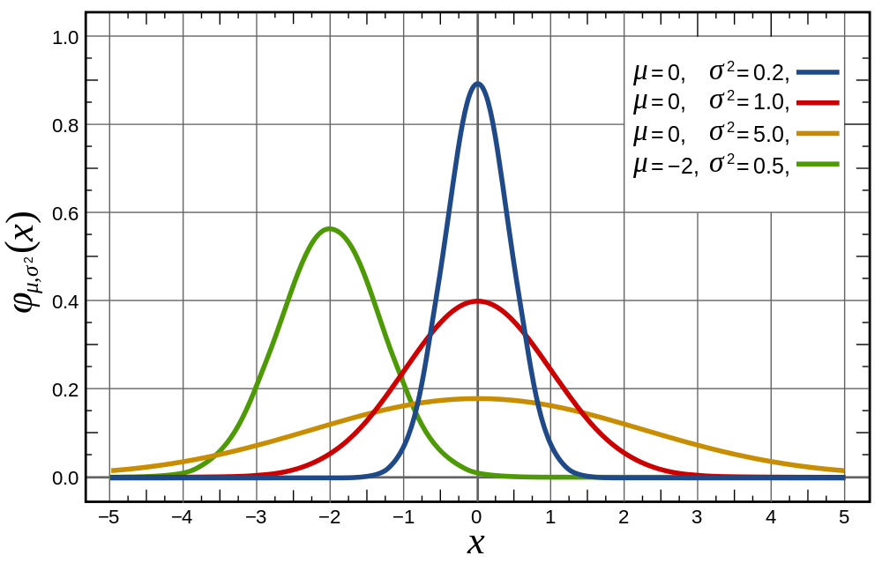
Reminder: Normal distribution
We assume (or test) that the actual data comes from a “normal distribution” of data
The shape of the normal distribution depends on two factors:
Mean (μ) – Measure of central tendency
Standard Deviation (σ) – Measure of variability

Slide 16
Parametric and non-parametric
If data fit a normal distribution, then we can use “parametric” statistical tests
If data do not fit a normal distribution, then we need to use “non-parametric” statistical tests – they are “distribution free”
Categorical data are non-parametric
One non-parametric test is Chi-squared, which is useful for determining if categorisations into two or more groups are different than chance
Notes:
Categorical data, and data that are not normally distributed, can be analyzed with non-parametric statistics. With categorical variables, you can't calculate a mean or standard deviation. Instead, you have frequencies. The data can be measured on the nominal or ordinal scale.

Slide 17

Example: Titanic
The ship Titanic sank in 1912 with the loss of most of its passengers
809 of the 1,309 passengers and crew died
= 61.8%
Research question: Did class (of travel) affect survival?
Notes:
Ask the audience what the null and hypothesis might be, what type of data we would have and what test we should consider using.

Slide 18
Chi squared Test
Null: There is NO association between class and survival
Research: There IS an association between class and survival
Class | Died | Survived | Total
1st | 123 | 200 | 323
2nd | 158 | 119 | 277
3rd | 528 | 181 | 709
Total | 809 | 500 | 1309
Notes:
Since we have two categorical variables and want to know if they are associated we can use a chi-squared test. Class could be considered as an ordinal variable but there are only 3 levels here and so a chi-squared test therefore be quite appropriate. Point out there are 3 rows and 2 columns in our table and hence this is called a 3x2 contingency table. Discuss whether the table suggests class and survival are connected and try to tease out that we might be better looking at the % of 1st class passengers that died/survived and compare this with the % for 2nd class and 3rd class.

Slide 19
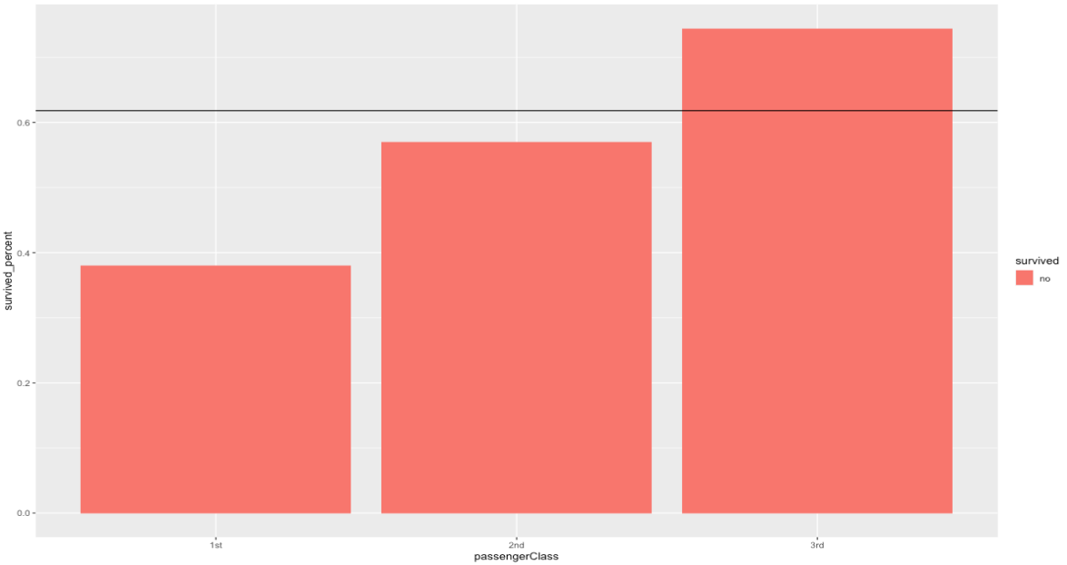
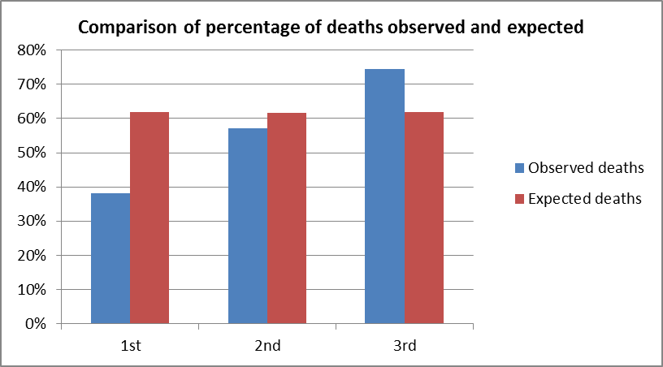
What would be expected if there is no association? Expected and actual values
Same proportion of people would have died in each class!
Overall, 809 people died out of 1309 = 61.8%
Notes:
Discuss that this is what the % would be if there was no difference between the classes with respect to the chances of survival.

Slide 20
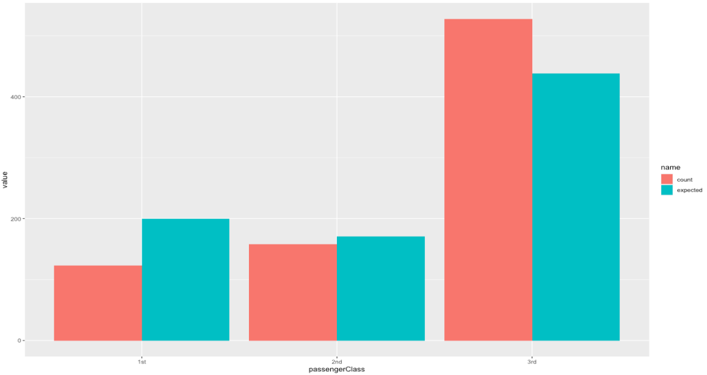
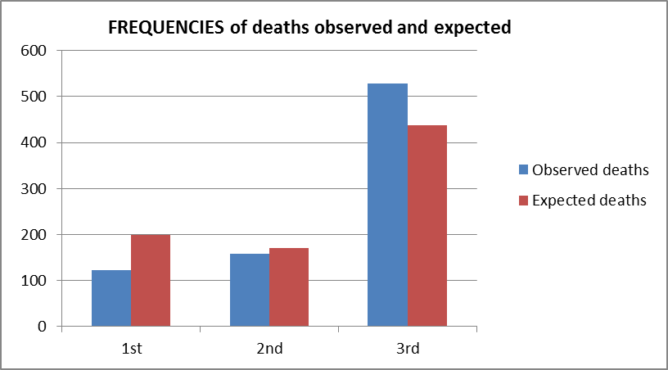
Chi-Squared Test Compares Observed and Expected Frequencies
Expected number dying in each class = 0.618 x number in each class
Notes:
This slide is shown since the chi-squared test formally compares the observed FREQUENCIES with the expected frequencies.

Slide 21
Chi-squared test statistic
The Chi-squared test is used when we want to see if two categorical variables are related
The test statistic for the Chi-squared test uses the sum of the squared differences between each pair of observed (O) and expected values (E)
Notes:
This is an optional slide if your session allowed time for this to be included and shows how the chi-squared test statistic compares the observed and expected.

Slide 22
Chi-squared test statistic: Computation
Class | Died | Survived | Total
1st | 123 | 200 | 323
2nd | 158 | 119 | 277
3rd | 528 | 181 | 709
Total | 809 | 500 | 1309
Observed
Expected
Class | Died | Survived | Total
1st | =323*.618 | =323*.382 | 323
2nd | =277*.618 | =277*.382 | 277
3rd | =709*.618 | =709*.382 | 709
Total | 809 | 500 | 1309
Class | Died | Survived | Total
1st | 200 | 123 | 323
2nd | 171 | 106 | 277
3rd | 438 | 271 | 709
Total | 809 | 500 | 1309
Notes:
This is an optional slide if your session allowed time for this to be included and shows how the chi-squared test statistic compares the observed and expected.

Slide 23
Chi-squared test statistic: Computation stage 2
Class | Died | Survived | Total
1st | 123-200 | 200-123 | 323
2nd | 158-171 | 119-106 | 277
3rd | 528-438 | 181-271 | 709
Total | 809 | 500 | 1309
O - E
(O - E)²
(O-E)²/E
Chi² = 127.86
Class | Died | Survived | Total
1st | -77 | 77 | 323
2nd | -13 | 13 | 277
3rd | 90 | -90 | 709
Total | 809 | 500 | 1309
Class | Died | Survived | Total
1st | 5869.7 | 5869.7 | 323
2nd | 173.9 | 173.9 | 277
3rd | 8070.9 | 8070.9 | 709
Total | 809 | 500 | 1309
Class | Died | Survived | Total
1st | 29.4 | 47.6 | 323
2nd | 1.0 | 1.6 | 277
3rd | 18.4 | 29.8 | 709
Total | 809 | 500 | 1309
Notes:
This is an optional slide if your session allowed time for this to be included and shows how the chi-squared test statistic compares the observed and expected.

Slide 24
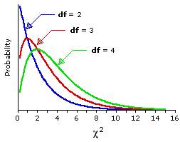
Chi squared distribution
The p-value is calculated using the Chi-squared distribution for this test
Chi-squared is a skewed distribution which varies depending on the degrees of freedom
degrees of freedom = (no. of rows – 1) x (no. of columns – 1)
For Titanic example, number of rows = 3 (class), number of columns = 2 (survived or not)
So for Titanic, degrees of freedom = …
Notes:
This slide is there to illustrate what the Chi-squared distribution looks like and that as the degrees of freedom increases (i.e. the amount of independent pieces of information we have from a study) then the more the wider the distribution is spread and becomes flatter.
Degrees of freedom = 2 for titanic

Slide 25
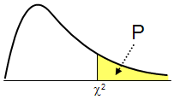
What’s a p-value?
In the Titanic example, the probability of getting a test statistic of 127.86 or above (just by chance) is < 0.001
P-value p < 0.001
Distribution of test statistics
Our test Statistic = 127.86
Notes:
This is to discuss what the p-value actually is.

Slide 26
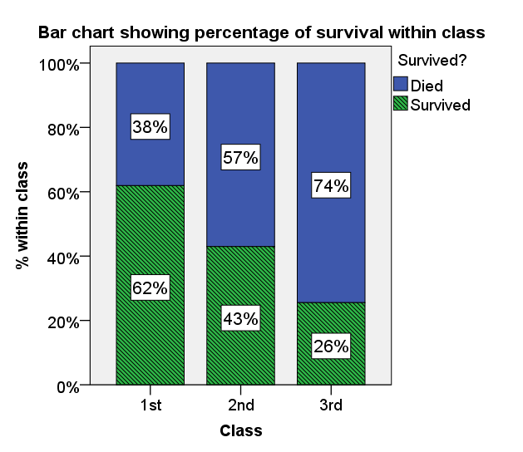
Interpretation of the Chi-squared test
Data collected on 1309 passengers aboard the Titanic was used to investigate whether class had an effect on chances of survival. There was evidence (χ²(2, N = 1309) = 127.86, p < 0.001) to suggest that there is an association between class and survival.
Figure 1 shows that class and chances of survival were related. As class decreases, the percentage of those surviving also decreases from 62% in 1st Class to 26% in 3rd Class.
Figure 1. Bar chart showing % of passengers surviving within each class
Notes:
For contingency table data, a multiple or stacked bar chart can be used based on frequencies or percentage within. Adding labels with the % to charts can be helpful.
When summarising data, encourage students not to include every table and graph and do not comment on every frequency or percentage. Think back to their original question of interest and answer that question and talk about every table/ graph you include in your report.

Slide 27
Assumptions of the Chi-squared test
Cells should have expected values >= 5
If any expected cell counts are <1 then cannot use the chi-squared distribution
In these cases, use Fishers’ Exact test
Notes:
Discuss what to do if there are low expected cell counts.

Slide 28
That’s the p-value. What about the effect?
How big is the relation between class and survival on the Titanic?
Chi-squared doesn’t tell us about the size of the association between categories because Chi-squared gets bigger the larger the numbers get:
Titanic: Chi²(2, N = 1309) = 127.86 Teenitanic: Chi² (2, N = 654) = 64.92
Class | Died | Survived | Total
1st | 123 | 200 | 323
2nd | 158 | 119 | 277
3rd | 528 | 181 | 709
Total | 809 | 500 | 1309
Class | Died | Survived | Total
1st | 61 | 100 | 161
2nd | 79 | 60 | 139
3rd | 264 | 90 | 354
Total | 404 | 250 | 654
Notes:
Teenitanic is half the size of the original in terms of passengers
Proportion of survived in each class the same in the two ships, but chi squared is different value

Slide 29
That’s the p-value. What about the effect? Cramer’s V
Cramer’s V adjusts for the number of observations
V = √ ( Chi-squared / (N * w) )
Where N is the total
w is the smaller of the (rows – 1) or (columns -1)
Titanic: Chi² = 127.86 Teenitinic: Chi² = 64.92
V = √ (127.68/(1309*1)) = .31 V = √ (64.92/(654*1)) = .32
Class | Died | Survived | Total
1st | 123 | 200 | 323
2nd | 158 | 119 | 277
3rd | 528 | 181 | 709
Total | 809 | 500 | 1309
Class | Died | Survived | Total
1st | 61 | 100 | 161
2nd | 79 | 60 | 139
3rd | 264 | 90 | 354
Total | 404 | 250 | 654
Notes:
Proportion of survived in each class the same in the two ships, but chi squared is different value

Slide 30
Interpreting the effect: Cramer’s V
Cramer’s V adjusts for the number of observations
Cramer’s V is between 0 and 1
A measure of the association between the row and column categories
0 = no association
1 = perfect association
In between … relative strength (but not absolute)
Notes:
Proportion of survived in each class the same in the two ships, but chi squared is different value

Slide 31
Summary
Chi-squared test is a measure of association between categories/nominal groups
Interpretation of Chi-squared and p-values
Expected and observed frequencies
Cramer’s V effect size measure of association

Slide 32
Questions?
I will be walking around while you work through the worksheet

