Slide 1
Quantitative Research Methods
Matthew Ivory
matthew.ivory@Lancaster.ac.uk

Slide 2
1. Introduction to the course
Session 1: Introduction to quantitative research methods using R
Session 2: Data management and data wrangling
Session 3: Exploratory data analysis
Session 4: Data visualization
Session 5: Live Coding Walkthrough
Session 6: Probability and distributions
Session 7: Tests for discrete variables: Analysing contingency tables
Session 8: Correlations and t-tests.
Session 9: ANOVA and linear regression
Session 10: Multiple regression, introduction to generalised linear regression

Slide 3
Session Outline
1. R Projects, RMarkdown, and Environment Setup
2. Live Data Wrangling Walkthrough
3. ???

Slide 4
1. Projects, RMarkdown, and Environment
Workflow tools for data science in R
This is how I structure and share my analyses
They aren’t essential to use right now, but they will improve your workflow and I strongly encourage you to use them
The follow slides will introduce these ideas because I use them in the live coding example, you can follow along in the slides, but they will be repeated in the worksheet

Slide 5
RStudio Projects
What do you do when you are working with multiple research projects at once?
What if you need to pause an analysis, wait a few weeks, and then come back?
How do I keep all my R files together and not have to manually set up my environment each time with setwd(), etc.
How can I make sure I can share all my analysis files needed?

Slide 6
Working Directory
Directory = folder
Your working directory is where R is looking for files
You can check your working directory by using the command getwd()

Slide 7
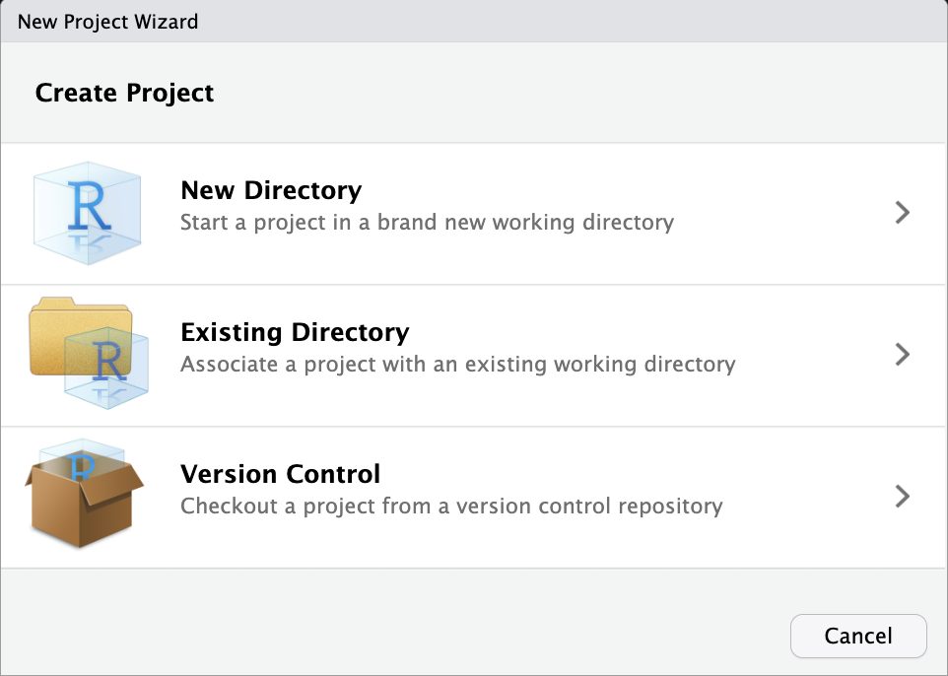
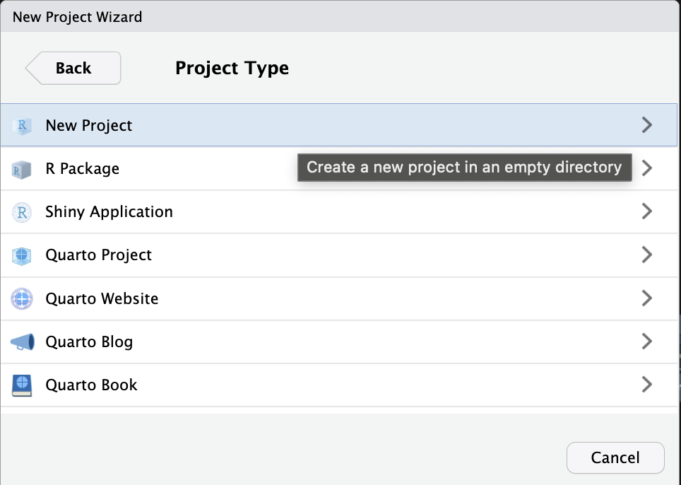
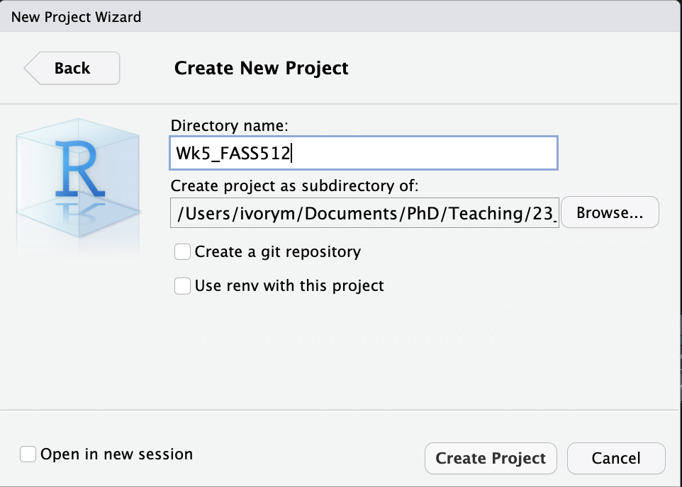
RStudio Projects

Slide 8
RStudio Projects
Once this process is complete, you’ll get a new RStudio project just for this book. Check that the “home” of your project is the current working directory using getwd()
This means R will be looking for files/folders in this folder and below
It ‘centralises’ your R scripts and files into one place
It offers the use of relative, not absolute paths

Slide 9
RStudio Projects
A way to:
handle multiple research projects
keep all your necessary files together
Share your work more easily

Slide 10
RMarkdown
Like scripts, but more
R Markdown files are designed to be used for:
For communicating conclusions not the code
For collaborating and sharing both your conclusions, and how you reached them (i.e. the code).
an environment in which we do data science, as a notebook where you can record your code, but also what you were thinking, and your research choices.
We can do something similar with code comments, but this is just more
Combines prose with chunks of code
Can then be compiled/knitted/rendered into a PDF, word document or a webpage

Slide 11
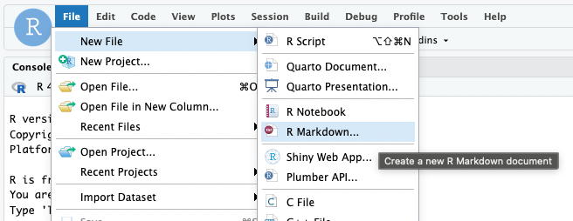
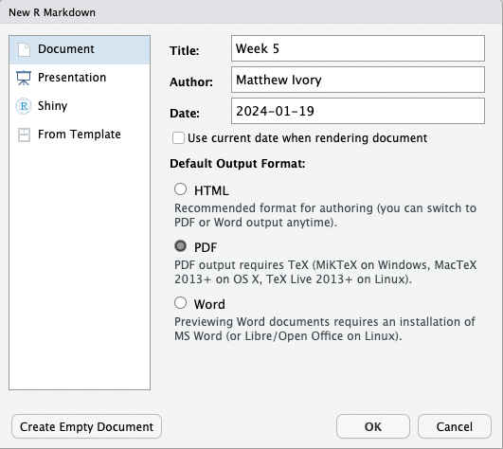
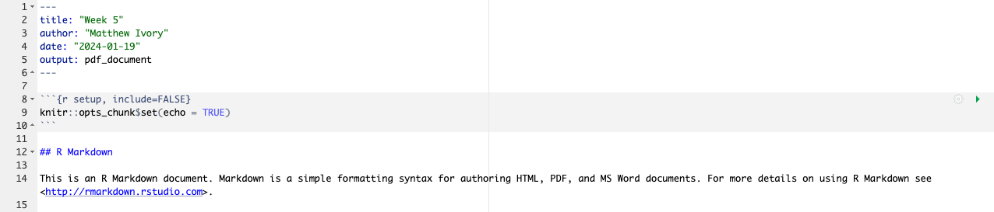

Slide 12
RMarkdown
Contains three important types of content
YAML (surrounded by ---)
Chunks of R code (surrounded by ```)
Regular text
You can mix both text and code
Code is run directly inside the document below each section
Helps keep related code together
Shows plots inside the document instead of the bottom right
To produce a complete report containing all text, code, and results, click “Knit” or press Cmd/Ctrl + Shift + K.

Slide 13
2. Data Wrangling Walkthrough
Data taken from Kaggle: https://www.kaggle.com/datasets/kanchana1990/swiss-national-crime-dataset-2008-2022
Some minor cleaning for the purpose of this task, only looking at 2022 data
Link to the data is in the worksheet
Feel free to code along, make notes, ask clarifying questions throughout

Slide 14
2. Data Wrangling Walkthrough
To RStudio we go…

Slide 15
Questions?
I will be walking around while you work through the worksheet

