Slide 1
Quantitative Research Methods
Matthew Ivory
matthew.ivory@lancaster.ac.uk

Slide 2
Session Outline
1. Introduction to the course
2. Quantitative Research
3. Introduction to R and RStudio
First steps in R

Slide 3

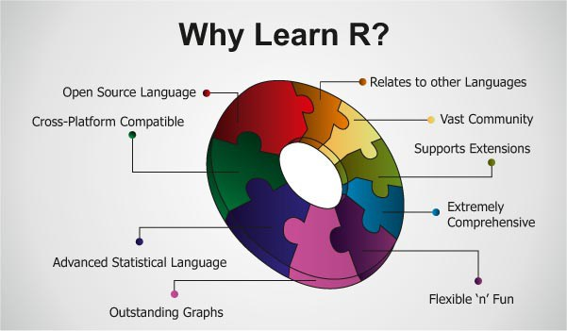
1. Introduction to the course
A practical introduction to quantitative data analysis using R
R is a programming language for statistical computing and graphic production. It is widely used for many reasons:
This Photo by Unknown Author is licensed under CC BY-SA
This Photo by Unknown Author is licensed under CC BY-SA

Slide 4
1. Introduction to the course
We will cover two things:
How to design, analyse, and interpret the results of statistical inquiry
How to carry this out in R
You will need to bring a laptop to each class – there is a practical element where you will be using R and RStudio

Slide 5
1. Introduction to the course
Session 1: Introduction to quantitative research methods using R
Session 2: Data management and data wrangling
Session 3: Exploratory data analysis
Session 4: Data visualization
Session 5: Mid-term assignment
Session 6: Significance tests for continuous variables
Session 7: Tests for discrete variables: Analysing contingency tables
Session 8: Correlation and linear regression. Tests for categorical variables.
Session 9: ANOVA and tests for N groups
Session 10: Multiple regression

Slide 6

1. Introduction to the course
Materials and files will be uploaded to Moodle
Please keep an eye on this as items will be uploaded weekly
Use the discussion forum to post any questions or issues you may have,
E.g., R errors or quantitative methods questions
You can help each other in providing solutions
I can step in to clarify and support these discussions
Especially useful for those taking the course asynchronously
This Photo by Unknown Author is licensed under CC BY-SA-NC

Slide 7
1. Introduction to the course
Sessions are recorded and will be available on Moodle – this is for those distance-learning.
Each session will be split between lecture material (explaining the core concepts relevant to the session) and a practical element (completing worksheets in R)
This balance will not always be 50:50.
Some of the worksheets will intentionally be designed to take more time than the time allocated in the session. Independent research and practice is critical for your development
Each week builds upon the previous weeks, so please ensure you complete the worksheets

Slide 8
1. Introduction to the course - Expectations
To complete the assigned tasks during class and in between classes. Most tasks will be practical, requiring the use of R to complete statistical analyses.
To engage in small group and whole class discussions during weekly sessions.
To provide supportive, constructive peer feedback. This means, for example, helping each other while programming in R.

Slide 9
Learning R is like learning a new language
This means:
only you can do the learning, nobody can do this on your behalf, and
the more you practice, the better you will become.
So, please complete the tasks carefully, and write down any questions you have.
You will really only learn how to do quantitative research using R by doing it yourself with your own data as part of your own project.
This course will prepare you for that, but it is impossible to prepare you for every single data challenge you will face.
So, I am hoping that this course also further develops your ability to help yourself!

Slide 10
Learning R is like learning a new language
A note on the use of ChatGPT and other AI-powered tools
It exists and can be useful for carrying out basic operations in R, but:
Please don’t use it
It is not always accurate
There are other, official sources that can be used
At this stage in your development, it is important that you understand what you are doing

Slide 11
Assessments
Two assignments to assess your ability to analyse and interpret datasets in R:
Mid-term assignment (1,500 words, 30% of total mark), due Friday, Feb 16, 2023, 12pm. Descriptive data analysis, numerical summaries, tables, graphics, etc
For everyone – a first chance to practice what you’ve learnt so far together
Final assignment (3,500 words, 70% of total mark), due Monday, April 23, 2023, 12pm. Confidence intervals and significance testing. Regression analysis and correlation.
For those taking the course for credit

Slide 12
2. Quantitative Research
A research strategy that focuses on quantification in the collection and analysis of data (Bryman, 2016).
Quantitative research relies (depends) on computational tools and statistical methods.
We collect and analyse large amounts of data to develop and test theories.
Quantitative research tends to be the default across the sciences (cognitive, social, natural, clinical, etc.).
Not better than qualitative research; complementary.
Typically adopts a realist approach

Slide 13
Two basic strategies in quantitative research
Observational research
Simply observe and describe behaviour in natural situations
Example: Systematic reviews, corpus analyses, correlational research, etc.
Experimental research
Systematically manipulate variables of interest and see what effect our manipulation has in the world
Example: Experimental studies in the lab or in the wild

Slide 14
Observational Research
We measure variables in a sample without attempts to influence or manipulate these variables.
There is no random assignment of participants to groups for comparison
These studies can show that a relationship or association exists between variables, but it is not necessarily a cause-and-effect (causal) relationship.
Example: more reflective styles of thinking are more “patient” and willing to delay gratification for a higher reward later (Frederick, 2005)

Slide 15
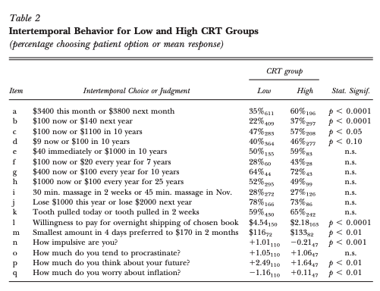
Frederick (2005)
Designed and tested the Cognitive Reflection Test; a measure of the propensity to engage in reflective/critical thinking and not use intuition
Higher levels of CRT corresponded with
Willing to wait for a greater reward
Lower compulsiveness
Frederick, S. (2005). Cognitive reflection and decision making. Journal of Economic Perspectives, 19(4), 25–42. https://doi.org/10.1257/089533005775196732

Slide 16
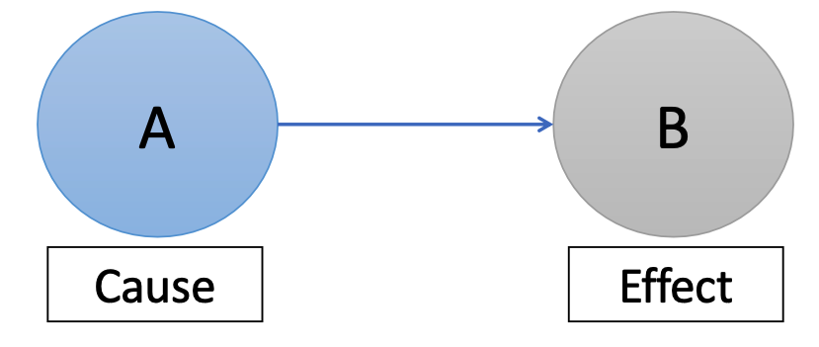
Experimental Research
In experimental research, we try to discover causal relationships between variables
We do this by manipulating certain variables to test the outcome on other variables
We randomly assign participants to groups where they experience different manipulations or their environment
Example: higher levels of glucose improves cognitive function following an overnight fast, but lower does are better following shorter fasts (Owen et al., 2011)

Slide 17
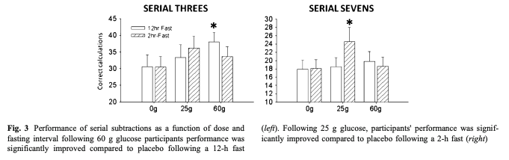
Owen et al. (2011)
Participants were assigned to conditions that varied in the glucose dose and for fasting interval
Tested on working memory performance
High glucose, long fast
Lower glucose, short fast
Owen, L., Scholey, A. B., Finnegan, Y., Hu, H., & Sünram-Lea, S. I. (2012). The effect of glucose dose and fasting interval on cognitive function: A double-blind, placebo-controlled, six-way crossover study. Psychopharmacology, 220(3), 577–589. https://doi.org/10.1007/s00213-011-2510-2

Slide 18
Introduction to R and RStudio
R is a programming language and environment doing statistics and data analysis.
There are many programming languages that could do the trick (e.g., Python).
But R is the particularly well-suited to perform the major components outlined in the data science workflow.

Slide 19
Introduction to R and RStudio
A very powerful tool for data analysis
Range and depth of statistical analyses that can be done in R are immense.
R has a standard set of “packages” that contains the entire repertoire of widely used statistical methods.
R has an extensive graphics library for visualizing your data.
R is extensible. You can add over 16,000 packages, which allow you to do more things and more easily.

Slide 20
Introduction to R and RStudio
Open-source software
R is free and open-source software. Anyone can use it and develop it further.
R, like many other open-source software, has a large and self-sustaining community of users and developers.
Very widely used (the new standard)
R is the standard computing platform in statistics. Almost every new or existing technique developed by statisticians is made available as a package in R.
As a result, R has become the new standard in data science and in the social and behavioural sciences.

Slide 21
A first look at RStudio
Once you have installed R and RStudio, all of your computing will be done via RStudio.
We don’t use R directly, it just runs in the background while we work with RStudio.
Rstudio is a Graphical User Interface (GUI; goo-ey) and helps make some actions and operations simpler to use

Slide 22
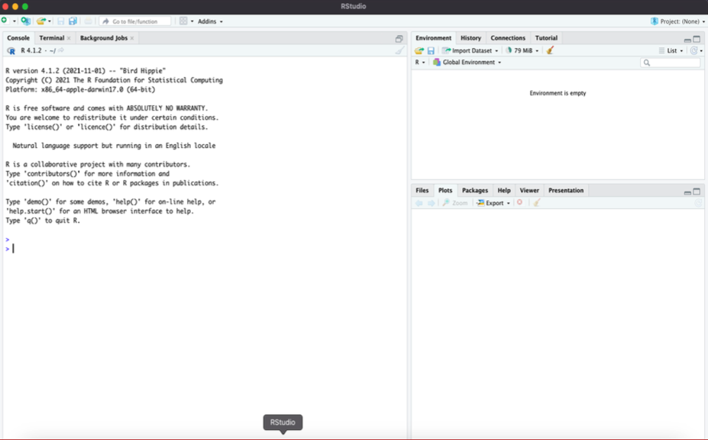
Opening RStudio for the first time
If RStudio looks like this, then please open a fourth important window, the script editor.
To open the script editor, please go to File > New File > R script.

Slide 23
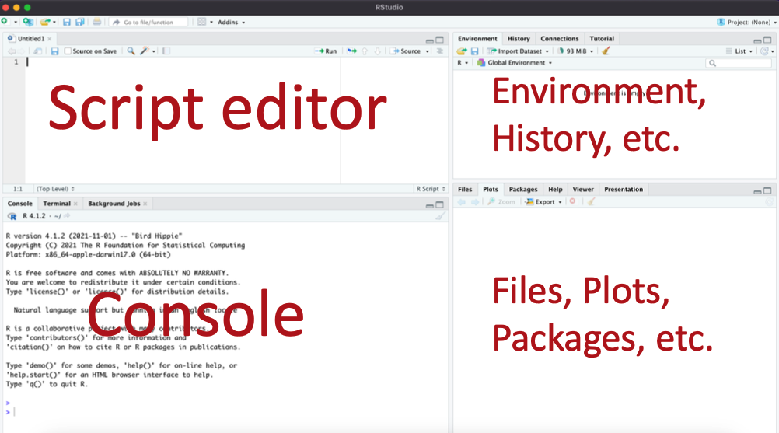
RStudio should now look like this:

Slide 24
Script Editor
This is where we write scripts of R commands.
Scripts are a sequence of commands; these can be saved for
later use and for sharing with other researchers.
In the script editor, you can execute individual lines of R commands, specific sections of R commands, i.e. several lines, or the entire scripts (all the commands).

Slide 25
Environment, History, etc.
This has several tabs. The most important ones are:
Environment (lists variables and data structures from our current work session and allows us to easily import data files) and
History (lists all the R commands we have typed in the session).

Slide 26
Files, Plots, Packages, Help, etc.
The Files tab is a file browser in which we can create, delete, view files and directories.
The Plots tab is where our graphics will appear.
The Packages tab shows us the packages we have installed in our session.
Importantly, The Help tab displays help pages for an R command or package.

Slide 27
Console
This is the most important window.
It also has multiple tabs, but we’ll be mostly using the
Console tab.
This is where we can type our R commands next to the >, press Enter to execute them and see the output just below.
Today, we will just use the Console, not the Script editor.

Slide 28
First steps in using R
Download the worksheet from Moodle
Go through each step at your own pace
Type each command in the worksheet, don’t just copy-paste
This is important: Learning to program is like practicing a conversation in a new language. You will improve gradually, but only if you practice.
Copy-paste will be used in later weeks, but for now, type it all out.
If you get stuck on a problem
Ask those around you for support
Use the help pages in RStudio and use online resources too (this will be covered properly next session)
Complete the worksheet, finish it at home if you need to

Slide 29
Questions?
I will be walking around while you work through the worksheet

