Slide 1


SQL for Analytics
Thomas Nield

Slide 2
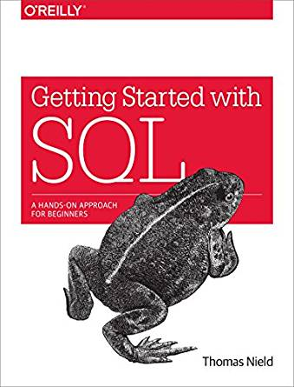



About the Instructor
Thomas Nield, business consultant at Southwest Airlines
Author of Getting Started with SQL (O’Reilly) and Learning RxJava (Packt)
Current Interests: operations research, machine learning, and mathematical optimization
https://medium.com/@thomasnield9727
thomasnield9727
https://github.com/thomasnield

Slide 3
Agenda
Setting up a SQLite Environment
Subqueries, derived tables, CTE’s, and unions
Regular Expressions
Advanced Joins
Windowing Functions
Programming with SQL (Python, R, and Java)

Slide 4
Prerequisites
To take this Learning Path, pleased be familiar with the following:
SELECT
WHERE
GROUP BY
ORDER BY
INNER JOIN / LEFT JOIN
If any of these operators are unfamiliar, please fill in any knowledge gaps with the Learning Path SQL Fundamentals

Slide 5
Section I
Setting up SQLite

Slide 6
Module I – Setting Up SQLite
Agenda for this module:
Setting up a SQLite Environment
Writing queries in SQLiteStudio

Slide 7
SQLite
We will be using SQLite with SQLiteStudio in this course
SQLite is a lightweight database and can be found on:
Android, iPhone, iPad, and Windows 10
Car consoles, thermostats, and other gadgets
Satellites and the Airbus A350 XWB
SQLite excels where simplicity and low overhead is needed

Slide 8
Setting Up a SQLite Environment
There are many options to set up a SQLite environment quickly and easily on your computer:
SQLiteStudio (https://sqlitebrowser.org/)
DB Browser (https://sqlitebrowser.org/)
SQLite Online (https://sqliteonline.com/)
Choose a client and follow the instructions on its respective site to install it.

Slide 9
Setting Up a SQLite Environment
The three recommended programs are all good, and it might be worth playing with all three to find your favorite.
SQLiteStudio has a familiar database explorer layout you will find in most SQL clients.
SQLite Online conveniently works in a web browser and requires no setup.
DB Browser is the most advanced and powerful SQLite client.

Slide 10
Getting Files for this Class
The few resources needed for this class are available on the GitHub link in the description.
Unzip the contents to a location of your choice, and note where you put them.
Contents include:
A SQLite database file called thunderbird_manufacturing.db
Class notes with all examples (in three formats)

Slide 11
Section II
Subqueries and Derived Tables

Slide 12
Module II – Subqueries and Derived Tables
Agenda for this module:
Scalar and multi-value subqueries
Derived tables and Common Table Expressions (CTE’s)
Unions versus CASE Expressions

Slide 13
Section III
Regular Expressions and Volatile Tables

Slide 14
Module III – Regular Expressions and SQL
Agenda for this module:
Intro to regular expressions
Using regular expressions in SQL
Volatile tables and joining with regular expressions

Slide 15
Section IV
Advanced Join Patterns

Slide 16
Module IV – Advanced Join Patterns
Agenda for this module:
Self-joins
Recursive self-joins
Cross joins

Slide 17
Section V
Windowing Functions

Slide 18
Module V – Windowing Functions
Agenda for this module:
PARTION BY
ORDER BY
Mixing PARTITION BY/ORDER BY
Rolling window functions

Slide 19
Section VI
Programming with SQL

Slide 20
Module VI – Programming with SQL
Agenda for this module:
SQL versus Code – Which do I use?
Using SQL in Python
Using SQL in R
Using SQL in Java
Preventing SQL injection

Slide 21
Programming with SQL
When using SQL with a programming platform like Python, Java, or R, you will constantly be making a decision where the onus of processing will happen.
Should the database engine do the computation work, or the programming platform?
You can simply pull in data and have your Python/Java/R codebase do the heavy-lifting.
You can also leverage more complex SQL against the database, and have Python/Java/R consume the results.
With a very large, expensive and calculated dataset you can save it to a temporary table and use it to support your Python/R/Java application.

Slide 22
Programming with SQL
A good rule of thumb: start with the simplest solution with minimal code/SQL that liberally hits the database as-needed, and gradually introduce caching strategies as performance starts to warrant it.
Never concatenate parameters, and use established SQL libraries to inject parameters safely to prevent SQL injection.

Slide 23
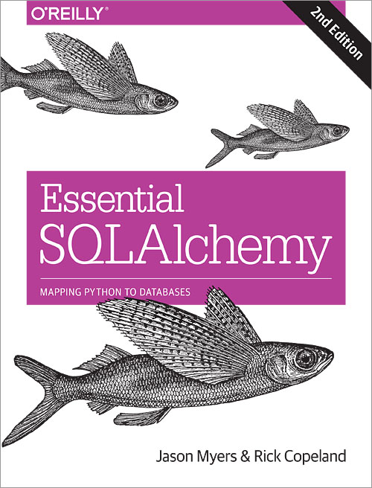
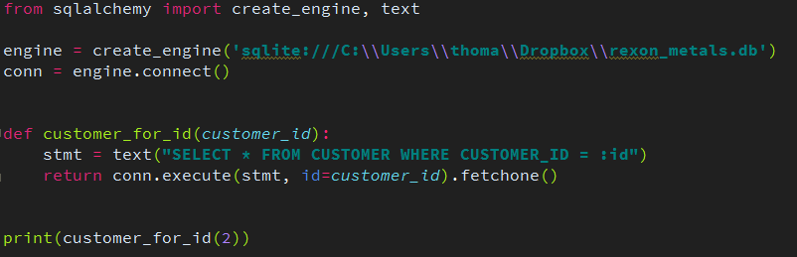
Preventing SQL Injection
To prevent SQL injection, never concatenate a SQL string with parameters.
Instead, use the right tools and libraries to safely inject parameters for you.
For Python, use SQLAlchemy
More info at:
http://www.sqlalchemy.org/

Slide 24
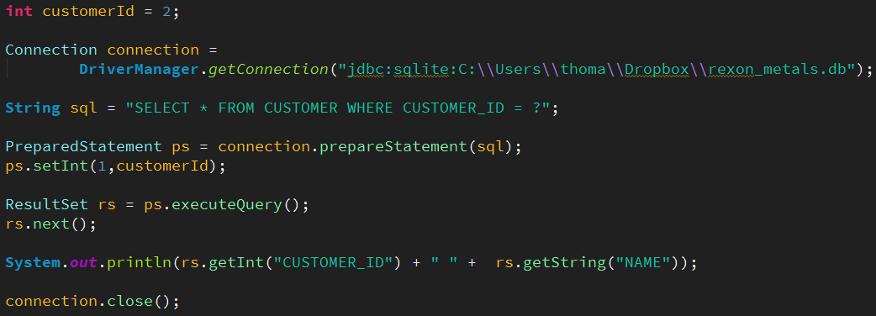
Preventing SQL Injection
For Java, Scala, Kotlin, and other JVM languages use JDBC’s PreparedStatement
More info at:
http://tutorials.jenkov.com/jdbc/index.html
http://www.marcobehler.com/make-it-so-java-db-connections-and-transactions

Slide 25

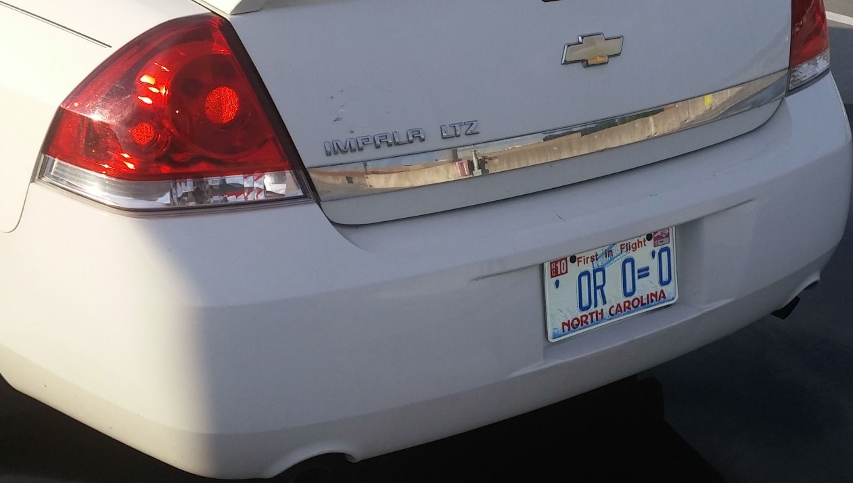
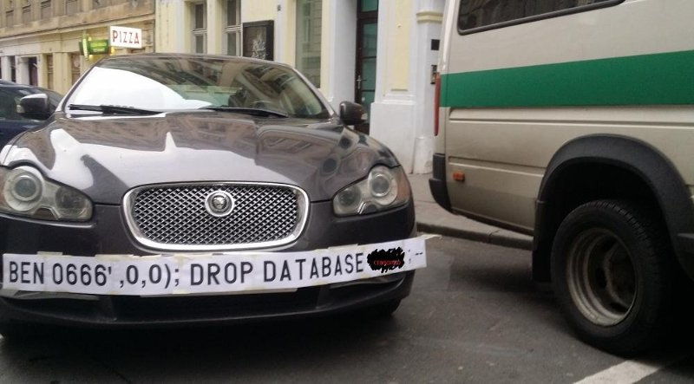

SQL Injection Humor

Slide 26
SQL Injection in the News
This couple cannot do the simplest things online because their last name is ‘Null’
https://thenextweb.com/insider/2016/03/27/last-name-null-is-tough-for-computers/
Catholic financial services hacked, 130K accounts exposed
http://www.twincities.com/2017/10/16/catholic-united-financial-data-breach-may-have-affected-nearly-130k-accounts/
South Africa’s massive data breach
https://www.moneyweb.co.za/news/tech/revealed-the-real-source-of-sas-massive-data-breach/
TalkTalk gets record £400K fine for failing to prevent October 2015 attack
https://ico.org.uk/about-the-ico/news-and-events/news-and-blogs/2016/10/talktalk-gets-record-400-000-fine-for-failing-to-prevent-october-2015-attack/

