Slide 1
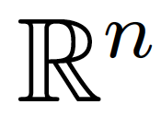
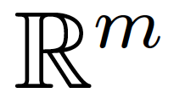
Row space
Column
space
0
0
Left null
space
Null space

Slide 2
Row space
Column
space
0
0
Left null
space
Null space

Slide 3
Row space
Column
space
Left null
space
Null space

