Slide 1
Creating your first chat bot

Slide 2
Frm Teacher
10 – 15min presentation
Context of the study (why the subject?)
Team, Project, Objectives
Different insights of the project [Technical stuff ]
Openings/conclusion
DEMO
Report
Description of pieces of the code.
Send the code to teacher with presentation and report.

Slide 3
Chat Bot Structure
Bot Engine
Artificial Intelligence
API's, Databases, ...

Slide 4
Sam’s Structure
Node js, ngrok, Facebook app
Dialogflow
Open Weather Map API

Slide 5
1. Register to Dialogflow
Register using your google account
Dialogflow will give the artificial intelligence so we will be able to recognise:
The user’s intent : What the user wants to do.
Ex. user says “Hello” -> Intent : Greeting.
Entities : values or variables the user specifies.
Ex. What is the weather in London ? -> Entity : Location = London

Slide 6
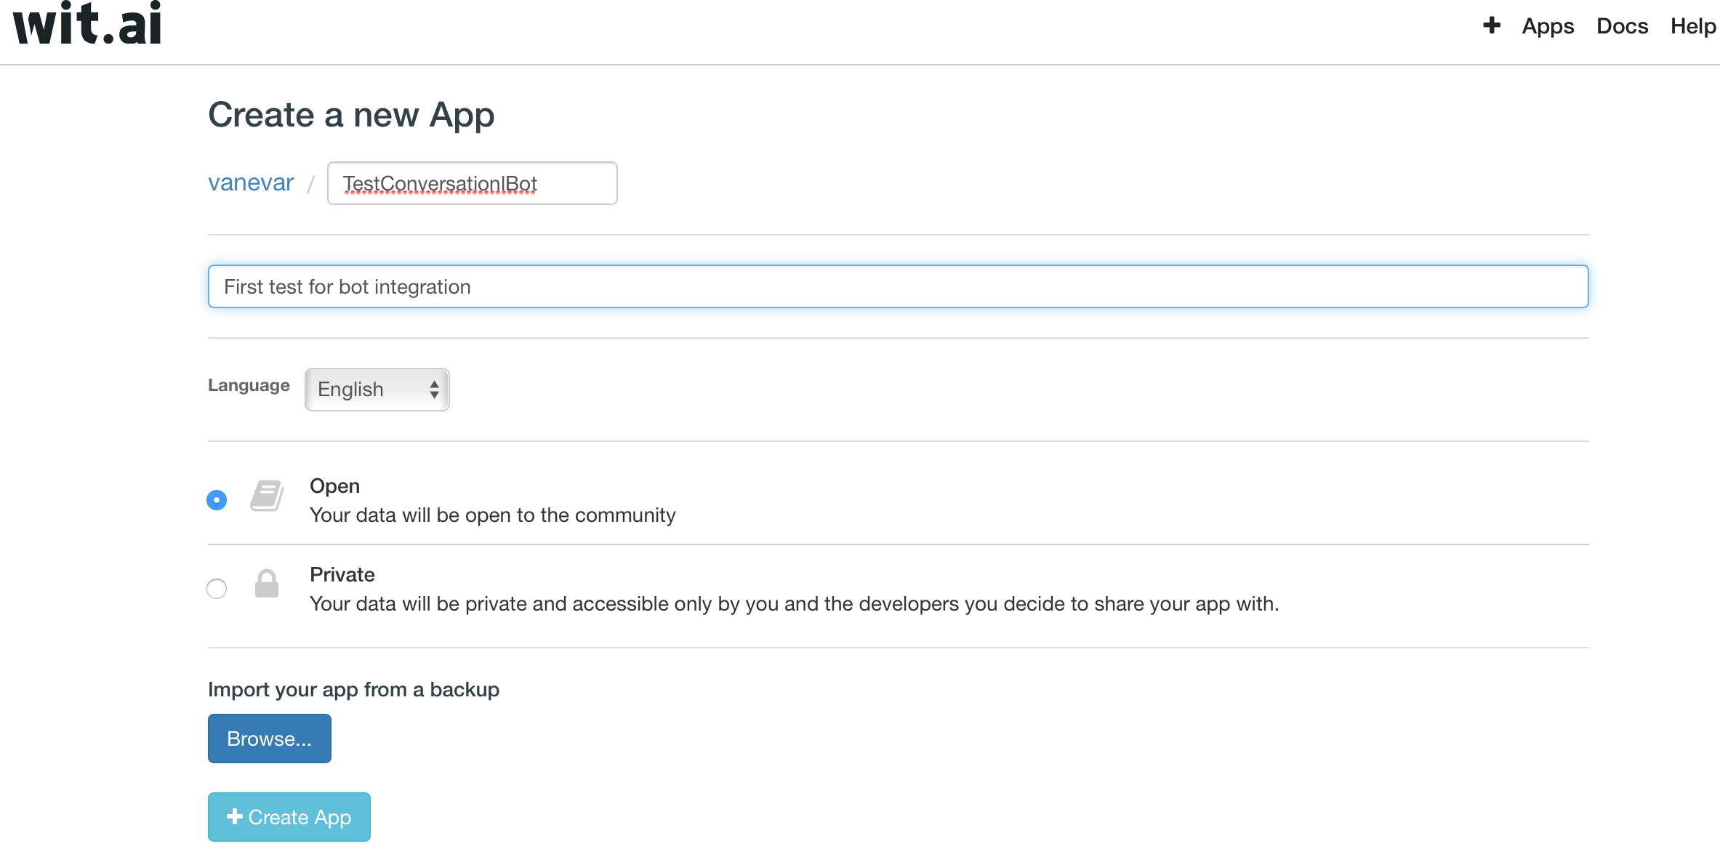
2. Create a new app

Slide 7
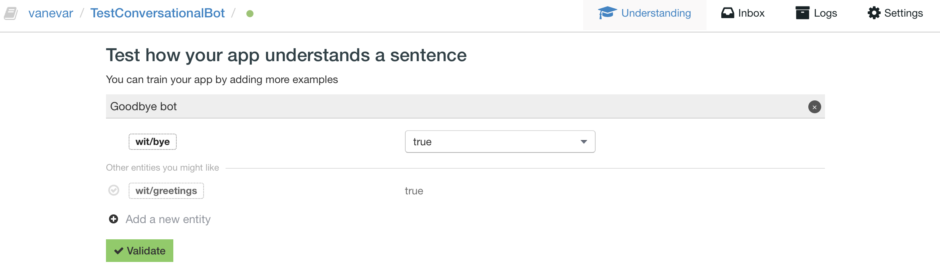
3. Add “entities”
Entities are allow you to understand what the user says.
An entity can have an intent behind it this is the real meaning behind the words.

Slide 8
4. Download botpress
Botpress is a tool that will help us publishing out bots.
We will use botpress to integrate our bot to Facebook messenger.
To download botpress:
npm install -g botpress
* Requires node >= 4.6 and uses npm as packet manager

Slide 9
5. Creating a botpress bot
Create a new empty directory
Execute the following command in the directory:
botpress init [my-bot-name]

Slide 10
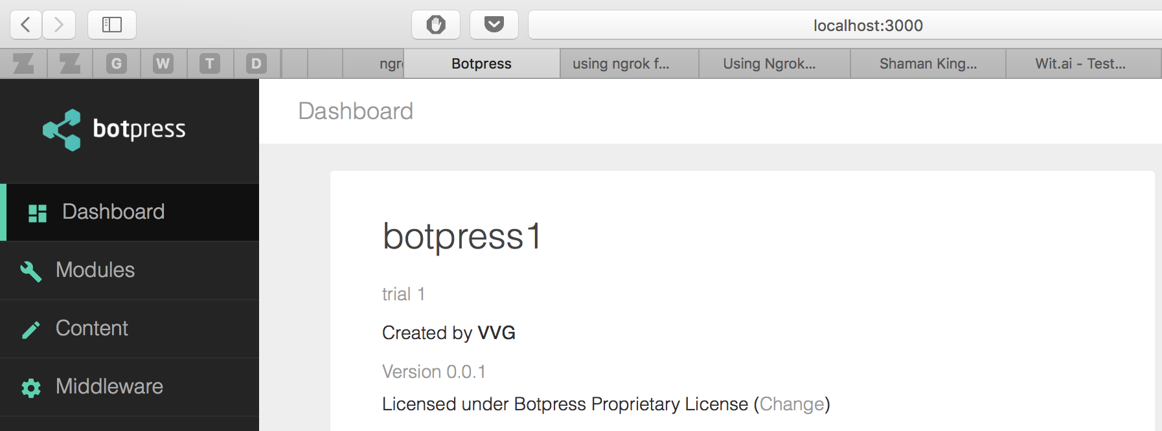
6. Starting the bot
botpress start

Slide 11
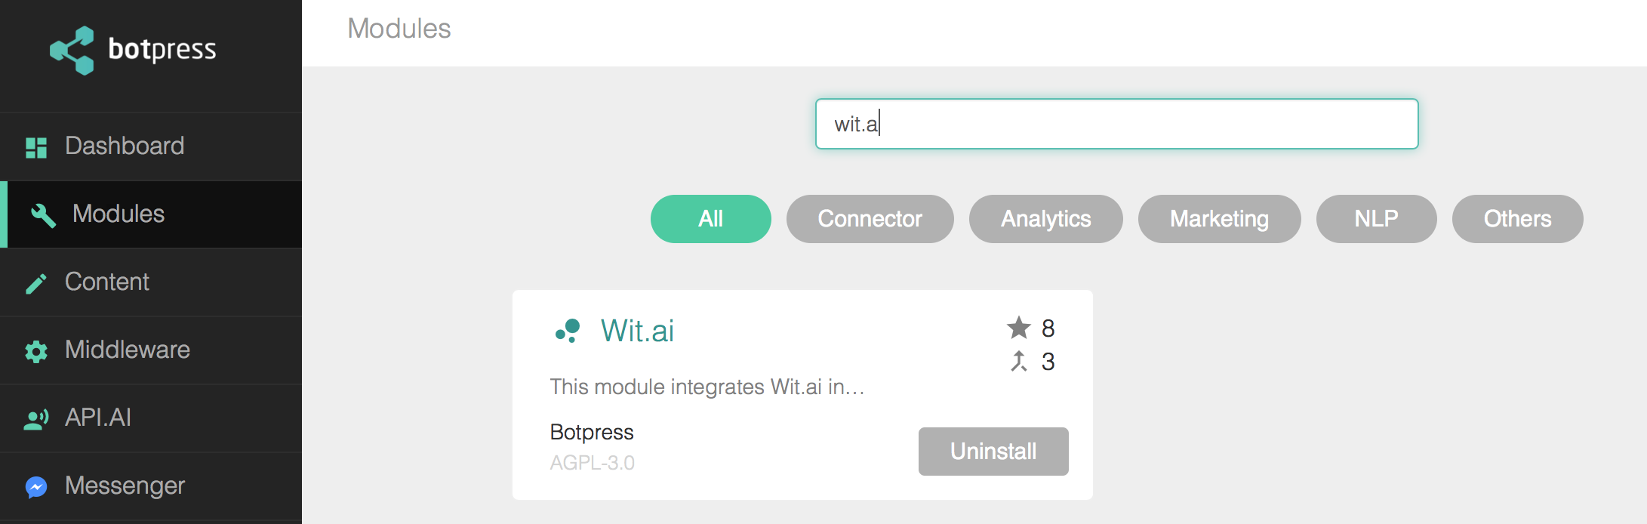
7. Adding the wit.ai and messenger modules

Slide 12
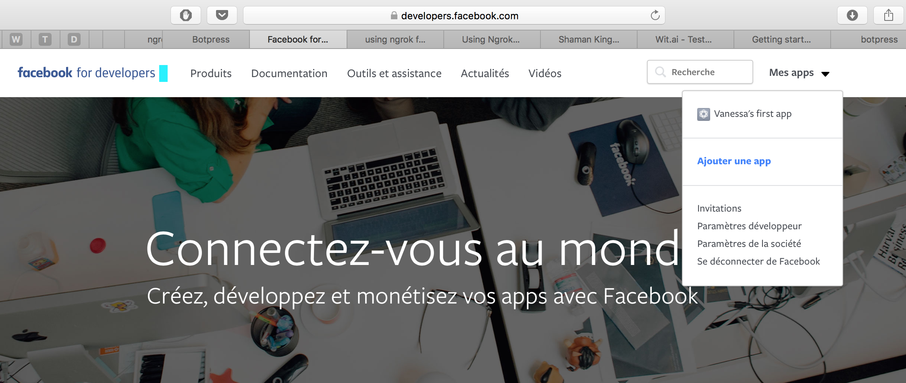
8. Creating a facebook app
You need to create a facebook page.

Slide 13
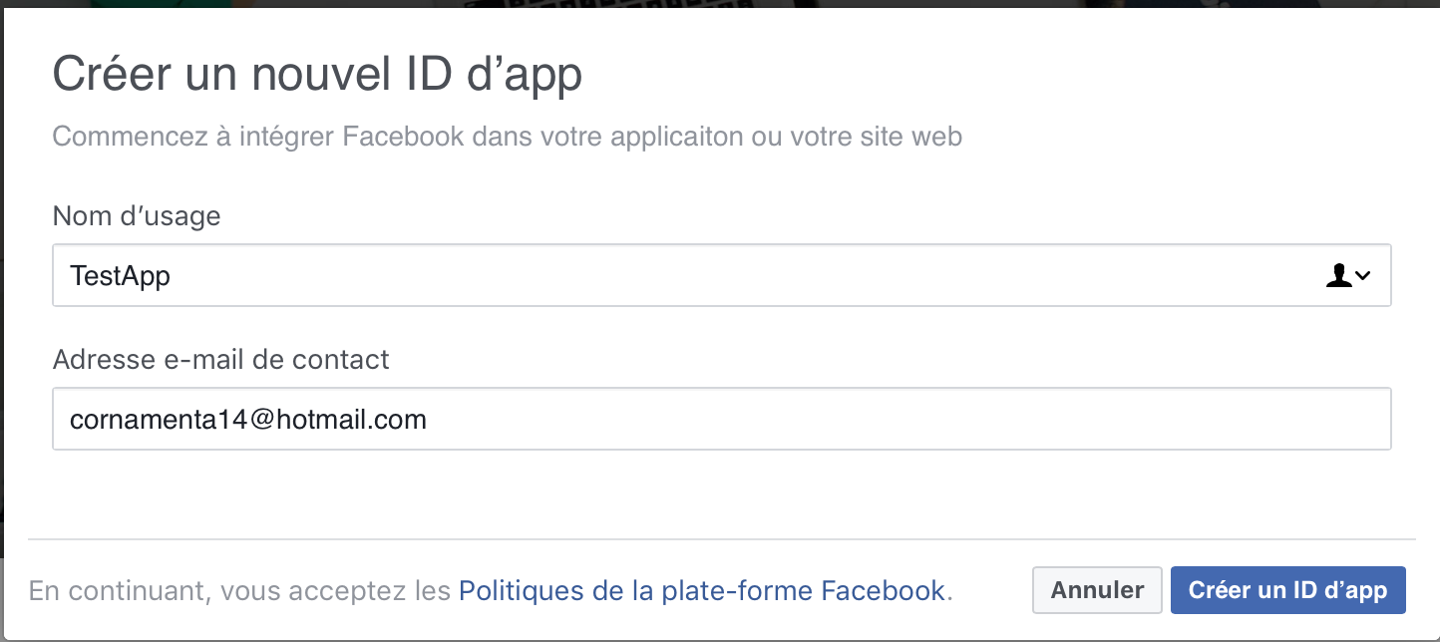

Slide 14
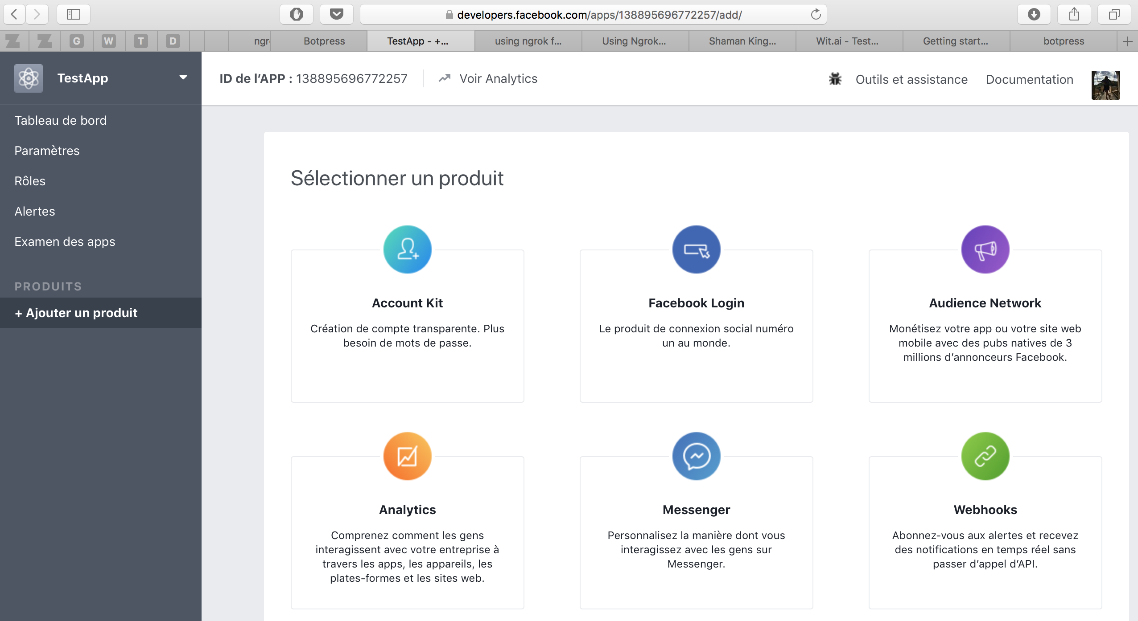

Slide 15
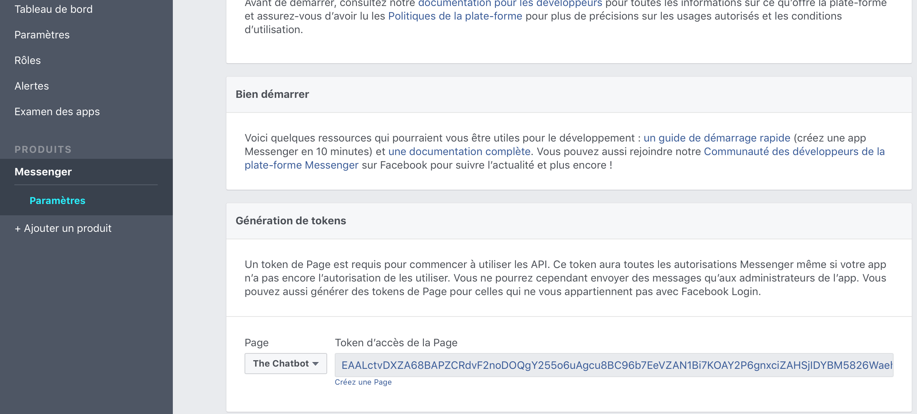

Slide 16
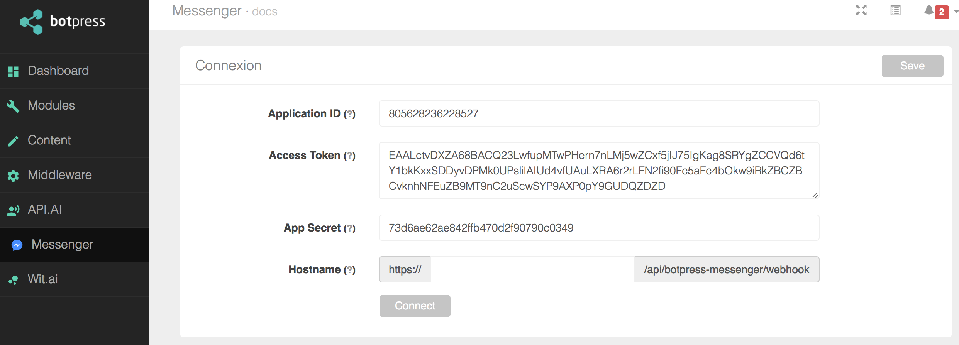
9. Fill the IDs from the facebook app in botpress

Slide 17
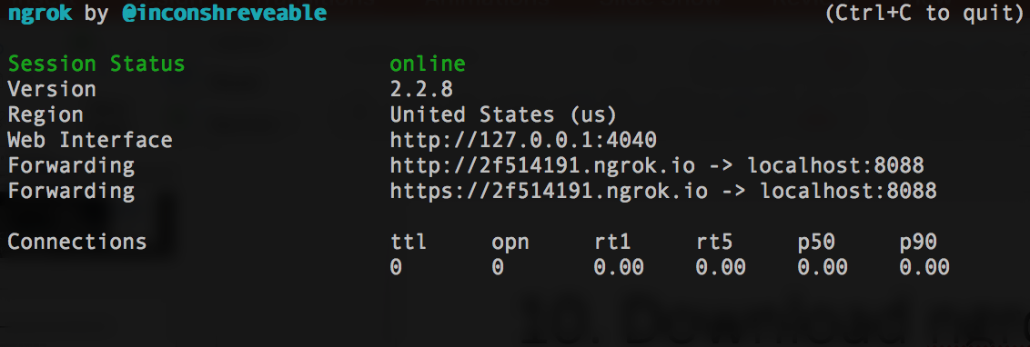
10. Download ngrok
This will allow us to have a secure public url to a local server.
Download and extract from their site: https://ngrok.com
./ngrok http 8088

Slide 18
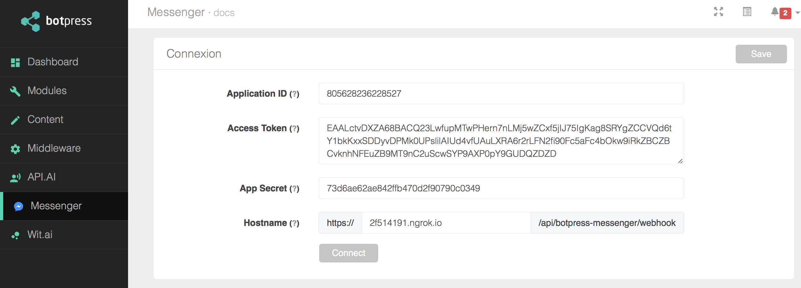
11. Add the host to the botpress

Slide 19
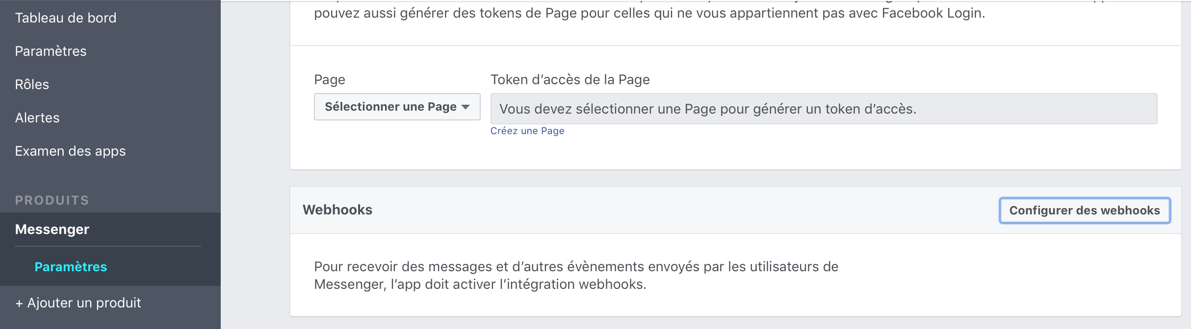
12. Add the webhook to the messenger app

Slide 20
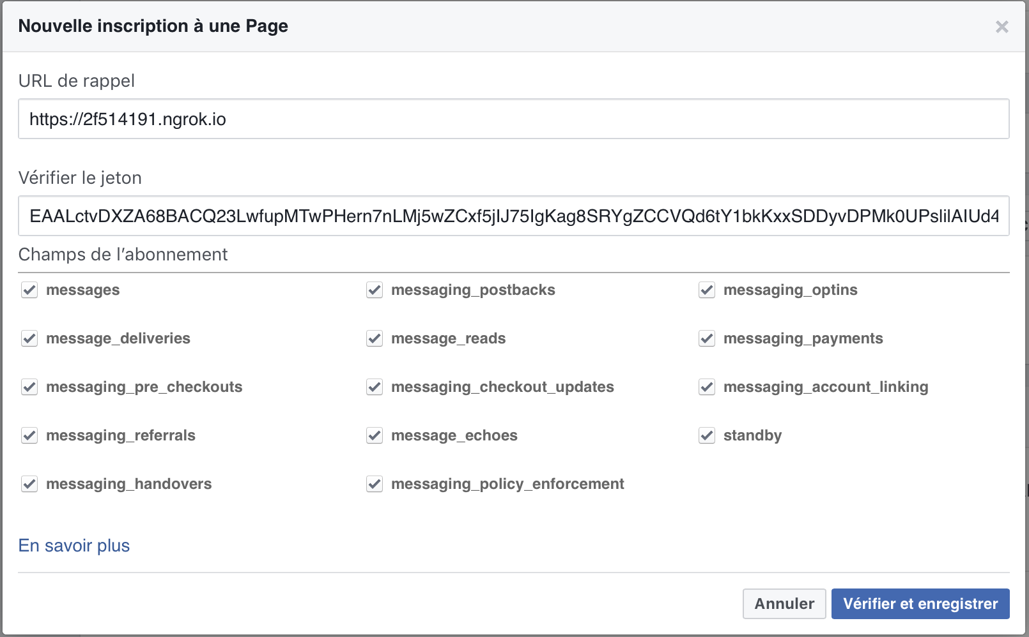
FROM ngrok
Generated earlier

