Slide 1
Creating your first chat bot

Slide 2
1. Register to wit.ai
Register using your git hub account
Wit.ai will give us the Artificial Intelligence engine behind our bot

Slide 3
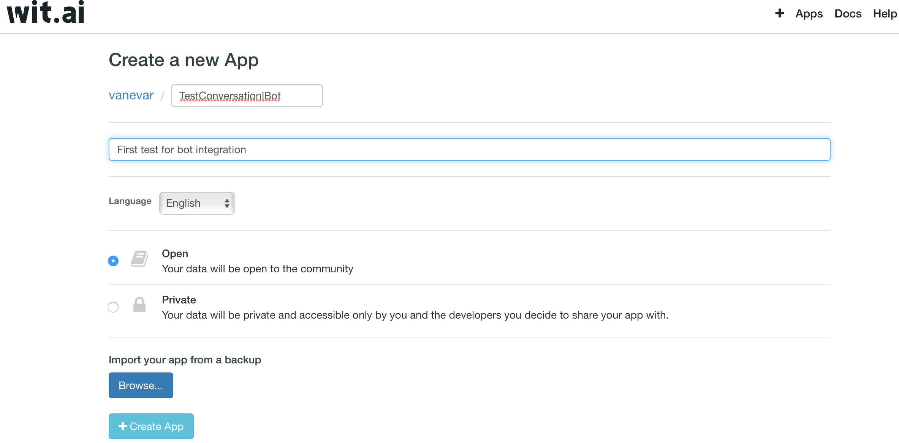
2. Create a new app

Slide 4
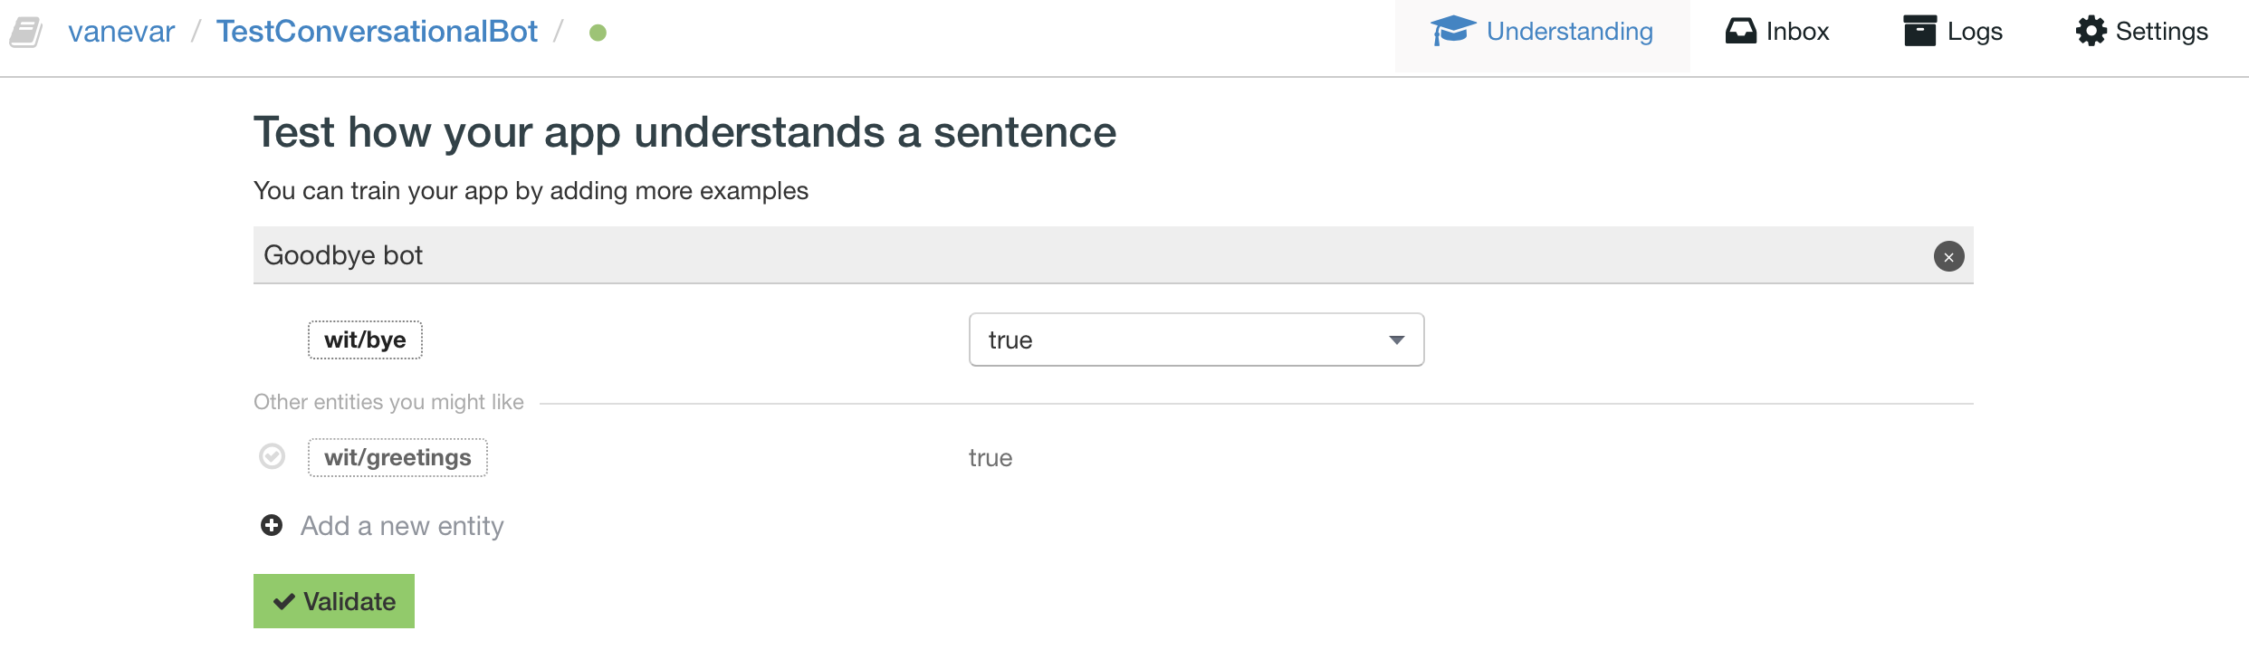
3. Add “entities”
Entities are allow you to understand what the user says.
An entity can have an intent behind it this is the real meaning behind the words.

Slide 5
4. Download botpress
Botpress is a tool that will help us publishing out bots.
We will use botpress to integrate our bot to Facebook messenger.
To download botpress:
npm install -g botpress
* Requires node >= 4.6 and uses npm as packet manager

Slide 6
5. Creating a botpress bot
Create a new empty directory
Execute the following command in the directory:
botpress init [my-bot-name]

Slide 7
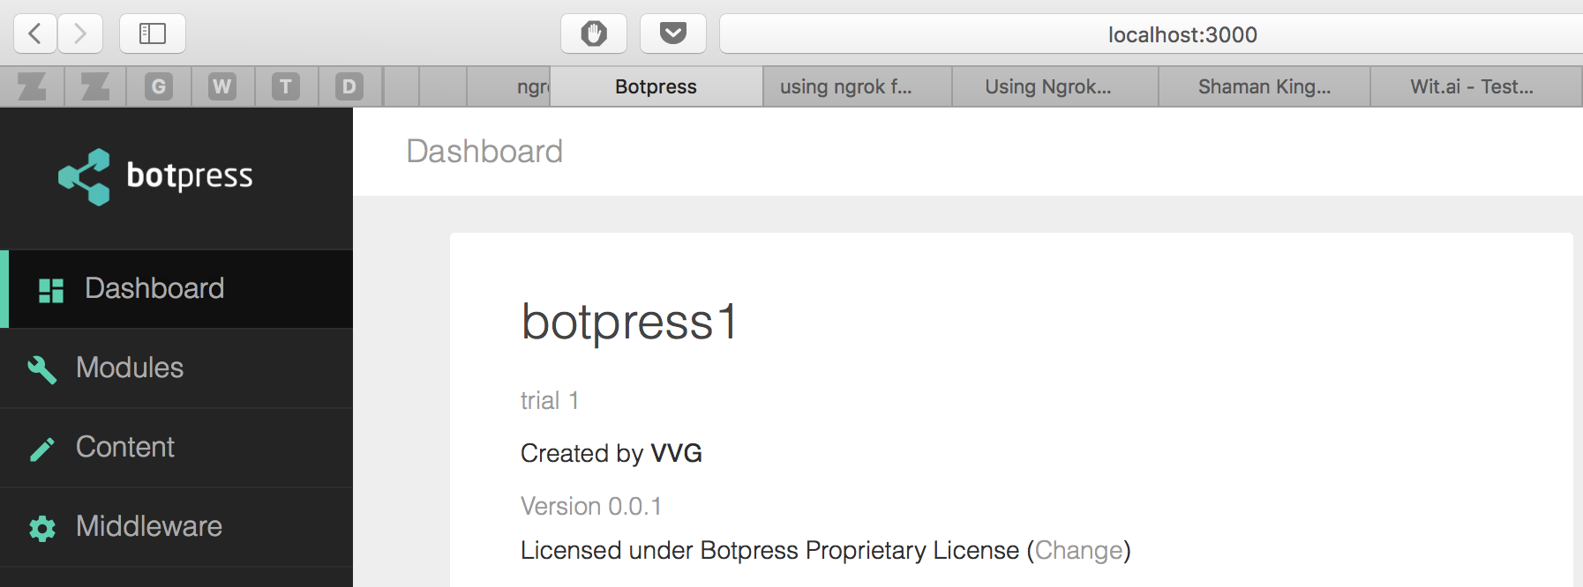
6. Starting the bot
botpress start

Slide 8
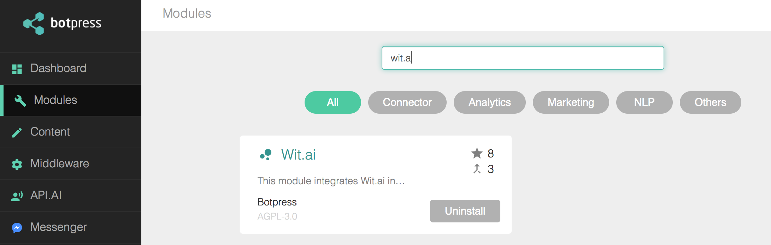
7. Adding the wit.ai and messenger modules

Slide 9
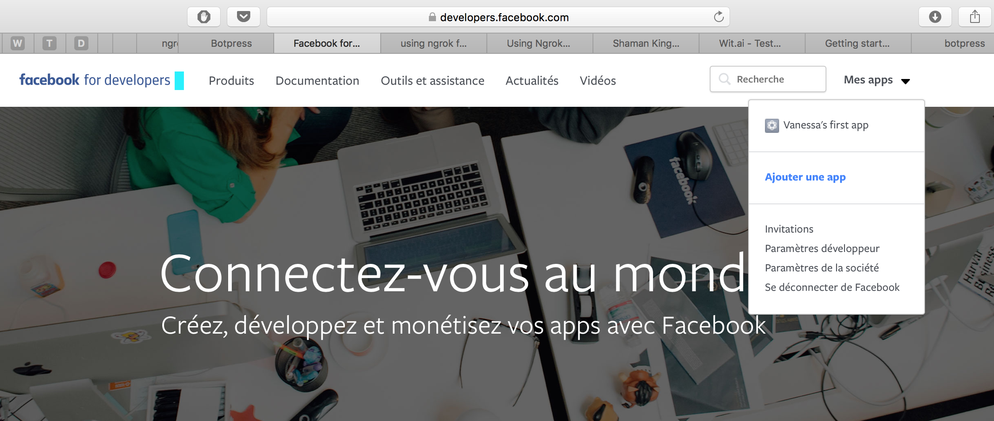
8. Creating a facebook app
You need to create a facebook page.

Slide 10
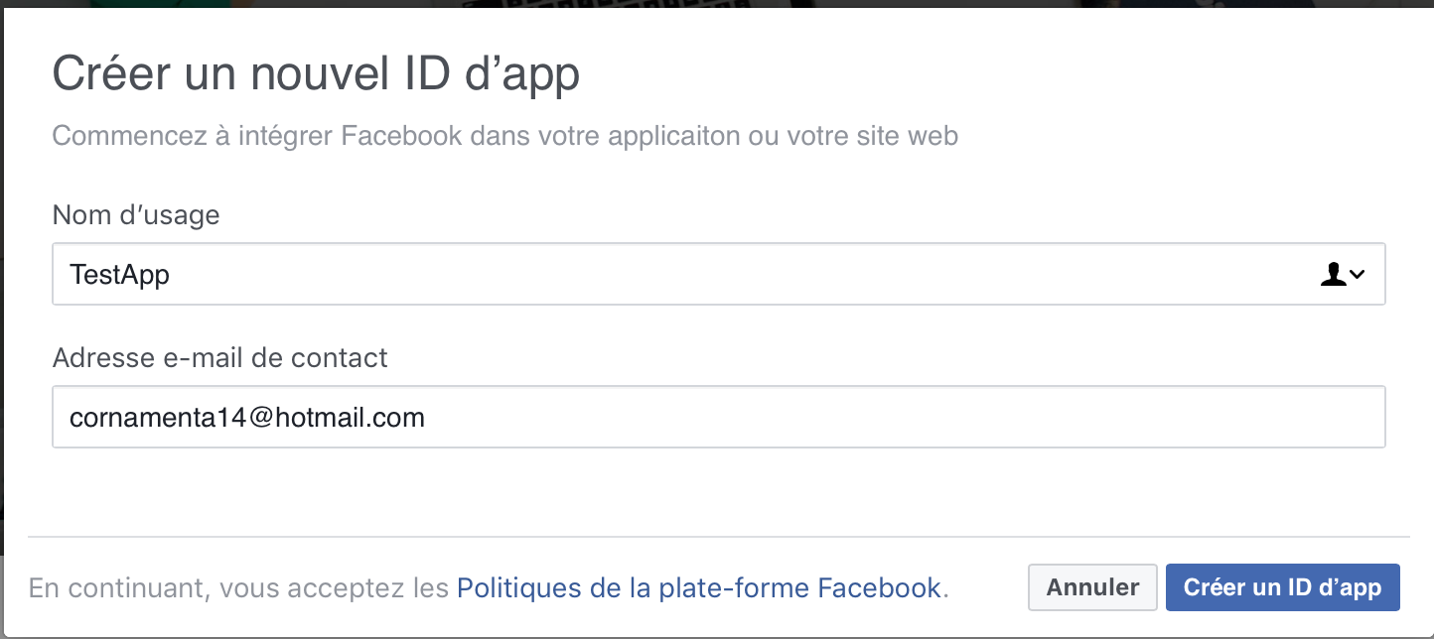

Slide 11
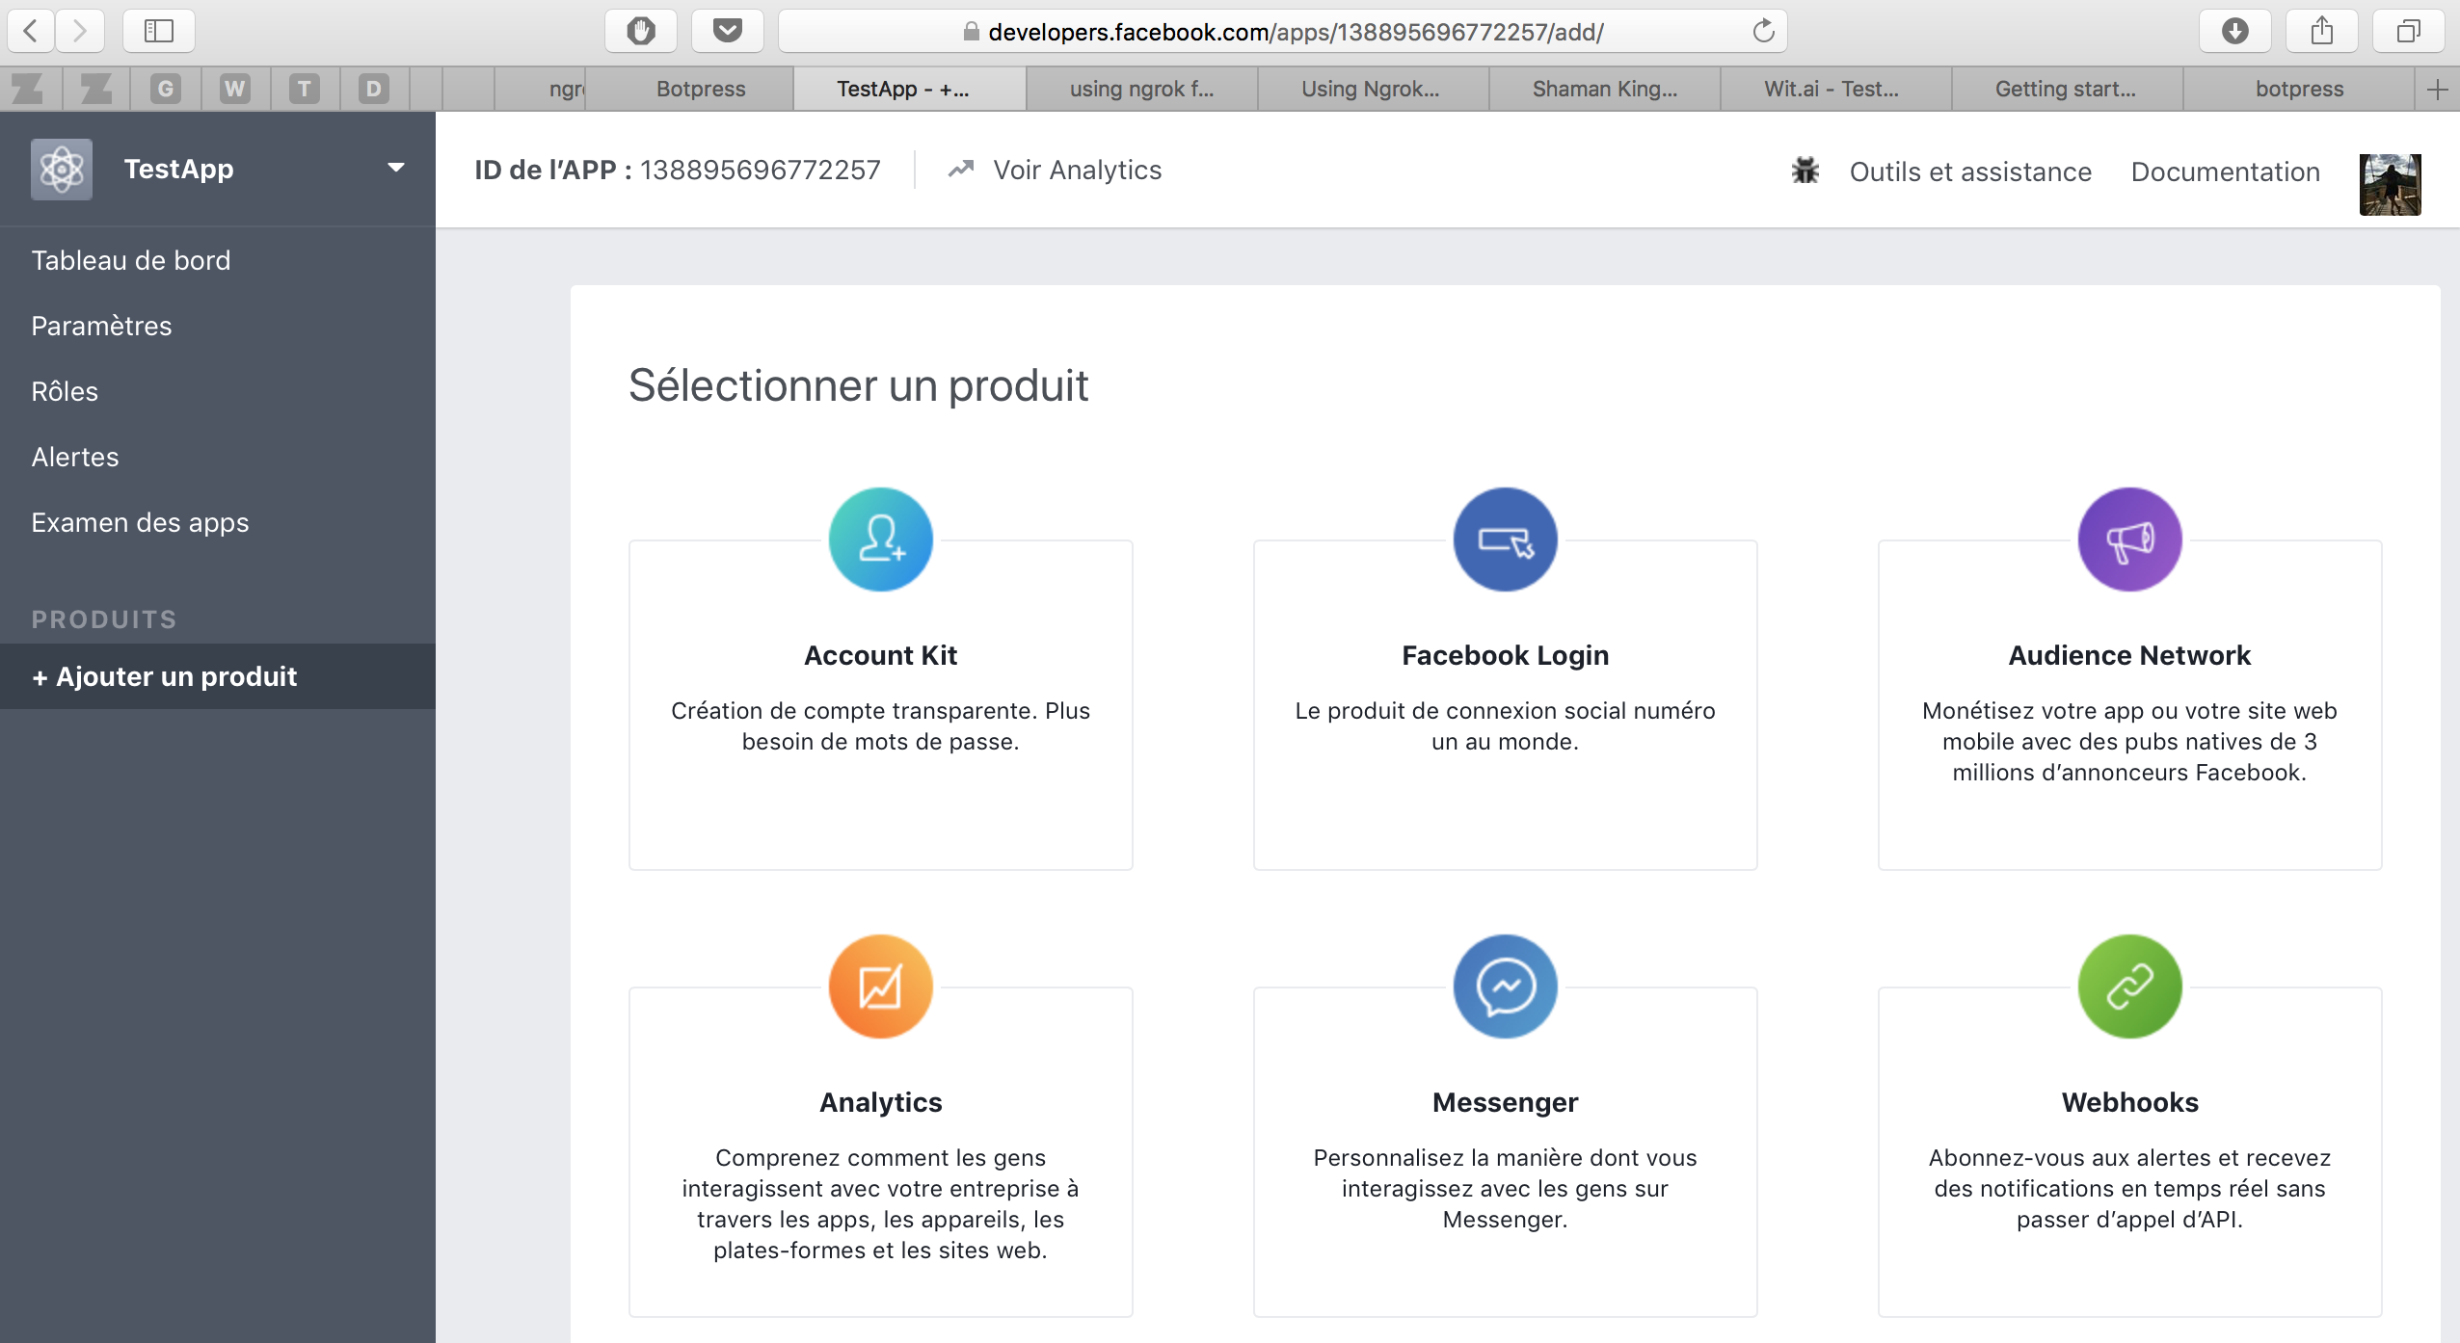

Slide 12
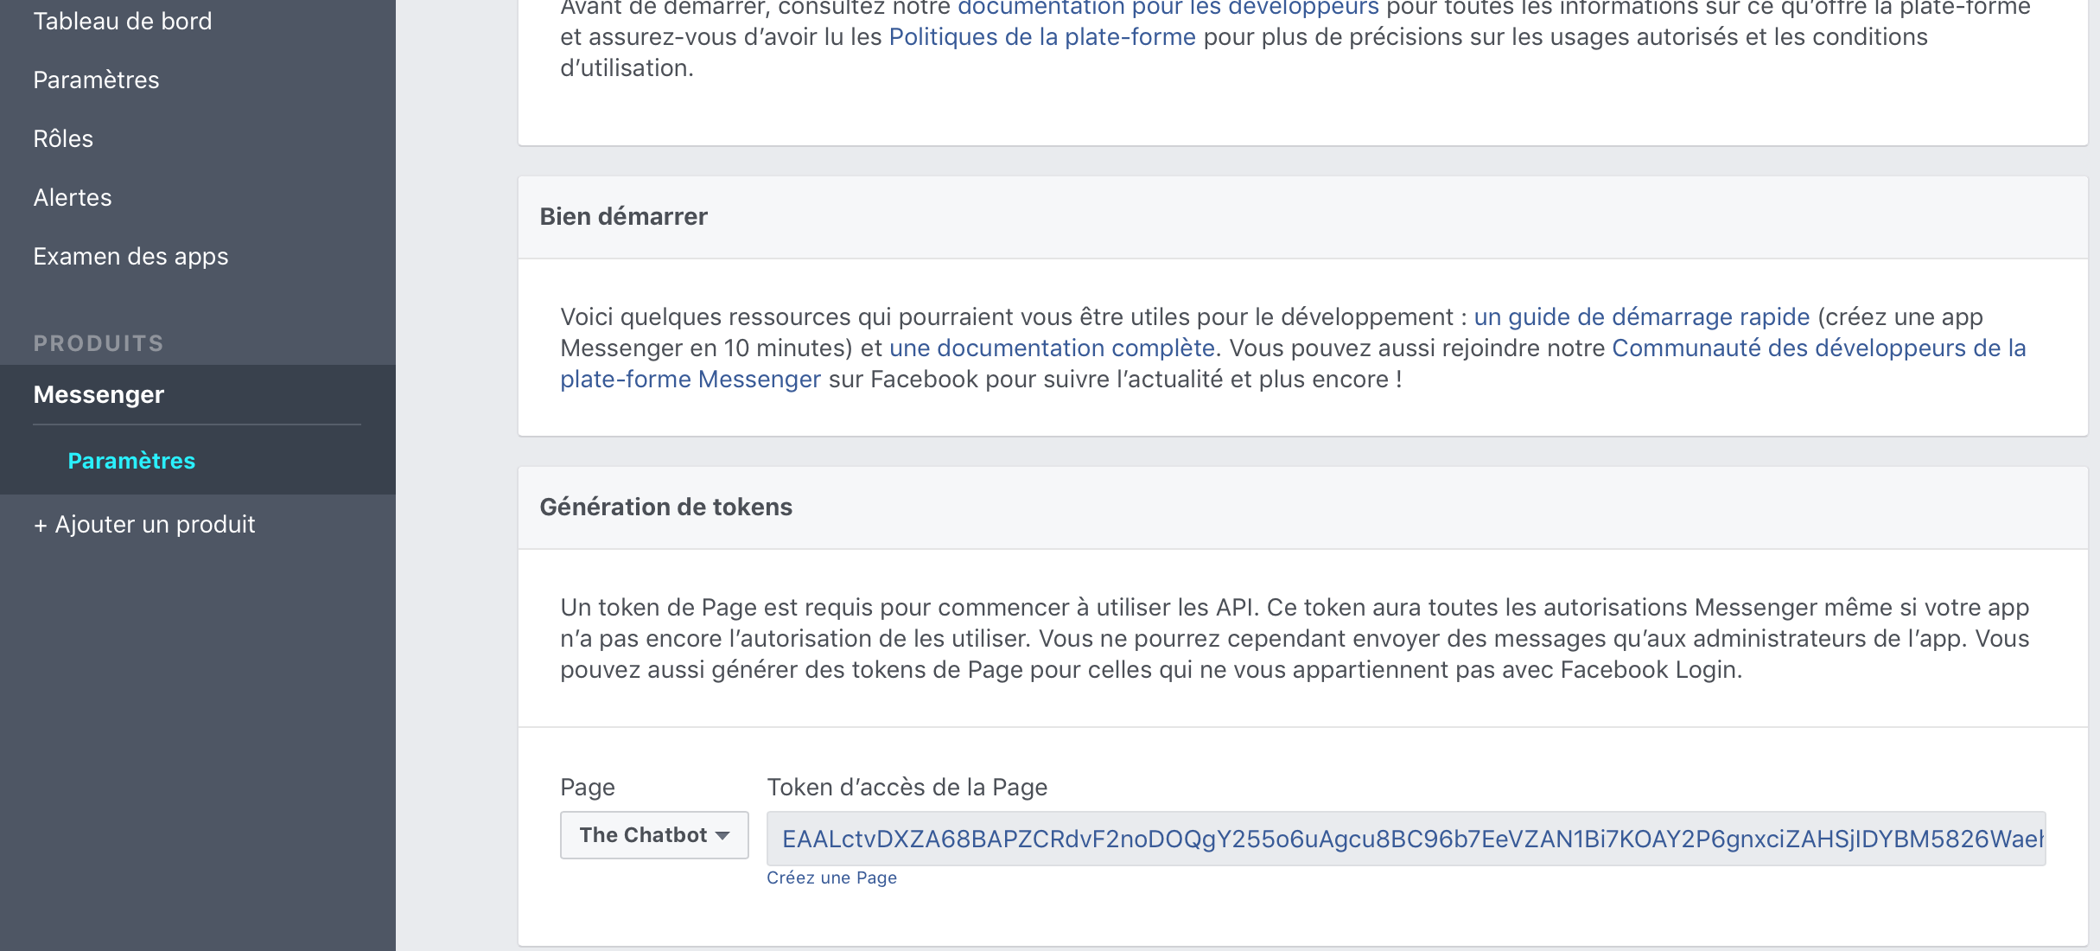

Slide 13
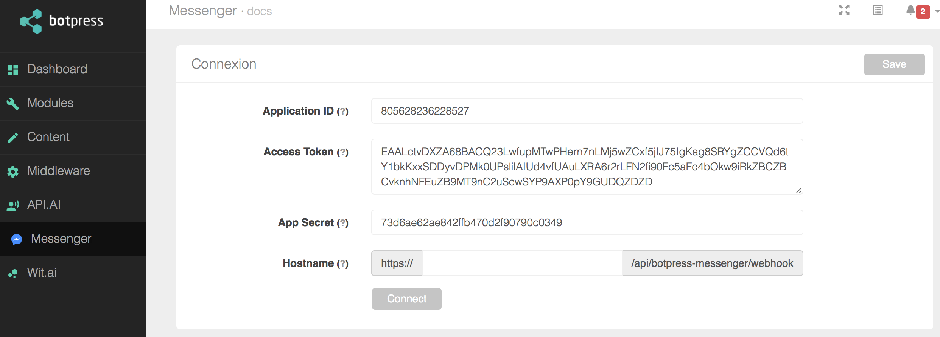
9. Fill the IDs from the facebook app in botpress

Slide 14
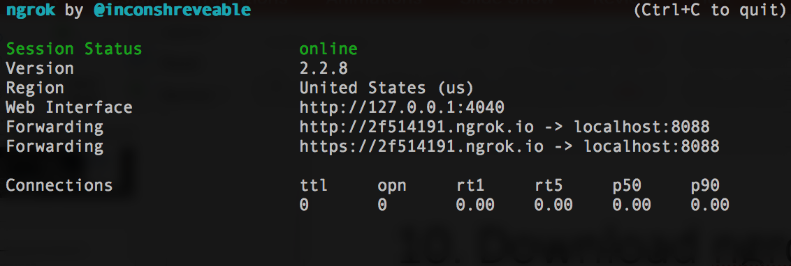
10. Download ngrok
This will allow us to have a secure public url to a local server.
Download and extract from their site: https://ngrok.com
./ngrok http 8088

Slide 15
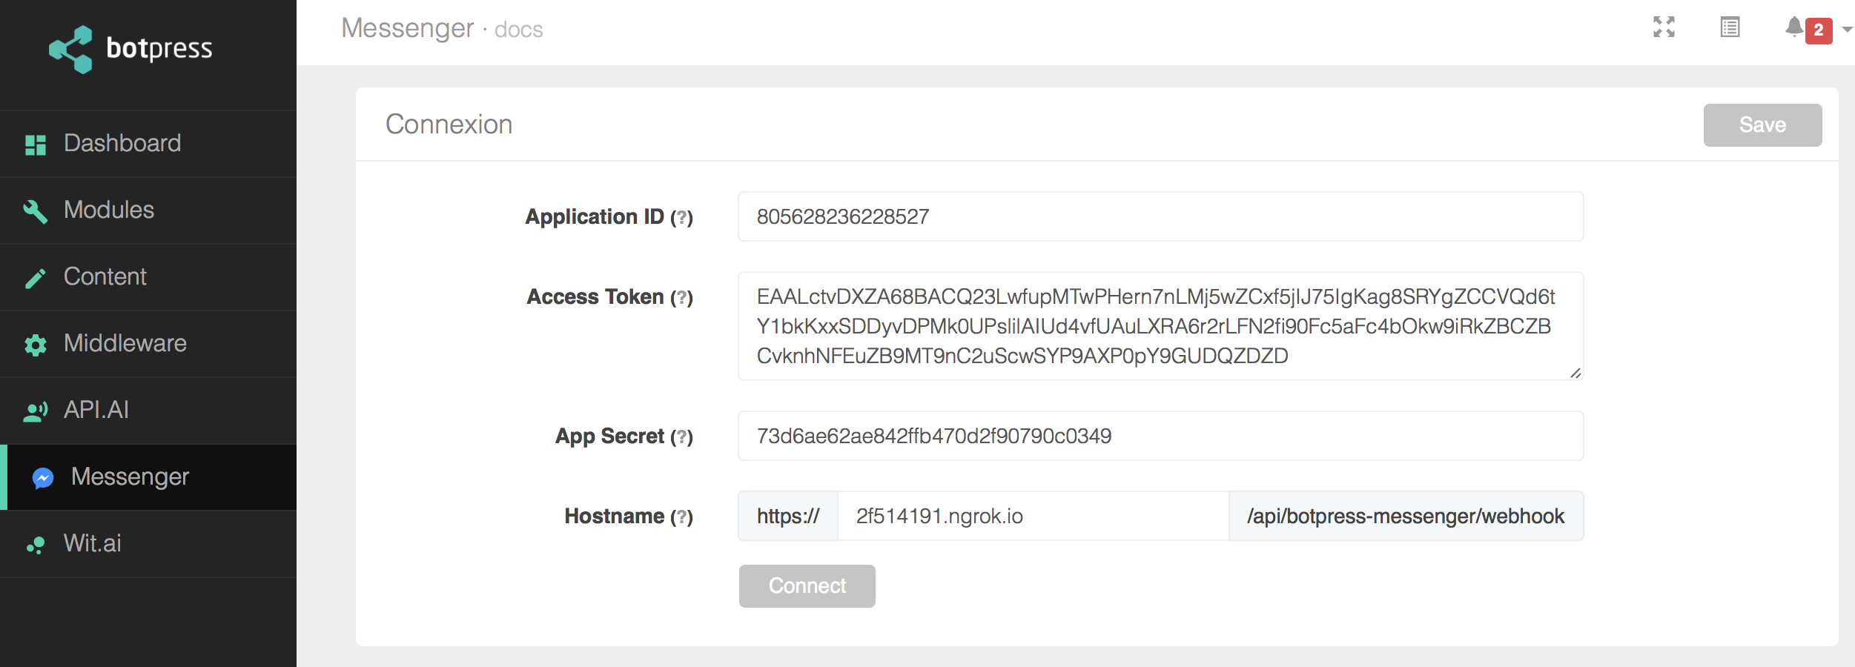
11. Add the host to the botpress

Slide 16
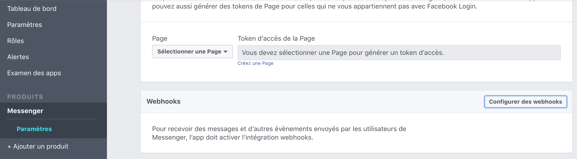
12. Add the webhook to the messenger app

Slide 17
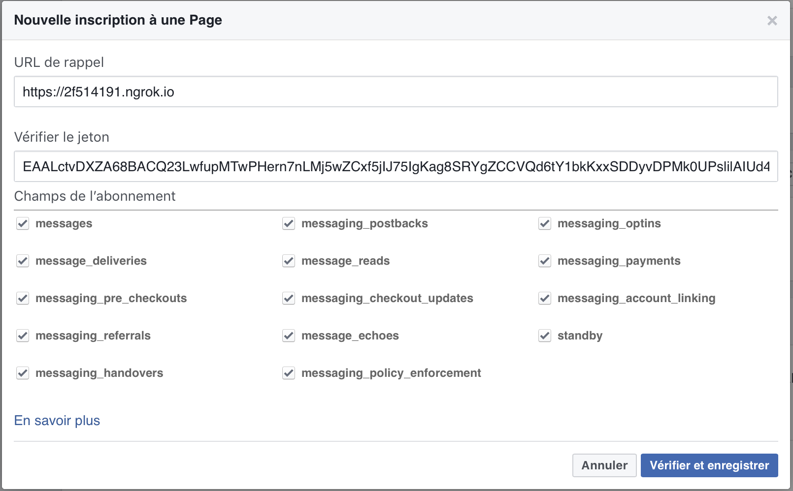
FROM ngrok
Generated earlier

